Slide 1


Technology Roadmapping and the Technology Mechanism
‘Technology roadmaps related to climate change'
Marc Londo, ECN
Bonn
March 25, 2013

Slide 2

Contents
Highlights of the background paper for the TEC
Some thoughts on TRMs and adaptation

Slide 3
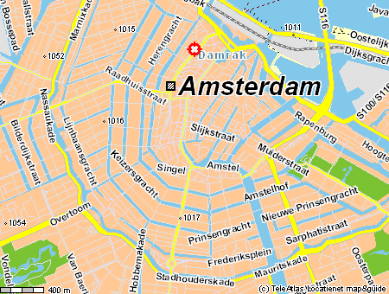
What are Technology Roadmaps?
A Technology Roadmap (TRM) serves as a coherent basis for specific technology development and transfer activities, providing
a common (preferably quantifiable) objective,
time-specific milestones
and a consistent set of concrete actions;
… and is developed jointly with
relevant stakeholders,
who commit to their roles
in the TRM implementation.

Slide 4
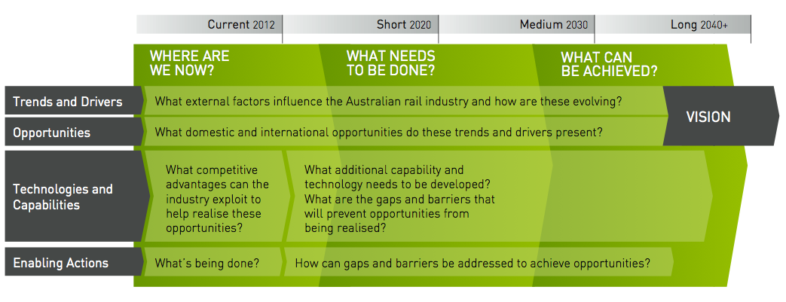
What are technology roadmaps?
Strategic planning tool in development and diffusion of technologies
  At corporate level (its origin)
  At sector level
  For (supra)national innovation policy
Not strictly defined: open, flexible
  In scope
  In process
  In result
Common objectives:
  Provide strategic focus,
  Mobilise relevant actors/stakeholders
  Create coherence in their actions

Slide 5
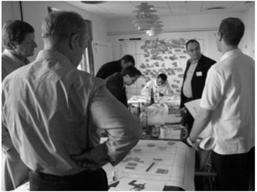
Evaluating
Technology Roadmaps
What is a quality roadmap?
  Process
  Document
  Visual Representation
Evaluation criteria:
  Credibility
  Desirability
  Utility
  Adaptability
Notes:
But within the 2000 roadmaps that we are reviewing, there is a wide range of quality. So what does a quality roadmap look like? It must be remembered that the flexibility of this approach is both its strength and weakness, so evaluating the quality of a roadmap is difficult over the whole spectrum of authors, and objectives.
So what makes a good roadmap? As we have discussed, the process is just as important at the final roadmap document, with associated communication benefits and consensus generated between participants.
A key academic writing on roadmaps has identified a set of questions that can help evaluate a roadmap, specifically roadmaps concerned with public policy for transition . McDowall groups these questions into 4 categories
CLICK
Credibility – for example does the roadmap draw on the right experts and stakeholders?
CLICK
Desirability – Is the roadmap’s vision desirable and address relevant political, social and economic goals?
CLICK
Utility – Does the roadmap advance the innovation system by outlining key actions and next steps?
CLICK
Adaptability – Is the roadmap flexible enough to take account of changes?
Some roadmap documents make no mention of the process they went through, whilst others describe in detail the participants, the workshops and the review processes. The On Track to 2040 roadmaps, which is one of the better roadmaps available, describes how over 200 participants from many organisations were involved. Research has shown that the quality of the participants is one key critical success factor. Others are …
CLICK
Secondly, there is also a range of quality in the roadmap document.
CLICK
The analysis of the public domain roadmaps will inform the good practice guidelines as part of the final deliverable.

Slide 6
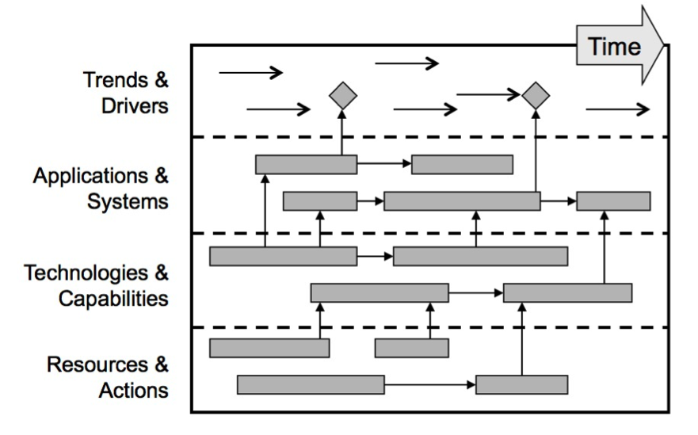
Possible relation with
TEC and Technology Transfer
Safeguard ‘demand-driven’ nature of TT
Improve coherence in TT activities
Improve stakeholder support and engagement (private and public parties)
Follow-up to TNAs?

Slide 7
TRM review for TEC
Inventory and selection of TRMs on climate change mitigation and adaptation technologies: 159 documents
Analysis:
  Technology
  Geographical source
  Geographical coverage
  Year of publication
  Time horizon
  Authoring organisation
  Substantive elements
    Process description Specs. of engaged stakeholders
    Quantifiable targets Actions assigned
    Visual representation Plan for update
Notes:
TRMs gathered

Slide 8
Key findings
Mitigation technologies dominate over adaptation
Geographical source: Annex-1 countries and IGOs
TRMs on renewables energy technologies more recent than others
IGO and Industry main authors
Very few “quality” TRMs (based on six substantive elements)
Need for guidance
in order to improve
the quality of TRMs.

Slide 9

Good practice examples
IEA:
  Comprehensive set of consistent TRMs,
  Guidance document
Various good elements in several TRMs identified

Slide 10
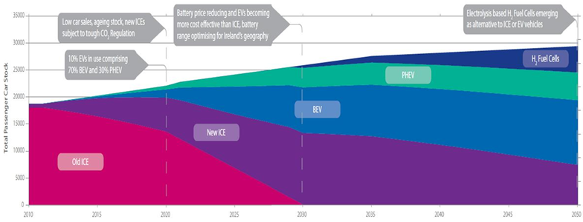
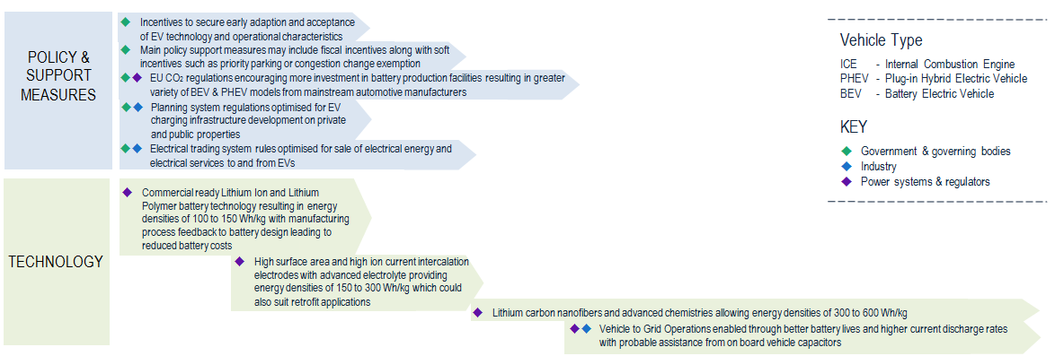

Slide 11
Further conclusions
Advantages of using TRMs
Particularly suitable for technology management and related policy
The strong consensus-building element useful for CTC&N?
Flexibility, adaptability: strength for Technology Mechanism with diversity of country contexts and technologies
Limitations of using TRMs
Risk of ‘lock-in’ or tunnel vision through consensus building.
Alignment with existing (governmental) plans and strategies.
  Create culture of openness
  Follow-up: iteration, refinement, monitoring, updating outcomes
  Integration with broader policy strategy

Slide 12



Profile of adaptation TRMs
Only 11 out of 159
  Water resources (8)
  Coastal zones (1)
  Public health (1)
  Generic (1)
OECD: 5
  Various techs.
  Relatively elaborate
Non-OECD: 5
  All on water
  Relatively concise

Slide 13
Why so few adaptation TRMs?
Not analysed thoroughly, but speculating:
Generally more attention for mitigation
Less prominent role of technology (development)
Underrepresentation in our selection? Hidden adaptation TRMs?
  Not explicitly climate change
  Not explicitly adaptation
  Not explicitly TRM

Slide 14
However, adaptation TRMs could be very useful
Tech transfer in broad sense
Importance of knowing context and capabilities in receiving country
Stakeholder engagement on both sides
So: A case for the TEC!

Slide 15

Thank you for your attention
Marc Londo (ECN) londo@ecn.nl
Elliott More (IfM) egm27@cam.ac.uk
Rob Phaal (IfM)
Laura Würtenberger (ECN)
ECN
Westerduinweg 3 P.O. Box 1
1755 LE Petten 1755 ZG Petten
The Netherlands The Netherlands
T +31 88 515 49 49 info@ecn.nl
F +31 88 515 44 80 www.ecn.nl
University of Cambridge
Institute for Manufacturing
17 Charles Babbage Road
Cambridge CB3 0FS
UK
T +44 (0)1223 765824
www.ifm.eng.com.ac.uk

