Slide 1
Report on unpaid CDM share of proceeds
SBSTA 61 agenda item 12
Matters relating to the operations of the clean development mechanism

Slide 2
Mandate
  SBSTA60 requested the secretariat to contact the CDM project participants that have not paid their share of proceeds to request them to confirm their intention to pay, and to report on the responses received to the SBSTA.

Slide 3
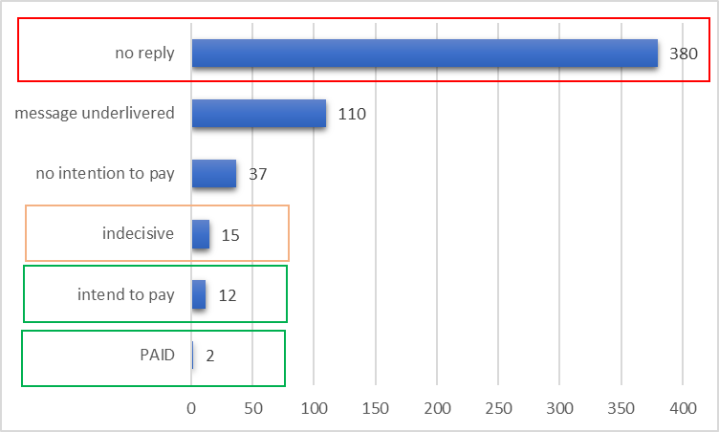
Results 1/2
Breakdown of responses, which represent 556 unique projects, resulting in a total of 703 issuances.
Notes:
Subregion top 3:
Eastern Asia (China, Republic of Korea and Democratic People's Republic of Korea)
Southern Asia (India, Sri Lanka)
South America (Brazil, Chile, Peru, Argentina, Uruguay, Ecuador)

Slide 4
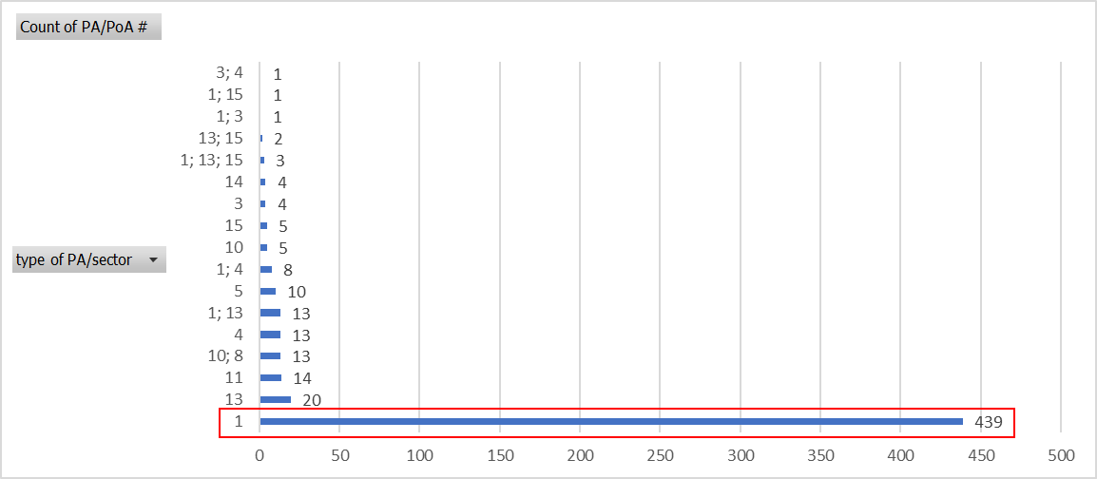
Results 2/2
Breakdown of responses by sectoral scope.
79% of the projects are concentrated solely in sector 1: Energy industries (renewable - / non-renewable sources)
Notes:
1 Energy industries (renewable - / non-renewable sources)
2 Energy distribution
3 Energy demand
4 Manufacturing industries
5 Chemical industries
6 Construction
7 Transport
8 Mining/mineral production
9 Metal production
10 Fugitive emissions from fuels (solid, oil and gas)
11 Fugitive emissions from production and consumption of halocarbons and sulphur hexafluoride
12 Solvent use
13 Waste handling and disposal
14 Afforestation and reforestation
15 Agriculture

