Slide 1
Warsaw International Mechanism for Loss and Damage associated with Climate Change Impacts
Workshop of the Koronivia Joint Work on Agriculture
49th Session of the Subsidiary Body for Scientific and Technological Advice, 03 December 2018
Executive Committee of the Warsaw International Mechanism for Loss and Damage
Notes:
Thank you [name] for that kind introduction. Good [morning / afternoon / evening] ladies and gentlemen and thank you for joining us here today. I’m [name and role: e.g. Name Surname, and I am one of the members] of the Executive Committee of the Warsaw International Mechanism for Loss and Damage. It is my distinct honour, on behalf of the Committee, to speak to you today about [topic of presentation].

Slide 2
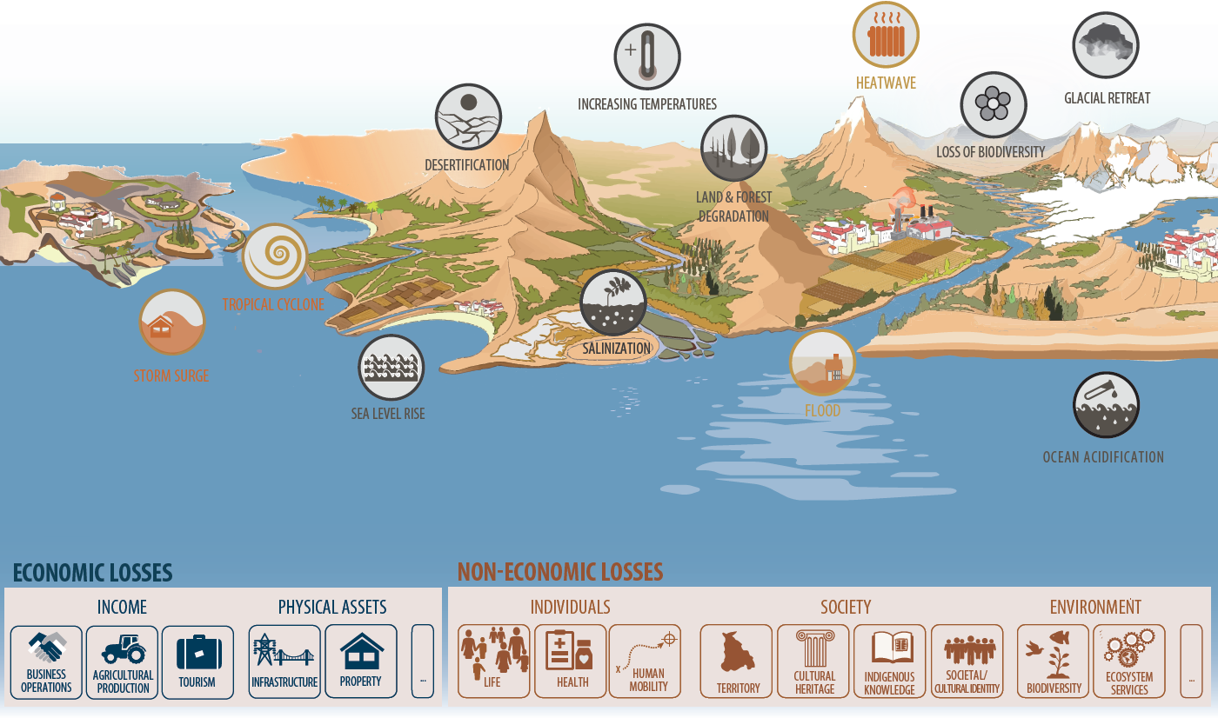

Loss and damage associated with climate change impacts
Slow onset events
Extreme events
DROUGHT
Notes:
COP 19 established the Warsaw International Mechanism for Loss and Damage associated with impacts of climate change, including extreme events and slow onset events, in developing countries that are particularly vulnerable to the adverse effects of climate change;
Here is an info-graphic that visually lays out some of the key extreme and slow onset events which our work seeks to avert, minimize and address, along with a non-exhaustive list of economic and also non-economic losses from the adverse impacts of climate change;
In terms of extreme events, you will see here the inclusion of heat waves, tropical cyclones, floods, droughts, and storm surges; take note also of the slow onset events, which cover sea level rise, ocean acidification, salinization, land and forest degradation, loss of biodiversity, increasing temperatures, glacial retreat, and desertification.
In terms of the losses, economic and non-economic, these may result from events, both rapid and slow onset.
In the rest of my presentation, I will briefly introduce the Warsaw International Mechanism, its core functions, governance structure, and technical components; its work that contribute to Parties’ work on agriculture as well as how its ongoing and future work can further help Parties advance their agriculture-related work.

Slide 3
What are the Warsaw International Mechanism
& its Executive Committee?
WARSAW INTERNATIONAL MECHANISM FOR LOSS & DAMAGE
To address loss and damage associated with impacts of climate change, including extreme events and slow onset events, in developing countries that are particularly vulnerable to the adverse effects of climate change (Decision 2/CP.19) THREE FUNCTIONS:
EXECUTIVE COMMITTEE
Guides the implementation of the functions of the Mechanism. Composed of 20 members
Enhancing understanding | Enhancing dialogue, coordination, coherence, synergies | Enhancing action and support
Expert groups, technical panels, etc.
To help execute the work of the Executive Committee
3
Notes:
As I mentioned on the last slide, the Warsaw International Mechanism for Loss and Damage was established at COP19 in Poland as the main vehicle under the Convention to promote the implementation of approaches to address loss and damage associated with impacts of climate change, including extreme events and slow onset events, in developing countries that are particularly vulnerable to the adverse effects of climate change;
In order to guide the implementation of the functions of the Mechanism, Parties decided to establish the Executive Committee (or Excom), under the guidance of, and accountable to, the COP. These three functions are to enhance understanding, to enhance dialogue, coordination, coherence, synergies and to enhance action and support;
The Committee may establish expert groups, in an advisory role, to help execute its work. Currently, there are three expert groups in the making under three of the five strategic worksctreams;
The Excom is composed of 20 members, taking into account the goal of gender balance pursuant to decision 23/CP.18: 10 members from Parties included in Annex I to the Convention (Annex I Parties), and the other 10 members from Parties not included in Annex I to the Convention (non-Annex I Parties), comprising two members each from the African, Asia-Pacific, and the Latin American and Caribbean States, one member from small island developing States, one member from the least developed country Parties, and two additional members from non-Annex I Parties;

Slide 4
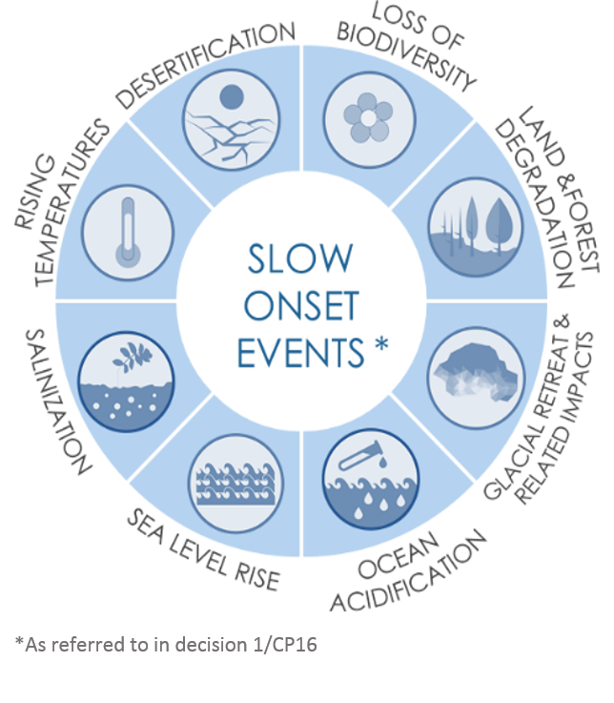
Strategic workstream (a): Enhanced cooperation and facilitation in relation to slow onset events
SOEs Database with more than 160 initiatives working to avert, minimize and address slow onset events and related impacts;
SOE expert group: to improve the knowledge base on and develop recommendations for approaches to addressing SOEs;

Slide 5

Strategic workstream (b): Enhanced cooperation and facilitation in relation to non-economic losses
NELs expert group: to develop inputs and recommendations to enhance data on and knowledge of reducing the risk of and address NELs;
NELs can be individual (e.g. loss of life, degraded health, migration), societal (e.g. loss of territory, cultural heritage, indigenous knowledge, societal/cultural identity) or environmental (e.g. loss of biodiversity and ecosystems services).

Slide 6
Strategic workstream (c): Enhanced cooperation and facilitation in relation to comprehensive risk management approaches
CRM technical expert group: to enhance knowledge and understanding of comprehensive risk management approaches;
Compendium on comprehensive risk management approaches;
Fiji Clearing House for Risk Transfer
Risk assessment
Risk reduction
Financial risk transfer
Risk retention
Transformational approaches
Enabling environment

Slide 7
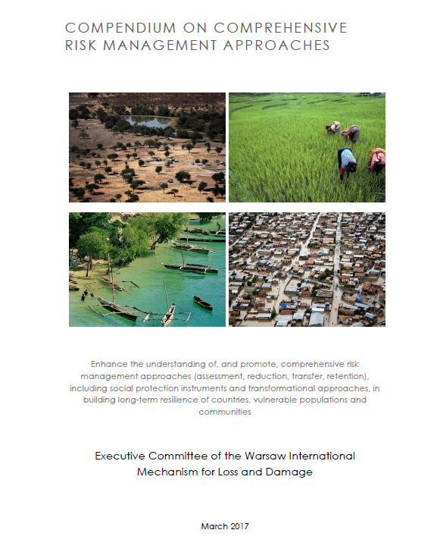
Examples from the Compendium on CRMs
Risk Assessment: Malawi Spatial Data Platform (MASDAP) GEONODE launched in 2012. It helps identify risks and strengthens disaster risk management effort;
Financial Risk Transfer: The Philippine Crop Insurance Corporation, a government-owned entity, provides insurance protection to farmers against loss arising from natural calamities, plant diseases and pest infestation of their crops.
Notes:
Parties can learn from and showcase good practices shared through the compendium

Slide 8
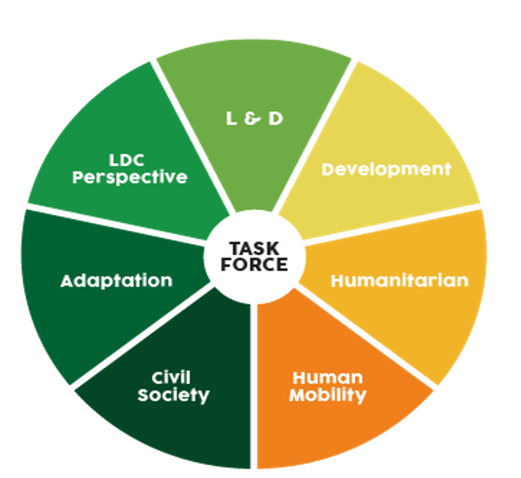
Strategic workstream (d): Enhanced cooperation and facilitation in relation to human mobility, including migration, displacement and planned relocation
Task Force on Displacement (TFD): to develop recommendations for integrated approaches to avert, minimize and address displacement related to the adverse impacts of climate change;

Slide 9
Strategic workstream (e): Enhanced cooperation and facilitation in relation to action and support
Invite relevant actors to consider how to facilitate or enhance, as appropriate, the availability of finance relevant to loss and damage at the regional and national levels;
Develop actions to address capacity-building for addressing loss and damage;
Invite relevant actors to continue developing insurance mechanisms, for example diversified agriculture insurances as a risk transfer mechanism that can help farmers
Finance
Technology
Capacity-building

Slide 10
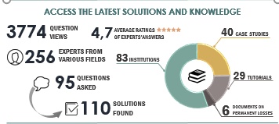
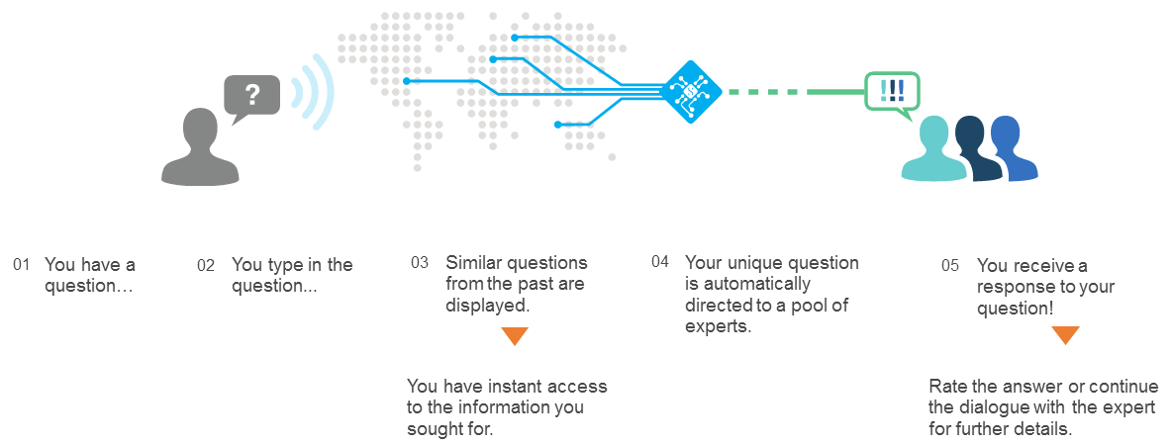
Collaborative partnership and knowledge-sharing platform
Fiji Clearing House for Risk Transfer, using cutting edge artificial intelligence to bridge world-wide supply of expertise and knowledge demand

Slide 11
For further information
on loss and damage under the UNFCCC
Visit www.unfccc.int/6056
Contact the Executive Committee at
loss-damage@unfccc.int
Thank you!
Notes:
Thank you very much for your attention. If you want to find out more, please visit the webpage shown on the screen, or also you can contact us via email.

