Slide 1
Overview of new knowledge on the LTGG emerging form the IPCC 2018-19 Special Reports
Presentation: Piers Forster (UK), Kirsten Zickfeld (Canada)
Q&A: Pauline Dube (Botswana), Michael Taylor (Jamaica)
(all are authors of the IPCC SR1.5 report)
Scenarios compatible with the LTGG considered in the IPCC 2018-19 special reports
Information and knowledge gaps addressed in the IPCC 2018-19 Special Reports with regard to scenarios to achieve the LTGG and the range of associated impacts
Challenges and opportunities for achieving the LTGG, as identified in the IPCC 2018-19 Special Reports

Slide 2
The talk covers:
Global warming to date
Link between regional and global warming
CO₂ and non-CO₂ emission requirements for LTGG
Overshoot and stabilisation
Remaining carbon budgets

Slide 3
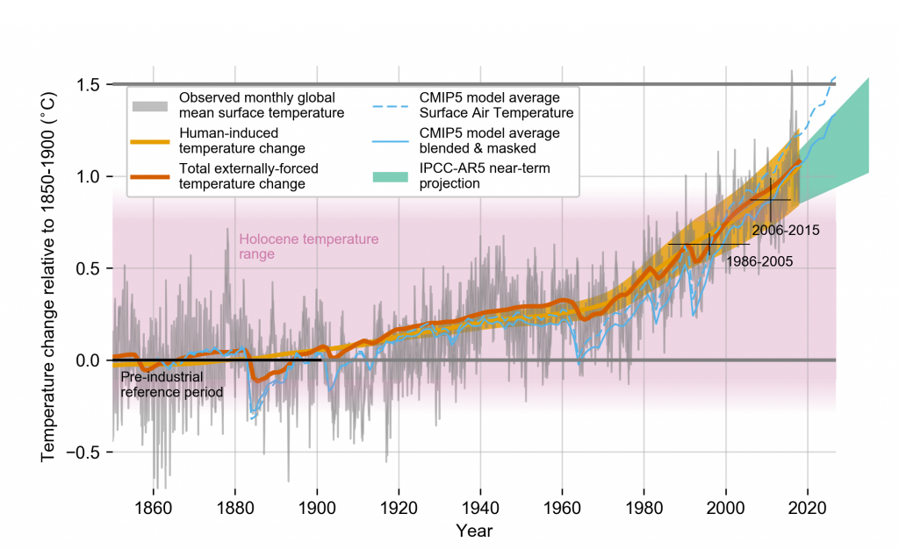
The best estimate of global warming from human-emissions was between 1.1 and 1.2ºC above preindustrial levels in 2020 using SR1.5 methods and approximately matched the observed warming
IPCC SR1.5 Report Figure 1.2

Slide 4
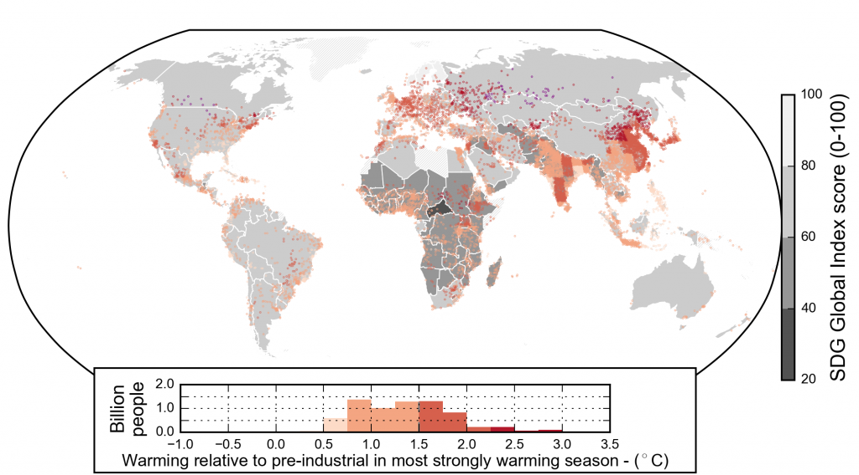
People are already living with climate change. Most impacts are expected to scale with warming level
IPCC SR1.5 Figure 1.2

Slide 5
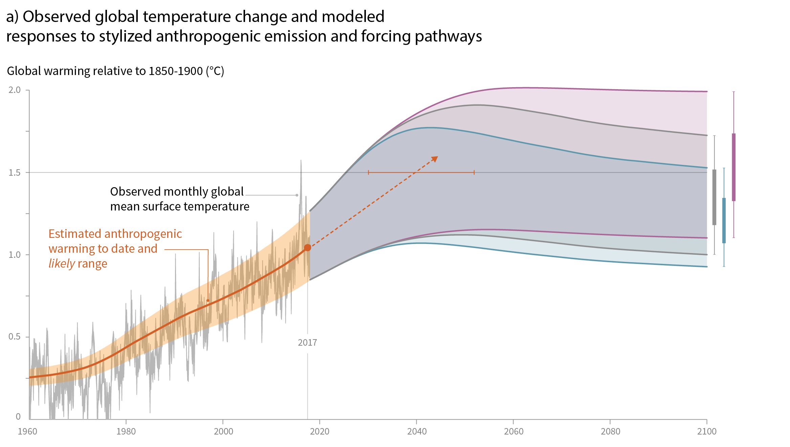
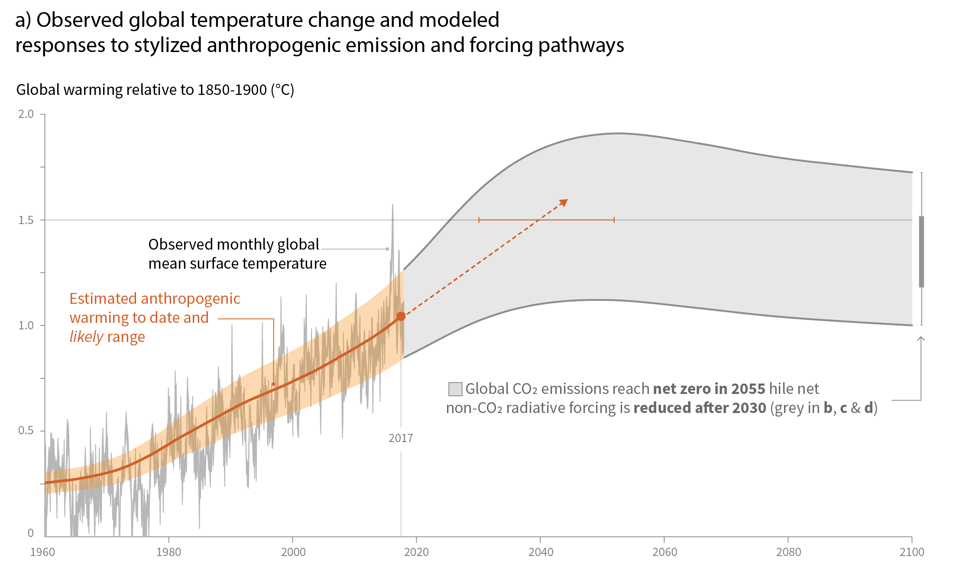
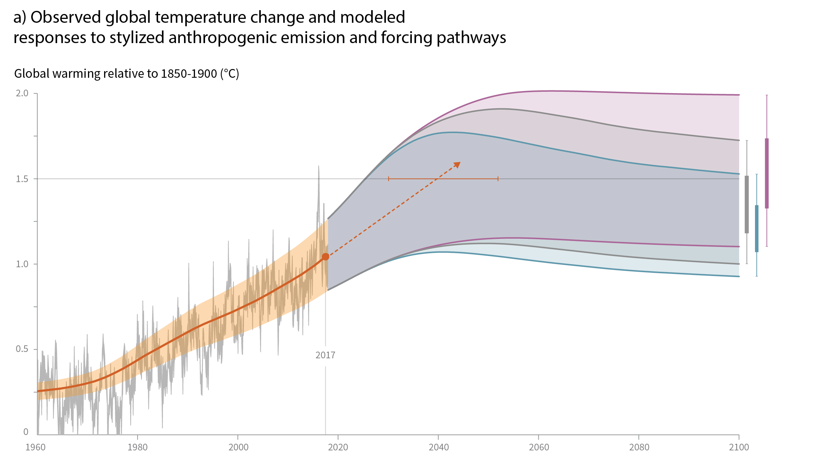
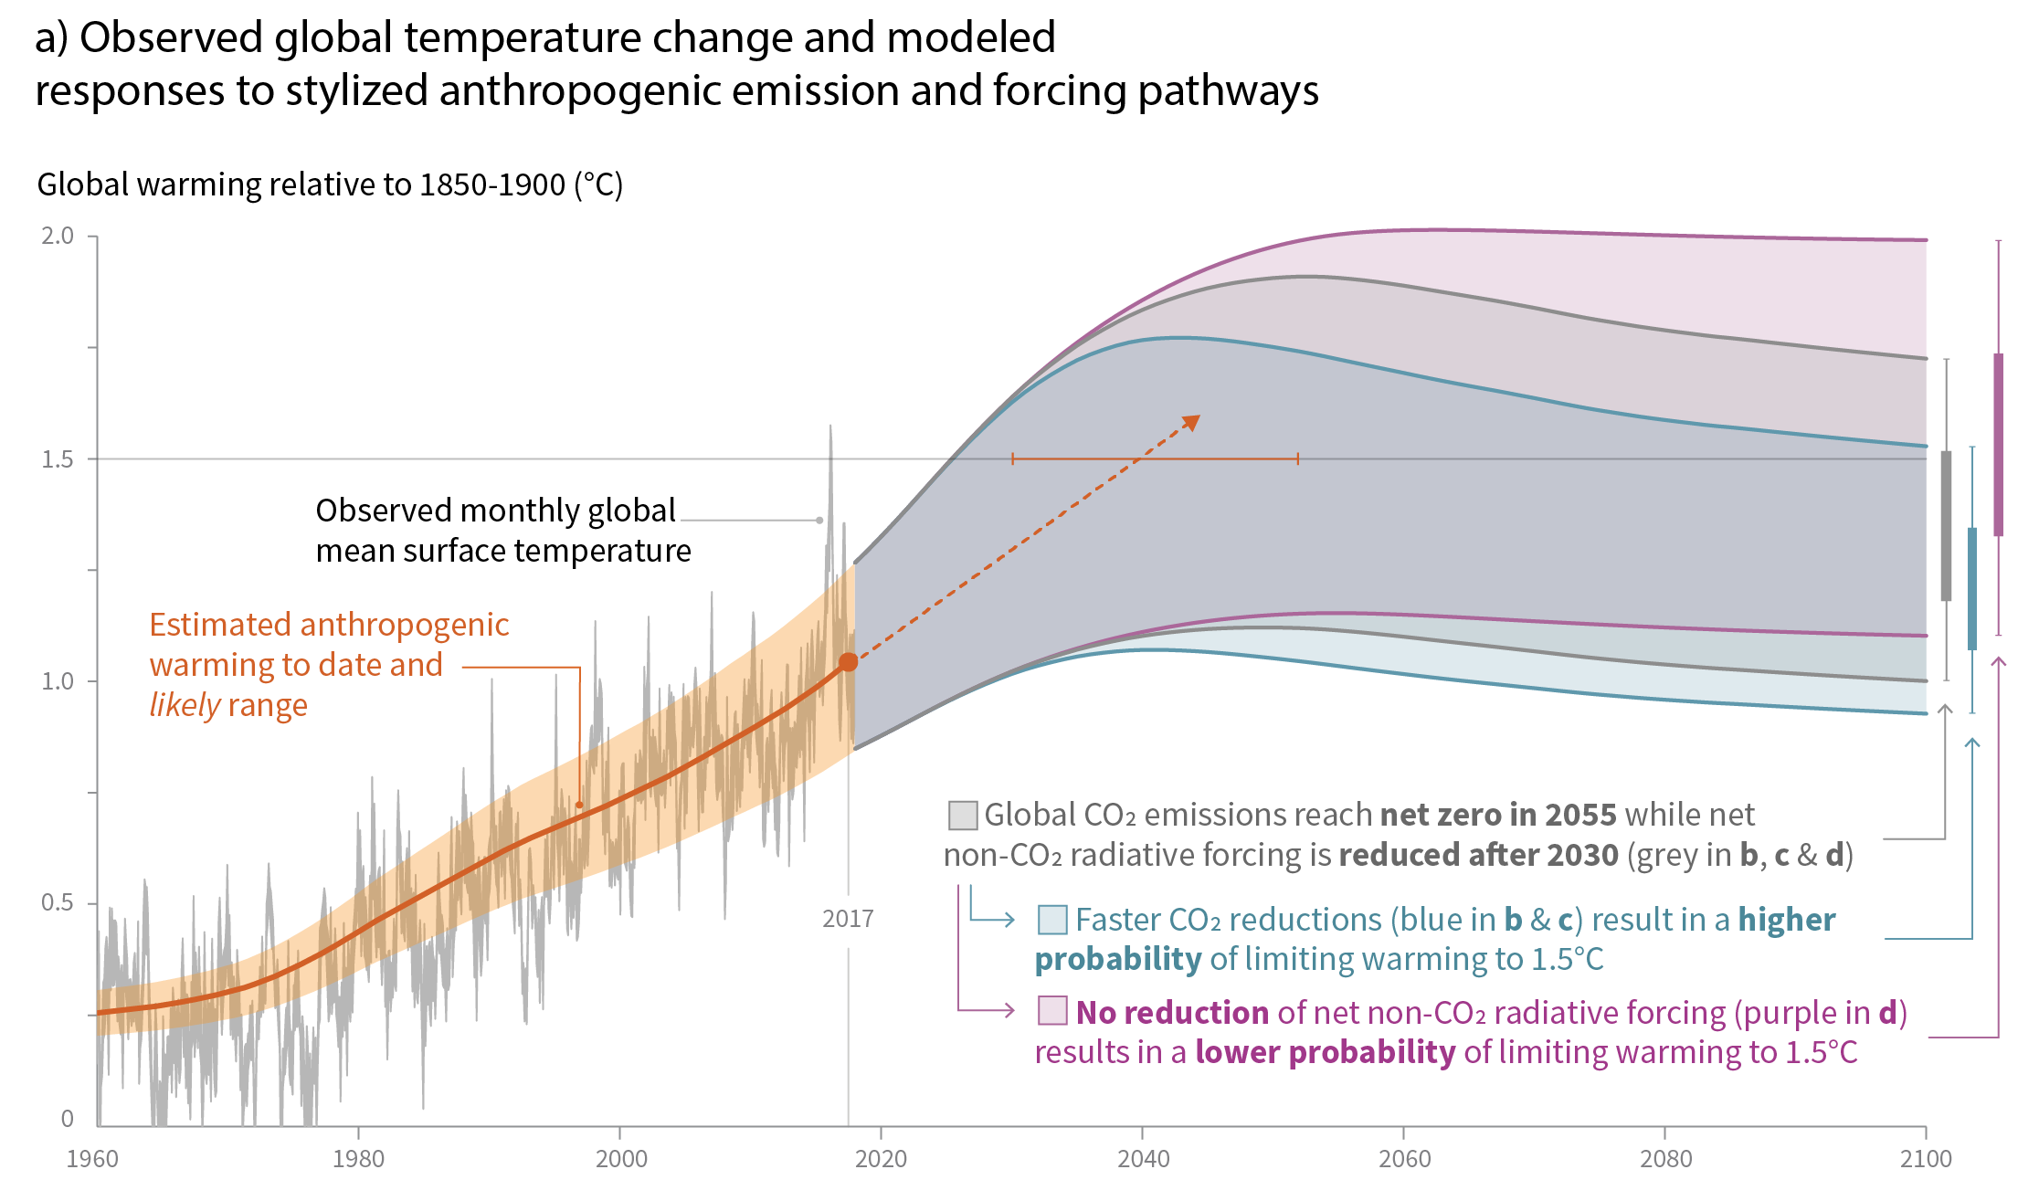
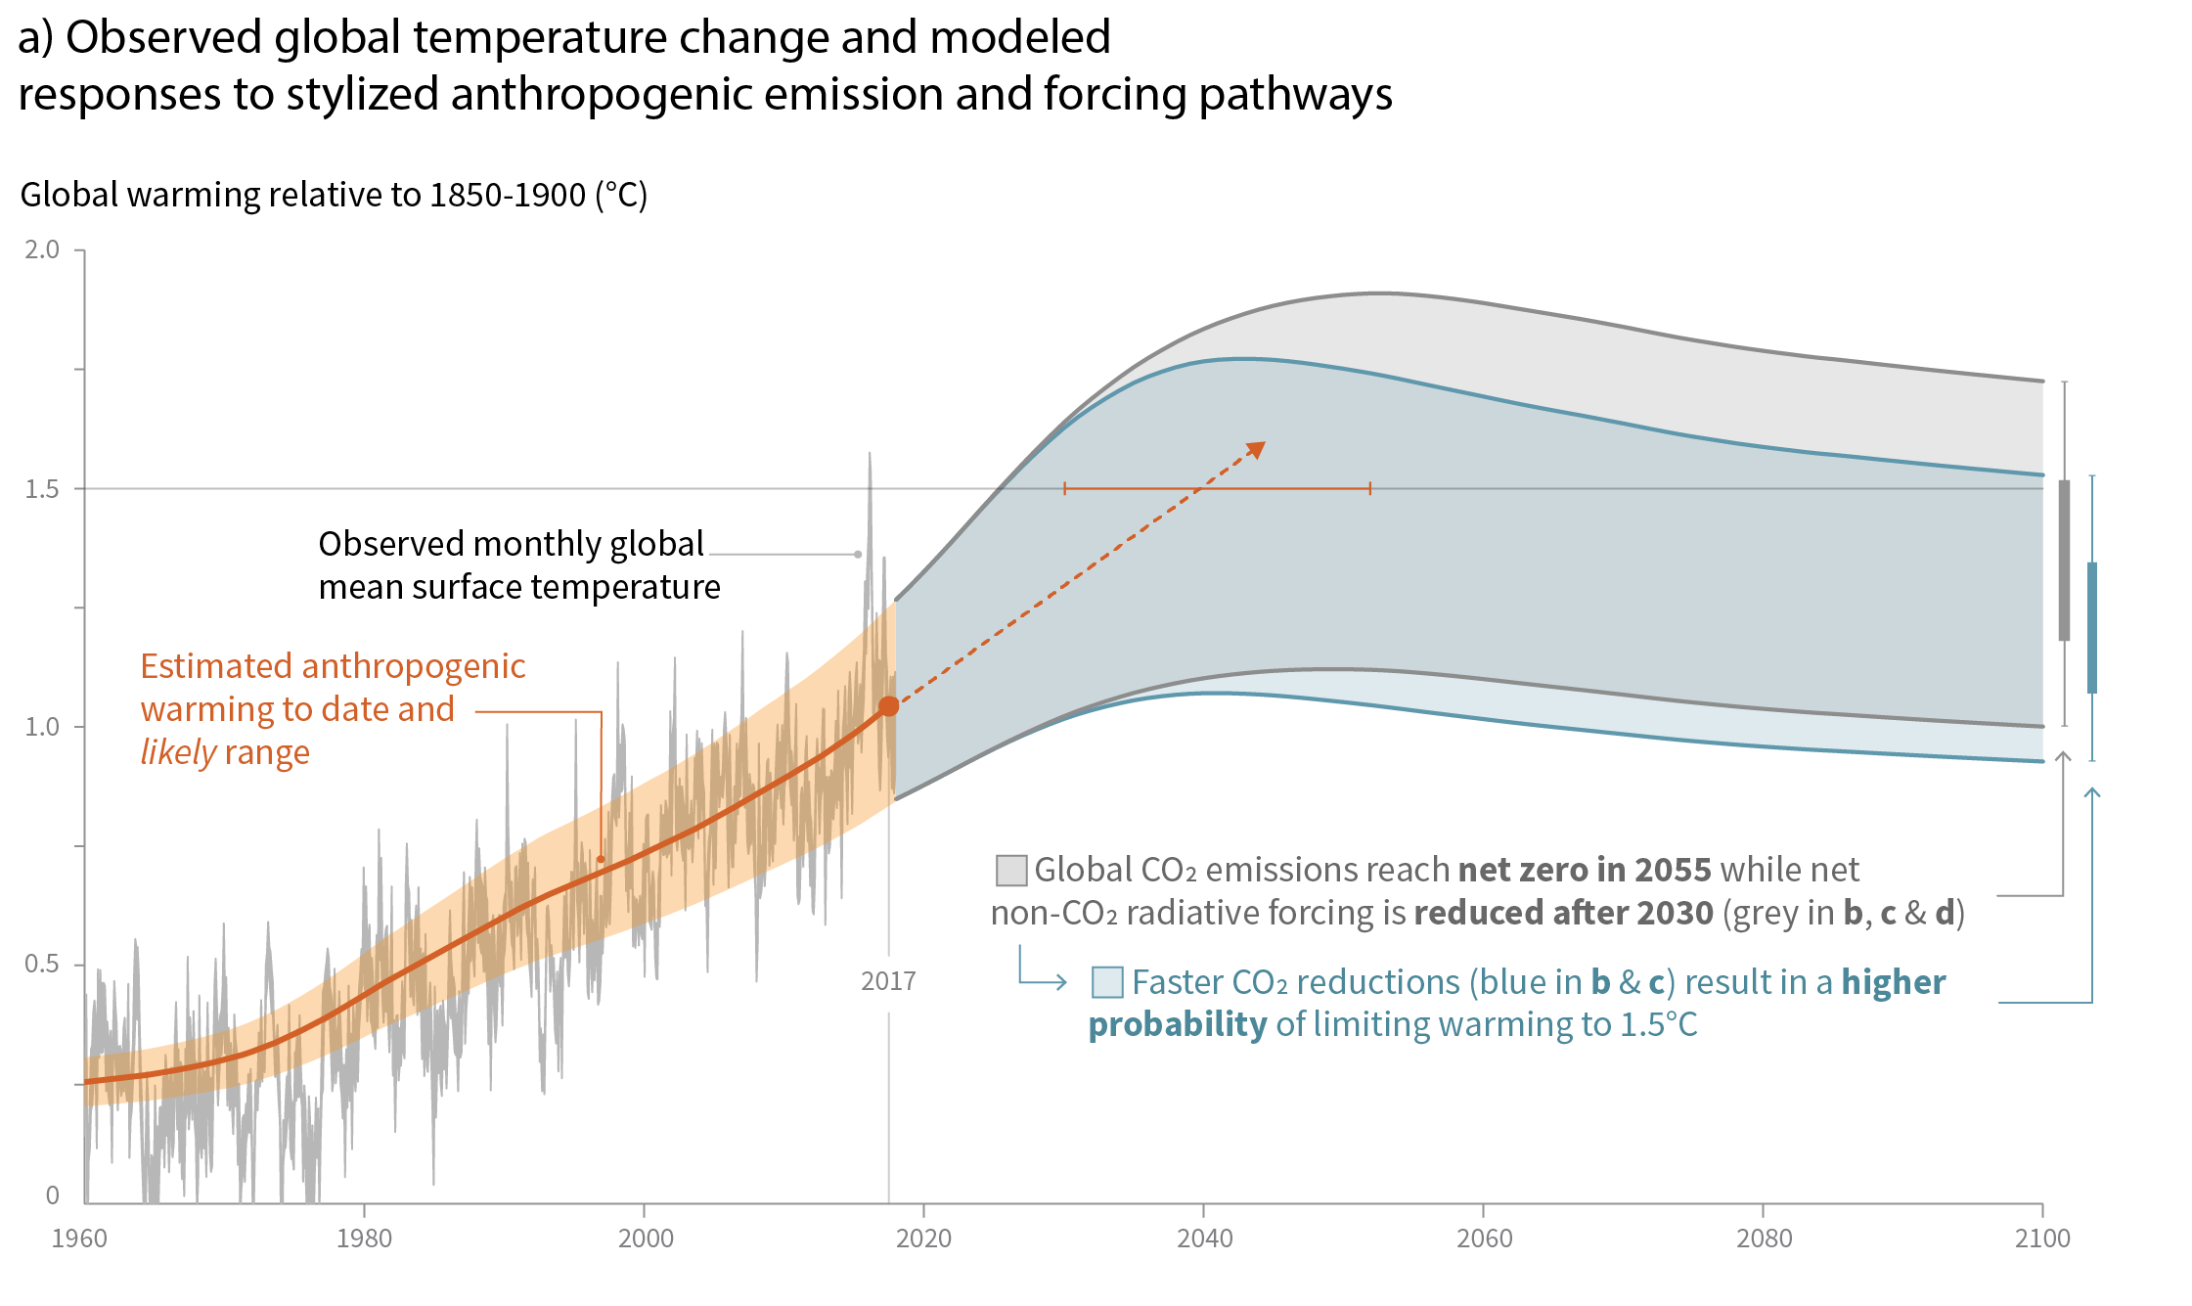
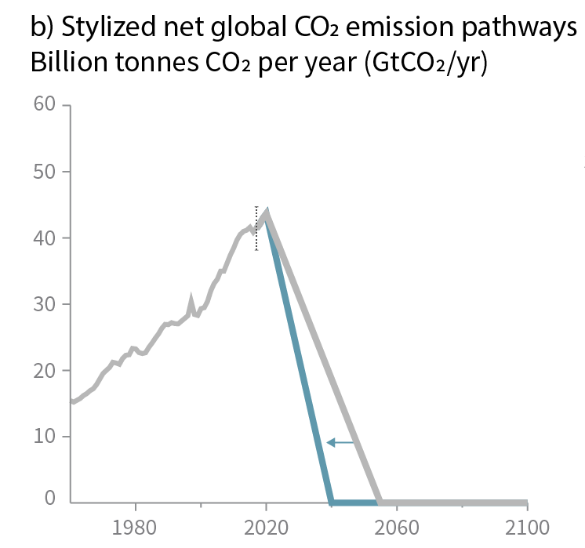
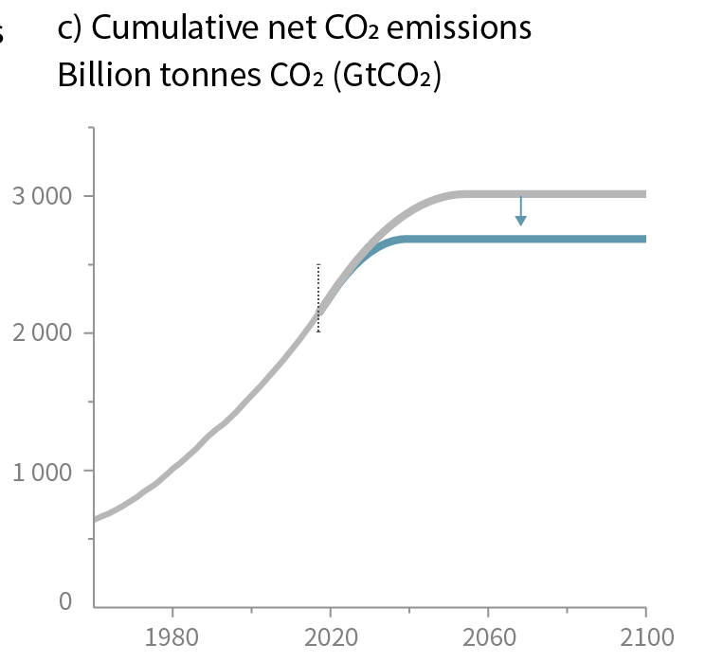
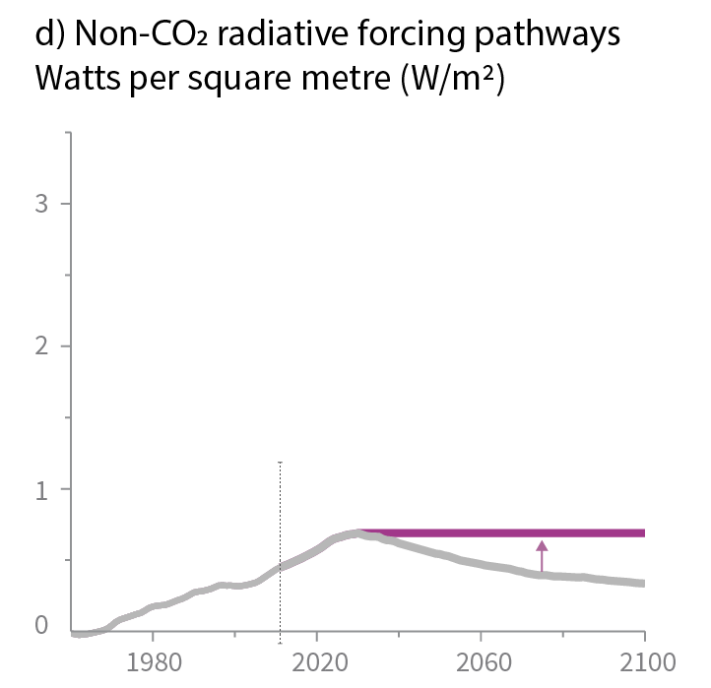
SPM1|
Cumulative emissions of CO₂ and future non-CO₂ radiative forcing determine the probability of limiting warming to 1.5°C
Maximum temperature rise is determined by cumulative net CO2 emissions and net non-CO2 radiative forcing due to methane, nitrous oxide, aerosols and other anthropogenic forcing agents.
Faster immediate CO₂ emission reductions limit cumulative CO₂ emissions

Slide 6
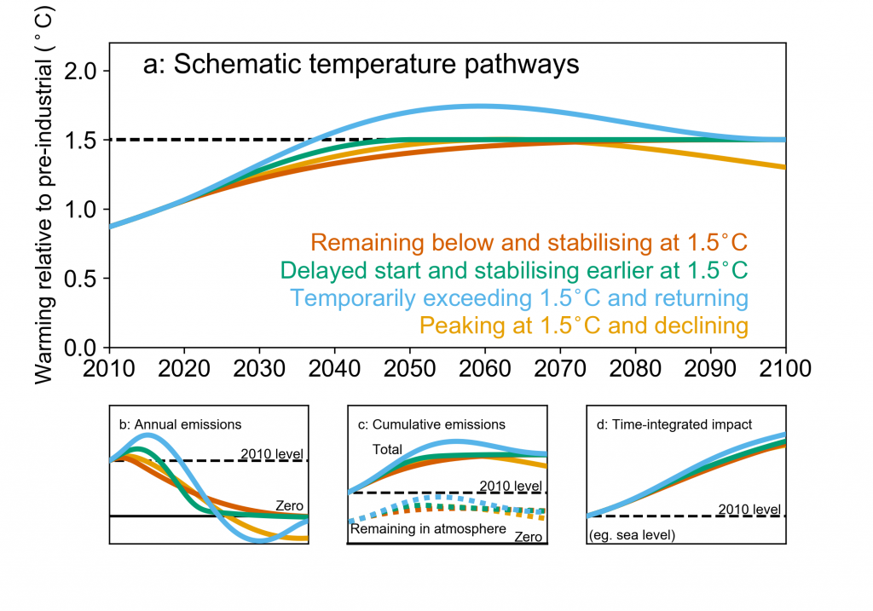
Eventual warming depends on cumulative CO2 emissions. Exceeding temperature limits will have additional impacts and require net CO2 removals to reverse warming
Approx. 220 GtCO₂ of removals would be needed to address an overshoot of 0.1ºC
Temperature overshoot could cause some irreversible impacts
IPCC SR1.5 Figure 1.4, SRCCL Chapter 6

Slide 7
Emissions need to stay within a remaining carbon budget to keep temperatures below a given warming level but uncertainty in climate response affects the chance
At the end of 2017:
580 GtCO₂ remained in the budget for 50% probability of staying below 1.5ºC
420 GtCO₂ remained in the budget for 67% probability of staying below 1.5ºC. Meeting this budget would stay below 1.5ºC in all but the highest climate sensitivity worlds
Permafrost and other Earth system feedbacks could add warming equivalent to 100 GtCO₂ over the century
1.5ºC
Remaining
CO₂ warming
Future non-CO₂
Global warming level
Warming to date
2200 ± 320 GtCO₂
0ºC
Approx. 42 GtCO₂ currently emitted per year
IPCC SR1.5 Chapter 2

Slide 8
Conclusions
Long-term temperatures depend on cumulative CO₂ emissions and level of non-CO2 emission reductions
Parts of the world are already experiencing higher temperatures than the LTGG temperature limits
To meet the LTGG temperature limits rapid emission reduction to net-zero CO₂ is needed as well as deep reductions in non-CO₂ GHGs
Meeting the LTGG temperature limit in an overshoot scenario could cause additional impacts that take decades to many centuries to reverse
Geophysical factors that make meeting the LTGG more challenging are:
If we are in a high climate sensitivity world
Future climate risk to land-based carbon dioxide removals
Other Earth system feedbacks such as GHG release from land systems

Slide 9
Conclusions
Reaching the ultimate LTGG may well imply achieving global sustainability, which requires significant transformative change in human systems.
*Global sustainability entails environmental sustainability; Social equity; and Economic prosperity
IPCC SR1.5 SPM (Fig. SPM.3b, Fig. SPM.4, D.6, D.6.3, D.7.4), SROCC SPM (C.4, C.4.7)

