Slide 1
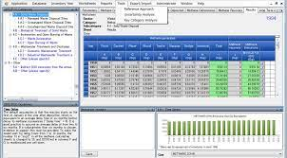
A collaboration to support countries in improving their national GHGs Inventories

Slide 2
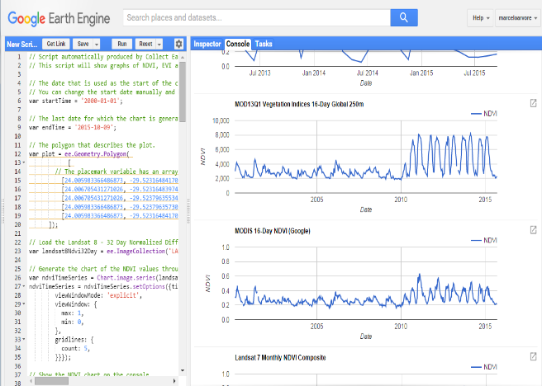
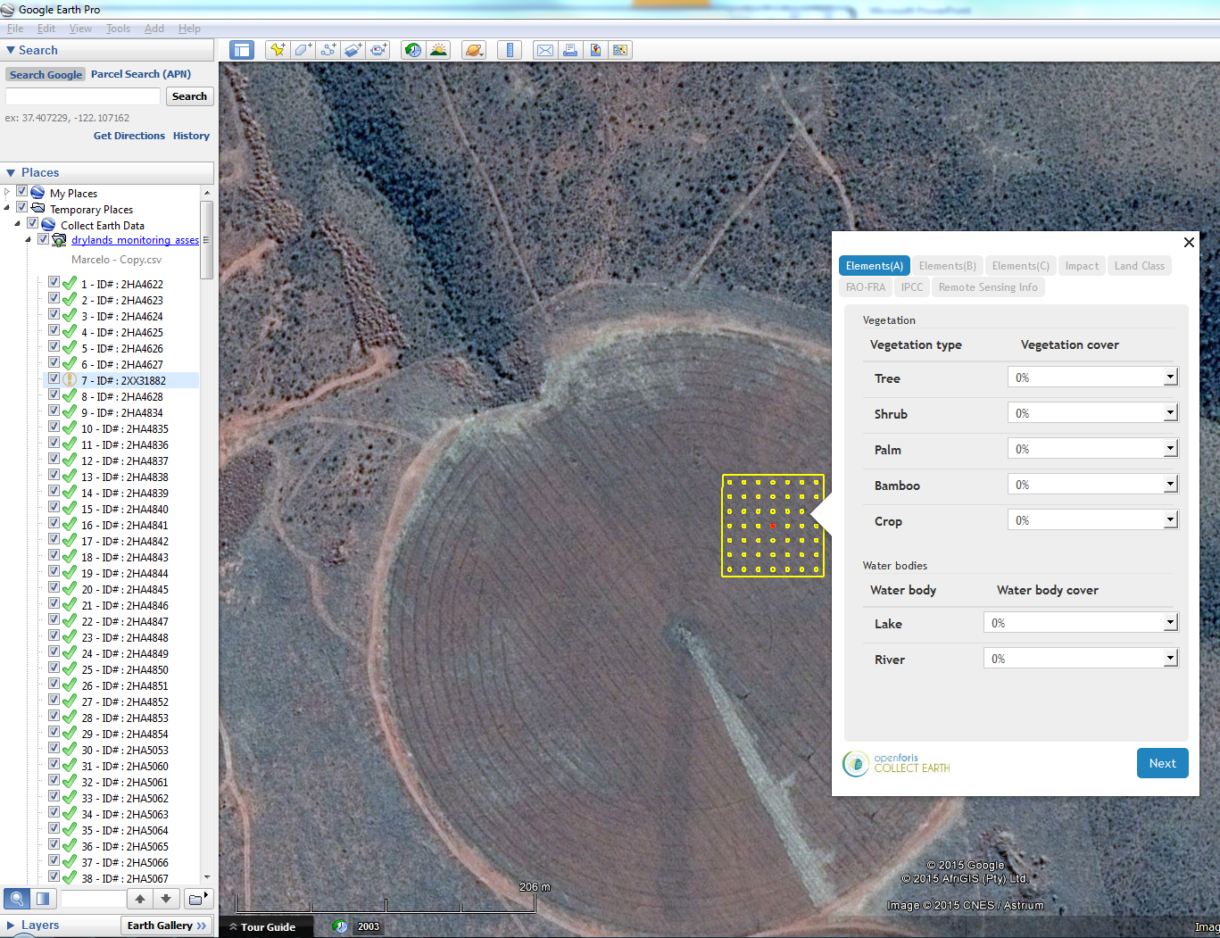
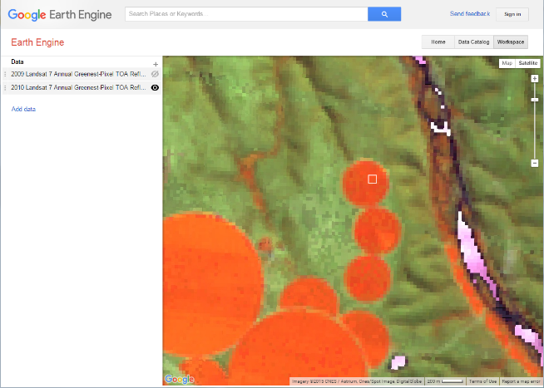
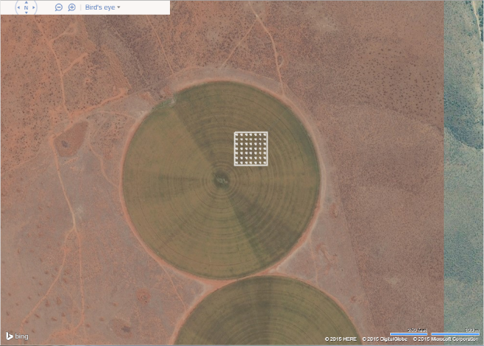
Collect Earth an open source tool for augmented visual interpretation
https://openforis.org/tools/collect-earth/
http://www.mdpi.com/2072-4292/8/10/807
Notes:
Collect Earth is an augmented visual interpretation tool for land monitoring through Google Earth, Google Earth Engine, Bing Maps and other freely available remote sensing data providers. Users can analyze high and very high-resolution satellite images together with climate and vegetation data for a variety of purposes, including multi-phase national forest inventories, LULUCF assessments, monitoring agricultural land and urban areas, quantifying deforestation, reforestation and desertification. Capacity building and support to GHGs national inventory with land representation for submission with official IPCC software

Slide 3
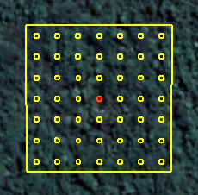
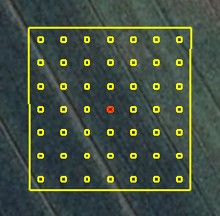
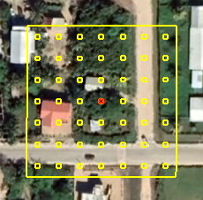
Consistent Representation of Lands
<2000
Land use
2000/2004
FOREST
2004/2015
CROPLAND
PRESENT
SETTLEMENT
2000
2004
2015
Collect Earth provides data to measure Land Use and Land Use Changes from 2000.
Collect Earth enables users to represent Land Use before 2000 through models regressions
Notes:
3

Slide 4
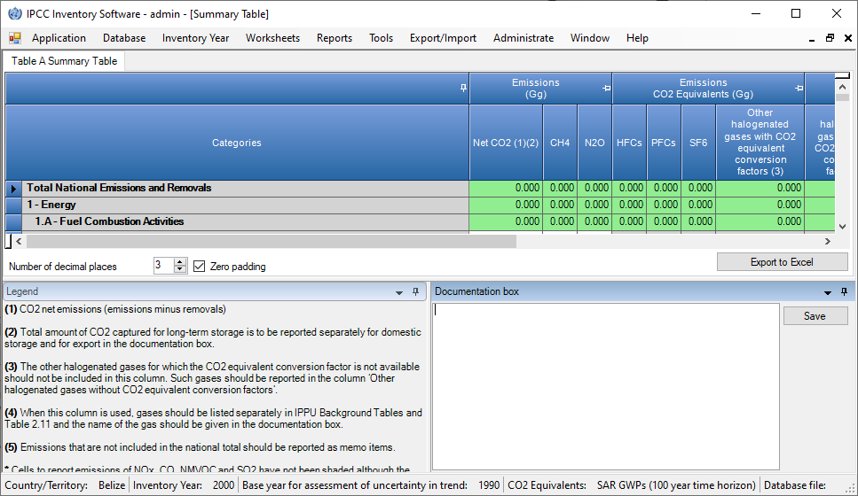
Collect Earth & IPCC Inventory software
CE Export the LU timeseries of the data in the DB
to an XML or CSV file (to be specified)
IPCC Inventory Software imports the file
building the land representation sheet
The Collect Earth module (adds-on) to export activity data
directly in the new IPCC software will be available early 2023

Slide 5
IPCC Software Wall-to-Wall Land Representation Add-on
Goal
to support wall-to-wall data collection for land representation and facilitate upload to the IPCC Software
Timeline
Tentative launch: June 2023
^{Join the Platform}
^{www.sepal.io}

Slide 6
1. GOAL: Update IPCC Inventory Software
IPCC Software Wall-to-Wall Land Representation Add-on
Add-on to IPCC software in order to allow countries to have the capacity to prepare a land representation:
by tracking units of land spatially and temporally (Approach 3)
or by reporting areas with identified changes in the land stratification for the entire transition period (20 years, IPCC default).
More specific:
1. infer data on land cover/land use through multi-spectral and multi-temporal analysis of remotely sensed image;
2. analyze data collected by producing a time series of annual matrices, for which data are available, of land use and land-use change (approach 2) or a dataset of units of land (approach 3);
3. assess and correct for bias and provides standard error for each area data;

Slide 7
2. STATUS Collaboration with Boston University, coding part finished with the Continuous Change Detection and Classification (CCDC) algorithm (Zhu and Woodcock, 2014) to evaluate changes in pixel values over time for a stack of images. Workflow in SEPAL is ready, using IPCC LCLU categories will be used to monitor changes Release expected June 2023
IPCC Software Wall-to-Wall Land Representation Add-on
4. Gap-fill the time series of annual matrices or datasets of units of land to ensure a complete land representation.
3. EXPECTED TIMELINE

Slide 8
Thank you!
Browse the Open Foris suite of tools
^{http://openforis.org/}

