Slide 1
IPCC Inventory Software: IPPU Updates
IPCC TFI Side-event
UNFCCC COP27
Sharm el-Sheikh, Egypt
November 2022

Slide 2
IPPU Main Updates
Implementation of higher Tiers
Higher Tiers mean more disaggregated data are needed, i.e. technology-specific EFs and plant-specific data
A user may use a mix of Tiers within the same category
Introduction of a category subdivisions (e.g. national, region, plant, etc.)
A user can enter a single subdivision (e.g., a national level) or many user-defined sub-divisions (e.g., prefectures or facilities)
More possibilities to select user-defined technologies, production processes and materials
Users can disaggregate each category according to its national circumstances according to country-specific technologies, production processes and input materials, and to enter country- or plant-specific values (EFs and parameters)

Slide 3
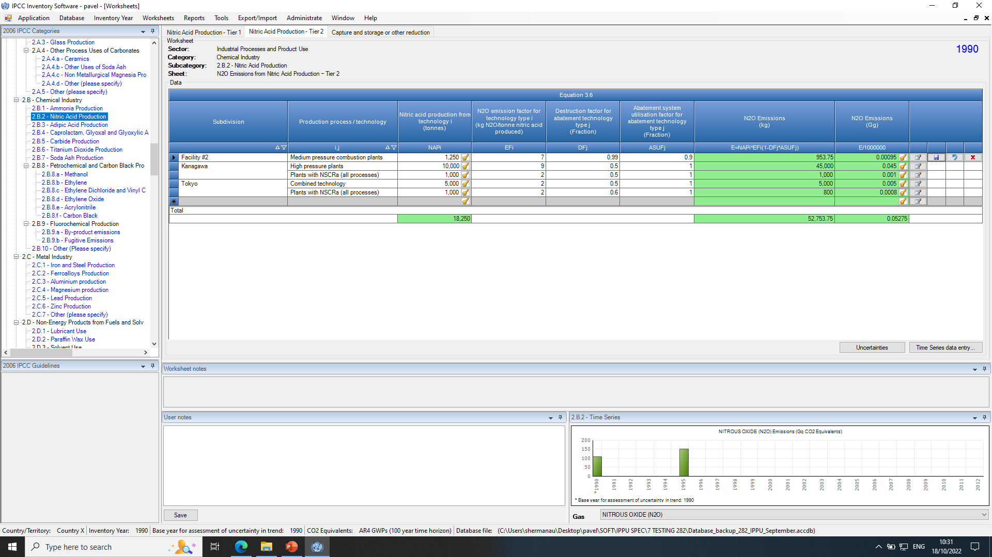
Example of a Worksheet
Sub-divisions
Worksheets Menu (Tiers)
Default or User-defined process/technology
Default or User-defined parameter

Slide 4
IPPU Worksheets
IPCC Category | Number of Worksheets
2 - Industrial Processes and Product Use (IPPU)
2.A - Mineral Industry | 28
2.B - Chemical Industry | 89
2.C - Metal Industry | 38
2.D - Non-Energy Products from Fuels and Solvent Use | 3
2.E - Electronics Industry | 24
2.F - Product Uses as Substitutes for Ozone Depleting Substances | 21
2.G - Other Product Manufacture and Use | 42
2.H - Other | 6
 | 251

Slide 5
2.A Mineral Industry
IPCC Category | Number of Worksheets | Number of Worksheets
 | Total | IPCC Tiers
IPCC Category |  | Tier 1 |  | Tier 2 | Tier 3
2.A - Mineral Industry
2.A.1 - Cement production | 8 | 2 (cement AD, ExIm, default EF) |  | 1 (clinker AD, CKD) | 4 (plant-specific AD, emissions total)
 |  | 1 (capture/reduction for all Tiers)
2.A.2 - Lime production | 6 | 1 (default EFs) |  | 1 (LKD, correction) | 3 (plant-specific AD)
 |  | 1 (capture/reduction)
2.A.3 - Glass Production | 3 | 1 (worksheet for Tier 1 and 2) |  |  | 1 (for each furnace)
 |  | 1 (capture/reduction)
2.A.4 - Other Process Uses of Carbonates
2.A.4.a - Ceramics | 2 | 2 (worksheets can be used for all Tiers: Tier 1 – defaults, Tier 2 – data on limestone/dolomite use, Tier 3 – carbonates AD, calcination)
2.A.4.b - Other Uses of Soda Ash | 2 | 2 (worksheets can be used for all Tiers, same as 2A4a)
2.A.4.c - Non Metallurgical Magnesia Production | 2 | 2 (worksheets can be used for all Tiers, same as 2A4a)
2.A.4.d - Other (please specify) | 3 | 2 (worksheets can be used for all Tiers, same as 2A4a), 1 (for reporting issues)
2.A.5 - Other (please specify) | 2* |  | 2 (1 generic worksheet AD x EF, 1 capture/reduction)
* Implements generic equation (AD x EF). No default values are provided in the 2006 IPCC Guidelines

Slide 6
2.B Chemical Industry
IPCC Category | Number of Worksheets
 | Total | IPCC Tiers
IPCC Category |  | Tier 1 | Tier 2 | Tier 3
2.B - Chemical Industry
2.B.1 - Ammonia Production | 2 | 2 (1 for all Tiers, where Tier 3 plant-specific, 1 for capture/reduction)
2.B.2 - Nitric Acid Production | 3 | 1 (AD x EF) | 1 (AD x EF plus abatement) | -- (measurements)
 |  | 1 (capture/reduction)
2.B.3 - Adipic Acid Production | 3 | 1 (same as 2.B.2) | 1 (same as 2.B.2) | -- (measurements)
 |  | 1 (capture/reduction)
2.B.4 - Caprolactam, Glyoxal and Glyoxylic Acid Production | 3 | 1 (same as 2.B.2) | 1 (same as 2.B.2) | -- (measurements)
 |  | 1 (capture/reduction)
2.B.5 - Carbide Production | 3 | 3 (for all Tiers same equation, where Tier 3 plant-specific data.1 worksheet for carbide production, 1 for carbide use in acetylene, 1 for capture/reduction )
2.B.6 - Titanium Dioxide Production | 3 | 1 (AD x EF) | 1 (carbon content and oxidation) | -- (no Tier 3)
 |  | 1 (capture/reduction)
2.B.7 - Soda Ash Production | 2 | 2 (same equation for two tiers, 1 worksheet for capture/reduction) |  | -- (measurements)

Slide 7
2.B Chemical Industry - Petrochemicals
IPCC Category | Number of Worksheets | Number of Worksheets
 | Total | IPCC Tiers
IPCC Category |  | Tier 1 | Tier 2 | Tier 3
2.B.8 - Petrochemical and Carbon Black Production
2.B.8.a - Methanol | 9 | 1 (AD, feedstock, technologies) |  | 4 (combustion, flares, vents + CH4 atm.measurement)
 |  | 2 (1 for CO2, 1 for CH4) | 1 (only CO2, mass-balance approach)
 |  | 1 (capture/reduction)
2.B.8.b - Ethylene | 9 | 2 | 1 | 4
 |  | 1
 |  | 1
2.B.8.c - Ethylene Dichloride and Vinyl Chloride Monomer | 9 | 2 | 1 | 4
 |  | 1
 |  | 1
2.B.8.d - Ethylene Oxide | 9 | 2 | 1 | 4
 |  | 1
 |  | 1
2.B.8.e - Acrylonitrile | 9 | 2 | 1 | 4
 |  | 1
 |  | 1
2.B.8.f - Carbon Black | 9 | 2 | 1 | 4
 |  | 1
 |  | 1
The same guidance for all 2.B.8 sub-categories – 2.B.8. a, b, c, d, e, f

Slide 8
2.B Chemical Industry - Fluorochemicals
IPCC Category | Number of Worksheets
 | Total | IPCC Tiers
IPCC Category |  | Tier 1 | Tier 2 | Tier 3
2.B.9 - Fluorochemical Production
2.B.9.a - By-product emissions | 12 | 2 (1 for HFC-23, 1 for other F-gases) | 1 (for HFC-23 based on efficiencies) | 8 (1 for HFC-23 direct method, 2 for HFC-23 proxy method, 2 HFC-23 monitoring method, 1 for other F-gases direct, 2 for others proxy method ) | 8 (1 for HFC-23 direct method, 2 for HFC-23 proxy method, 2 HFC-23 monitoring method, 1 for other F-gases direct, 2 for others proxy method )
 |  | 1 (capture/reduction)
2.B.9.b - Fugitive Emissions | 2 | 2 (for all others, 1 capture/reduction) | [under development]
2.B.10 - Other (Please specify) | 2* |  | 2 (1 generic worksheet AD x EF, 1 capture/reduction)

Slide 9
2.C Metal Industry
IPCC Category | Number of Worksheets
 | Total | IPCC Tiers
IPCC Category |  | Tier 1 | Tier 2 | Tier 3
2.C - Metal Industry
2.C.1 - Iron and Steel Production | 9 | 2 (1 for Iron&Steel, 1 for Coke in Energy – CO2, CH4 EF) | 6 (2 for Coke in Energy, 1 for Iron&Steel, 1 for Sinter, 1 for Pellets, 1 for DRI – CO2 mass-balance) | -- (plant-specific data and measurements)
 |  | 1 (capture/reduction)
2.C.2 - Ferroalloys Production | 9 | 1 (AD x EF) | 1 (for reducing agents EF) | 1 (for reducing agents CC)
 |  |  | 5 (ore, slag, products, non-products, summary)
 |  | 1 (capture/reduction)
2.C.3 - Aluminium production | 9 | 2 (1 for CO1, 1 for PFCs) | 6 (for Tier 2/3 for CO2 for Soderberg and Prebake, and for PFCs for Slope and Overvoltage)
 |  | 1 (capture/reduction)
2.C.4 - Magnesium production | 5 | 2 (1 for CO1, 1 for SF6) | 2 (1 for CO1, 1 for SF6) | -- (measurements)
 |  | 1 (capture/reduction)
2.C.5 - Lead Production | 2 | 2 (1 AD x EF, 1 capture/reduction) | -- (mass-balance of CC) | -- (measurements)
2.C.6 - Zinc Production | 2 | 2 (same as 2.C.5) | -- (same as 2.C.5) | -- (same as 2.C.5)
2.C.7 - Other (please specify) | 2* |  | 2 (1 generic worksheet AD x EF, 1 capture/reduction)

Slide 10
2.D Non-Energy Products from Fuels 2.E Electronics Industry
IPCC Category | Number of Worksheets
 | Total | IPCC Tiers
IPCC Category |  | Tier 1 | Tier 2 | Tier 3
2.D - Non-Energy Products from Fuels and Solvent Use
2.D.1 - Lubricant Use | 1 | 1 (1 worksheet for default and CS EFs) |  | -- (no Tier 3)
2.D.2 - Paraffin Wax Use | 1 | 1 (1 worksheet for default and CS EFs)
2.D.3 - Solvent Use | -- (no guidance)
2.D.4 - Other (please specify) | 1 | 1 (generic guidance AD x EF)
2.E - Electronics Industry
2.E.1 - Integrated Circuit or Semiconductor | 7 | 1 (AD x EF) | 6 (2 for managers: F-gas and by-products, 2 for Tier 2a: F-gas and by-products, 2 for Tier 2b: F-gas and by-products) | -- (plant-specific data)
2.E.2 - TFT Flat Panel Display | 7 | 1 (same as 2.E.1) | 6 (same as 2.E.1)
2.E.3 - Photovoltaics | 7 | 1 (same as 2.E.1) | 6 (same as 2.E.1)
2.E.4 - Heat Transfer Fluid | 2 | 1 (EF approach) | 1 (mass-balance approach) | -- (no Tier 3)
2.E.5 - Other (please specify) | 1* |  | 1 (generic worksheet AD x EF)

Slide 11
2.F Product Uses as Substitutes for ODS
IPCC Category | Number of Worksheets
 | Total | IPCC Tiers
IPCC Category |  | Tier 1 | Tier 2 | Tier 3
2.F - Product Uses as Substitutes for Ozone Depleting Substances (ODS)
2.F.1 - Refrigeration and Air Conditioning
2.F.1.a - Refrigeration and Stationary Air Conditioning | 4 | 1 (default/spreadsheet model, Tier 1a/b) | 3 (1 for parameters, 1 for Tier 2a EF-approach, 1 for Tier 2b mass-balance) | -- (no Tier 3)
2.F.1.b - Mobile Air Conditioning | 4 | 1 (same as 2.F.1a) | 3 (same as 2.F.1a)
2.F.2 - Foam Blowing Agents | 6 | 2 (default/spreadsheet, 1 for closed cells, 1 for open cells) | 4 (2 for open cell parameters and Tier 2 estimation, 2 for closed cell parameters and estimation)
2.F.3 - Fire Protection | 1 | 1 (default/spreadsheet) | -- (no Tier 2 and Tier 3)
2.F.4 - Aerosols | 1 | 1 (default and CS application and data) |  | -- (no Tier 3)
2.F.5 - Solvents | 3 | 1 (default) | 2 (1 for parameters, 1 for estimation)
2.F.6 - Other Applications (please specify) | 2 | 2 (1 for emissive applications, 1 for contained applications) | -- (no Tier 2 and Tier 3)

Slide 12
2.G Other Product Manufacture and Use (1)
IPCC Category | Number of Worksheets
 | Total | IPCC Tiers
IPCC Category |  | Tier 1 | Tier 2 | Tier 3
2.G - Other Product Manufacture and Use
2.G.1 - Electrical Equipment | 1 | -- (at the level of category 2.G.1 only Tier 3 method can be used which is mass-balance for utility level) |  | 1
2.G.1.a - Manufacture of Electrical Equipment | 9 | 1 (default and country-specific) |  | 7 (3 for mass-balance, 4 for EF approach)
 |  | 1 (capture/reduction)
2.G.1.b - Use of Electrical Equipment | 4 | 1 (default and country-specific) |  | 2 (1 for mass-balance, 1 for EF approach)
 |  | 1 (capture/reduction)
2.G.1.c - Disposal of Electrical Equipment | 9 | 1 (default) | 1 (specific for disposal) | 6 (3 for mass-balance, 3 for EF approach)
 |  | 1 (capture/reduction)
2.G.2 - SF6 and PFCs from Other Product Uses
2.G.2.a - Military Applications | 3 | 1 (AD x EF) | 1 (mass-balance) | -- (no Tier 3)
 |  | 1 (capture/reduction)
2.G.2.b - Accelerators | 4 | 1 (default) | 1 (by accelerator) | 1 (mass-balance)
 |  | 1 (capture/reduction)
2.G.2.c - Other (please specify) | 4 | 4 (1 for adiabatic uses, 1 for sound-proof glazing, 1 for other applications, 1 for capture/reduction) | -- (no Tier 2 and Tier 3) | -

Slide 13
2.G Other Product Manufacture and Use (2)
IPCC Category | Number of Worksheets
 | Total | IPCC Tiers
IPCC Category |  | Tier 1 | Tier 2 | Tier 3
2.G - Other Product Manufacture and Use
2.G.3 - N2O from Product Uses
2.G.3.a - Medical Applications | 2 | 2 (1 for estimation based on quantities in Years T and T-1, 1 for capture/reduction) | -- (no Tier 2 and Tier 3)
2.G.3.b - Propellant for pressure and aerosol products | 2 | 2 (same as 2.G.3.a)
2.G.3.c - Other (Please specify) | 2 | 2 (same as 2.G.3.a)
2.G.4 - Other (Please specify) | 2* |  | 2 (1 generic worksheet AD x EF, 1 capture/reduction)

Slide 14
2.H Other
IPCC Category | Number of Worksheets | Number of Worksheets
 | Total | IPCC Tiers
IPCC Category |  | Tier 1 | Tier 2 | Tier 3
2.H - Other
2.H.1 - Pulp and Paper Industry | 2* |  | 2 (1 generic worksheet AD x EF, 1 capture/reduction)
2.H.2 - Food and Beverages Industry | 2* |  | same as 2.H.1
2.H.3 - Other (please specify) | 2* |  | same as 2.H.1
* Implements generic equation (AD x EF). No default values are provided in the 2006 IPCC Guidelines
(NMVOCs emissions from Pulp and Paper Industry and Food and Beverage Industry in the Revised 1996 IPCC Guidelines)

Slide 15
Summary
All IPPU methods provided in the 2006 IPCC Guidelines are implemented in the IPCC Inventory Software (i.e. all equations in Volume 3 of the 2006 IPCC Guidelines)
Flexibility of the IPCC Inventory Software to meet national circumstances is ensured (as per a Tiered approach)
Sub-national reporting allows tracking specific activities/emissions within a national GHG inventory
The Guidebook for IPPU sector to guide users in implementing each and every IPCC method in IPPU is under preparation

Slide 16
Thank you Users’ feedback is most welcome! Please provide it at: ipcc-software@iges.or.jp

