Slide 1
IPCC Inventory Software for National GHG inventories Overview of the Energy Sector
IPCC TFI Side Event
Sharm el-Sheikh - Climate Change Conference
UNFCCC COP27
November 2022

Slide 2
Major updates
Subnational disaggregation at a category level
Fuel Manager
Higher Tiers methods in 2006 IPCC Guidelines (Volume 2)
Improvements in worksheet structure and layout

Slide 3
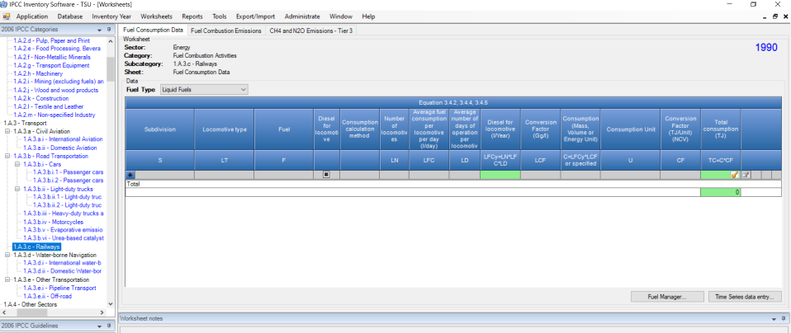
Subnational disaggregation
Subdivision’s Column allows to report at subnational level as well as to further disaggregate estimates according to e.g. drivers/stakeholders and/or relevant variables

Slide 4
Fuel Manager
Contains main parameters on fuels, i.e. fuel type, calorific value, carbon content- needed to estimate GHG emissions from combustion
Allows input of user-defined fuels and their parameters
Information from fuel manager transfers to all corresponding worksheets

Slide 5
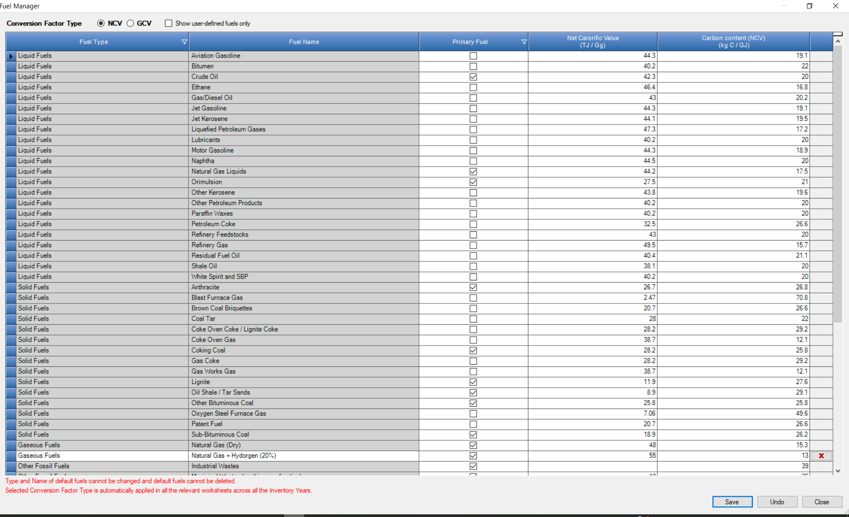
Fuel Manager

Slide 6
Higher Tiers
Stationary Combustion
further disaggregation of estimates by technology type and its penetration rate
Mobile Combustion
further disaggregation of estimates by vehicle/equipment type, operating conditions/road type, and emission control technology
Fugitive emissions
For coal: further disaggregation of estimates by coal rank and emissions rate before abandonment,
For oil: further disaggregation of venting and flaring estimates by quantity of gas vented/flared and its composition

Slide 7
Improvements in worksheet structure and layout
Combination of Tiers within the same set of worksheets, where the structure of IPCC equations allows e.g. Stationary Combustion
Addition of (set of) worksheets for each different Tier, where IPCC equations do not allow combination of multiple tiers
166 worksheets in total available, among which the user selects those that better deal with national circumstances.
Such a large number allows any combinations of tiers to be composed to estimate GHG emissions from the Energy sector.

Slide 8
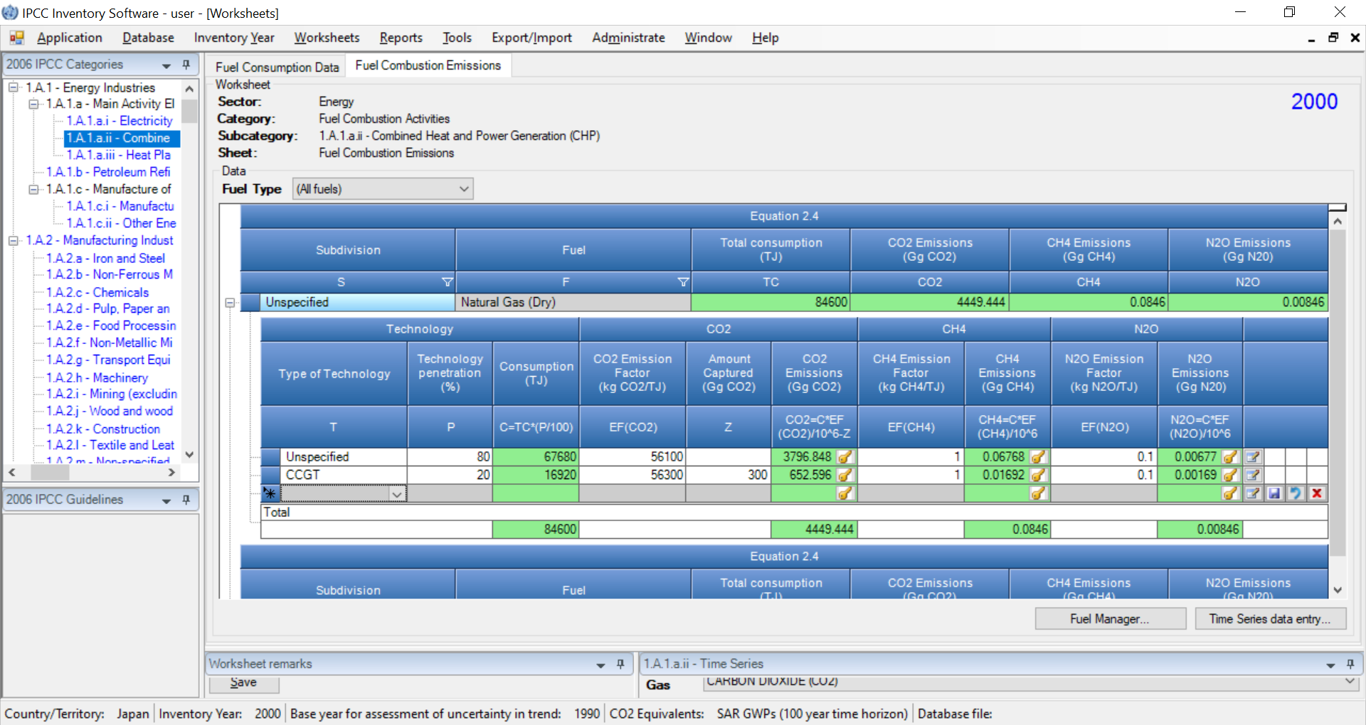
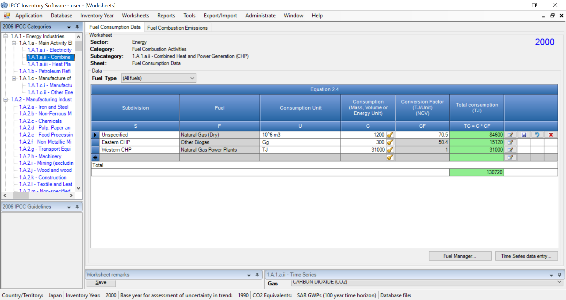
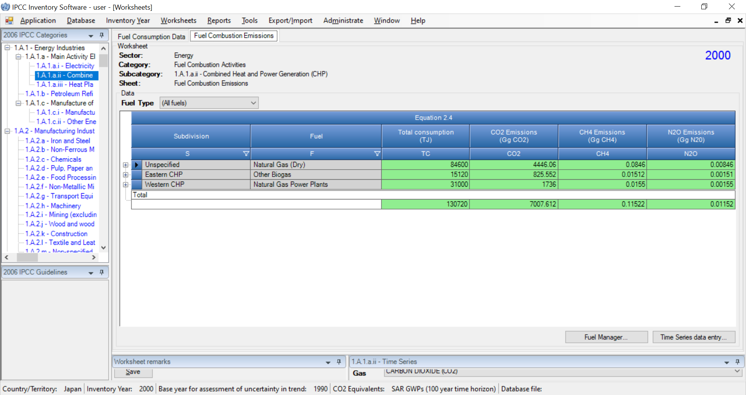
Improvements in worksheet structure and layout
Stationary Combustion

Slide 9
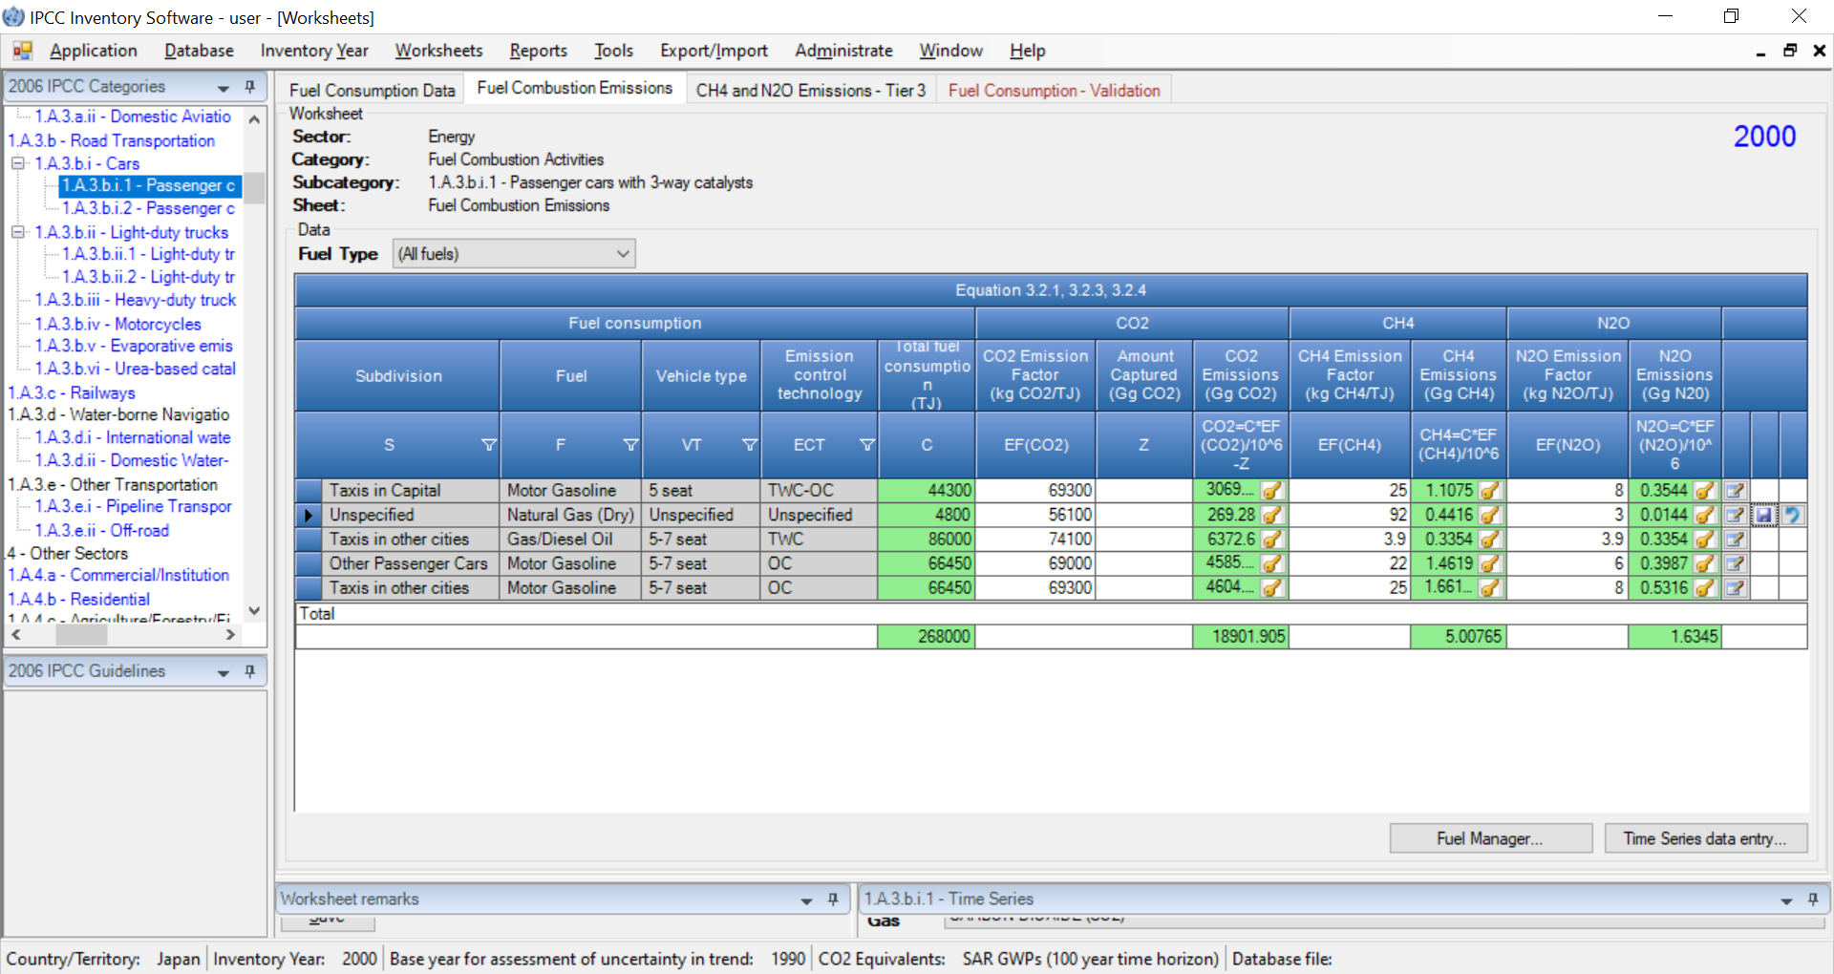
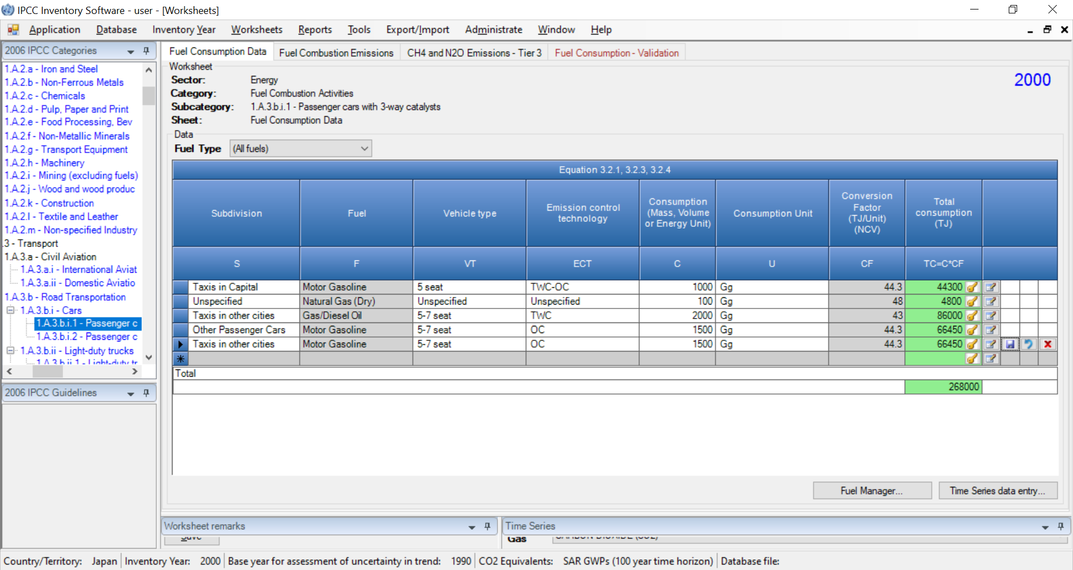
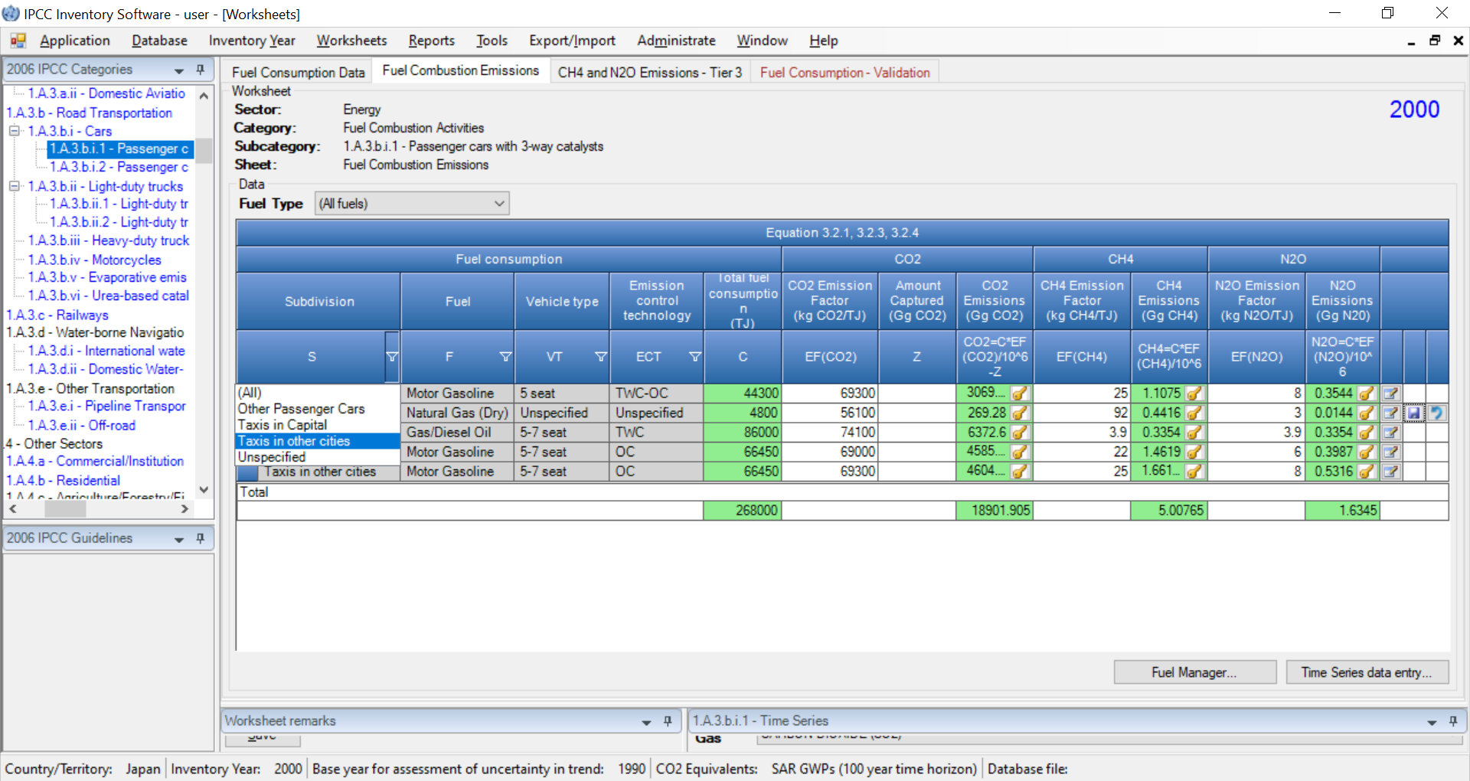
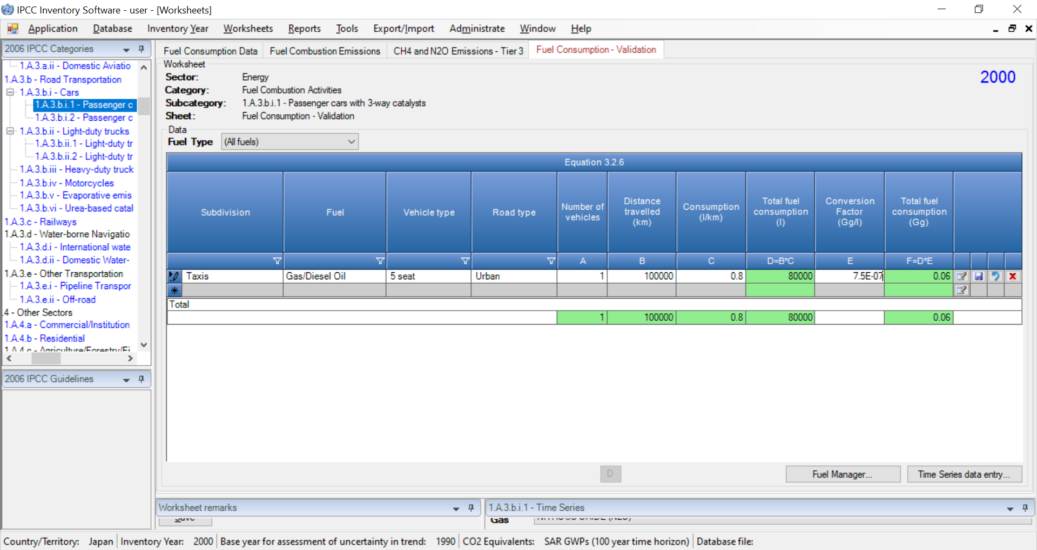
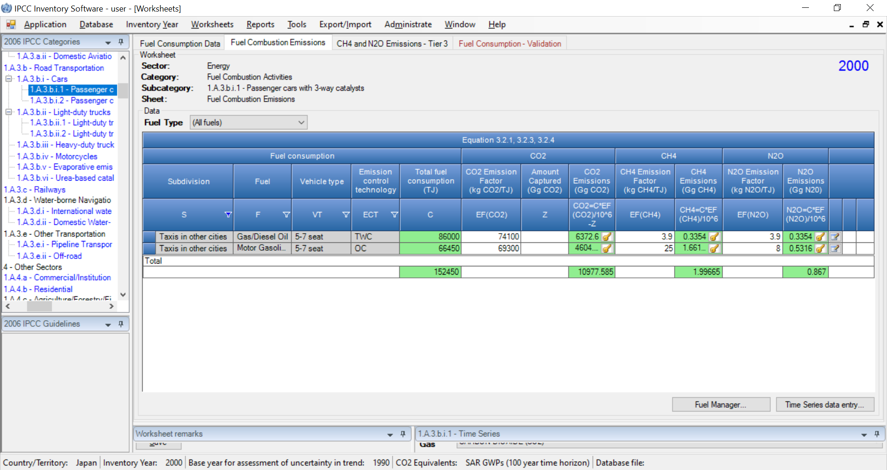
Improvements in worksheet structure and layout
Road Transportation
Applying Filters

Slide 10
Worksheets map [sectoral approach]
IPCC Category | Number of Worksheets
IPCC Category | Total | IPCC Tier (Equations)
 |  | Tier 1 | Tier 2 |  | Tier 3
1.A.1 - Energy Industries | 12
1.A.1.a - Main Activity Electricity and Heat Production | 6
1.A.1.a.i - Electricity Generation | 2 | 2
1.A.1.a.ii - Combined Heat and Power Generation (CHP) | 2 | 2
1.A.1.a.iii - Heat Plants | 2 | 2
1.A.1.b - Petroleum Refining | 2 | 2
1.A.1.c - Manufacture of Solid Fuels and Other Energy Industries | 4
1.A.1.c.i - Manufacture of Solid Fuels | 2 | 2
1.A.1.c.ii - Other Energy Industries | 2 | 2
1.A.2 - Manufacturing Industries and Construction | 26
1.A.2.a - Iron and Steel | 2 | 2
1.A.2.b - Non-Ferrous Metals | 2 | 2
1.A.2.c - Chemicals | 2 | 2
1.A.2.d - Pulp, Paper and Print | 2 | 2
1.A.2.e - Food Processing, Beverages and Tobacco | 2 | 2
1.A.2.f - Non-Metallic Minerals | 2 | 2
1.A.2.g - Transport Equipment | 2 | 2
1.A.2.h - Machinery | 2 | 2
1.A.2.i - Mining (excluding fuels) and Quarrying | 2 | 2
1.A.2.j - Wood and wood products | 2 | 2
1.A.2.k - Construction | 2 | 2
1.A.2.l - Textile and Leather | 2 | 2
1.A.2.m - Non-specified Industry | 2 | 2
Stationary combustion Tiers 1 & 2 do not stratify by technology-specific EFs (thus, variable T is “unspecified” and variable “P” is “100”%)

Slide 11
IPCC Category | Number of worksheets
IPCC Category | Total | IPCC Tier (Equations)
 |  | Tier 1 | Tier 2 | Tier 3
1.A.3 - Transport | 54
1.A.3.a - Civil Aviation | 8 |  | LTO vs Cruise
1.A.3.a.i - International Aviation (International Bunkers) | 4 | 2
 |  |  | 2
1.A.3.a.ii - Domestic Aviation | 4 | 2
 |  |  | 2
1.A.3.b - Road Transportation | 31 |  | Vehicle type & ECT** | AD: km travelled per Operating conditions
1.A.3.b.i - Cars | 11 | 2* (+1) | ECT | Operating conditions and Km travelle
1.A.3.b.i.1 - Passenger cars with 3-way catalysts | 4 | 2 (+1) |  | 1**
1.A.3.b.i.2 - Passenger cars without 3-way catalysts | 4 | 2 (+1) |  | 1**
1.A.3.b.ii - Light-duty trucks | 11 | 2* (+1)
1.A.3.b.ii.1 - Light-duty trucks with 3-way catalysts | 4 | 2 (+1) |  | 1**
1.A.3.b.ii.2 - Light-duty trucks without 3-way catalysts | 4 | 2 (+1) |  | 1**
1.A.3.b.iii - Heavy-duty trucks and buses | 4 | 2 (+1) |  | 1**
1.A.3.b.iv - Motorcycles | 4 | 2 (+1) |  | 1**
1.A.3.b.v - Evaporative emissions from vehicles
1.A.3.b.vi - Urea-based catalysts | 1 | 1
1.A.3.c - Railways | 3 |  | Locomotive type | AD: Engine power per load factor per hour
1.A.3.c - Railways | 3 | 2 |  | 1**
1.A.3.d - Water-borne Navigation | 4 |  | Vessel/Engine type
1.A.3.d.i - International water-borne navigation (International bunkers) | 2 | 2
1.A.3.d.ii - Domestic Water-borne Navigation | 2 | 2
1.A.3.e - Other Transportation | 5
1.A.3.e.i - Pipeline Transport | 2 | 2
1.A.3.e.ii - Off-road | 3 |  | Vehicle/Equipment type | AD: Engine power per load factor per hour
1.A.3.e.ii - Off-road | 3 | 2 |  | 1
(+1) Additional Tab for validating fuel consumption data
Notes:
Tier 2 for Civil Aviation

Slide 12
Worksheets map [sectoral approach]
IPCC Category |  | Number of worksheets
IPCC Category |  | Total | IPCC Tier (Equations)
 |  |  | Tier 1 | Tier 2 | Tier 3
1.A.4 - Other Sectors |  | 11
1.A.4.a - Commercial/Institutional |  | 2 | 2
1.A.4.b - Residential |  | 2 | 2
1.A.4.c - Agriculture/Forestry/Fishing/Fish Farms |  | 7
1.A.4.c.i - Stationary |  | 2 | 2
1.A.4.c.ii - Off-road Vehicles and Other Machinery |  | 3 | 2 |  | 1
1.A.4.c.iii – Fishing (mobile combustion) |  | 2 | 2
1.A.5 - Non-Specified |  | 20
1.A.5.a - Stationary |  | 2 | 2
1.A.5.b - Mobile |  | 12
1.A.5.b.i - Mobile (aviation component) |  | 4 | 2
 |  |  |  | 2
1.A.5.b.ii - Mobile (water-borne component) |  | 2 | 2
1.A.5.b.iii - Mobile (other) | road | 6 | 2 |  | 1**
 | off-road |  | 2 |  | 1
1.A.5.c - Multilateral Operations | aviation | 6 | 2
 |  |  |  | 2
 | waterborne |  | 2

Slide 13
Worksheets map [sectoral approach]
IPCC Category | Number of Worksheets
IPCC Category | Total | IPCC Tier (Equations)
 |  | Tier 1 | Tier 2 | Tier 3
1.B.1 - Solid Fuels | 14
1.B.1.a - Coal mining and handling | 11
1.B.1.a.i - Underground mines | 7
1.B.1.a.i.1 - Mining | 2 | 2
1.B.1.a.i.2 - Post-mining seam gas emissions | 2 | 2
1.B.1.a.i.3 - Abandoned underground mines | 2 | 1
 |  |  | 1***
1.B.1.a.i.4 - Flaring of drained CH₄ or conversion of CH₄ to CO₂ | 1 | 1
1.B.1.a.ii - Surface mines | 4
1.B.1.a.ii.1 - Mining | 2 | 2
1.B.1.a.ii.2 - Post-mining seam gas emissions | 2 | 2
1.B.1.b - Uncontrolled combustion and burning coal dumps | 2 | 2 | 2
1.B.1.c - Solid fuel transformation | 1 |  | 1****
at Tier 2: AD by Coal Rank, while EF by Emission rate before closure and Time since closure,
at Tier 3 historical emissions corrected by an emission factor and by methane recovery

Slide 14
Worksheets map [sectoral approach]
IPCC Category | Number of Worksheets
IPCC Category | Total | IPCC Tier (Equations)
 |  | Tier 1 | Tier 2 | Tier 3
1.B.2 - Oil and Natural Gas | 22
1.B.2.a - Oil | 14
1.B.2.a.i - Venting | 3 | 1 | 1
 |  | 1
1.B.2.a.ii - Flaring | 5 | 1 | 3
 |  | 1
1.B.2.a.iii - All Other | 6
1.B.2.a.iii.1 - Exploration | 1 | 1
1.B.2.a.iii.2 - Production and Upgrading | 1 | 1
1.B.2.a.iii.3 - Transport | 1 | 1
1.B.2.a.iii.4 - Refining | 1 | 1
1.B.2.a.iii.5 - Distribution of oil products | 1 | 1
1.B.2.a.iii.6 - Other | 1 | 1
1.B.2.b - Natural Gas | 8
1.B.2.b.i - Venting | 1 | 1
1.B.2.b.ii - Flaring | 1 | 1
1.B.2.b.iii - All Other | 6
1.B.2.b.iii.1 - Exploration | 1 | 1
1.B.2.b.iii.2 - Production | 1 | 1
1.B.2.b.iii.3 - Processing | 1 | 1
1.B.2.b.iii.4 - Transmission and Storage | 1 | 1
1.B.2.b.iii.5 - Distribution | 1 | 1
1.B.2.b.iii.6 - Other | 1 | 1
1.B.3 - Other emissions from Energy Production | 1 |  | 1****
Tier 2 AD are quantity of gas vented/flared and its composition

Slide 15
Worksheets map [sectoral approach]
IPCC Category | Number of Worksheets
IPCC Category | Total | IPCC Tier (Equations)
 |  | Tier 1 | Tier 2 | Tier 3
1.C.1. – Transport of CO₂ | 3
1.C.1.a. Pipelines | 1 | 1 | 1
1.C.1.b. Ships | 1 |  | 1 | 1
1.C.1.c Other (please specify) | 1 |  | 1 | 1
1.C.2. Injection and Storage | 2
1.C.2.a Injection | 1 |  | 1 | 1
1.C.2.b Storage | 1 |  | 1 | 1
1.C.3. Other | 1 |  | 1 | 1

Slide 16
Worksheets map [reference approach]
Energy sector Reference approach | Number of Worksheets
Energy sector Reference approach | Total | IPCC Tier (Equations)
 | 3 | Reference Approach Data
 |  | Estimating Excluded Carbon
 |  | Comparison

Slide 17
Worksheets map [Energy sector]
IPCC Category | Number of Worksheets
IPCC Category | Total
1.A. - Fuel Combustion Activities | 120
1.A.1 - Energy Industries | 12
1.A.2 - Manufacturing Industries and Construction | 26
1.A.3 - Transport | 54
1.A.4 - Other Sectors | 11
1.A.5 - Non-Specified | 20
1.B. - Fugitive emissions from fuels | 37
1.B.1 - Solid Fuels | 14
1.B.2 - Oil and Natural Gas | 22
1.B.3 - Other emissions from Energy Production | 1
1.C. - Carbon dioxide Transport and Storage | 6
1.C.1 - Transport of CO₂ | 3
1.C.2 - Injection and Storage | 2
1.C.3 - Other | 1
Reference Approach | 3
TOTAL ENERGY SECTOR | 166

Slide 18
Worksheets map [notes]
* the use of worksheet at this aggregate level suits IPCC Tier 1 only, since the use of country-specific EFs requires reporting at subcategory level
** CH₄ and N₂O only
*** CH₄ only
**** Implements the generic IPCC equation, AD x EF. No default values are provided in the 2006 IPCC Guidelines. It accommodates Tier 3 when plant-specific data are used

Slide 19
Summary
All methods in the 2006 IPCC Guidelines are implemented in the IPCC Inventory Software
Thus, needed flexibility to deal with any national circumstances, as per IPCC tiered approach, is ensured
Subnational disaggregation
Thus, tracking of specific activities/projects, and associated emission level & trend, within a national GHG inventory is allowed
Energy sector Guidebook – version 1 under revision

Slide 20
Thank you
https://www.ipcc-nggip.iges.or.jp/index.html

