Slide 1




Please use this QR code to provide your contact details for the mailing list.
Thank you!
https://www.surveymonkey.com/r/NLS2GPD

Slide 2

Hands-on training session for technical expert reviewers under the Paris Agreement
Transparency Division
12 November 2024
Notes:
Welcome to Hands-on training session for technical expert reviewers under the Paris Agreement.
This event is part of the series of events called #Together4Transparency, an initiative coordinated by the UNFCCC secretariat which covers a range of climate transparency-related issues, in preparation for the Enhanced Transparency Framework and supporting the full implementation of the Paris Agreement.
As you may know this year – 2024 – is a pivotal year for transparency, as we close the chapter of Biennial Reports and Biennial Update Reports under the Convention and prepare to receive the first Biennial Transparency Reports under the Paris Agreement.
At SB60, UNFCCC, together with our collaborating partners, will a wide range of events – from dialogues, workshops, to information and capacity-building sessions, covering all aspects of climate transparency.
Our full calendar of #Together4Transparency events can be accessed on the website at https://unfccc.int/Together4Transparency. We welcome all stakeholders to join us here in Bonn and let’s work “Together4Transparency”!

Slide 3
Agenda
Welcome
Course A overview
How to build good questions?
Q&A
Course C1 highlights
Practical activity
Course C2 highlights
Practical activity
Q&A
Notes:
Today training aims to get you one step closer to becoming part of the Technical Experts Review Team. As you may see in this slide, the plan is to start with a brief revision of some key concepts from the Overview course that you should already familiar with since all of you have passed course A, but we wanted to reinforce them and put them into practice. Then we will turn our focus to Course C1 which covers: National circumstances, institutional arrangements and description of NDCs and again we will touch on some key elements and then do some practical activities. We also will have some Q&A sections, we hope this training is useful in your path to becoming an Technical Expert Reviewer.

Slide 4
Overview Course

Slide 5
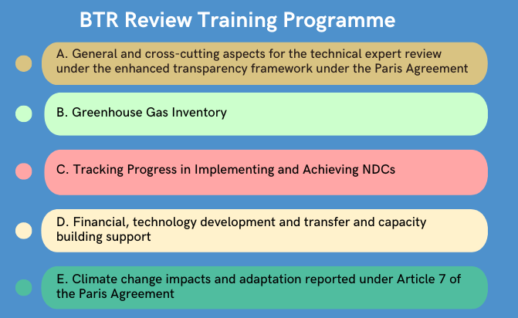
Structure of Courses
Notes:
To start here we included a short reminder on how the training programme for reviewers of the biennial transparency reports looks like, I imagine that all of you are familiarized with it and recall that the aim of the programme is to help experts understand the essential concepts on the ETF reporting and reviewing requirements as well as the guidance and tools available to become a Technical Expert Reviewer.
As mentioned before, oday we will focus on some aspects from Course A which all of you have already passed and on C1 [and C2] which touches upon the National circumstances, institutional arrangements and description of NDCs.

Slide 6
Guiding principles of the ETF
Respecting national sovereignty and avoiding undue burden
Building on and enhancing the transparency arrangements under the Convention
Providing flexibility to those developing country Parties that need it in the light of their capacities
Promoting transparency, accuracy, completeness, consistency and comparability
Ensuring that double counting is avoided and ensuring environmental integrity
Recognizing the importance of facilitating improved reporting and transparency over time
The ETF is guided by a group of guiding principles set out in the Paris Agreement and its MPGs. These principles apply to all elements of the ETF, and you should take them into account when participating in a TER.
Notes:
First of all a very useful reminder to start with is that the ETF is guided by a set of principles outlined in the Paris Agreement and the MPGs. These principles apply to all elements of the ETF, and you should consider them when conducting the TER of any thematic area.

Slide 7
Scope of the TER
Review of consistency with the MPGs
Consideration of the Party’s implementation and achievement of its NDC
Consideration of the Party’s support provided, if applicable
Identification of areas of improvement for the Party related to ETF implementation
For those developing country Parties that need it in the light of their capacities, assistance in identifying capacity-building needs
Notes:
Now we turn our attention to the scope of the review itself.
To review a BTR you should first assess if the Party’s BTR submission is consistent with the MPGs taking into consideration the five key reporting principles (transparency, accuracy, completeness, consistency and comparability).
Then You should focus your assessment on the information provided in both narrative and tabular format regarding the tracking of progress in implementing and achieving NDCs. This will be the key task for those experts who focus on the NDC thematic area. Something key to remember is that You must not review the adequacy or appropriateness of a Party’s NDC and its associated description and indicators or the adequacy of a Party’s domestic action.
Also If you focus on the FTC thematic area You will review the information provided on financial, technology development and transfer and capacity-building support provided and mobilized by developed country Parties, if any. However You must not review the adequacy of a Party’s support provided
As I mentioned before facilitating improved reporting and transparency over time is one of the guiding principles of the MPGs. Each BTRs cycle provides and opportunity for continuous improvement of reporting.
It is expected that the information available from Parties and their reporting capacities are at different stages of development but will improve over time, facilitated by the TER.
On the basis of your TER findings, you should assist Parties in identifying areas for improvement, either in the form of “recommendations” (for “shall” provisions) or “encouragements” (for non-“shall” provisions).
One important element to highlight regarding reporting provisions, is that none of them are “voluntary”, they are mandatory and not mandatory, but in both cases Parties are expected to include either the information requested in the reporting provision or an explanation for not reporting. If they don’t report something, then they will get either a recommendation or an encouragement depending if the reporting provision was a shall or a should.
Coming back to the areas for improvements, remember to formulate them according to the following principles:
They need to be linnked to Specific reporting requirements – use the wording of the MPGs as much as possible;
Be specific and clear – make sure that a national expert of the country under review will be able to understand what the issue was and the corresponding areas for improvement identified by the TER team;
Make it time-bound – add that it should be addressed in the next BTR.
In the case of those developing country Parties that need it in the light of their capacities you should provide assistance in identifying capacity-building needs in consultation with the Party. This should be based on your TER findings and the interaction between the TER team and the Party during the TER.
While assessing the section of the Party’s BTR for which you are responsible, you should seek additional information or clarification from the Party by sending it questions as necessary, before or during the review week. These shall concern the areas that are inconsistent with the MPGs or non-compliant with the TACCC reporting principles

Slide 8
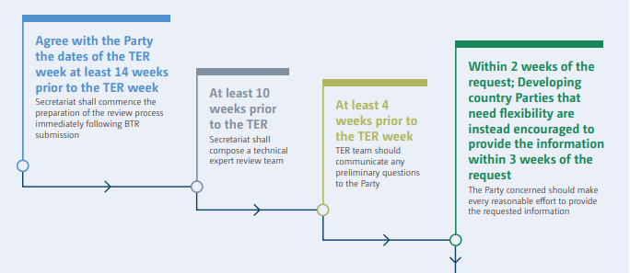
Procedures and schedule of TER
Prepare well before review week
Secretariat shall commence the preparation of the review process immediately following BTR submission
Secretariat shall
Compose a technical expert review team
TER team should
communicate any
preliminary questions
to the Party
The Party concerned should make every reasonable effort to provide the requested information
Review week
Notes:
As you may remember, paragraph 162 of the MPGs establishes the three different stages of a TER: before the review week, during the review week and after the review week.
In the coming slides we will focus on the stages 1 and 2 and the preparatory work you have to focus on before the review week in order to have a more smooth review week.
The TER starts at least 14 weeks of review week immediately after the submission of the BTR when the Secretariat agrees with the Party the dates of the Review Week.
After that the Secretariat composes the TER team, which will prepare and assess the submission and will raise preliminary questions to the party at least 4 weeks before review week. The party will have 2 or 3 weeks (in the case of Flex) to provide answers to the preliminary questions.
During the review week, if it is an in country review, which will be the case of most of the BTR1, the TER team goes to the Party to conduct the review. There the TERT will have the opportunity to meet with the national experts and clarify any additional questions or ask for additional information that helps in the assessment of the BTR. At the End of the review week TER team will communicate to the Party the draft areas of improvement, through preliminary “recommendations” (for “shall” provisions) and/or “encouragements” (for non-“shall” provisions), and, for those developing country Parties that need flexibility any capacity-building needs identified in consultation with the Party.

Slide 9
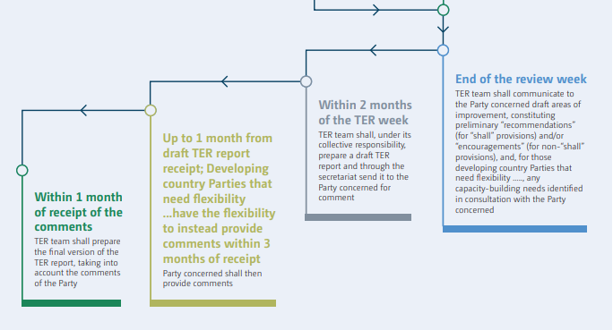
Procedures and schedule of TER
Review week
TER team shall communicate to the Party concerned draft areas of improvement, constituting preliminary “recommendations” (for “shall” provisions” and/or “encouragements” (for non- “shall” provisions), and, for those developing country Parties that need flexibility…., any capacity-building needs identified in consultation with the Party concerned.
TER team shall, under its collective responsibility, prepare a draft TER Report and through the secretariat send it to the Party concerned for comment
TER team shall prepare the final version of the TER report, taking into account the comments
of the Party
Party concerned shall then provide comments
Notes:
Additionally, at the end of the review week the draft zero of the review report will have to be ready, after that the secretariat will proceed with editing and quality assurance steps.
Within 2 months of the TER week, the secretariat will share the draft TER report with the Party for comment. The Party has 1 or up to 3 months (for Developing country Parties that need flex after receiving the report to provide comments
Lastly the TER team will prepare the final version of the TER report, taking into account the comments of the Party which will be published in the UNFCCC website

Slide 10
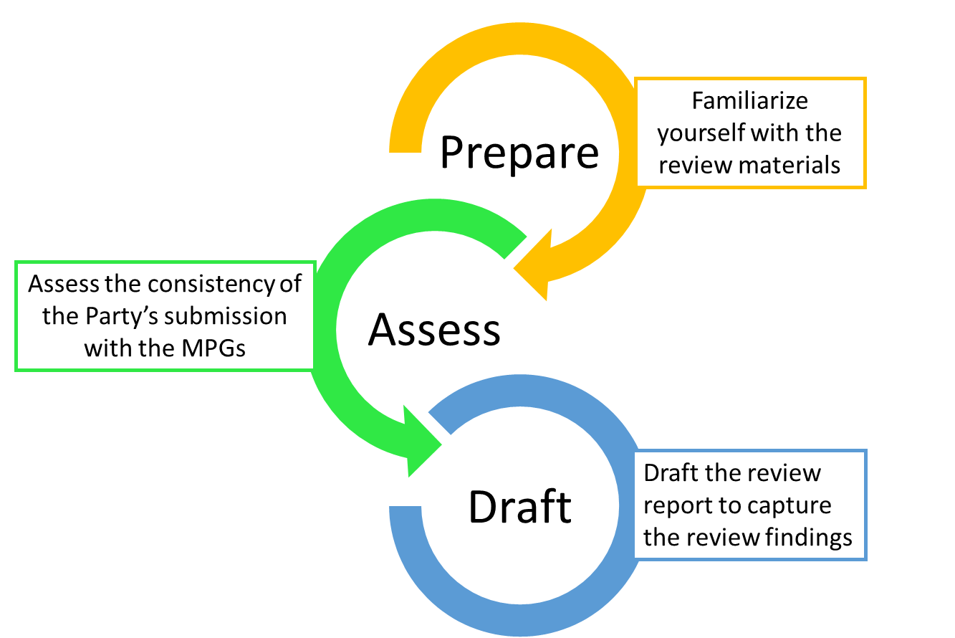
Steps to conducting a review
Step 1. Prepare
Your first task as a reviewer is to familiarize yourself with the review materials, including the MPGs, the Party’s submission (BTR and CTF tables), the review tools provided by the secretariat and the previous TER reports, including previous recommendations and encouragements. This can involve a large amount of information. You should therefore prioritize your consideration of the review materials and focus first on the submissions.
Notes:
Now I will focus on the three key tasks that you will do as a technical expert reviewer:
Prepare, Assess, and Draft.
Your first task as a reviewer is to familiarize yourself with the review materials, including the MPGs, the Party’s submission (BTR and CTF tables), the review tools provided by the secretariat and the previous TER reports, including previous recommendations and encouragements. In the case of BTRs these will come from BUR or BRs. As you may imagine this can involve a large amount of information. You should therefore prioritize your consideration of the review materials and focus first on the submissions and the checklist. We also suggest checking the review practice guidance which is a document prepared by Lead reviewers and summarize issues that have occurred in other reviews and suggest a common approach to resolve them.

Slide 11
Steps to conducting a review
Step 2. Assess
According to your expertise, you will review specific thematic areas of the Party’s submission (namely, the NIR, information necessary to track progress in implementing and achieving the NDC, and information on financial, technology development and transfer and capacity-building support provided to developing countries). Your primary task as a reviewer is to review the consistency of information reported in the BTR on the above-mentioned thematic areas with the MPGs.
Notes:
After that according to your expertise, you will review specific thematic areas of the Party’s submission (namely, the NIR, information necessary to track progress in implementing and achieving the NDC, and information on financial, technology development and transfer and capacity-building support provided to developing countries). Your primary task as a reviewer is to review the consistency of information reported in the BTR on the above-mentioned thematic areas with the MPGs.
This phase is key, it might be the most important part of your job, and it is very important that you do this before the review week, if you do so the review week might be more smooth. Firstly, you should assess the report, complete the checklist raise all the questions to the party, also remember to going through the report template to identify if you have all the information needed or if additional questions need to be raised. When u raise a question start thinking on areas the areas of improvement and CBN in the case of developing country Parties. It is also important to start drafting the report, but I will expand on this in the coming slide.

Slide 12
Steps to conducting a review
Step 3 - Draft
As a reviewer, you should contribute to a TER report containing the TER results for the Party under review.
Your work on the review report should begin before the review week, when you start reading the review materials.
You should have an initial draft of the review report ready on the first day of the review week. The complete draft TER report should be ready by the end of the review week.
After comments from the Party are received and addressed, the review report should be published no later than four months after the review week (or no later than six months for those developing country Parties that need flexibility in the light of their capacities).
Notes:
Lastly, As a reviewer, you should contribute to a TER report containing the TER results for the Party under review.
To do so be as specific as possible and follow the review report template which will be provided by the secretariat.
Each of your findings should include:
A clear reference to the specific reporting provision;
A summary of the information that is correctly provided (when required by the template);
If you found any issues related to the specific reporting provision, a clear description of the nature of the issue(s), including precisely which information is missing, reported inconsistently with the TER practice guidance or non-compliant with the TACCC principles. If more than one issue is found for that reporting provision, ensure that each issue is clearly described;
An outline of the clarification provided by the Party, if any;
The areas of improvement identified for the Party related to the reporting provision (if applicable).

Slide 13
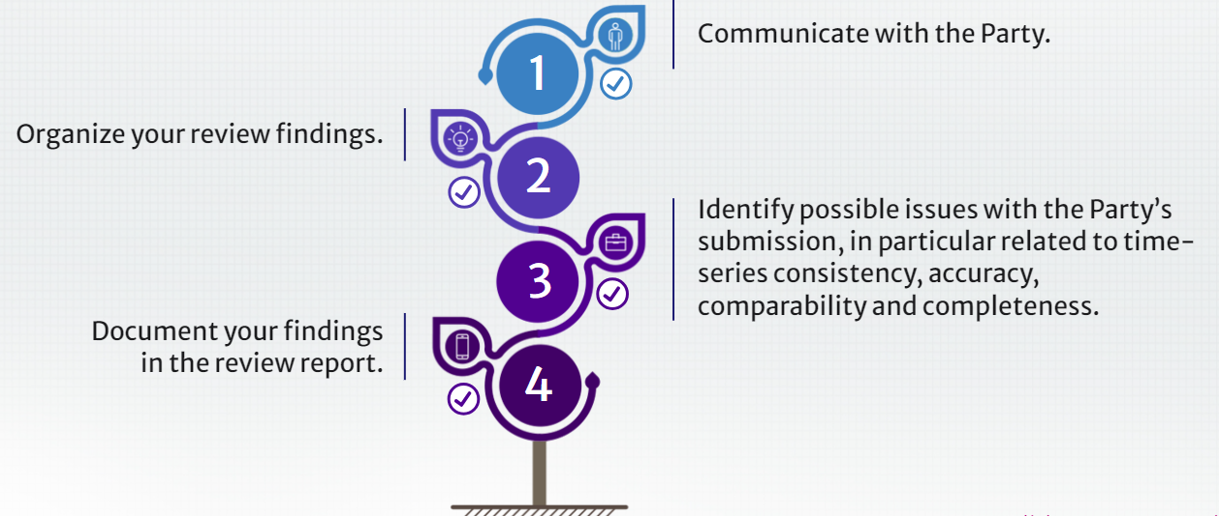
Review tools and templates
The tools will help you to:
Notes:
In order to facilitate your job, the secretariat will make available to you a variety of tools to help to support you in the review process. The tools will help you to:

Slide 14
Review tools and templates
Templates & checklists
The secretariat will develop templates and checklists in order to facilitate and organize your assessment and drafting of your findings in the output documents established in the MPGs. Templates are intended to promote:
Consistency in the reviews among different Parties;
Consistency in the contents among the outputs of the review (i.e. draft areas of improvement, capacity-building needs identified in consultation with the Party concerned (if appropriate), and the draft review report).
It is important to adhere to any templates provided by the secretariat. These templates will provide you with the space to include your findings that are specific to the review.
Notes:
One set of tools are the templates and checklist, this documents are developed by the secretariat to help organize better your assessment and connect more easily the reporting provisions, the findings you have the questions you raise and the information that then will be needed for the report. Since the assessment and the report is prepared by a team, the tools also promote the consistency between the reports of different parties and the way the different output of the review are formulated. For example, the checklist helps you by including some guidance and questions you may ask yourself on how to assess the information reported and the draft report template provides you with examples of language to facilitate formulating your findings and capacity building needs consistenly.

Slide 15
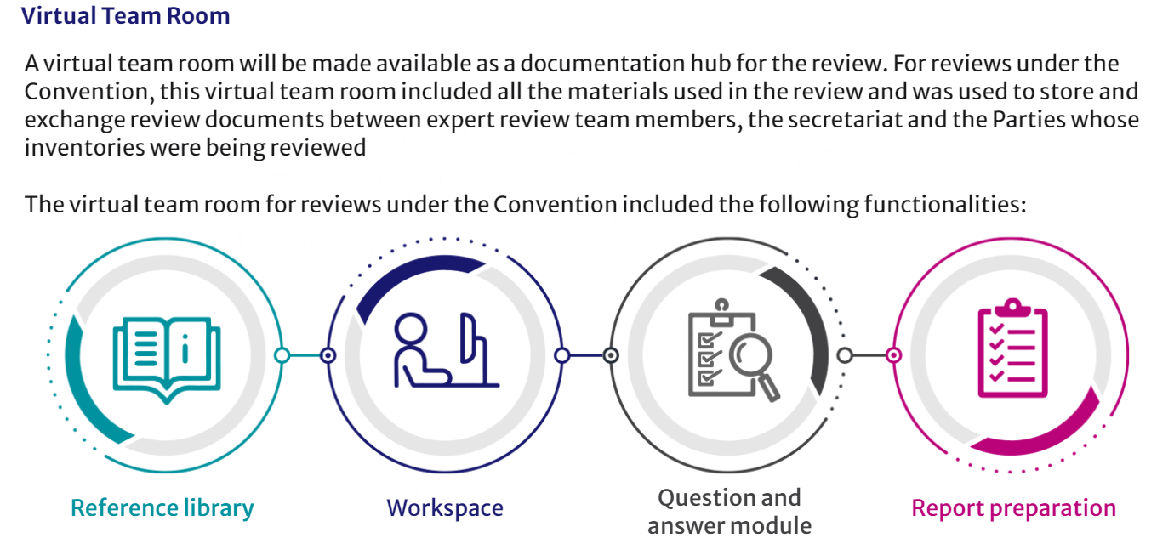
Review tools and templates
Notes:
Then we will have a set of IT tools which will facilitate the communication with the Party and within the team. This tools being finalized and they will probably will include a BTR Virtual Team Room where you will raise the questions and capacity building needs to the Party and receive the answers, and Sharepoint to work collaboratively in the checklist and the report draft.

Slide 16
How to draft questions to a Party?
When the reporting does not meet the requirement since it might be not complete or not transparent, the TERT should communicate any preliminary questions on the provision not met or not clearly reported to the Party for their clarification. The TERT may also request additional information to the Party during the Review Week.
A well-drafted question:
Starts by noting what information was – or was not- reported or not clear to the TERT, by the Party in relation to the reporting requirements (including references to the particular section/page of the report and/or CTF table);
Continues with an assessment of what information is incorrect/ missing/ unclear/etc. based on the MPGs reporting requirement (using a language as close as possible to the language of the MPGs);
Finishes with a clear and specific question to the Party on the expected information (and/or explanation as to why the information could not be provided) to be provided to the TERT.
Notes:
Now we would like to focus on how to draft questions to the Party

Slide 17

Questions?

Slide 18
Course C1:
National circumstances, institutional arrangements and description of NDCs

Slide 19


Description of Nationally Determined Contributions
As part of the information necessary to track progress in implementing and achieving NDCs under Article 4 of the Paris Agreement, Parties are required to provide
a description of their NDC, including information on the type of the NDC targets, relevant reference points and values;
the time frame for implementation;
scope and coverage;
intention to use cooperative approaches under Article 6;
and any updates or clarifications.
This information will be used to track progress in implementing and achieving the NDC.
When you are preparing for the review you should familiarize yourself with the Party’s NDC
The reporting requirements related to the description of the NDC are contained in paragraph 64 of the MPGs

Slide 20

Paragraph 64
Each Party shall provide a description of its NDC under Article 4, against which progress will be tracked. The information provided shall include the following, as applicable, including any updates to information previously provided:
Target(s) and description, including target type(s) (e.g. economy-wide absolute emission reduction, emission intensity reduction, emission reduction below a projected baseline, mitigation co-benefits of adaptation actions or economic diversification plans, policies and measures, and other);
Target year(s) or period(s), and whether they are single-year or multi-year target(s);
Reference point(s), level(s), baseline(s), base year(s) or starting point(s), and their respective value(s);
Time frame(s) and/or periods for implementation;
Scope and coverage, including, as relevant, sectors, categories, activities, sources and sinks, pools and gases;
Intention to use cooperative approaches that involve the use of internationally transferred mitigation outcomes under Article 6 towards NDCs under Article 4 of the Paris Agreement;
Any updates or clarifications of previously reported information (e.g. recalculation of previously reported inventory data, or greater detail on methodologies or use of cooperative approaches).

Slide 21



Type of targets
Economy-wide absolute emission reduction or limitation targets, expressed as an emission reduction or limitation from the level in a specified base year;
Emission peaking targets, expressed as a maximum level of emissions in a specified year where subsequent emissions are expected to continuously decline;
Carbon budget, expressed as a total amount of emissions that can be emitted over a given period;
Emission intensity targets, expressed as emissions per unit of GDP (or other unit);
Emission reductions below a projected baseline scenario, expressed in relation to a ‘business as usual’ scenario
Other qualitative and quantitative targets, for example, emission reductions associated with low-emission development strategies, plans or actions, in line with national circumstances.
Mitigation co-benefits of adaptation actions or economic diversification plans, policies and measures, expressed as emission reductions associated with other actions;

Slide 22
Practice activity – Raising questions to Parties
Read the following Party submission for paragraph 64.e:
F’s NDC covers the following sectors: Energy, Industrial processes and product use, LULUCF and Waste.
Gases covered: CO₂, N₂O, HFCs, PFCs, SF₆, NF₃
Pools covered: All LULUCF pools are included in the NDC.
Would you raise any question?
If yes, please prepare them taking into consideration the guidance provided before.

Slide 23

Practice activity – Raising questions to Parties
Drop your questions in the Menti!
Join at menti.com or scan the QR code and insert code:
29 95 93 1
Notes:
https://www.menti.com/almop7i3mqhf

Slide 24
Course C2:Information necessary to track progress in implementing and achieving NDC

Slide 25
Indicators for tracking progress towards the implementation and achievement of NDCs
There is no definition in the MPGs on what an indicator is, except that it should be self-determined by Parties, must be relevant for the NDC.
Paragraph 65 of the MPGs indicates that:
“Each Party shall identify the indicator(s) that it has selected to track progress towards the implementation and achievement of its NDC under Article 4. Indicators shall be relevant to a Party’s NDC under Article 4, and may be either qualitative or quantitative.”
When you are preparing for the review, you should familiarize yourself with the Party’s NDC
Parties can include more than one target in their NDCs that may be qualitative or quantitative
TERTs will not review the adequacy or appropriateness of the indicators selected by Parties to track progress in implementing and achieving their NDCs.

Slide 26
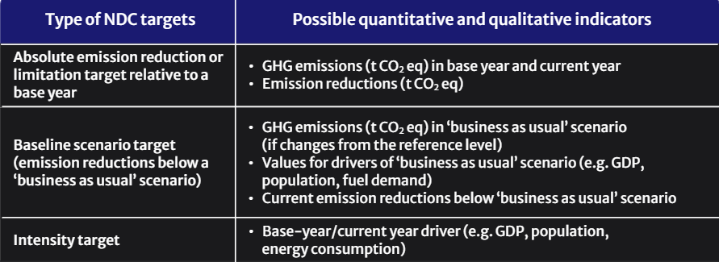
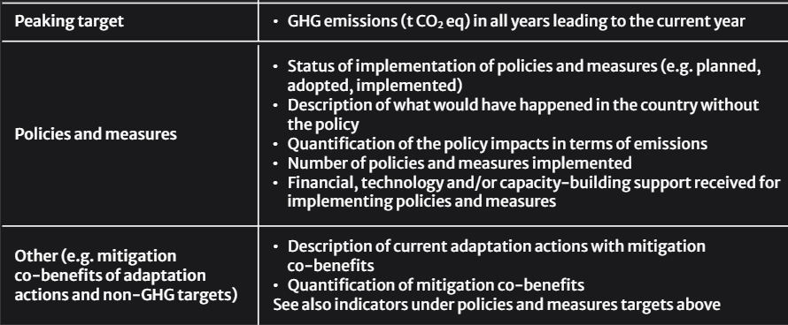
Type of targets and possible indicators for tracking progress

Slide 27
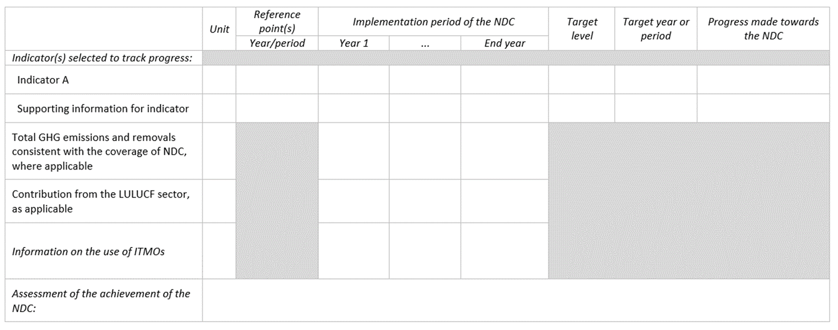
Structured summary (CTF table 4) is a centerpiece for providing information necessary to track progress in implementing and achieving NDCs

Slide 28
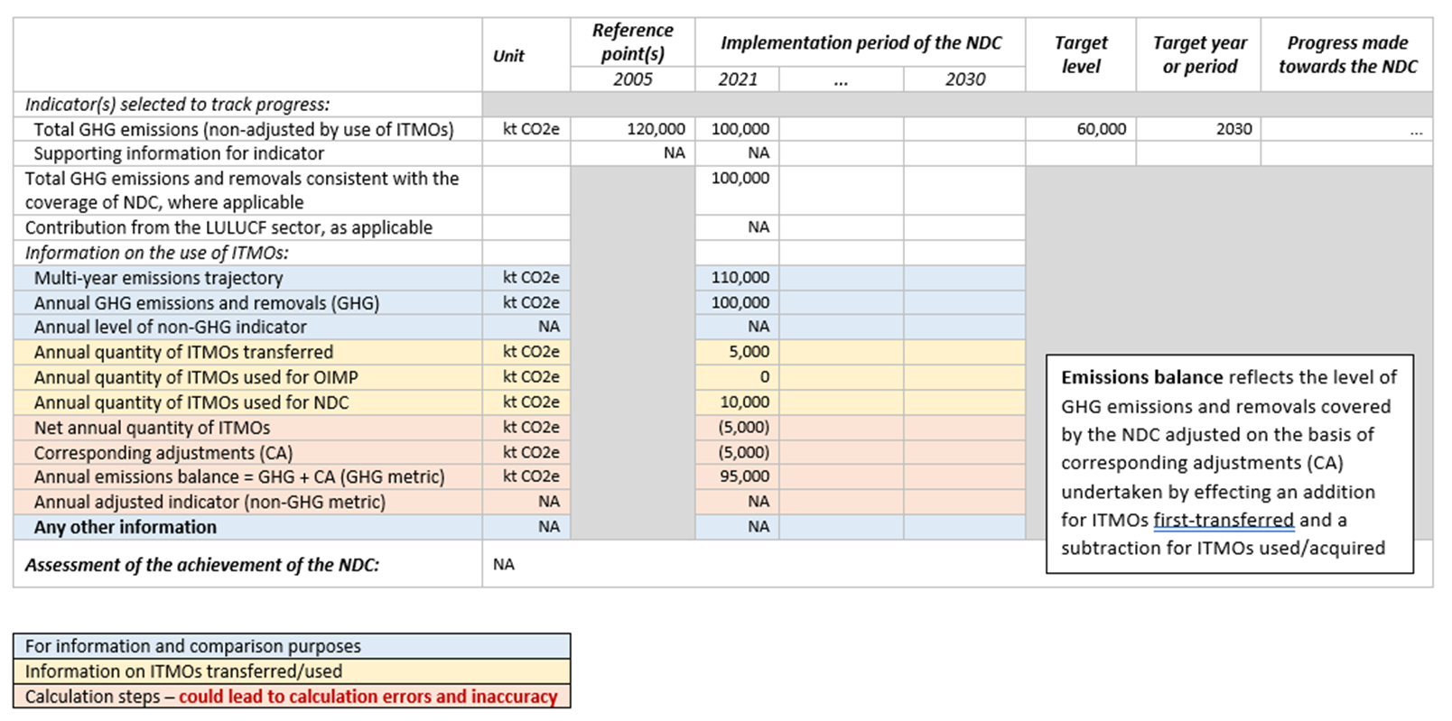
Structured summary (CTF table 4) - example

Slide 29
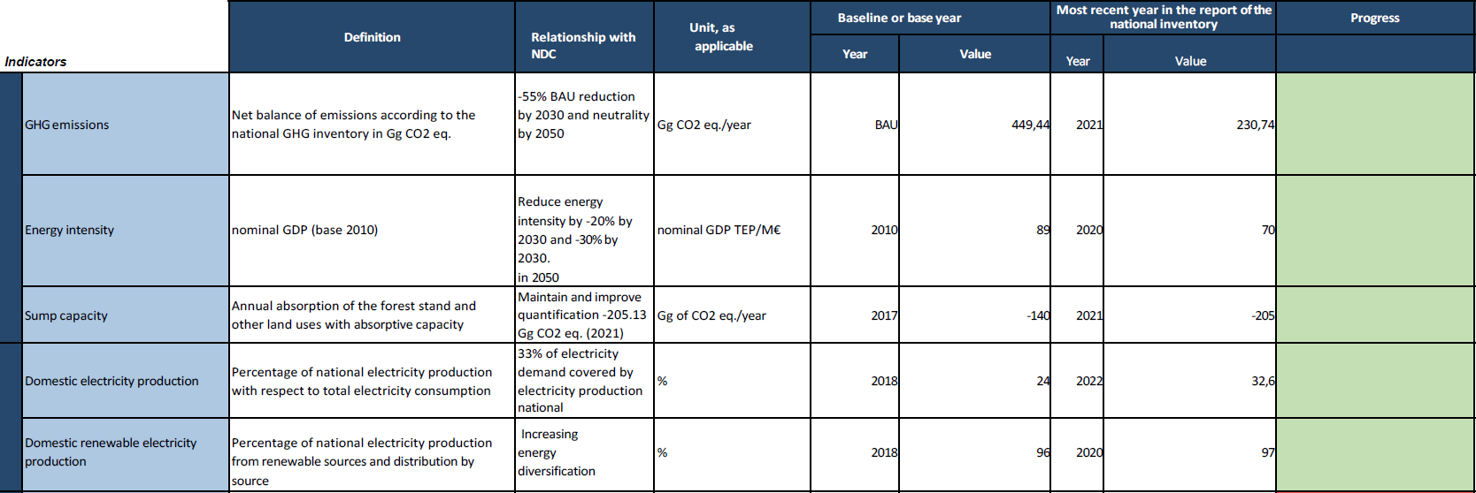
NDC target type: baseline scenario target
Check the information necessary to track progress of NDC from Party’s BTR submission

Slide 30
Practice activity
1. Draft a finding incorporating the following elements:
  The description of the finding and to which paragraph (or subparagraph) of the MPGs reporting requirements it is related;
  An encouragement or recommendation, as appropriate, to the Party on what to include in and how to improve consistency of information in its next BTR.

Slide 31
Practice activity - Formulating findings
Please draft your findings in Menti!
Join at menti.com or scan the QR code and insert code:
29 95 93 1
​
Notes:
https://www.menti.com/almop7i3mqhf

Slide 32
Questions?

Slide 33


To contact us:
transparency-expert-training@unfccc.int
Please scan QR code to complete feedback survey:
Training programme website

Slide 34

Thank you!
Let’s work #Together4Transparency!
Help us shape future
events with this
30-sec survey
bit.ly/T4TAttendanceStats

Slide 35


Thank you!
Let’s work #Together4Transparency!
bit.ly/T4TGroup
bit.ly/T4TCalendar
Join our LinkedIn Community
Explore all COP29
Transparency Events

