Slide 1
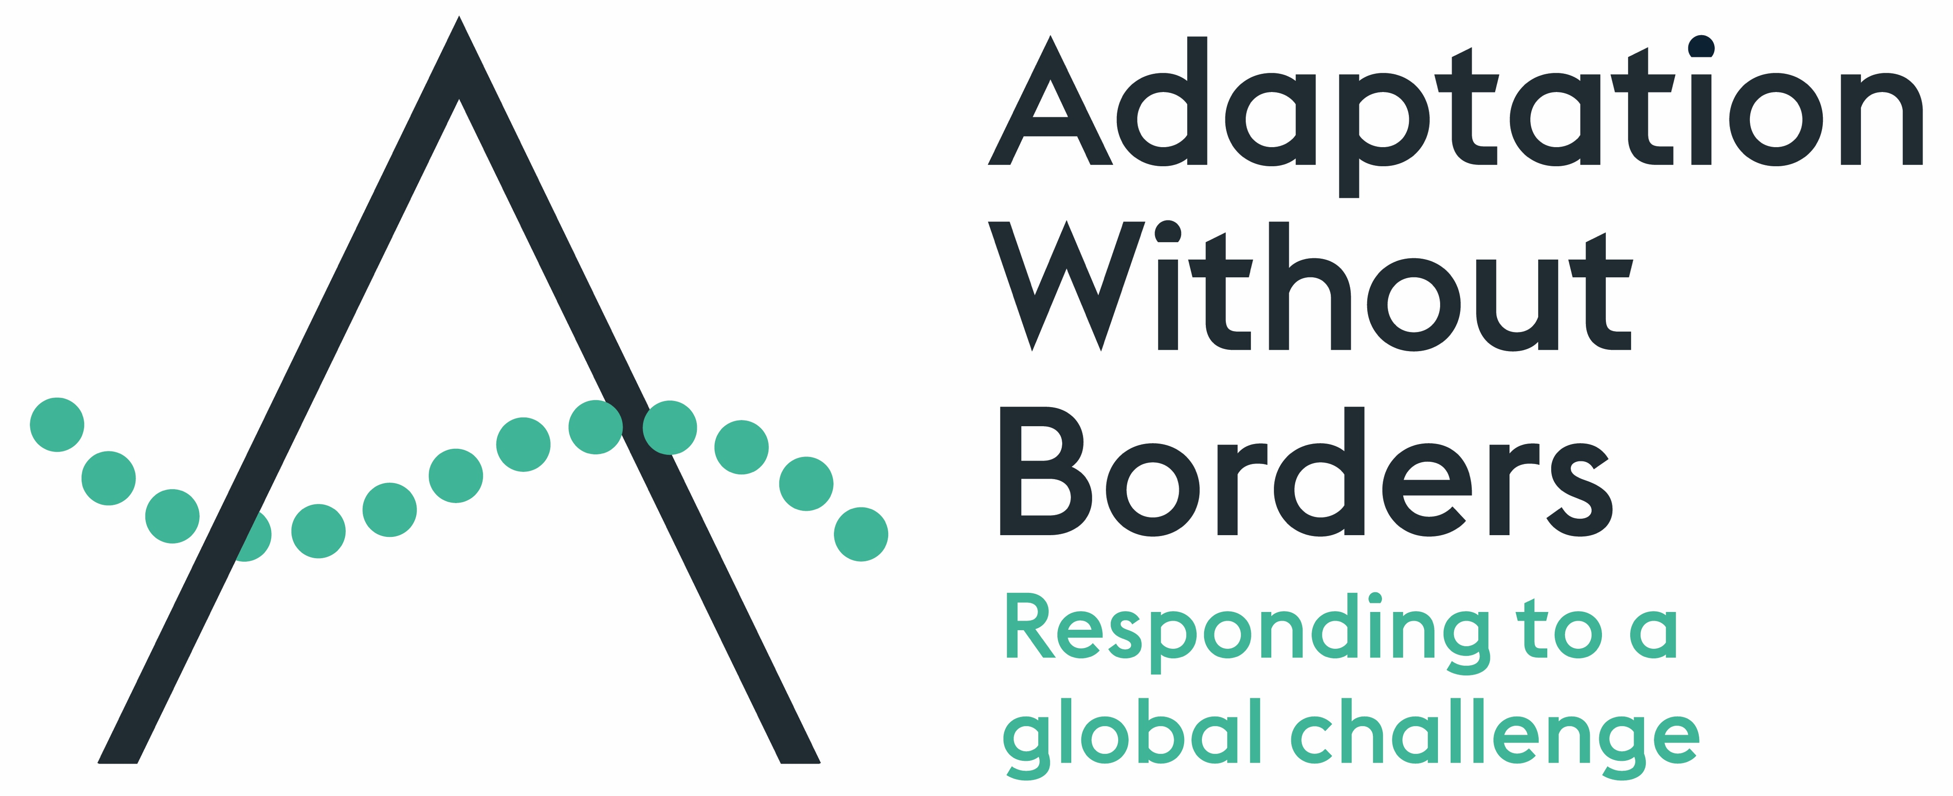
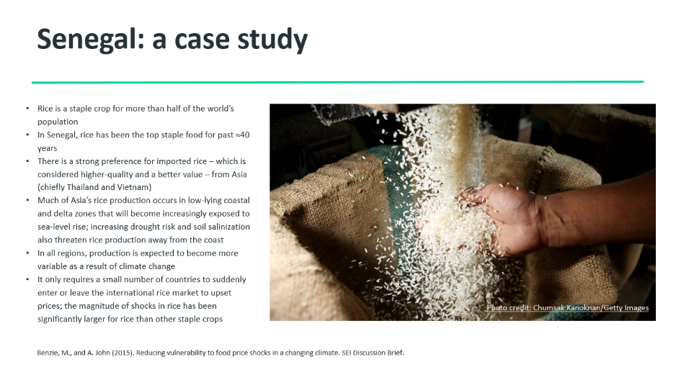
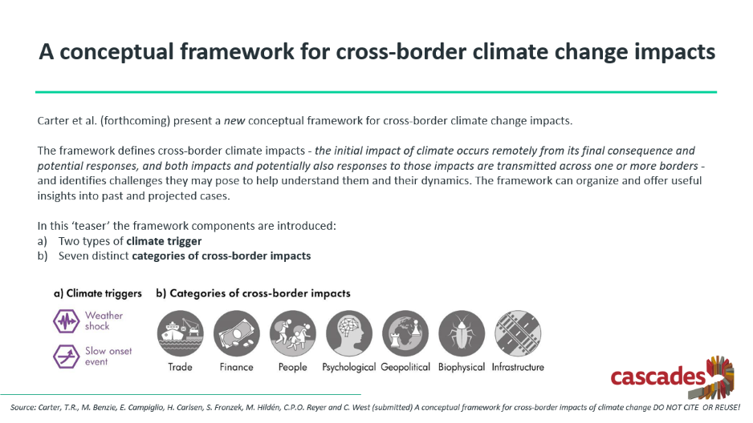
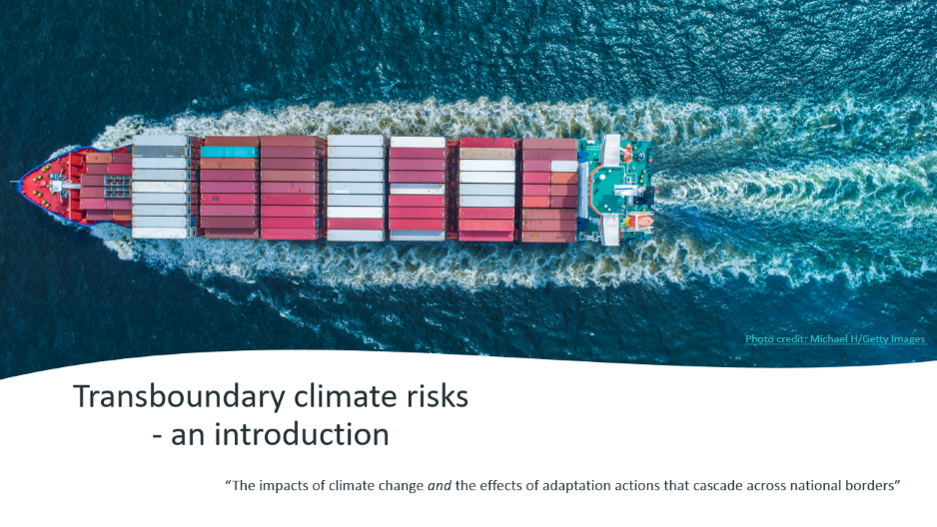
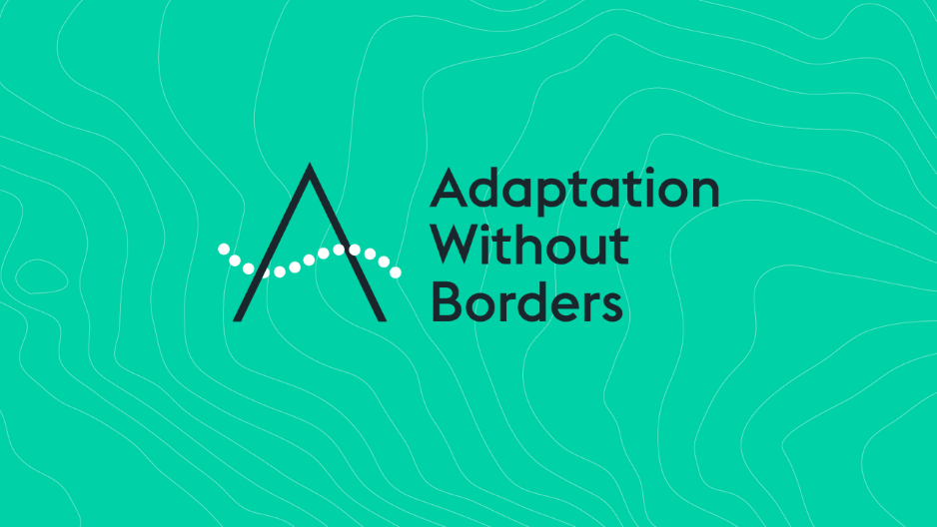
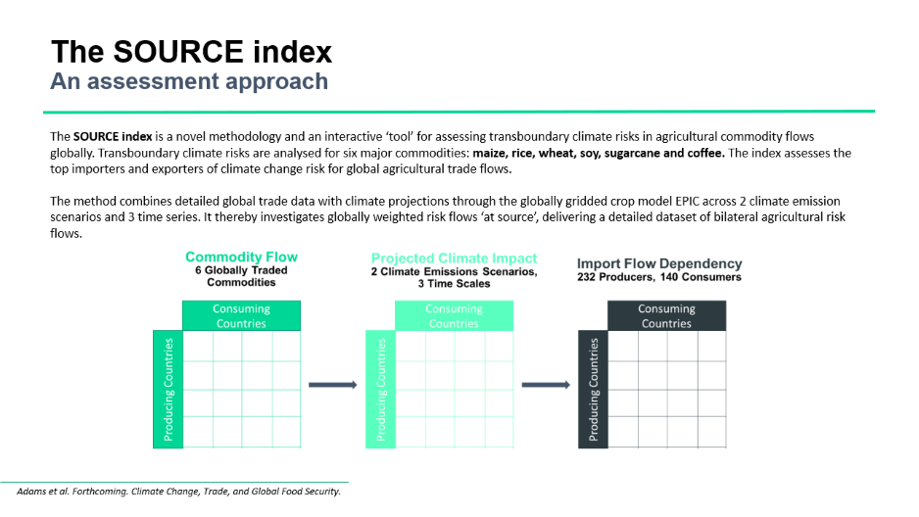
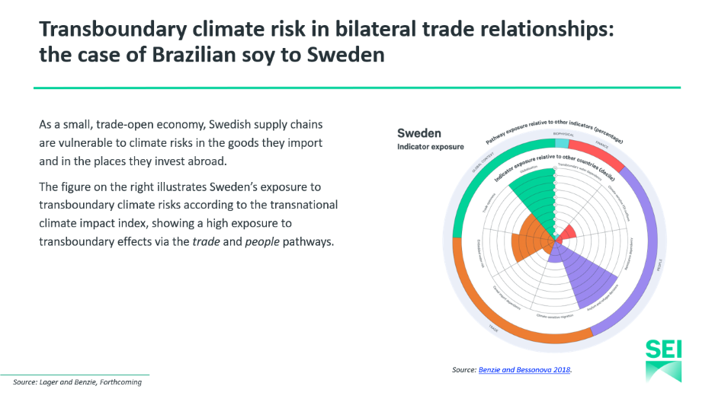
Managing transboundary climate risk to meet the global challenge of adaptation
Frida Lager, Katy Harris and Magnus Benzie, UNFCCC Research Dialogue, November 2020
@: frida.lager@sei.org; katy.harris@sei.org; magnus.benzie@sei.org

Slide 2
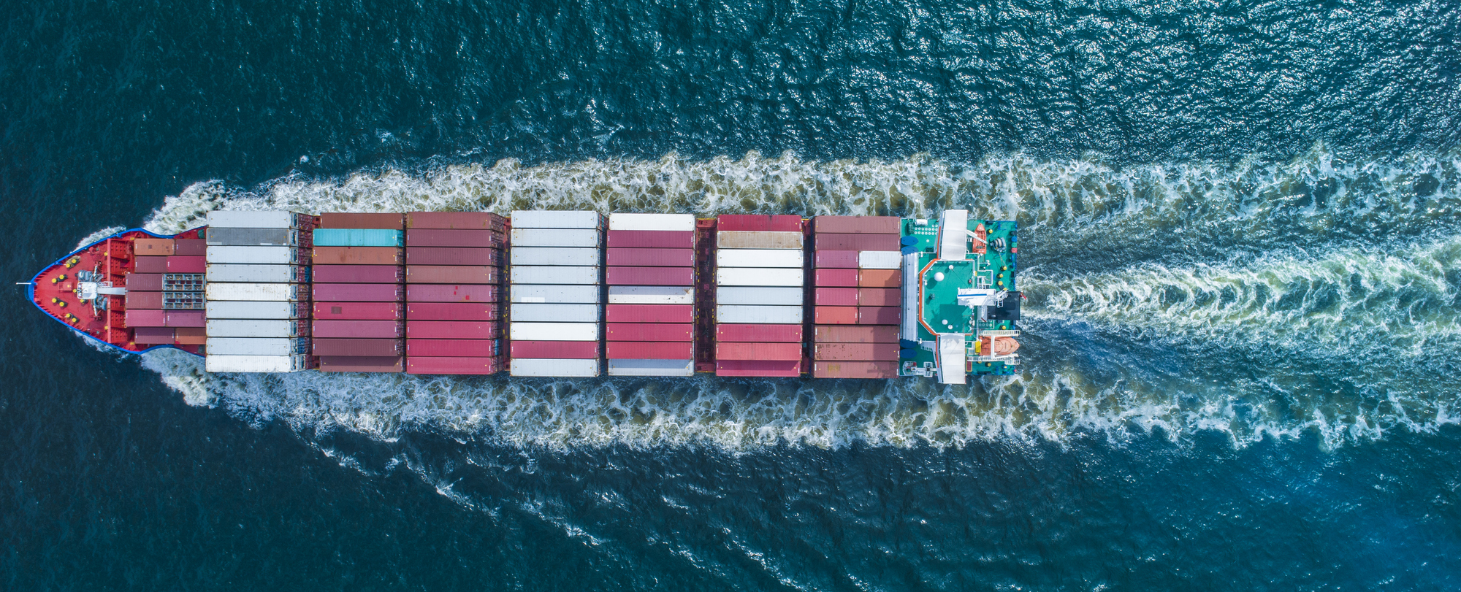
Photo credit: Michael H/Getty Images
Transboundary climate risks
- an introduction
“The impacts of climate change and the effects of adaptation actions that cascade across national borders”

Slide 3

What does climate change mean for our societies, economies and environments in a globalized and interdependent world?
Photo credit: 123RF/Konstantin Faraktinov

Slide 4
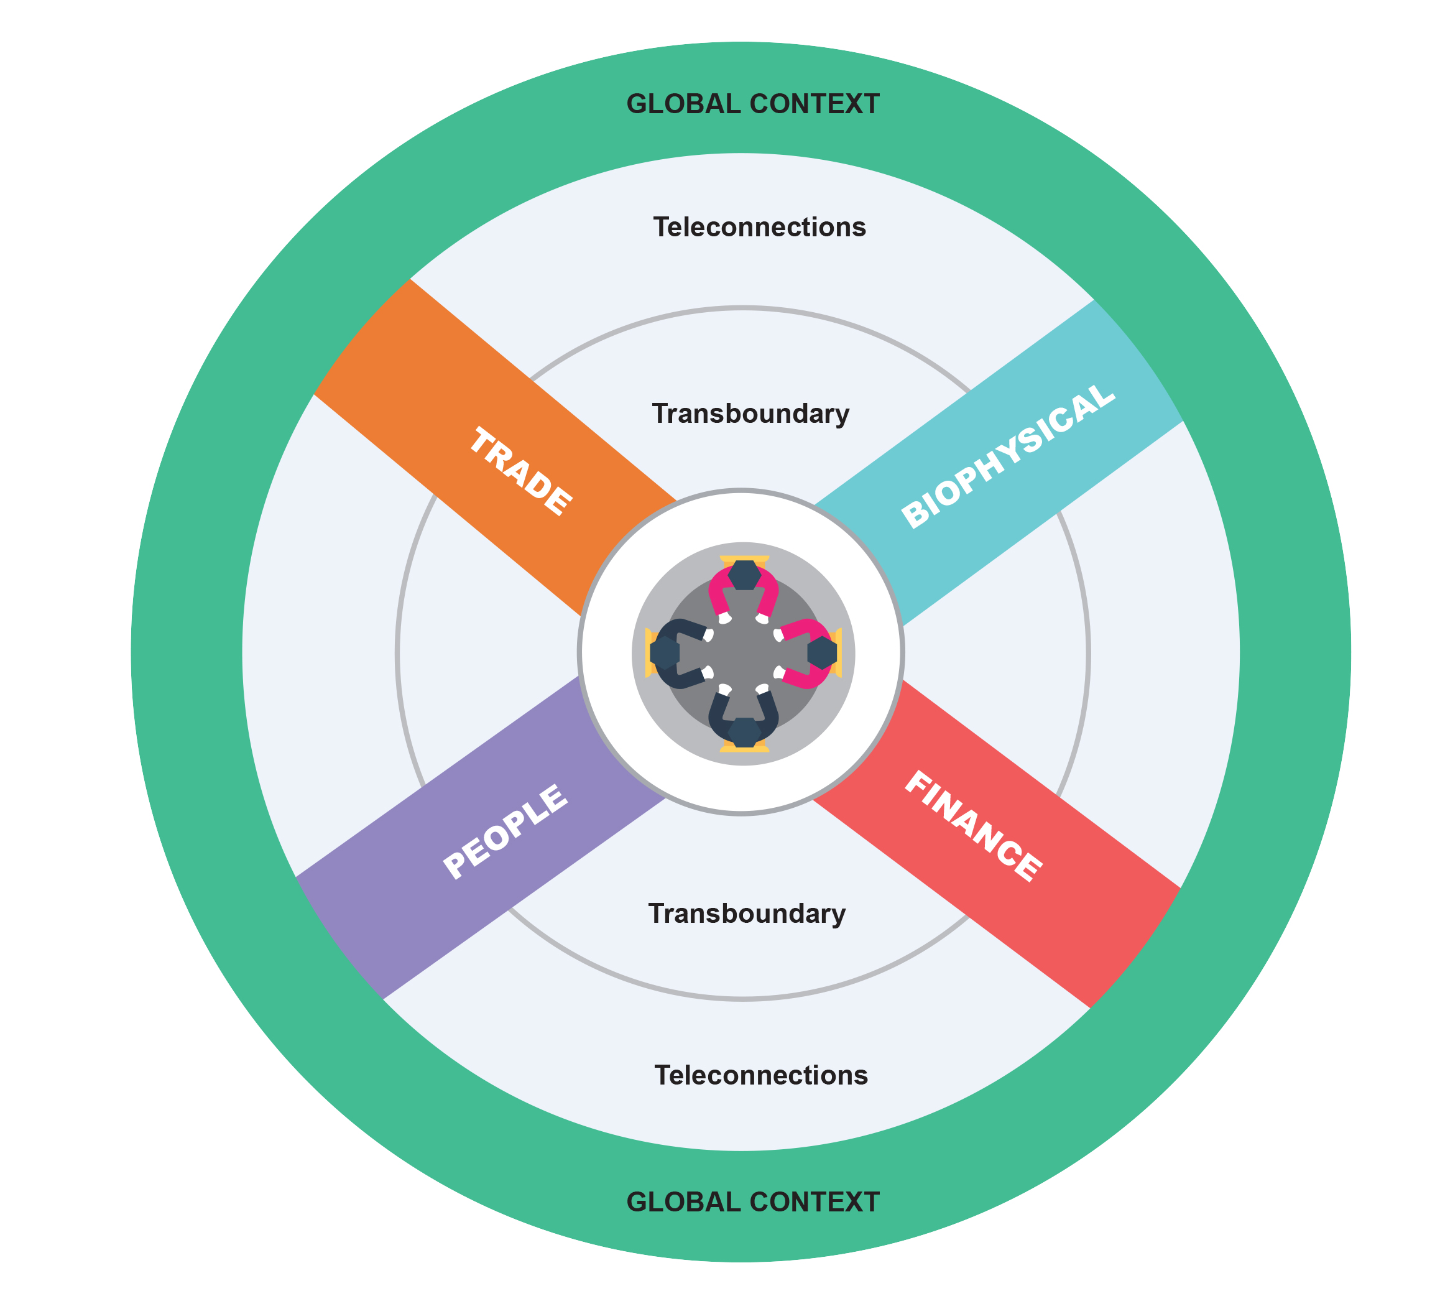
The pathways through which transboundary climate risks can flow…
Trade: flows of commodities and products via supply chains and markets
Biophysical: rivers, oceans, cross-border movement of species
Finance: public and private investment, insurance, remittances
People: human migration, tourism, health risks

Slide 5
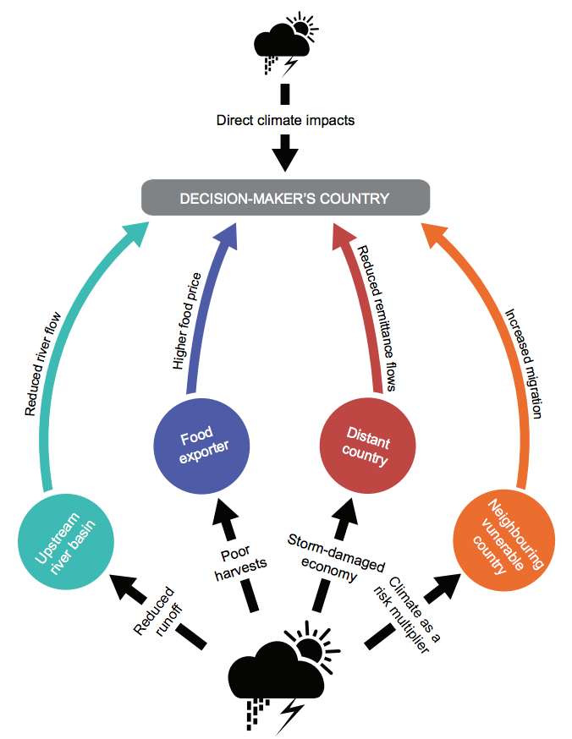
The pathways through which transboundary climate risks can flow…
The figure on the right shows an example of what those four pathways might look like to a decision-maker in a particular country.
Decision-makers will need to account for direct climate impacts within their borders – at the top of the diagram – as well as transboundary climate impacts – at the bottom of the diagram – in the countries they are connected to. The example shows impacts transmitted through a shared river basin, their import of critical food commodities, their economy’s reliance on remittance flows and/or their hosting of refugees and migrants.
For a more in-depth discussion on the governance of transboundary climate risks see Benzie and Persson 2019.

Slide 6
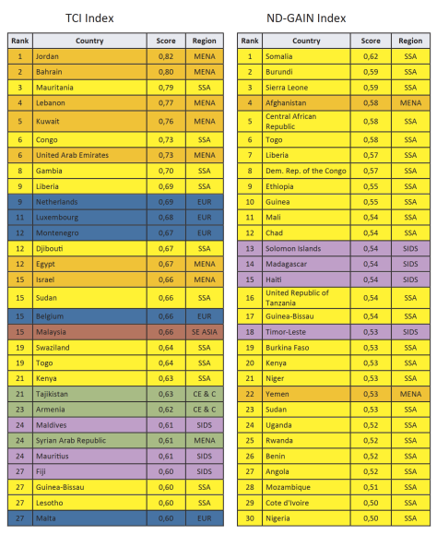
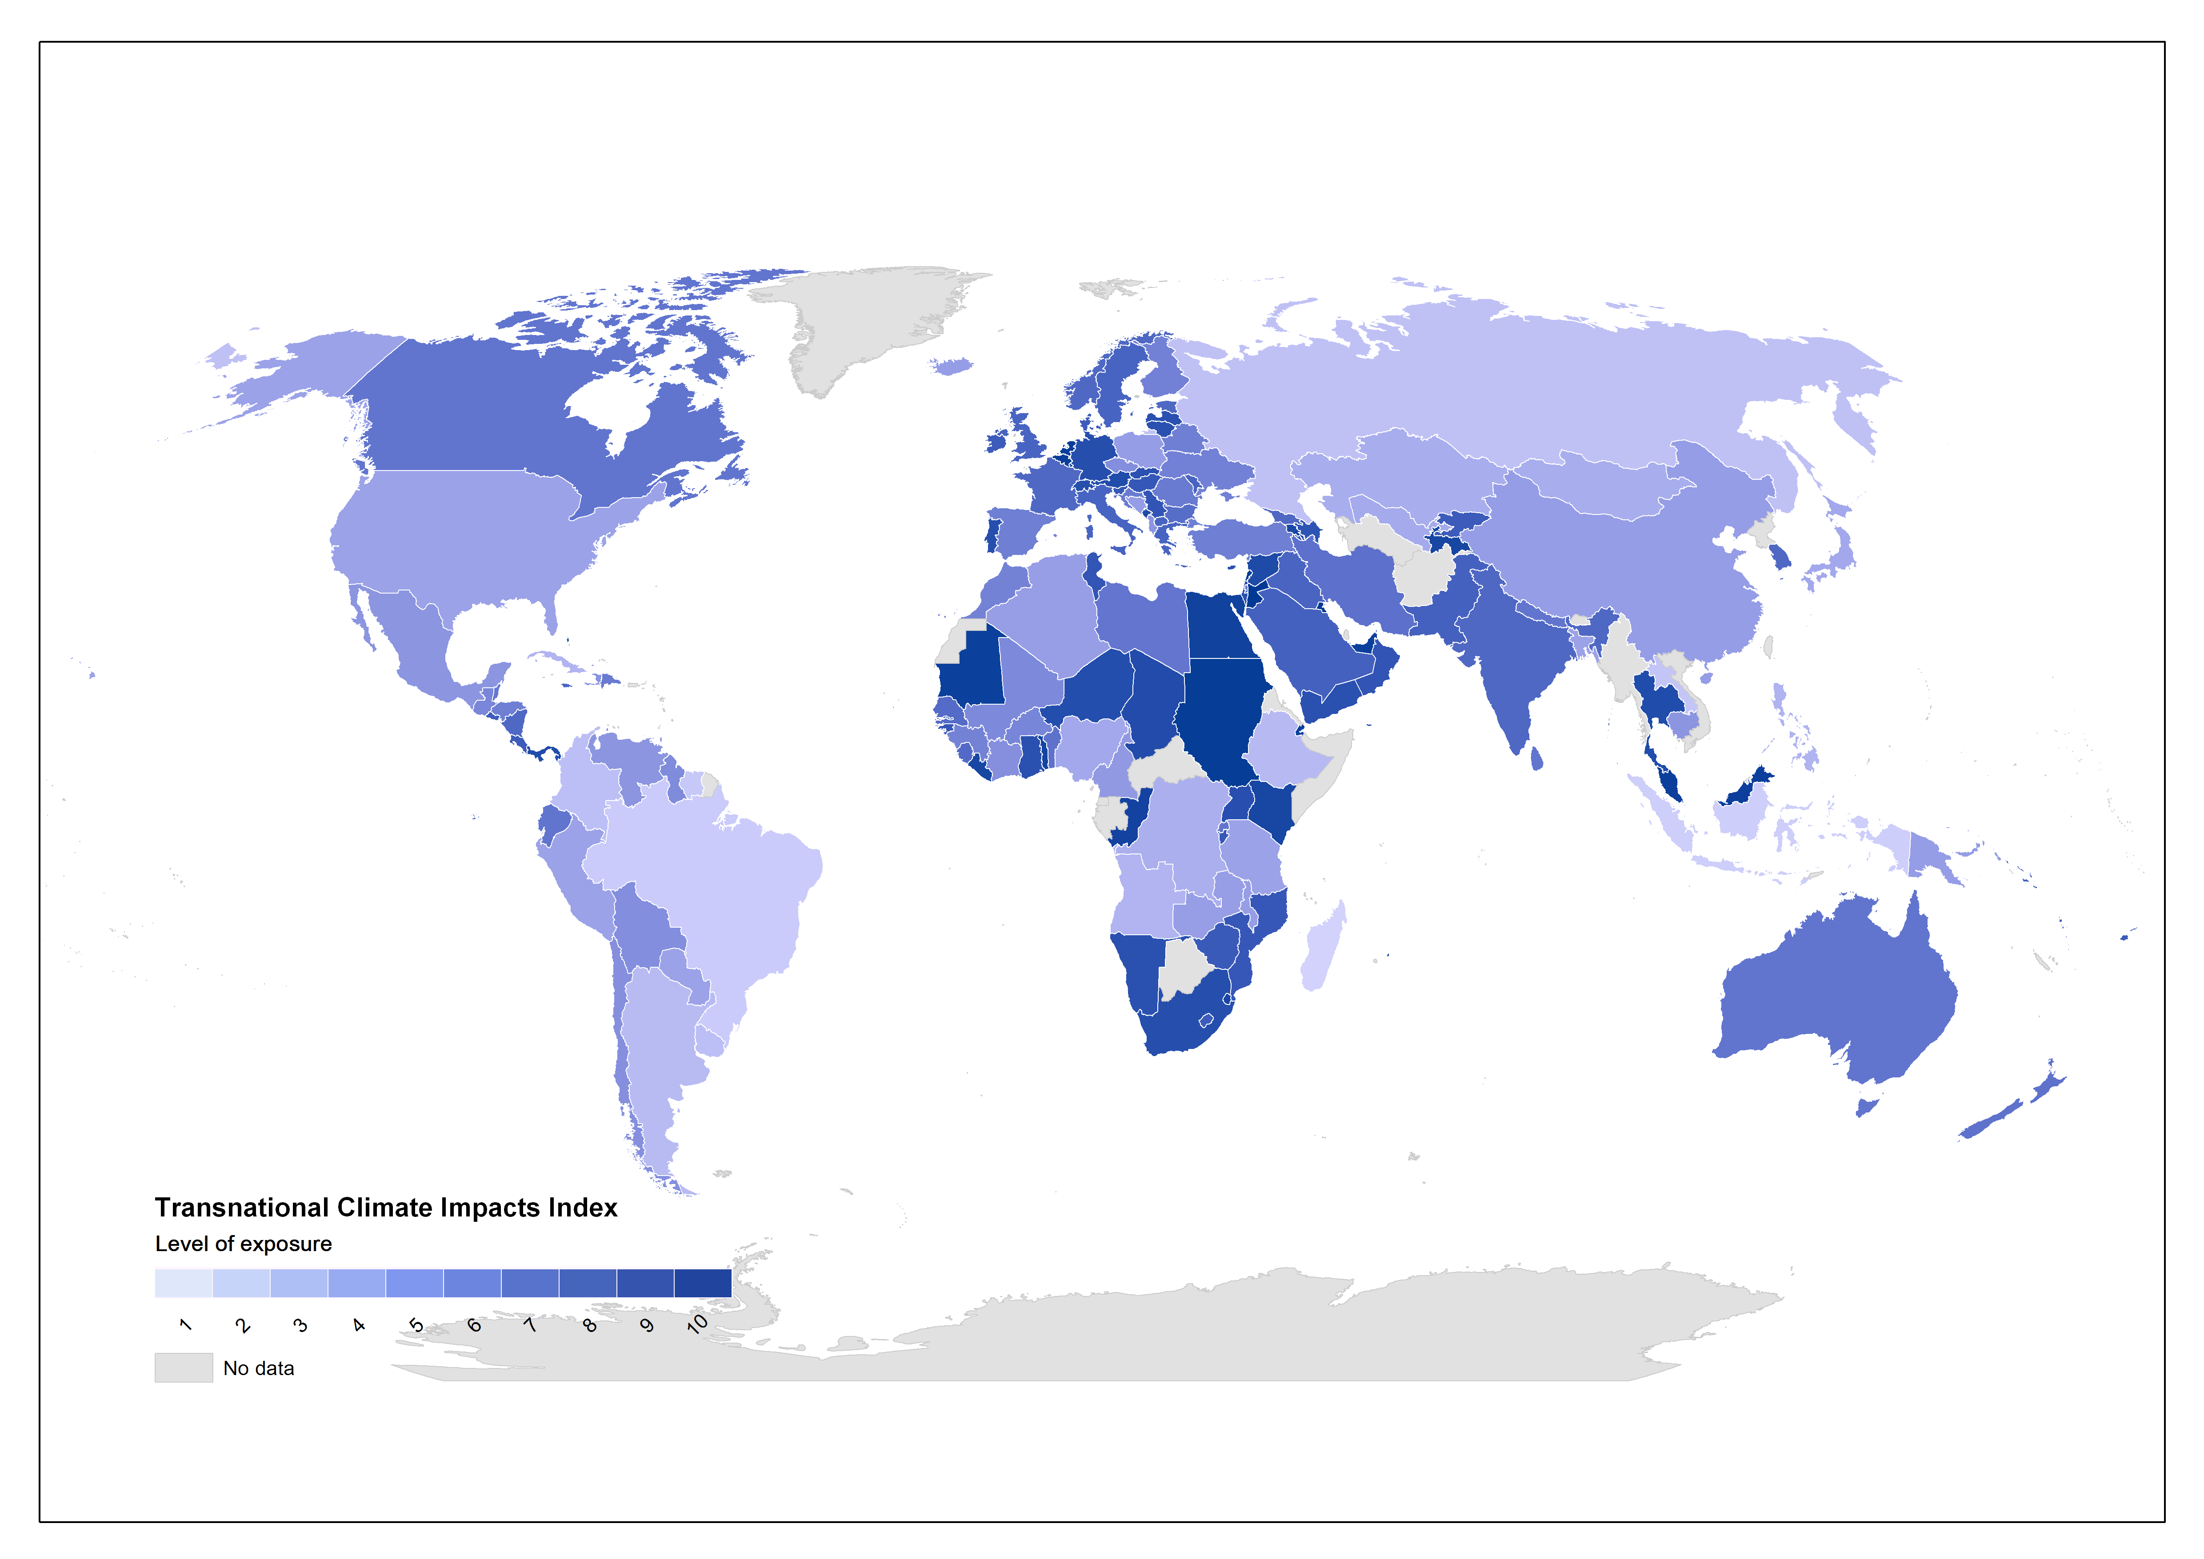
Transnational Climate Impacts Index
A framework for examining national-level exposure to climate change impacts from an international perspective. It combines nine different indicators of exposure at the country level, comparing 192 countries.
Comparing direct climate vulnerability (using ND-GAIN Country Index scores) shows a very different distribution of risk when compared to exposure to transboundary climate risks (using TCI Index scores).
Benzie, M., J. Hedlund and H. Carlsen (2016). Introducing the Transnational Climate Impacts Index: Indicators of country-level exposure – methodology report. Working Paper 2016-07. Stockholm Environment Institute: Stockholm.
Hedlund, J., Fick, S., Carlsen, H. and Benzie, M. (2018). Quantifying transnational climate impact exposure: New perspectives on the global distribution of climate risk. Global Environmental Change, 52. 75–85. DOI: 10.1016/j.gloenvcha.2018.04.006

Slide 7
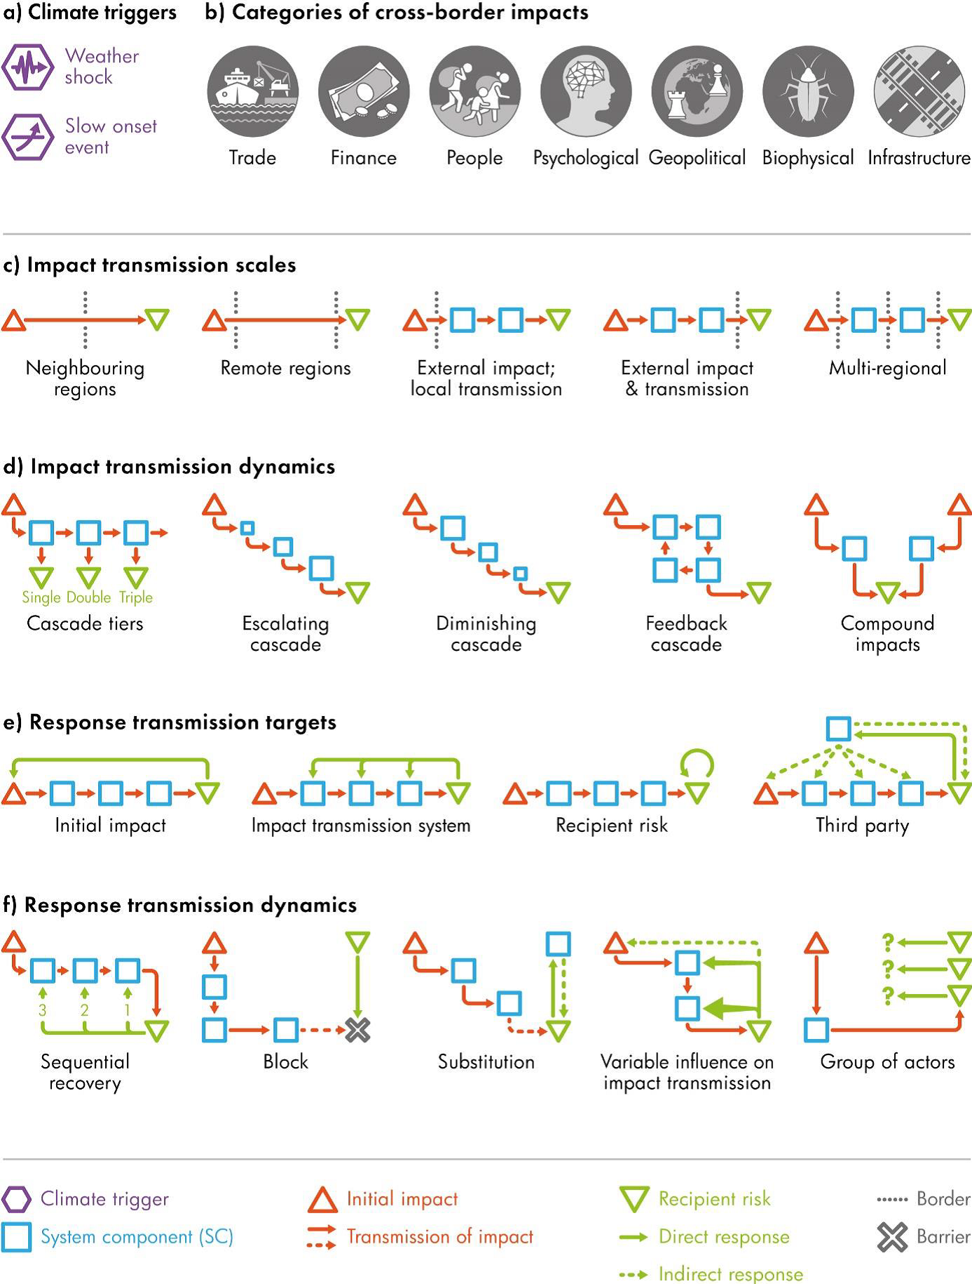

A conceptual framework for cross-border climate change impacts
Carter et al. (forthcoming) present a new conceptual framework for cross-border climate change impacts.
The framework defines cross-border climate impacts - the initial impact of climate occurs remotely from its final consequence and potential responses, and both impacts and potentially also responses to those impacts are transmitted across one or more borders - and identifies challenges they may pose to help understand them and their dynamics. The framework can organize and offer useful insights into past and projected cases.
In this ‘teaser’ the framework components are introduced:
Two types of climate trigger
Seven distinct categories of cross-border impacts
Source: Carter, T.R., M. Benzie, E. Campiglio, H. Carlsen, S. Fronzek, M. Hildén, C.P.O. Reyer and C. West (submitted) A conceptual framework for cross-border impacts of climate change DO NOT CITE OR REUSE!

Slide 8
A conceptual framework for cross-border climate change impacts
Impact transmission: scales and dynamics
Impacts may be transmitted at different scales. Impact propagation from the initial impact to the recipient risk occurs across a border or borders that can be administrative, physical or societal.
Dynamics: The transmission of impacts can take place in many different configurations, sometimes combining features of several of these.
Source: Carter, T.R., M. Benzie, E. Campiglio, H. Carlsen, S. Fronzek, M. Hildén, C.P.O. Reyer and C. West (submitted) A conceptual framework for cross-border impacts of climate change DO NOT CITE OR REUSE!

Slide 9
A conceptual framework for cross-border climate change impacts
Response transmission: targets and dynamics
Responses designed to ameliorate the risk of cross-border impacts can be directed towards a number of possible sources of that risk.
The transmission of responses to ameliorate propagating impacts can be highly complex, with many potential impediments or amplifiers affecting the dynamics of transmission.
Source: Carter, T.R., M. Benzie, E. Campiglio, H. Carlsen, S. Fronzek, M. Hildén, C.P.O. Reyer and C. West (submitted) A conceptual framework for cross-border impacts of climate change DO NOT CITE OR REUSE!

Slide 10
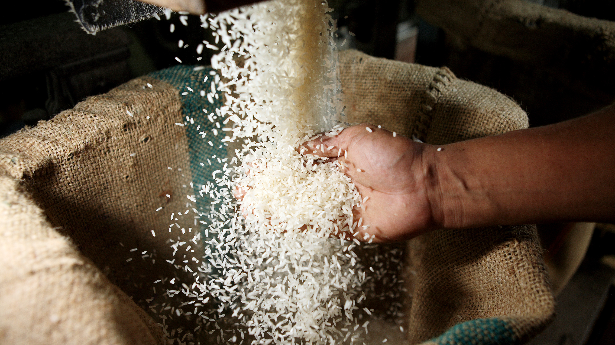
Senegal: a case study
Rice is a staple crop for more than half of the world’s population
In Senegal, rice has been the top staple food for past ≈40 years
There is a strong preference for imported rice – which is considered higher-quality and a better value – from Asia (chiefly Thailand and Vietnam)
Much of Asia’s rice production occurs in low-lying coastal and delta zones that will become increasingly exposed to sea-level rise; increasing drought risk and soil salinization also threaten rice production away from the coast
In all regions, production is expected to become more variable as a result of climate change
It only requires a small number of countries to suddenly enter or leave the international rice market to upset prices; the magnitude of shocks in rice has been significantly larger for rice than other staple crops
Photo credit: Chumsak Kanoknan/Getty Images
Benzie, M., and A. John (2015). Reducing vulnerability to food price shocks in a changing climate. SEI Discussion Brief.

Slide 11
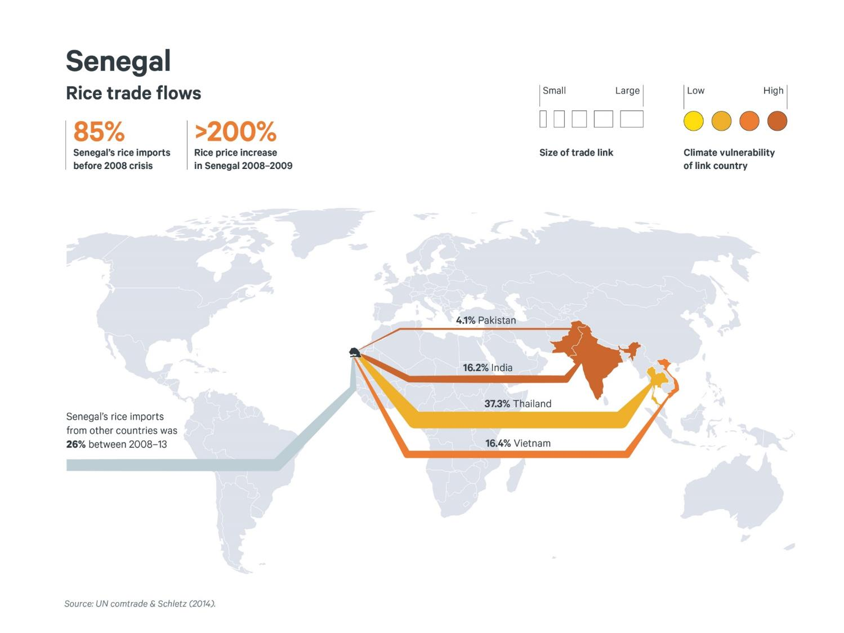
Senegal experienced this firsthand 2007-2008 when India, a major rice exporter, banned rice exports
This led to panic buying by major rice importers (e.g. the Philippines) and further rice export restrictions by other major rice exporters (e.g. Vietnam) in order to stabilize their own domestic rice prices
Trade-dependent countries such as Senegal saw their own domestic prices skyrocket, leading to social instability and protests
What could be the effect in Senegal if climate change causes countries in Asia to stop producing as much rice?
And moreover, what happens if those countries stop their international exports altogether in order to feed their own populations?
Despite potentially facing a significant transboundary climate risk, there is very little that Senegal – a country that ultimately depends on the success of adaptation measures taken thousands of miles away in Asia – can currently do about it.

Slide 12
Photo credits: Flickr/Chris Ford; Flickr/Rikolto (Vredeseilanden)
Intensifying domestic rice production In Senegal could help – by reducing dependence on imports and thus exposure to international price fluctuations
However, the government’s strategy to produce 100% of Senegal’s rice domestically increases exposure to direct climate impacts, reduces the diversity of Senegal’s agriculture and concentrates risks in one crop
It also means that other crops will be displaced which could be a source of nutrition or cash for food-insecure households, especially during rice price shocks
Rice production is also a key source of income for many poor communities in India, Thailand and Vietnam and makes up significant portions of GDP in these countries
Reducing levels of rice imports is one of the only steps Senegal can currently take to manage this transboundary risk… and yet:
Adaptation investment in Southeast Asia has the potential to pay double-dividends and increase the resilience of groups living continents apart

Slide 13
Adaptation is a global challenge
Climate impacts in one country may spillover into others
1
Adaptation in one country may redistribute or increase vulnerability in others
2
Adaptation in one country may provide benefits to others
3
Therefore we should be doing more to ASSESS these risks and COOPERATE in managing them

Slide 14
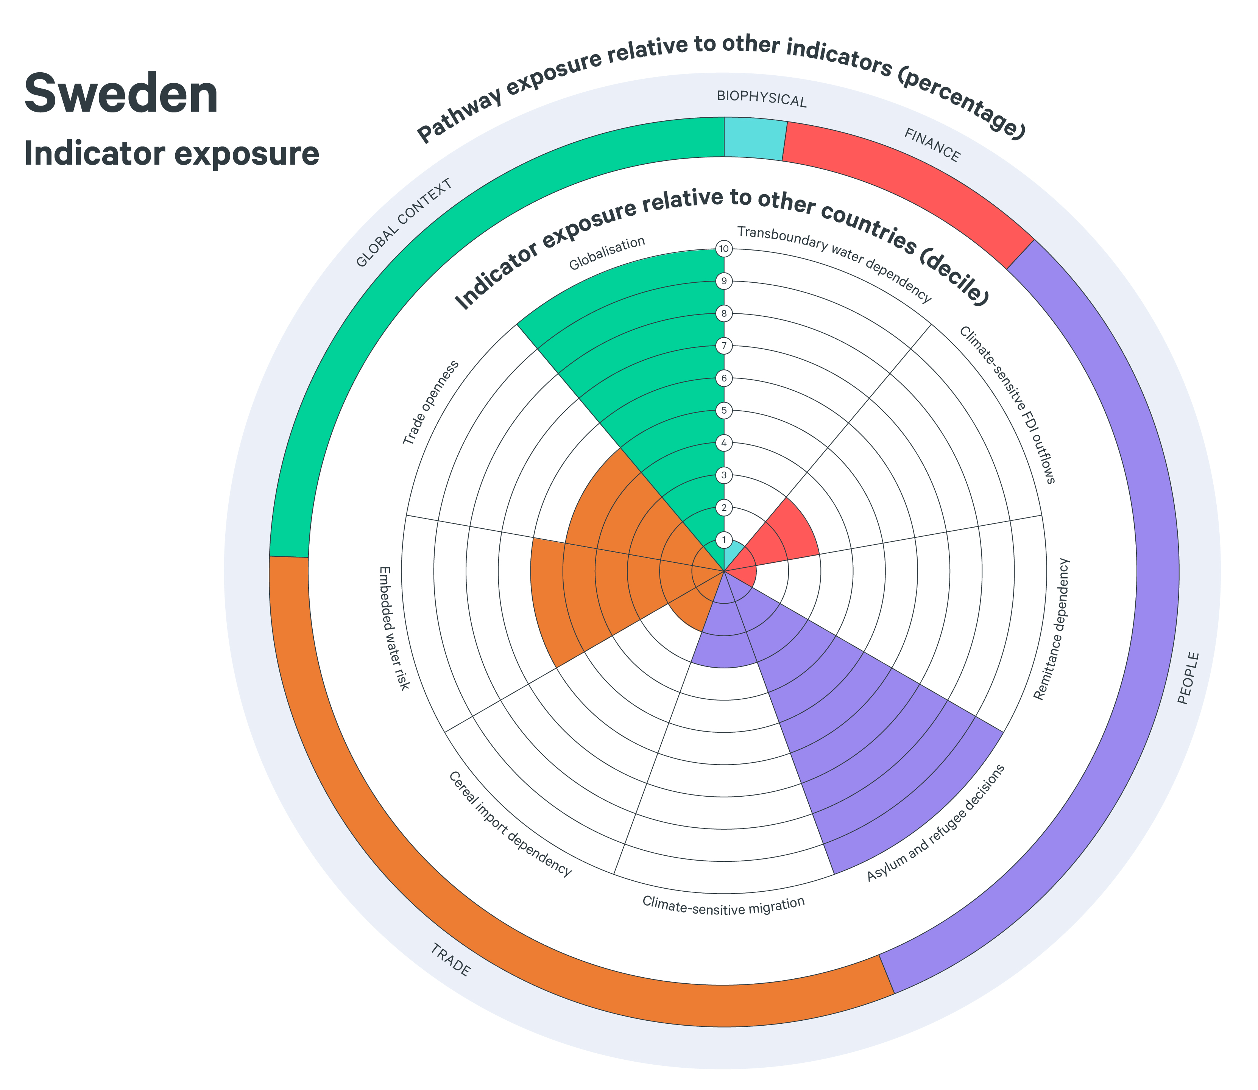
Transboundary climate risk in bilateral trade relationships: the case of Brazilian soy to Sweden
As a small, trade-open economy, Swedish supply chains are vulnerable to climate risks in the goods they import and in the places they invest abroad.
The figure on the right illustrates Sweden’s exposure to transboundary climate risks according to the transnational climate impact index, showing a high exposure to transboundary effects via the trade and people pathways.
Source: Benzie and Bessonova 2018.
Source: Lager and Benzie, Forthcoming

Slide 15
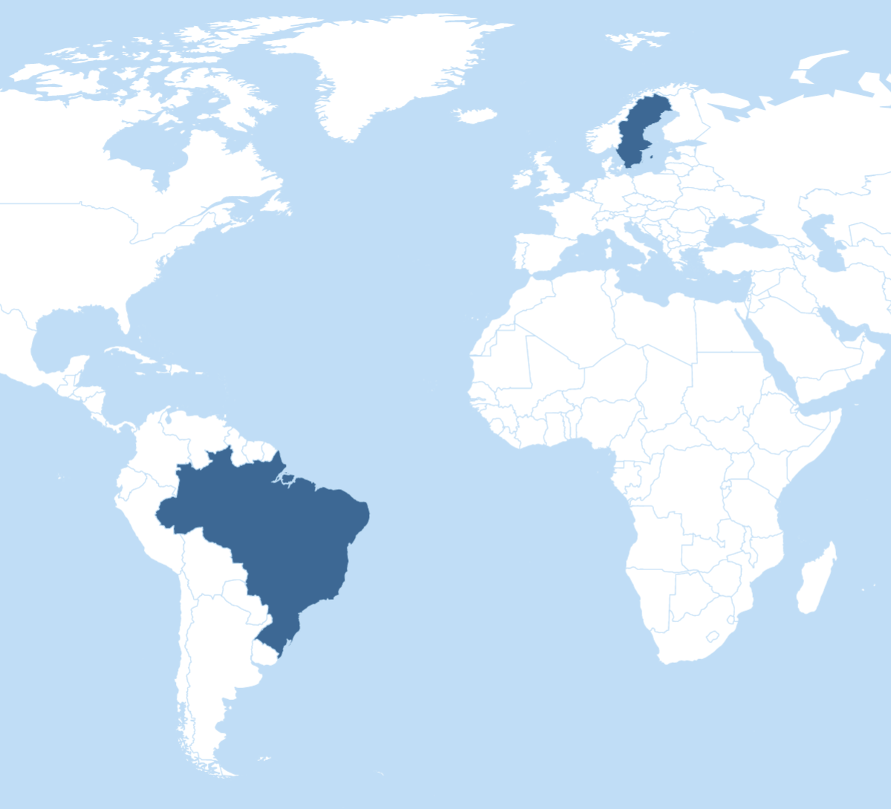
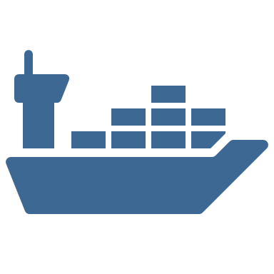









Sweden and food security
In Sweden, more than half of all food consumed is directly imported.
As such, the issue of future food security in a changing climate should arguably be exploring the answers to questions such as:
How could global food trade be at risk from climate change?
Where does Sweden source its key food imports from?
And where we might see the reverberating effects of climate impacts happening outside of Sweden’s borders?
Brazil-Sweden
relations
of Soy imported directly to Sweden is shipped through Brazilian northern ports via Norway
60%
In the Swedish agricultural and food manufacture sectors, Brazilian resource inputs accounts for:
Soy is primarily used as fodder in the meat and dairy industries
Brazil is the single largest exporter of agricultural products to the EU worldwide
14%
Brazil is the world largest soy exporter, with ca of world soy production
of land use
30%
13%
of material use
Inland transport routes in Brazil is one of the top “choke points” in global food trade due to poor infrastructure and hazard risk
4%
of blue water use
Brazil was in 2019 the 11th largest recipient of FDI outflows from Sweden
Climate change increases the threat of disruption of supply chains, acting as a hazard multiplier. In the case of Brazilian soy for Swedish end consumption, temperature change and drought risk affecting future yields of soy and altered rain patterns increase landslide and flood risk in Brazilian road networks.
Source: Lager and Benzie, Forthcoming

Slide 16
Climate change increases the threat of disruption of supply chains, acting as a hazard multiplier. In the case of Brazilian soy for Swedish end consumption, temperature change and drought risk affecting future yields of soy and altered rain patterns increase landslide and flood risk in Brazilian road networks.
Inland transport routes in Brazil is one of the top “choke points” in global food trade due to poor infrastructure and hazard risk
Sweden and food security
This study examines bilateral transboundary risk flows through a case study, focusing on exposure to climate change risks via the Swedish consumption of Brazilian soy.
It takes into account both the exposure of agricultural production to climate change in Brazil, and the potential climate vulnerability of the transport network that is used in the agricultural supply chain, investigating risk in Brazilian inland transport routes from farm to port.
Brazil is the world largest soy exporter, with ca of world soy production
30%
Source: Lager and Benzie, Forthcoming

Slide 17
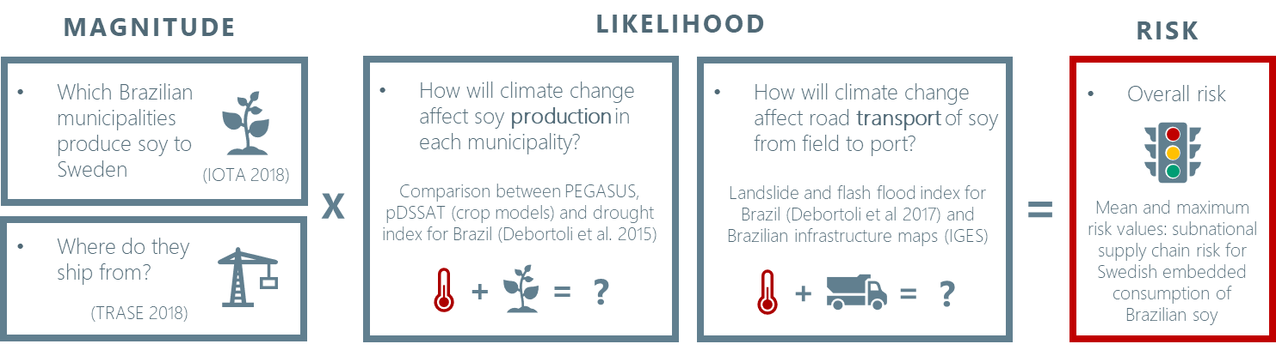
Transboundary climate risk in bilateral trade relationships: the case of Brazilian soy to Sweden
The study brings together data and methods from eight different sources to assess climate risks to production and transport in a novel integrated climate risk assessment. The ability to link consumption data, production data and transport network information together at a municipality resolution constitutes a major innovation and step forward in climate-related supply chain risk assessment.
Figure showing a visual representation of data sources and definition of risk as magnitude x likelihood of adverse impact
Source: Lager and Benzie, Forthcoming

Slide 18
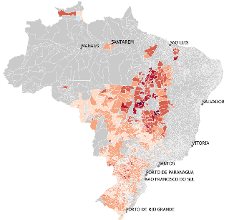
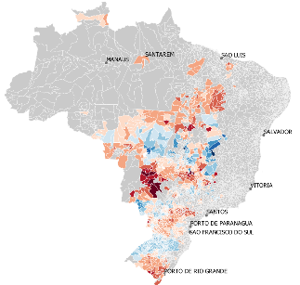
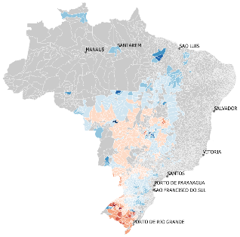
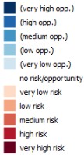
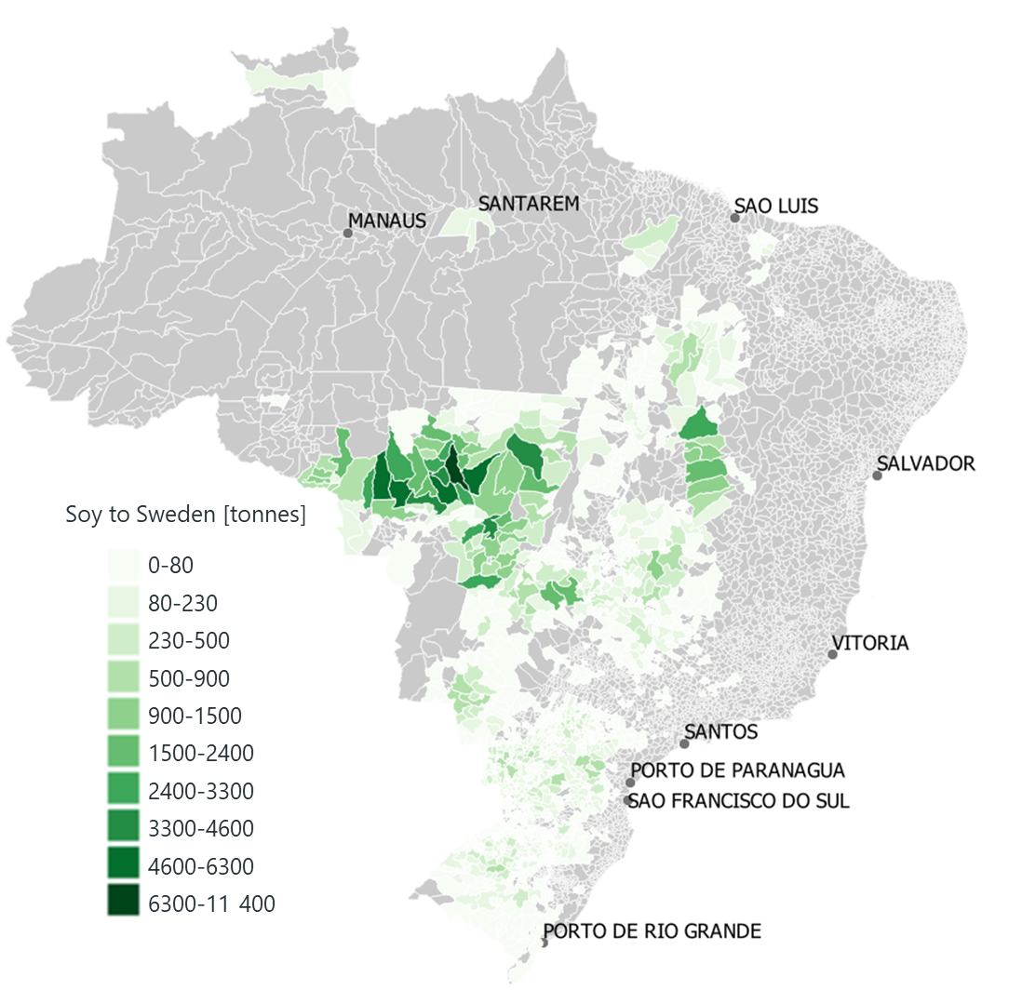
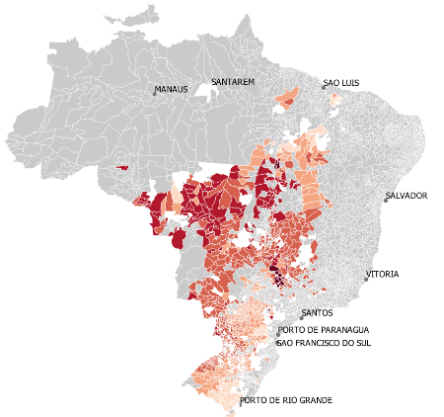
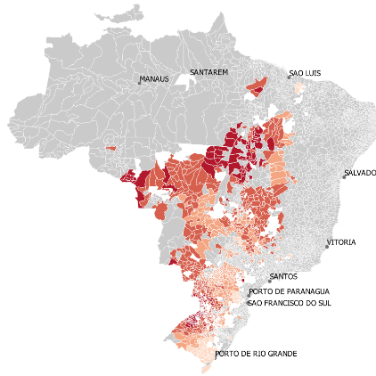
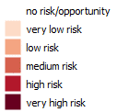
Transboundary climate risk in bilateral trade relationships: the case of Brazilian soy to Sweden
The figures to the right are the detailed results of the case study, highlighting the regional differences in where soy is sourced from, as well as the projected climate impacts on production and transport, and the variation between input models.
Drought vulnerability index
Crop model: PEGASUS
Crop model: pDSSAT
Climate risk to soy production
Swedish sourcing patterns
Transport risk: farm to port
Landslide risk from producing area to port
Flash flood risk from producing area to port
Swedish sourcing patterns of Brazilian soy
Source: Lager and Benzie, Forthcoming

Slide 19


Transboundary climate risk in bilateral trade relationships: the case of Brazilian soy to Sweden
The study finds that future risks posed to Swedish sourcing of Brazilian soy are relatively low. Considering dynamic effects of the future market, however, suggests that securing future supplies of soy could still be a challenging task for Sweden.
Source: Lager and Benzie, Forthcoming

Slide 20
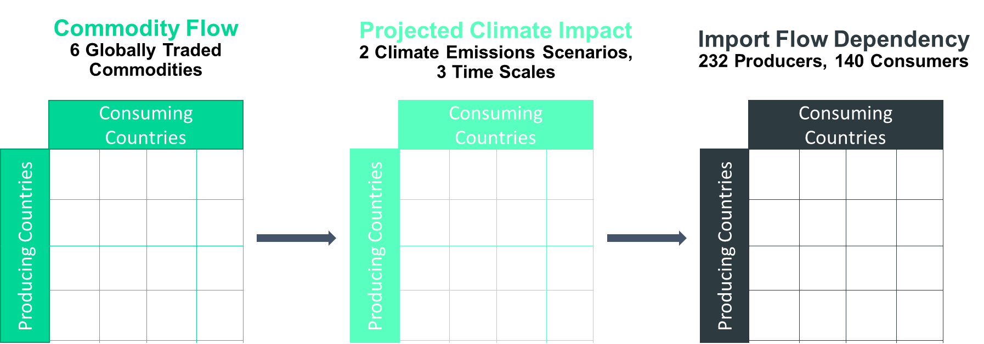
The SOURCE index
An assessment approach
The SOURCE index is a novel methodology and an interactive ‘tool’ for assessing transboundary climate risks in agricultural commodity flows globally. Transboundary climate risks are analysed for six major commodities: maize, rice, wheat, soy, sugarcane and coffee. The index assesses the top importers and exporters of climate change risk for global agricultural trade flows.
The method combines detailed global trade data with climate projections through the globally gridded crop model EPIC across 2 climate emission scenarios and 3 time series. It thereby investigates globally weighted risk flows ‘at source’, delivering a detailed dataset of bilateral agricultural risk flows.
Adams et al. Forthcoming. Climate Change, Trade, and Global Food Security.

Slide 21
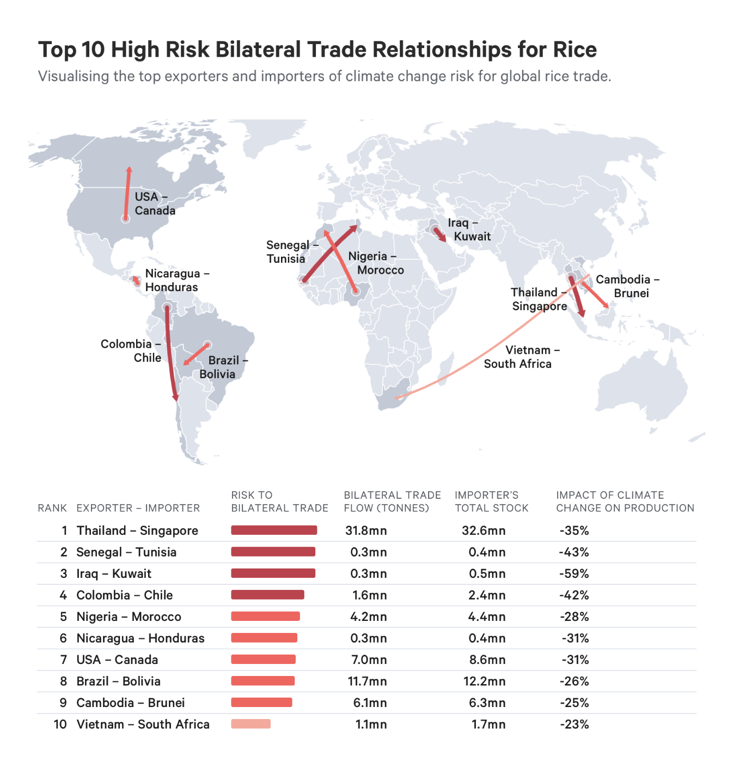
The figure on the right shows an example of the preliminary results, providing the Top 10 High Risk Bilateral Trade Relationships for Rice.
Adams et al. Forthcoming. Climate Change, Trade, and Global Food Security.

Slide 22
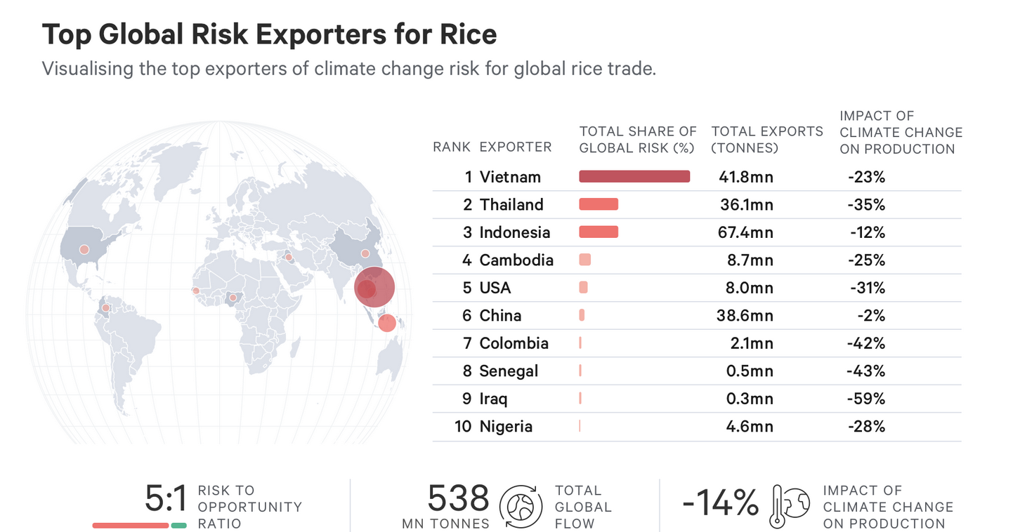
The figure below shows another example of the preliminary results, highlighting the Top Global Risk Exporters for Rice around the world.
Adams et al. Forthcoming. Climate Change, Trade, and Global Food Security.

Slide 23
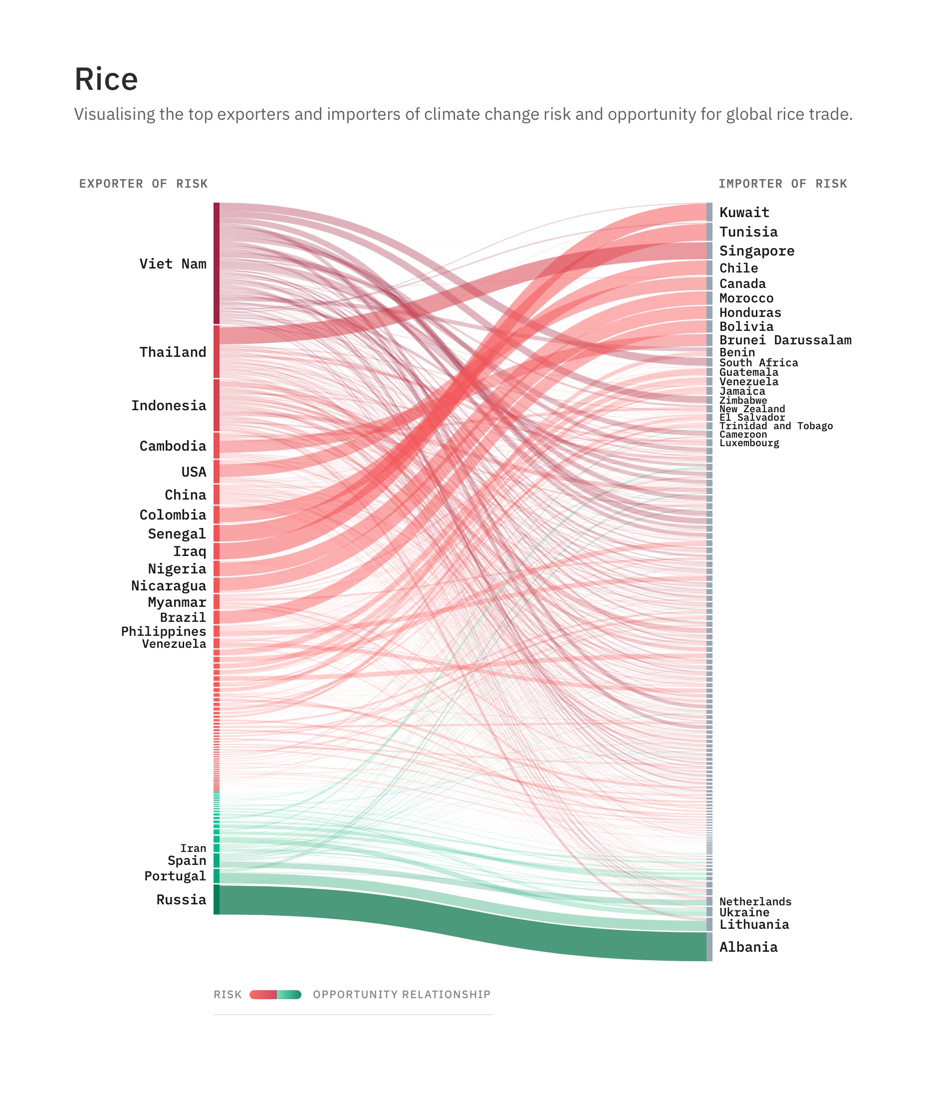
The SOURCE index
An assessment approach
Results suggest that the distribution of transboundary climate risks differs substantially across crops, exporters and importers.
The research also reveals that a limited number of major agricultural producers contribute disproportionately to transboundary climate risk in global food trade.
The interdependencies that are revealed by this type of analysis raise important questions about the role of research in influencing policy, such as: should shared risks via trade motivate new allocations or applications of climate finance, for example to reduce the vulnerability of importers by investing in the resilience of agricultural production for export?
Adams et al. Forthcoming. Climate Change, Trade, and Global Food Security.

Slide 24


Slide 25

In 2019, IDDRI, ODI and SEI hosted a multi-stakeholder dialogue at the UK’s Wilton Park, convening forty participants from nineteen countries, within and beyond the climate community, to advance the state of knowledge on transboundary climate risk.
The dialogue resulted in the Wilton Park Agenda on Adapting to Transboundary Climate Risk and called for “a new multi-partner Initiative… to bridge science and policy on transboundary climate risk”.
And so Adaptation Without Borders was born. We’re a new global partnership working to strengthen systemic resilience to the cross-border impacts of climate change.
We aim to create visibility of transboundary climate risks, gather evidence to analyse their extent and magnitude, build connections between different stakeholder groups who are affected by them and inspire action in policy and practice to better manage them.
“ Our vision is that countries, communities and companies are empowered to effectively and justly manage the full range of climate risks to which they’re exposed. Together, they coordinate their adaptation efforts in ways that deliver global public goods, building a resilient world in which all people are secure and can prosper.”

Slide 26
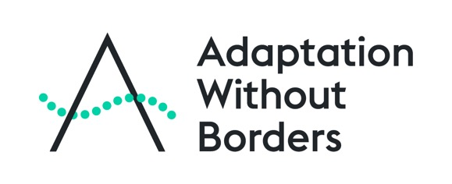

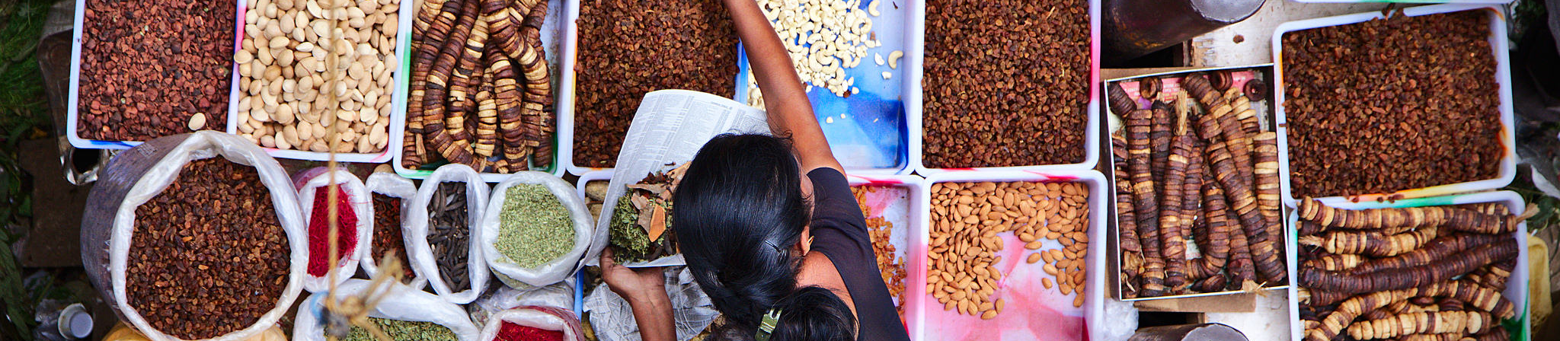
Three strategic agendas via which we’ll aim to leverage impact:
    1. Pathways of risk
    AWBI will advance the state of knowledge on transboundary climate risk and strengthen demand for breakthrough insights – conceptually and empirically – on the transboundary climate risks posing the greatest threat to humankind and the pathways through which they propagate
    2. Policy engagement
    AWBI will address a critical blind spot in the UNFCCC policy agenda, and a restrictive, territorial framing of adaptation in the wider climate community, and harness the opportunities this reframing reveals to catalyse progress on the Global Goal on Adaptation and strengthen the 2023 Global Stocktake
    3. Planning and implementation
    AWBI will build demand among, and the capacity of, national adaptation planners to account for transboundary climate risks – to strengthen the resilience of NAPs, spark cooperation regionally/globally and strengthen accountability for transboundary risk management
Photo credit: Flickr/Vanila Balaji

Slide 27
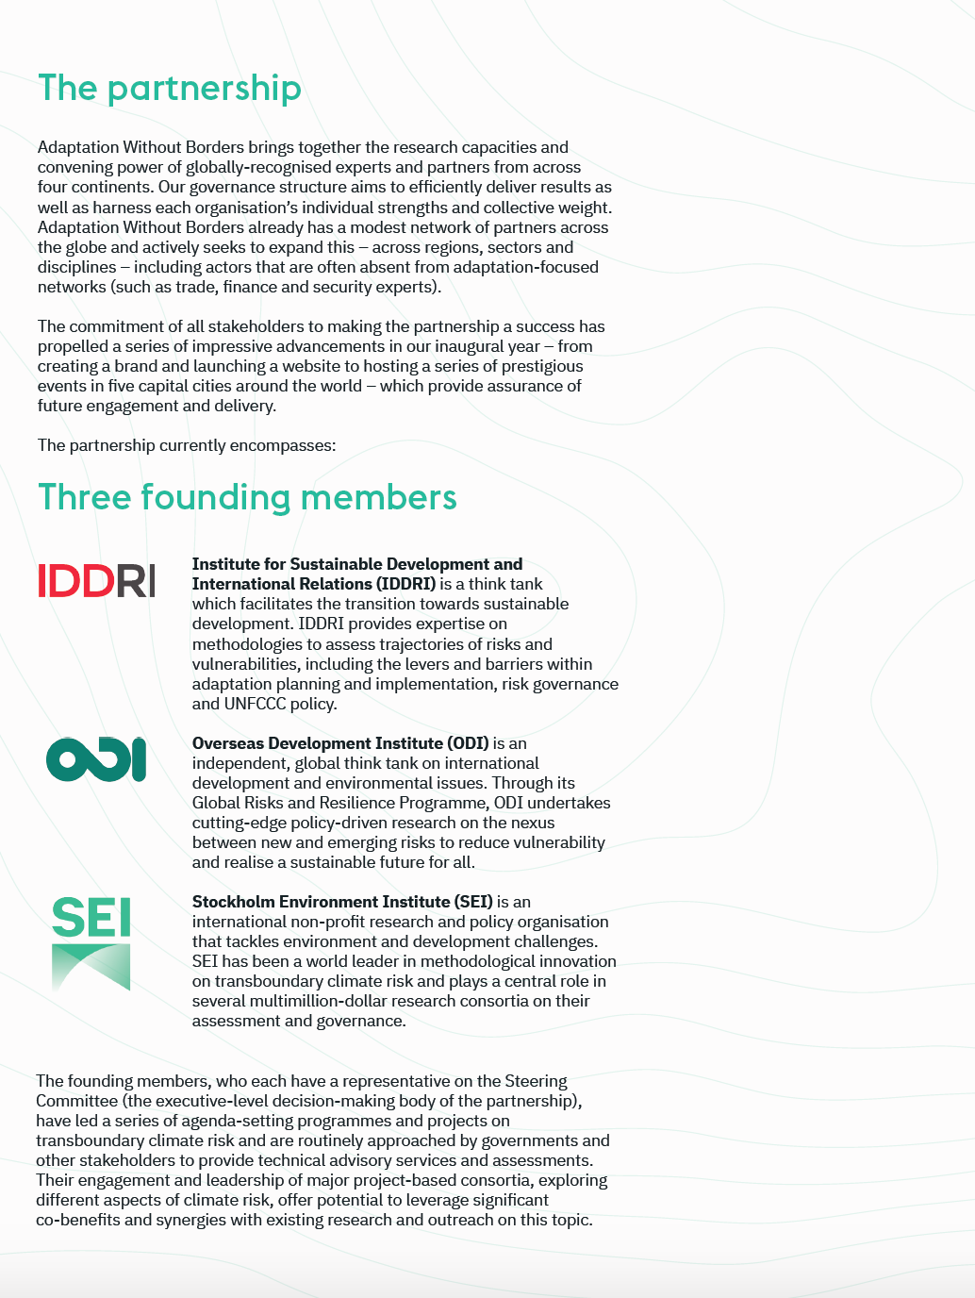
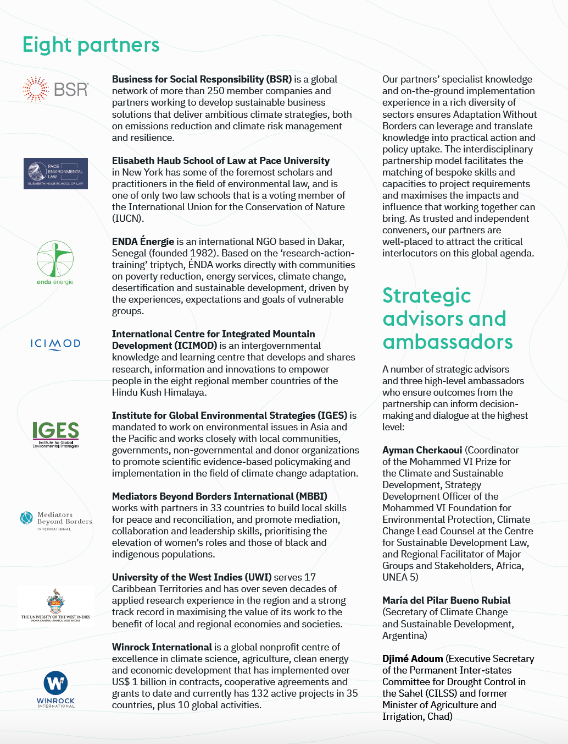

Slide 28
Managing transboundary climate risk to meet the global challenge of adaptation
Recent research and perspectives
What the pandemic reveals about globalization, supply chain risk, and adapting to climate change
Climate-resilient trade and production: the transboundary effects of climate change and their implications for EU member states
Meeting the global challenge of adaptation by adapting to transboundary climate risk
Frida Lager, Katy Harris and Magnus Benzie, UNFCCC Research Dialogue, November 2020
@: frida.lager@sei.org; katy.harris@sei.org; magnus.benzie@sei.org

