Slide 1


Key findings from the
Technical Dialogue of the first Global Stocktake
2023 Annual High-level Ministerial Roundtable on pre-2030 Ambition.
Presentation by
Harald Winkler and Farhan Akhtar, co-facilitators of the GST1 TD
5 December 2023, COP28, UAE

Slide 2
The first Global Stocktake: Technical Dialogue in context
CMA Decision and/or Declaration
Input Collection
Technical Dialogue
Consideration of outputs
High-level events at CMA6
Identify opportunities and challenges in enhancing action and support as well as possible measures and good practices and international corporation
Summarize key political messages, including recommendations for strengthening action and enhancing support
All topics covered
Three meetings (June 2022-June 2023)
Managed by two co-facilitators
Inclusive and diverse participation
Prepared 3 summary reports and final factual synthesis report
Started November 2021
Reports from subsidiary and constituted bodies
National reporting
IPCC Reports
Submissions from Parties and Non-Party Stakeholders, international and reginal organizations
Secretariat synthesis reports

Slide 3
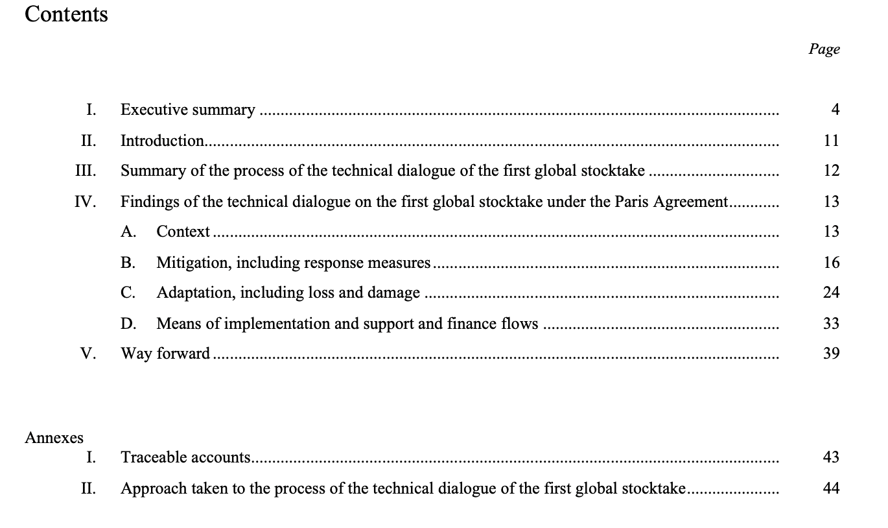
Synthesis report of technical dialogue (TD) of GST1 – in overview
  Executive summary (7 pages) and longer TD SYR (~40 pages)
  17 key findings, across four sections
  Technical basis for consideration of outputs
Notes:
TD SYR lays a strong technical basis
- informed by inputs component (252 hours of discussion, and over 170,000 pages written)
- basis for political Consideration of Outputs – which Ministers will discuss
- our focus on technical dialogue, across all topics, in the light of best available science and equity
Focus on cluster of findings releveant to MWP, note that their should be understood in context of full TD SYR

Slide 4
Mitigation, including response measures
Global emissions are not in line with modelled global mitigation pathways consistent with the temperature goal of the Paris Agreement, and there is a rapidly narrowing window to raise ambition and implement existing commitments in order to limit warming to 1.5 °C above pre-industrial levels.
Much more ambition in action and support is needed in implementing domestic mitigation measures and setting more ambitious targets in NDCs to realize existing and emerging opportunities across contexts, in order to reduce global GHG emissions by 43 per cent by 2030 and further by 60 per cent by 2035 compared with 2019 levels and reach net zero CO2 emissions by 2050 globally.
Achieving net zero CO2 and GHG emissions requires systems transformations across all sectors and contexts, including scaling up renewable energy while phasing out all unabated fossil fuels, ending deforestation, reducing non-CO2 emissions and implementing both supply- and demand-side measures.
Just transitions can support more robust and equitable mitigation outcomes, with tailored approaches addressing different contexts.
Economic diversification is a key strategy to address the impacts of response measures, with various options that can be applied in different contexts.
Source; GST TD SYR
https://unfccc.int/event/the-first-global-stocktake-technical-dialogue-s-co-facilitators-launch-of-the-td-synthesis-report
Notes:
FOR MINISTERIAL:
4. Mitigation is not on track to limit global warming to 1.5 °C
5. Implementing more ambitious mitigation measures is a matter of urgency
6. Net zero emissions requires transformations across systems
7. Just transitions and fair contributions are key dimensions in ways of addressing equity in mitigation
8. Economic diversification is a key strategy to address the impacts of response measures, with various options that can be applied in different contexts
AT VIRTUAL LAUNCH:
In the mitigation, including response measures cluster, we present 5 findings, the first speaks to global trends, the second on national targets and implementation, the third on specific opportunities within systems transformations, and fourth speaks to addressing equity in mitigation. The last focuses on response measures and economic diversification.

Slide 5
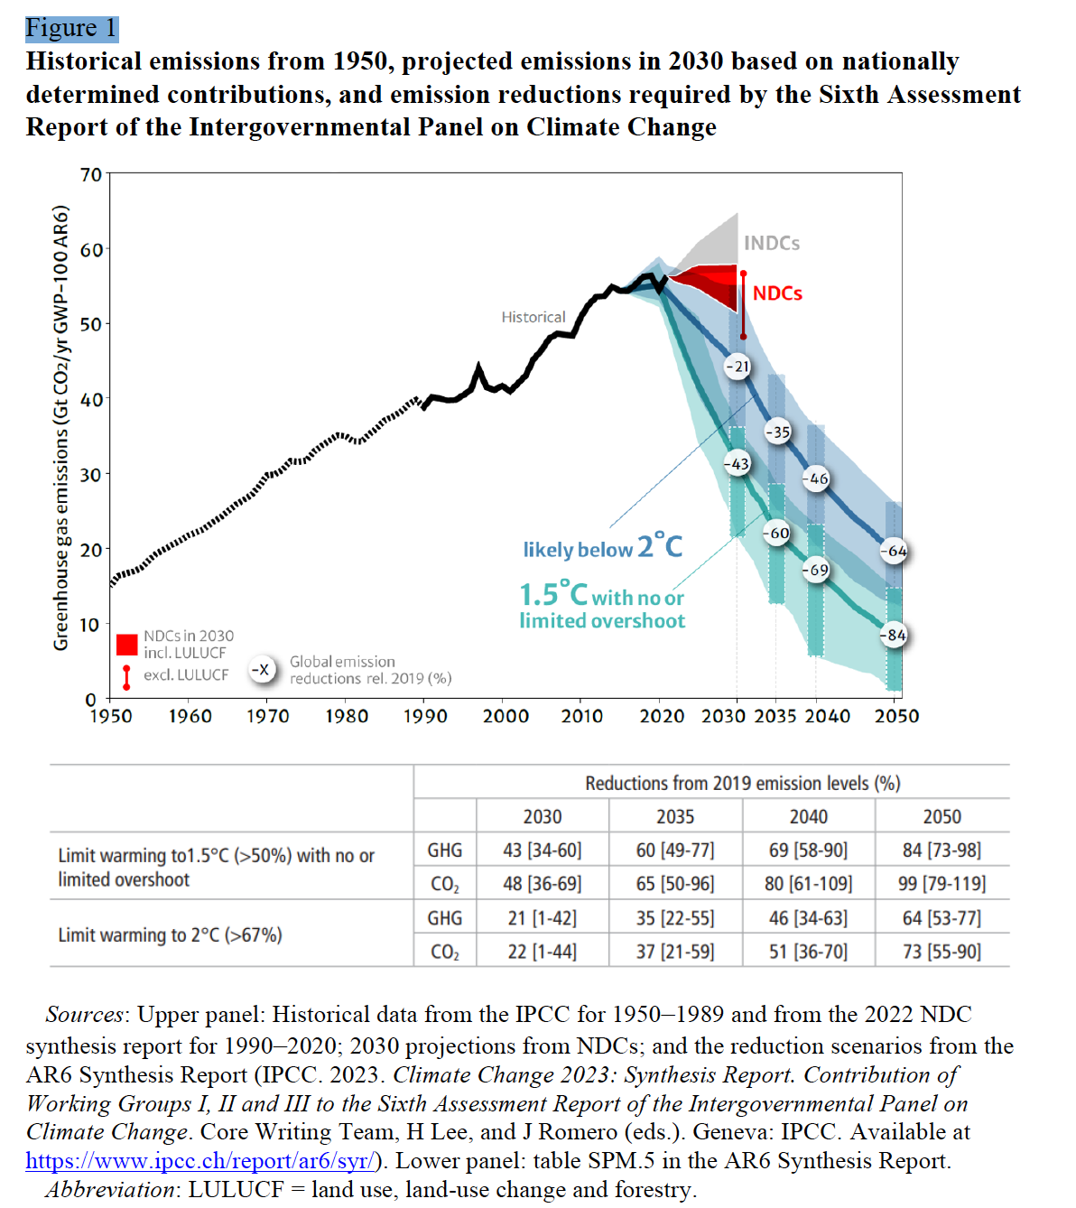
Key Finding 4
Global emissions are not in line with modelled global mitigation pathways consistent with the temperature goal of the Paris Agreement, and there is a rapidly narrowing window to raise ambition and implement existing commitments in order to limit warming to 1.5 °C above pre-industrial levels.
Key finding 4 speaks to global GHG emission trends and forecasts.
Both these trends and forecasts are not in line with what is needed to be consistent with the temperature goal of the Paris Agreement, according to the latest IPCC findings
Source; GST TD SYR
https://unfccc.int/event/the-first-global-stocktake-technical-dialogue-s-co-facilitators-launch-of-the-td-synthesis-report
Notes:
FOR MINISTERIAL:
4. Mitigation is not on track to limit global warming to 1.5 °C
5. Implementing more ambitious mitigation measures is a matter of urgency
6. Net zero emissions requires transformations across systems
7. Just transitions and fair contributions are key dimensions in ways of addressing equity in mitigation
8. Economic diversification is a key strategy to address the impacts of response measures, with various options that can be applied in different contexts
AT VIRTUAL LAUNCH:
In the mitigation, including response measures cluster, we present 5 findings, the first speaks to global trends, the second on national targets and implementation, the third on specific opportunities within systems transformations, and fourth speaks to addressing equity in mitigation. The last focuses on response measures and economic diversification.

Slide 6
Key Finding 5
Much more ambition in action and support is needed in implementing domestic mitigation measures and setting more ambitious targets in NDCs to realize existing and emerging opportunities across contexts, in order to reduce global GHG emissions by 43 per cent by 2030 and further by 60 per cent by 2035 compared with 2019 levels and reach net zero CO2 emissions by 2050 globally.
Urgent action and support are needed to ramp up implementation of domestic mitigation measures by realizing opportunities across all sectors and systems.
More ambitious mitigation targets in NDCs are needed to reduce emissions more rapidly and to align with each country’s LT-LEDS towards just transitions to net zero emissions by or around 2050, while enhanced transparency can help track progress.
Mitigation measures that successfully deliver on other sustainable development goals can be scaled up and replicated across different contexts.
Source; GST TD SYR
https://unfccc.int/event/the-first-global-stocktake-technical-dialogue-s-co-facilitators-launch-of-the-td-synthesis-report
Notes:
FOR MINISTERIAL:
4. Mitigation is not on track to limit global warming to 1.5 °C
5. Implementing more ambitious mitigation measures is a matter of urgency
6. Net zero emissions requires transformations across systems
7. Just transitions and fair contributions are key dimensions in ways of addressing equity in mitigation
8. Economic diversification is a key strategy to address the impacts of response measures, with various options that can be applied in different contexts
AT VIRTUAL LAUNCH:
In the mitigation, including response measures cluster, we present 5 findings, the first speaks to global trends, the second on national targets and implementation, the third on specific opportunities within systems transformations, and fourth speaks to addressing equity in mitigation. The last focuses on response measures and economic diversification.

Slide 7
Key Finding 6
GHG emissions requires systems transformations across all sectors and contexts, including scaling up renewable energy while phasing out all unabated fossil fuels, ending deforestation, reducing non-CO2 emissions and implementing both supply- and demand-side measures.
Scaling up renewable energy and phasing out all unabated fossil fuels are indispensable elements of just energy transitions to net zero emissions
Measures to implement systems transformations in industry, transport, buildings and other sectors must rapidly reduce process and energy emissions
More effective international cooperation and credible initiatives can contribute to bridging implementation and emissions gaps.
Source; GST TD SYR
https://unfccc.int/event/the-first-global-stocktake-technical-dialogue-s-co-facilitators-launch-of-the-td-synthesis-report
Notes:
FOR MINISTERIAL:
4. Mitigation is not on track to limit global warming to 1.5 °C
5. Implementing more ambitious mitigation measures is a matter of urgency
6. Net zero emissions requires transformations across systems
7. Just transitions and fair contributions are key dimensions in ways of addressing equity in mitigation
8. Economic diversification is a key strategy to address the impacts of response measures, with various options that can be applied in different contexts
AT VIRTUAL LAUNCH:
In the mitigation, including response measures cluster, we present 5 findings, the first speaks to global trends, the second on national targets and implementation, the third on specific opportunities within systems transformations, and fourth speaks to addressing equity in mitigation. The last focuses on response measures and economic diversification.

Slide 8
Key Finding 7
Just transitions can support more robust and equitable mitigation outcomes, with tailored approaches addressing different contexts.
The discussions showed that concept of equity is complex and multidimensional.
In discussions at the first TD, diverse views were expressed on dimensions of equity in mitigation.
A common thread was that equity should align with an upward spiral of ambition in implementing the Paris Agreement.
Collective and participatory decision-making processes can promote equity and reduce the disruptive consequences of rapid systems transformations, as countries chart pathways to net zero emissions..
Source; GST TD SYR
https://unfccc.int/event/the-first-global-stocktake-technical-dialogue-s-co-facilitators-launch-of-the-td-synthesis-report
Notes:
FOR MINISTERIAL:
4. Mitigation is not on track to limit global warming to 1.5 °C
5. Implementing more ambitious mitigation measures is a matter of urgency
6. Net zero emissions requires transformations across systems
7. Just transitions and fair contributions are key dimensions in ways of addressing equity in mitigation
8. Economic diversification is a key strategy to address the impacts of response measures, with various options that can be applied in different contexts
AT VIRTUAL LAUNCH:
In the mitigation, including response measures cluster, we present 5 findings, the first speaks to global trends, the second on national targets and implementation, the third on specific opportunities within systems transformations, and fourth speaks to addressing equity in mitigation. The last focuses on response measures and economic diversification.

Slide 9
Key Finding 8
Economic diversification is a key strategy to address the impacts of response measures, with various options that can be applied in different contexts.
Informed approaches can address negative impacts of response measures and promote positive synergies within LT-LEDS, including through economic diversification.
Economic diversification is one of the strategies to address negative impacts of response measures and promote positive synergies.
Global job creation resulting from just energy transitions will potentially be 3.5 times greater than job losses by 2030.
Opportunities for such diversification include green industrialization, the greening of supply chains and diversifying to related and unrelated products.
Source; GST TD SYR
https://unfccc.int/event/the-first-global-stocktake-technical-dialogue-s-co-facilitators-launch-of-the-td-synthesis-report
Notes:
FOR MINISTERIAL:
4. Mitigation is not on track to limit global warming to 1.5 °C
5. Implementing more ambitious mitigation measures is a matter of urgency
6. Net zero emissions requires transformations across systems
7. Just transitions and fair contributions are key dimensions in ways of addressing equity in mitigation
8. Economic diversification is a key strategy to address the impacts of response measures, with various options that can be applied in different contexts
AT VIRTUAL LAUNCH:
In the mitigation, including response measures cluster, we present 5 findings, the first speaks to global trends, the second on national targets and implementation, the third on specific opportunities within systems transformations, and fourth speaks to addressing equity in mitigation. The last focuses on response measures and economic diversification.

Slide 10
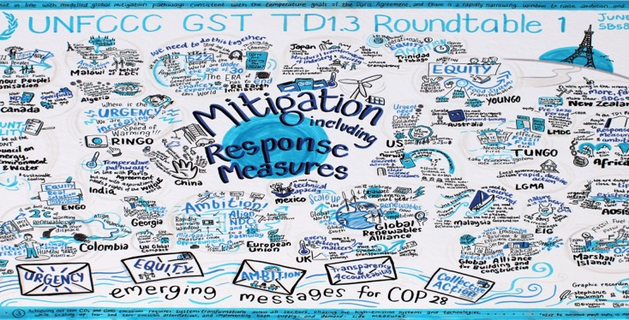
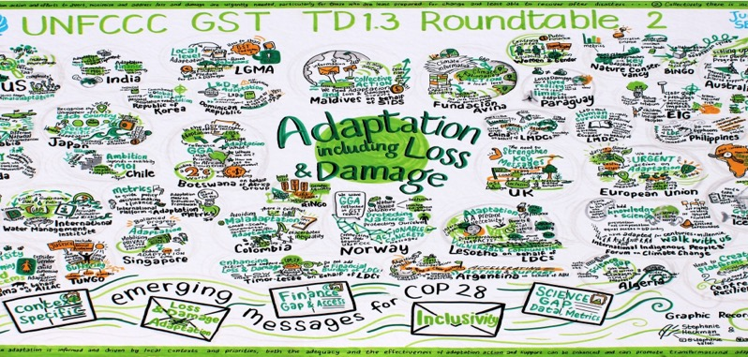
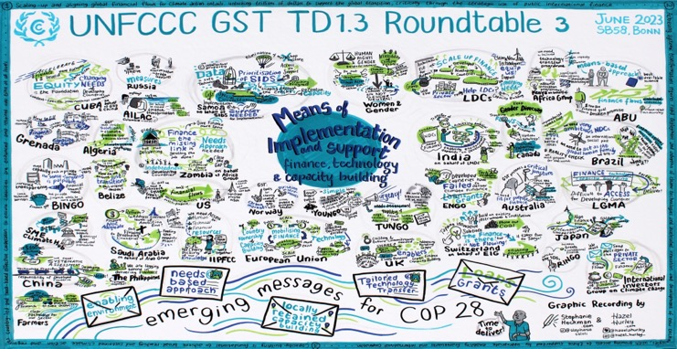
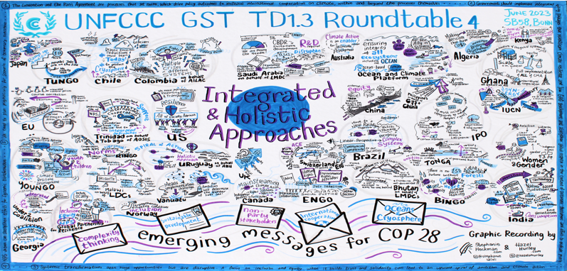
Thank you
Email: gst@unfccc.int | Website: https://unfccc.int/topics/global-stocktake | Dedicated synthesis report webpage: https://unfccc.int/event/the-first-global-stocktake-technical-dialogue-s-co-facilitators-launch-of-the-td-synthesis-report
Notes:
The first TD has been based on the best available science, drawing on the findings of the AR6 and other knowledge sources, with extensive involvement of experts. During the TD it became clear that many actionable solutions and creative suggestions to overcome challenges identified during the input and technical phases of the GST are ready to be implemented. Information gaps also emerged that the scientific community might address in the years ahead in order to better inform the next GST and work programmes and other processes under the Paris Agreement. The information generated from the first GST can inform ongoing processes and work programmes under the Paris Agreement, and those efforts can in turn inform assessments of collective progress under future GSTs. As Parties prepare their next NDCs, they may draw on the rich technical information drawn from the input and technical assessment phases of the first GST

