Slide 1
Rights centered climate and biodiversity action in practice

Slide 3
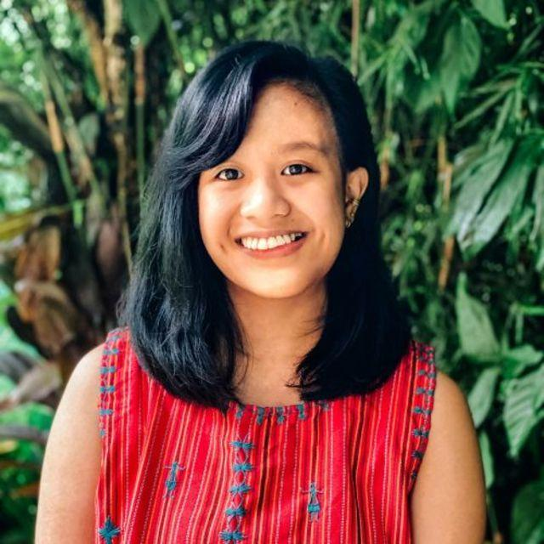
Josefa Tauli
Josefa Tauli is an Ibaloi-Kankanaey Igorot indigenous youth activist. She is Policy Co-coordinator of the Global Youth Biodiversity Network (GYBN), which serves as the youth constituency to the UN Convention on Biological Diversity (CBD). An advocate for meaningful youth participation, human rights, and Indigenous Peoples’ rights and knowledge, she has coordinated the engagement of youth delegations to more than 10 rounds of CBD negotiations during the development of the Kunming-Montreal Global Biodiversity Framework. She is also the Advocacy Officer of Partners for Indigenous Knowledge Philippines (PIKP), a learning network of organizations and individuals with initiatives on promoting and strengthening Indigenous knowledge.

Slide 4
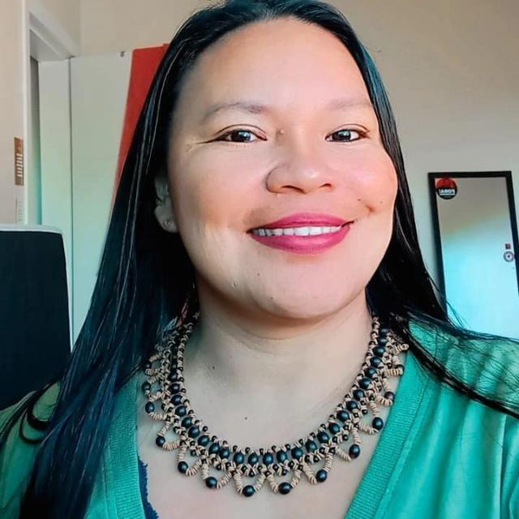
Braulina Baniwa
Braulina Baniwa is the Executive Director of the Articulação Nacional das Mulheres Indígenas Guerreiras da Ancestralidade (ANMIGA), author and researcher of the New Economy for the Brazilian Amazon (NEA-BR). She has a master in Social Anthropology at the University of Brasília (UnB). Is a researcher, specialist in gender (indigenous women), socio-bioeconomy, health and Indigenous, environmental and territorial rights.

Slide 5
Caroline Rocha
Caroline Rocha is a Co-Founder of Amazonians for Climate Network (RAC) and Member of LACLIMA. she is an expert in Climate Policy and Climate Justice. Caroline also goes beyond her professional role, having authored the book 'Environmental Justice and the Water Crisis.' Her academic journey includes a law degree from the Federal University of Pará, complemented by Master's and PhD degrees from the Faculty of Law at the University of São Paulo.

Slide 6
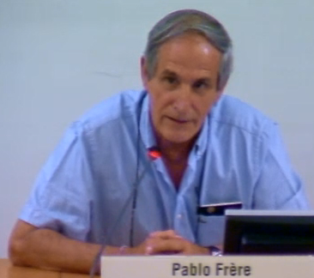
Pablo Frere
Pablo Frere is a veterinarian from Argentina. He is the executive secretary of Redes Chaco, a multistakeholder platform for the Gran Chaco region including several pastoralist members. He is also a focal point for the World Alliance for Mobile and Indigenous People, the global alliance of pastoralists.

Slide 7
Q&A

Slide 8
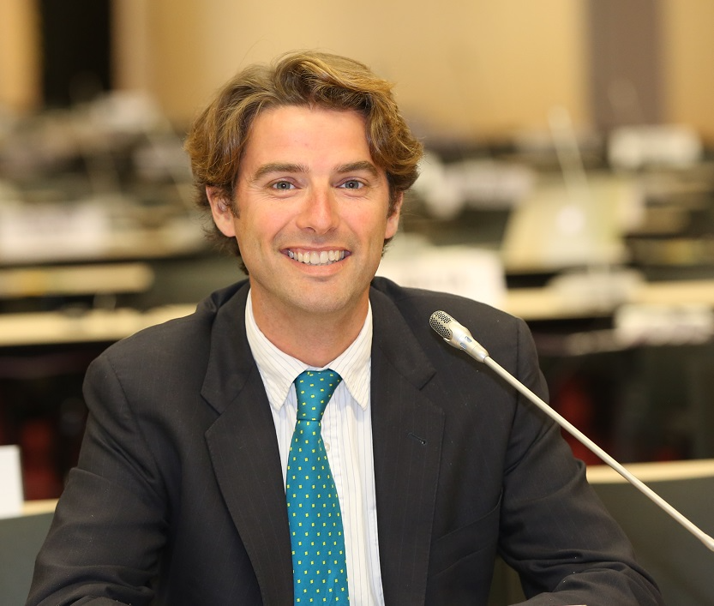
Tristan Tyrrell
Tristan Tyrrell is a Programme Management Officer for Biodiversity and Climate Change, Dry & Sub-humid Lands at Secretariat of the Convention on Biological Diversity (CBD)

Slide 9
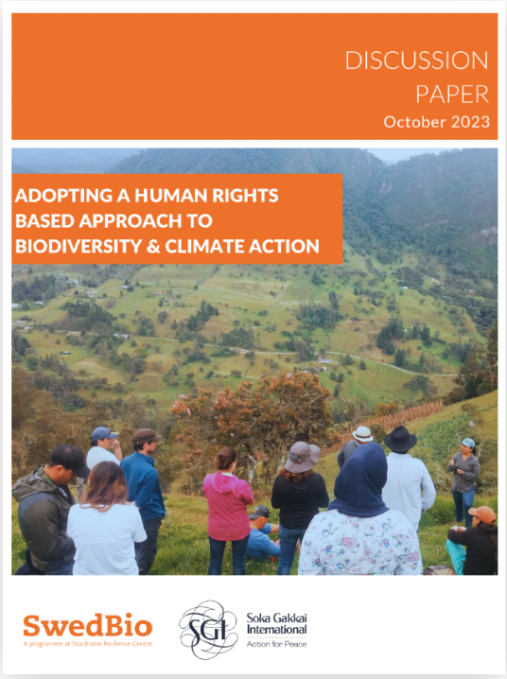
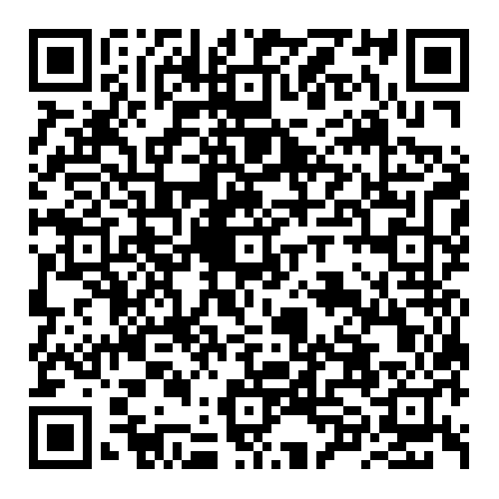
A human rights-based approach (HRBA) is essential to address biodiversity and climate challenges
HRBA are present in different policy processes (e.g. the ongoing SBSTTA25 negotiations)
The case studies in this publication demonstrate how a HRBA for climate and biodiversity action can contribute to living in harmony with nature.

