Slide 1
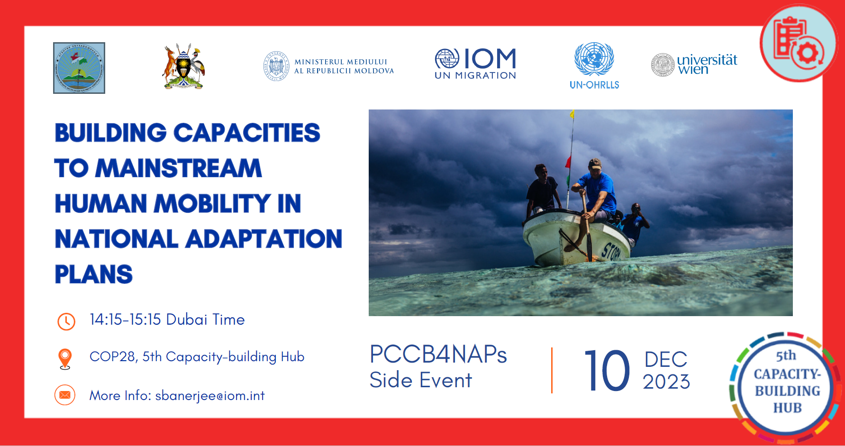

Slide 2
Addressing Human Mobility-Related Challenges and Opportunities in the Context of Climate Change: A Supplement to the UNFCCC Technical Guidelines for the National Adaptation Plan Process
Building Capacities to Mainstream Human Mobility in
National Adaptation Plans
Dubai, UAE
10 December 2023
Harald STERLY
University of Vienna, Department of Geography and Regional Research

Slide 3

Starting point: Why should human mobility be mainstreamed in National Adaptation Plans?
Adaptation helps to avert, minimize and address climate induced displacement and involuntary mobility.
Certain types of human mobility (e.g., planned evacuation, planned relocation, labor migration, etc.) can contribute to adaptation.
Refugees, internally displaced persons, and migrants in transit are among the most vulnerable to climate risks.

Slide 4
What is the Supplement?
How does it work?
Step-by-step guide to mainstream human mobility into the NAP formulation process.
Concise, operational, and user-friendly information and tools.
Designed for stakeholders interested and active in mainstreaming human mobility into the adaptation planning.
Based on the experiences of main-streaming human mobility into the NAPs of Ecuador, Republic of Moldova, Tajikistan, the Republic of Marshall Islands, Turkmenistan, and Uzbekistan.
Inclusion of a broad range of human mobility types.
Mainstream human mobility in all stages of the NAP formulation process.
Include relevant stakeholders, and consider diversity of needs and perspectives.
Focus on a rights-based approach, and those who are most vulnerable.
Notes:
???Plus Flexibility: No one-size-fits-all approach; entry points and approaches need to be adapted to the specific contexts and institutional needs

Slide 5
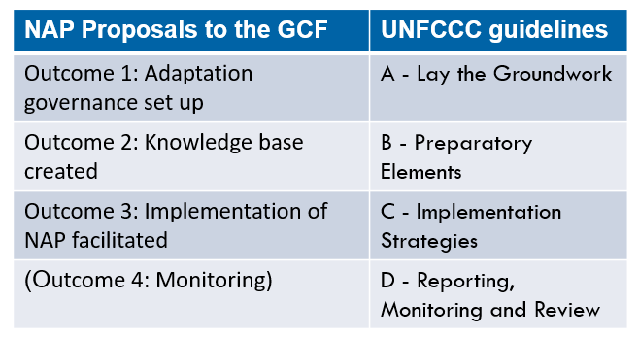
How does the supplement look?
The supplement has four parts:
1. Introduction (rationale)
2. Background (human mobility types)
3. National Adaptation Plans (NAP process)
4. Key steps for mainstreaming migration into NAPs (step-by-step tools)
4.1 The national coordination, steering mechanism, and institutional arrangement
4.2 Evidence and knowledge base
4.3 NAP implementation strategy
4.4 Reporting, monitoring and evaluation
Parts of NAP Process (“Outcomes” GCF Readiness Proposals // “Elements” of the UNFCCC Guidelines

Slide 6
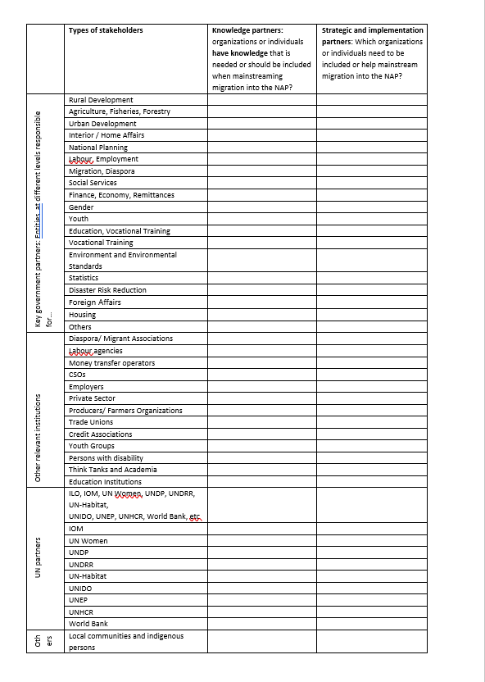
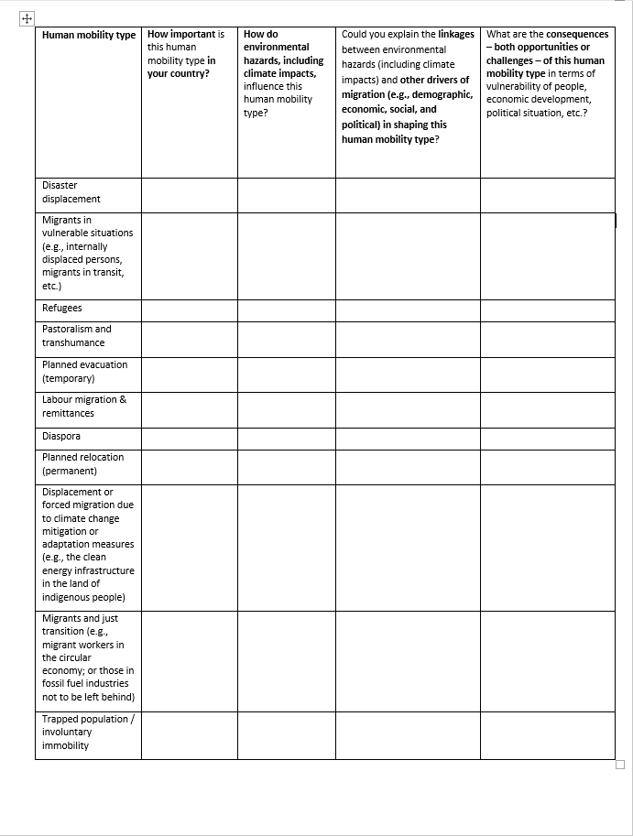
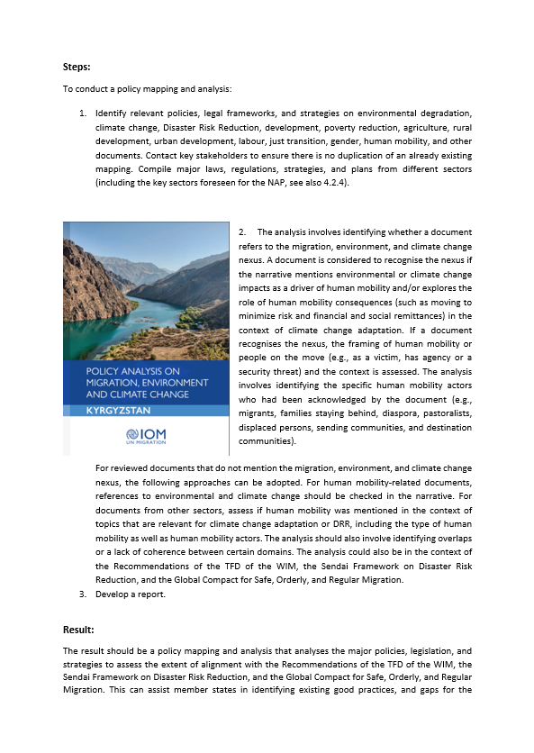
“4.1 National coordination, steering mechanism, and institutional arrangement are established”
“4.1.1 Establishing Institutions and coordinating bodies”
Tools: Stakeholder lists, and template for initial and bilateral briefings.
“4.1.2 Stocktaking: Systematize existing knowledge and gaps”
Tools: Checklists for stocktaking of human mobility and adaptation issues; for situation analysis; and materials for policy mapping.
“4.1.3 Capacity building of coordinating bodies”
Tools: Materials for capacity building workshops.

Slide 7
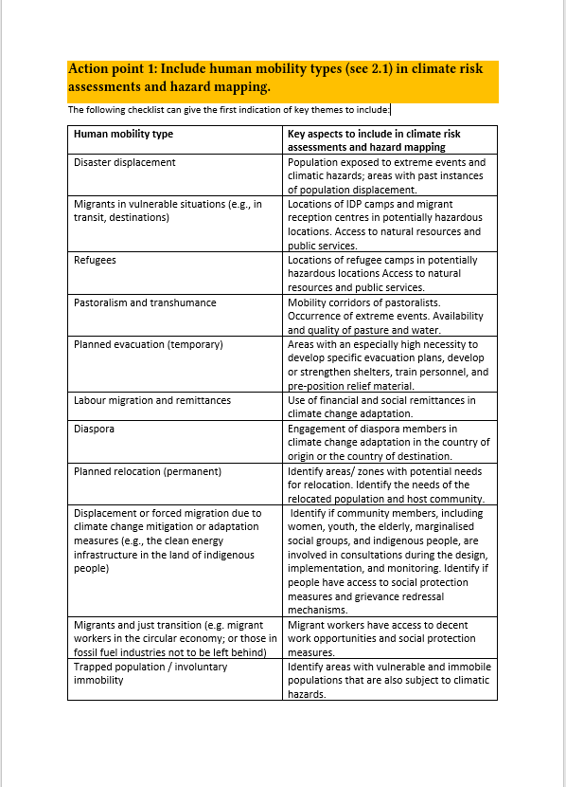
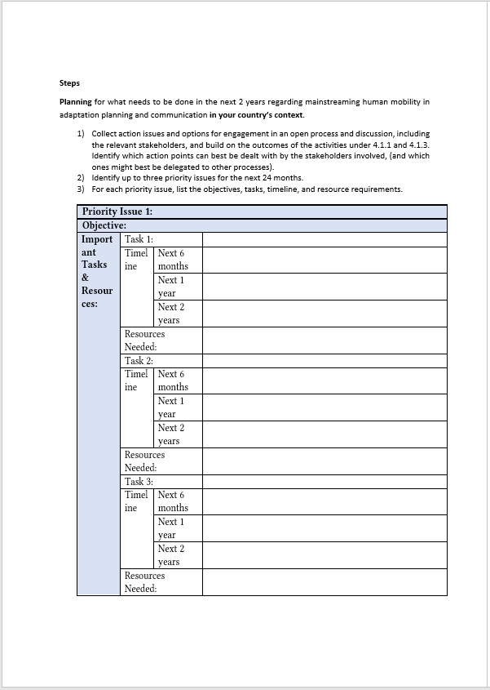
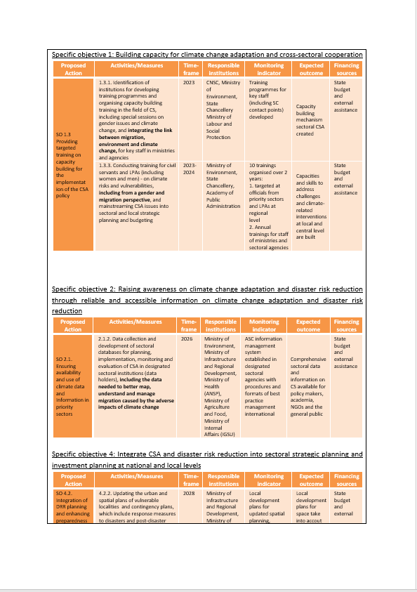
“4.2 Evidence and knowledge base created, NAP formulated”
“4.2.1 Evidence base: Systematize climate risks & impacts”
Tools: Checklists for mainstreaming human mobility into mapping of risks, vulnerability and adaptation; principles and examples for case studies.
“4.2.2 Evidence base: Review adaptation options”
Tool for operationalizing adaptation.
“4.2.3 Compile and communicate the NAP”
Tools: Checklists and steps to include human mobility in drafting and reviewing the NAP document; and examples from the NAP documents in different countries.
“4.2.4 Sectoral mainstreaming”
Tools: Steps for sectoral briefings and stakeholder inclusion; checklists for including human mobility in key sectors.

Slide 8
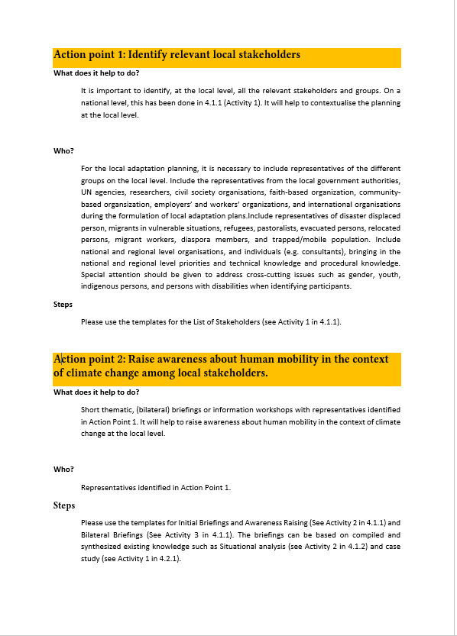
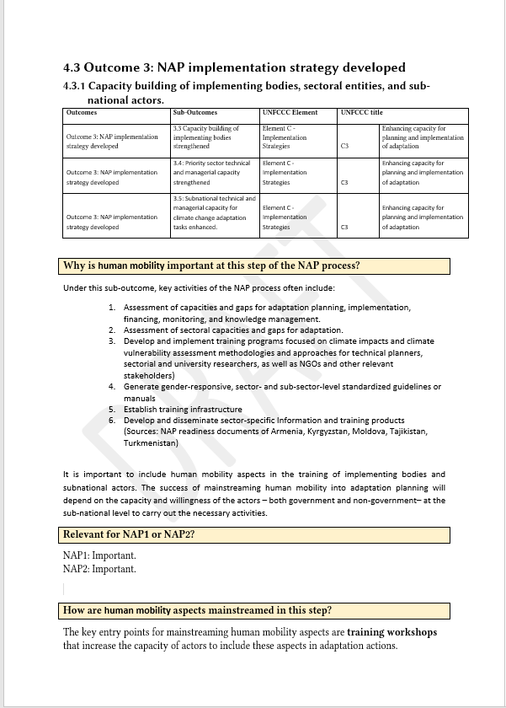
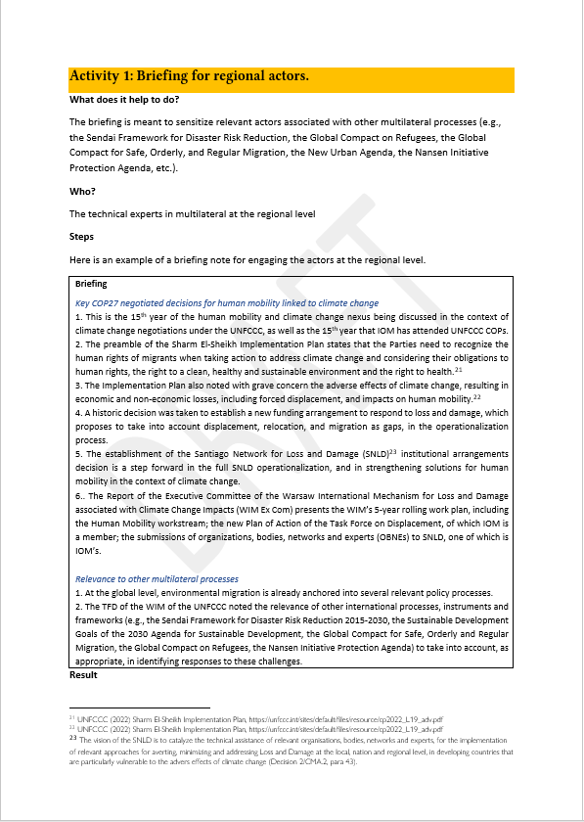
“4.3 NAP implementation strategy developed”
“4.3.1 Capacity building of implementing bodies”
Tools: Materials for training workshops.
“4.3.2 Developing local adaptation plans”
Tools for local stakeholder inclusion, awareness raising, drafting local plans, and capacity development.
“4.3.3 Synergies at the regional level”
Tools: Materials for briefing regional actors, and for promoting coordination and synergy in the context of different global policy frameworks.

Slide 9
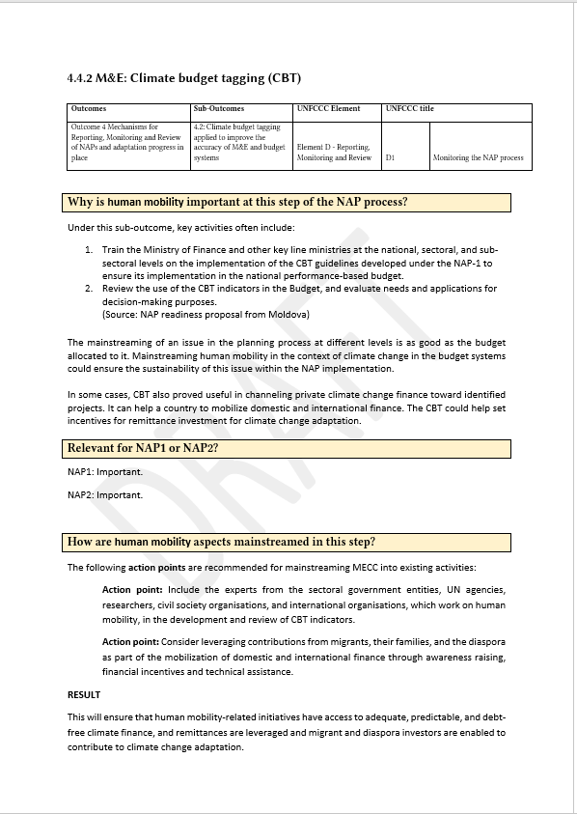
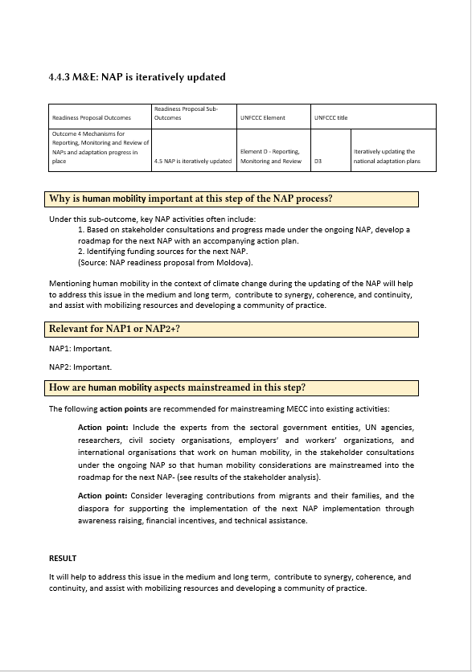
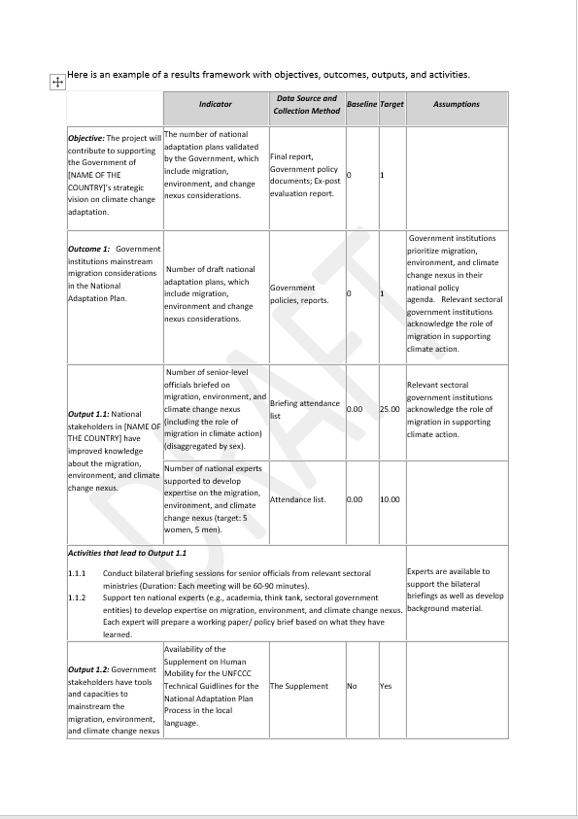
“4.4 Mechanisms for Reporting, Monitoring and Reviewing of NAPs”
“4.4.1 M&E: Indicators and Reporting Strategies”
Tools: Materials for including human mobility stakeholders in formulating indicators and reporting; for including human mobility stakeholders in working groups.
“4.4.2 M&E: Climate budget tagging (CBT)”
Tools: Guidance for including human mobility stakeholders and considering migrants in designing CBT.
“4.4.3 M&E: NAP is iteratively updated”
Tools: Guidance for human mobility stakeholder inclusion.
“4.4.4 Publish NAP and Outreach”
Tools: Material for human mobility stakeholder inclusion, consultations, curricula, and outreach.

Slide 10
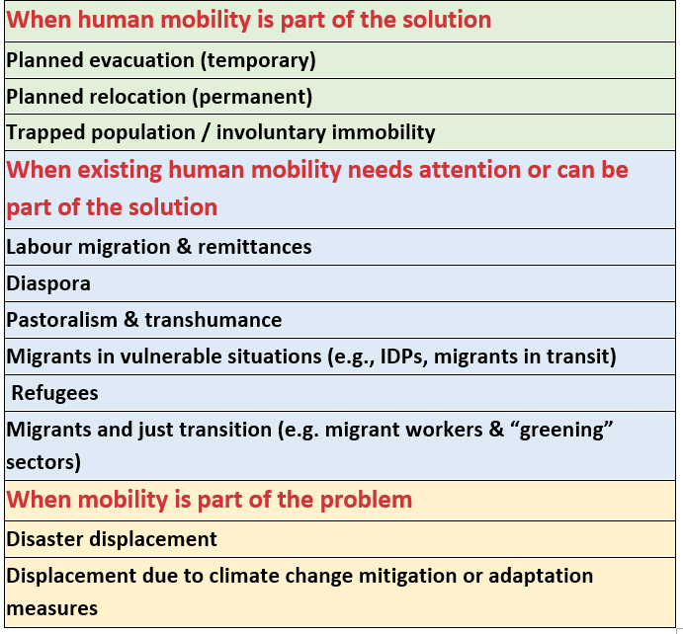
Wrapping it up – a human mobility supplement on the NAP
Practical and hands-on collection of tools.
Considers a broad range of human mobility types.
Mainstreaming of human mobility in all stages of the NAP formulation process.
Inclusion of relevant stakeholders on all levels, emphasizing the local, and the diversity of needs.
Focus on a rights-based approach, and on those who are most vulnerable.

Slide 11

Thank you for your attention
Harald Sterly
University of Vienna
harald.sterly@univie.ac.at
Potato fields in Mae Chaem District, Thailand (picture: Harald Sterly, 2020)

Slide 12
Tour de Table
Sharing the experiences of roundtable participants

Slide 13
Guiding Questions
Mainstreamed human mobility
Introduce yourself (name, designation, institutional affiliation, and country).
Did your country mainstream human mobility in the NAP formulation?
Would like to mainstream human mobility
Introduce yourself (name, designation, institutional affiliation, and country).
Youth
Introduce yourself (name, designation, institutional affiliation, and country).
Why was it necessary to mainstream human mobility in the NAP formulation in your country?
What were three key lessons learned from this mainstreaming process that would be valuable to other roundtable participants?
Based on your experience, what are/ were two key capacity-building needs related to mainstreaming human mobility into the NAPs in your country?
Is your country planning to mainstream human mobility in the NAP formulation?
Why is it necessary to mainstream human mobility in the NAP formulation in your country?
Based on your experience, what are three key capacity-building needs related to mainstreaming human mobility into the NAPs in your country?
What were the main adaptation-related outcomes from the COY?
How does the youth envisage participating in the NAP formulation and implementation?
From the youth perspective, what are three key capacity-building needs related to mainstreaming human mobility into the NAPs?

Slide 14

Slido Questions
We will answer a few questions using Slido.
Participants can join at Slido.com with code #2150139 or scan the QR code.
Notes:
Can also launch online using - https://auth.slido.com/eu1/api/latest/the-auth/user/lifecycle-process/shareable-link/init?token=f9964ff7001186fd3795f4b3a342f02adda863a4d878f817a99f0d4dd505fd47
Must have an account

Slide 15


Please name the country you represent?
ⓘ Start presenting to display the poll results on this slide.

Slide 16
Which department is responsible for NAP formulation in your country?
ⓘ Start presenting to display the poll results on this slide.

Slide 17

What do you see as the main challenge to integrate human mobility in NAP formulation and implementation in your country?
ⓘ Start presenting to display the poll results on this slide.

Slide 18
In which areas are capacity-building activities needed for mainstreaming human mobility into the NAP process in the short- and medium-term?
ⓘ Start presenting to display the poll results on this slide.

Slide 19

Any additonal feedback?
ⓘ Start presenting to display the poll results on this slide.

