Slide 1




Strengthening collaboration between Ministries of Finance and Ministries of Environment
for National Adaptation Plans (NAP) implementation
Rohini Kohli, Senior Technical Advisor, Adaptation Policy and Planning, UNDP
14 November 2024, 6th Capacity Building Hub,
“Finance for NAPs Day”

Slide 2
Overview
Part 1: What does the NAP process entail?
Part 2: Finance for Ministries of Environment
Part 3: Adaptation for Ministries of Finance

Slide 3

What is the NAP Process?
The National Adaptation Plan (NAP) process enables countries to formulate and implement NAPs as a means of identifying medium to long-term adaptation needs and developing and implementing strategies and programmes to address those needs.
It is a progressive, iterative process that follows country-driven, gender sensitive, participatory, and transparent approach.
Addressing climate vulnerability is a core objective.
Notes:
National Adaptation Plans offer the main vehicle for delivering on adaptation under the Paris Agreement.
NAPs provide a coordinated framework that integrates adaptation efforts across sectors.
The First Global Stocktake points to gaps and needs. All countries NAPs should be formulated by 2030. UAE-Belem Framework for Global Climate Resilience targets also agreed for 2030.

Slide 4
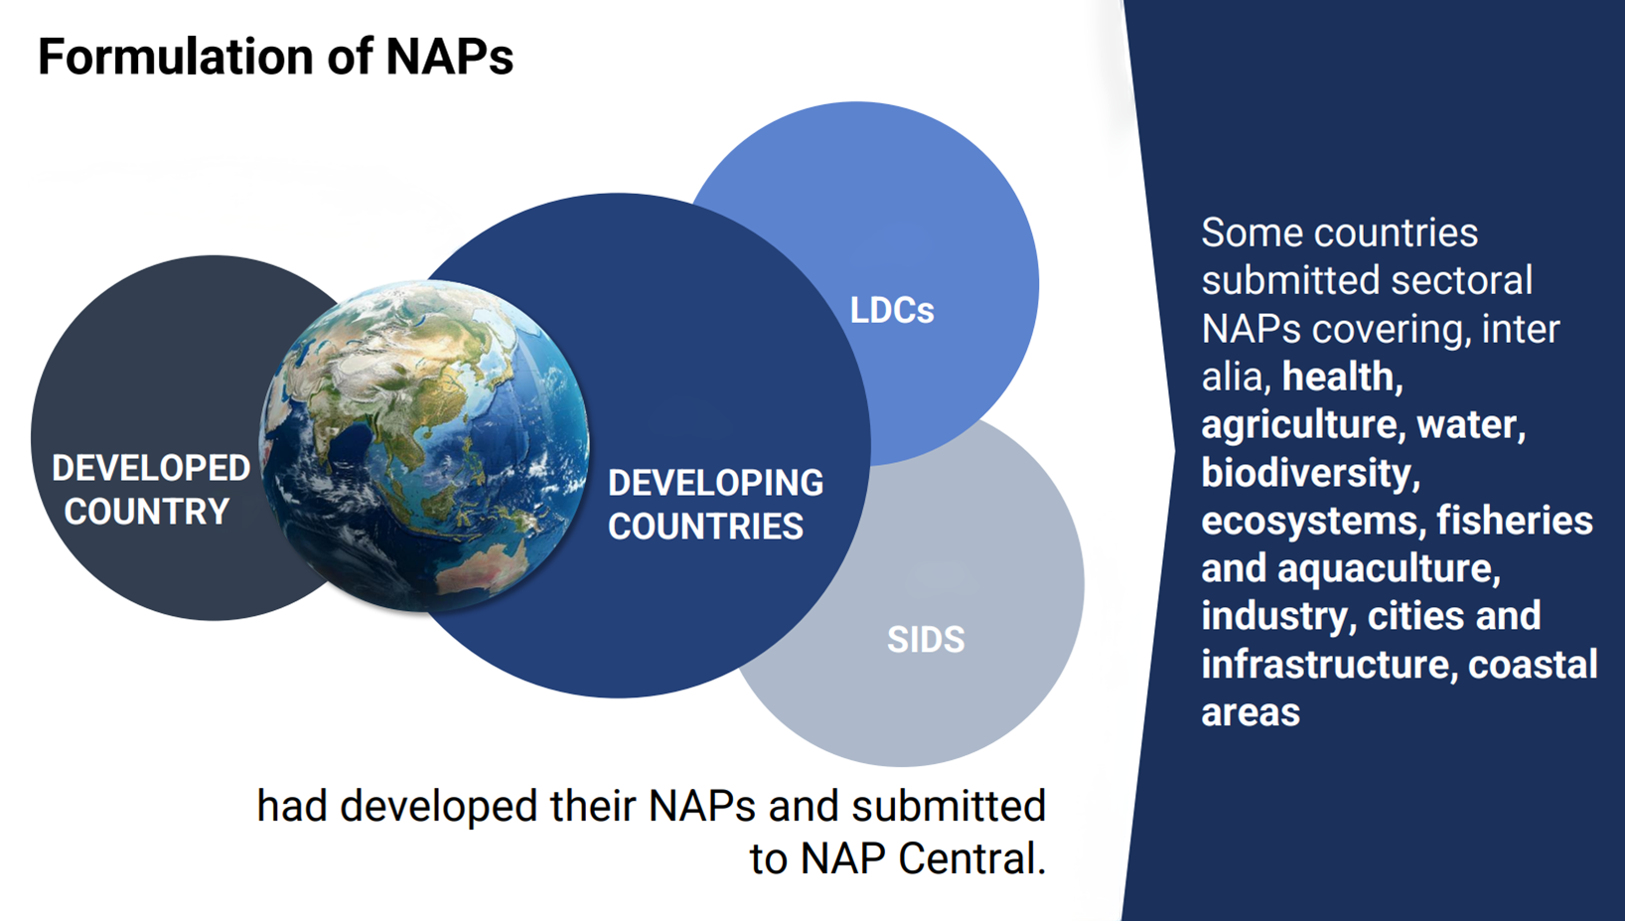
As of November 2024,
22
2
60
12
Source: UNFCCC
Notes:
Of the submitted NAPs, 38 were supported by UNDP
NAPs submitted since 2019 tend to be more detailed and comprehensive than earlier NAPs. This may be the result of financial and technical support that became available after around 2018

Slide 5
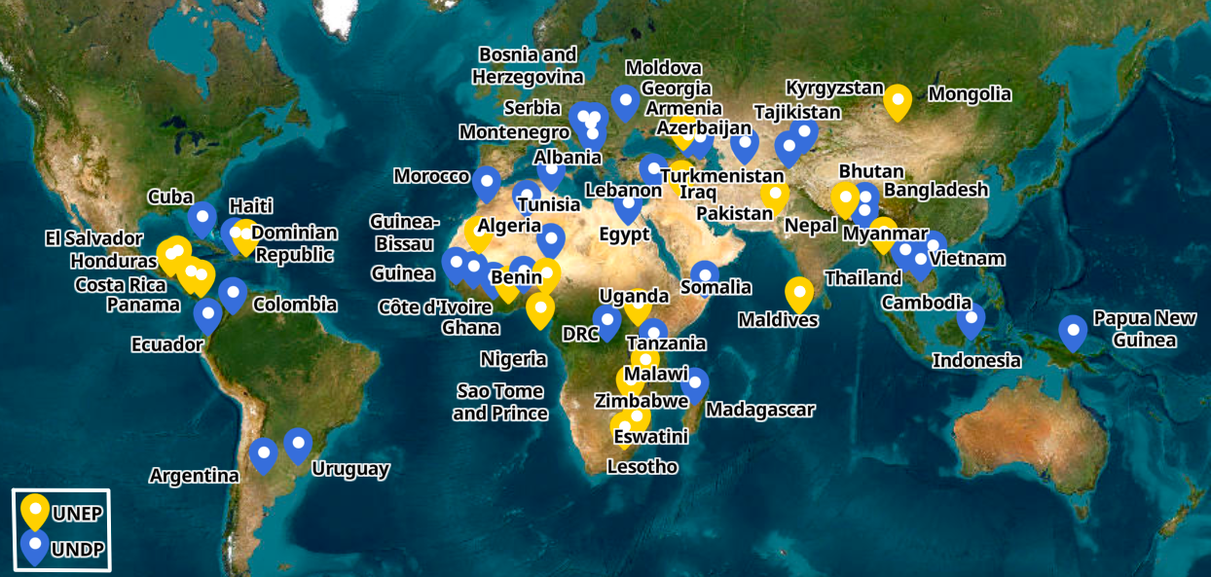


UNDP and UNEP support to Adaptation Planning
Notes:
UNDP 50 countries
UNEP 24 countries

Slide 6
Adaptation Planning through NDCs and NAPs
NDCs
NAPs
Mitigation and Adaptation - vision and objectives
142 countries have included adaptation commitments (2020/21 update)
Short to medium term (5-10 years), update every 5 years
NDC 3.0 by 2025
¼ Coalition members are actively involved in the NDC process
Adaptation – priorities and action plan
60 developing countries submitted to the UNFCCC
Medium to long term (5-10 years)
All countries to submit NAPs by 2025
Mainly led by the Ministries of Environment, limited engagement of Ministries of Finance
142 Countries have undertaken at least one activity related to the process to formulate and implement NAPs.
Notes:
2025 NDC update is a significant opportunity for adaptation acceleration
UNDP NAP: 32 Countries supported to achieve greater alignment between their NDC, NAP, and sector plans and budgets
170 Parties have submitted new or updated NDCs, and 142 have adaptation components
Agriculture & food security, water, and ecosystems/ biodiversity are the top sectors in the adaptation components of NDCs and submitted NAPs.

Slide 7
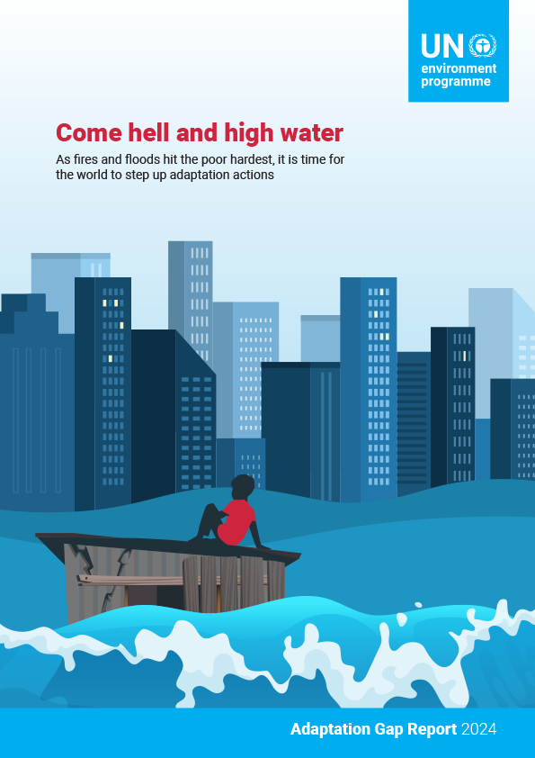
AGR 2024
As climate impacts intensify and hit the world’s poorest hardest, the AGR 2024 finds that nations must dramatically step up adaptation, starting with a commitment to act on finance at COP 29.

Slide 8
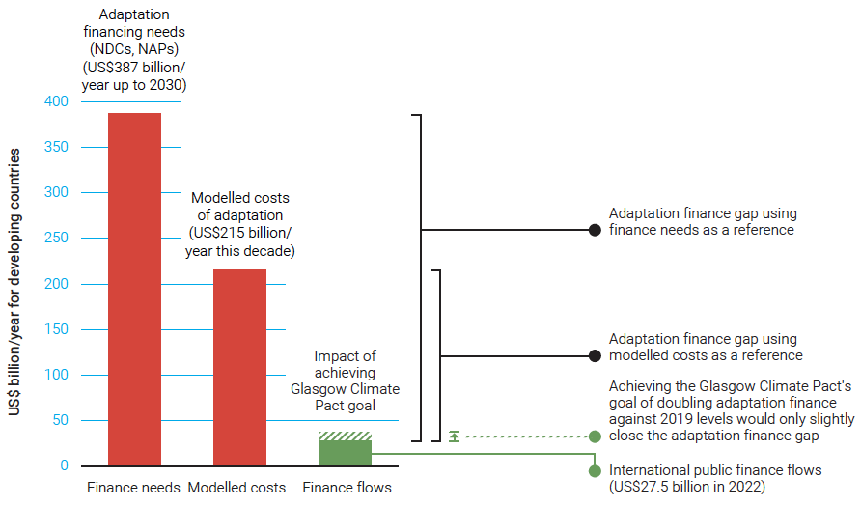
Adaptation Gap Report 2024
International public adaptation finance flows are rising, but there remains a huge gap between what is needed and what is being delivered.
Planning and implementation of adaptation are generally increasing, but not fast enough. More support and more ambition are required.
Enabling factors, new approaches and financial instruments are key for unlocking adaptation finance, for both the public and private sectors.
Notes:
AGR 2024
Additional details on bullet 1:
International public adaptation finance flows to developing countries increased from US$22 billion in 2021 to US$28 billion in 2022: the largest absolute and relative year-on-year increase since the Paris Agreement.
However, even achieving the Glasgow Climate Pact goal would only reduce the adaptation finance gap, which is estimated at US$187-359 billion per year, by about 5 per cent.
Additional details on bullet 3:
For the public sector, these enablers include the creation of funds and financing facilities, climate fiscal planning and climate budget tagging, mainstreaming in national development planning and medium-term expenditure frameworks, and adaptation investment planning.
New approaches and financial instruments are also emerging that could increase adaptation financing. These include risk finance, insurance-linked instruments, performance-based grants, resilience credits and bonds, debt for adaptation swaps, and payments for ecosystem services.
For the private sector, investment can be encouraged through climate risk disclosure frameworks, transition planning and adaptation taxonomies, and by strengthening approaches and instruments that de-risk private-sector finance using public finance (blended finance). These can be supported by adaptation accelerators and platforms.
Source: AGR 2024 key messages

Slide 9
What does the NAP process entail?
Albania: Inter-ministerial Working Group on Climate Change collaborates with stakeholders to mainstream climate adaptation into Albania’s policies and development strategies, focusing on strengthening institutional capacity, addressing climate vulnerability, and securing financing for long-term adaptation initiatives.
Mainstreaming in plans and budgets
Climate risk and vulnerability assessments
Strengthening adaptation governance
Nature based solutions
Enhancing evidence base/metrics
Financing strategies
Adaptation capacity & knowledge
Tonga: Risk screening and climate cost benefit analysis of adaptation projects
Azerbaijan: Vulnerability assessments of the 20 most vulnerable rayons (districts) and a detailed assessment and projections exercise in the agriculture sector.
Indonesia: Climate budget tagging, review of adaptation allocations and expenditure
Chile: Climate change fiscal frameworks
Moldova: A comprehensive M&E systems as part of its NAP, developing metrics and systems to track adaptation activities and effectiveness at the national, municipal and local level, and across different sectors.
Bosnia and Herzegovina: four municipalities have developed and adopted local Climate adaptation finance strategies and developed project concepts.
Gambia: Ecosystem based adaptation integrated in domestic budgets
Notes:
Gambia (UNEP example):
MoF's guidelines include EbA and sectoral EbA interventions
EbA integrated in the new National Development Plan
Budget call circular integrates EbA
Extending budget spending on EbA

Slide 10


Why Climate Adaptation Matters for Finance Ministries
Economic resilience and fiscal stability - reducing climate-related fiscal risks and preserving macro-stability.
Mobilizing finance for adaptation - enhance international and domestic sources of finance to boost resilience and adaptive capacities.
Triple dividend - 1) avoid future costs and losses, 2) stimulate economic activity, and 3) social and environmental co-benefits.
Policy coordination - supporting whole-of-government approach to climate adaptation planning (i.e. NAPs and NDCs) across all ministries, especially MoEs and MoFs.

Slide 11

  Accelerating Adaptation
“Adaptation plans must be transformed into investment plans, with new collaborative models that bring together governments, funders, development partners, and civil society. By 2025, every vulnerable developing nation should have the support they need to develop and implement adaptation investment plans.”
UN Secretary-General, November 2023
Notes:
Collaboration between MoFs and MoEs critical in accelerating adaptation

Slide 12


Rohini Kohli,
UNDP Senior Technical Adviser,
Climate Change Adaptation Policy and Planning
Rohini.kohli@undp.org
www.undp.org
@UNDP
climatepromise.undp.org
@UNDPClimate
Sign up for our newsletter

