Slide 1
Norway’s Facilitative, Multilateral Consideration of Progress
State Secretary Astrid Hoem
19 May 2026
Notes:
Dear SBI,
It is a great honour for me to present Norway’s climate policies and our progress towards our targets.
I would also like to thank the parties that have asked us questions.

Slide 2
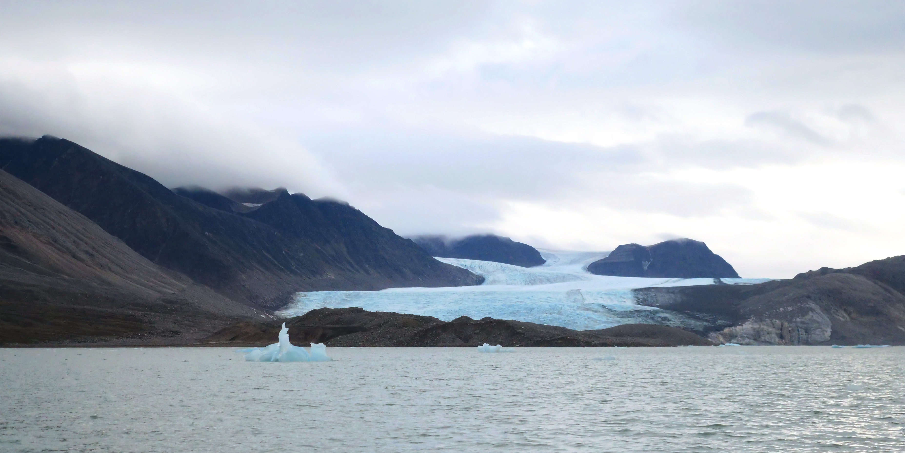
© Ministry of Climate and Environment
Notes:
This presentation is set against the backdrop of continued record-high temperatures in Norway and globally. As the Arctic warms at record speed, Norway's temperatures are outpacing the global average.
Our glaciers are retreating, and extreme weather events such as heavy rainfall, floods and landslides are becoming more frequent and more intense.
Norway is blessed with rich natural resources. Almost all electricity production comes from renewable energy sources, mainly flexible hydropower. As a result, Norway’s main mitigation challenge lies in reducing emissions in other sectors.

Slide 3
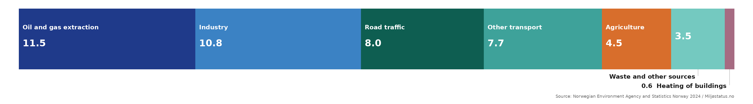
Norwegian Emissions in 2024
Total emissions in 2024: 44.6 million tonnes CO₂ equivalents
Emissions down 13% since 1990
Oil and gas, industry and transport are the largest sources of emissions
Notes:
Total greenhouse gas emissions in Norway were approximately 44.6 million tonnes of CO₂ equivalents in 2024, down from 46.6 million tonnes in 2023, excluding LULUCF. Emissions are cut 13 percent from 1990, and we expect this trend to continue.
This figure shows Norwegian emissions by sectors. The oil and gas sector, industry and transport are the main sources of emissions.

Slide 4
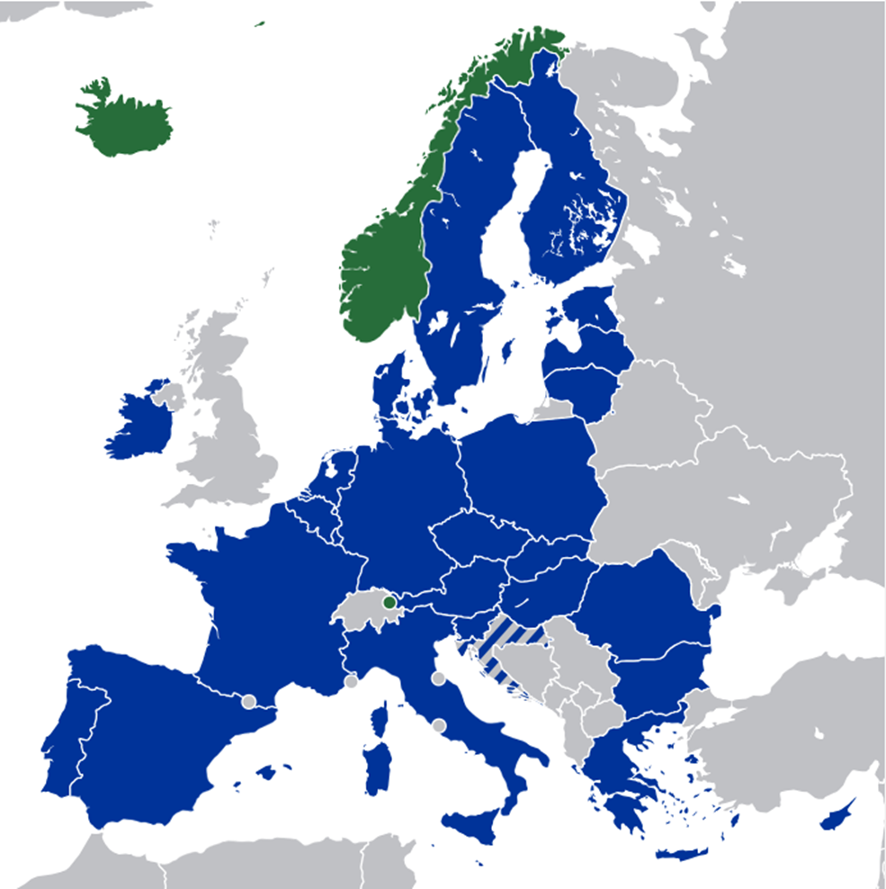
Norwegian climate policy is shaped at two levels
Domestic
European
How policy is set within Norway
How Norway is bound to EU policy
Parliament
Government
Municipalities
Sets the policy framework
Implements policies and measures
Deliver on the ground
EU
EFTA
EEA
27 member states set the rules
Iceland, Liechtenstein and Norway
European Economic Area agreement
Notes:
We have a democratic parliamentary system. The Storting – the Norwegian parliament – sets the overall framework for climate policy, while the Government is responsible for implementing and administering policies and measures.
Although Norway is not a member of the European Union, it is part of the European Economic Area. Through the EEA Agreement, Norway participates in the EU internal market and implements relevant EU legislation, including in the field of climate and environment.

Slide 5
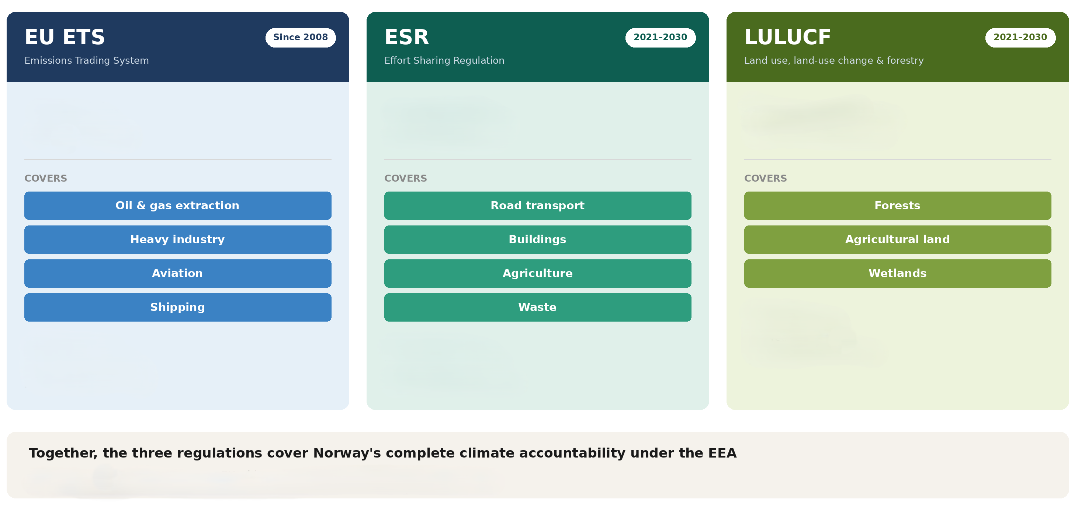
Three EU regulations cover Norway’s full emissions picture
Notes:
We cooperate closely with the European Union on climate policy and fulfil our targets under the Paris Agreement in cooperation with the EU and Iceland.
We participate in key elements of EU climate legislation for the period 2021–2030, including the EU Emissions Trading System, the Effort Sharing Regulation, and the LULUCF Regulation.
This framework is central to achieving Norway’s climate targets.
It is not yet clear whether this cooperation, together with additional measures in the LULUCF sector, will be sufficient to achieve the 2030 target. This partly depends on accounting rules, particularly for ETS cooperation.
We have therefore established a safety valve, the Norwegian Global Emission Reductions Initiative, which is an Article 6 cooperation with developing countries.

Slide 6
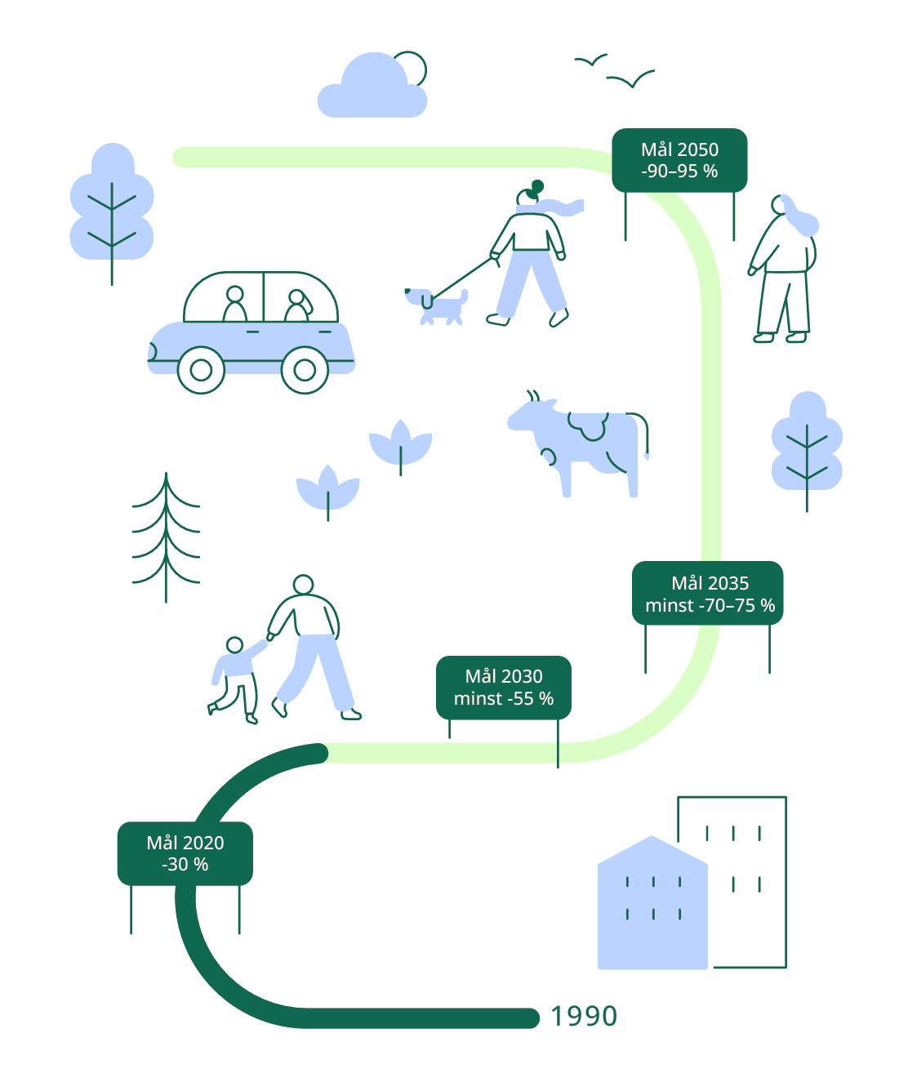
Norway’s climate targets are legally binding
Target 2050
-90–95 %
Target 2035
at least -70–75 %
Target 2030
at least -55 %
Target 2020
-30 %
Notes:
This slide presents Norway’s climate targets and the increasing level of ambition over time.
Norway overachieved both targets under KP1 - by 13 percentage points - and KP2 by 8.
Norway’s NDC for 2030 is to reduce emissions by at least 55 percent compared to 1990 levels.
Norway’s NDC for 2035 is to reduce emissions by at least 70–75 percent compared to 1990 levels.
Our long-term goal is to become a low-emission society by 2050, reducing emissions by 90–95 percent.
These targets are anchored in the Norwegian Climate Change Act.

Slide 7

Policies and measures
Key principles:
Cost-effectiveness and cross-sectoral policies
The polluter pays principle
Main instruments:
Combining pricing, regulation and support
Taxes on greenhouse gas emissions
Emissions trading (EU ETC)
Support for research and technology development, including through Enova.
Requirements and bans
Notes:
Cost-effectiveness and cross-sectoral policies are key principles of Norwegian climate policy. In addition, the polluter pays principle plays an important role, meaning that those responsible for emissions should bear the costs.
Norway has a comprehensive set of measures covering almost all greenhouse gas emissions.
In addition, Norway uses a range of other policy instruments to support the transition.
These include support for research and technology development, for example through Enova, which supports low-emission technologies and investments.
We also use regulatory measures and bans.
An example is the ban on fossil oil for heating in buildings and construction sites, which followed decades of carbon pricing and contributed to a full phase-out.

Slide 8
Carbon pricing is a central element
Gradual increase in the carbon tax to 2035
2 400 NOK per tonne in 2030
3 400 NOK per tonne in 2035
Carbon tax increased in 2026 to 1 639 NOK per tonne
Notes:
Carbon pricing is a central element of Norwegian climate policy.
CO₂ taxes and emissions trading together cover close to 85 percent of Norwegian greenhouse gas emissions.
Roughly half of emissions are covered by the EU Emissions Trading System, while the other half is subject to a CO₂ tax. The petroleum sector has both.
The diagram illustrates the distribution of emissions across these instruments.
A gradual increase in the carbon tax was signalled already in 2021, and the Government has proposed to increase the tax to NOK 3 400 per tonne by 2035.
While the overall direction is clear, some exemptions remain and certain sectors follow a slower trajectory.
Recent global developments have also led to temporary adjustments that affect the pace of implementation.

Slide 9

From fossil fuels to zero emission vehicles
98 percent of all new passenger cars sold in Norway are now zero emission.
Focus is now shifting to other transport segments
 | EV share 2025
 | Sales | Fleet
Vans | 45 % | 10 %
Trucks | 17 % | 4 %
City buses | 89 % | 26 %
Long distance buses | 32 % | 9 %
© Foto: Enova
Notes:
We have chosen to highlight two policies where there have been significant developments since we presented two years ago.
First: Zero emission vehicles. Norway’s decentralised settlement pattern and long distances give rise to a relatively high demand for transport, and transport accounts for a significant share of our emissions.
To address this, we implemented a wide range of measures, with carbon pricing and taxation as central instruments.
A key goal was that all new passenger cars should be zero-emission vehicles by 2025.
Strong incentives, particularly through the tax system, have driven a rapid increase in electric vehicle uptake. In 2025, zero-emission vehicles accounted for about 96 percent of new passenger car sales, and around 98 percent so far in 2026.
The focus is now shifting to other transport segments, where the share of zero-emission vehicles remains lower. As shown in the table, the share of zero-emission vehicles varies significantly across these transport segments, where also other measures than taxes are needed to get the necessary transformation in an early phase of technology implementation.

Slide 10
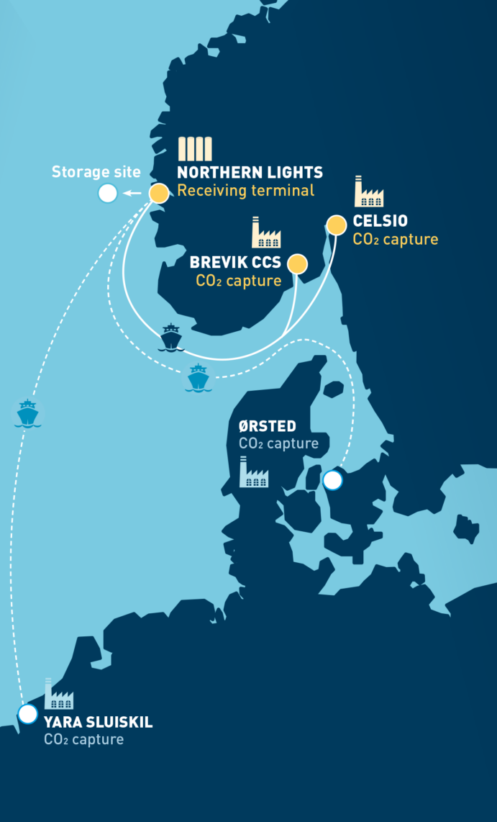
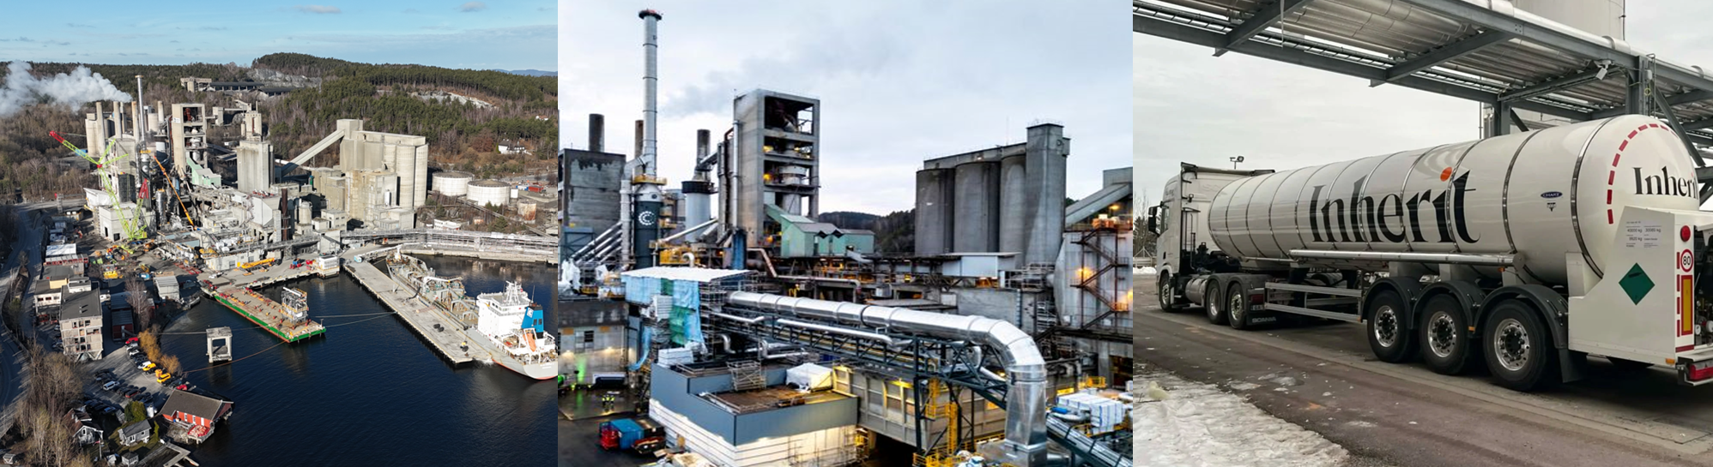
Carbon capture and storage
CCS in Norway since 1996
Longship is a full-scale CCS project
CO₂ capture, transport and storage through Northern Lights
Close cooperation between the Government and industrial partners
Operational from 2025
© Gassnova 2022
Notes:
Since 1996, CO₂ from natural gas production at the Sleipner field has been captured and stored below the seabed, and the Snøhvit project has been in operation since 2008.
Norway is now developing Longship, a full-scale CCS project covering capture, transport and storage.
The project includes CO₂ capture from industrial facilities and transport and storage through the Northern Lights project, and is developed in close cooperation between the government and industrial partners.
The project is now operational.
CO₂ is captured from industrial facilities, such as Heidelberg Materials’ cement plant in Brevik, which started operations in 2025, and a waste-to-energy plant in Oslo operating since a few weeks.
Additional projects are also being developed, including smaller-scale capture of biogenic CO₂, which is transported to storage.
Captured CO₂ is transported, by ship and pipeline, to the Northern Lights storage site on the Norwegian continental shelf.
The storage facility is designed to receive CO₂ from across Europe, and Northern Lights has already entered into agreements with industrial partners in several countries.
The project is being expanded, with increased storage capacity in a second phase.
Norway has also supported the development of CO₂ capture technology through the Technology Centre Mongstad, which has played an important role in enabling these large-scale projects.
We are also developing international cooperation, including bilateral collaboration with Switzerland on carbon capture and storage under Article 6 of the Paris Agreement.

Slide 11

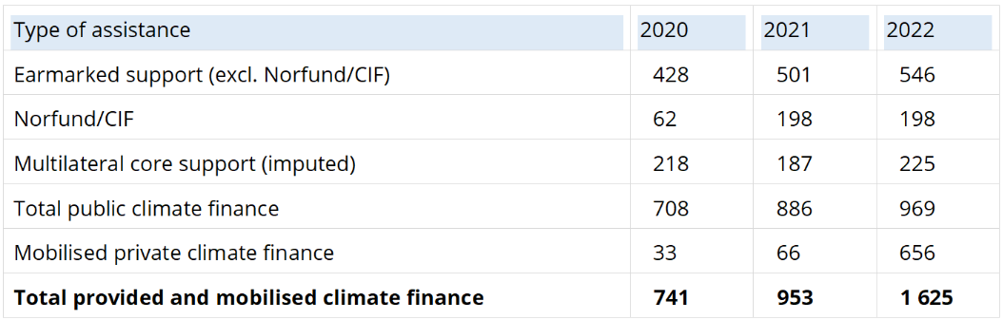
Financial support, technology transfer, and capacity building support
Notes:
Finally, I turn to how we track and report financial support, technology transfer and capacity-building.
Total climate finance provided and mobilised by Norway increased from 741 million USD in 2020 to 1.6 billion USD in 2022.
Most public climate finance is provided as grants, in addition to non-grant instruments through our agencies.
Norwegian climate finance is focused on forest and biodiversity, renewable energy, and climate adaptation.
Norway also supports technology development and transfer.
This work aims both to develop and implement new technologies domestically, and to share knowledge and experience internationally, including through initiatives such as CCS and clean energy partnerships.
At the same time, technology transfer remains difficult to measure systematically.
Norway provides extensive capacity-building support through international partnerships, sectoral programmes and climate funds such as the GCF, GEF and the NDC Partnership.
Key priorities include climate adaptation, food security and disaster risk reduction.
Norway remains committed to strengthening this work going forward and ensuring transparent and effective support for climate action.

Slide 12
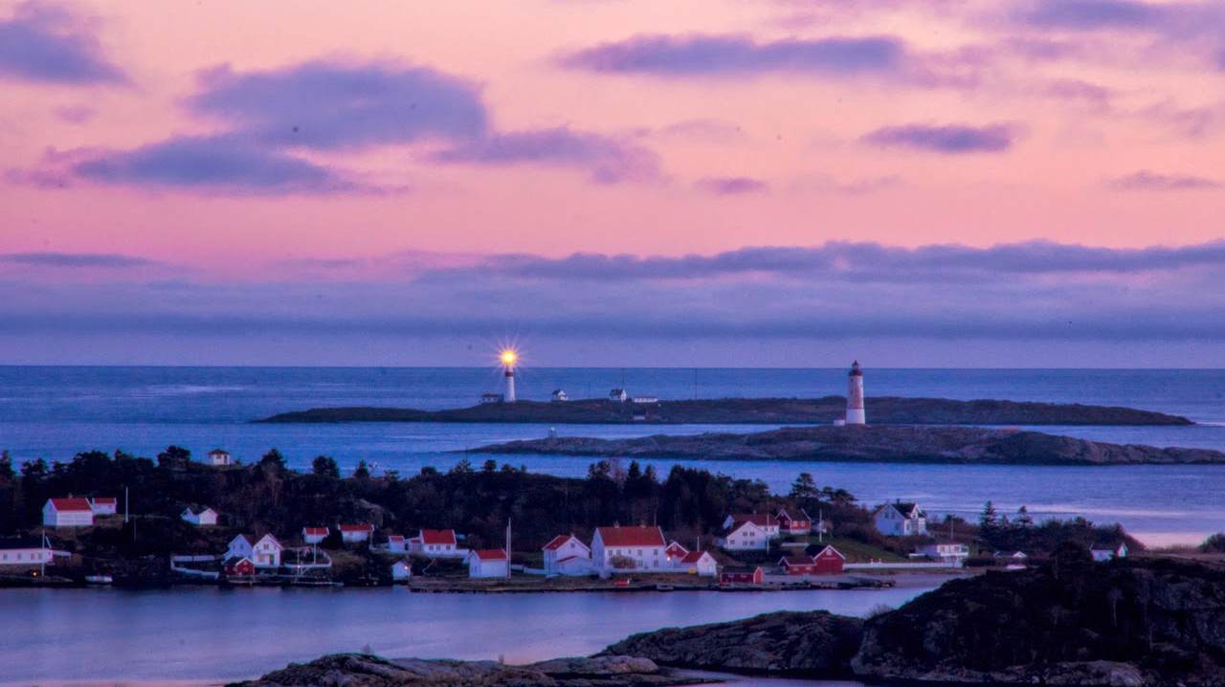

Photo: Jarle J. Kvam, 2014
Notes:
Thank you for your attention!

