Slide 1


Australia
Financing for domestic forest fire management
20 May 2025

Slide 2
We acknowledge the First Nations people of Australia, the Aboriginal and Torres Strait Islander peoples, who are the Traditional Owners of our country and one of the oldest surviving cultures in the world.
We recognise Indigenous Peoples of all nations and their continuing connection to land, waters and culture. We pay our respects to their Elders past and present, and all Indigenous Peoples with us today.

Slide 3
Overview – Fire management in Australia
Climate change increasing the severity and frequency of fires
Key components of fire management:
  Planning
  Hazard reduction/ preventative action
  Emergency response
  Recovery and rehabilitation
Native vegetation is fire tolerant or fire dependent – controlled burning an important fire prevention strategy
Fast Facts
3

Slide 4
Governance and funding
NATIONAL
Nationally signification environmental matters, international policy, coordination
National Emergency Management Agency
Australasian Council for Fire and Emergency Services
Federal departments (climate change/ environment, agriculture/ forestry etc.)
STATE AND TERRITORY*
Primary responsibility for land use and emergency management
New South Wales
- NSW Rural Fire Service
- NSW National Parks & Wildlife Service
- Forestry Corporation
- Fire and Rescue NSW
Victoria
- Forest Fire Management Victoria
- Office of Bushfire Risk Management
- Parks Victoria
Queensland
- Queensland Parks & Wildlife Service
- Queensland Fire Department
Western Australia
- Dept. of Fire & Emergency Services
- Dept. of Biodiversity, Conservation & Attractions
South Australia
- Dept. for Environment & Water
- SA Country Fire Service
- Forestry SA
Tasmania
- Tasmania Fire Service
- Parks & Wildlife Service
- Sustainable Timber Tasmania
Australian Capital Territory
- ACT Emergency Services Agency, ACT Parks & Conservation Service
Northern Territory
- NT Fire & Emergency Services, Bushfires NT, Regional Committees
LOCAL GOVERNMENTS
Primary responsibility for land use planning, also plays a role supporting collaboration with all fire agencies, community engagement, asset management
FUNDING
- Public funding (national and state/ territory)
- Levies (e.g. NSW Emergency Services Levy on insurance companies, local governments and foreign insured policy holders)
-
Market-based mechanisms (ACCU Scheme)
Voluntary community contributions
*List of relevant agencies is not comprehensive
4

Slide 5
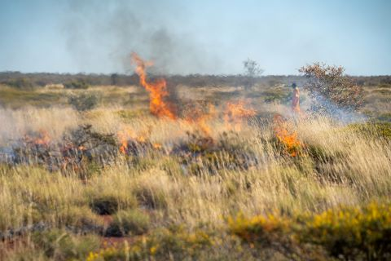
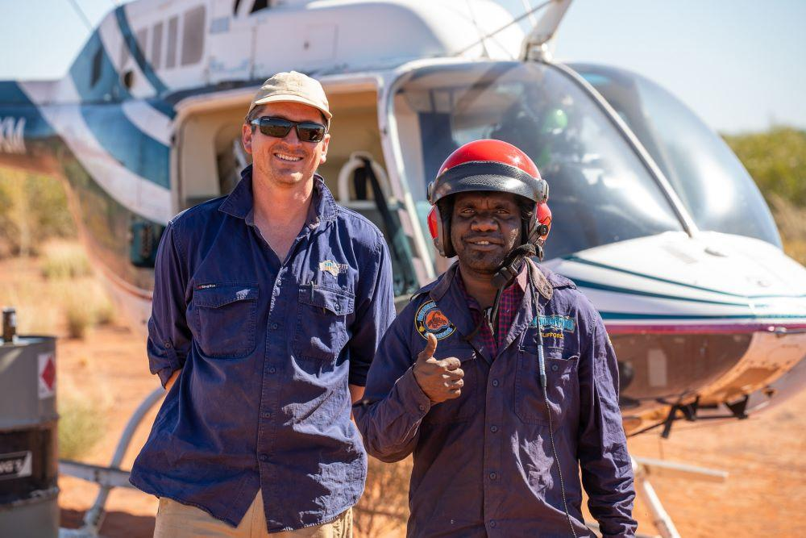
Case study:
Traditional methods of controlled burning (cultural burning)
Cultural burning maintains a traditional ecological practice that has worked effectively for tens of thousands of years.
The Australian Government helps to support cultural burning in savanna ecosystems is through the Australian Carbon Credit Unit Scheme.
Participants can earn a carbon credit unit for every tonne of CO2e stored or avoided – which can be sold on the domestic voluntary offsets market.
Savanna fire management methods abate around 1.2 Mt of emissions a year in Australia.
70% of all savanna fire management projects are Indigenous owned and operated.

Slide 6
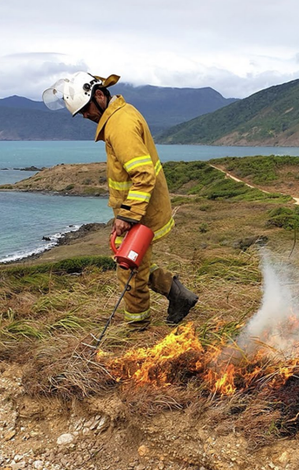
Case study:
Indigenous Protected Areas Program
The Indigenous Protected Areas Program supports First Nations people to lead land management work on their traditional land.
Management plans are developed to protect natural and cultural values – applying Traditional Knowledge and modern science. Cultural burning is a common management action.
Often delivered by Indigenous Ranger groups.
Public, grant-based funding from the federal government, utilizing competitive and non-competitive grand rounds.
Managed by Indigenous Organisations.

