Slide 1

Regional NAP Expo
Translating Belem Adaptation
Indicators into National MEL Systems
Climate Week 3 – Yeosu, Republic of Korea
Adaptation Committee

Slide 2

Session objectives
To identify practical approaches for integrating Belém Adaptation Indicators into national monitoring, evaluation and learning systems, with a focus on feasibility, usability and relevance for decision-making.

Slide 3
Agenda
Part II. Translating Belém Adaptation Indicators into National MEL Systems
Opening and framing
Framing inputs
Breakout groups
Closing

Slide 4

Lives, livelihoods, ecosystems, and economies face growing and interconnected risks
Moderator: Angela Rivera, Adaptation Committee
Presentations and Interventions:
Tiffany van Ravenswaay, Adaptation Committee
Mokoena France, LDC Expert Group Chair
Ju Yeon, KEI
Opening and framing

Slide 5
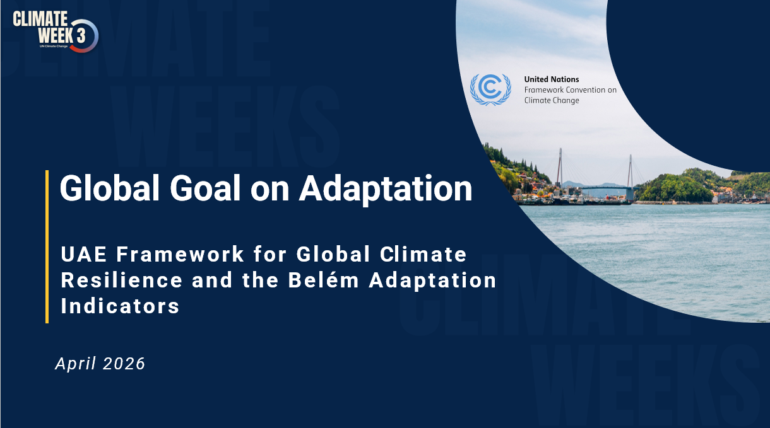
FRAMING OF SESSION 3.2
Adaptation Committee
Translating Belém Adaptation Indicators into National MEL Systems
By Tiffany van Ravenswaay, Adaptation Committee
  Venezia Hotel, Burano Hall (3rd Floor) - MR3
  Yeosu, Republic of Korea
  21 April 2026

Slide 6
Global goal on adaptation – a timeline (overview)
Establishes the Global Goal on Adaptation of enhancing adaptive capacity, strengthening resilience and reducing vulnerability to climate change, with a view to contributing to sustainable development and ensuring an adequate adaptation response in the context of the temperature goal referred to in Article 2.
Article 7.1 of the Paris Agreement
(2015)
Adopted the UAE Framework for Global Climate Resilience with 7 (seven) thematic targets and 4 (four) dimensional targets of the adaptation iterative cycle
Launched the UAE-Belém work programme on the indicators
CMA 5
(2023)
CMA 6
(2024)
Launched the Baku Adaptation Roadmap (BAR)
Provided further guidance and criteria relating to the indicators
Adopted Belém Adaptation Indicators (59 indicators)
Established the Belém-Addis Vision on Adaptation (BAVA)
Adopted activities for the 1st phase of the Baku Adaptation Roadmap (2026-2028)
CMA 7
(2025)

Slide 7


MEL in the current adaptation landscape
MEL systems support:
Tracking progress on adaptation
Informing policy and planning processes
Strengthening evidence-based decision-making
As implementation progresses, MEL systems are increasingly expected to:
Go beyond tracking activities
Support adaptive management and learning
2

Slide 8

Supporting Parties
The Adaptation Committee provides:
Technical support and guidance to Parties
Inputs to reporting, knowledge and learning processes
As requested by Parties, the AC:
Supports implementation of the UAE Framework for Global Climate Resilience
Contributes to improving adaptation-related reporting
Works in collaboration with:
Least Developed Countries Expert Group (LEG)
Consultative Group of Experts (CGE)
3

Slide 9

Ongoing work under the GGA
Parties are advancing work on:
Indicators to measure progress toward the GGA
This includes:
The Belém Adaptation Indicators under the UAE Framework
Ongoing technical work includes:
Improving methodologies and metadata
Identifying data gaps and synergies
4

Slide 10

Integration into national contexts
A key consideration is:
How indicators can be used within national systems
This involves:
Building on existing national processes, including NAPs
Strengthening monitoring, evaluation and learning systems
Ensuring relevance for national decision-making processes
5

Slide 11

Operationalizing indicators
This session aims to:
Identify practical approaches for integrating indicators into national MEL systems
Consider:
Feasibility and usability
Data availability and capacity needs
Facilitate exchange on:
Experiences, challenges and opportunities
6

Slide 12
Lives, livelihoods, ecosystems, and economies face growing and interconnected risks
Presentation/
Intervention:
Mokoena France, LDC Expert Group Chair

Slide 13
Lives, livelihoods, ecosystems, and economies face growing and interconnected risks
Presentation/
Interventions:
Ju Yeon, KEI

Slide 14


Lives, livelihoods, ecosystems, and economies face growing and interconnected risks
Interactive session:

Slide 15
Lives, livelihoods, ecosystems, and economies face growing and interconnected risks
Breakout discussions

Slide 16
Breakout discussions
Lives, livelihoods, ecosystems, and economies face growing and interconnected risks
Guiding questions:
What is the minimum viable MEL system needed to operationalize Belém Adaptation Indicators?
What are the most critical data gaps and realistic short-term solutions (2026–2028)?
How can MEL systems better inform policy, planning and investment decisions
Design principles:
Focus on practical, country-driven solutions
Prioritize interaction and peer exchange
Build on existing systems and improve iteratively
Emphasize decision-relevant and usable data

Slide 17
Lives, livelihoods, ecosystems, and economies face growing and interconnected risks
Plenary and Closing
Adaptation Committee

Slide 18


Adaptation Committee
E-mail: ac@unfccc.int ​
​
Important links​
AC: https://unfccc.int/Adaptation-Committee
Contact Details & Key links

