Slide 1


Fostering a shared understanding of Indigenous Peoples and local communities´ stewardship of forests
Fifth global dialogue and investment-focused event
under the Sharm el-Sheikh mitigation ambition and implementation work
programme
Juan Carlos Jintiach Arcos
Executive Secretary, the Global Alliance of territorial Communities (GATC)

Slide 2

GATC and IPLC in tropical Forests
Threats for our Forests
Indigenous agricultural systems and bioeconomy
IPLC participation at UNFCCC
Our Demands

Slide 3
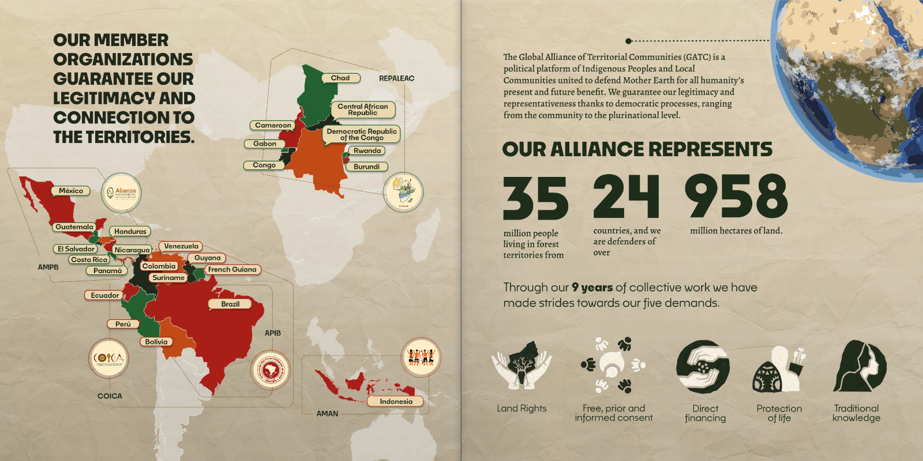

Slide 4
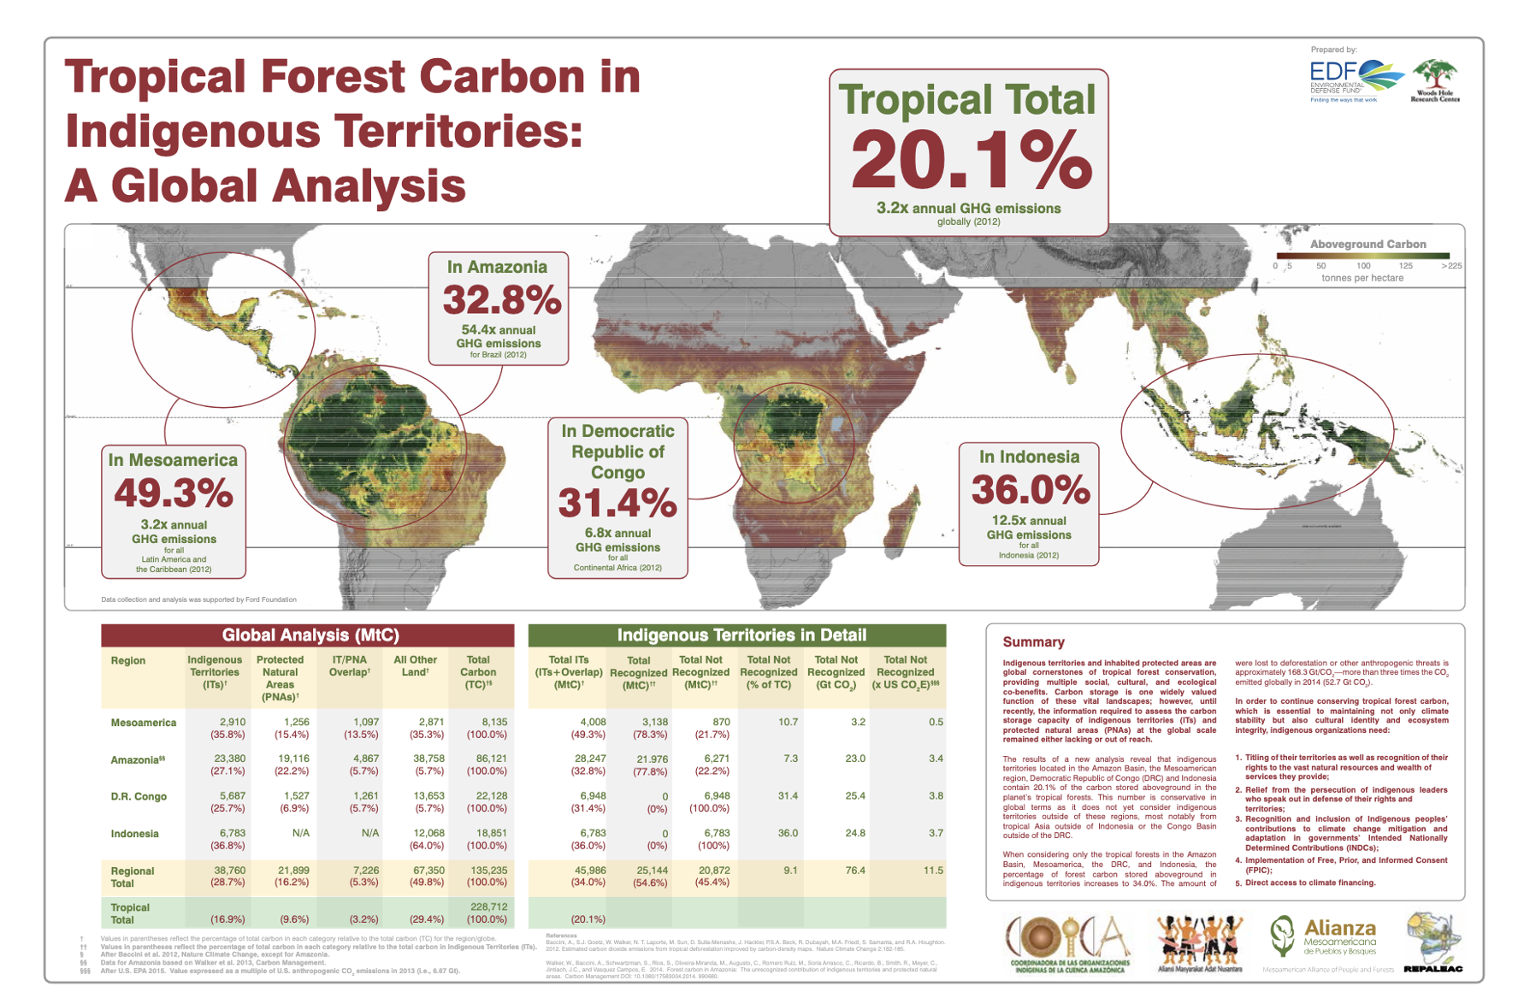

Slide 5
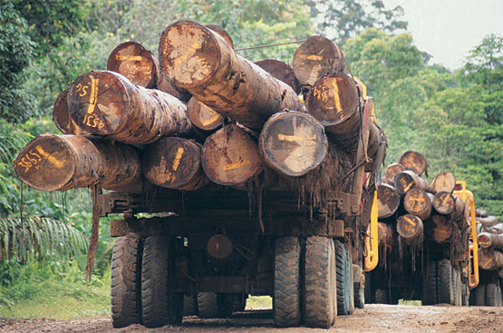
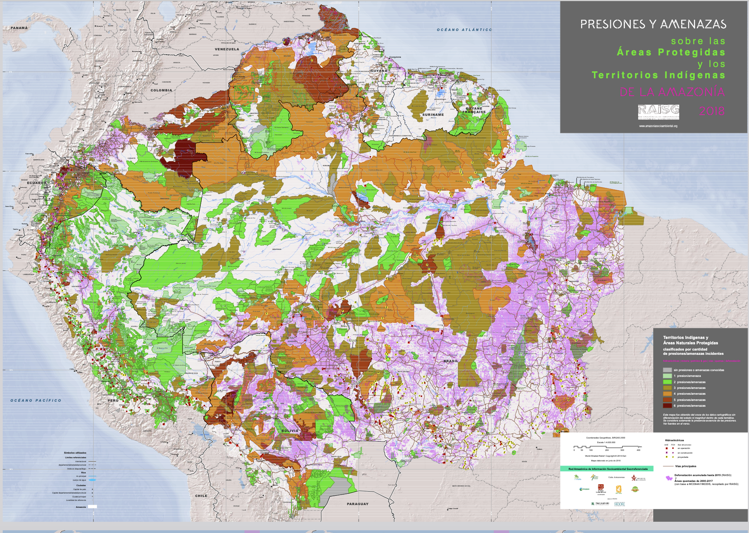
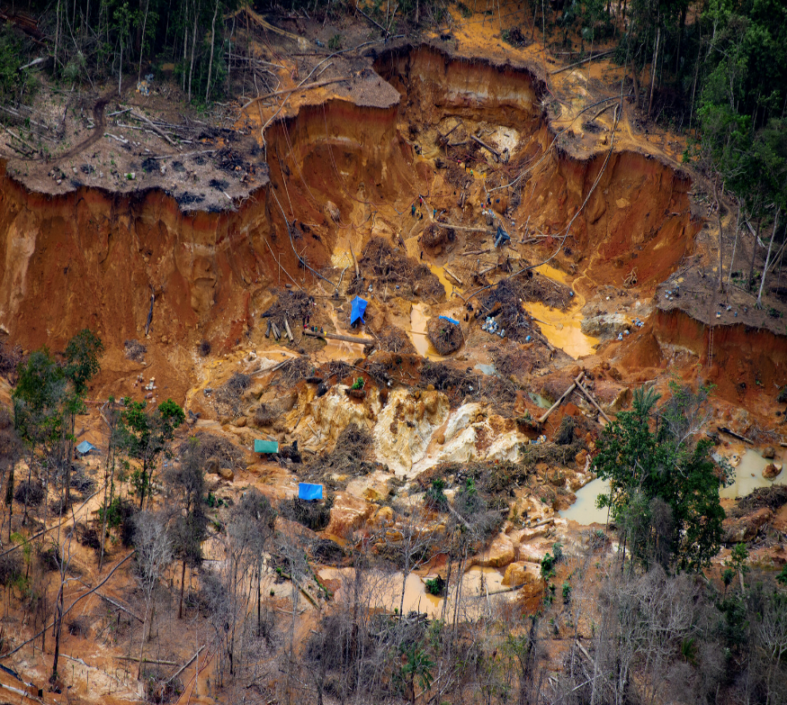
Threats for our Forests

Slide 6
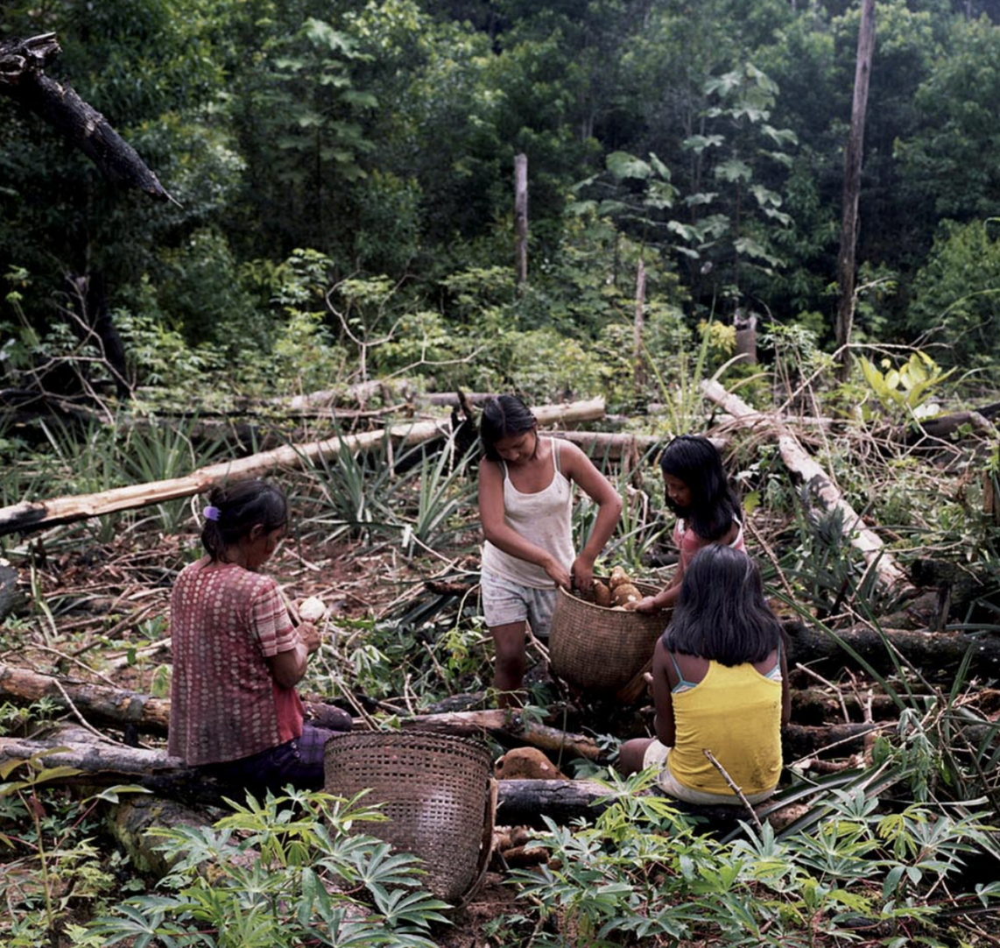
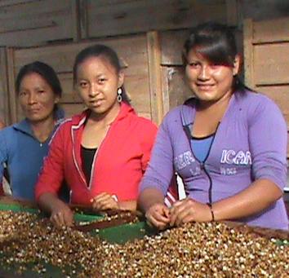
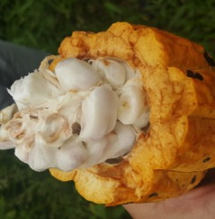
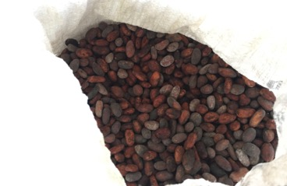
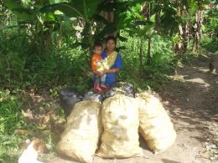
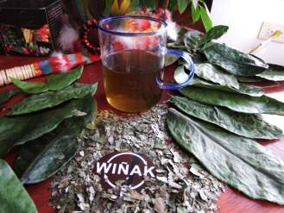
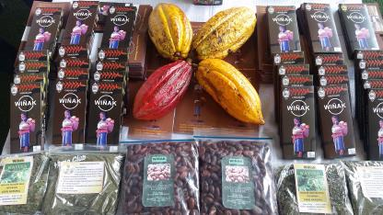
Indigenous agricultural systems and bioeconomy

Slide 7
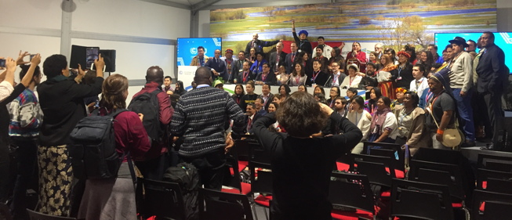
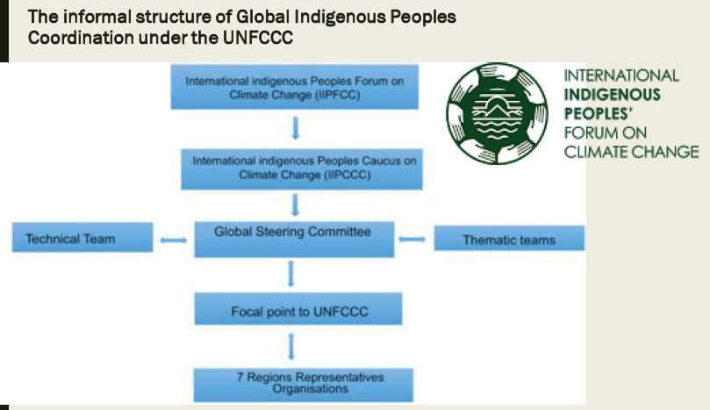
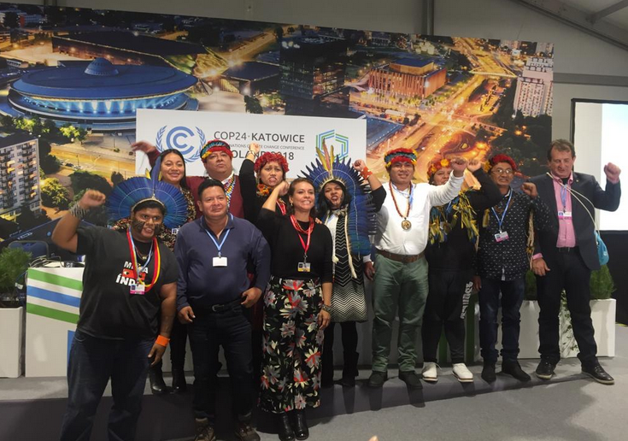
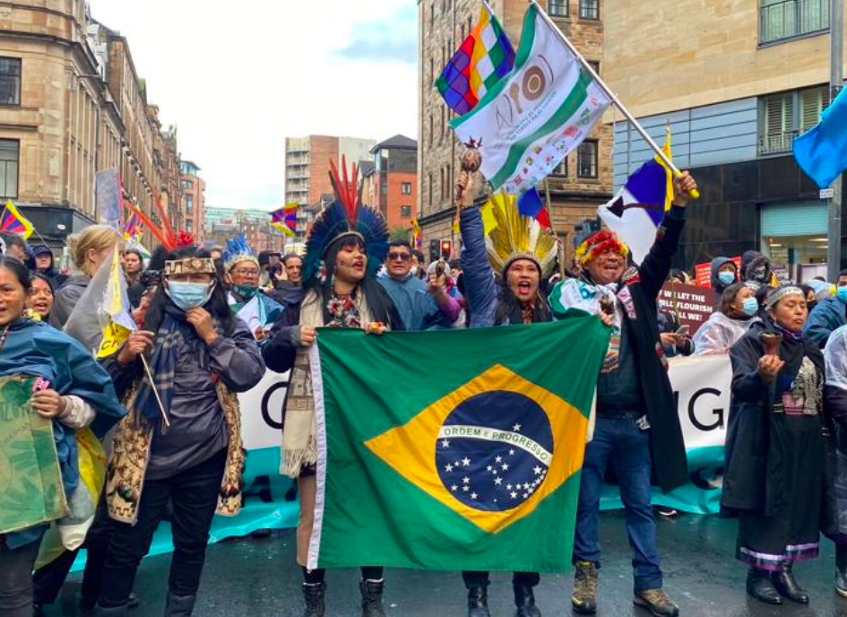
IPLC participation at UNFCCC

Slide 8
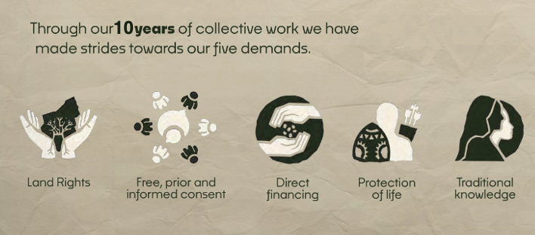
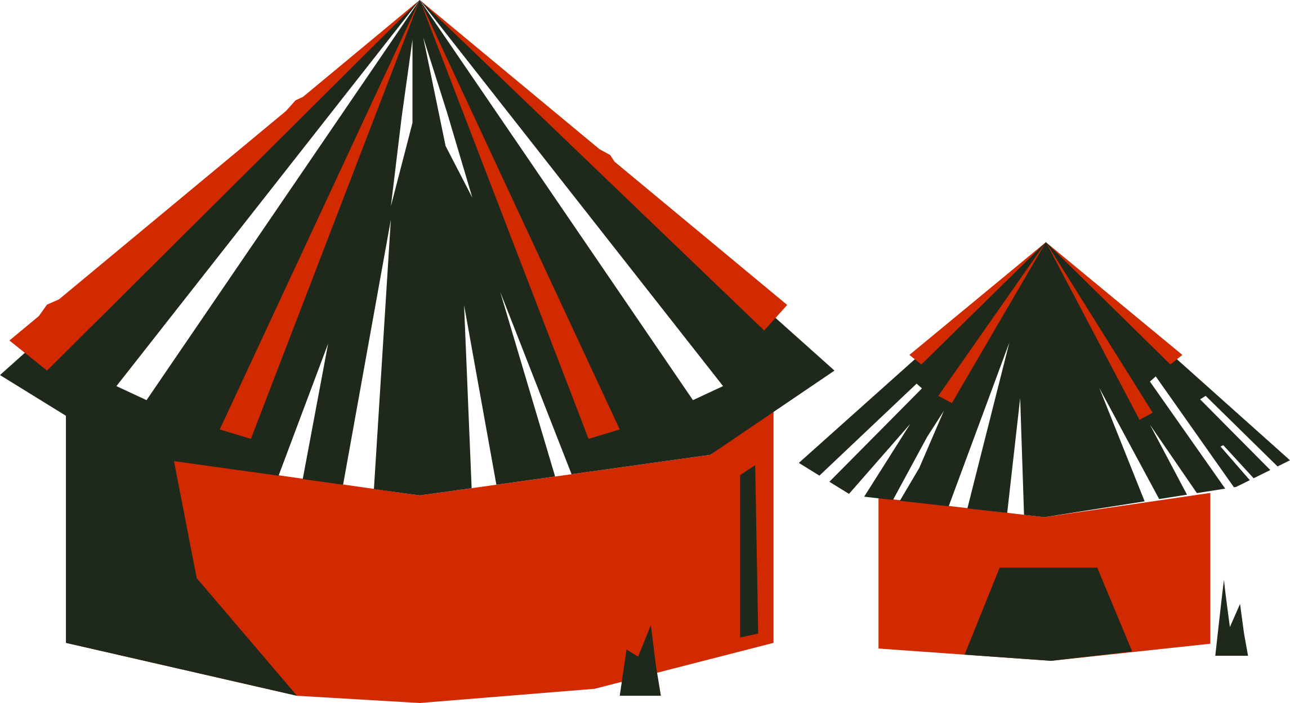

OUR DEMANDS
Consideration and Inclusion of IPLC contribution to mitigation, NDCs and framework
Loss and damage

Slide 9
THANK YOU - GRACIAS
Fifth global dialogue and investment-focused event
under the Sharm el-Sheikh mitigation ambition and implementation work
programme
Juan Carlos Jintiach Arcos
Executive Secretary, the Global Alliance of territorial Communities (GATC)

