Slide 1
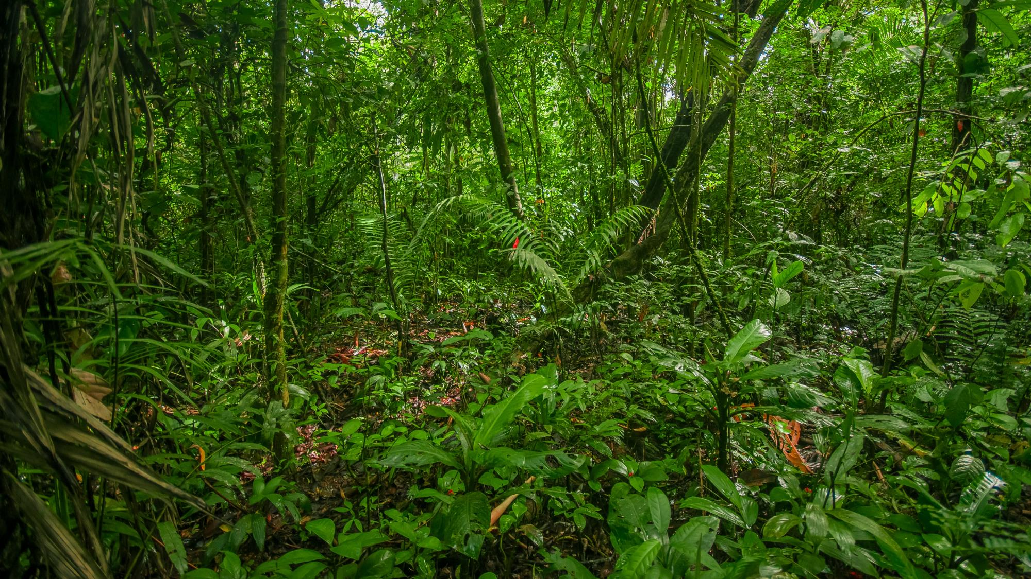

Fifth Global Dialogue and Investment-Focused Event
19-20 May 2025 | Panama City, Panama
Public Document
Managing Unit: AMA/DEFAM

Slide 2
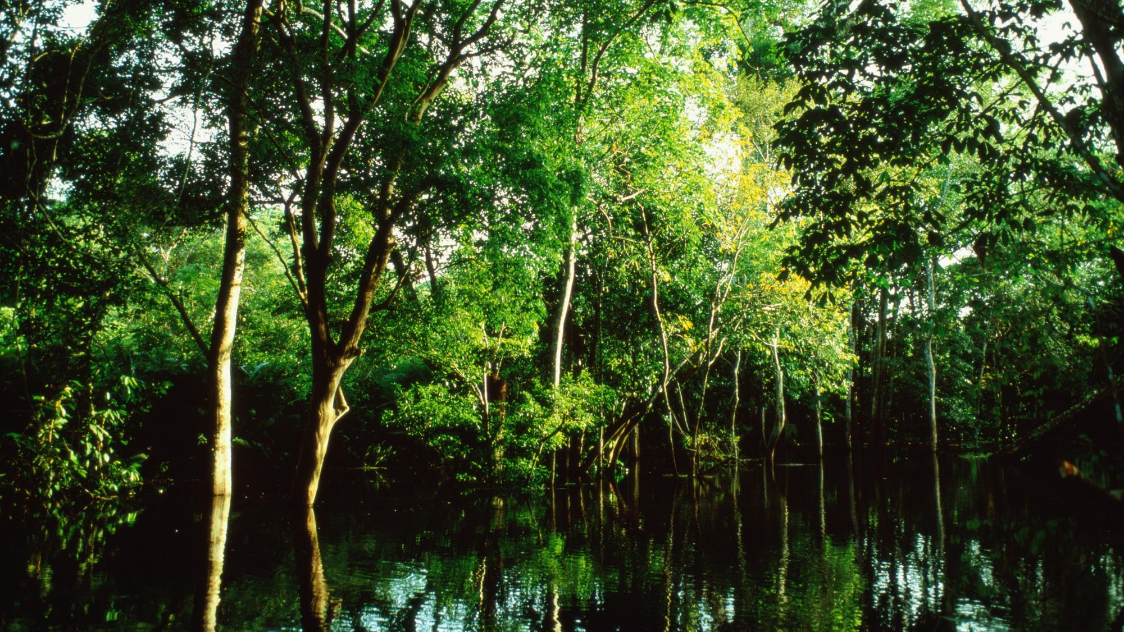
Amazon Fund – 17 Years of a successful initiative
Largest and most successful REDD+ initiative in the world (in terms of values ​​and results) – US$ 1,5 billions donations
Main concrete action for international cooperation on the agenda to combat deforestation in the Amazon
Most audited fund in Brazil
Public Document
Managing Unit: AMA/DEFAM

Slide 3


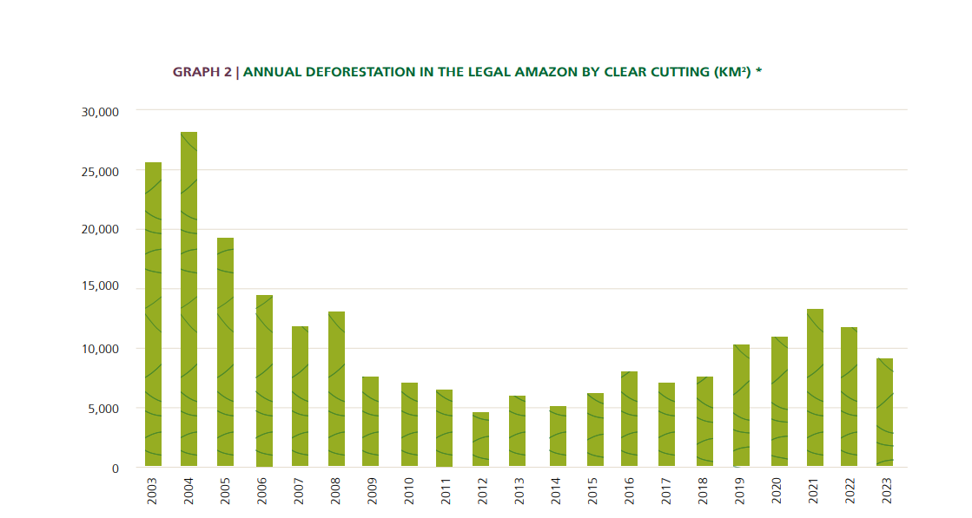
Deforastation rates (INPE)
PPCDAm Launch: 27.000
Amazon Fund
presented in COP13
12.000
- 1,2 Ton CO2
After 8 years
6.500
Brazil’s National Institute for Space Research (INPE)
Public Document
Managing Unit: AMA/DEFAM

Slide 4


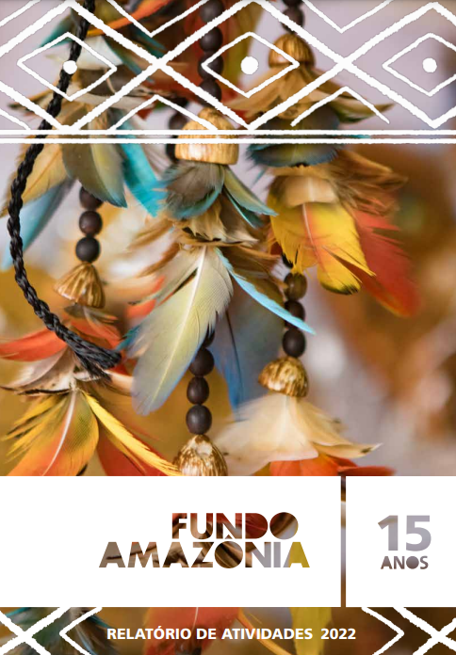


History
2004
2007
2008
2023
PPCDAM
Creation of the action plan for the prevention and control of deforestation on the Amazon region
COP13 UNFCCC
The Amazon Fund final concept presented by the Brazilian government to possible donors
Result based payments (REDD+)
Decree 6.527/2008
The Amazon Fund creation
Non-reimbursable support to prevention, command and control actions to fight deforestation and for sustainable use of biodiversity
15 years
Benchmark on climate financing
Main global initiative on REDD+
Fund-raising mechanisms
Fund governance
(manager and commitees)
Operation management (financial and project suport)
Reports and independent audit
Public Document
Managing Unit: AMA/DEFAM

Slide 5
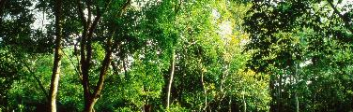
Amazon Fund Steering Committee
10
Federal Government
9
Amazon States
6
Civil Society
Ministry of Environment and Climate Change
Ministry of Development, Industry, Trade and Services
Ministry of Foreign Affairs
Ministry of Agriculture
Ministry of Agricultural Development and Family Agriculture
Ministry of Science, Technology and Innovation
Office of the President’s Chief of Staff
Ministry of Indigenous People
Ministry of Justice and Public Security
BNDES
Acre
Amapá
Amazonas
Maranhão
Mato Grosso
Pará
Rondônia
Roraima
Tocantins
National Confederation of Industry (CNI)
Coordination of the Indigenous Organization of the Brazilian Amazon (COIAB)
National Confederation of Agricultural Workers (CONTAG)
Brazilian Forum of NGOs and Social Movements for the Environment and Development (FBOMS)
National Forum for Forest-based Activities (FNABF)
Brazilian Society for the Progress of Science (SBPC)
5
Public Document
Managing Unit: AMA/DEFAM
Notes:
Passa pelo COFA tem participação o Social – povos indígenas – por ter suspendido a governança Bolsaonaro – ficou paralisado o Fundo doadores – proibiram novos projetos -

Slide 6
Restart 2023
New Strategy
Reestablishment of Governance
Re-creation of structure dedicated to the Amazon Fund
Reconstruction of public policy institutional framework
Determination of new guidelines for the application of Amazon Fund resources
Urgency, Scale e Impact:
Review and approval of interrupted projects
Construction and launch of public calls with initiatives linked to public policies covering the entire territory
Working in partnership with states and municipalities
6
Public Document
Managing Unit: AMA/DEFAM
Notes:
Resiliência e força dop instrumento

Slide 7
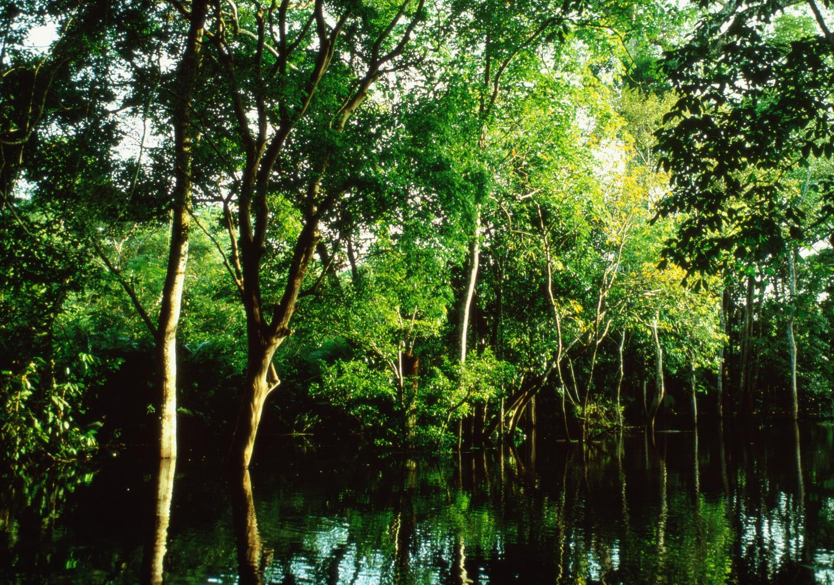
US$ 1,5 billion in donations
7
Public Document
Managing Unit: AMA/DEFAM

Slide 8
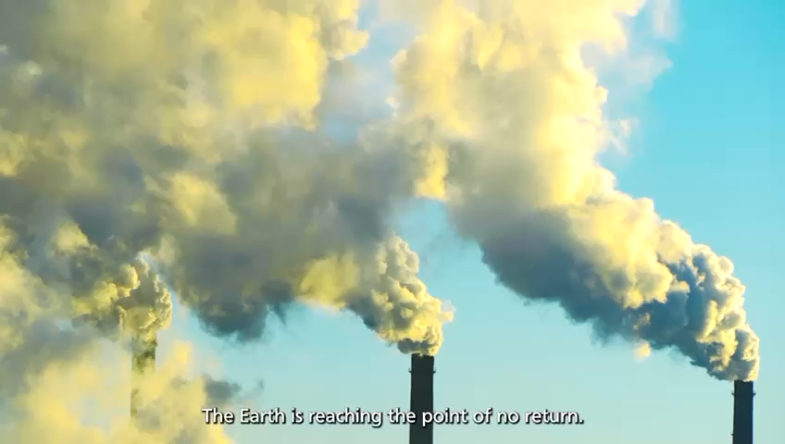


Slide 9
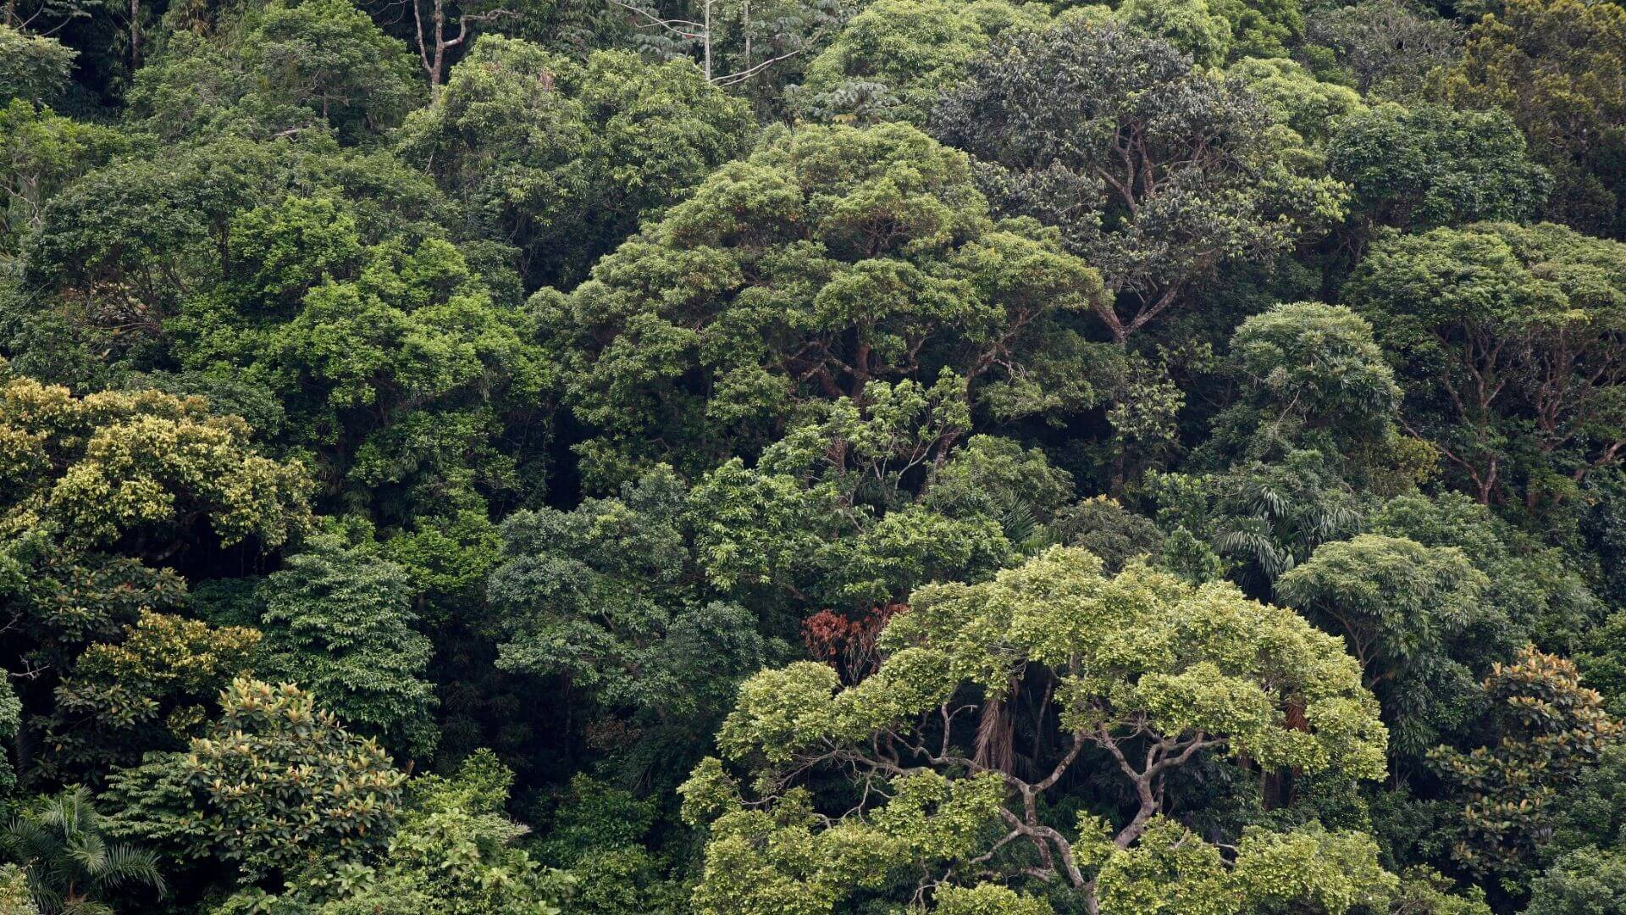

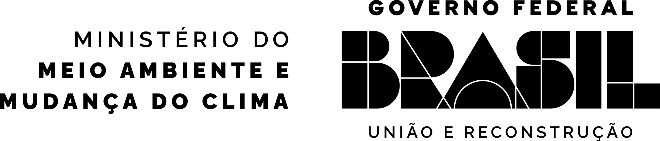
National Plan for the Recovery
of Native Vegetation (2025-2028),
and the Arc of Restoration 2050​

Slide 10
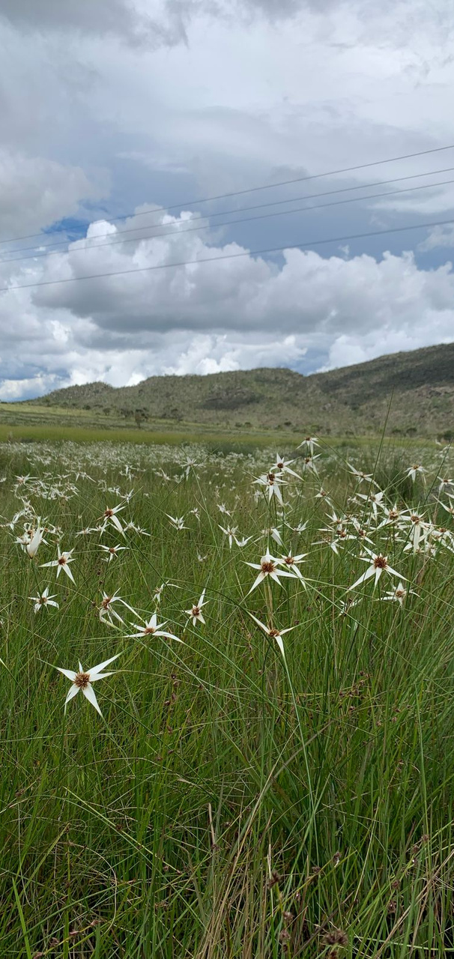
Guidelines
01
Raising awareness
02
Promoting the recovery production chain
03
Improving the regulatory environment for recovery with economic benefit
04
Expanding technical assistance
05
Structuring a spatial planning and monitoring system
06
Promoting research and innovation of recovery-related techniques

Slide 11
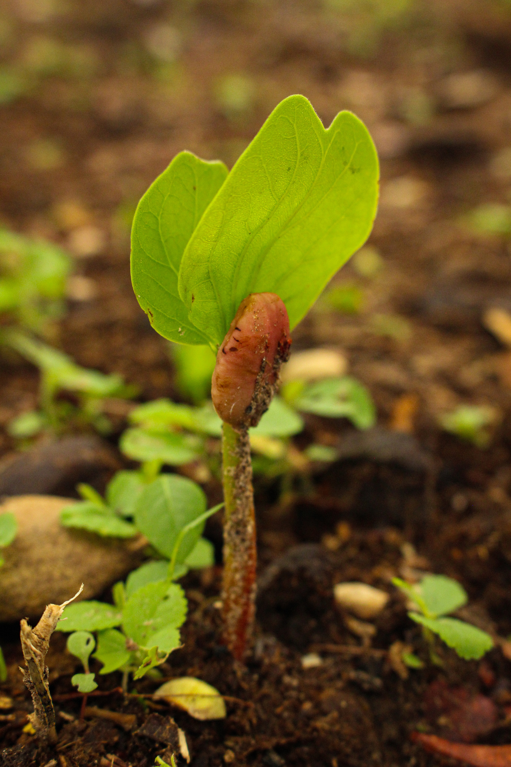

Cross-Cutting Strategies
Structuring and consolidating the agenda for the recovery of native vegetation, on its various fronts: monitoring, strengthening the supply chain, financing and research.
SPATIAL INTELLIGENCE AND MONITORING
SUPPLY CHAIN
RESEARCH, DEVELOPMENT and INNOVATION
FINANCE

Slide 12
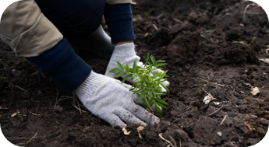
Implementation Clusters
Promote large-scale recovery (12 million hectares), contributing to other public policies in a coordinated manner across territories.
RECOVERY OF NATIVE VEGETATION IN PRIVATE AREAS
RECOVERY OF RURAL AREAS WITH LOW PRODUCTIVITY
RECOVERY OF PUBLIC AREAS

Slide 13
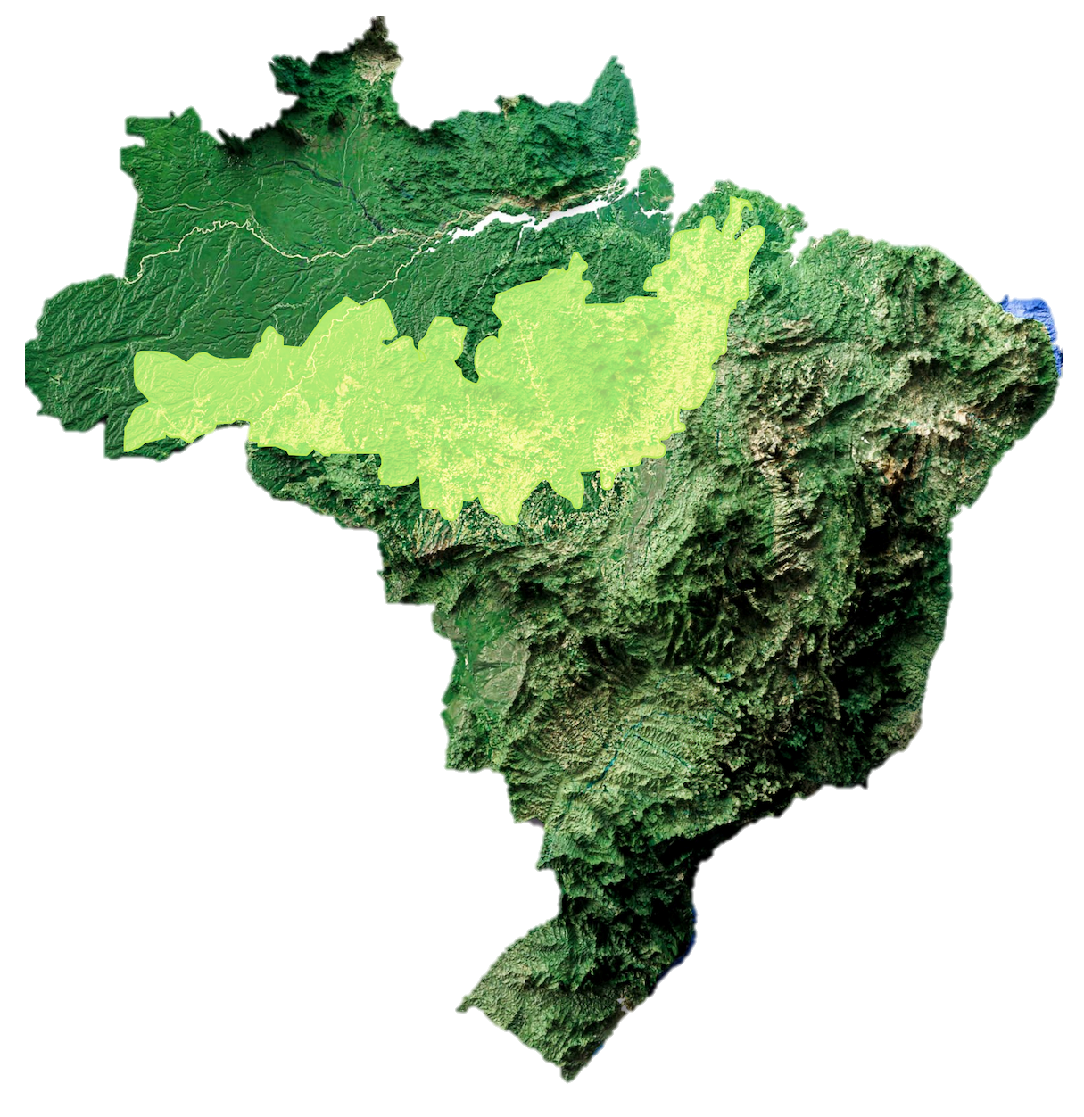
Arc of Restoration
Target: 24 million hectares by 2050
Phase 1 – up to 2030
Restore priority areas, starting with those less complex/costly: 6 million hectares
Investments: USD 10 billion (BRL 51 billion)
Phase 2 – 2030-2050
Restore 18 million hectares
Investments: USD 30 billion (BRL 153 billion)
1ST
Restore Amazon
USD 90 million (w/ resources from the Amazon Fund)
STEP

Slide 14
Restore Amazon (Amazon Fund)
3 Macroregions
1
2
3
Amazonas, Acre e Rondônia
(IBAM)
Mato Grosso e Tocantins
(FBDS)
Pará e Maranhão
(CI Brazil)
7 states and 50+ municipalities involved
TERRITORIES
Conservation Units (less complex and lower restoration costs)
Indigenous & Local Communities Lands (communities in the restoration chain)
Agrarian Reform Settlements (focus on productive restoration)
Family Farming Properties (Forest Code and productive restoration)
Undesignated public areas

Slide 15
3 Public calls launched
Conservation units
Investment: USD 20 million (50% BNDES, 50% PETROBRAS)
Target: 4500 hectares
Indigenous and Local Communities Lands
Investment: USD 20 million
Target: 5400 hectares
Agrarian Reform Settlements
Investment: USD 30 million
Target: 5400 hectares

Slide 16


Financing the Arc of Restoration
Countries
Multilaterals
Capital Markets
Donations
Financing
Amazon Fund
Climate Fund
Non-reimbursable projects
Financing
(hedge from treasury)
Conservation units
IPLC Lands
Family Farming areas
...
Rural producers
Productive forests
Companies
16
Public Document
Managing Unit: AMA/DEFAM

Slide 17
Challenges
scale
storage limitations
new KPIs
land tenure
environmental crimes
Opportunities
new value chains
bioeconomy
socioeconomic inclusion
synergies between the Rio Conventions

Slide 18









Increased Credibility – Since 2023
New Contracts - US$ 270 Million
USD 206 Million internalized
Pledges of New Donations - estimate
USD 143 Million
United Kingdom
USD 104 Million*
Norway
USD 60 Million
Norway
USD 50 Million
United Kingdom
USD 45 Million
United States
USD 53 Million
European Union
USD 22 Million
Germany
USD 38 Million
Denmark
USD 22 Million*
Ireland
USD 16 Million
Switzerland
USD 6 Million
Japan
USD 3 Million
18
Public Document
* Estimated values, partially disbursed to the Amazon Fund
Managing Unit: AMA/DEFAM
Public Document
Managing Unit: AMA/DEFAM

Slide 19
Donations to the Amazon fund – 15 years
–Nominal value
US$ 254 MM
*
* Includes US$ 38 million contracted on 12/22/22 under the coordination of the Lula Government
Values ​​considered in the year of signing of the respective contracts
19
Public Document
Managing Unit: AMA/DEFAM

Slide 20

Amazon Fund Logical Framework
Sustainable Production Activities
Environmental Monitoring and Control
Science, Innovation and Economic Instruments
Land use Planning
Public Document
Managing Unit: AMA/DEFAM

Slide 21

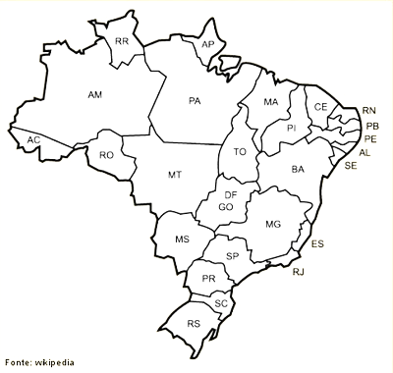
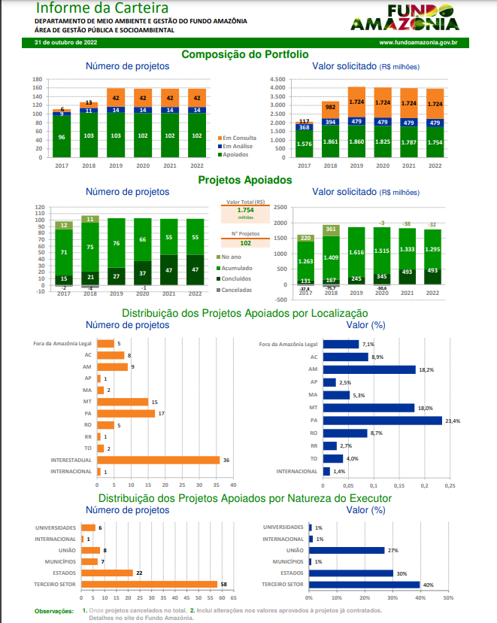
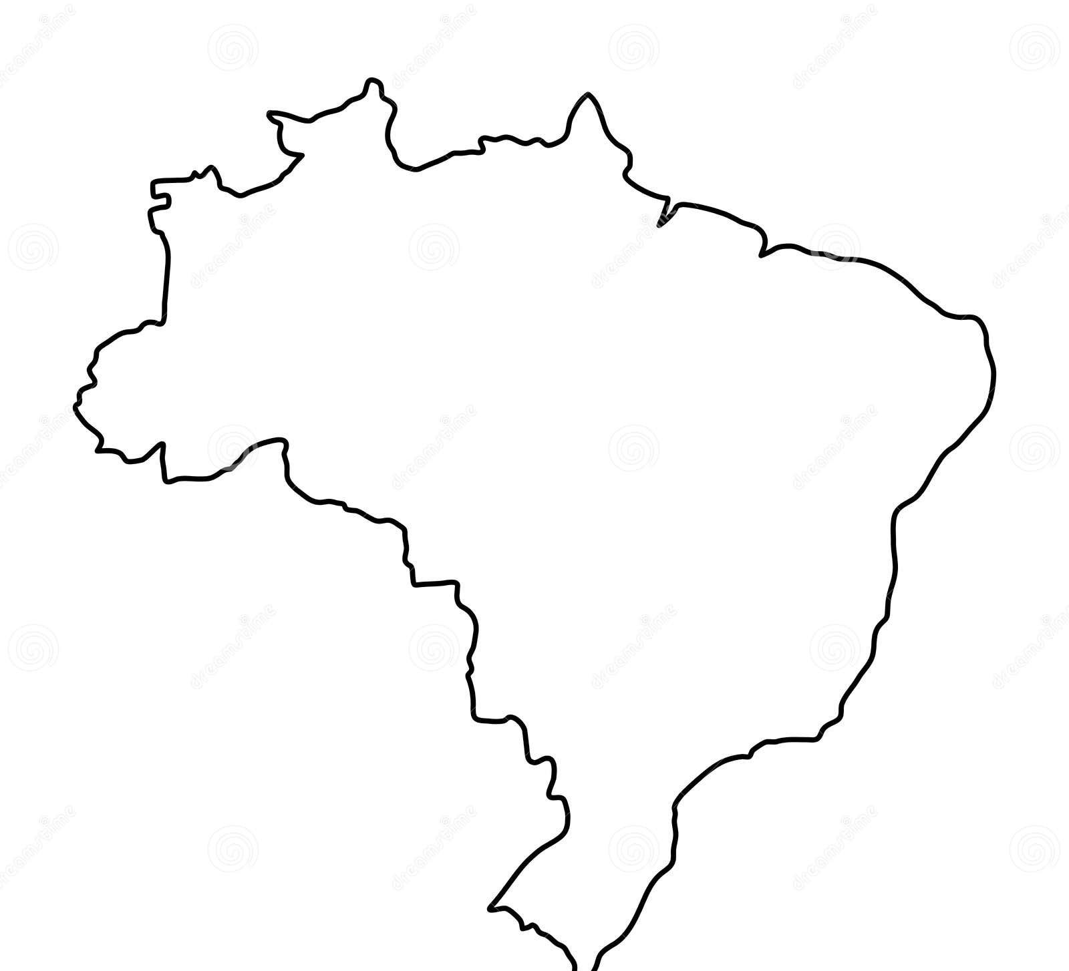

124 projects supported
US$ 920 million
support
US$ 676 million disbursed
Portfolio
2
2
3
1
11
18
10
16
6
2
1
1
1
1
48
1
21
Public Document
Managing Unit: AMA/DEFAM

Slide 22
Policies for the future: initiatives and projects that promote
The conservation of sociobiodiversity, with improvements on the quality of life.
The environmental Governance strengthening
The improvement of prevention and control of deforestation and fires on native vegetation
22

Slide 23
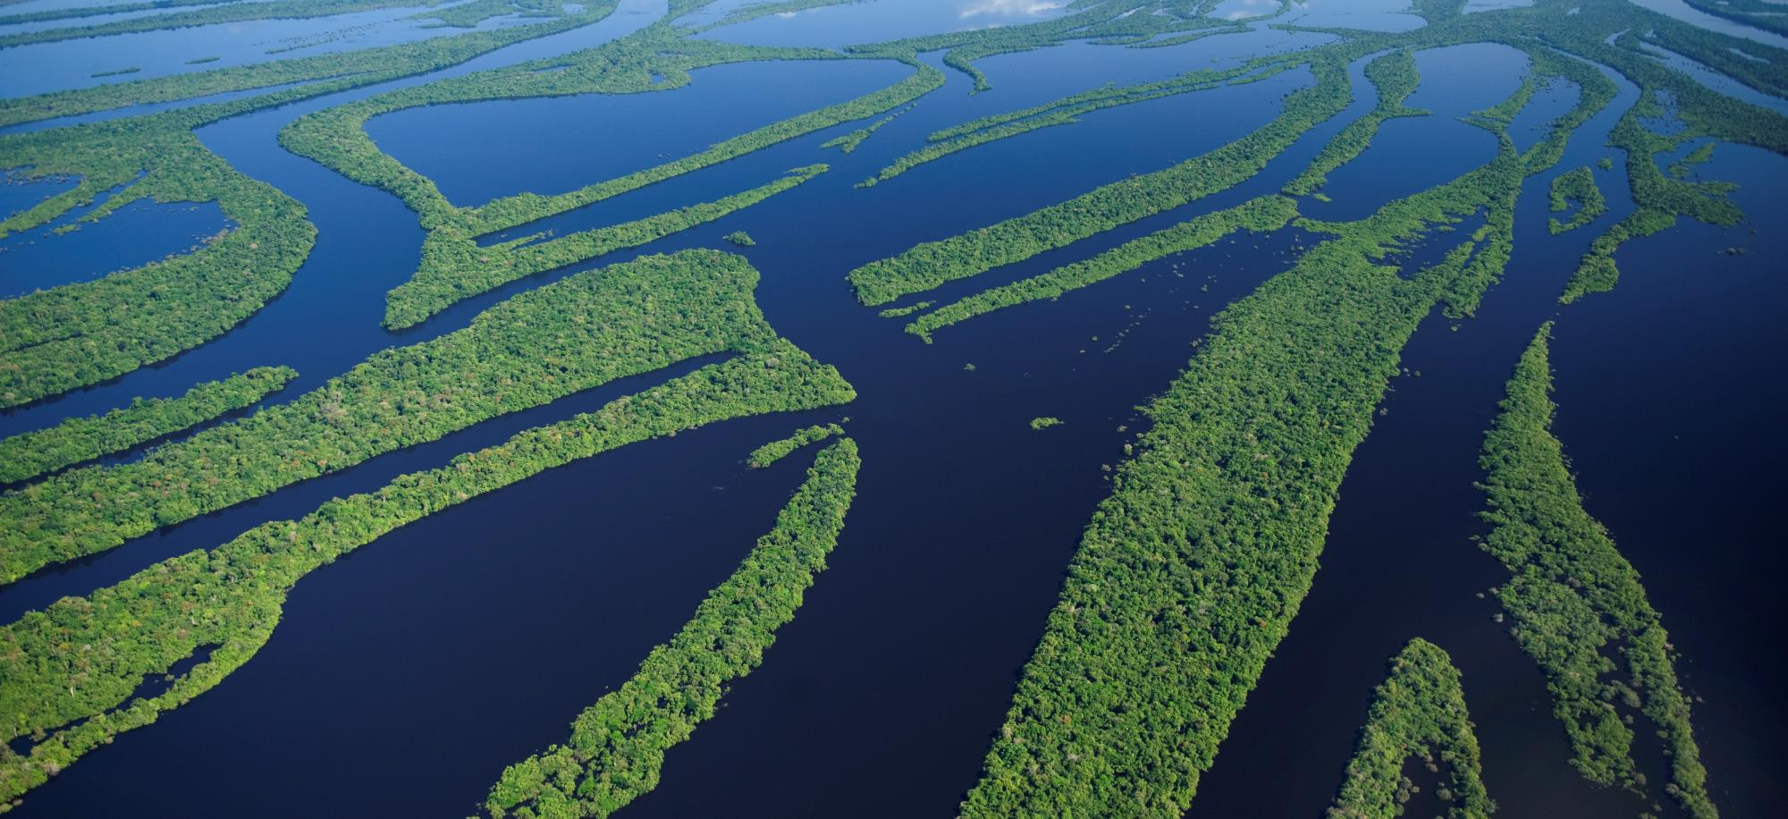
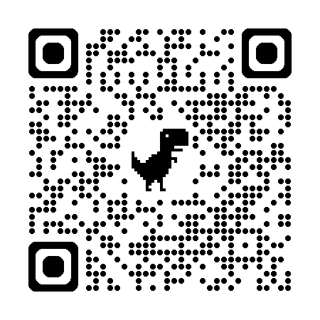
Brazil protects it. The world supports it. Everyone wins.
All information about the Amazon Fund, Project supported, public calls, are available at
www.fundoamazonia.gov.br
Public Document
Managing Unit: AMA/DEFAM

