Slide 1
SR1.5, October 2018
SRCCL, August 2019
SROCC, September 2019
WGII: Avoiding Impact (Severity) guiding AMBITION in Mitigation and Adaptation
Hans-O. Pörtner, Co-Chair IPCC WGII AR6
IPCC 6th Assessment Cycle: 3 Special Reports released
between October 2018 and September 2019

Slide 2
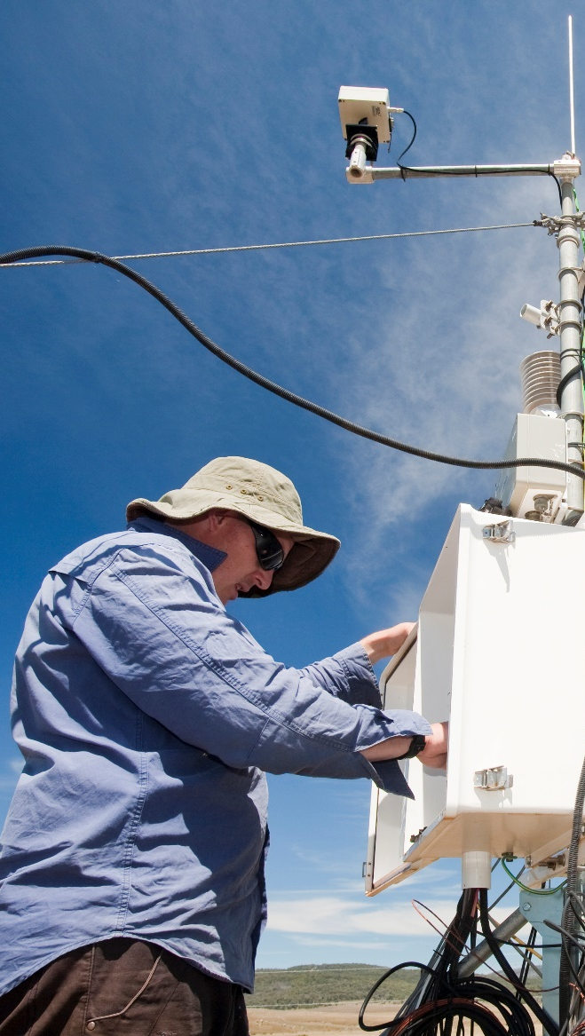
SR1.5
Where are we?
Since pre-industrial times, human activities have caused approximately 1.0°C of global warming.
Already seeing consequences for people, nature and livelihoods
At current rate, would reach 1.5°C between 2030 and 2052
Past emissions alone do not commit the world to 1.5°C
Ashley Cooper / Aurora Photos

Slide 3
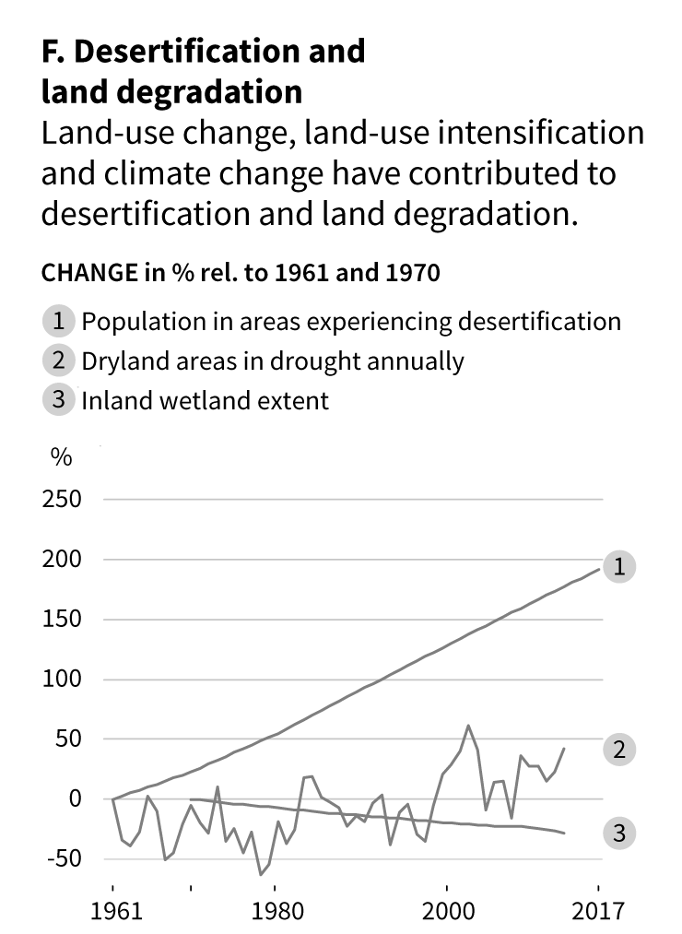
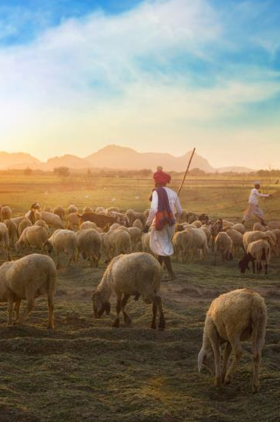
SRCCL
Drylands currently cover about 46.2% of global land and are home to 3 billion people.
Current
background:
unsustainable
uses of land
Population in drylands
Dryland in annual drought
SRCCL PM Figure 1 – F
Wetland

Slide 4
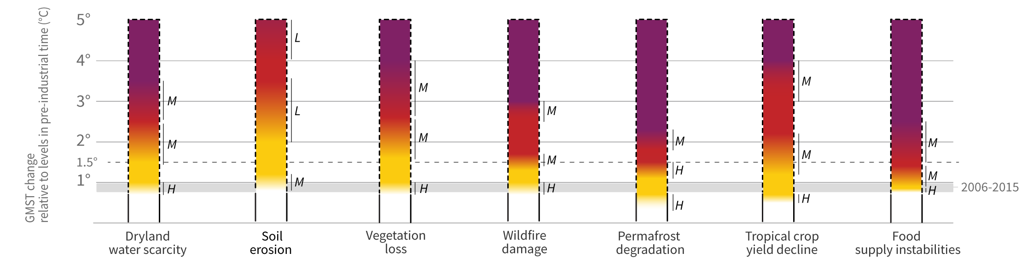

Risks to humans and ecosystems from changes in land-based processes as a result from climate change
SRCCL
2.0°C
1.5°C
Level of additional impact/risk due to climate change
Human food security is at stake
Very high
High
SPM Figure 2 – A
Moderate
Undetectable
Notes:
A NOTE REGARDING BURNING EMBERS FIGURES:
The concept of the embers can be difficuly to explain succinctly to those not familiar with the it. Suggestion: anyone presenting the burning embers would be to show the legend (and time permitting the worked examples) before showing the embers.

Slide 5
SROCC in a nutshell
…on 80 % of the earth surface climate change affects the life sustaining systems - from the top of the mountains to the depth of oceans. These changes will continue for generations to come.
TS.2
Current background: unsustainable ocean uses

Slide 6

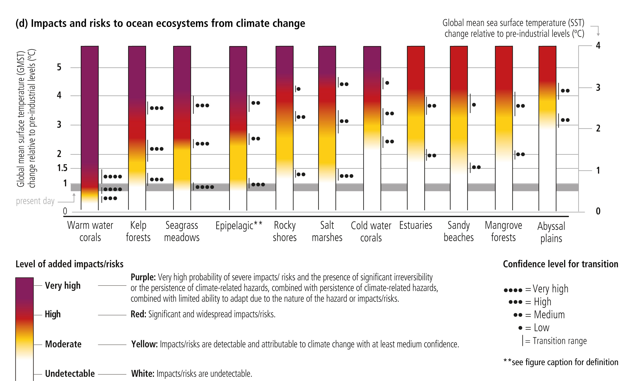
Ocean and coastal ecosystems: future risks
SROCC
Ecosystems would benefit from ambitious mitigation
2.0°C
1.5°C

Slide 7
+2.4°C
SROCC
RCP 4.5
Marine biodiversity projections
Drivers of change:
Warming and velocity....
RCP4.5 versus 8.5
Ultimate Species Heat Limits surpassed in Tropics
+4.3°C
Garcia-Molinos
et al. 2015,
2017 NCC
RCP 8.5
Projections: Large changes in community composition expected driven by local invasions and losses

Slide 8
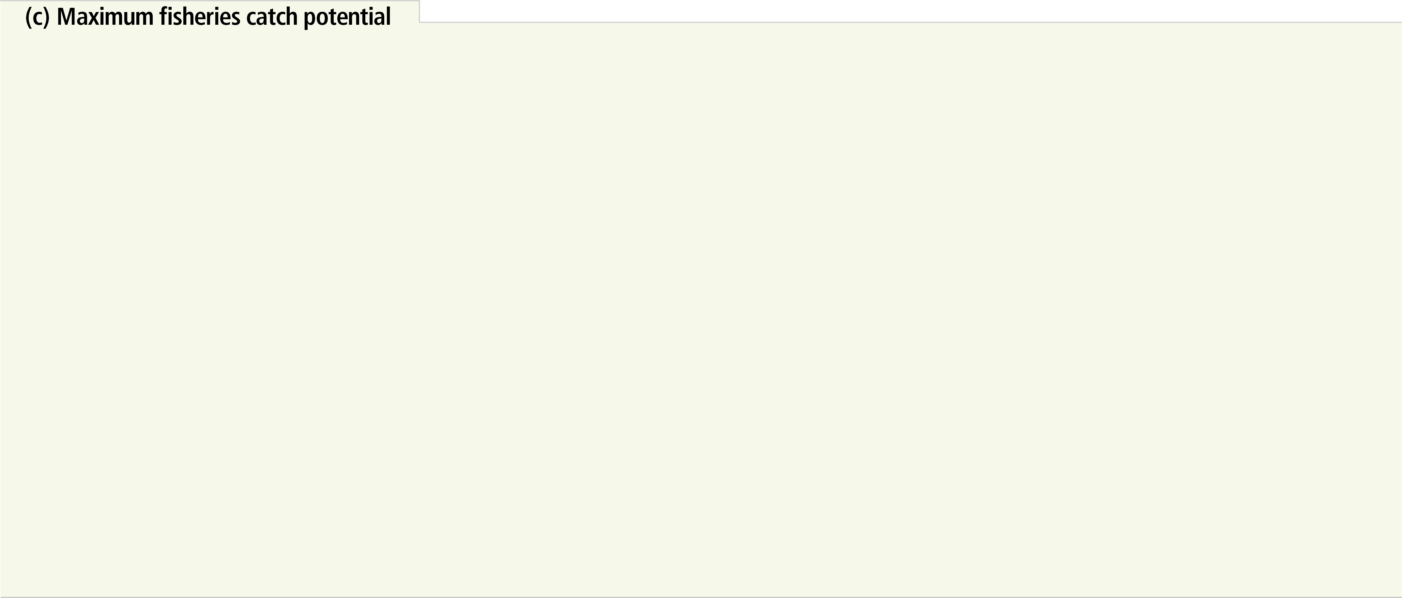
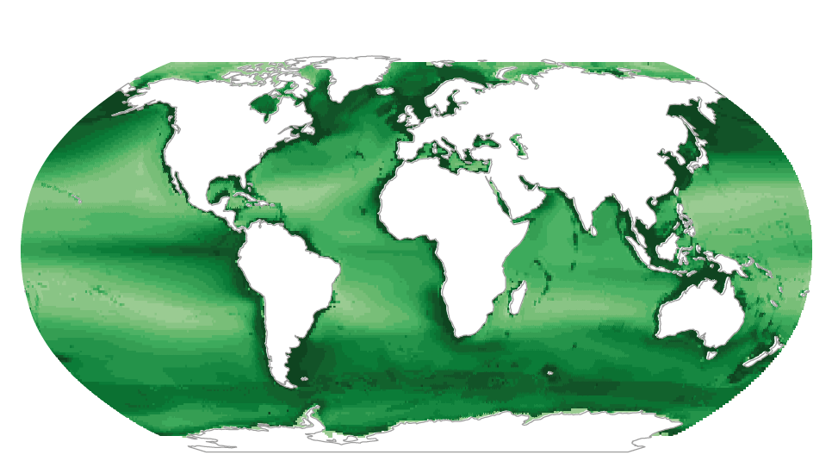
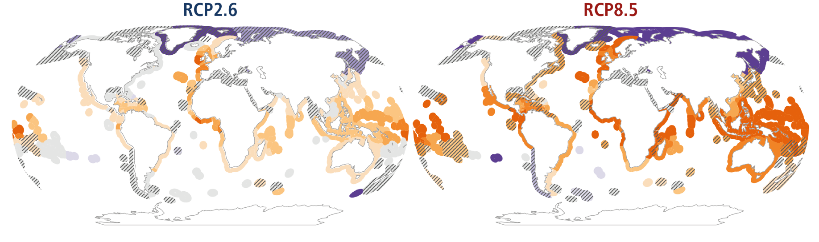
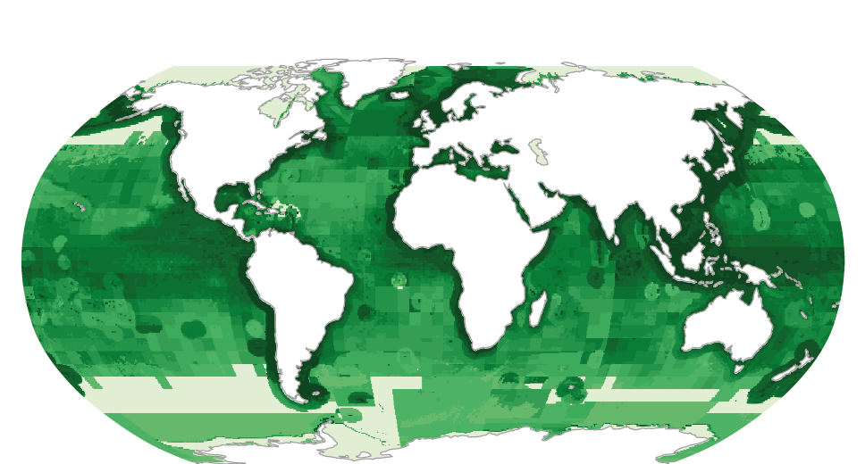
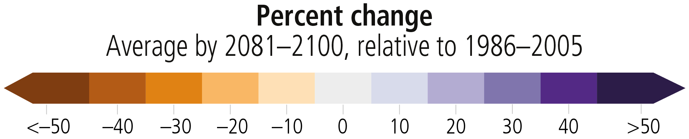
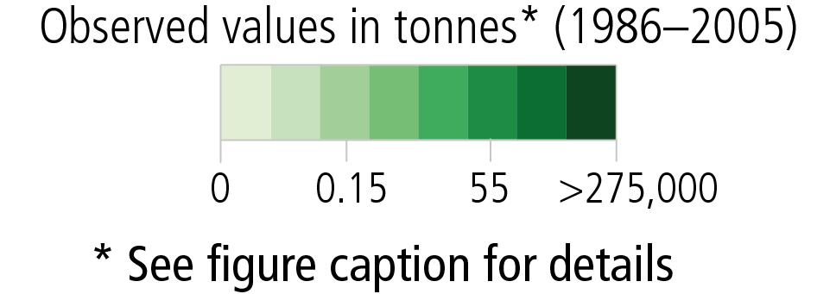

fisheries
+1.5°C
+4°C
~
~
Notes:
Figure SPM.3 | Projected changes, impacts and risks for ocean regions and ecosystems: a) depth integrated net primary production (NPP from CMIP527), b) total animal biomass (depth integrated, including fishes and invertebrates from FISHMIP28), c) maximum fisheries catch potential and d) impacts and risks for coastal and open ocean ecosystems. The three left panels represent the simulated (a,b) and observed (c) mean values for the recent past (1986–2005), the middle and right panels represent projected changes (%) by 2081–2100 relative to recent past under low (RCP2.6) and high (RCP8.5) greenhouse gas emissions scenario {Box SPM.1}, respectively. Total animal biomass in the recent past (b, left panel) represents the projected total animal biomass by each spatial pixel relative to the global average. c) *Average observed fisheries catch in the recent past (based on data from the Sea Around Us global fisheries database); projected changes in maximum fisheries catch potential in shelf seas are based on the average outputs from two fisheries and marine ecosystem models. To indicate areas of model inconsistency, shaded areas represent regions where models disagree in the direction of change for more than: a) and b) 3 out of 10 model projections, and c) one out of two models. Although unshaded, the projected change in the Arctic and Antarctic regions in b) total animal biomass and c) fisheries catch potential have low confidence due to uncertainties associated with modelling multiple interacting drivers and ecosystem responses. Projections presented in b) and c) are driven by changes in ocean physical and biogeochemical conditions e.g., temperature, oxygen level, and net primary production projected from CMIP5 Earth system models.
**The epipelagic refers to the uppermost part of the ocean with depth <200 m from the surface where there is enough sunlight to allow photosynthesis.
Continued on next slide.

Slide 9

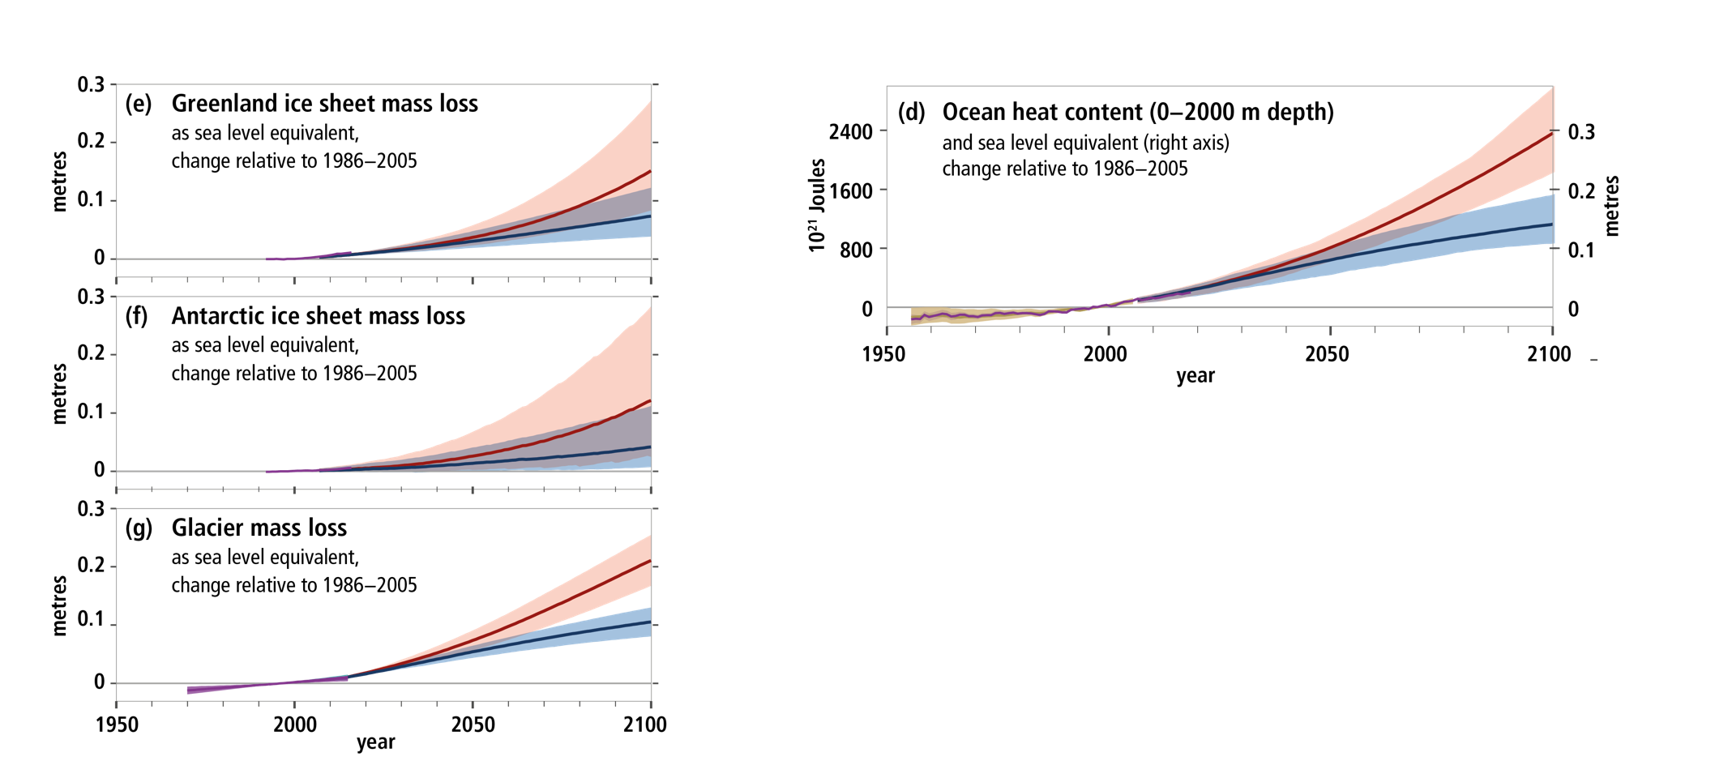
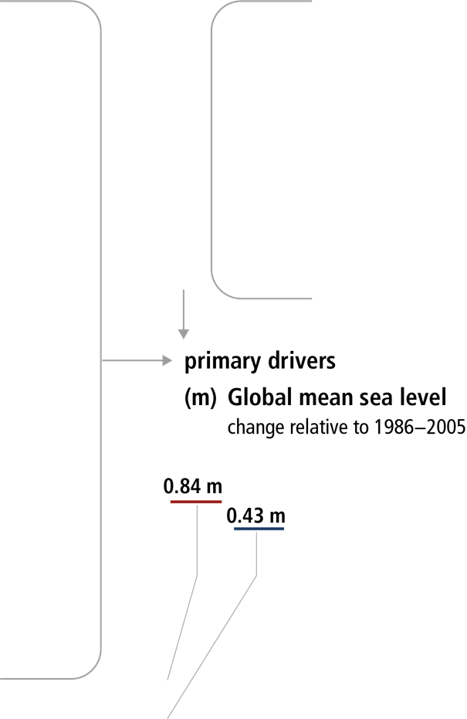
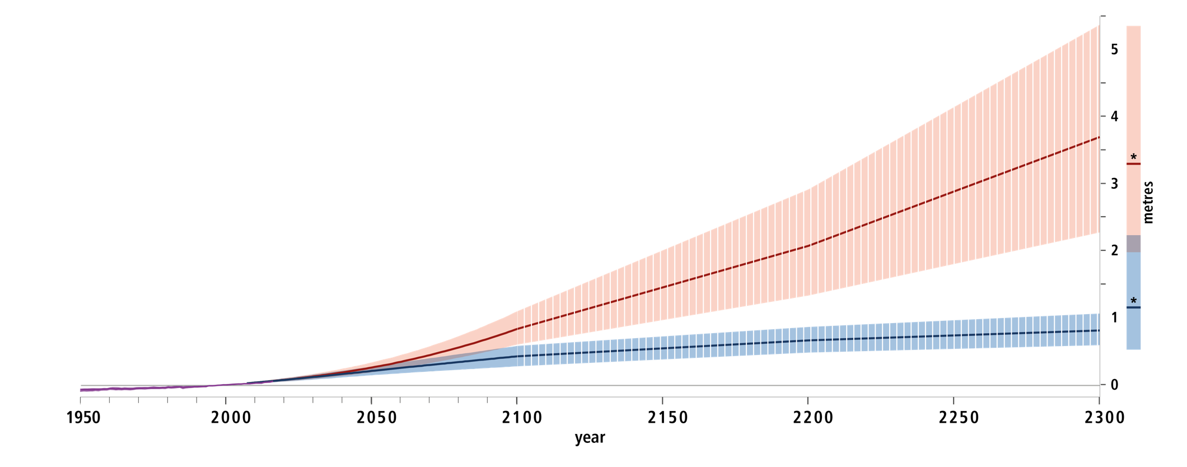
SROCC
Sea level:
according to present knowledge... we have choices between below 1 metre or up to several metres by 2300 due to
Thermal expansion
Glacier melt
Ice sheet melt
~
1.5°C
Notes:
Figure SPM.1 | Observed and modelled historical changes in the ocean and cryosphere since 1950, and projected future changes under low (RCP2.6) and high (RCP8.5) greenhouse gas emissions scenarios. {Box SPM.1}
Continued from previpus slide.
Sea level changes with likely ranges for (m) Global mean sea level change. Hashed shading reflects low confidence in sea level projections beyond 2100 and bars at 2300 reflect expert elicitation on the range of possible sea level change {4.2.3, Figure 4.2}; and components from (e,f) Greenland and Antarctic ice sheet mass loss {3.3.1}; and (g) Glacier mass loss {Cross-Chapter Box 6 in Chapter 2, Table 4.1}. Further cryosphere-related changes with very likely ranges for (j) Arctic sea ice extent change for September {3.2.1, 3.2.2 Figure 3.3}; (k) Arctic snow cover change for June (land areas north of 60oN) {3.4.1, 3.4.2, Figure 3.10}; and (l) Change in near-surface (within 3–4 m) permafrost area in the Northern Hemisphere {3.4.1, 3.4.2, Figure 3.10}. Assessments of projected changes under the intermediate RCP4.5 and RCP6.0 scenarios are not available for all variables considered here, but where available can be found in the underlying report. {For RCP4.5 see: 2.2.2, Cross-Chapter Box 6 in Chapter 2, 3.2.2, 3.4.2, 4.2.3, for RCP6.0 see Cross-Chapter Box 1 in Chapter 1}

Slide 10
Extreme events on top of sea level rise
SROCC

Slide 11
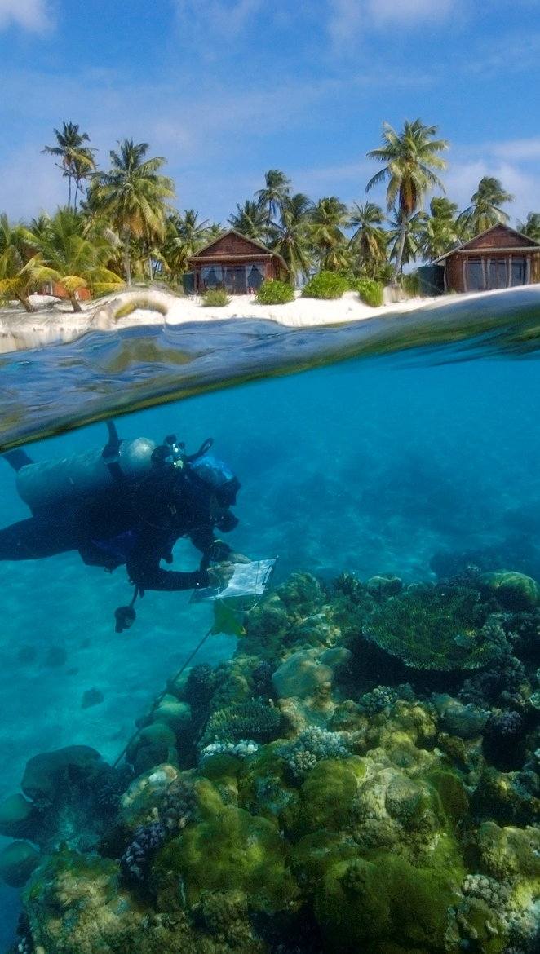
SR1.5
Where do we want to go? Considering land and ocean impacts
At 1.5°C compared to 2°C:
Smaller reductions in yields of maize, rice, wheat and sorghum, smaller reductions in fisheries yields
Global human population exposed to water stress is up to 50% less, also less water stress for ecosystems
Up to several hundred million fewer people exposed to climate-related risk and susceptible to poverty by 2050
Lower impact on biodiversity and species
Andre Seale / Aurora Photos

Slide 12
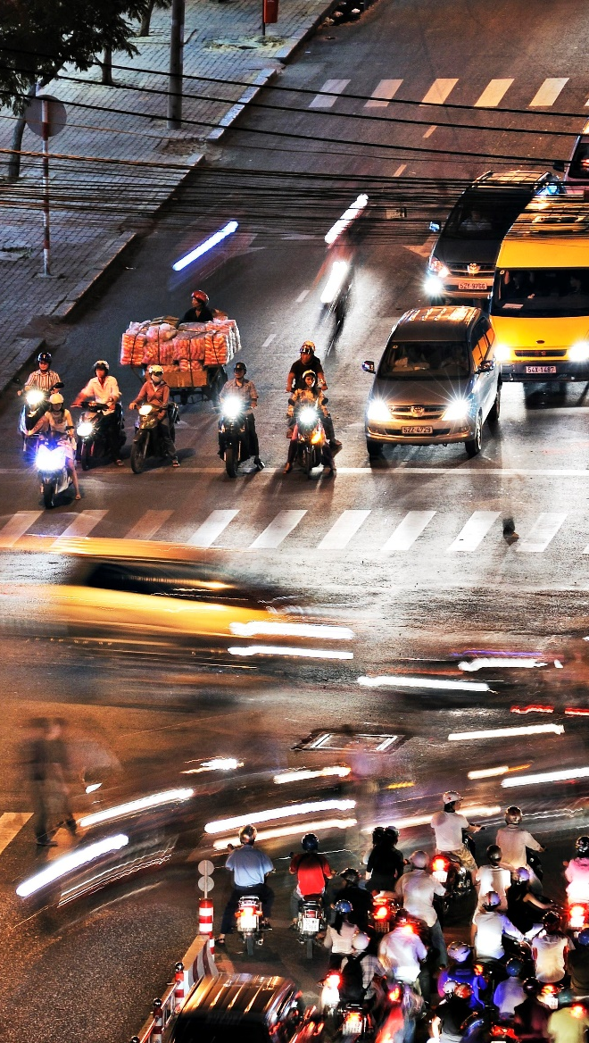
SR1.5
Avoided impact (severity) for land and oceans:
guiding ambition in adaptation and mitigation
How do we get there?
To limit warming to 1.5°C, CO₂ emissions fall by about 45% by 2030 (from 2010 levels)
Compared to 20% for 2°C
To limit warming to 1.5°C, CO₂ emissions would need to reach ‘net zero’ around 2050
Compared to around 2075 for 2°C
Reducing non-CO₂ emissions would contribute and also have direct and immediate health benefits
Gerhard Zwerger-Schoner / Aurora Photos

Slide 13
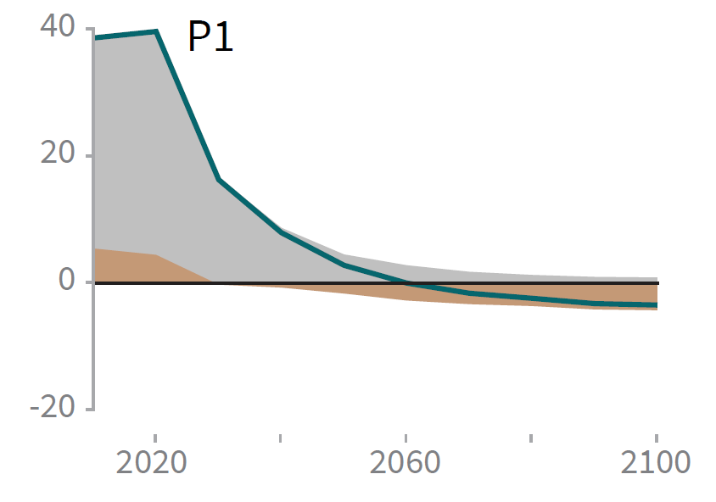
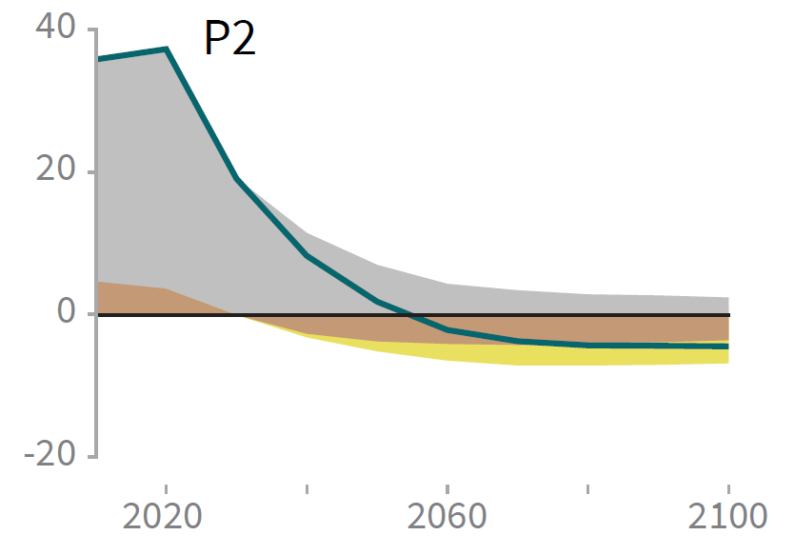
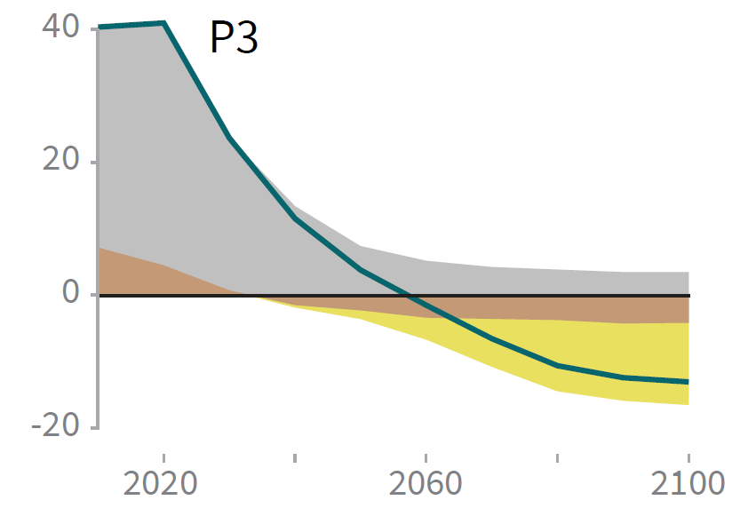
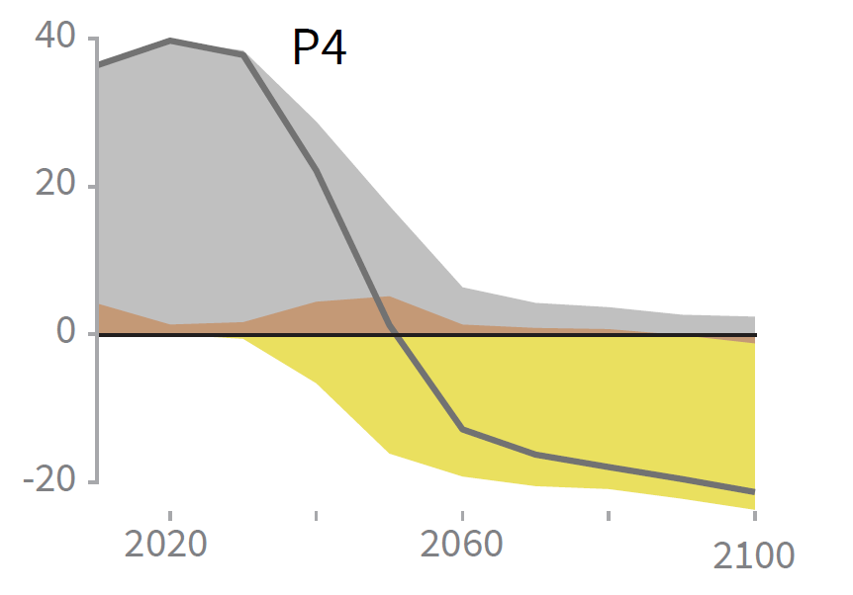
SR1.5
For keeping warming to 1.5°C ADAPTATION and MITIGATION measures
can bring their own risks:
Different pathways and mitigation strategies have variable needs for negative emission technologies, e.g. BECCS, i.e. Bioenergy and Carbon Capture and Storage
2020
Delayed emissions reduction may increase the need for BECCS….
Risks for ecosystems, biodiversity, food security
Billion tonnes CO₂ per year (GtCO₂/yr)
Early entry important
Year

Slide 14
SR1.5
Pathways of global warming with the goal to reach and maintain 1.5°C
14

Slide 15
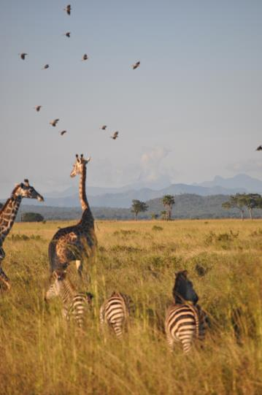
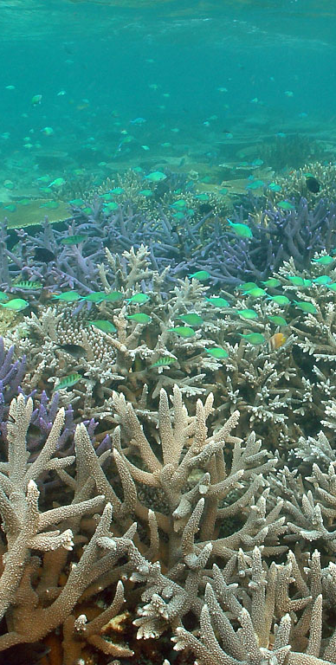
SR1.5, SRCCL, SROCC
Ambitious mitigation combined with land and ocean management for sustainability support biodiversity conservation
and food security for human society
15

Slide 16
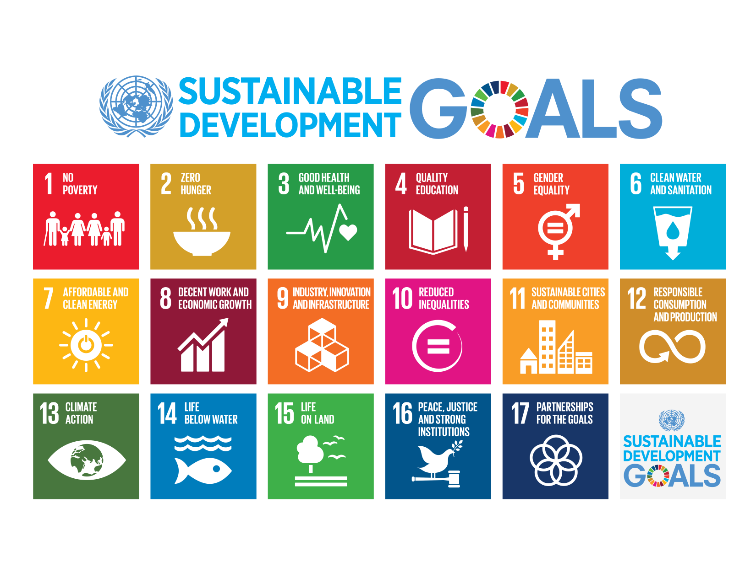
SR1.5, SRCCL, SROCC
1.5°C facilitates reaching SDGs:
Multiple synergies between mitigation and adaptation technologies

Slide 17
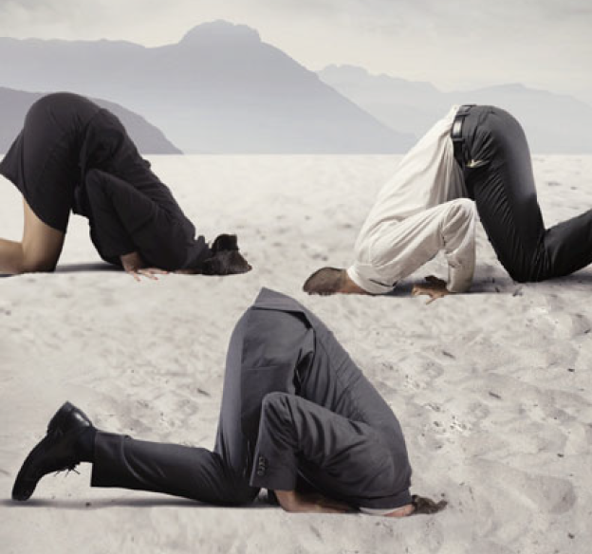
The Paris agreement and climate impacts provide a sense of urgency:
Overcoming societal inertia, political paralysis and inaction in transformation ... reaching sustainability for ecosystems and people
  Feasibility at various levels:
  Keeping warming to 1.5 according to the laws of chemistry and physics ---- yes
  Technologies to support mitigation and adaptation measures ---- yes
  Redirection of financial flows ---- yes (stopping fossil fuel subsidies)
  Institutions --- yes
  Informed policy and governance leading and directing societal transformation ---- may be .....? BOTTLE NECK
A common response even among those who (should) know...!?

Slide 18
Production gap:
Extraction plans for fossil fuels do not meet climate targets
21.11.2019
UNEP Production Gap Report 2019

Slide 19
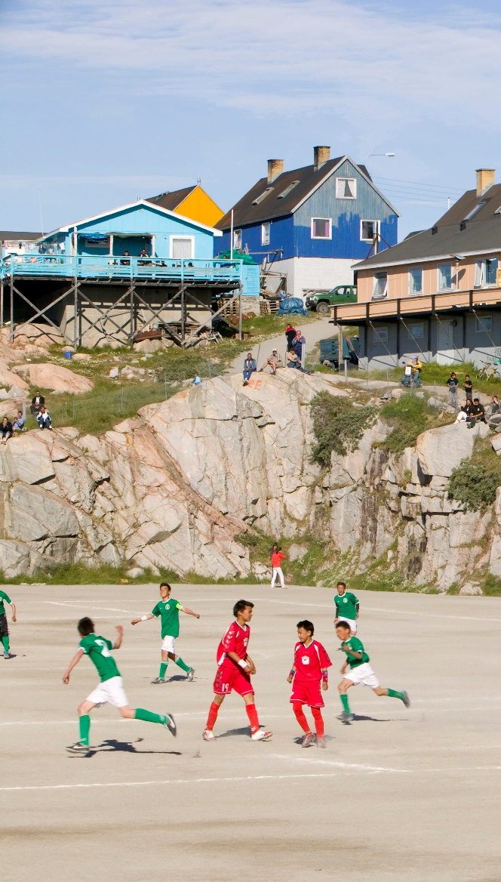
SR1.5, SRCCL, SROCC:
For minimizing impact (severity) and associated risks….
Every bit of warming matters
Each year matters
Each choice matters…. closely following 1.5°C emission trajectories matters
Political and societal will matters
Let us unite behind the science (Haakon, Crown Prince of Norway, OurOceans Oslo 2019)
Ashley Cooper/ Aurora Photos

Slide 20
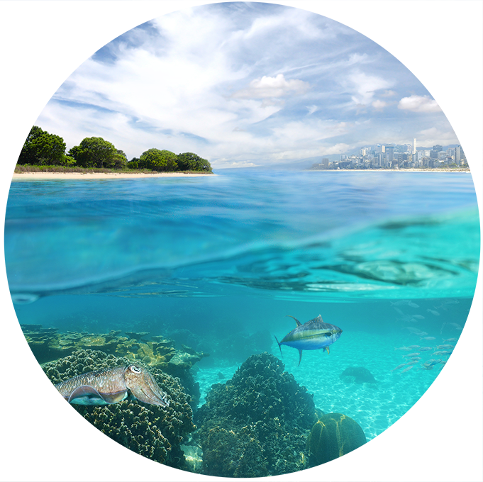

More Information:
Website: http://ipcc.ch microsites: SR1.5, SRCCL, SROCC
IPCC Secretariat: ipcc-sec@wmo.int
IPCC Press Office: ipcc-media@wmo.int
Find us on:
@IPCC_CH
@IPCCNews
@IPCC_Climate_Change
www.vimeo.com/ipcc
www.youtube.com/c/ipccgeneva

