Slide 1


Korea Climate Week
Proposed GEF-9 Directions and
LDCF/SCCF Strategy
Juan Pablo Hoffmaister
Conventions and Trustfunds Division
April 23, 2026

Slide 2

GEF At A GLANCE

Slide 3

Transversal Themes framing GEF-9 *
GEF Family of Funds
Whole of Government and Policy Coherence
Whole of Society
GEF Family of Funds offer flexible, synergistic financing for country needs
Mainstream policy coherence into Programming and country portfolio planning
20% of GEF-9 resources to support CSOs, Indigenous Peoples, women and youth
Innovation and Risk
Blended Finance and Private Sector engagement
Knowledge and Learning
Knowledge and Learning
Operationalize innovative solutions through GEF-9 high-risk appetite for impact and leverage
Raise ambitions for increased used of non-grant instruments, particularly with MDBs and the Private Sector
Generation and application of knowledge from GEF projects and programs in adaptive management
* Update presented on bases of draft materials for consideration by GEF Assembly. Subject to Adoption in June 2026

Slide 4
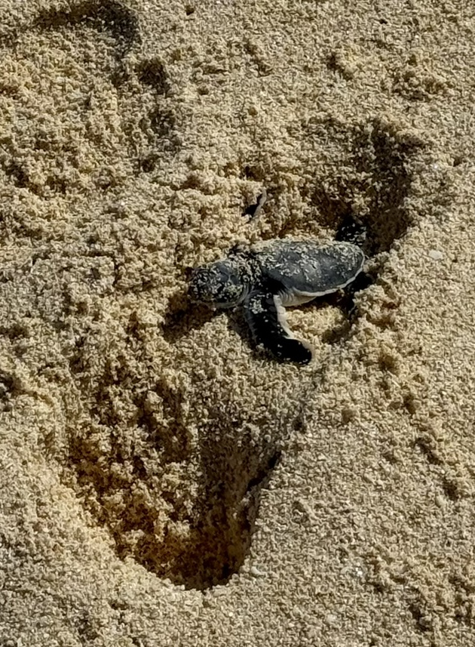
Blended Finance: leveraging impact at scale
Blended Finance (NGI)
Increased Blended Finance / NGI funding window to 10%
Incentivized STAR programming, with countries capturing reflows
Mainstream in programming to achieve 25% total blended finance investment
Increase technical support to countries for strategic investments

Slide 5
GEF-9 Focal Areas
Biodiversity
Climate Change Mitigation
Land Degradation
Landscape & seascape approaches
Integration with MFA, MTF investments, including GBFF
Biodiversity finance and domestic resource mobilization
Mainstreaming ecosystem restoration
Drought management and resilience
UNCCD alignment on drought and LDN
Decarbonized energy access
Nature-based solutions
Resource efficiency: energy and materials
Chemicals & Waste
International Waters
Private sector and blended financing enhancements
Innovation and technology scaling
Plastic pollution efforts
Large marine ecosystems
Support to the BBNJ Agreement
Strengthened focus on groundwater

Slide 6






LDCF/SCCF Proposed Themes & Approaches
Agriculture &
Food Systems
Water
NbS & Infrastructure
Themes
Approaches
Policy Integration & Country Leadership
Adaptive
Social Protection
Partnerships
with MDBs & IFIs
Innovative Finance & Market Development
Cross-cutting
Fragility and Conflict-affected Situations,
Locally-led Adaptation, & Whole of Society
* Update presented on bases of draft materials for consideration by LDCF/SCCF. Subject to Adoption in June 2026
Notes:
.

Slide 7
Proposed Funding Windows
 | LDCF | SCCF Window A | SCCF Window B
Countries | LDCs | Non-LDC SIDS | All countries for technology, innovation, & private sector engagement
Financial instruments | Grant only |  | Grant & non-grant
Country cap | YES - Predictable access |  | No
Catalytic finance for scale-up | Based on country demand |  | YES - Primary focus
Global & Regional Programs & Partnerships
➡ Next slide

Slide 8
Global & Regional Programs & Partnerships
Challenge Program for Adaptation Innovation
Increased frequency and size of RfPs
Support:
Global and Regional Initiatives
Support:
LDCF
SCCF-A
SCCF-B
LDCF
SCCF-A
SCCF-B
GEF partnership Expansion
Accelerating Innovation
Sustainability & Scale-up
Response to UNFCCC guidance
Strategic Partnerships
Knowledge & Learning
Non-Grant Instrument (NGI) Program for Climate Adaptation
Catalyzing private sector investment
Support:
SCCF-B
Capacity Building and Institutional Strengthening
Support:
LDCF
SCCF-A
Country
Engagement
PrIA Capacity
Building Program
Piloting new
models
Risk
Tolerance
Complementary
to Global NGI
In-country executing partners

Slide 9
PrIA: Program Structure
Track 1
Existing Partner Enhancement
Track 2
New Partner Integration
Elements for
PrIA Program
1
Fiduciary & Safeguards Capacity
Current Executing Entities | OFP-endorsed national entities
Non-traditional Partners | Challenge Program methodology
Fiduciary & financial management
Procurement
systems
M&E frameworks
& GEF indicators
Environmental & social safeguards
Fragile & conflict-affected situations
Innovation &
technology transfer
Experimental
approaches support
Graduated implementation (medium projects start)
2
3
Project Design & Results Management
Climate Finance Architecture coordination
4
5
Knowledge
Management &
Learning
Specialized
Thematic
Expertise

Slide 10
Proposed Policy Directions
Readiness for Early GEF-9 Delivery
Durable ambition
Anchors enhanced guidance and ambitious goals within the GEF-9 framework
Operational clarity
Crystalizes expectations for Secretariat, Agencies and countries early in GEF-9
Bridge to authorizing environment
Provides a stable reference point for Council consideration and decisions
Predictability and early delivery
Predictable policies unlock early results and build trust for GEF-9 programming

Slide 11
Thank you

