Slide 1
GCF at the Climate Capital Marketplace
Pavlos Troulis
Head of Readiness and Preparatory Support Department of Investment Services, Green Climate Fund
Yeosu Climate Week, 2026
23 Apr 2026

Slide 2





Access to climate finance is constrained by structural, institutional, & pipeline bottlenecks
Despite growing climate finance commitments, countries face persistent barriers that prevent the translation of needs and plans into sustained and scalable access to finance.
Why this matters
Institutional and capacity constraints limit effective engagement
Weak enabling environments constrain investment readiness
Fragmented and underdeveloped project pipelines
Structural access barriers within climate finance systems
Problem Statement
Question
What kind of constraints do you face in your country?

Slide 3




The GCF Readiness Strategy (2024-2027) addresses systemic barriers by strengthening institutions, enabling investment environments, and building a pipeline of bankable projects.
Outcome: By 2027, developing countries have strengthened programming capacities & enabling environments for NDC, NAP, & LTS implementation, investment planning & enhanced access to GCF resources through an enhanced focus on climate programming & direct access to advance implementation of the UNFCC & Paris Agreement.
Climate finance coordination
& enabling environment
Pipeline development &
implementation
Knowledge-sharing
& learning
30
60
10
Strengthen coordination mechanisms across stakeholders
Support development and implementation of NDCs, NAPs, LTS
Develop policies, instruments, and investment plans
Strengthen Direct access entities (DAEs) and accreditation capacity
Develop and update country programmes
Build pipelines of high-quality project ideas & concept notes, that lead to approved proposals
Strengthen capacity of NDAs and DAEs for project implementation, financial management and M&E
%
Generate and disseminate knowledge to address policy gaps
Capture and share best practices and lessons learned
Strengthen regional cooperation and partnerships and South-South collaboration
%
%
Percentage of funds allocated (indicative)
Readiness acts as an upstream enabler—transforming capacity into access, and access into sustained climate finance flows.

Slide 4
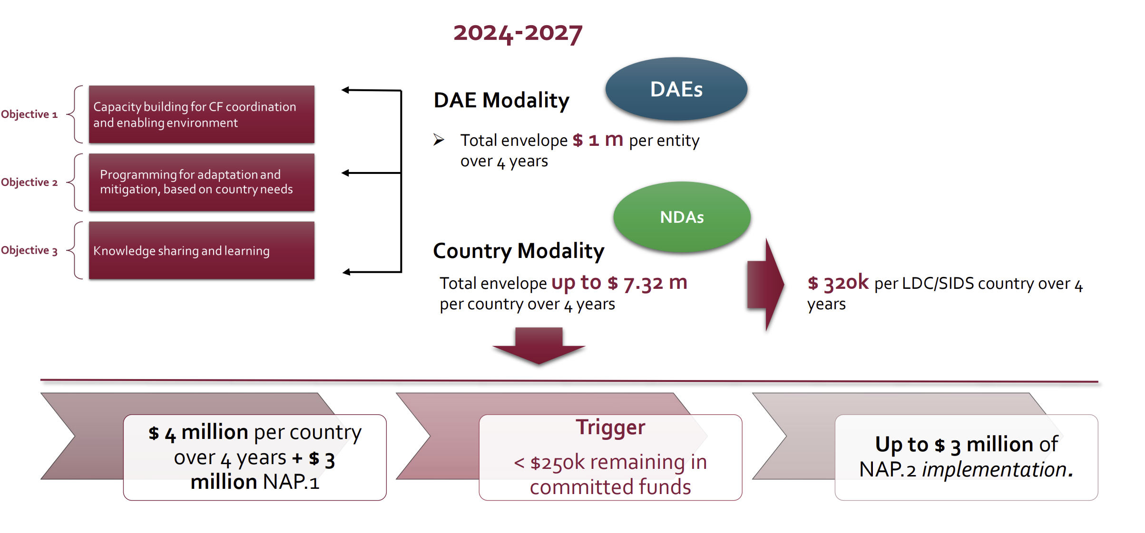
Readiness support is delivered through distinct modalities aligned to country needs and access pathways

Slide 5
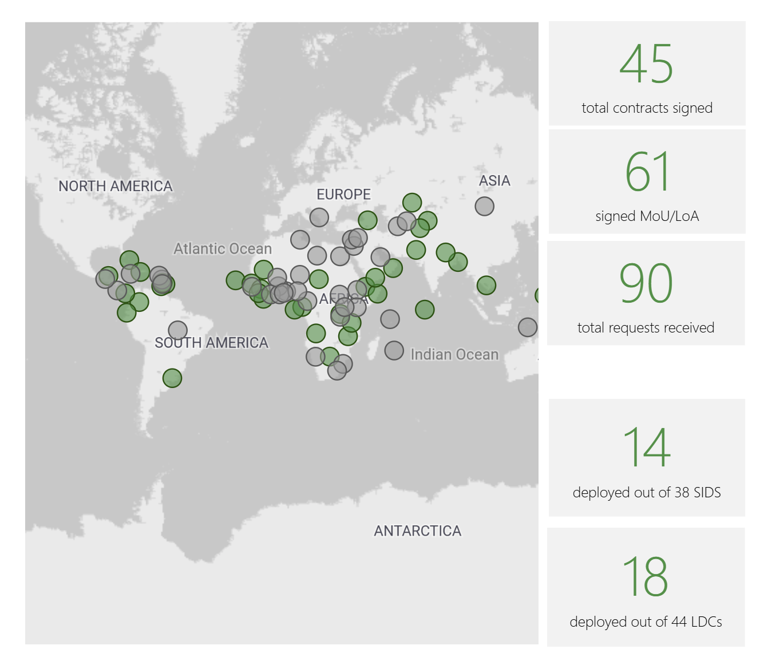
GCF Liaison Officers provide in-country coordination support, strengthening engagement between national stakeholders and the Fund to facilitate more effective access to Readiness and project financing.
Received
Contracts signed
28
14
SIDS
32
18
LDCs
39
17
AFR
17
10
APAC
ECM
12
7
18
11
LAC

Slide 6



In parallel, dedicated resources remain available through the Project Preparation Facility (PPF) to support country’s accredited entities in advancing mature concepts into fully developed, fundable proposals.
GCF/B.37/05
GCF/B.37/05: The Project Preparation Facility (PPF) will support project and programme preparation with a view to enhancing access to GCF resources and the balance and diversity of the GCF project pipeline, and increasing the quality of transformational projects and programmes that fit the vision and mandate of the GCF.
What does PPF do?
What support looks like
What this enables
Bridges the gap from concept to funding proposal
Unlocks access to GCF finance
PPF addresses key preparation bottlenecks
PPF supports Accredited Entities to prepare investment-ready projects that meet GCF requirements
Feasibility studies, and project design
Environmental and social studies, including Indigenous Peoples studies (ESIA, ESMP, GRM)
Gender studies (GA, GAAP)
Stakeholder engagement plans
Risk assessments (risk, EFA, EE FMCA, etc.)
Assessment of climate impact potential for mitigation and adaptation activities
Identification of project-level indicators
Pre-contract services, e.g., bidding documents
Advisory services to structure project activities
Other preparation activities
Converts early-stage concepts into fundable proposals
Strengthens the pipeline of high-quality projects
Reduces barriers to access

Slide 7
Why PPF Matters Now
Impact, deployment gap and strategic opportunity
USD 3.3B
GCF Financing Unlocked
USD 74M
Remaining to Deploy
Strategic Opportunity
58 FPs approved totalling USD 11B
119 PPF approvals since 2016
PPF can accelerate priority pipeline development.
Opportunity to align PPF strategy and operations with regional programming priorities.
Total allocation: USD 148.3M
Target: 70% deployment by mid-2027
~USD 35M within next 15 months
7
Notes:
60 PPF Requests approved; 32.3M of PPF Commitments; have supported approval of 58 FPs; unlocking USD 3.3B;
GCF-3 preparation increases focus on delivery performance
How can PPF better support DECM’s pipeline?
Regions play a critical role in scaling its impact before GCF-3.
PPF slow… NOLs take a long time to come; TORs take long to write – can we standardize; Legal processing – AE receives UNOPS legal agreement
FP development does not need to use up the 2 year allowable time; It can be done in a shorter time.

Slide 8
Access Modalities: Funding vs Service
Two complementary approaches
Feature | PPF Funding | PPF Service
Provided to | AE/PSAA Applicant | AE/PSAA Applicant (via GCF-procured firm)
Structure | Grant or equity | Consulting services
Management | AE manages funds | AE manages consultant deliverables (32 Firms available)
Typical Use | Strong AE capacity | Limited AE capacity, complex or specialised preparation
Timeline | Review & Approval (6 wks.) + Grant agreement (2-4 mos.)+ Implementation (<=24 mos.) | Review (6 wks.) + Procurement & Approval (2-3 mos.) + Implementation (<=24 mos.)
Funding Size: Up to USD 1.5M (up to USD 3M case-by-case).

Slide 9
Thank you
We will do a deep dive on how to access these modalities in our next session
Contact details: Pavlos Troulis
pavlos.troulis@gcfund.org

