Slide 1
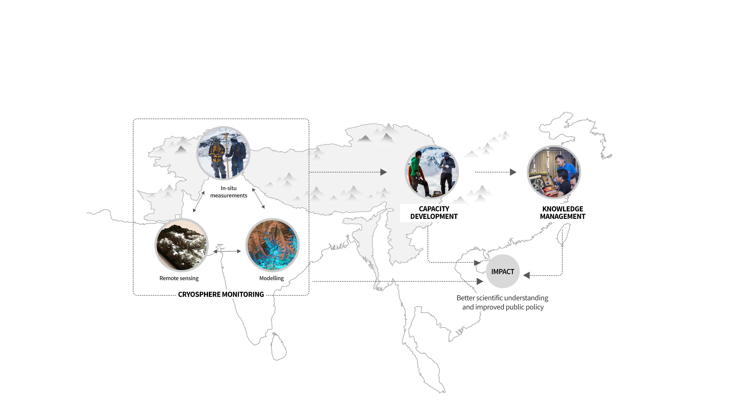
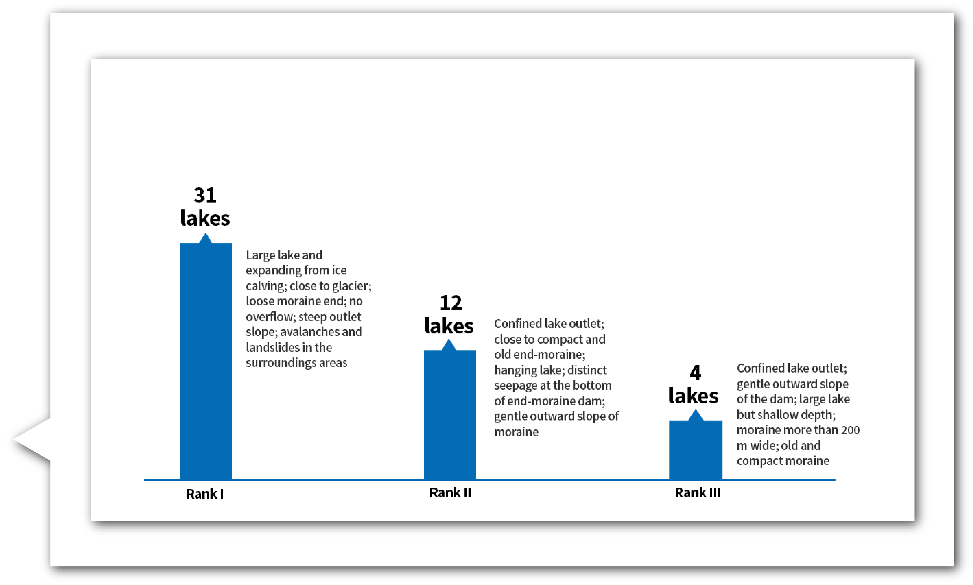
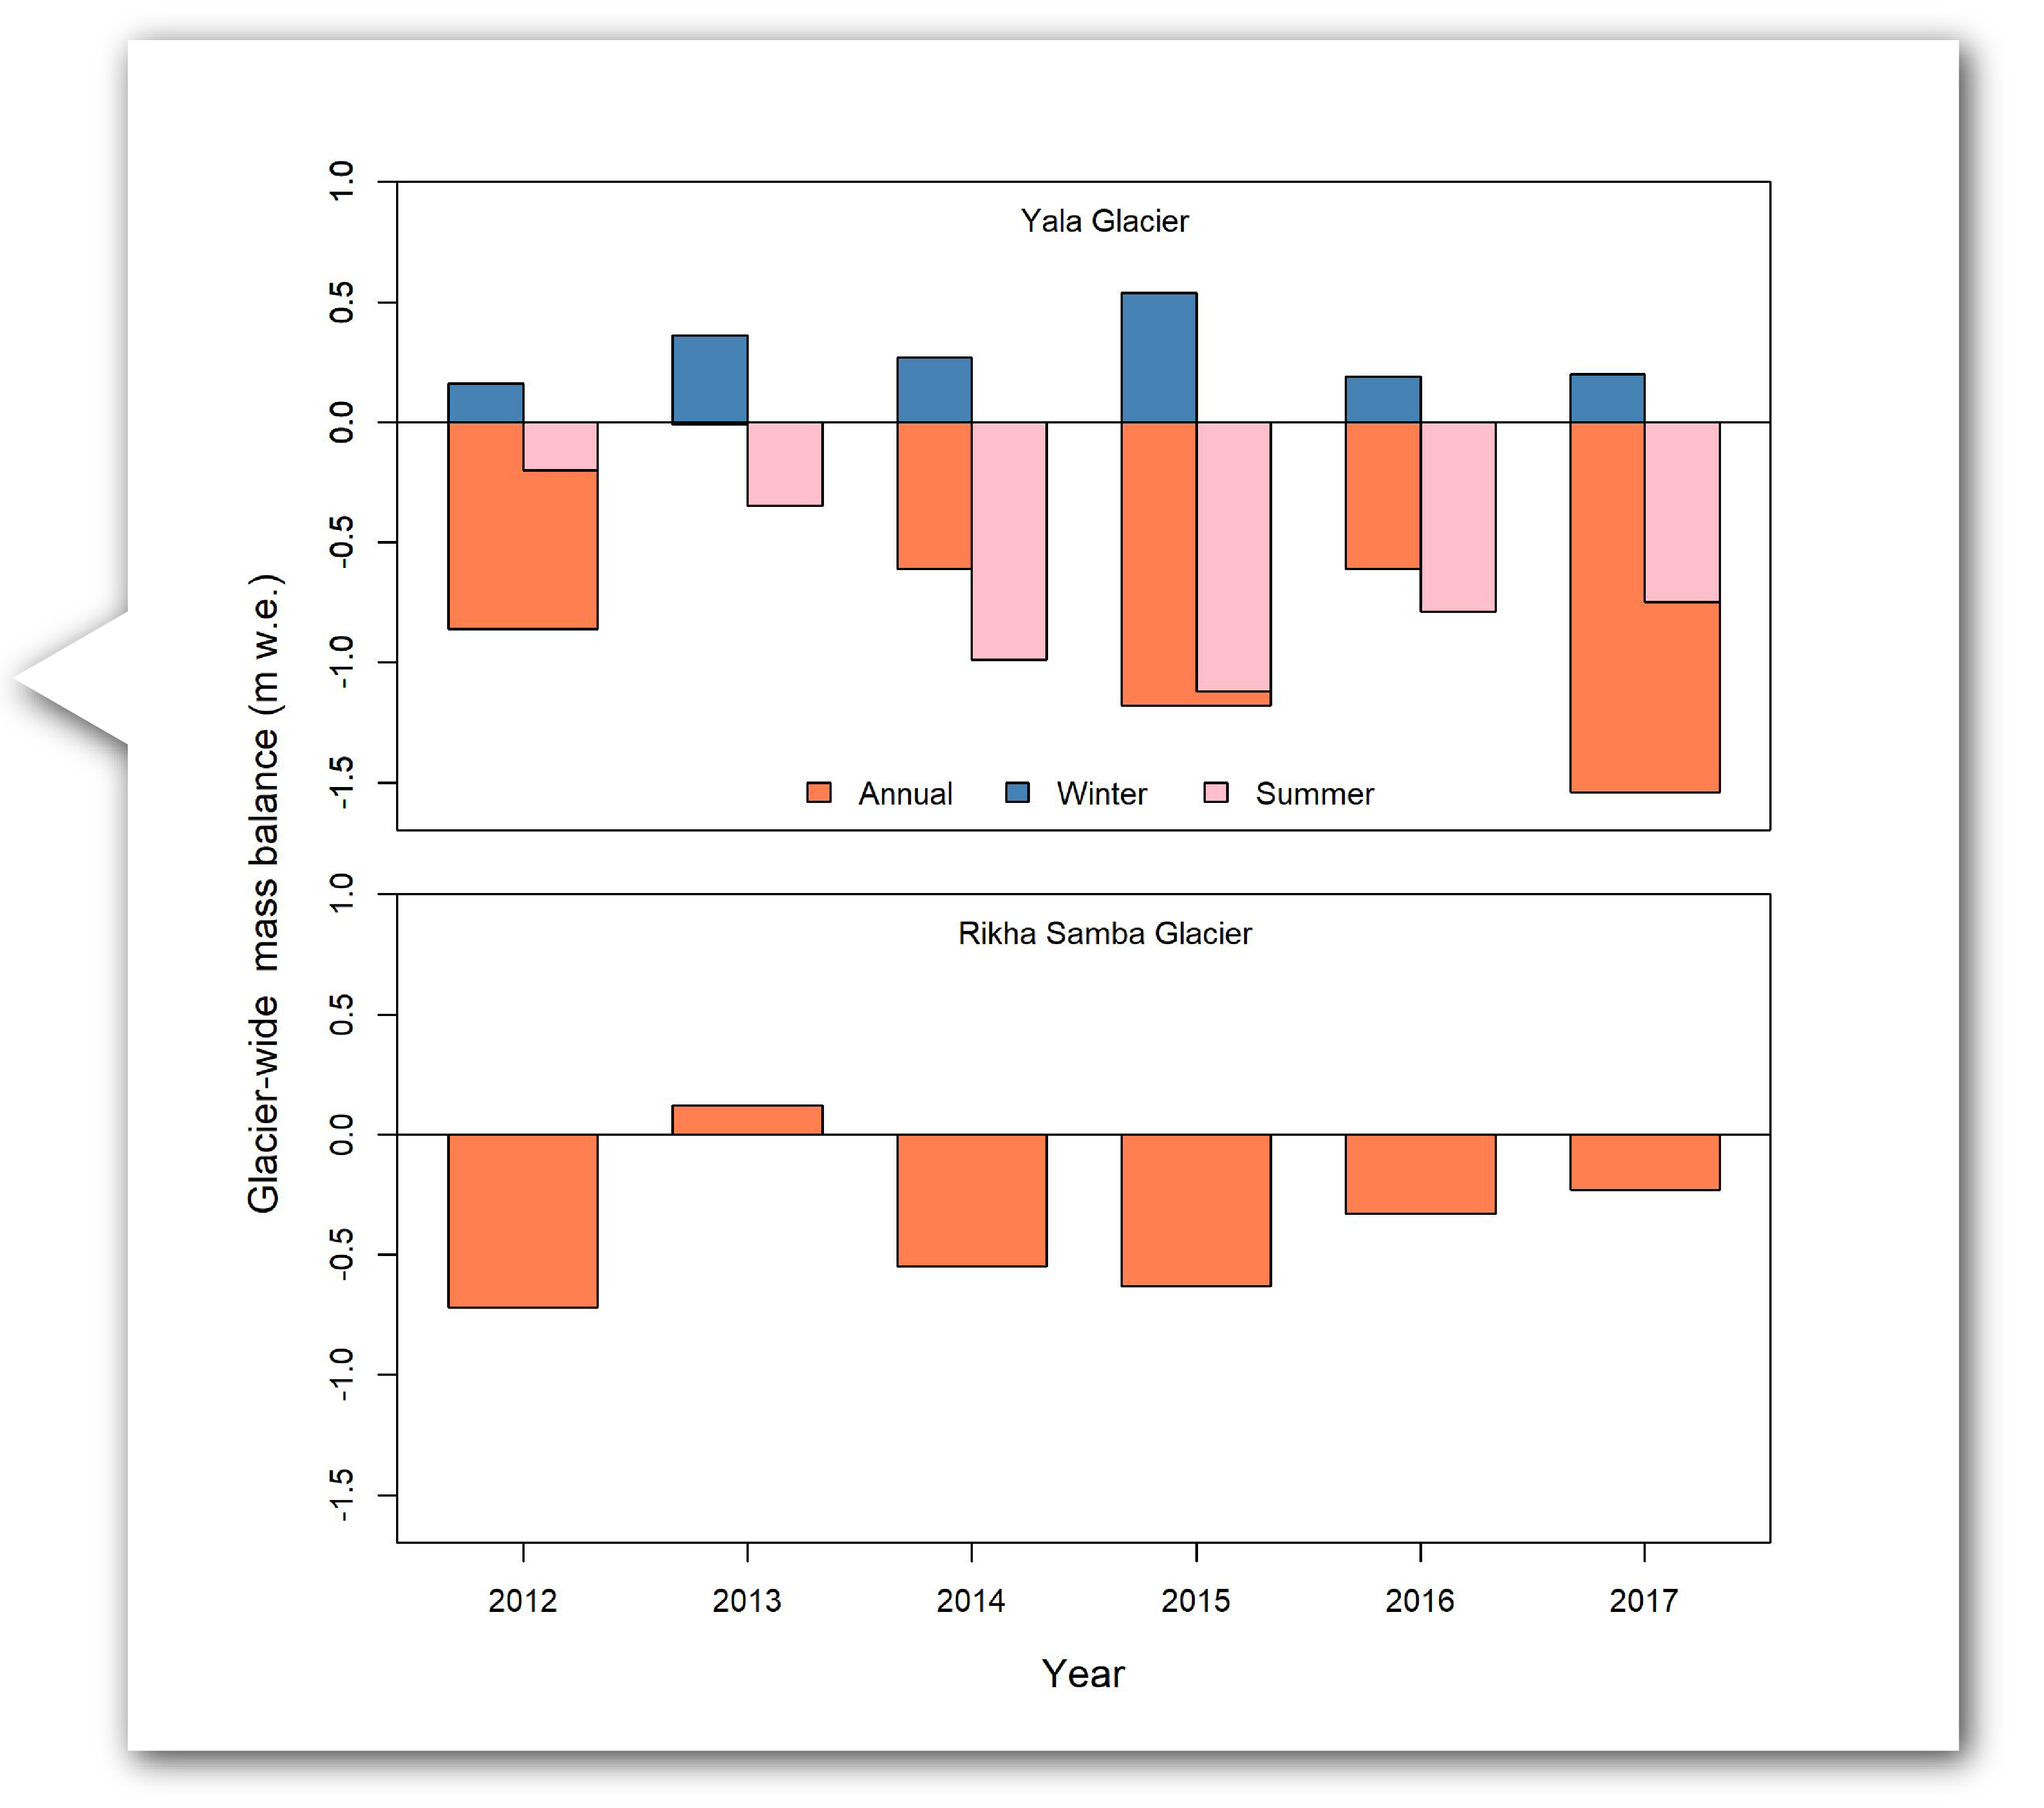
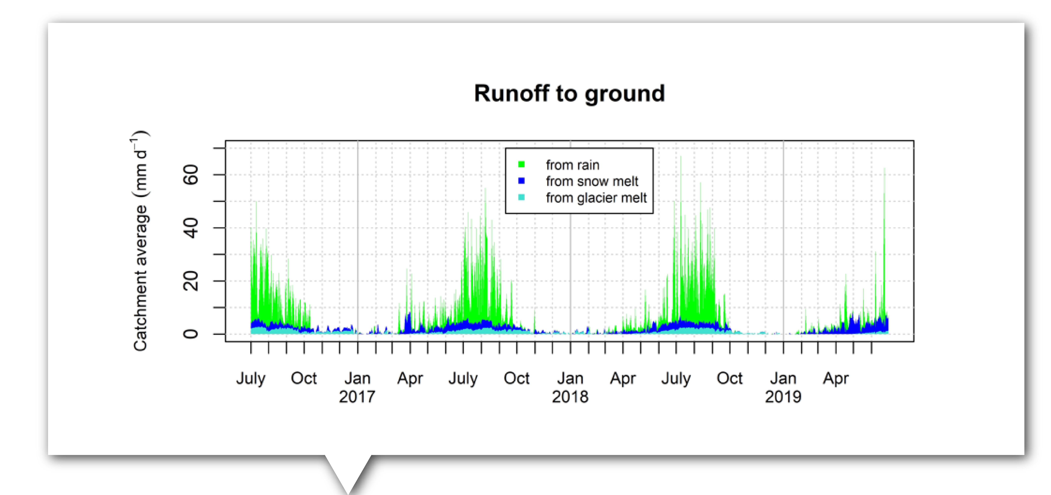
Monitoring the cryosphere in the Hindu Kush Himalaya
Measurements, analysis and dissemination
Over 1,500 professionals and young researchers trained in monitoring cryosphere change using the latest Earth observation tools and techniques
Training on the R software has become an annual training event based on demand
Field-based monitoring of Yala and Rikha Samba glaciers reveal that they are shrinking and follow the general trend of glaciers in the Himalayas.
The HKH CryoHub is a dedicated page through which the cryosphere data we have collected over the years is made publicly accessible.
47 potentially dangerous glacial lakes within the Koshi, Gandaki, and Karnali river basins of Nepal, the Tibet Autonomous Region of China, and India were identified using high-resolution satellite imagery.
Snowmelt is a major contributor to streamflow during the non-monsoon seasons when rain is sparse.
The Hindu Kush Himalaya region
Miriam Jackson, Programme Coordinator, Cryosphere Initiative, River Basins and Cryosphere
International Centre for Integrated Mountain Development | www.icimod.org

