Slide 1
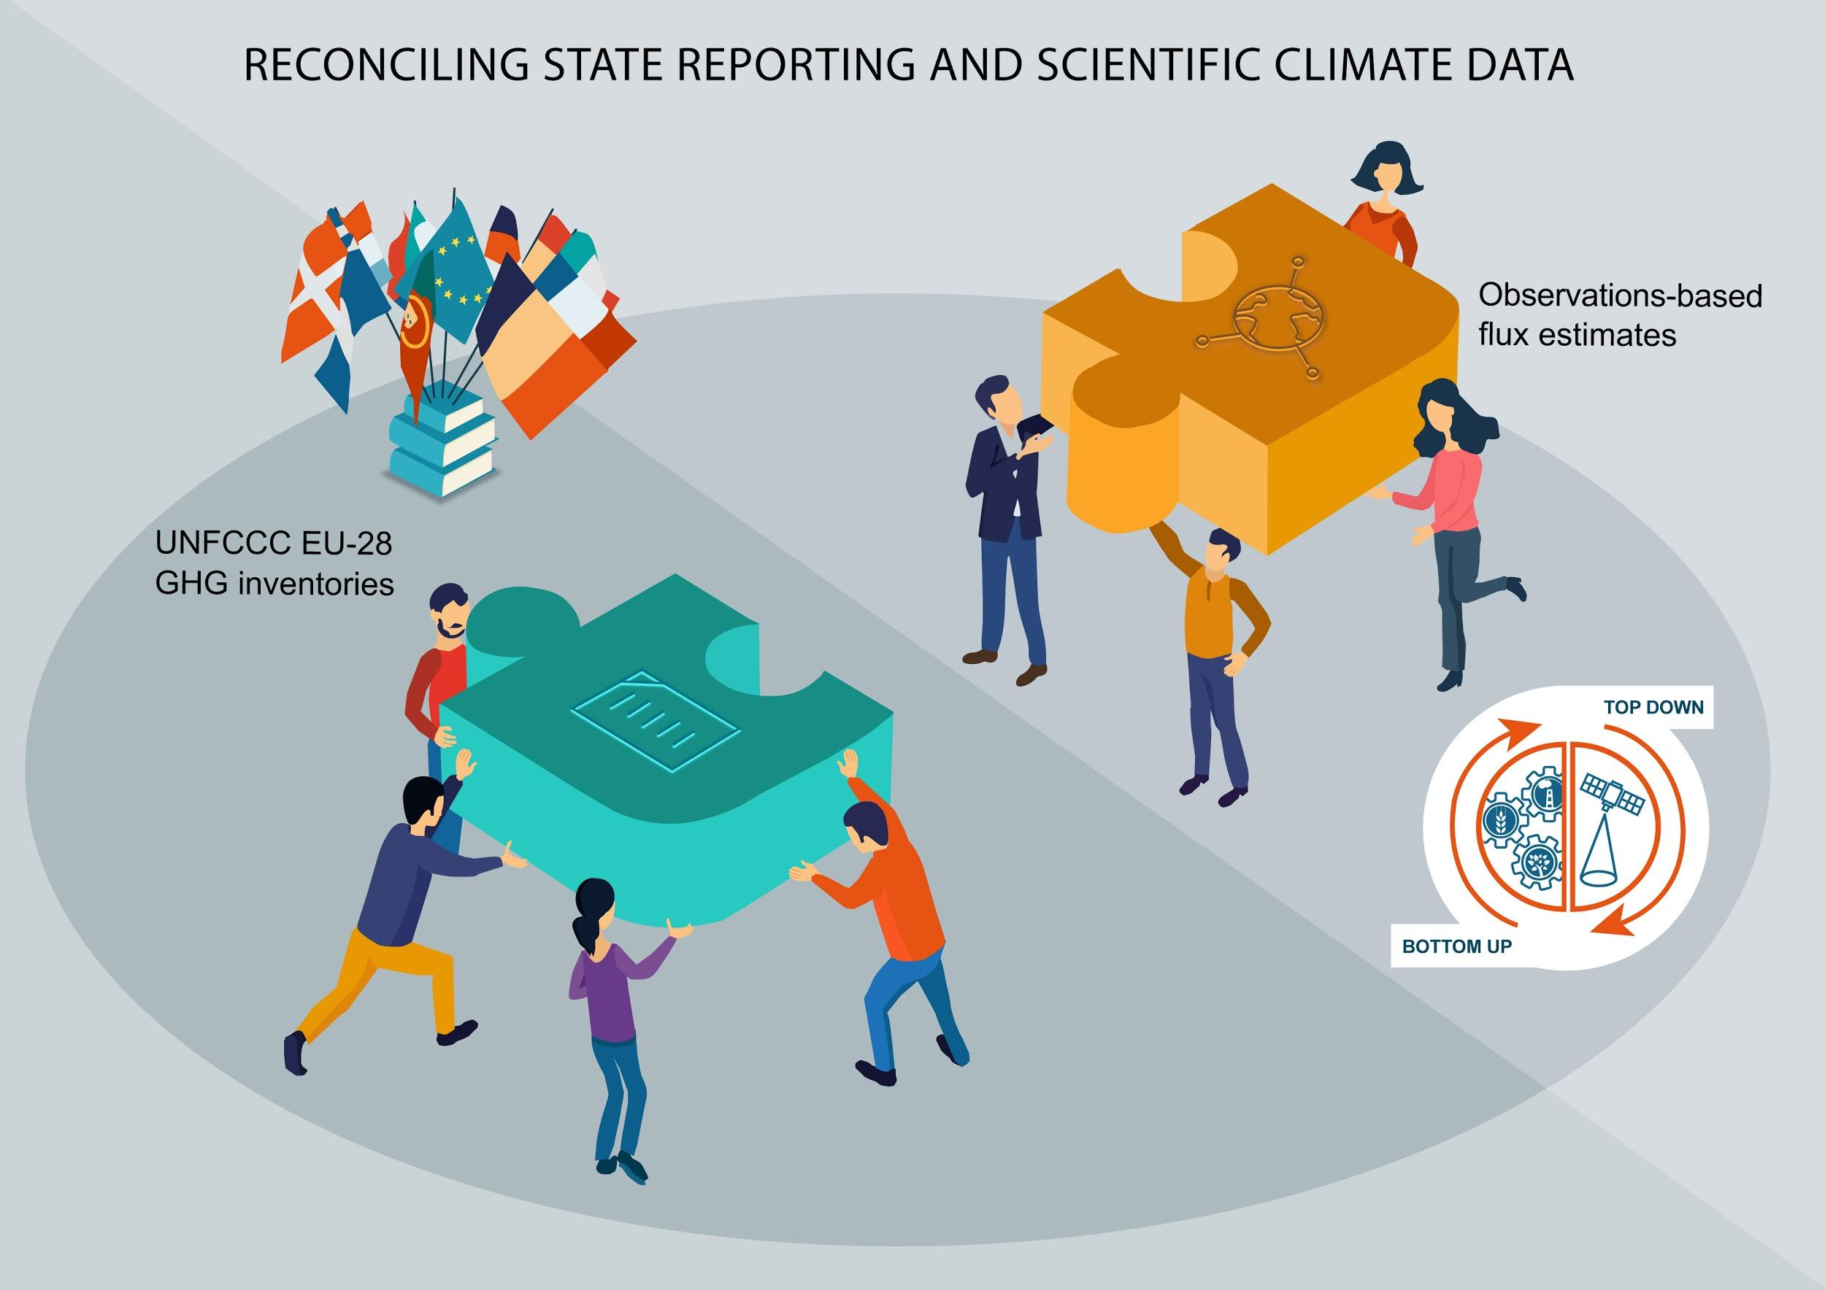
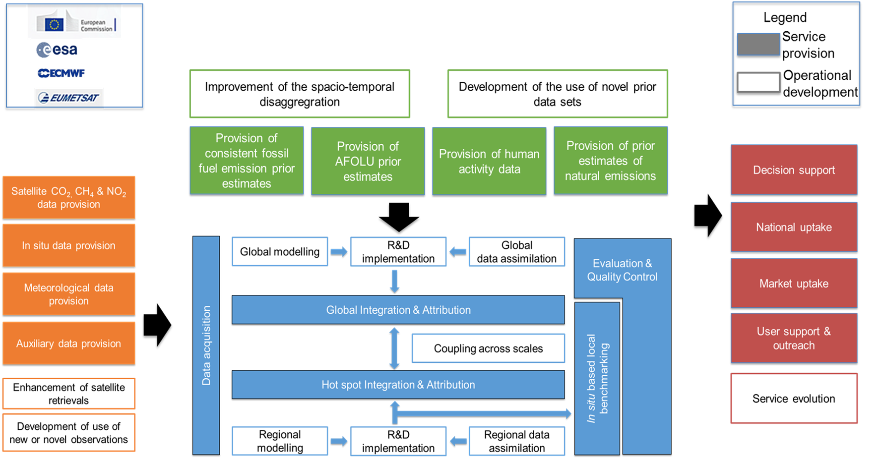
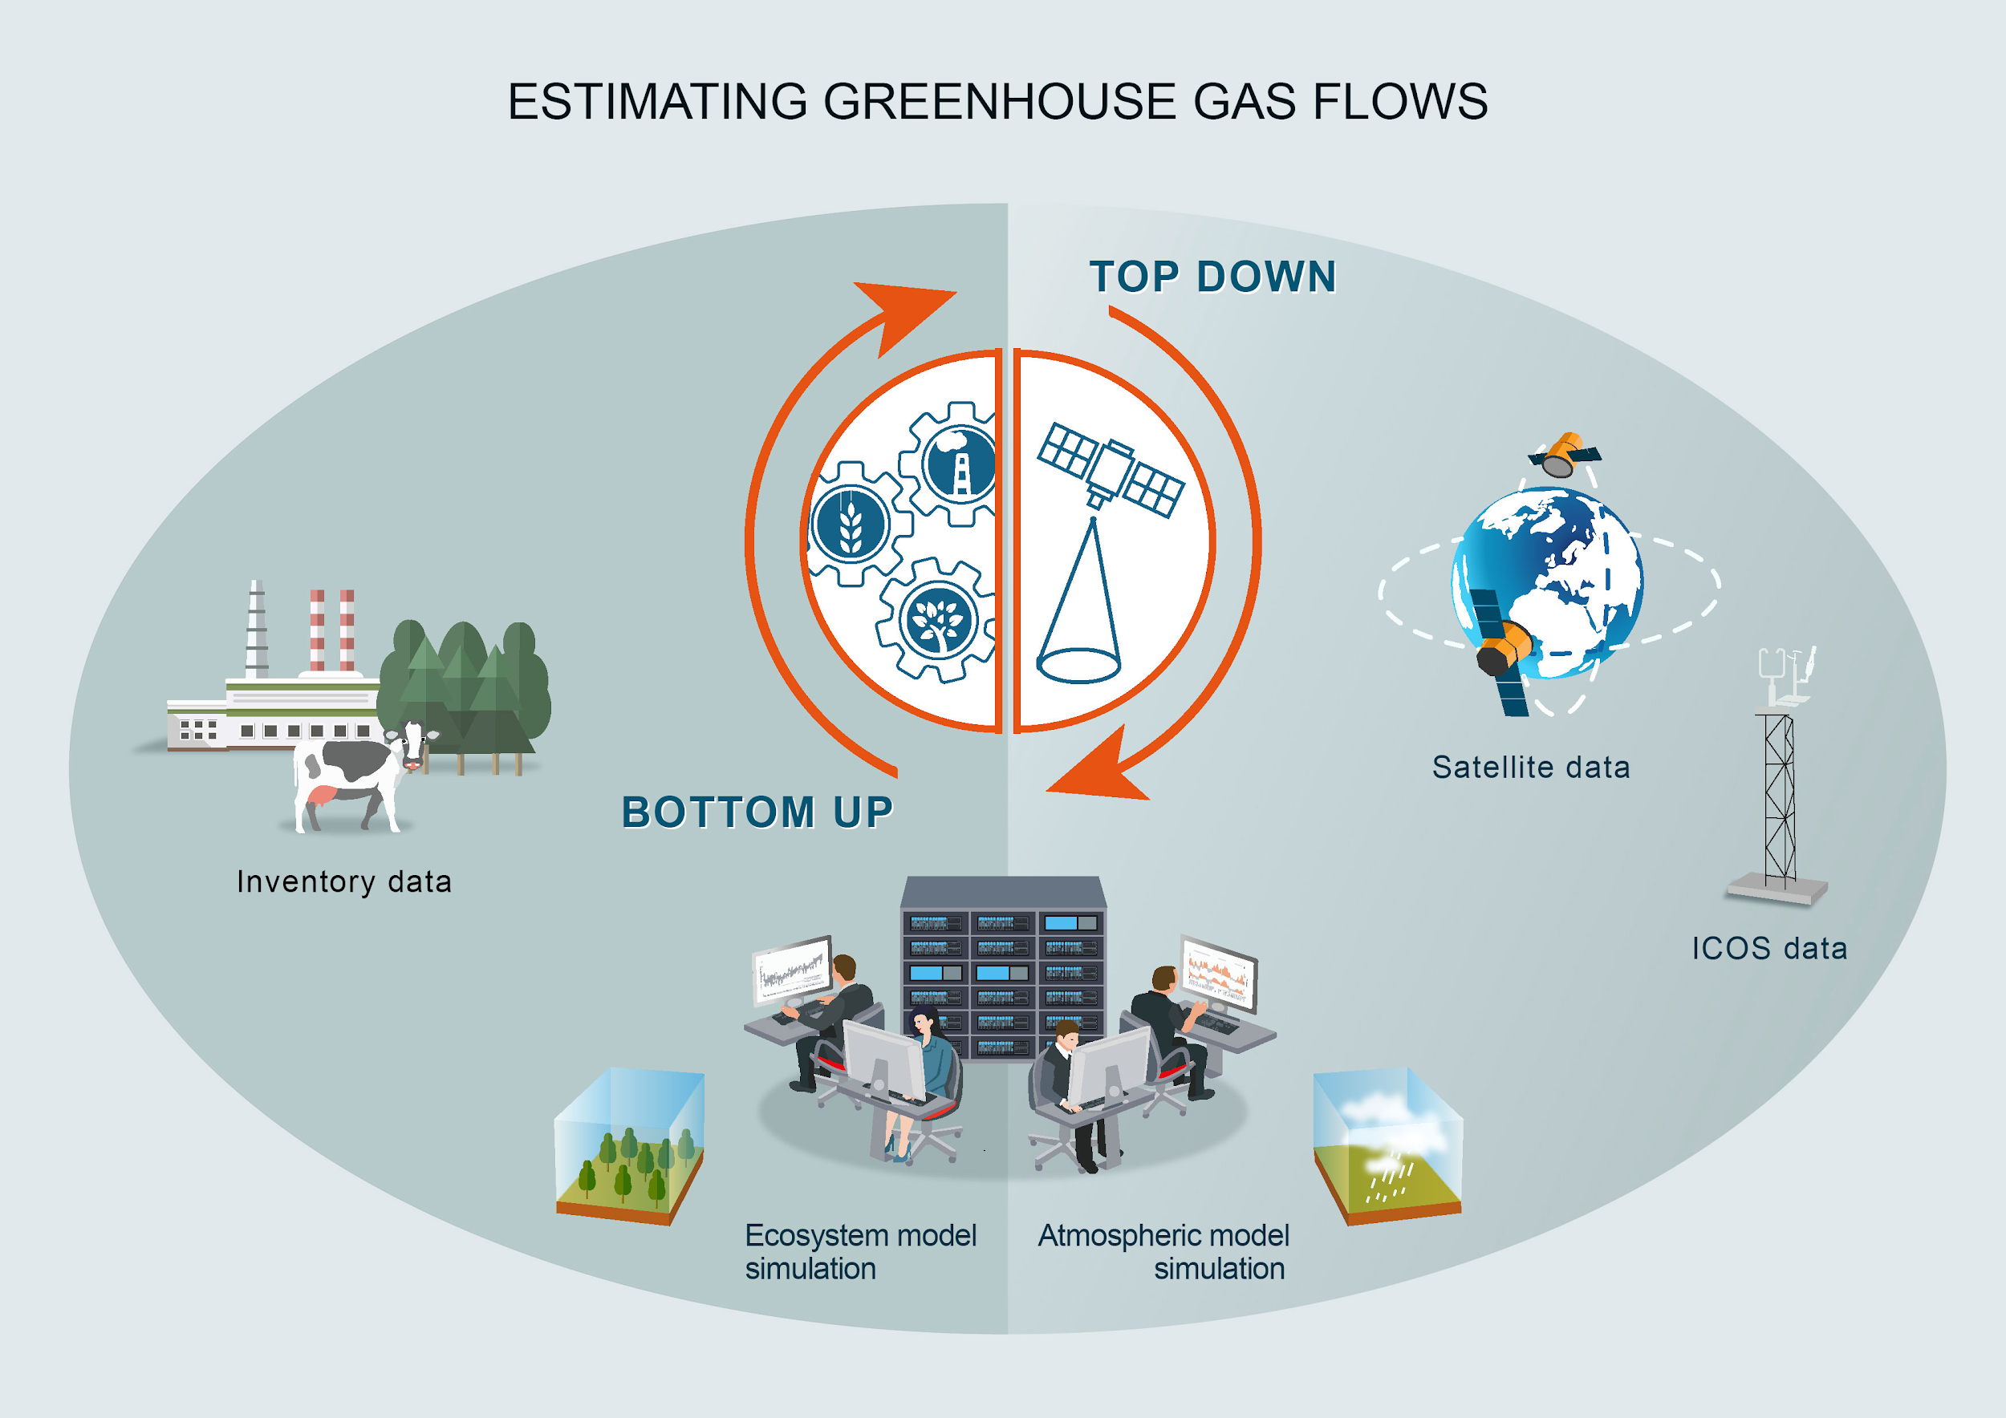
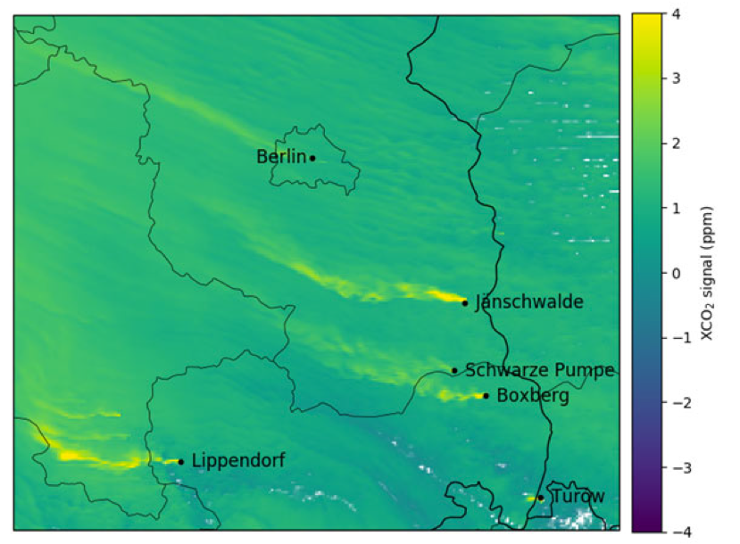
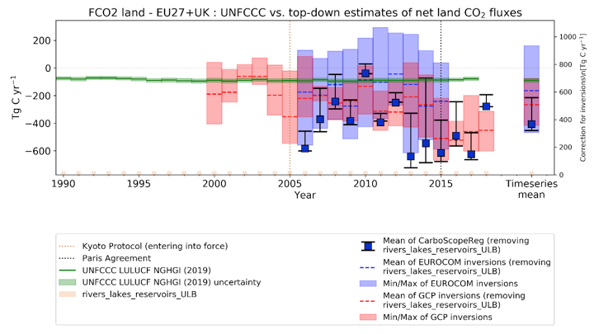
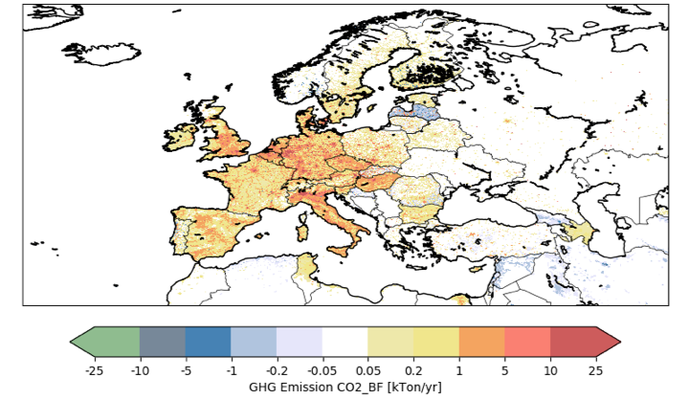
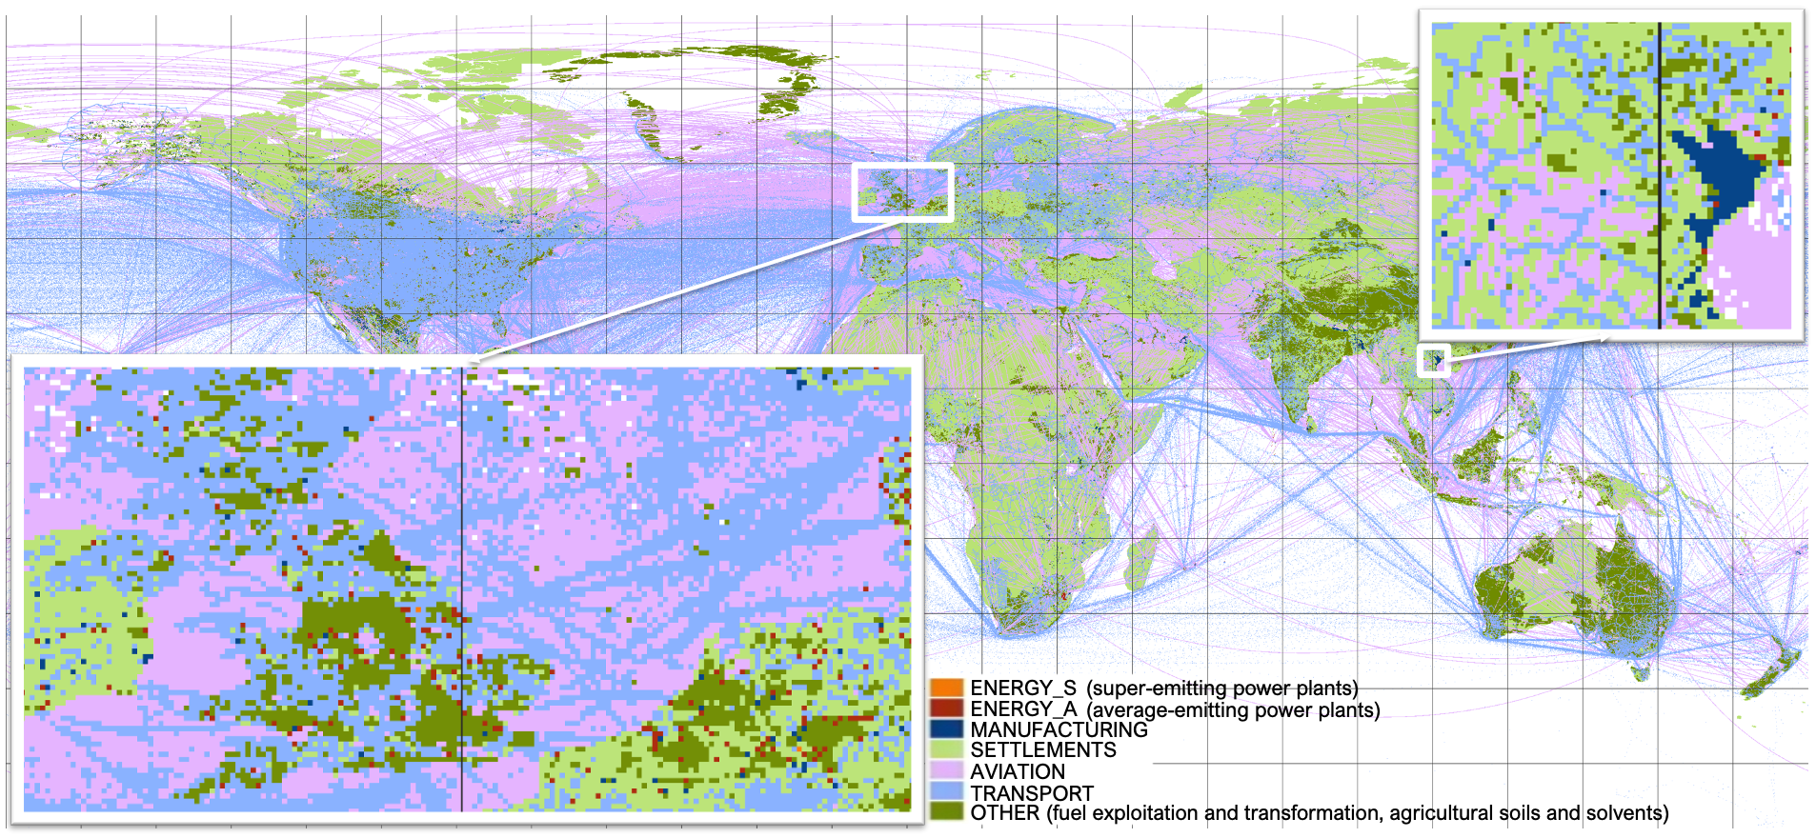
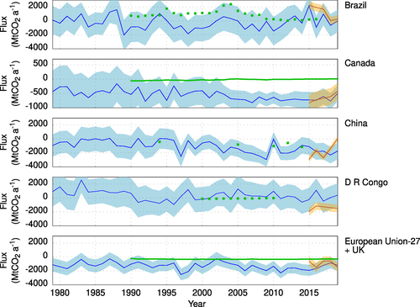
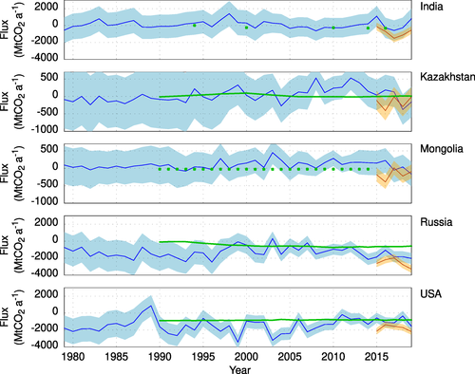
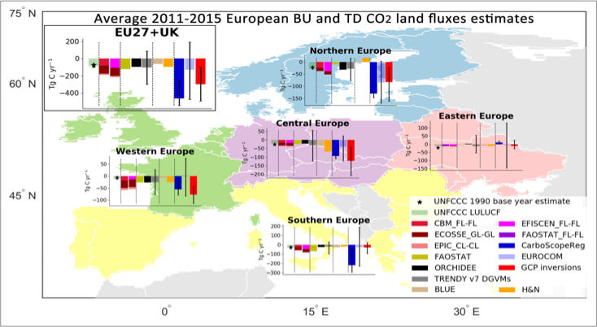
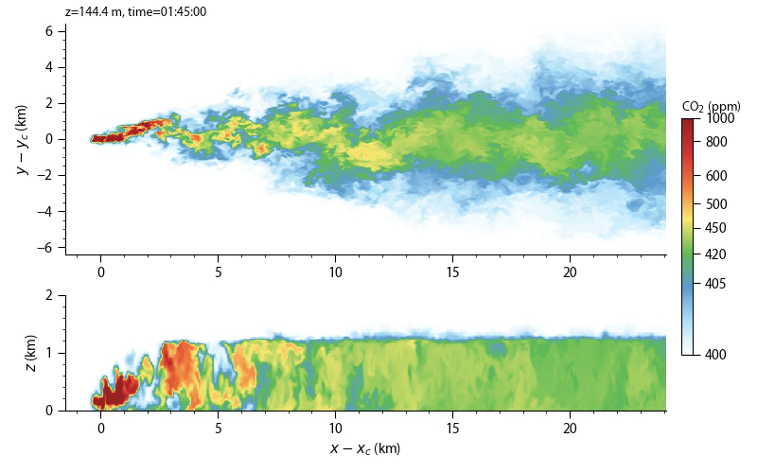
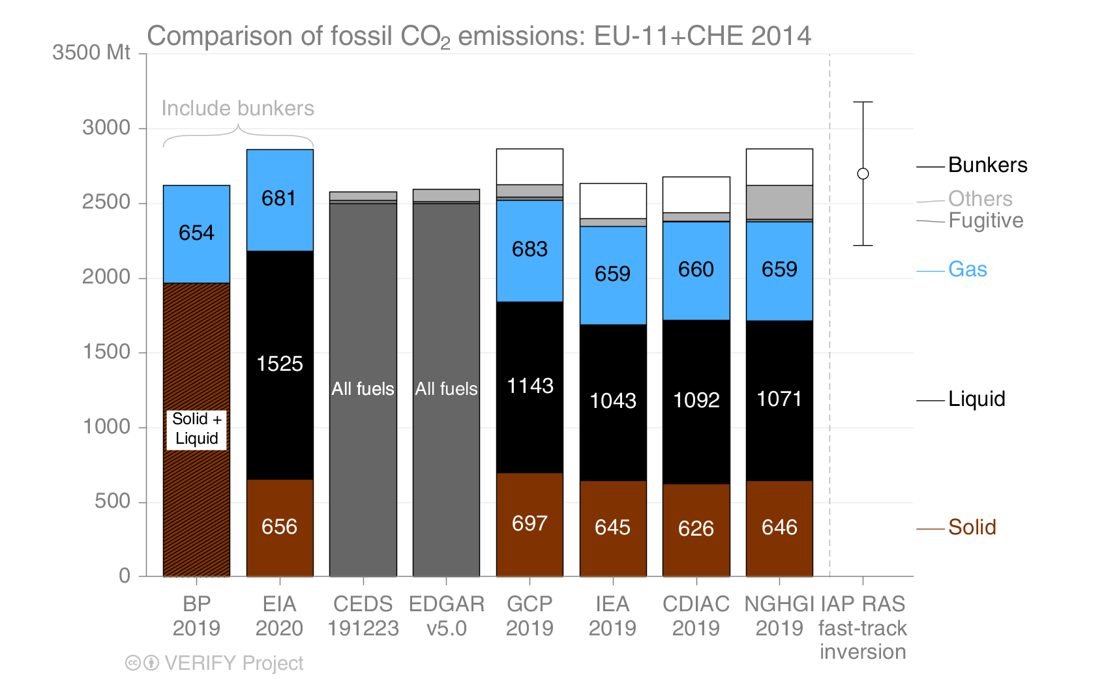
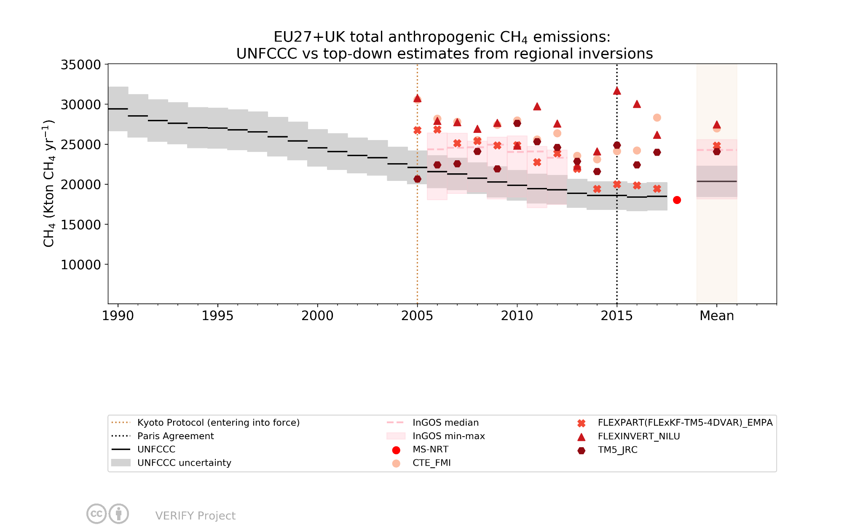
Moving towards a European capacity to monitor anthropogenic / natural CO2 emissions
The CoCO2 and VERIFY European projects
Philippe Peylin (LSCE), Richard Engelen (ECMWF), Gianpaolo Balsamo (ECMWF) on behalf of the VERIFY Team (http://verify.lsce.ipsl.fr/ - 40 partners) and the CoCO2 Team (https://coco2-project.eu - 25 partners)
Objectives: An operational system to support national GHG inventories
Method: Observation-based system to estimate GHG fluxes
INTEGRATE EFFORTS from the research community, national inventory compilers, operational centers, international organizations.
DEVELOP a Copernicus CO₂ Monitoring and Verification Support Capacity (CO2MVS)
⇒ Use of atmospheric & ecosystem measurements (in situ and satellite) with existing modeling systems
ENHANCE current observation & modeling abilities.
DEVELOP NEW research approaches to monitor anthropogenic GHG fluxes.
PRODUCE annual synthesis of GHG balance in Europe.
Combine complementary approaches including atmospheric inversions and process-based / data-driven models: global & regional (Europe) applications
Data Assimilation to merge information from model and observations
Develop a Community Inversion Framework
Exploit Anthropogenic Activity Data as demonstrated by carbonmonitor.org
Develop smart algorithms to estimate emissions from satellite-observed hotspots.
Simulations from ESA SMARTCARB study (EMPA) used for detection/estimation algorithm development.
CO2 fossil / biofuel
CO2 land biosphere
Change in biofuel emissions from 2005 to 2015
Sectoral CO₂ fossil fuel emissions and uncertainties allow attribution from atmospheric inversions. Dominant emissions groups are shown in the figure.
Global: Inversions (CAMS system) using either in situ surface (blue) or OCO-2 satellite (orange) observations show larger variability compared to National Inventories (green)
Net land fluxes (EU27 +UK)
Above: Regional (blue) and global (Red) inversions compared to National Inventories (green) for Europe. Below: European synthesis of process-based/statistical models, atmospheric inversions and National Inventories.
Large increase in biofuel use in Europe over the past decades.
Annual CO2 flux from the Agricultural, Forestry and Other Land Use (AFOLU) sector in ten large countries or groups of countries estimated by the 1-σ uncertainty envelope of the two CAMS atmospheric inversions (blue with surface data and orange with satellite-data). Green curve is for the reported fluxes to UNFCCC by all countries. Positive values indicate that the country is a source of CO2 to the atmosphere. Chevallier et al., GRL, 2021.
Dominant sector of the CO2 fossil fuel emissions (Choulga et al. 2021) based on EDGAR 4.3.2 global emissions dataset.
Time series of CO2 fossil fuel emissions split per sector for Europe
Detailed modelling supports the satellite detection and estimation of emissions from power plants.
Europe
⇒ Bottom-up models (process-based and data-driven) show large interannual variations but agree with National GHG Inventories (NGHGIs) reported to UNFCCC.
⇒ Top-down inversions generally indicate stronger sinks compared to NGHGIs, with significant variations between individual members of each ensemble.
⇒ Care must be taken with inversions for small regions !
(Petrescu et al., ESSD, 2021a)
Fossil CO₂ emissions from 9 sources, including UNFCCC NGHGI, and a first inversion estimate (IAP RAS).
Differences mostly due to different accounting systems:
understanding them is critical for for further analysis and communication; Inversions are still very uncertain and at their infancy.
CH4 anthropogenic
Acknowledgement
CH₄ total regional inversions (Europe) larger than total NGHGI emissions
Differences due to underestimated natural fluxes or anthropogenic fluxes (Petrescu et al. ESSD, 2021b)
The CoCO2 / VERIFY projects have received funding from the European Union’s Horizon 2020 research and innovation programme under grant agreement No 958927 / No 776810
This presentation reflects the views only of the author, and the Commission cannot be held responsible for any use which may be made of the information contained therein.
Detailed atmospheric modelling of the behaviour of CO₂ plumes emitted from large power plants. These simulations support a more accurate interpretation of the satellite and in-situ observations of atmospheric CO₂.
Results for all EU countries under: http://webportals.ipsl.jussieu.fr/VERIFY/FactSheets/

