Slide 1
Copernicus Climate Change Service
Samantha N Burgess
Deputy Director, C3S
COP26 – 3rd Nov 2021 – UNFCCC Earth Info Day

Slide 2
Copernicus Climate Change Service – the nexus between observations and society
https://cds.climate.copernicus.eu
103.500 registered users
Free and open data that is traceable and transparent
109 Catalogued Datasets
24 catalogued public applications
+ 19 available the European Climate Data Explore (EEA)
Notes:
As part of Copernicus, ECMWF developed the “Climate Data Store”, which is a cloud-based service (SaaS) allowing solution to work directly on a number of (massive) datasets, stored at ECMWF and in a few other places in Europe (such as CMIP climate projections). http://cds.climate.copernicus.eu

Slide 3
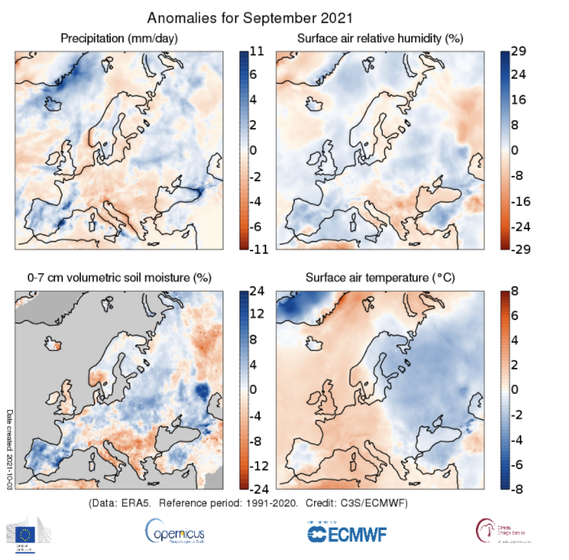
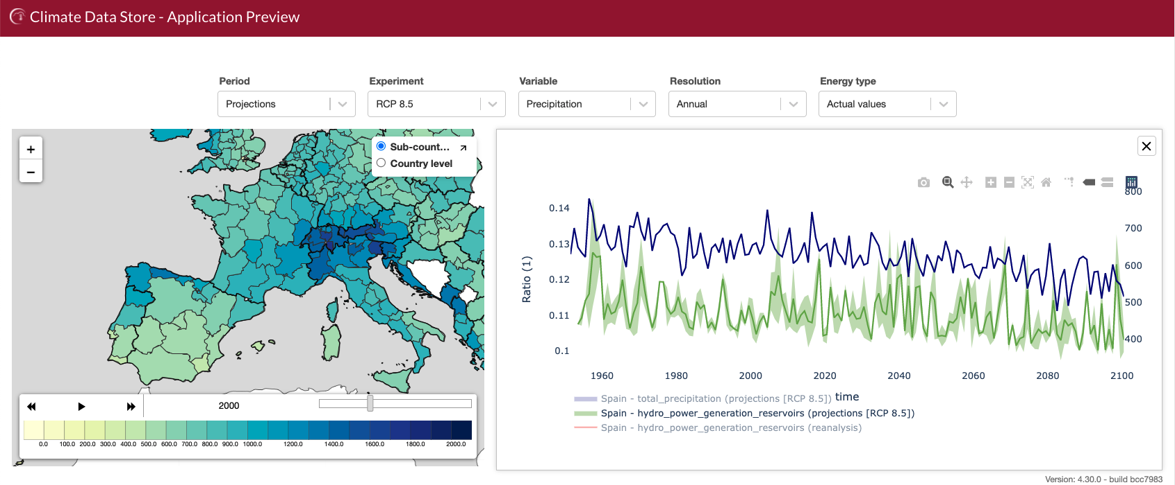
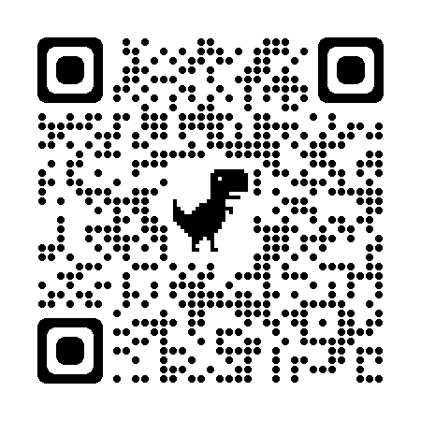
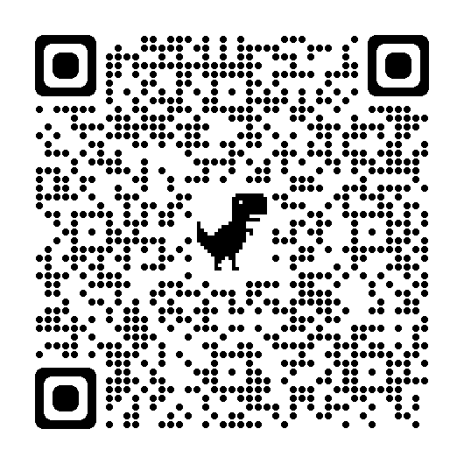
A new tool for monitoring a warming climate

Slide 4
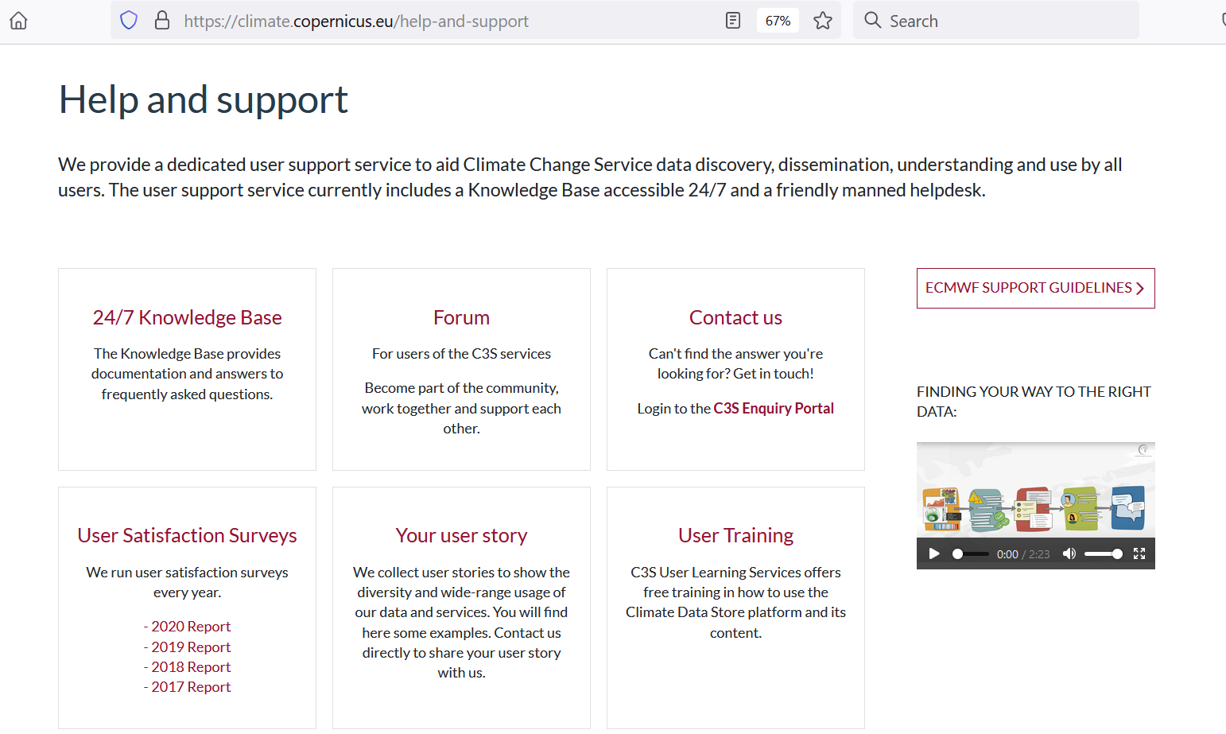
Operational service for users….
Find us:
climate.copernicus.eu
cds.climate.copernicus.eu
atmosphere.copernicus.eu
@CopernicusECMWF @CopernicusEU
@ECMWF
For press inquiries:
copernicus-press@ecmwf.int

