Slide 1
Action for Climate Empowerment
Euroclima+ Programme
October 19th

Slide 2
THE BEGINNING FOR NATIONAL ACE STRATEGIES
EUROCLIMA+ is the EU flagship cooperation programme on environmental sustainability and climate change with the Latin American region.
EUROCLIMA+ carries out actions that are considered of strategic importance for the implementation of the countries’ Nationally Determined Contributions (NDCs). The Programme:
Corresponds to expressed needs of one or several countries.
Carries out actions where European cooperation can add particular value.
Supports intra-regional dialogue and cooperation on climate issues within Latin America.
Supports bi-regional dialogue and cooperation between Latin America and the EU in international climate fora around shared strategic interests, guided by the Paris
Agreement and the Sustainable Development Goals.
Is implemented by agencies of EU Member States (AECID, AFD, Expertise France, FIIAPP, GIZ) and the UN (ECLAC and UN Environment).
Nationally Determined Contributions (NDCs): GOALS in Education, training, …
Euroclima+ offers financial and technical support

Slide 3
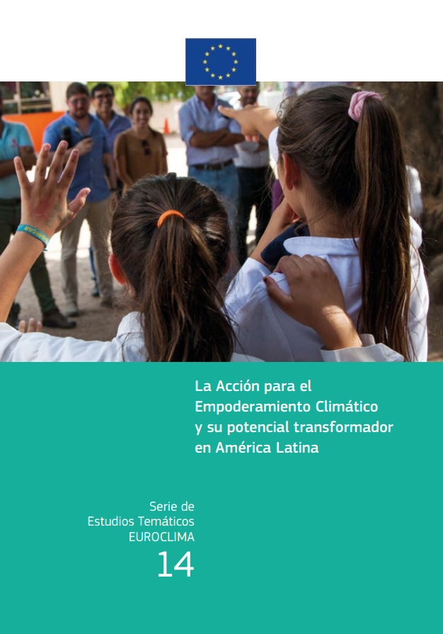
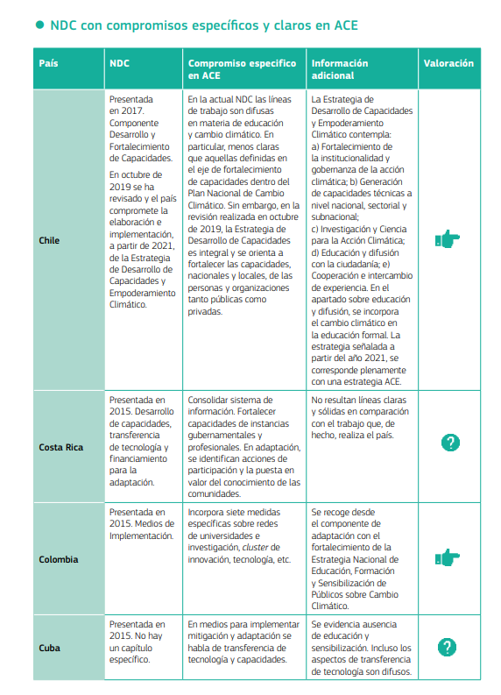
ACE BASELINE REPORT IN THE REGION: STATE OF THE ART
More information: EUROCLIMA+ es un programa financiado por la Unión Europea - Un nuevo Estudio Temático analiza el estado del Arte en ACE en América Latina

Slide 4
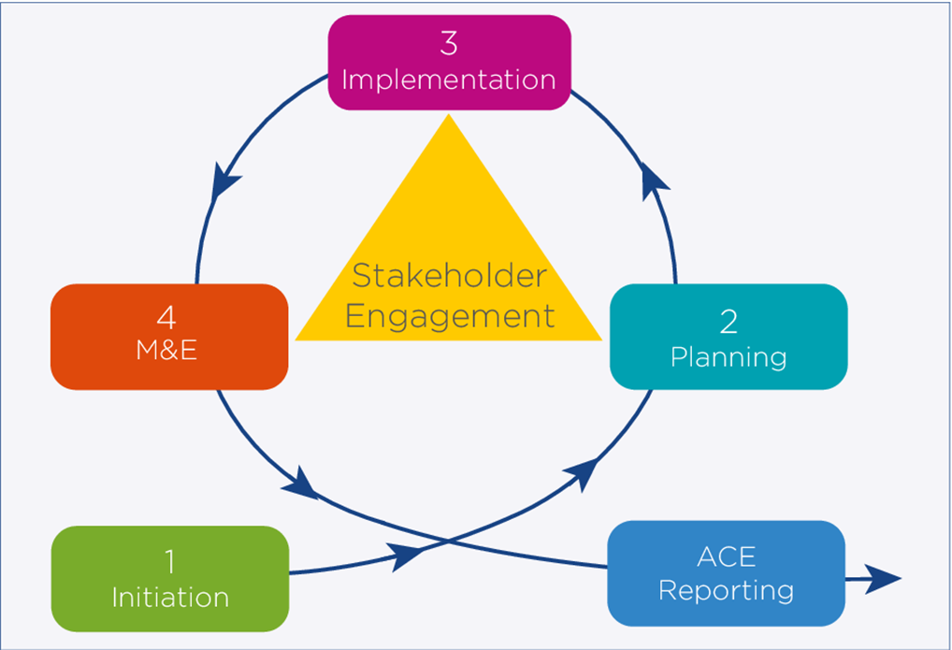
NATIONAL ACE STRATEGY (ENACE) PROCESS
Guidelines for accelerating solutions through education, training and public awareness (UNESCO and UNFCCC).
Team (Coordinator, environmental education, M&E, participatory process, gender and cultural diversity, C&V…)
Initiation or Diagnostic studies: State of the ART and Baseline (regulatory frameworks that promote ACE).
Participatory processes with civil society: transversal and continuous component in the ENACE supported by systematizations.
Collaborative, interdisciplinary, interministerial and multilevel work.
Draft document in the process of citizen public consultation.
Piloting actions in ACE (innovation, replicability, scalability, continuity and M&E)
Backbone: the participatory process (ongoing process)

Slide 5
6 ELEMENTS?
Training
Education
Public
Participation
Public
Awarness
Access to public information
Internacional
cooperation

Slide 6
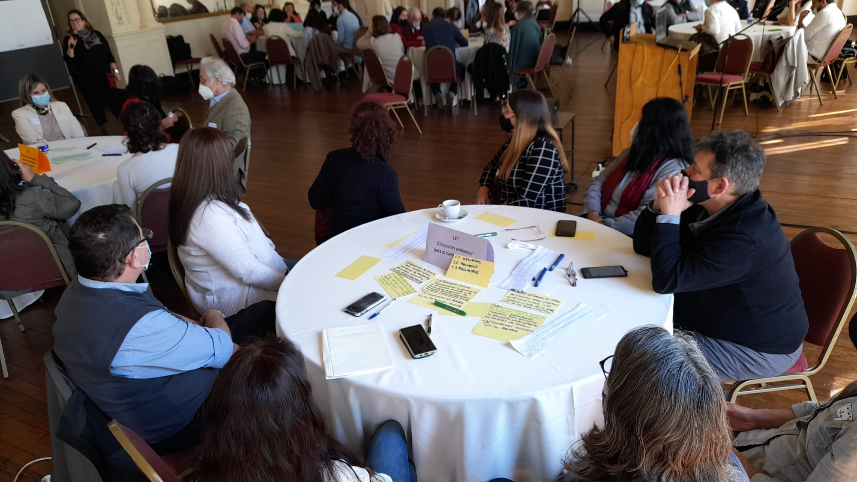
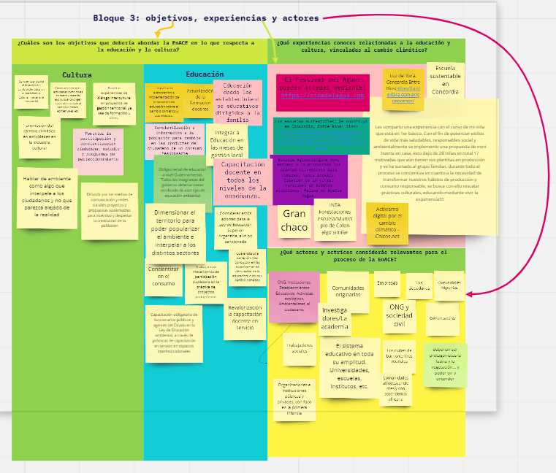
PUBLIC PARTICIPATION
During the whole process:
Perception studies
Surveys
ENACE public consultation
Sectoral/territorial participatory workshops
Participatory workshops with youth
After the process:
Systematization of public consultation workshops
Categorization of observations
Improvement proposal reports
Information return

Slide 7
MAINSTREAMING IN THE ENACE
Cultural diversity
Gender
Just transition
Federalism
Culture…

Slide 8
SUPPORTING: THEORETICAL AND PRACTICAL FRAMEWORK
1.- CAP ACE: COMMUNITY OF PRACTICE (FIIAPP-OREAL UNESCO)
2.- STRATEGIC EXPERTS ADVICE
3.- COLLECTIVE INTELLIGENCE (INNOVATION)
Internacional
cooperation
Países participantes (15)
Argentina
Chile
Colombia
Costa Rica
Cuba
Ecuador
Perú
Uruguay
Venezuela
El Salvador
España
Guatemala
Honduras
México
Panamá
…
Training

Slide 9
DOCUMENTS OF INTEREST
Technical Documents:
State of the Art of ACE: Ace status in the region (2020).
Theoretical - Practical Frameworks:
Climate Competence: a cross-cutting proposal on capacities in Action for Climate Empowerment.
ACE strategic guide to public policy (draft)
Webinars:
- ACE and its transformative potential in Latin America Empowering for Climate Action: Visions and Learnings - COP26
- Launching of the Capacity and Climate Empowerment Strategy process Chile
- Joint regional event: Climate empowerment: education to drive ambition.
Systematization of Experiences:
Participatory processes: systematization reports Participatory Processes ECEC Chile, Argentina and Costa Rica.

Slide 10
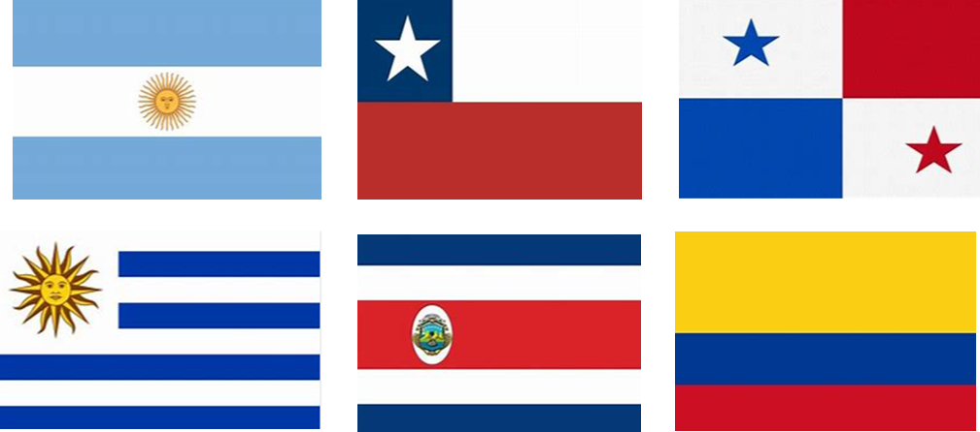
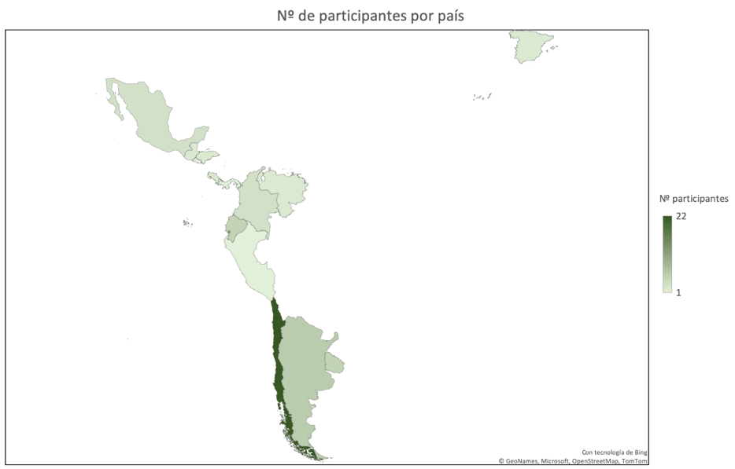
ACTIONS IN PROGRESS
NATIONAL ACTIONS
CHILE: CHILE: Climate Empowerment Capacity and Development Strategy and Participatory Process in Public Consultation. .
URUGUAY:
Educational Resources: Amelia/ Environmental Education and Gender.
National Climate Empowerment Strategy. .
PANAMÁ: National Climate Empowerment Strategy.
ARGENTINA: National ACE Strategy (M&E)
COSTA RICA: National ACE Strategycon (M&E, C&V ACE)
COLOMBIA: Reviewing ACE dentro su ECDBCAR.
ACCION REGIONAL ESTRATEGICA ACE:
Regional events: Regional ACE Workshop / LACCW / COP27
Community of Practice in ACE
Theoretical and practical framework

Slide 11
SOME LESSONS LEARNED
Strengthening of the Regional Dimension: Identity
Construction of Collaborative Spaces at the regional level with Exchange with Countries among counterparts: CAP ACE 2022 space and The ACE Regional Meeting in Argentina – Community building (October 2022 )
Transversal Approaches in the NDC's and LTS through: * Facilitation of theoretical-practical frameworks: Climate Competition Strategic or Guide for the mainstreaming of ACE in climate public policies.
Coordination of ENACES with long-term Climate Strategies from multi-actor and multi-sector coordination. The ENACEs are means of implementation of the mitigation and adaptation policies.
The ENACEs have an interdisciplinary character, covering instances that have to do with the 6 elements of ACE.
Broad and diverse participatory processes with civil society and key and specific actors.
The need to continue deepening the monitoring and evaluation systems of the ENACEs, both quantitatively, qualitatively and with indicators that measure impact.
Capacity building in ACE for the Public Sector

Slide 12
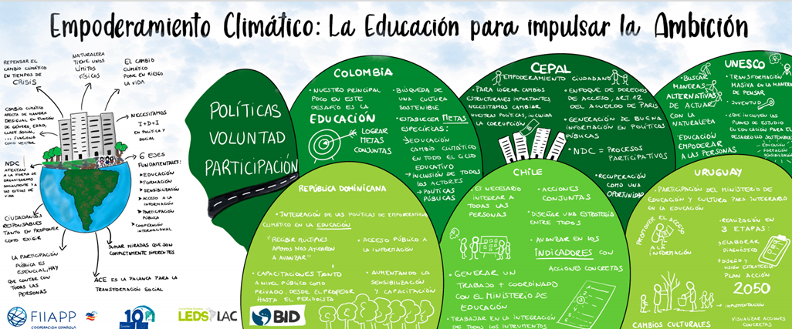
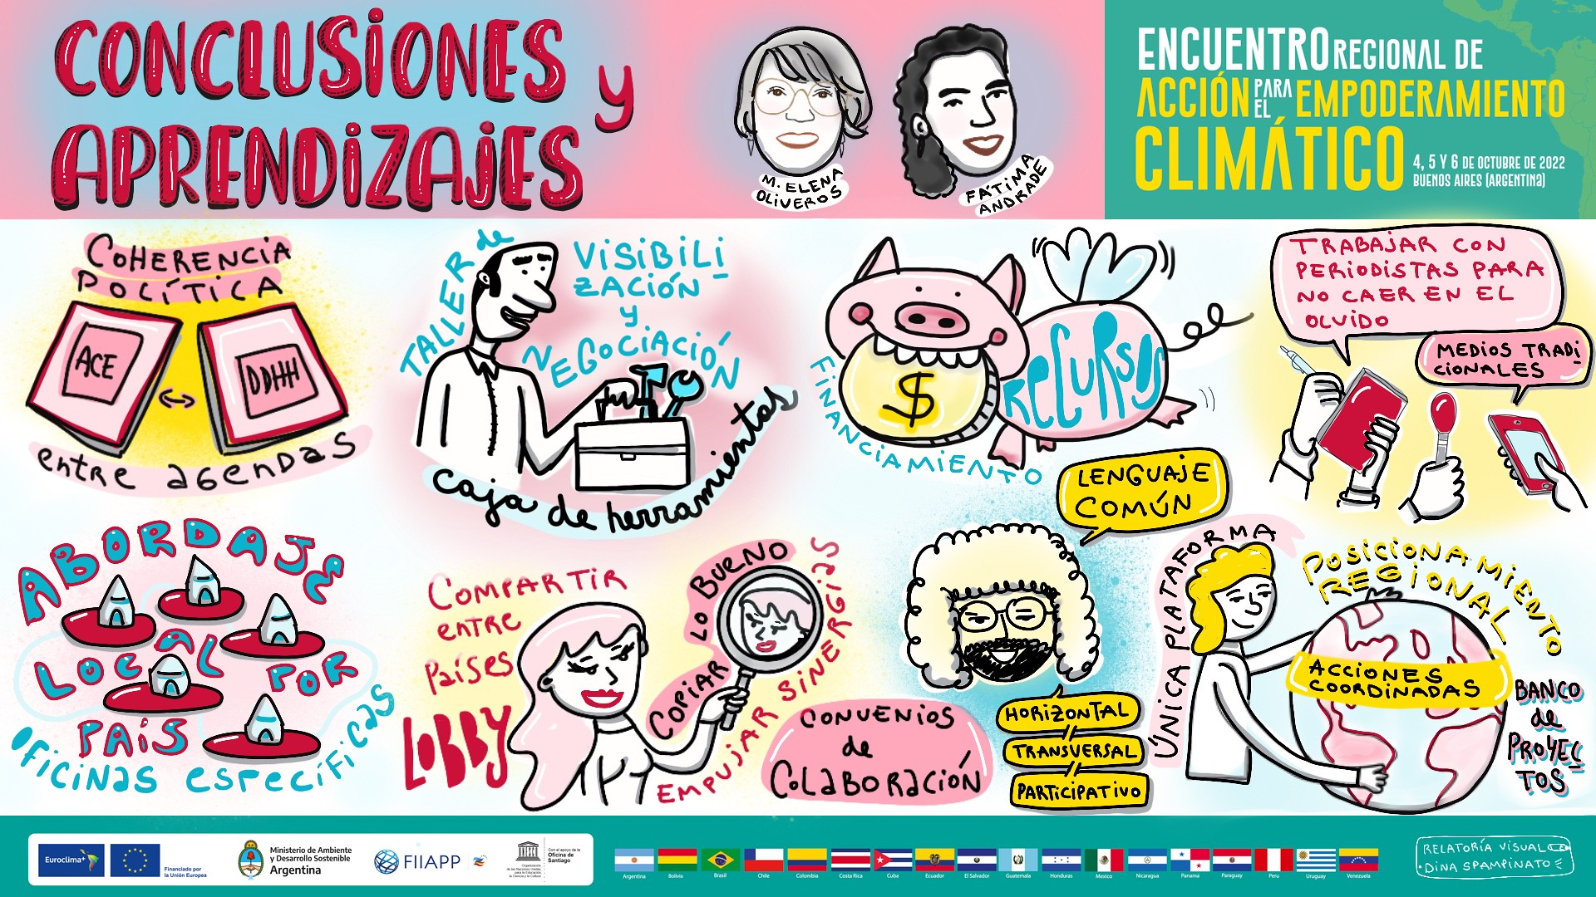
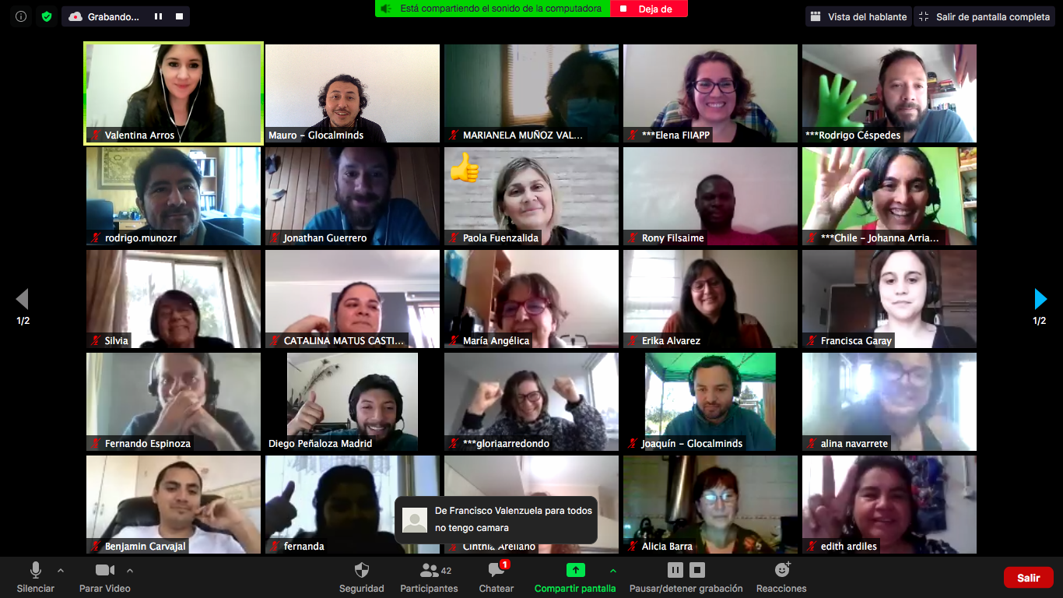
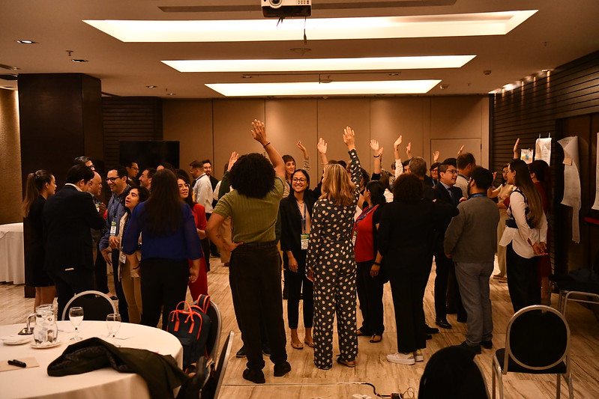
ACTION FOR CLIMATE EMPOWERMENT

Slide 13
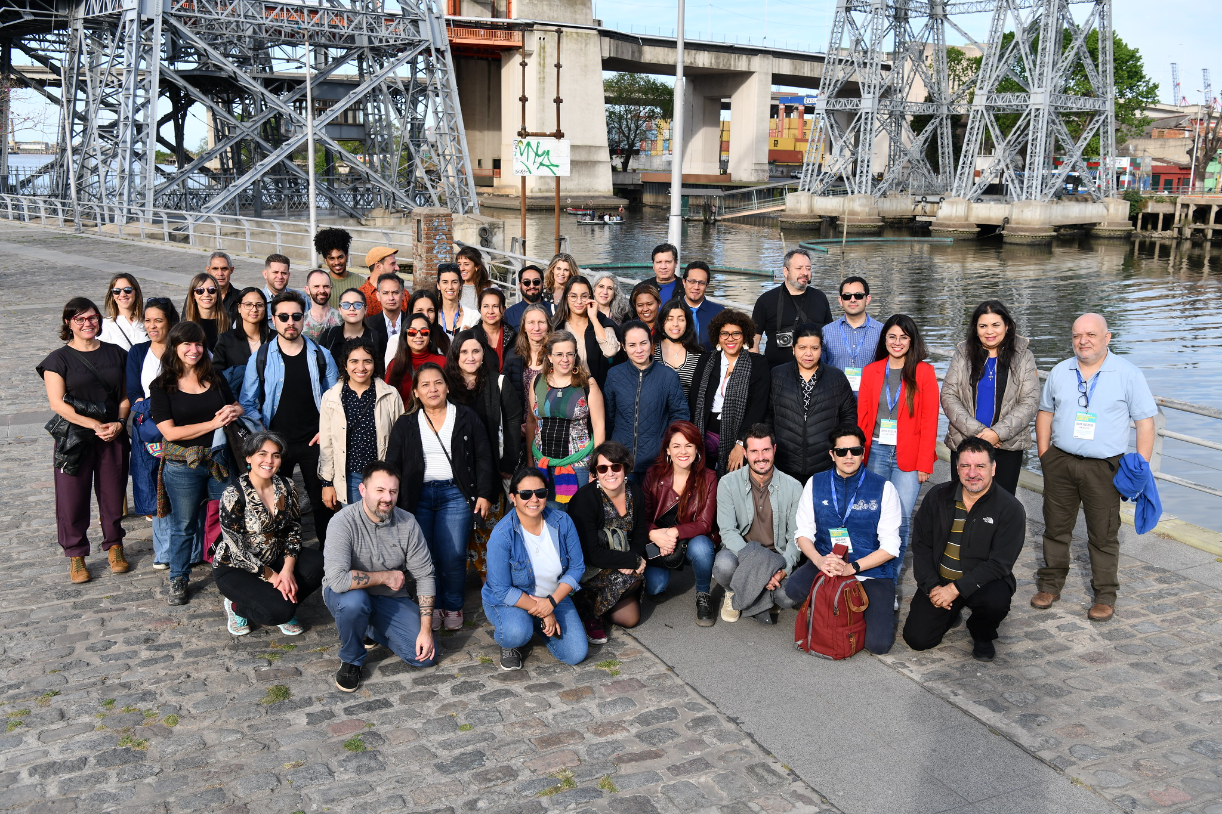
COMMUNITY – BELONGING - EMOTION

Slide 14
THANK YOU
EUROCLIMA+ es un programa financiado por la Unión Europea - Action for climate empowerment

