Slide 1
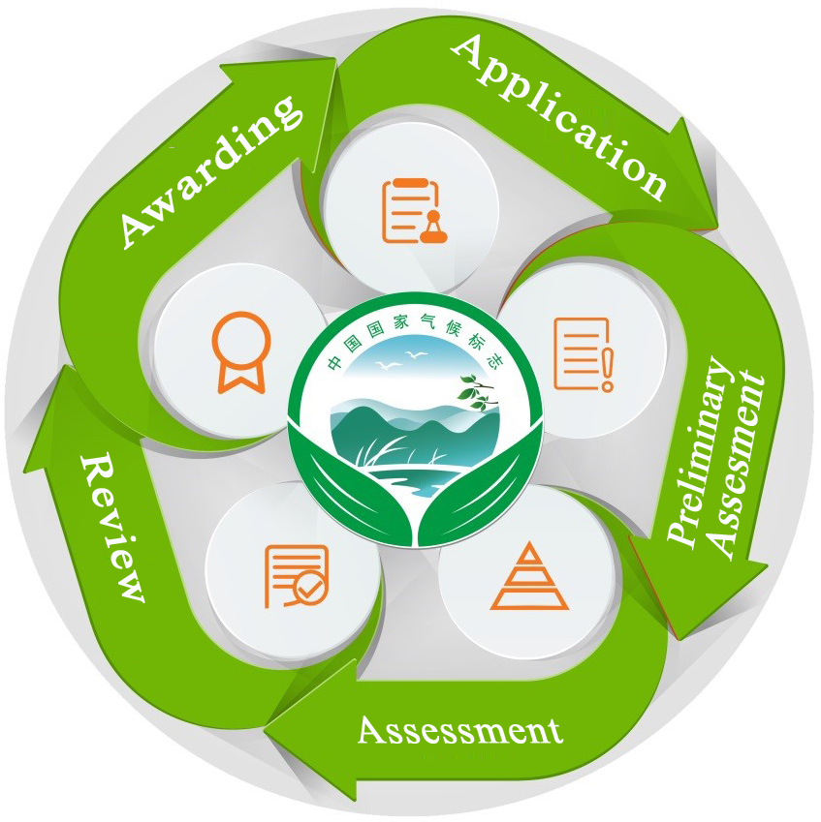
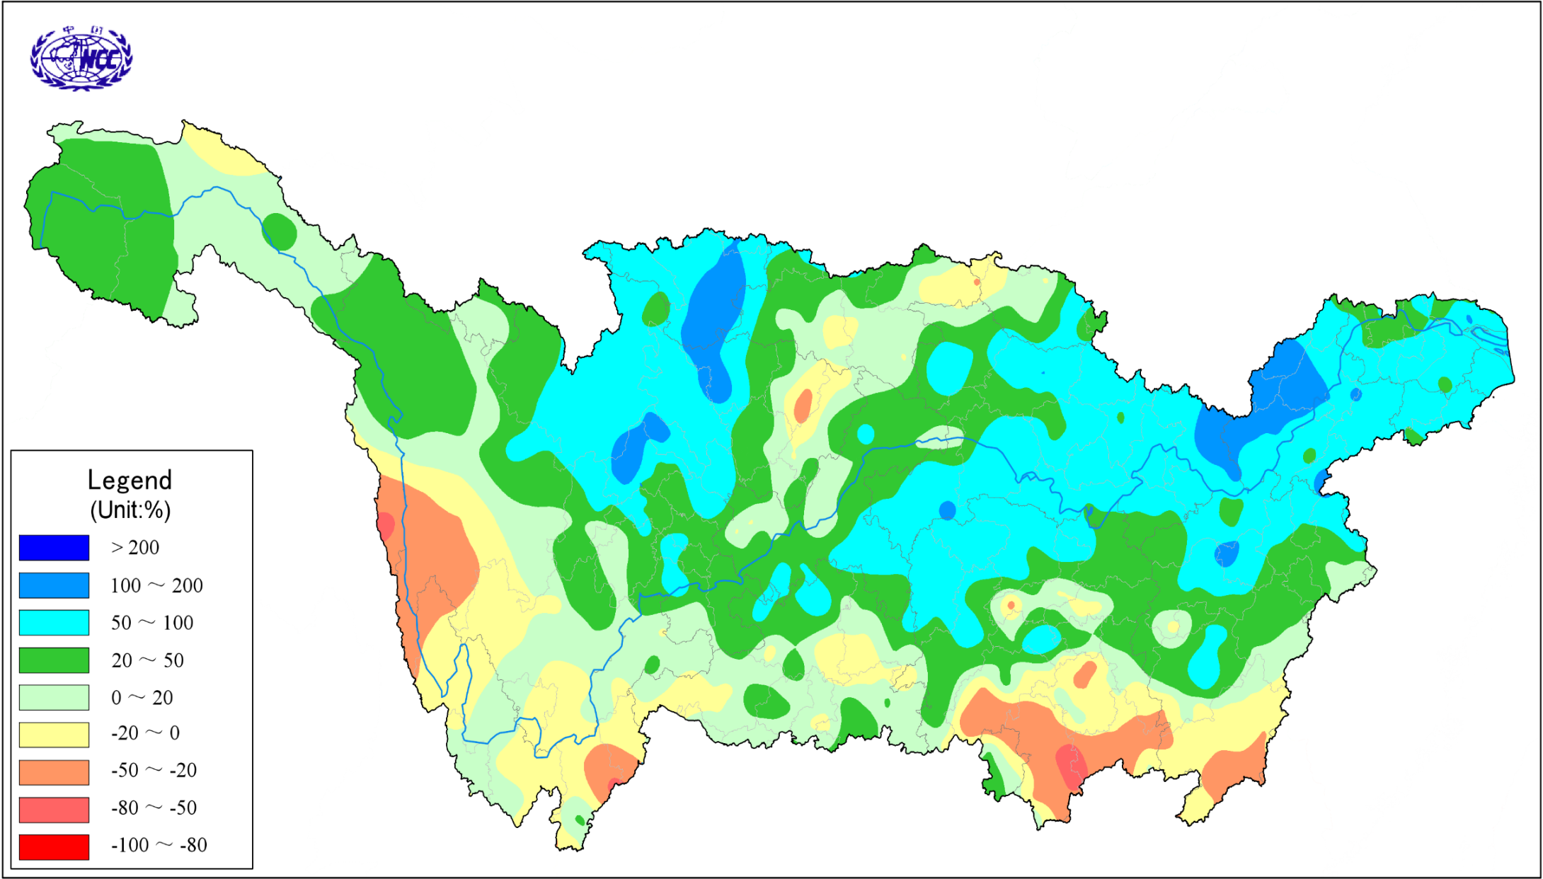
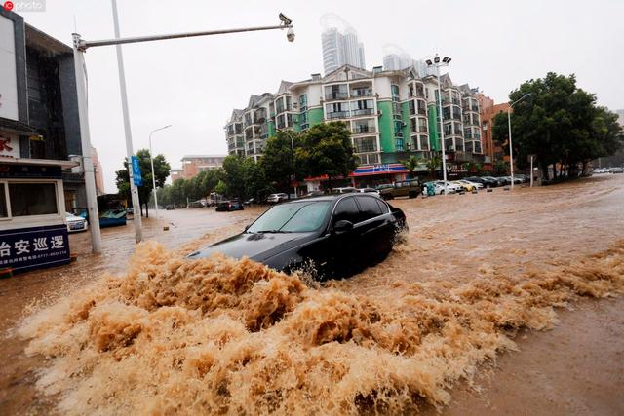
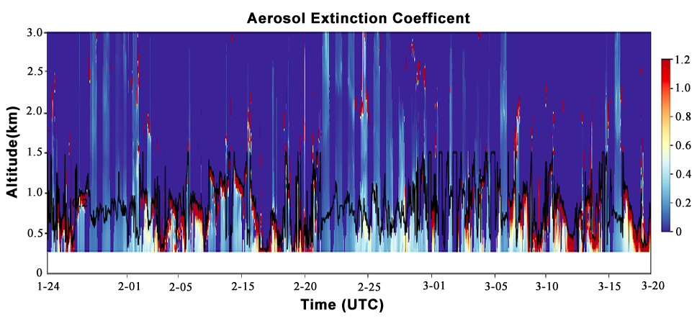
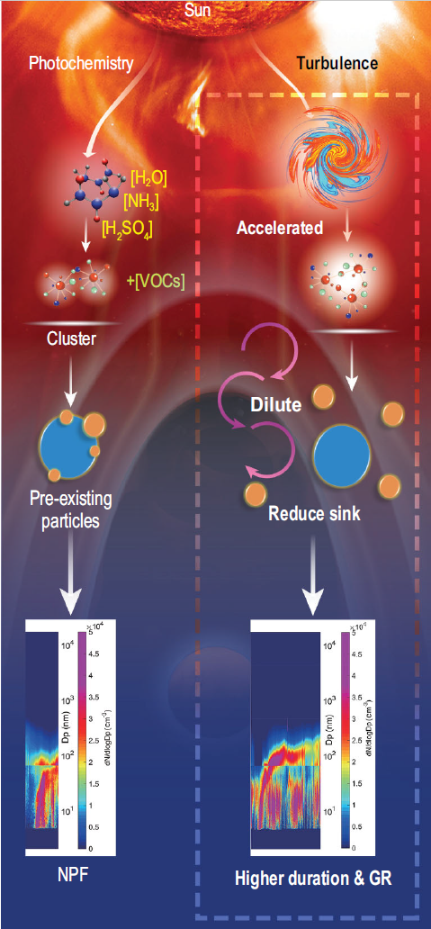
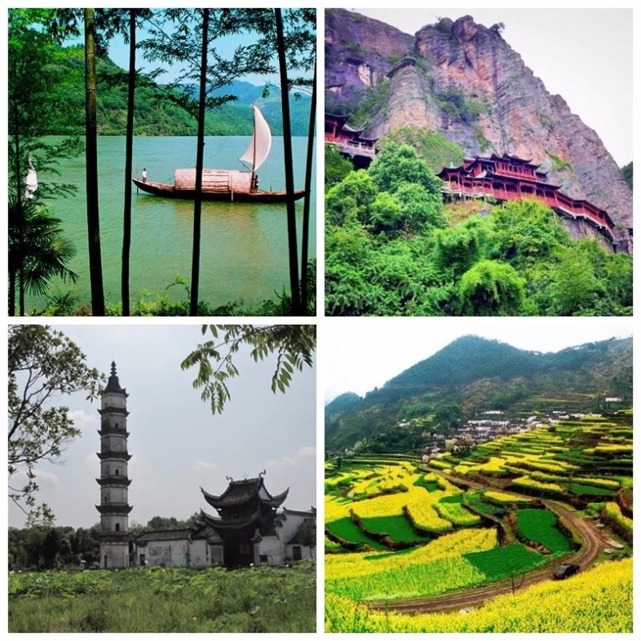
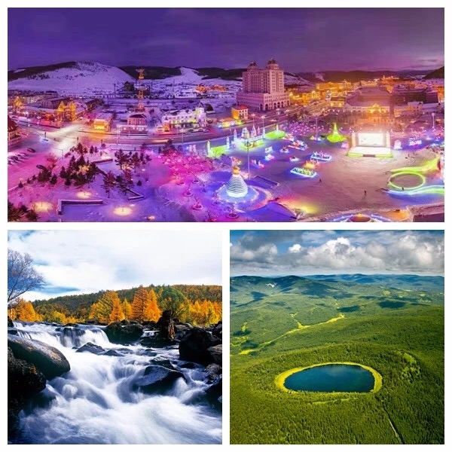
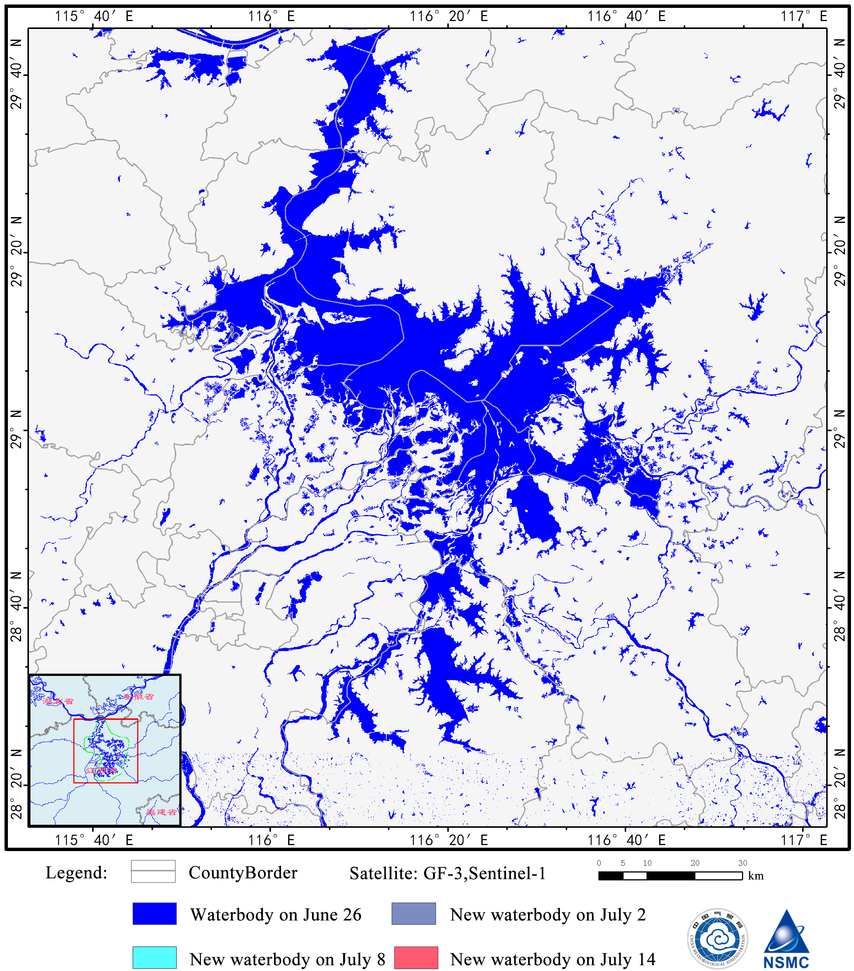
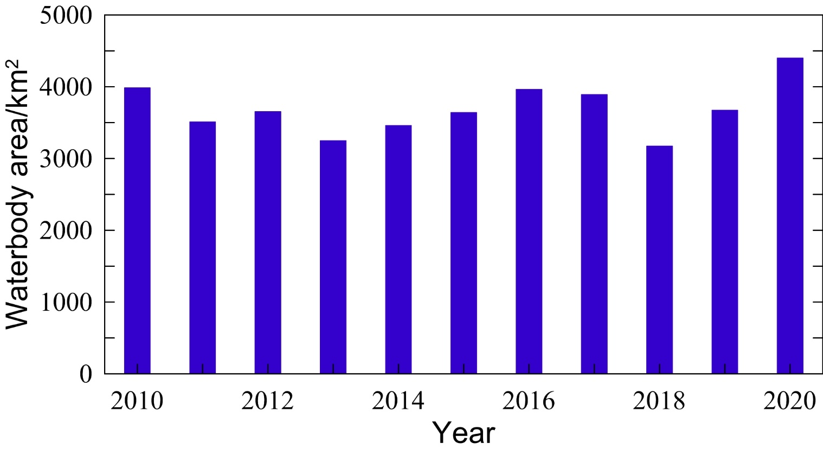
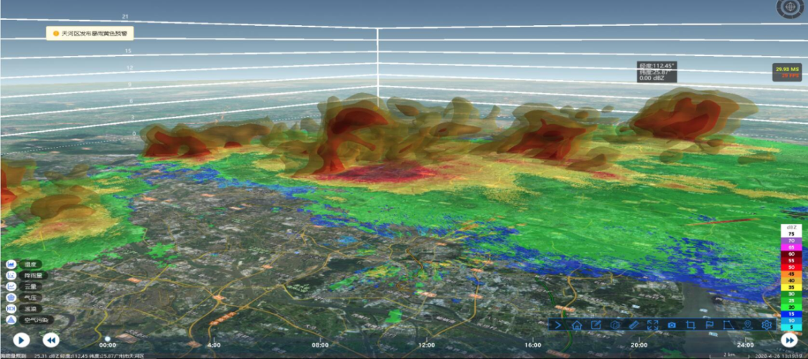
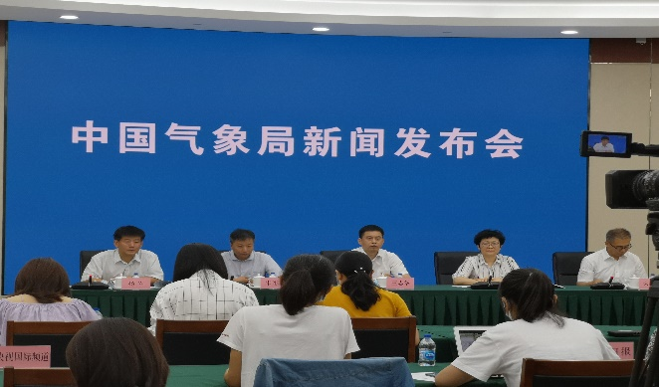
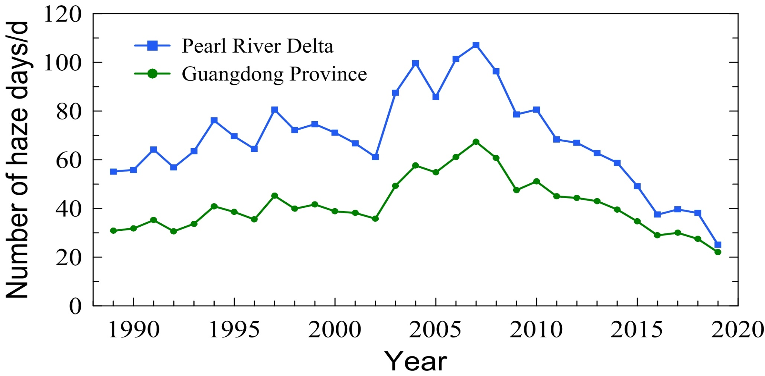
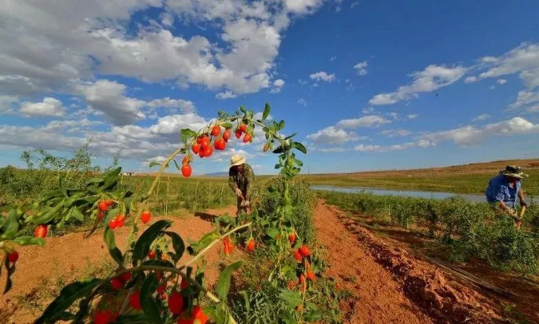
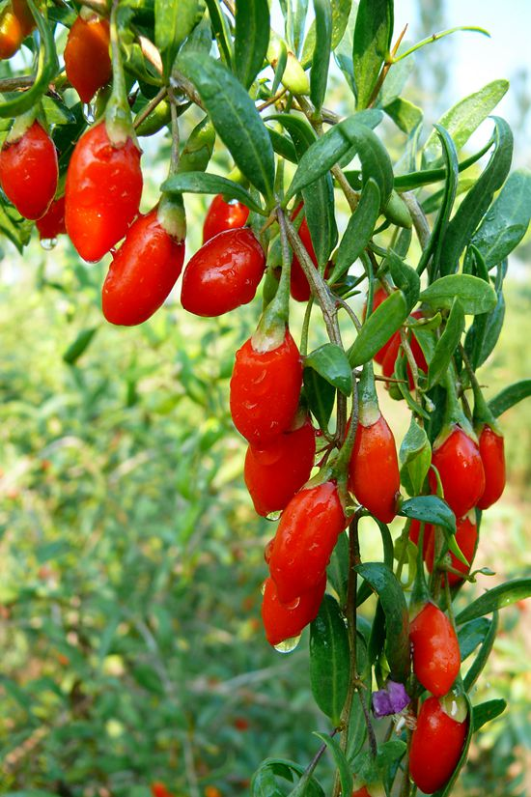
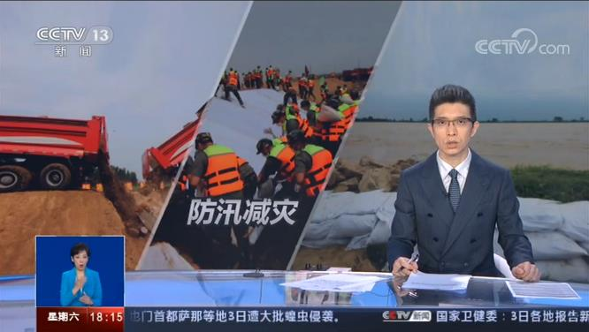

Applications of Integrated Earth Information in achieving SDGs and promoting Ecological Civilization Construction in China
Qingchen CHAO¹, Caiying WEI², Changxing LI³, Penling WANG¹, Lijuan MA¹, Xiuzhen HAN² and Fa TAO³
¹National Climate Centre, China Meteorological Administration (CMA) ²National Satellite Meteorological Centre, CMA ³CMA Meteorological Observation Centre
Case I. Key role of products from satellite in preventing 2020 extreme floods in the middle and lower reaches of the Yangtze River
Case II. Comprehensive observation network of the megacities in supporting regional governance of atmospheric environment
Case III. National Climatic Indication: evaluating local natural climatic
environment to facilitate the Construction of a Wild China
In Summer 2020, the Yangtze River Basin witnessed the highest precipitation since 1961,
with the Huaihe River and Taihu Lake Basin the second largest rainfall in history.
In the Pearl River Delta region, the megacities comprehensive observation network was established, consisting of a variation of new remote sensing devices, such as Ka-Cloud Radar, Microwave Radiometer, Wind Profile Radar, Aerosol Lidar and X-band Weather Radar, to detect atmospheric temperature, humidity, wind, hydrometeor, and aerosol.
A bunch of monitoring products were developed to support the regional efforts in the governance of atmospheric environment.
In order to protect climate ecology, tap climate value, meet the people's growing needs for a better life, help build a Wild China and promote economic and social development, the National Climate Center makes every effort to create "National Climatic Indication" climate brand at national level.
Three types of National Climatic Indications:
Climate Livable
Climate Ecology
Climate Quality
Microwave Radiometer
Ka-Cloud Radar
Wind Profile Radar
X-band Weather Radar
Distribution of precipitation anomaly percentages
across the Yangtze River Basin in summer 2020
A car in Yichang struggling through
the water on June 27, 2020
Aerosol Lidar
Information of water body area changes of major rivers and lakes was provided to the government and the public for flood prevention, by combing FengYun (FY), Gaofen, and Sentinel 1 satellites observations.
Jiande City, Zhejiang Province
(Climate Livable City)
Arxan City, Inner Mongolia Autonomous Region
(Climate Ecology City)
Annual max. area of Poyang Lake
Aerosol extinction coefficient monitoring products from Micro Pulse Lidar at Guangzhou Station
Multi-source satellite monitoring confirmed that the main body of Poyang Lake and its adjacent waters have reached 4403 km² on July 14 , 2020, the largest coverage since 2000, when its water level hit record high on July 12th, 2020.
3D fine monitoring of meso-scale weather processes
The number of tourists received increased by 13.5% year-on-year, and the investment rate of tourist projects increased by 10.8%.
The number of tourists received in Arxan increased by 17% and the tourist income by 18% year-on-year.
CMA New Press
Zhongning, Ningxia Hui Autonomous Region
(Climate Quality of Agricultural Products)
In addition to support local socio-economy development and boost ecological civilization, this campaign will also arouse and improve the whole society‘s awareness of the climate, and understand climate scientifically, use climate reasonably, as well as adapt to the climate change and make efforts to protect climate.
No catastrophe in the extreme flood year demonstrated great success in China’s flood prevention and disaster relief system, new emergency management system, jointly consultation, accurate warning, monitoring and early warning information sharing among meteorological, hydrology and natural resources departments.
Authoritative media
Combine the mechanism of new particles generation, the number of haze days decreased substantially in the Pearl River Delta in the past decade.
Schematic illustration of the impact of turbulence on the nucleation, duration and growth rate of a new particle formation process (Wu et al., 2020)
Sales of the distinctive agricultural products have surged.

