Slide 1
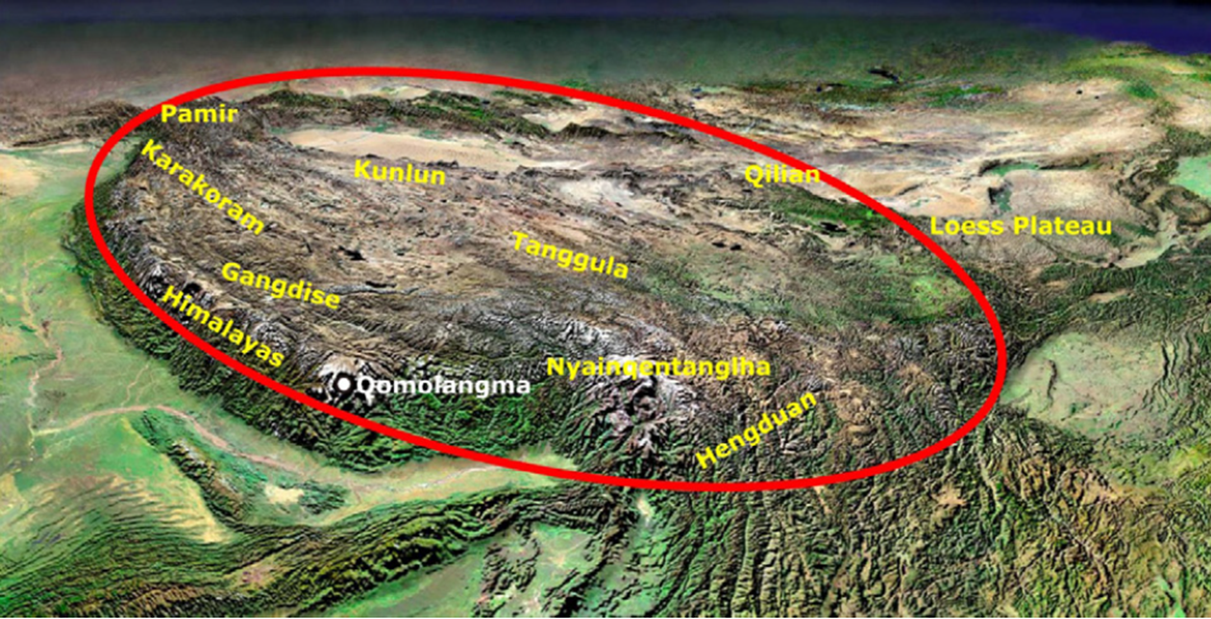
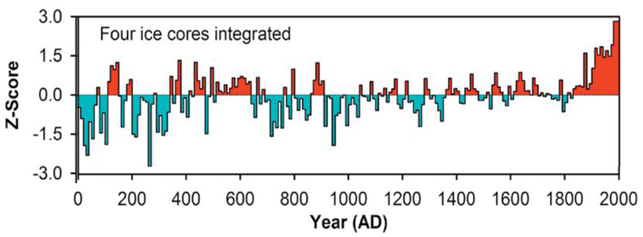
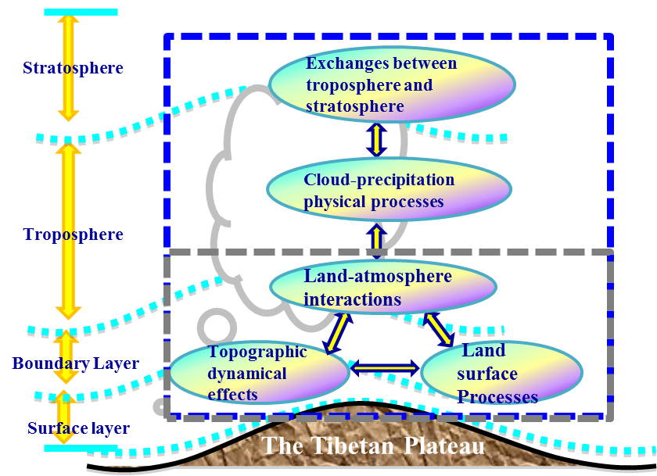
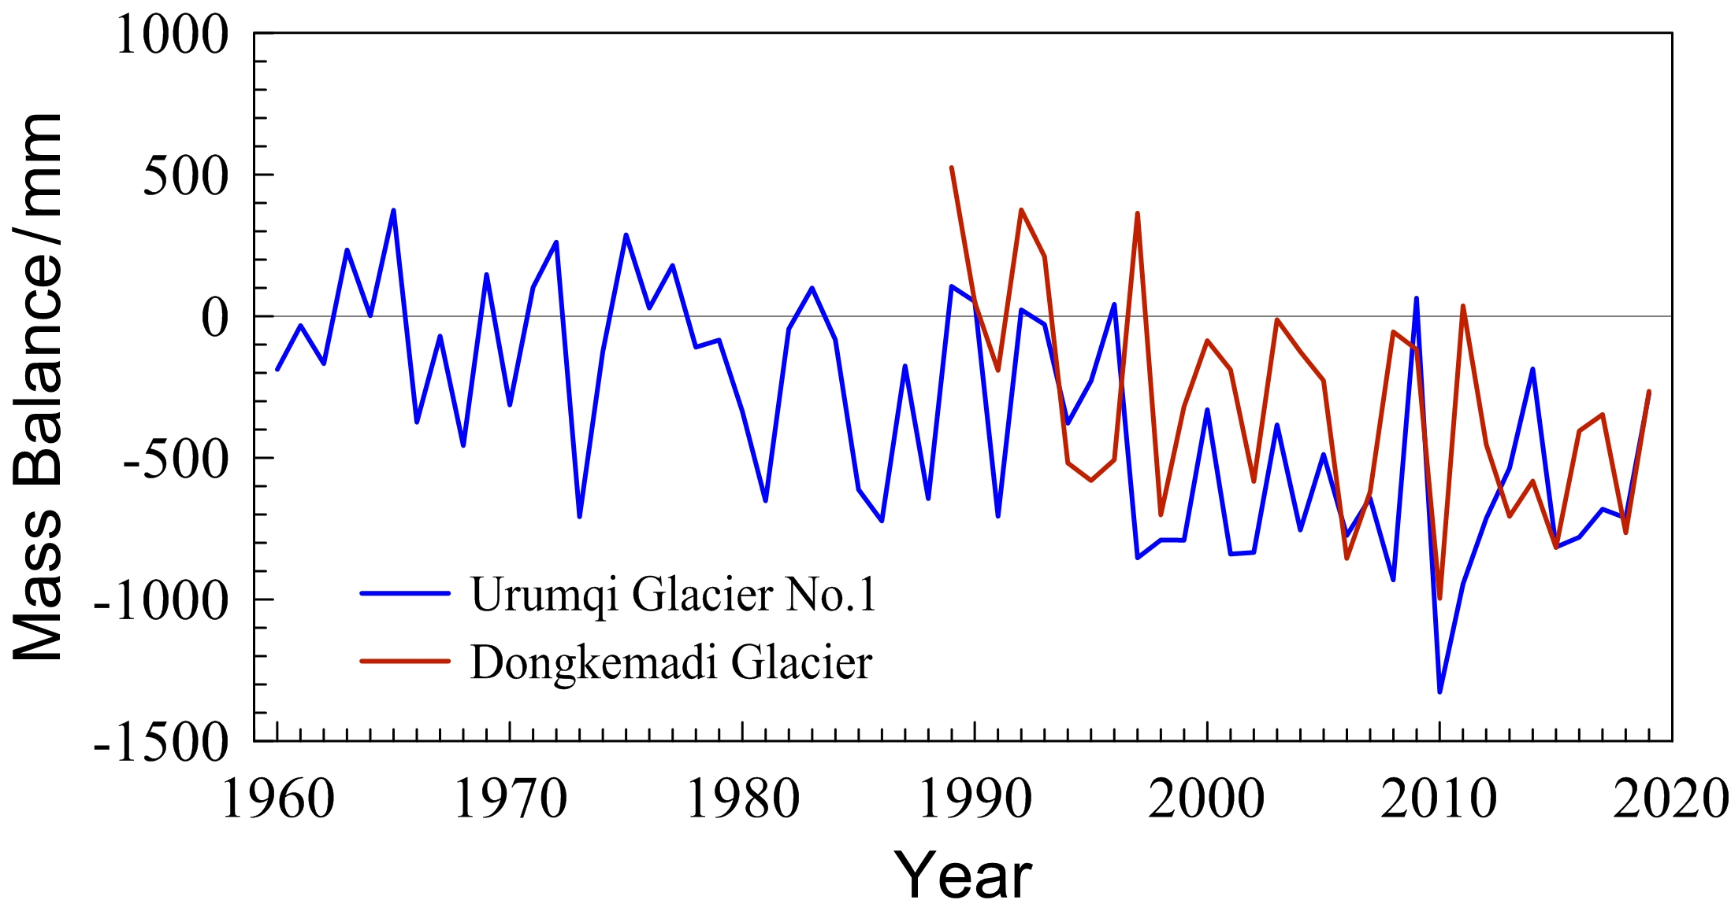
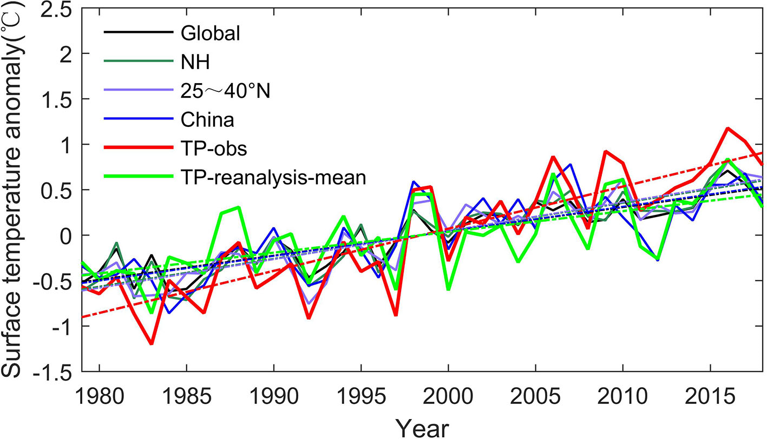
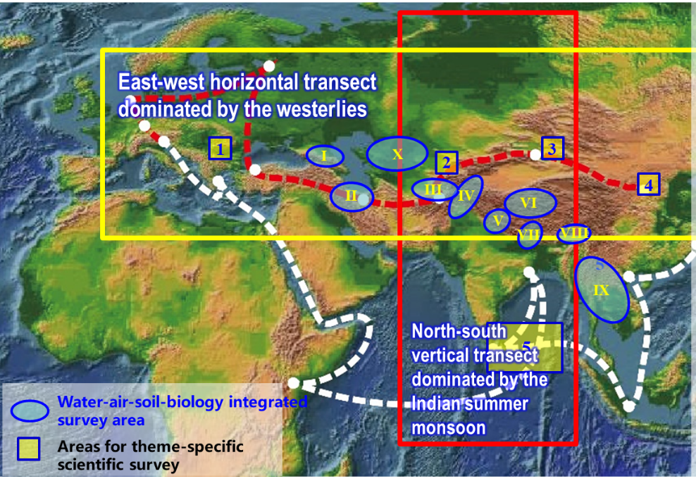
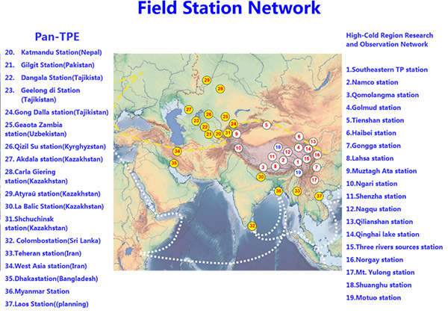
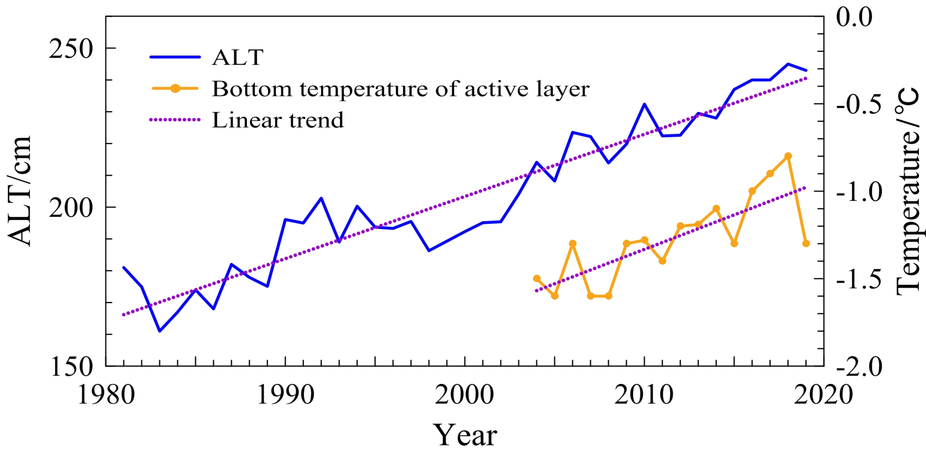
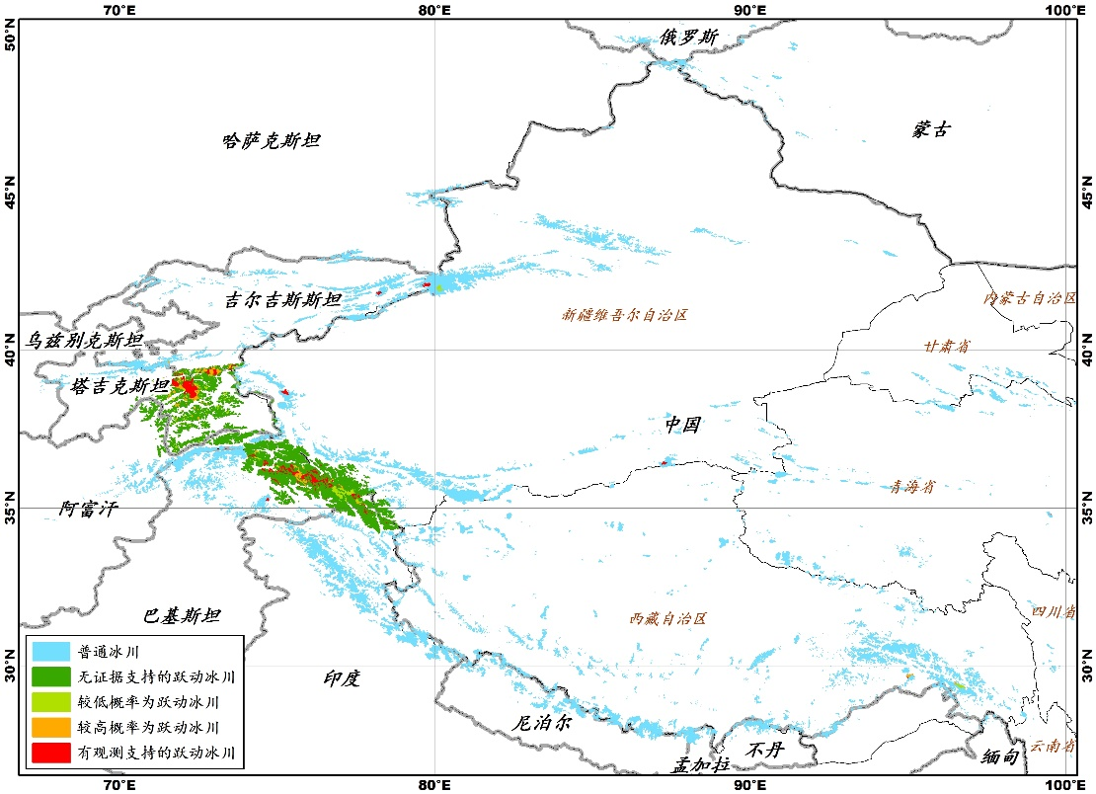
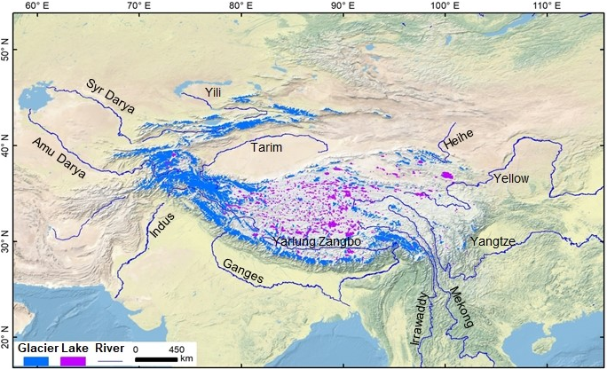
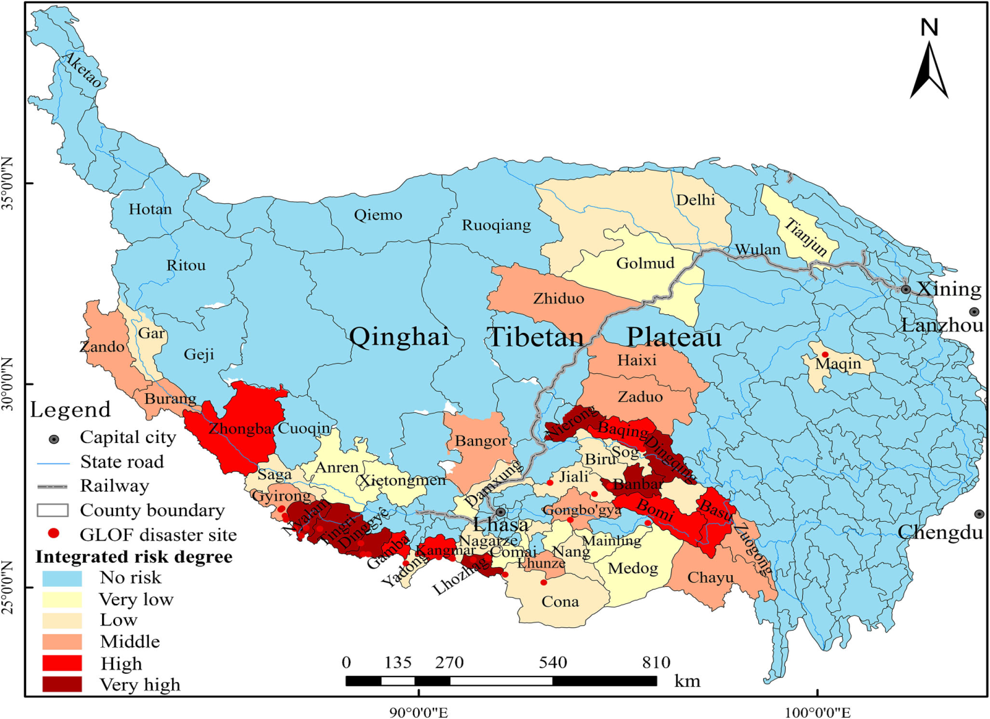
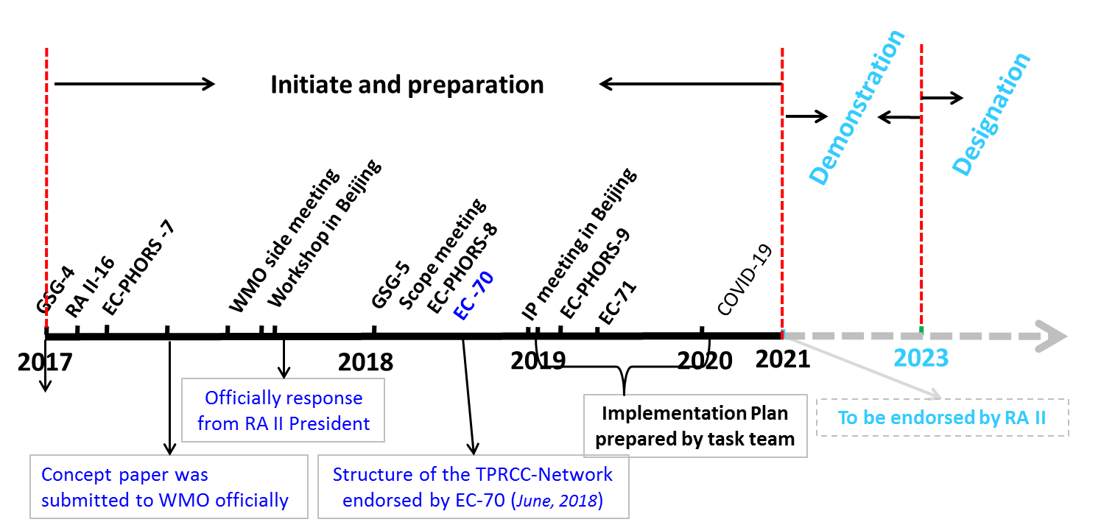
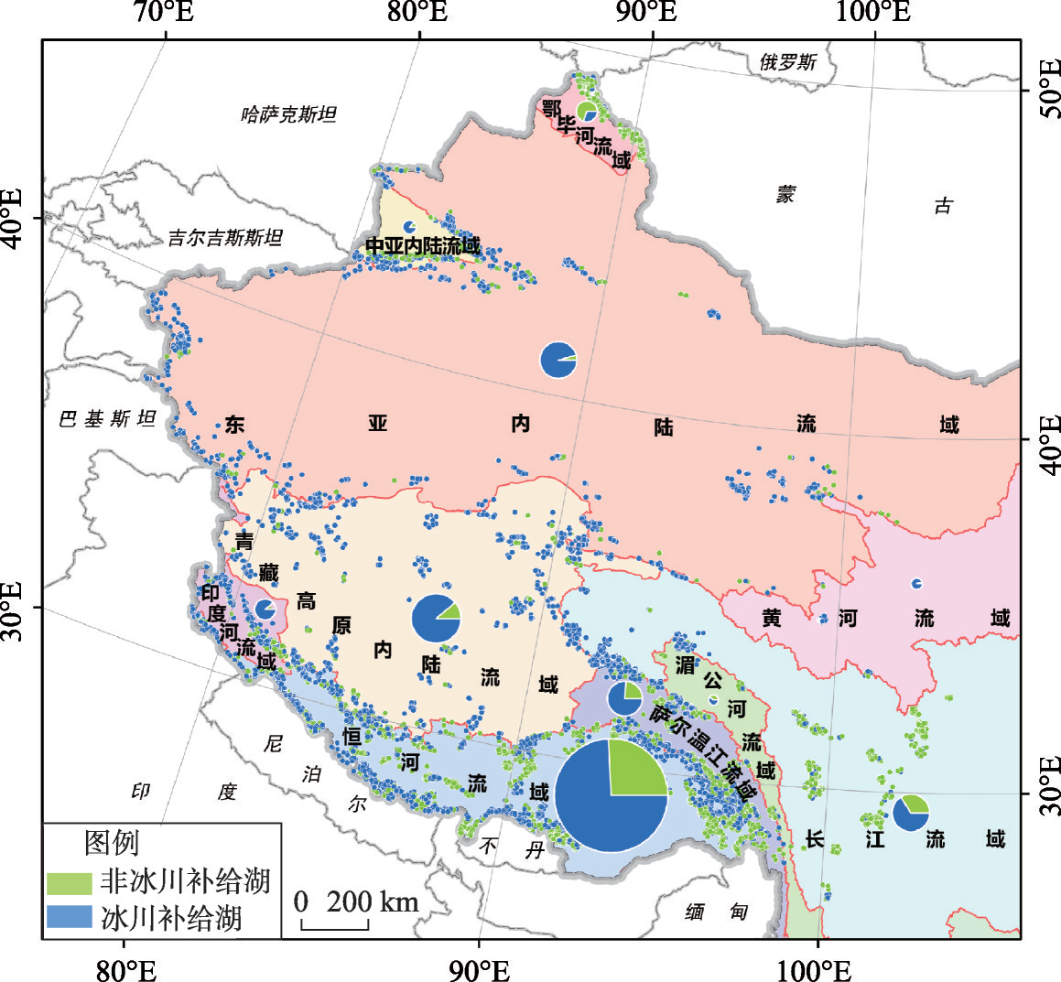
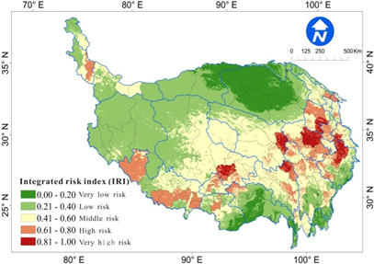
Tackling Rapid Warming and Environmental Changes in the Third Pole: from Observation to Climate Information Services
Qingchen CHAO, Lijuan MA*, Pengling WANG National Climate Centre, China Meteorological Administration
1. Recent Findings on Climate Change in the Third Pole
2. Comprehensive Observation & New Cognition on Climate System
The Third Pole region has been experiencing dramatic climatic and environmental changes, accompanying widely impacts on natural ecosystems and socio-economic development.
Integrated monitoring for climate system over the Third Pole, including the land surface, boundary layer, troposphere, and lower stratosphere, promotes the understanding of the Earth–atmosphere coupled processes, of the mechanism of rapid change of cryosphere, and their effects on weather and climate, towards serving for Belt and Road Initiative.
TIPEX-III
10-yr period
Extend to tropospheric and stratospheric physical processes.
Yao et al., 2019
Yao et al, 2012
Temperature changes in the past 2,000 years reconstructed from four ice cores in the Third Pole. The z score refers to the normalized anomalies.
TIPEX-I
May-August, 1979
TIPEX-II
May-August, 1998
The Third Pole is referred to the Tibetan Plateau and its surrounding mountains.
TIPEX-III, a plateau-scale observation network and 4 regional-scale intensive networks (black dots and squares)
Zhao et al., 2018
Yan et al., 2020
Annual surface mean temperature anomalies, TP vs other areas by different data sources. All trends reach 95% significant level.
Glacier surging
Glacier surging may block rivers and cause floods, or slide into glaciers lakes and cause GLOF.
Blue Book on Climate Change in China, 2020
The 2nd Comprehensive Science Expedition on Tibetan Plateau (2017-2021).
Source: TPE program
Active layer thickness and bottom temperature of active layer along the Qinghai-Tibet Highway increase significantly (data from the SKLCS, CAS)
RGI_Consortium, 2017
3. Regional cooperation for Climate Resilience and Sustainable Development
The runoff from cryosphere provides up to 45% of the total river flow (Yao et al. 2020).
The area of glacier fed lakes reaches 74.6% of the total area of ice lakes in western China (Yang et al, 2019).
Glacier and cryosphere fed rivers
GLOF
Under framework of WMO, the Third Pole Regional Climate Center Network (TPRCC) was established in 2018, which will deliver regional monitoring, prediction, data, and training services to users that concern the changes of climate system in this region, through a joint effort of NHMSs, research institutes, universities, as well as international programs.
Addressing gaps in data and information, e.g.
limited data scattered across different institutions,
low-accuracy and resolution of operational products and climate-related information
Glacier-feed lakes
Yao et al., 2019
Wang et al., 2020
Vision: Co-construction and sharing, for fit-for-purpose climate services
It is estimated that the Tibetan Plateau region will reach peak water between 2030 and 2050 (Yao et al. 2020)
Snow disaster
user-oriented and fit-for-purpose climate products and information services
specific cryosphere monitoring assessment and risk management
research on key climate-water-environment related scientific issues and climate change adaptation strategies
Non-glacial replenishment
glacial replenishment
Yang et al., 2019
Roadmap of TPRCC-Network
Wang et al., 2019
Notes:
10-yr averages of δ18O in the past 2,000 years recorded in the Guliya, Dunde, Puruogangri, and Dasuopu ice cores.
RGI 6.0中国西部及周边地区具有不同等级的跃动冰川分布(RGI_Consortium, 2017)
2015年中国西部冰湖分布图（杨成德等，2019）
The plateau-scale network: 46 sites; built in September, 2015
The regional-scale network in Naqu: 33 sites; built in August, 2015
The other three regional-scale networks: in the subsequent years

