Slide 1

Loss & Damage

Slide 2


Loss and Damage Policy
within the UNFCCC
Eva Peace Mukayiranga, Training Coordinator
Loss and Damage Youth Coalition

Slide 3
Session Objectives
Understand loss and damage (L&D) policy within the UN Climate Framework (UNFCCC)
2. Highlight the current state of play on loss and damage during the SBs 58

Slide 4
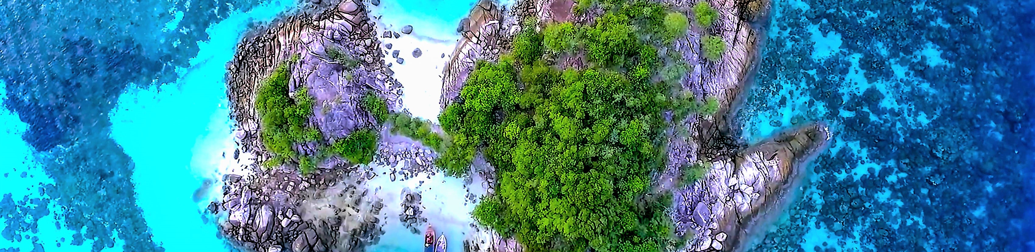
Definition
The negative impacts of Climate Change not avoided through Mitigation and Adaptation

Slide 5

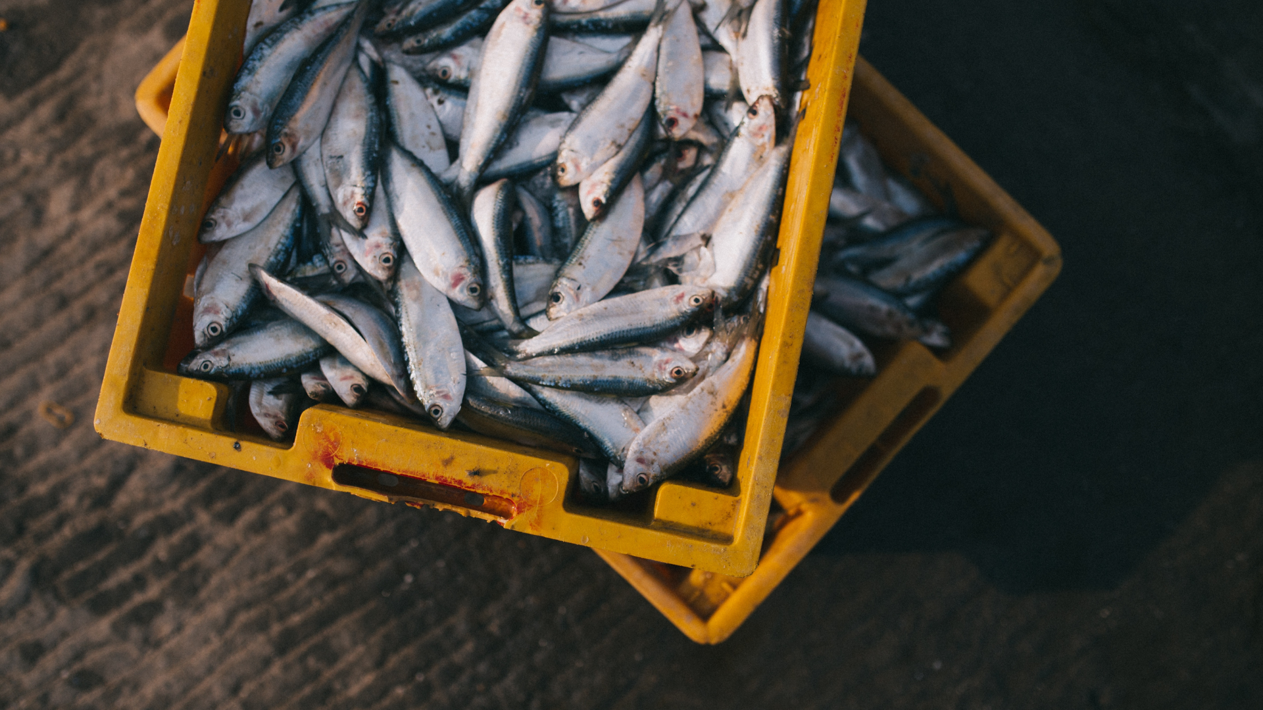
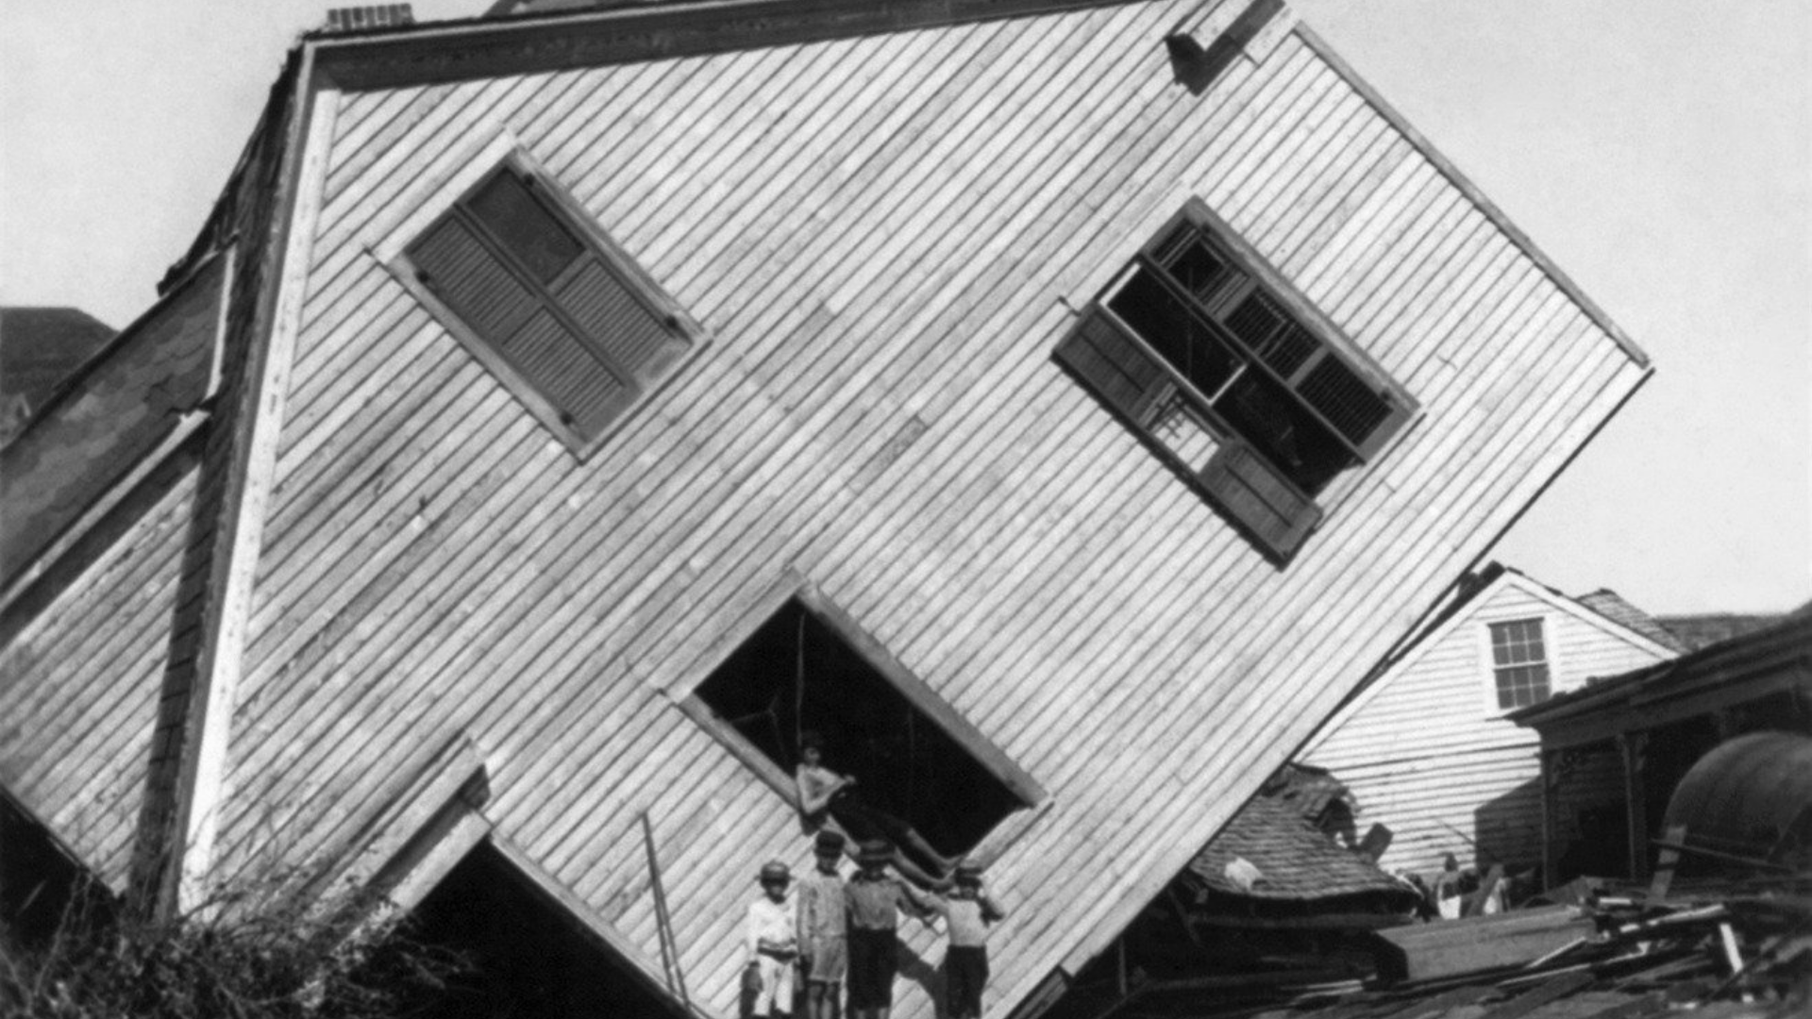
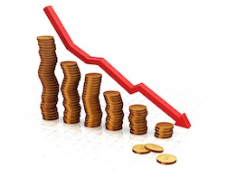
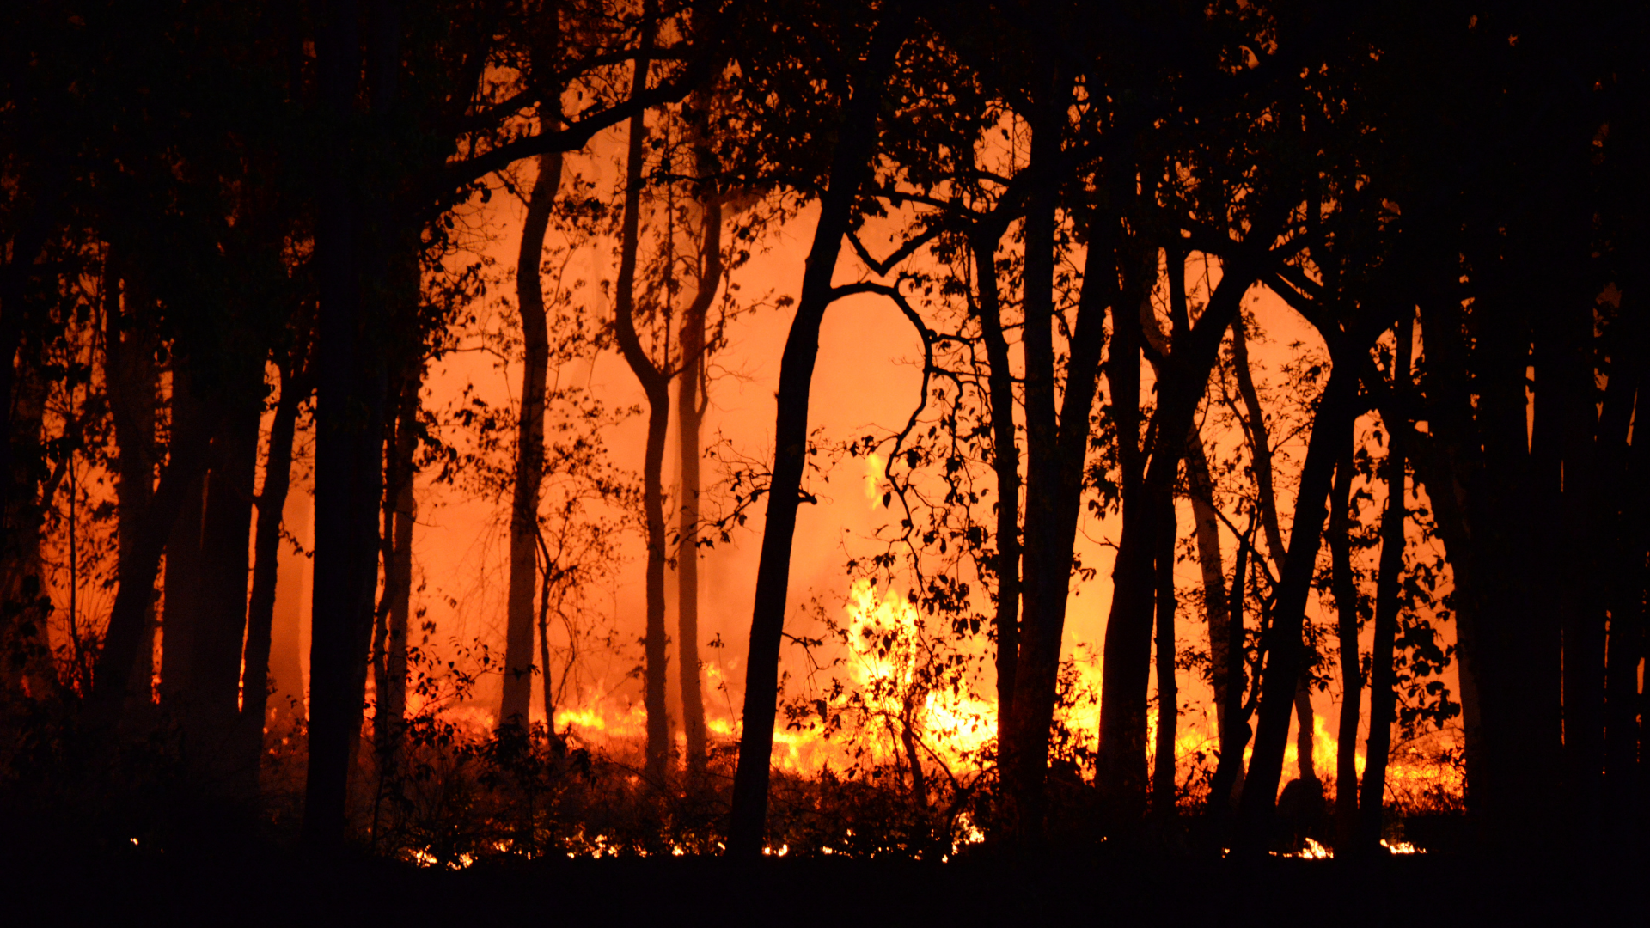
What is Loss & Damage?
Loss
Damage
Irreplaceable
Replaceable
Notes:
The biggest climate
justice issue you may not have heard of
UNFCCC defines it as the third cost of Climate Change after Adaptation and Mitigation [investments - mitigation (reducing emissions - sustainable agriculture, renewable energy) adaptation (dealing with consequences of unavoidable climate change) L&D - Residual climate costs not avoided]
The L&D issue has its origins in Small Island Developing States calling for compensation for climate change impacts, particularly sea level rise. It is often characterised as a highly political, contentious and polarised debate between developed and developing countries
Loss:
Health - heatwaves affect elderly, respiratory patients Eg. asthma.
Lives, Livelihoods- fisherfolk have to go further out to sea which is dangerous, catches are declining
Culture (Migration), Ecosystems - wildfires
Damage:
Economic - income & physical assets
Psychosocial effects of losing home, living in a disaster zone
-Non-economic -individuals
-society
-environment
Extreme and Slow Onset
Photo Credits:
Royal Meteorological Society

Slide 6
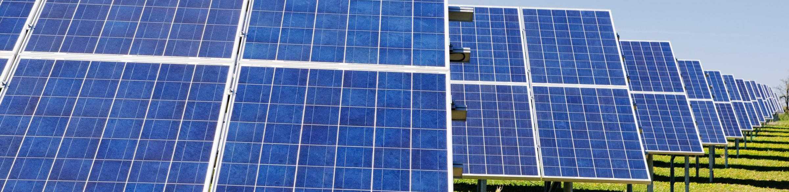
Loss and Damage Policy within the UNFCCC

Slide 7
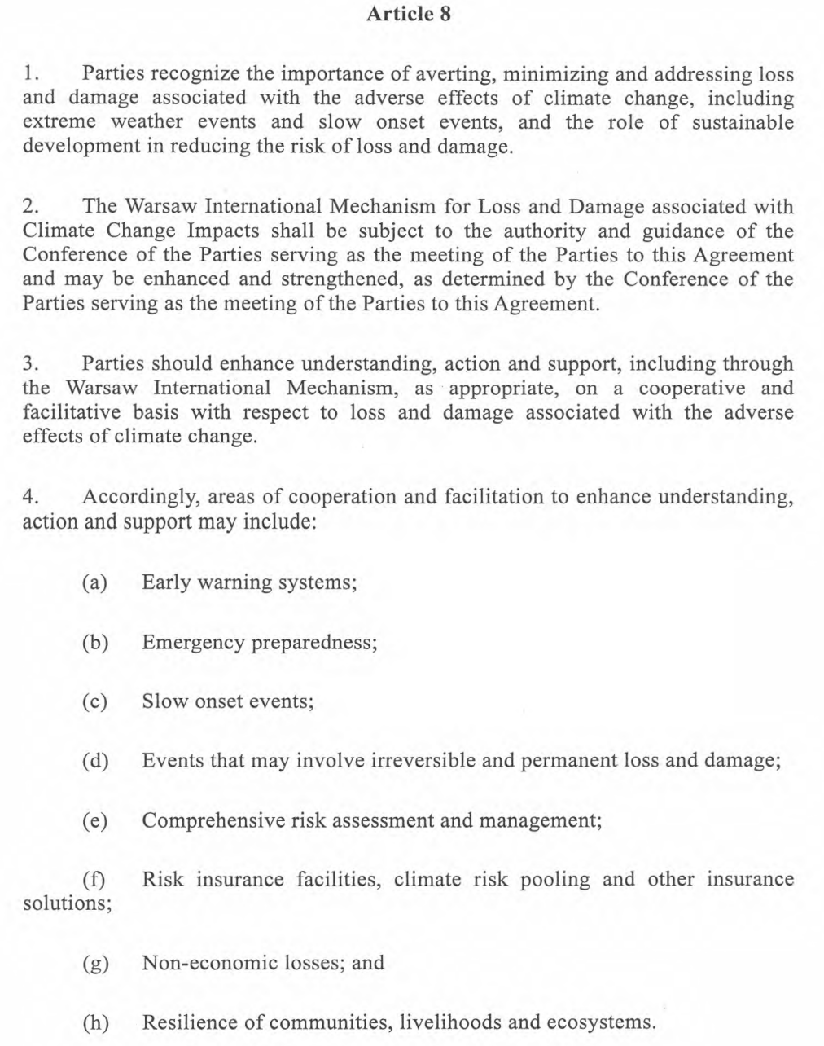
Paris
Agreement
- Article 8

Slide 8
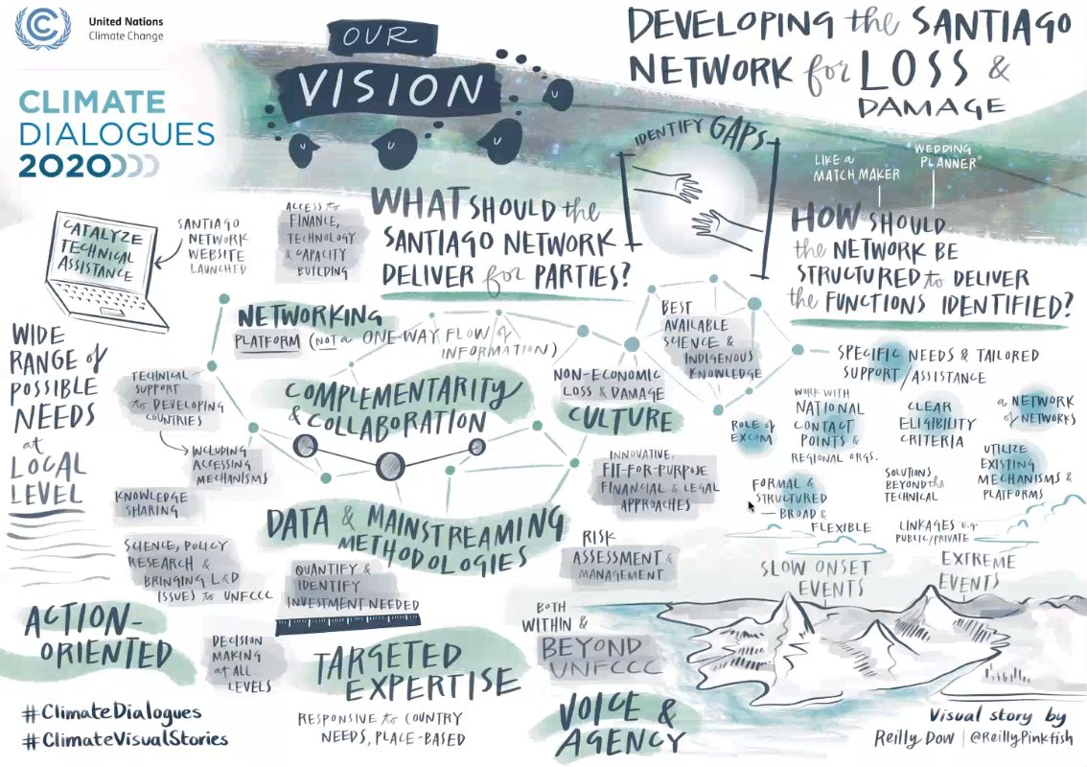
Santiago Network for Loss and Damage (SNLD)
Established at COP25
Network for technical support
Meant to deliver on-the-ground support
Institutional arrangement agreed at COP27
on -going process on selecting the host
Photo: Loss&Damage Network
Notes:
The Santiago Network for Loss and Damage (SNLD) was established at COP25 in 2019 as part of the WIM. Its vision is to catalyze the technical assistance of different stakeholders for averting, minimizing and addressing L&D associated with the adverse effects of climate change. At COP26 countries agreed on the functions of the SNLD.

Slide 9
Glasgow Dialogue - How was it created
Glasgow Loss and Damage Facility by G77 members and China
BLOCKED by developed countries and high-level decision makers
Glasgow Dialogue
Notes:
In the beginning of the COP26, G77 members and China suggested creating a Glasgow Loss and Damage Facility to demand international communities to act on loss and damage
But this got blocked by many developed countries and high-level decision-makers
Instead, they created the Glasgow Dialogue and its purpose for that is to find ways to fund loss and damage
In other words, it was to help developed countries “save face” to avoid failure and further criticisms

Slide 10
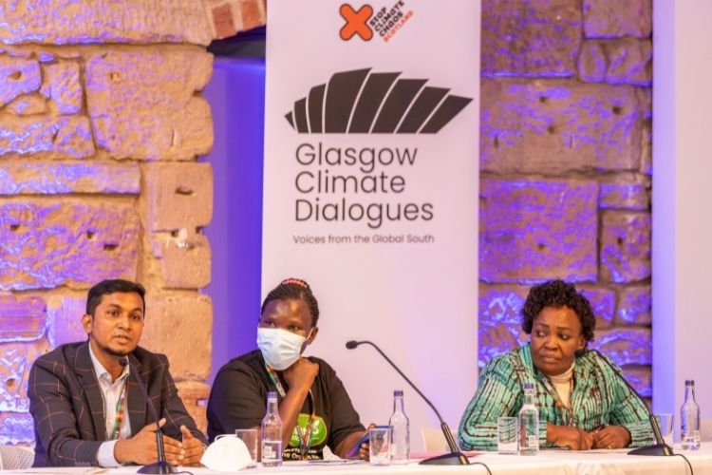

Glasgow Dialogue
The Glasgow Dialogue were established at COP 26 as compromise after a failure to establish the Loss and Damage finance facility vulnerable countries asked for
The Glasgow dialogue will serve as a platform for relevant stakeholder to discuss funding for loss and damage activities. It was agreed that the dialogue will take place each year during the SB session and to conclude in June 2024
Notes:
No clear structure or mandate outcomes
Only focuses on available funding resources
Does not address gaps communities may face
Does not discuss responsibilities and accountability
Does not discuss other ways to increase loss and damage finance

Slide 11
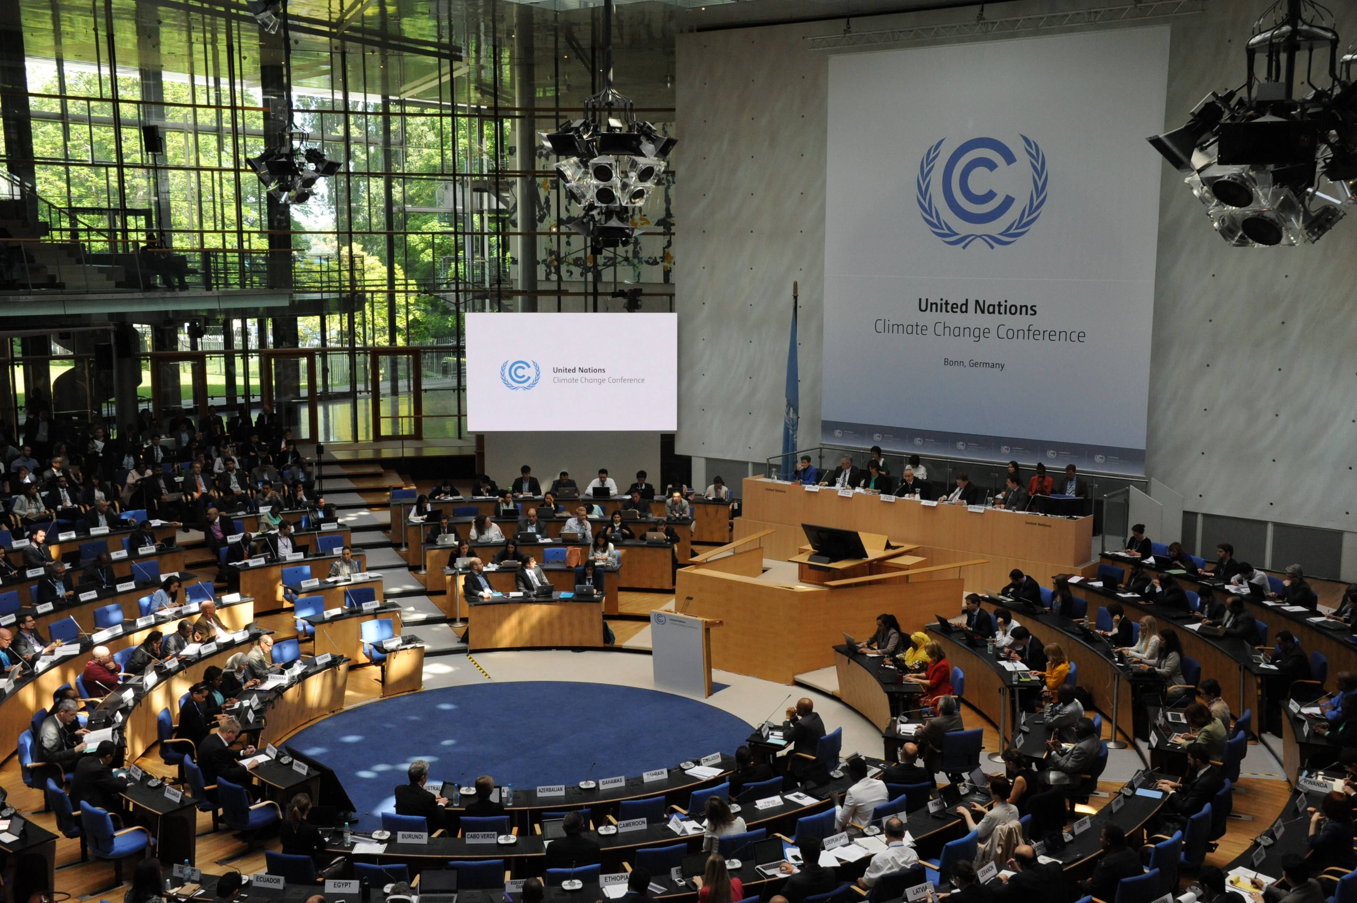
The Focus for the Second Glasgow Dialogue
Operationalising the Loss and Damage Fund (LDF) at COP28
Discussion on the funding arrangement of loss and damage fund
Source: UNFCCC

Slide 12
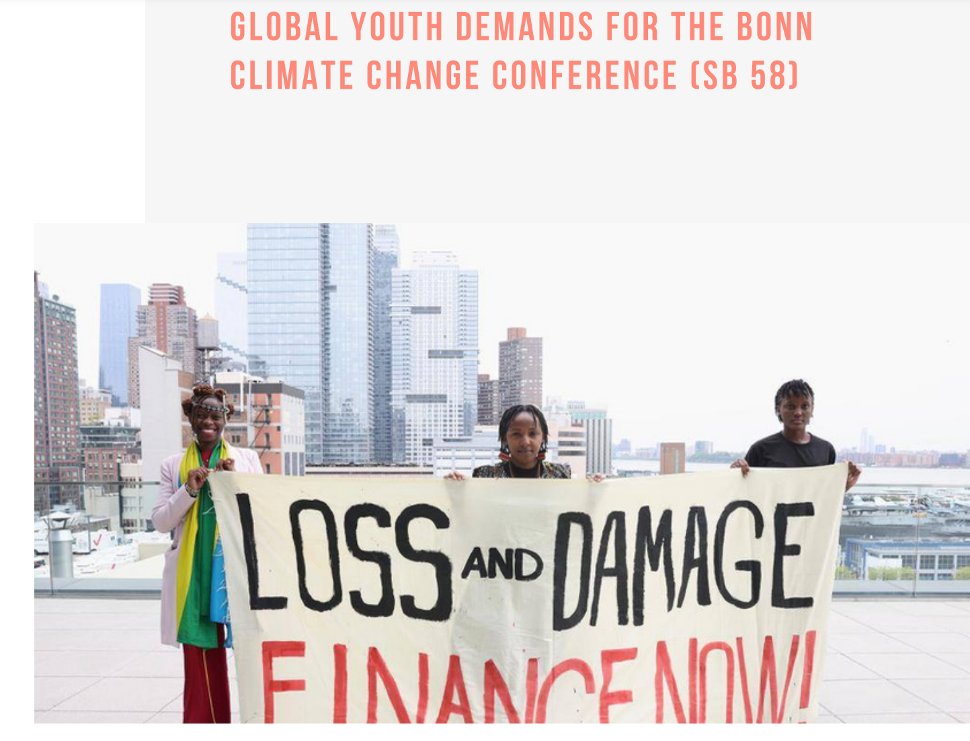
LYDC Demands from the COP27 Presidency Open letter
Loss and Damage Finance should be new, additional, predictable, accessible and adequate to support the frontline communities
Operationalization of the loss and damage fund at COP28
Youth inclusion in decision making
Link:
LDYC sb58 demand

Slide 13

Co-creating Tools for
Loss and Damage
Alvaro Rojas Ferreira, Senior Project Associate
United Nations University - Institute for Environment and Human Security

Slide 14
Take Home Messages
Loss and Damage is an evolving topic politically, technically, and for implementation
There are significant gaps conceptually, in evidence, and in technical tools and solutions
Analytic tools offer a bridge between concepts and decision-making
Technical assistance needs to be accessible, scalable, and flexible – collaboration and local skill development are the base for addressing these challenges
Notes:
* constructive ambiguity

Slide 15
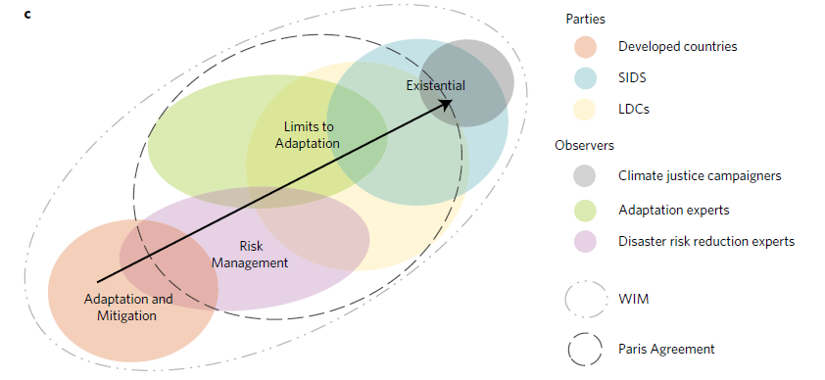
Conceptual Spectrum
(Boyd, James, Jones, Young, and Otto, 2017)
Notes:
* constructive ambiguity

Slide 16
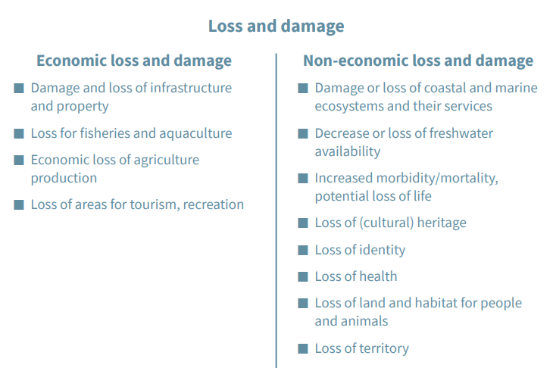
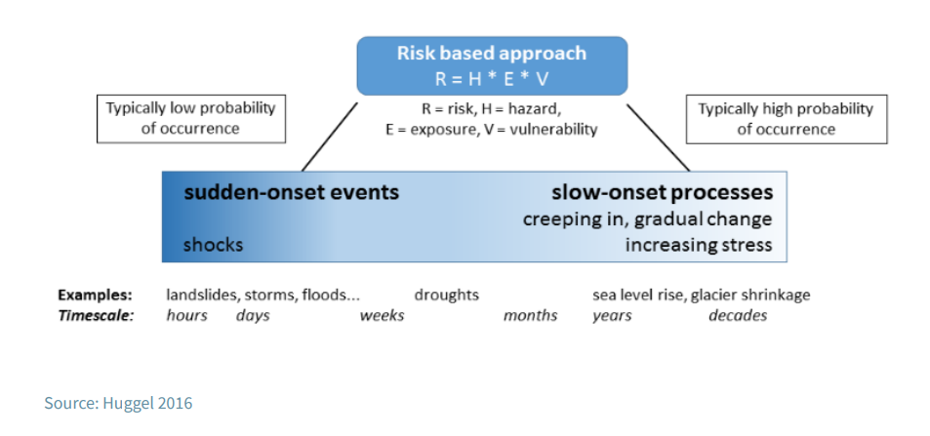
Important Elements
Examples of
(Huggel, 2016)
(Germanwatch, 2021)

Slide 17
Key Knowledge and Conceptual Gaps
Quantification and valuation
Attribution and causality
Regional and sectoral variations
Data limitations
Social and non-economic losses
Forward-looking approaches
Governance and finance
Notes:
1. Quantification and valuation: One of the major challenges in loss and damage research is accurately quantifying and valuing the losses and damages caused by climate change. There is a lack of standardized methodologies and approaches to assess the economic, social, and environmental costs of loss and damage, making it difficult to compare and aggregate findings across different studies.
2. Attribution and causality: Determining the causality and attribution of specific losses and damages to climate change is complex. It is challenging to isolate the impacts solely caused by climate change from other factors such as socioeconomic conditions, natural variability, or human activities. Improved methods for attributing losses and damages to climate change are needed to enhance our understanding of its impacts.
3. Regional and sectoral variations: Loss and damage occur in diverse geographical regions and affect different sectors of society in various ways. However, there is a lack of comprehensive regional and sector-specific studies on loss and damage. More research is needed to understand the regional and sectoral variations in vulnerability, exposure, and impacts, and how they contribute to loss and damage.
4. Data limitations: Adequate data is essential for robust loss and damage research. However, data availability and quality remain significant challenges. Many regions, particularly in developing countries, lack comprehensive data on loss and damage, making it difficult to assess the full extent of impacts and develop effective policies and strategies.
5. Social and non-economic losses: Loss and damage extend beyond economic impacts and include social, cultural, and non-market losses. These losses are challenging to quantify and often overlooked in research and policy discussions. More efforts are needed to incorporate qualitative and non-economic dimensions of loss and damage, such as the loss of traditional knowledge, cultural heritage, and social cohesion.
6. Forward-looking approaches: Most loss and damage research has focused on retrospective analysis and documenting current and past impacts. However, there is a need for forward-looking approaches that consider future risks and potential loss and damage scenarios under different climate change trajectories. Such approaches can help in developing effective adaptation and risk reduction strategies.
7. Governance and finance: The governance and finance mechanisms for addressing loss and damage remain underdeveloped. There is a lack of clear frameworks and mechanisms to support countries and communities in addressing loss and damage, including funding mechanisms and legal frameworks. Research is needed to explore innovative governance and financial mechanisms to support vulnerable countries and communities in managing loss and damage.

Slide 18
Technical Assistance Needs
 | Incremental | Transformational
Technology Transfer | Weather stations Technology for EWS | Locally coordinated IAMs
Governance | Institutional guidance (agency cooperation) Regulatory guidance (framework and coordination) | Transboundary collaboration, coordination on methods, standards, and initiatives to manage shared resources and risks
Capacity building | Identification of LnDs Documenting LnDs Communication of risks and benefits (means that reach the vulnerable) Targeted results | Education and awareness raising on responsible use of resources
Facilitation | Research agenda Agreement on standards and methods Academic and non-academic networks (regional knowledge co-production) Insurance solutions | Observatory on NELD Systems for leveraging traditional knowledge and practices
(Author notes on SNLD workshops)

Slide 19
Take Home Messages
Loss and Damage is an evolving topic politically, technically, and for implementation
There are significant gaps conceptually, in evidence, and in technical tools and solutions
Analytic tools offer a bridge between concepts and decision-making
Technical assistance needs to be accessible, scalable, and flexible – collaboration and local skill development are the base for addressing these challenges
Notes:
* constructive ambiguity

Slide 20

Discussion
Notes:
* constructive ambiguity

Slide 21
Questions
What is the most significant climate-related impacts that you have experienced in your community, and how have they affected you and your family?
In your opinion, what are the critical priorities for the L&D fund to address, and how should they be prioritized?
How can the L&D fund best support vulnerable communities in building resilience to climate change impacts?
Notes:
* constructive ambiguity

Slide 22
Questions
What steps can be taken to ensure that the L&D fund is transparent, equitable, and effective in delivering support to those who need it most?
How can young people be involved in the decision-making process for the allocation of funds from the L&D fund, and what role can they play in monitoring and evaluating its effectiveness?
Notes:
* constructive ambiguity

Slide 23
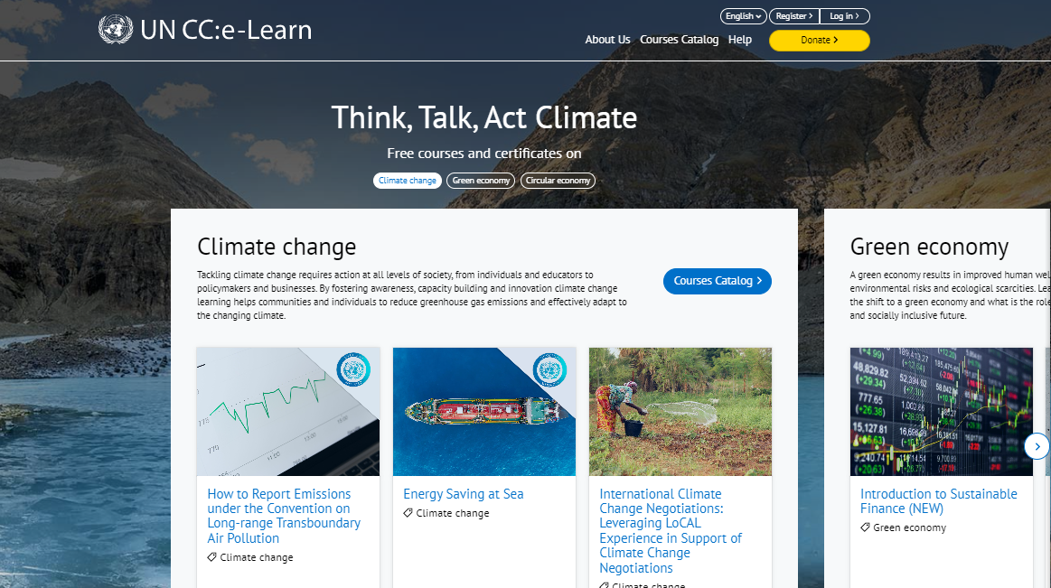
UN CC:Learn E-Learning Platform
Over 700,000 registered
users and over 300,000 certificates delivered
+50 courses in several
languages on climate change
and green economy
Climate Change
Quiz – Test your
Knowledge!

Slide 24
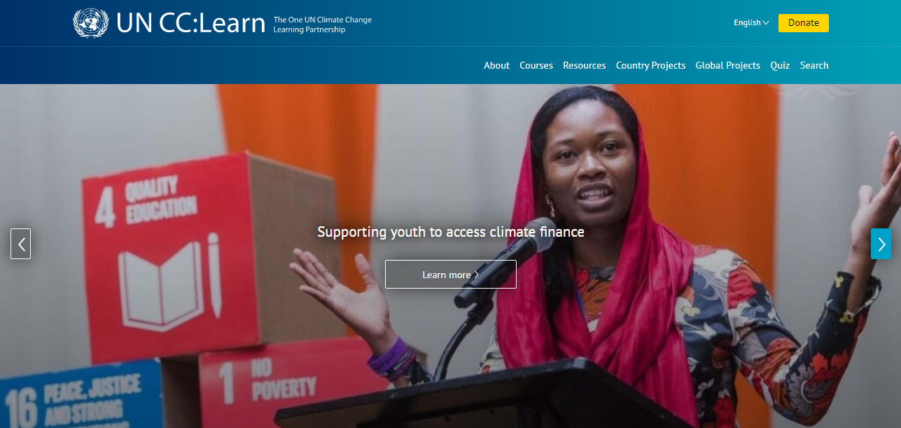
Knowledge-Sharing Platform
Library of climate
change and green
economy resources
Several platforms
and useful
tools for youth
Latest UN CC:Learn
news and beneficiary
stories

Slide 25





Learn more:
www.uncclearn.org / www.unccelearn.org
More about the Climate Classroom:
https://www.uncclearn.org/global-projects/climate-classroom-4/
Follow us!
UN CC:Learn
@uncclearn
@un_cclearn
@uncclearn
UN Climate Change Learn

Slide 26
THANK YOU!

