Slide 1
UNFCCC NATIONAL ACE FOCAL POINT ACADEMY
Meaningfully Engage Young People
Save the Planet and Our Future
HAILEY CAMPBELL AND OPEYEMI ELUJULO
Notes:
Today we will be starting with a poll:
1. How old were you when you began working or volunteering on climate action?
Under 18
19-24
25-35
Older than 35
2. When is the last time you partnered or worked with a youth organization or leader in your country on climate policy development or implementation?
3. How many youth climate leaders from your country can you list?
0
1-5
6-10
Moore than 10

Slide 2
One Billion
Notes:
According to UNICEF, there are nearly one billion children and young people ‘extremely high risk’ of the impacts of the climate crisis TODAY. According to the IPCC, young people will witness 4-5 times more extreme climate disasters than we do today.
Let that sink in.

Slide 3
78
years
Notes:
There are 78 years until 2100 in which under current trajectories many scientists agree that we could see warming of up tp 3.2 degrees Celsius. Scientists predict we will se severe and catastrophic vents under 1.5 degrees Celsius of warming.

Slide 4
2.6
Percent
Notes:
According to the IPU, the global proportion of members of parliament under the age of 30 around the world is 2.6%. With more than 50% of the world’s population under 30 and the fact that 2100 is less than a lifetime away - it is clear that young people are not adequately represented.

Slide 5
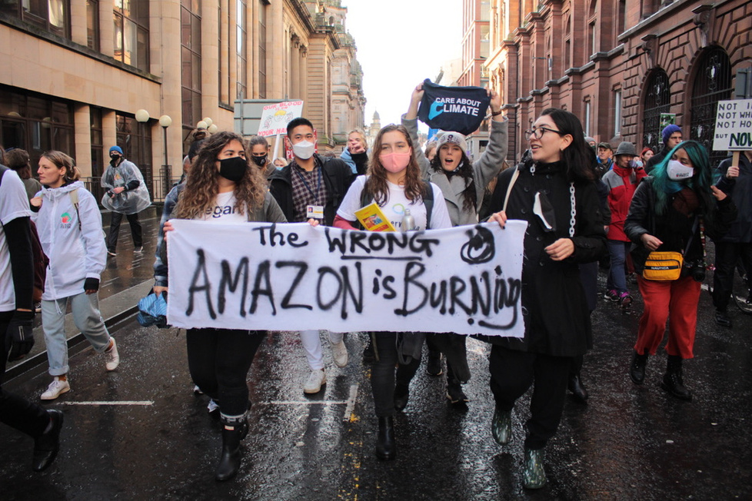
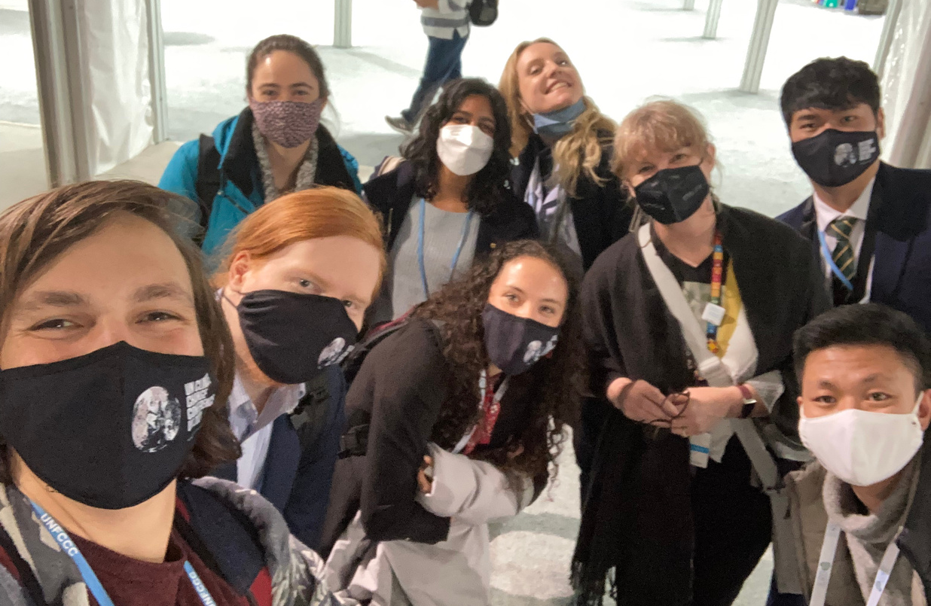
How are we holding leaders accountable?
Notes:
We are mobilizing and calling for action on the streets and making partnerships with like-minded, supportive teams, such as the UNFCCC ACE Team who are amazing stewards of youth inclusion, such as by co-organizing the ACE Youth Exchange and inviting us here today.

Slide 6
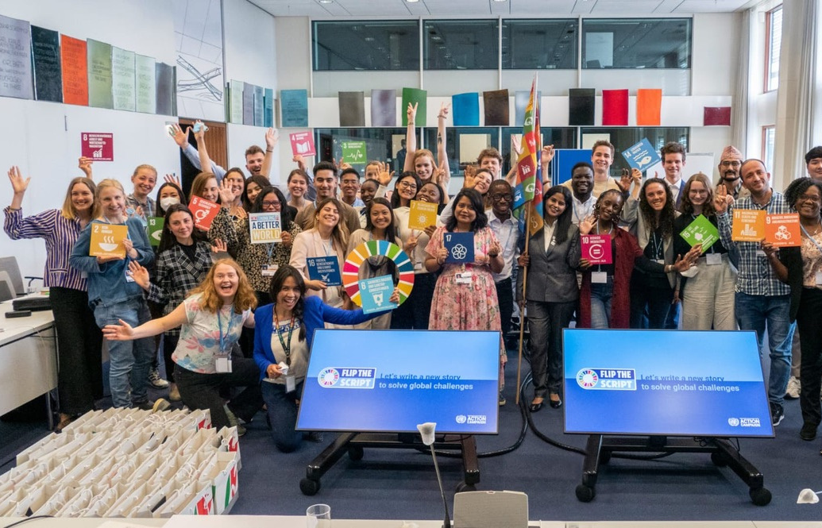
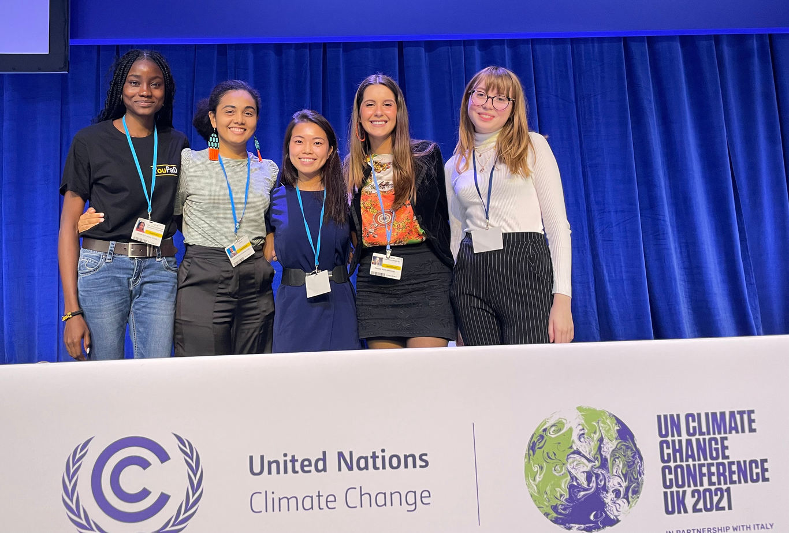
How are we holding leaders accountable?
Notes:
We are also conducting our own research, starting non-profits, like Care About Climate, and showing up to decision-making spaces despite funding, education, language, accessibility, and other barriers. We are creating the future we want to see, starting with each other.
Yet, we don't choose to miss school, wake up for meetings in the middle of the night, and spend every hour of our free time while navigating the complexities of life to rise in solidarity to fight the climate crisis because we think it's fun. We do this because we care about our future, we care about decisions that will decide who among our friends and global community lives, dies, and/or gives up their culture due to forced migration.

Slide 7
UNFCCC NATIONAL ACE FOCAL POINT ACADEMY
What does Care About Climate do to
hold leaders accountable?

Slide 8
OUR MISSION
Care About Climate empowers global youth to equitably address the climate crisis by bridging knowledge with action and bringing youth-led ideas to the international stage.

Slide 9
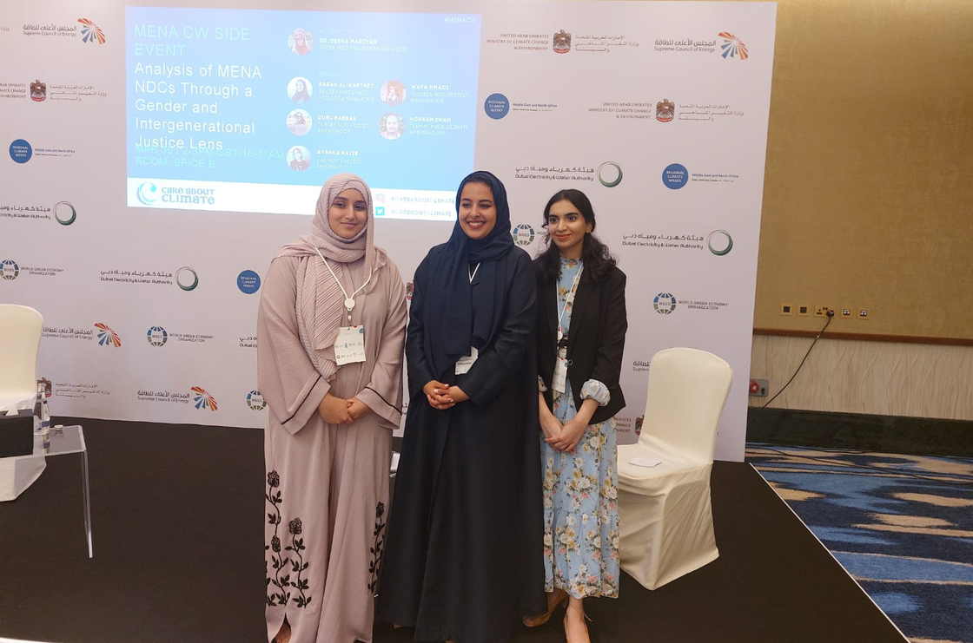
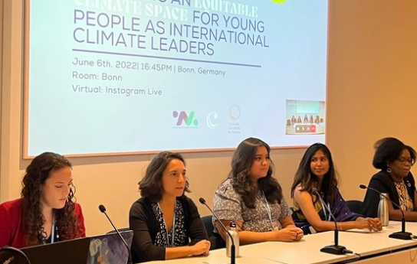
#1: Create Access
Care About Climate
MENA Climate Week
Care About Climate Members
Hosting an SB56 Event

Slide 10
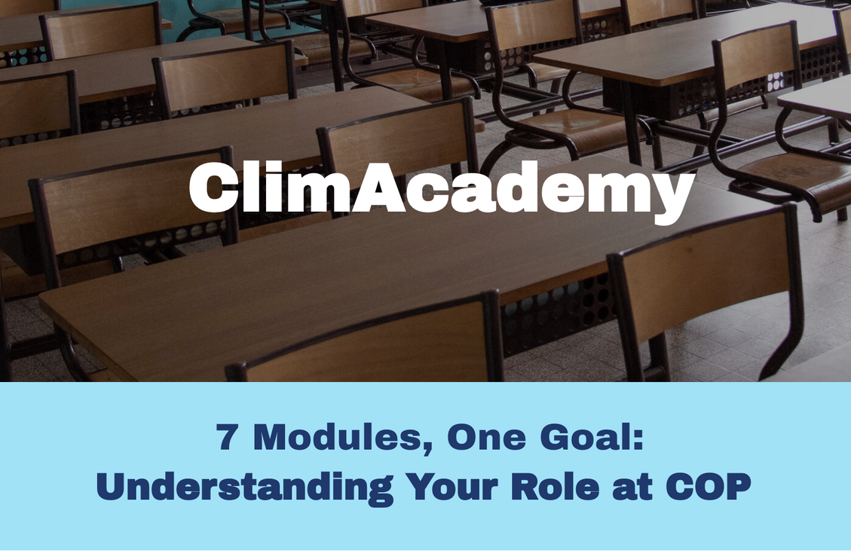
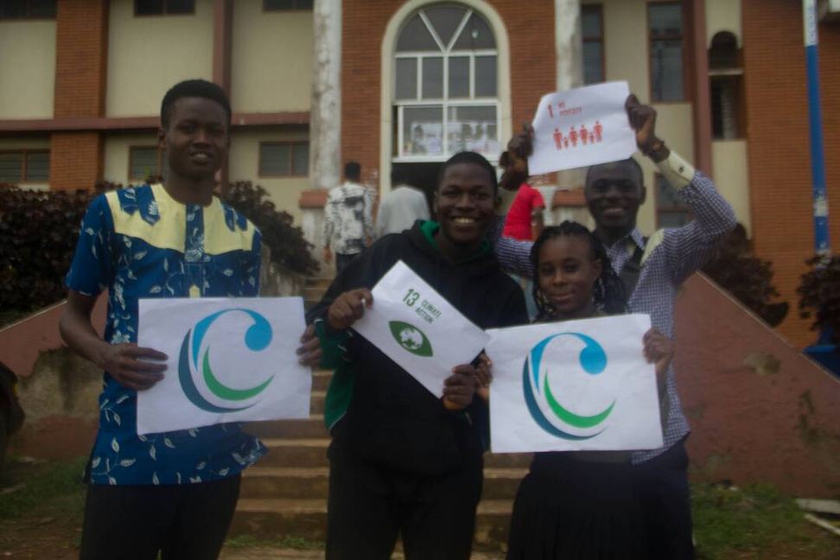
#2: Train Each Other
Care About COP Course
Youth Mentorship for
climate action projects

Slide 11
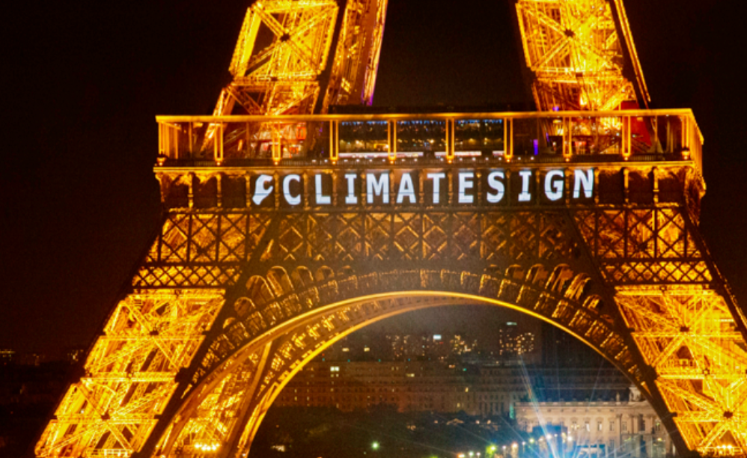
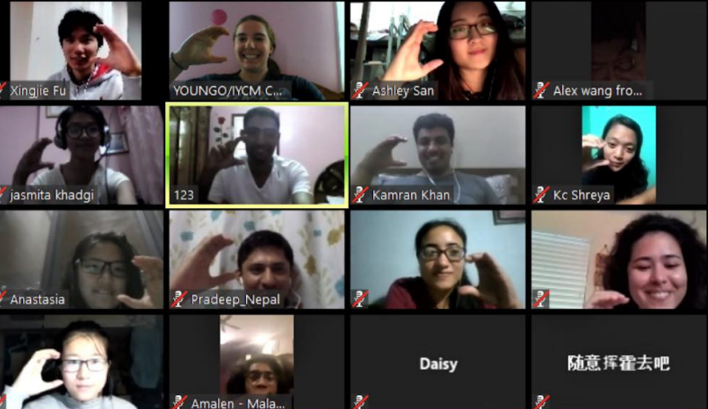
#3: Build Community
Climate Sign on the Eiffel Tower
Global solidarity and
training calls

Slide 12
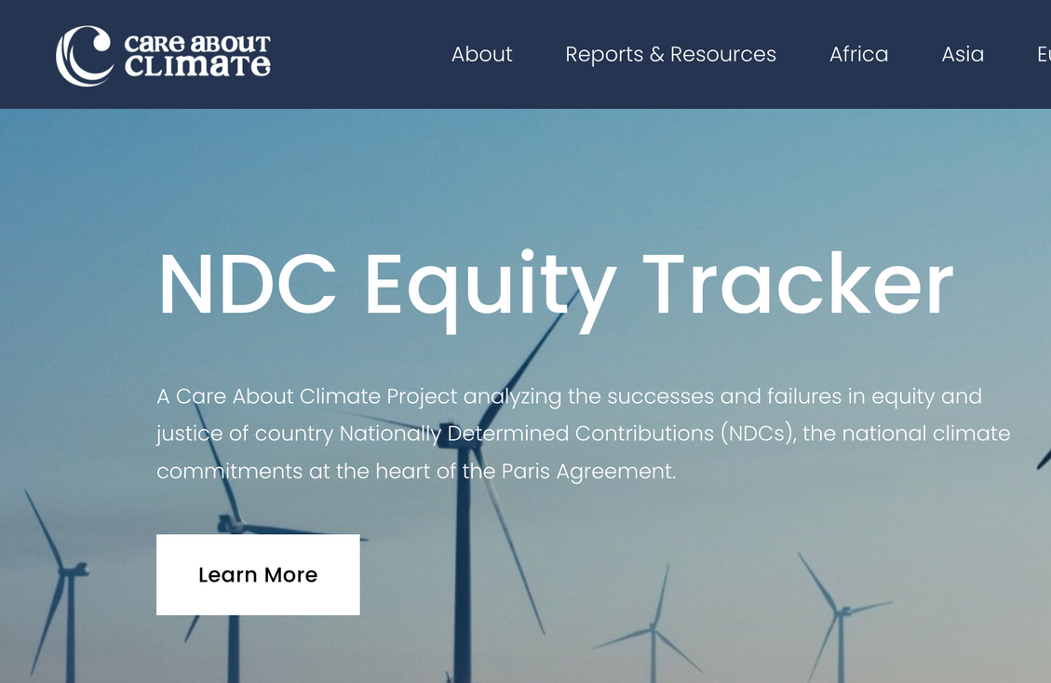
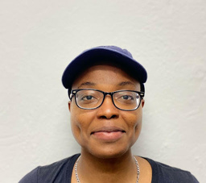
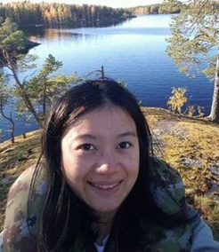
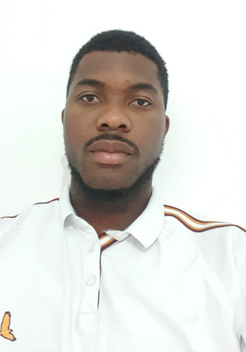
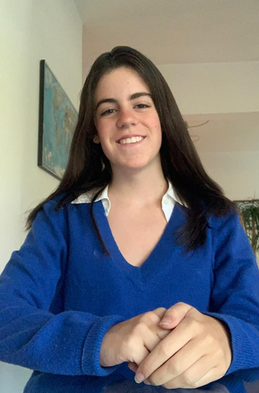
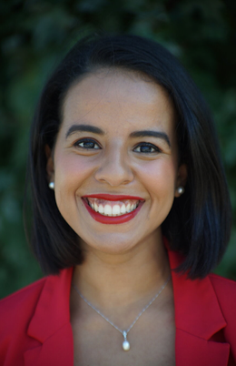
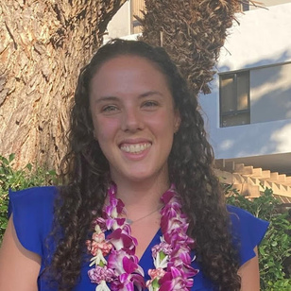
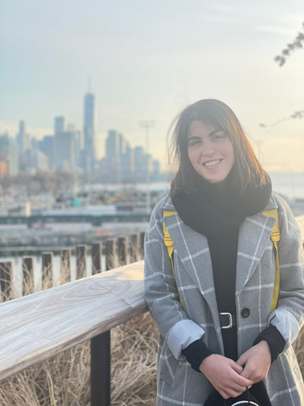
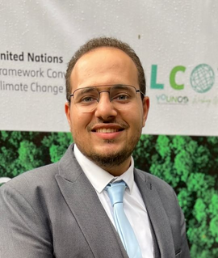
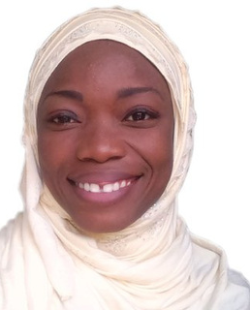
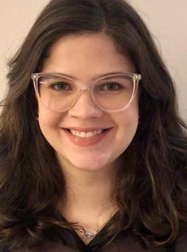
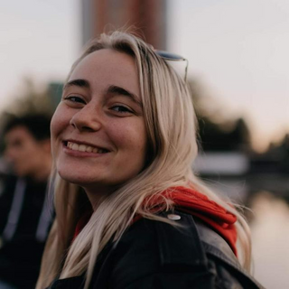
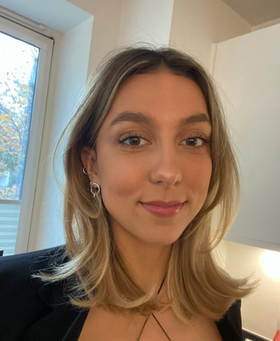
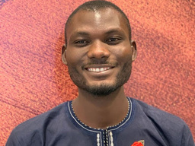
#4: Empower Action
NDC Equity Training
and Analysis
Green job training

Slide 13
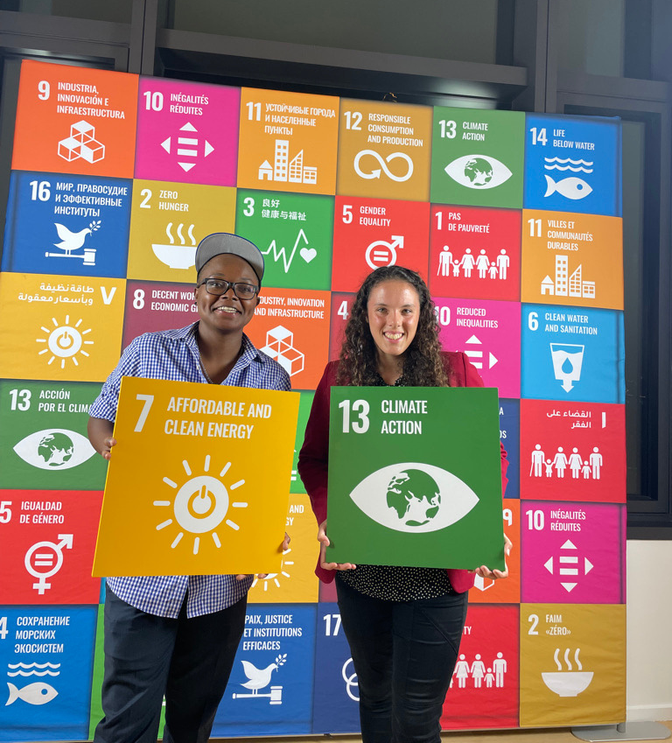
Our Findings: NDCs
Intergenerational equity remains an underdeveloped area of climate policy
Some countries get by on mentioning youth in NDCs and National Communications
Many countries make no mention at all of young people in NDCs and National Communications
A few countries have made progress on youth inclusion via capacity-building support, youth councils, and green jobs

Slide 14
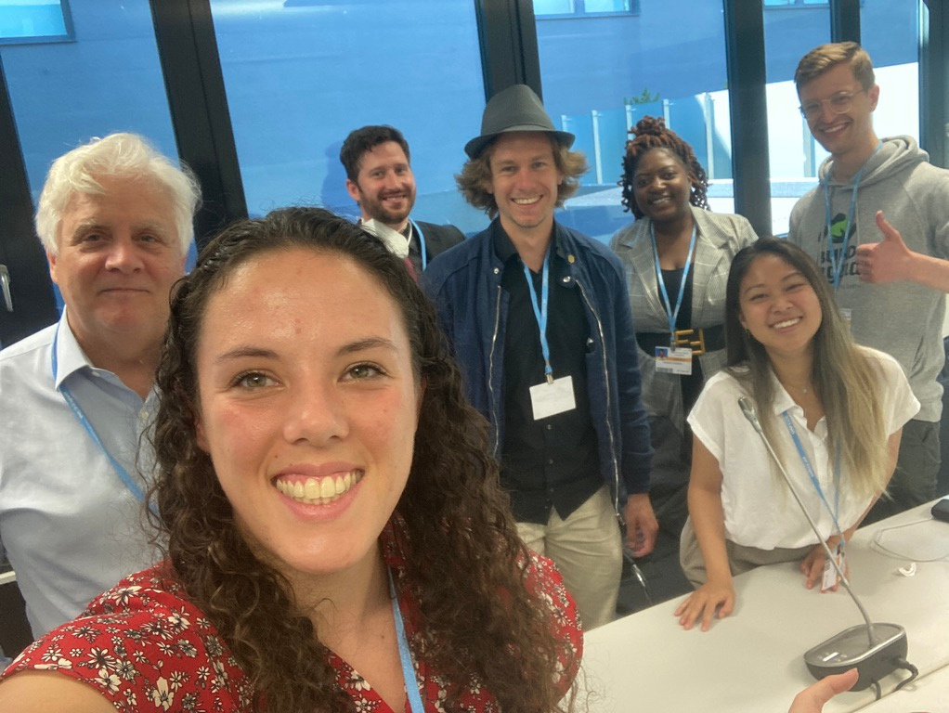
Our Findings: Young People & Policy
Negotiators will meet with us, but not follow through on commitments
Young negotiators often speak to older generation decisions and statements
Delegations with young people are not trusted or empowered with positions and responsibilities
Rarely are there honest conversations with decision-makers

Slide 15
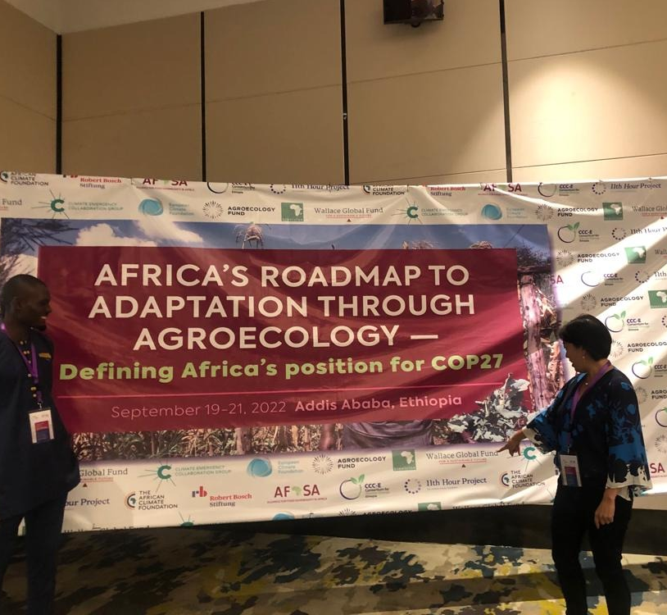
Our Findings: Capacity-Building & Access
Climate change education remains elusive
Young people do not always have the luxury of safety to speak up for action
Young people are not fairly compensated to do the same work as older generations
Rarely do national governments support youth with funding or access to climate decision-making spaces

Slide 16
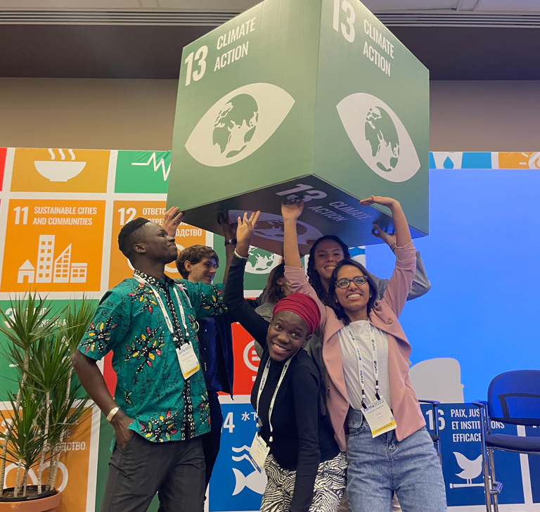
Our Findings: Young People Rock!!
Skilled at connecting across generations
Creative at increasing awareness and action on climate change
Willing to compromise for solidarity and climate action
Community champions for climate action
Build bridges across cultures and know when they need to yield the floor for others

Slide 17
UNFCCC NATIONAL ACE FOCAL POINT ACADEMY
Policies don't change
the world
People, especially young people, do

Slide 18
UNFCCC NATIONAL ACE FOCAL POINT ACADEMY
How can you meaningfully include young people in international climate decisions and beyond?
HAILEY CAMPBELL

Slide 19
Actions YOU can take:
Listen to young people with the intent of acting and providing honest answers to questions
Reduce hiring barriers for young people (in politics)
Connect "Big NGOs" with youth-led NGOs
Provide grants and funding opportunities for the type of climate work being done by young people
Create a national youth advisory group on climate action (or at least ACE)

Slide 20
Actions YOU can take:
Host youth listening sessions on climate action before, during, and after COP
Enable young people to bring a "peer" to conversations
Partner with youth NGOs or groups to create policy priorities, engagement activities, and webinars
Recognize youth climate leaders from across your communities
Establish youth inclusion quotas and policies for protecting our rights to actively contribute

Slide 21
UNFCCC NATIONAL ACE FOCAL POINT ACADEMY
More young people
as climate leaders
More inclusive & ambitious climate policies

Slide 22
THERE IS NO CLIMATE JUSTICE WITHOUT INTERGENERATIONAL EQUITY AND YOUTH EMPOWERMENT
Hailey@careaboutclimate.org
@careaboutclimate
@careboutclimate

