Slide 1
Workshop: Modalities for implementation of the outcomes of the five in-session workshops on issues related to agriculture and other future topics that may arise from this work Adaptation Committee: Work on Agriculture
Katowice, Poland, 3 December 2018

Slide 2
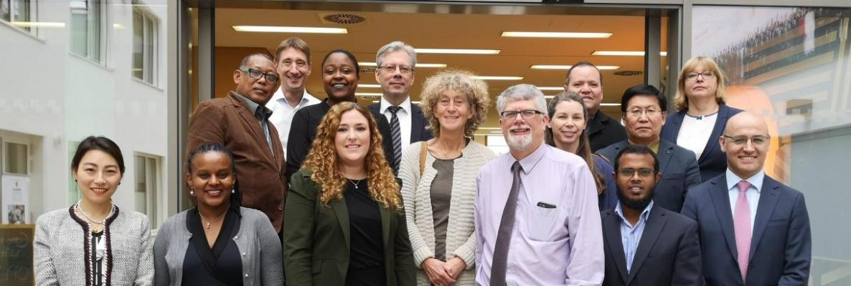
Overview: The Adaptation Committee
The Adaptation Committee (AC) is the principal body under the UNFCCC tasked with accelerating global adaptation action by providing authoritative technical advice and guidance to Parties

Slide 3
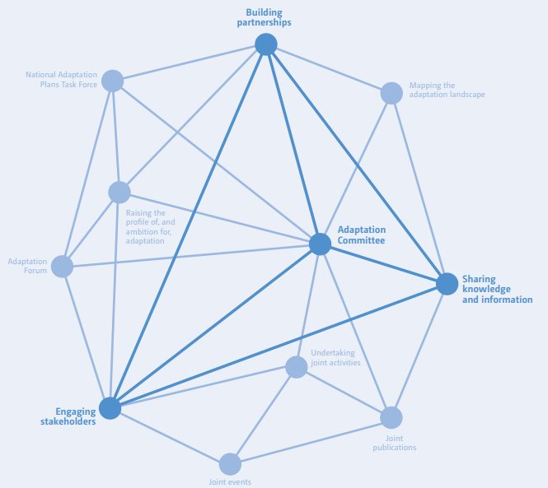
I: Mandate and background: connecting the dots
Parties established the Adaptation Committee as part of the 2010 Cancun Adaptation Framework
The AC is mandated to promote the implementation of enhanced action on adaptation in a coherent manner under the Convention.

Slide 4
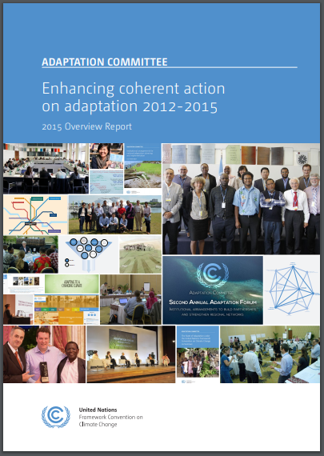
I: Mandate and background: workstreams
The Adaptation Committee’s work is organized under four workstreams:
Promoting overarching coherence
Providing technical support and guidance to the Parties on adaptation action
Providing technical support and guidance to the Parties on means of implementation
Awareness-raising, outreach and information-sharing
Notes:
Providing technical support and guidance to the Parties on adaptation action
E.g. through thematic and overview papers on various adaptation topics, including case studies; organizing events that facilitate sharing of knowledge and tools for adaptation; supporting developing countries’ NAP formulation through the NAP task force
Providing technical support and guidance to the Parties on means of implementation
E.g. including through coordinating with and offering inputs to other bodies under the Convention; publishing technical and information papers on topics related to the implementation of adaptation actions; engaging with the private sector on adaptation action
Awareness-raising, outreach and information-sharing
E.g. through annual Adaptation Forums; producing biannual Adaptation Finance bulletins; disseminating findings through user-friendly information products; creating a video documentary for a general audience

Slide 5
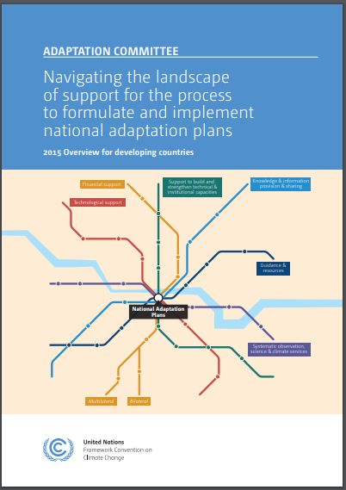
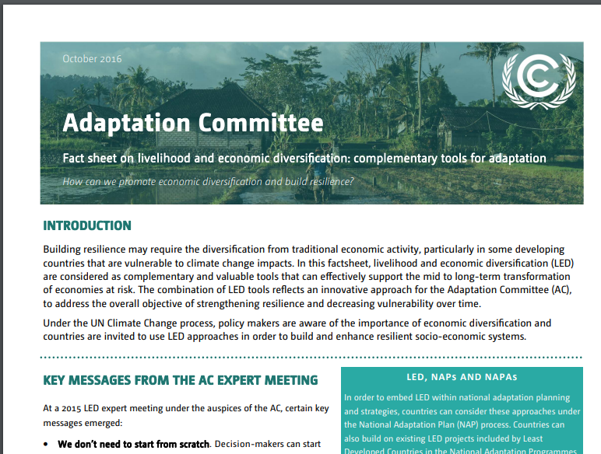
I: Mandate and background: workstreams 1 and 2
Promoting overarching coherence
E.g. through mapping mandates with adaptation relevance under the Convention; collaborating with other relevant institutions, organizations, frameworks, networks, and centres outside the Convention to enhance implementation of adaptation action
Providing technical support and guidance to the Parties on adaptation action
E.g. through thematic and overview papers on various adaptation topics, including case studies; organizing events that facilitate sharing of knowledge and tools for adaptation; supporting developing countries’ NAPs formulation and implementation through the NAP task force
Notes:
Providing technical support and guidance to the Parties on adaptation action
E.g. through thematic and overview papers on various adaptation topics, including case studies; organizing events that facilitate sharing of knowledge and tools for adaptation; supporting developing countries’ NAP formulation through the NAP task force
Providing technical support and guidance to the Parties on means of implementation
E.g. including through coordinating with and offering inputs to other bodies under the Convention; publishing technical and information papers on topics related to the implementation of adaptation actions; engaging with the private sector on adaptation action
Awareness-raising, outreach and information-sharing
E.g. through annual Adaptation Forums; producing biannual Adaptation Finance bulletins; disseminating findings through user-friendly information products; creating a video documentary for a general audience

Slide 6
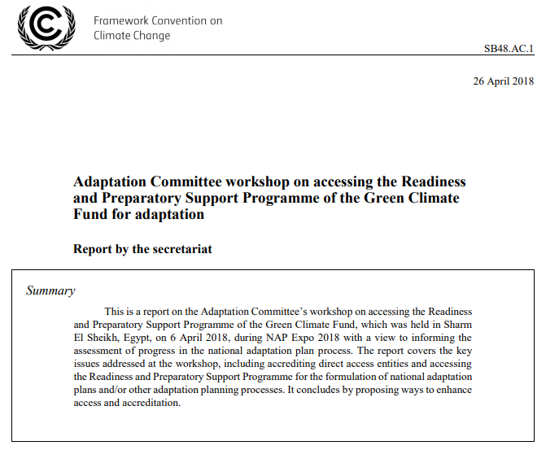
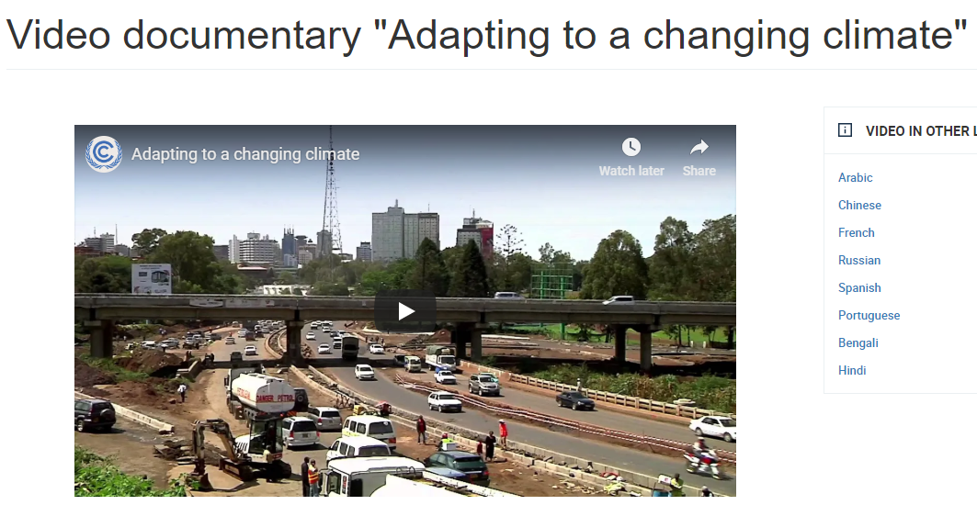
I: Mandate and background: workstreams 3 and 4
Providing technical support and guidance to the Parties on means of implementation
E.g. including through coordinating with and offering inputs to other bodies under the Convention, including the GCF; publishing technical and information papers on topics related to the implementation of adaptation actions; engaging with the private sector on adaptation action
Awareness-raising, outreach and information-sharing
E.g. through annual Adaptation Forums; producing biannual Adaptation Finance bulletins; disseminating findings through user-friendly information products; creating a video documentary for a general audience
Notes:
Providing technical support and guidance to the Parties on adaptation action
E.g. through thematic and overview papers on various adaptation topics, including case studies; organizing events that facilitate sharing of knowledge and tools for adaptation; supporting developing countries’ NAP formulation through the NAP task force
Providing technical support and guidance to the Parties on means of implementation
E.g. including through coordinating with and offering inputs to other bodies under the Convention; publishing technical and information papers on topics related to the implementation of adaptation actions; engaging with the private sector on adaptation action
Awareness-raising, outreach and information-sharing
E.g. through annual Adaptation Forums; producing biannual Adaptation Finance bulletins; disseminating findings through user-friendly information products; creating a video documentary for a general audience

Slide 7
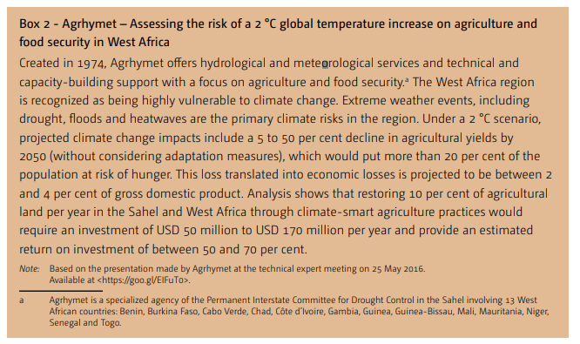
II: Helping Parties Advance Work on Agriculture: 1
While the AC’s work is not typically sector-specific, much of the Body’s past work is nonetheless applicable to accelerating adaptation action in the agriculture sector
This includes technical papers featuring agriculture case studies (e.g. on assessing the risk of temperature rise on agriculture and food security; the water, energy, agriculture, environment nexus approach; corporate support to climate-resilient agriculture)
Also includes explorations of broader topics such as long-term adaptation planning that can inform adaptation efforts in many sectors, including adaptation
Notes:
Case study examples drawn from document FCCC/TP/2016/6 – Technical paper on “Opportunities and options for enhancing adaptation actions and supporting their implementation: reducing vulnerability and adaptation)

Slide 8
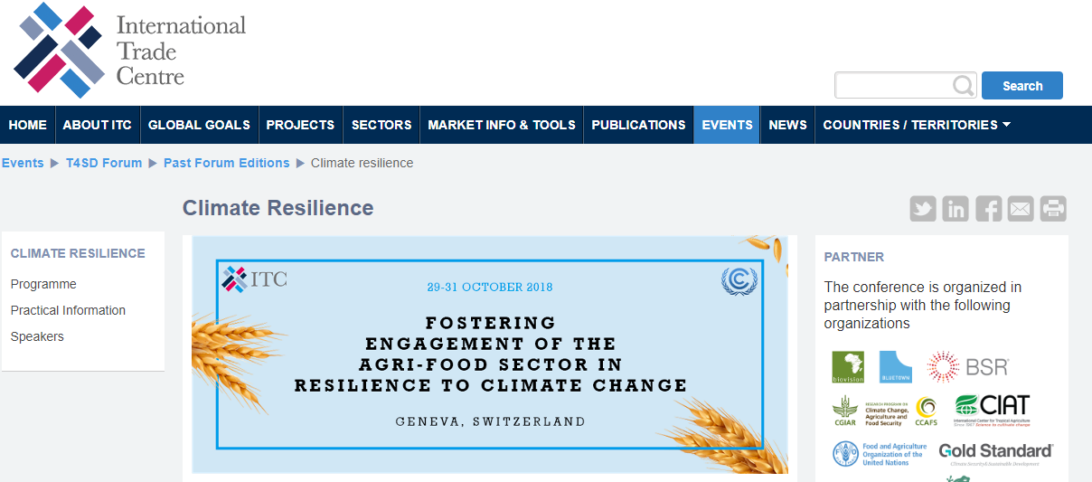
II: Helping Parties Advance Work on Agriculture: 2
The AC recently co-hosted, in partnership with the International Trade Centre, a workshop titled “Fostering the engagement of the agri-food sector in resilience to climate change”
Three main topics:
Assessing climate risks for enterprises in the agri-food sector and designing adaptation strategies;
Implementing climate change adaptation strategies;
Designing policies to scale up private sector adaptation action.

Slide 9
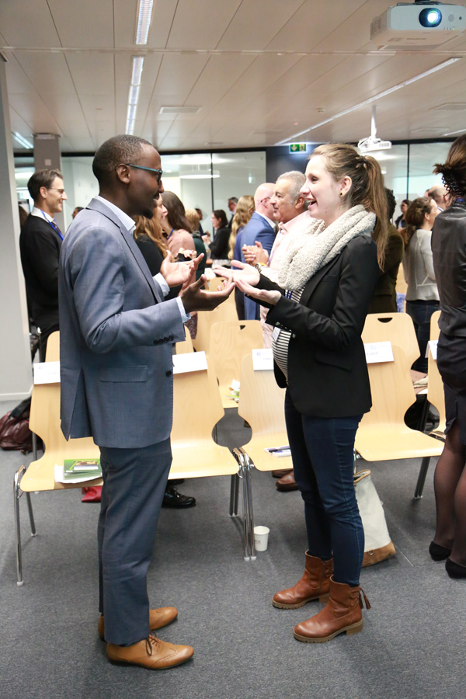
II: Helping Parties Advance Work on Agriculture: 3
The workshop convened entrepreneurs, government representatives, experts from UN-affiliated agencies, farmers, scientists, researchers, business owners, civil society organizations, and banks
It yielded insights on enduring gaps and challenges in adapting the agriculture and food sector to climate change, innovative tools and processes for building resilience along the value chain, and how to foster an enabling environment for scaling up private sector adaptation action
Outcome report to be published early 2019, setting the stage for further AC work on agriculture

Slide 10
III: Helping Parties Advance Work on Agriculture: Going Forward
The AC’s work can help Parties advance their work on agriculture by:
Disseminating and building on the outcomes of the agri-food sector workshop
Incorporating an agriculture lens into an upcoming technical paper on information and methodologies useful to assess progress on enhancing adaptive capacity, strengthening resilience and reducing vulnerability to climate change
Providing guidance to the Nairobi Work Programme on potential agriculture-related activities to include in its ongoing knowledge-to-action work
Incorporating an agriculture lens into an upcoming information paper on linkages between mitigation and adaptation
Particularly relevant to Koronivia work on “Methods and approaches for assessing adaptation, adaptation co-benefits, and resilience” (Decision 4/CP.23 paragraph 2(b))

Slide 11
Thank you
More information available at https://unfccc.int/process/bodies/constituted-bodies/adaptation-committee-ac

