Slide 1
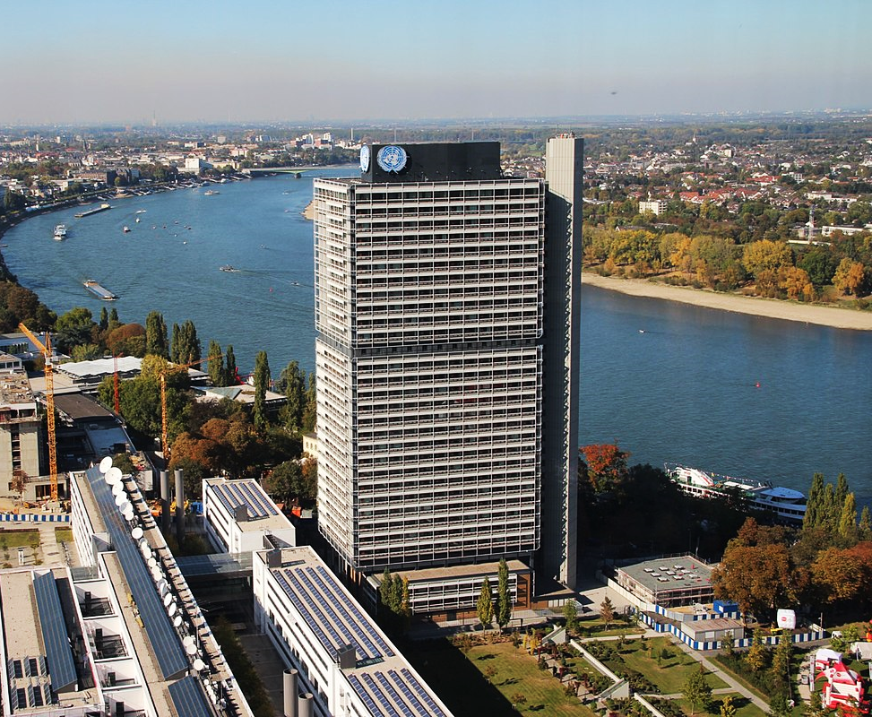
Targeted Technical Support Clinics to Project participants
Completing CDM Transition Requirements under the Article 6.4 Mechanism
17-18 September 2026
IMAGE CREDITS: Niederkasseler

Slide 2


Welcome & Introduction
Nadine Nimal
Team Lead
Article 6 Capacity Building Unit
UNFCCC secretariat

Slide 3
Before we begin
Mic and camera off
Keep your mic muted and camera off when you are not speaking
Use the chat
Type your questions and comments in the Zoom chat
Raise your hand
Use Zoom's Raise Hand button before taking the floor
When you speak
Unmute and, if bandwidth allows, turn on your camera
Interpretation
Simultaneous interpretation: click the globe and pick your language
You will find these controls at the bottom of your Zoom window
Video
Mute
Chat
Raise Hand
Interpretation

Slide 4
Agenda
WELCOME REMARKS
SESSION 02
Completing the Addendum form (A6.4-FORM-AC-012)
WRAP-UP
Interactive Q&A session
1
2
3
4
5
SESSION 01
Overview of CDM Transition to the Article 6.4 Mechanism
SESSION 03
Understanding and using the Article 6.4 Sustainable Development Tool

Slide 5
Overview of CDM transition to the Article 6.4 Mechanism
SESSION 1

Slide 6
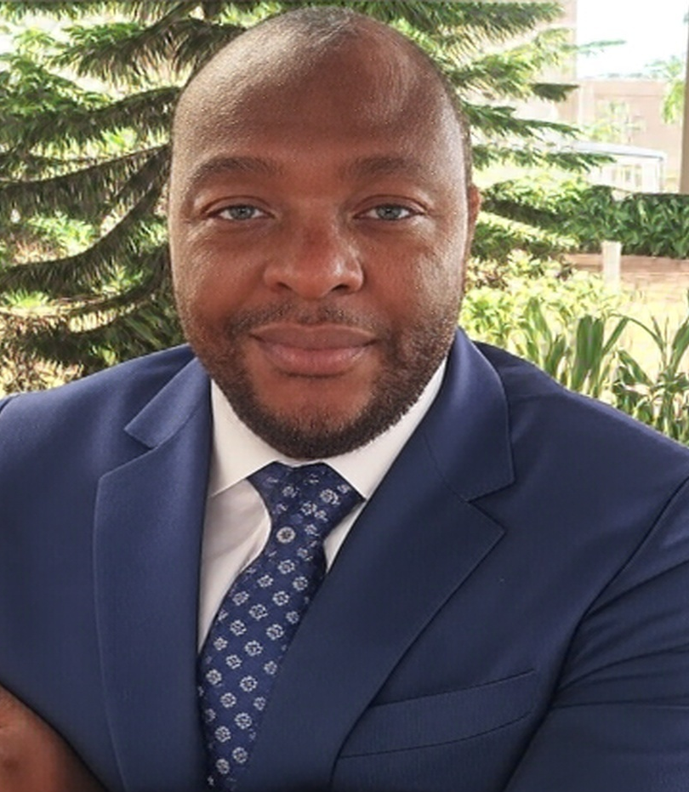
Speaker
Photo
WABO Yannick A.
Article 6 and Carbon Pricing expert
RCC West and Central Africa

Slide 7
The focus has shifted to activity-level completion
418
31 DEC 2026
CDM activities have received
Host Party approval for transition (8 Sep 2026)
Deadline for the main transition pathway
For activities continuing to apply their current CDM methodology, the Project Participants must submit the Addendum Form and applicable A6.4 SD Tool documentation by this date.
35
Registered
26
In process
357
Pending Additional Documentation
Host Party approval is a milestone — not the completion of transition.

Slide 8
Transition Process and Timeline
1
2
3
4
5
Transition request
Host Party approval
Additional documents
Additional documents
Secretariat checks
SB outcome
Submitted and published
Approval received
Current action point
Current action point
Completeness + substance
Approval and finalisation
Clinic focus
Complete, consistent and timely documentation

Slide 9
Transition Process and Timeline
Step 1
2023
Step 3
Step 4
Step 5
Approve, approve with modifications or reject
Step 2
2026
Processing of the Transition Request
Step 6
Submission of the Transition Request
Host Party Approval
Submission of additional documentation
Completeness Check
Substantive
Review
Publication of additional documentation
Period to request a review
Review
The host Party may submit a request for review
Step 7
Project Participants
Host Party (HP)
Secretariat
SBM
Transition Steps
Timeline
1
Submit the transition request
31 December 2023 (all activities except A/R)
31 December 2025 (Afforestation/Reforestation)
2
Global Stakeholder Consultation
28 days from publication of the transition request on the UNFCCC website
3
Submission of Host Party Approval
Before 30 June 2026, 24:00 CET
4
If continuing with the CDM methodology: 31 December 2026
If applying an A6.4 methodology: within 1 year from approval of the host Party or from when the new methodology becomes available, whichever occurs later
Submission of Additional Documentation
5
Processing of the Transition Request
• Collection of the transition fee • Completeness Check (7 days)
• Substantive Review (21 days) • Summary note with recommendation (14 days)
Complete, consistent documents reduce avoidable pauses and protect short response windows.
6
Request for Review by the Host Party or the SBM
May be requested by the host Party, or any SB member/alternate, within 28 days of the substantive review
7
Finalization of the transition request
Approve, Approve with Modification (7 days to respond), Reject

Slide 10
Which methodology pathway applies to your activity?
PATHWAY A
PATHWAY B
Continue the current
CDM methodology
Replace with an
Article 6.4 methodology
Submit by 31 December 2026
Different documentation and timing
• Addendum to the PDD / PoA-DD / CPA-DD.
• A6.4 SD Tool documentation, as applicable.
• Submission through the dedicated interface.
• Revised Article 6.4 design document(s).
• Validation by an accredited DOE.
• Submit within one year of Host Party approval or methodology availability, whichever is later.
Both pathways stay open — the choice depends on whether the current CDM methodology still applies to your activity.

Slide 11
Pathway A: two connected document packages
01
02
Addendum to the design document (PDD)
A6.4 Sustainable Development Tool
A6.4 –FORM- AC-015 Risk assessment
A6.4 –FORM- AC-016 Management plan, if required
A6.4 –FORM- AC-017 Sustainable development impacts
A6.4-FORM-AC-012 | v.03.1
Attests implementation against the registered CDM design document and demonstrates compliance with the additional Article 6.4 transition requirements. PDD Addendum, per Appendix 3 of the Transition Procedure
The Tool is mandatory for eligible CDM activities submitting additional documentation from 11 February 2025 onward.
Consistency check: align the Addendum and SD Tool across all activity information.

Slide 12
Pathway B: revised design and DOE validation
01
02
Revised Article 6.4 design documents
DOE validation and submission
DOE accredited for the relevant sectoral scope
Validates methodology and registration compliance
Submits design documents and validation report
Article 6.4 forms | Mechanism methodology
Revise the PDD, PoA-DD and CPA-DDs to apply the selected Article 6.4 methodology and demonstrate compliance with additional registration requirements.
Deadline: within one year of publication of Host Party approval or methodology availability, whichever is later.
Submission package: revised design document(s) + positive DOE validation report.

Slide 13
Additional documentation: How is it submitted?
Yes
No
MIS — Online Platform
Email submission
pacm.unfccc.int
A6.4mechanism-info@unfccc.int
Only authorized Focal Point Contact (FPC) entities may register, using the email recorded in the CDM MoC. The system currently covers only single-host-Party activities using CDM methodologies in transition, with additional features and workflows to be introduced progressively.
Activities with more than one host Party (multi-Party)
Activities using an Article 6.4 methodology in the transition
The MIS does not yet cover these cases — for now, they go directly by email.

Slide 14
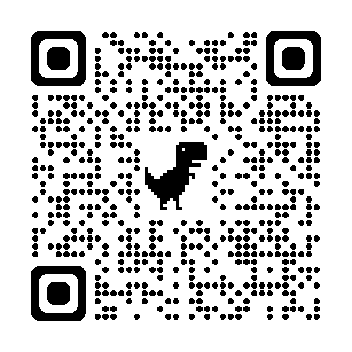
How much does the transition from the CDM to the PACM cost?
≤ 15,000
15,001 – 50,000
> 50,000
tCO₂e/year
tCO₂e/year
tCO₂e/year
USD 1,500
USD 5,000
USD 10,000
The fee is determined based on the estimated annual average of reductions/removals.
When is it paid?
1
2
3
4
5
6
Transition
request
Approval by the
host Party
Additional
documentation
Secretariat determines
the transition fee
PP pays the fee
Processing of
the transition
What changes depending on the transition route?
Key message: the transition fee structure does not change depending on the route; costs associated with the DOE/validation may vary.
Fees available in Appendix 1 of the Article 6.4 Project Activity Cycle Procedure.

Slide 15
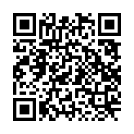
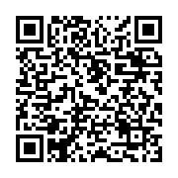
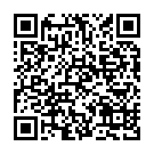
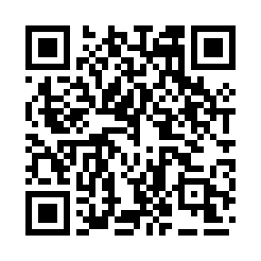
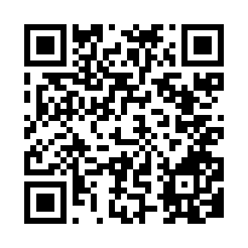
Secretariat knowledge products at a glance
ONLINE MODULE
ADDENDUM EXPLAINER
SD TOOL EXPLAINER
Learn the transition pathway, responsibilities, deadlines and remaining activity-level steps.
Complete A6.4-FORM-AC-012 section by section and address common consistency issues.
Apply safeguards and sustainable development requirements through forms AC-015, AC-016 and AC-017.
Two reference products — scan to open
PRACTICAL GUIDANCE
Transitioning eligible CDM activities to Article 6.4
CLINIC Q&A — FIRST SESSIONS
Answers to recurring implementation and form-completion questions

Slide 16
Completing the Addendum form
SESSION 2

Slide 17
Speaker
Karla Solis-Garcia
Programme Officer
Regulatory Framework Implementation Team
UNFCCC secretariat

Slide 18


Completing the Addendum form (A6.4-FORM-AC-012)
Session 02

Slide 19
Addendum to design document: A6.4-FORM-AC-012
The objective of this session is to:
Develop a thorough understanding of the Addendum to the Design Document; and
Equip participants with the knowledge required to begin completing the Addendum accurately and effectively.
Notes:
After the host Party's approval, the next important step is the submission of additional documentation, which is the responsibility of the project participants. There are two possible cases depending on the methodology that applies to your project. [CLICK] Case 1: [CLICK] If the project continues using its current CDM methodology, participants must prepare an Addendum to the Project Design Document (PDD) using Form A6.4-AC-012. This form must be submitted after the PA's Transition Approval and until 31 December 2026. Case 2: [CLICK] If applying with an Article 6.4 methodology, the PDD must be revised using the new A6.4 templates, validated by a Designated Operational Entity (DOE), and then submitted together with the validation report. This information must be submitted within one year after the publication of the PA's Approval, or once the new methodology becomes available, whichever occurs later. This is after the PA's Transition Approval and until 31 December 2026. [CLICK] Next slide.

Slide 20
Key references for completing the Addendum
CORE REFERENCES
VERSION
A6.4-FORM-AC-012
Addendum to design document for CDM activity transition request
03.1
A6.4-STAN-AC-001
Standard: Transition of CDM activities to the Article 6.4 mechanism
05.1
A6.4-PROC-AC-001
Procedure: Transition of CDM activities to the Article 6.4 mechanism
07.0
A6.4-SBM021-A04
Methodological tool: Fraction of non-renewable biomass
01.0
A6.4-STAN-METH-002
Standard: Requirements for activities involving removals under the Article 6.4 mechanism
01.0
Explainer: Addendum to Design Document for CDM Activity Transition Request

Slide 21
Addendum to design document: A6.4-FORM-AC-012
The addendum is part of the ‘additional documentation’ that activity participant(s) submit to request the transition of a CDM activity to A6.4 mechanism.
It attests that the CDM activity (PA/PoA/CPAs) has been implemented as per the corresponding registered PDD or PoA-DD and CPA-DD.
It supplements the registered CDM design document and demonstrates that a transitioning activity complies with A6.4 requirements while it continues to apply its CDM methodology.
It documents three key aspects:
the environmental, social, and sustainable development impacts evaluated by applying the A6.4 SD Tool with AC-FORM-AC-015, 016 and 017.
non-permanence risks; and,
compliance with the registered design document (such as post-registration changes and with the requirements for removals activities).
The addendum can be submitted by the activity participant(s) no later than 31 December 2026.

Slide 22
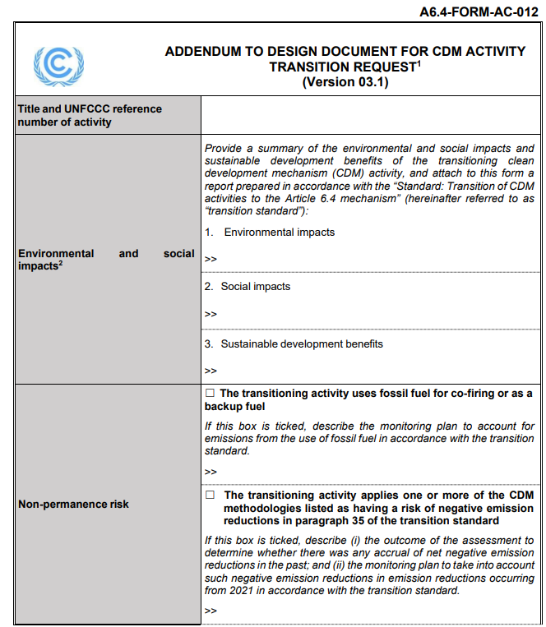
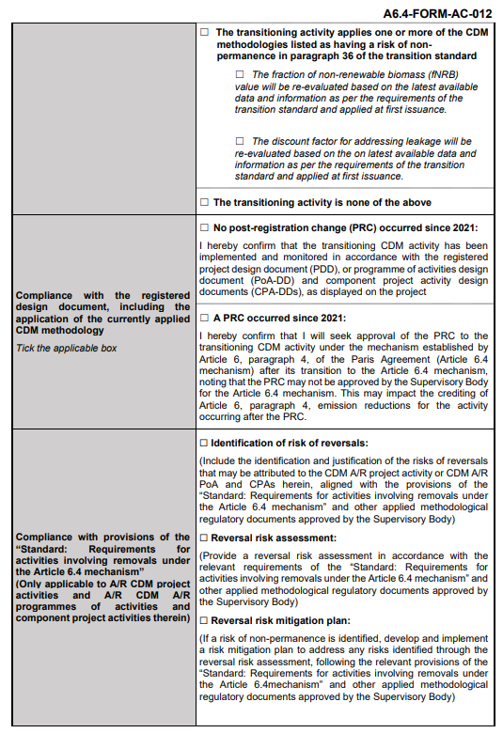
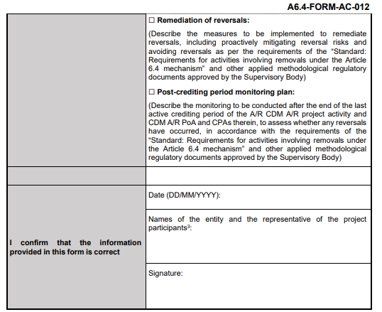
Addendum – A6.4-FORM-AC-012

Slide 23
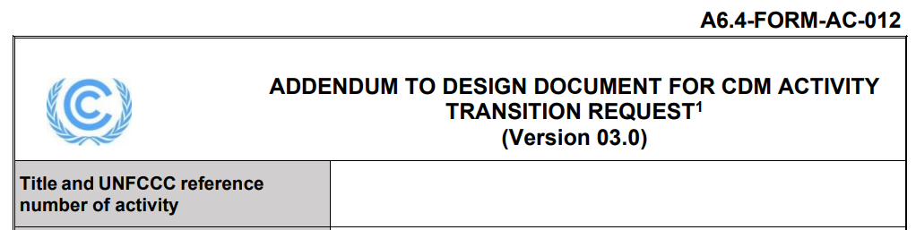
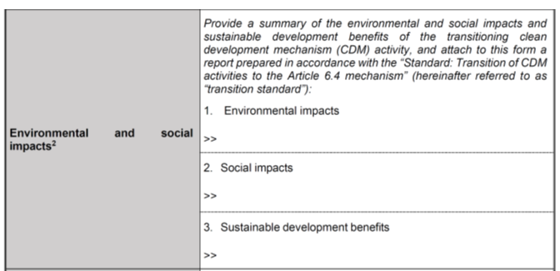
Title of the Activity and Environmental and social impacts
Title and UNFCCC reference of the activity
Environmental and social impacts
Summary from Elements 1, 2 and 3 (Forms 015 and 016)
The title and UNFCCC reference must match the title and CDM registration number.
Summary from Elements 4 to11 (Forms 015 and 016)
Summary from SDGs and SD indicators (Form 017)
For the impact summary, participants must reflect the results of the A6.4 SD Tool, through:
A6.4-FORM-AC-015
A6.4-FORM-AC-016
A6.4-FORM-AC-017
Safeguards risk assessment
Environmental and social management plan
Sustainable development impact
Evaluates the environmental and social risks.
Defines mitigation measures to the identified risks (in Form 015).
Identifies positive and negative impacts against the (17) SDGs and establishes activity-level SD indicators.

Slide 24
Non-permanence risk section
Non-permanence risk relates to the risk that stored carbon is released back into the atmosphere as CO₂ during the permanence period for CDM activities.
Under this section, the form seeks information on whether the transitioning activity has:
1
Fossil Fuel Use
Fossil fuels use for co-firing or as a backup fuel. E.g.: an emergency diesel generator.
2
Negative Emission Reduction Risk: 11 large-scale CDM methodologies
The activity applies one or more of the CDM methodologies listed in paragraph 35 of the Transition Standard.
3
Non-Permanence Risk: 4 small-scale CDM methodologies
The activity applies small-scale CDM methodologies identified as having a non-permanence risk, listed in paragraph 36 of the Transition Standard
Each of these three situations is examined in detail in the following slides.

Slide 25
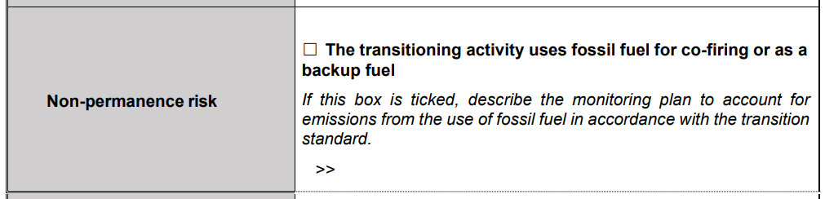
Fossil Fuels Use
The activity in transition uses fossil fuel for co-firing or as backup
Step 1
Step 2
Review the PDD to confirm whether it uses fossil fuel for co-firing or as backup (e.g. emergency diesel generators). Refer to paragraph 34 of the Transition Standard.
If applicable, confirm whether the monitoring plan includes the use of such fuel accounting for project emissions. Refer to paragraph 34 of the Transition Standard.
If the project uses fossil fuel for co-firing or as backup and the PDD does not include a procedure to account for the project emissions, participants shall describe the monitoring plan to account for emissions from the use of fossil fuel.

Slide 26
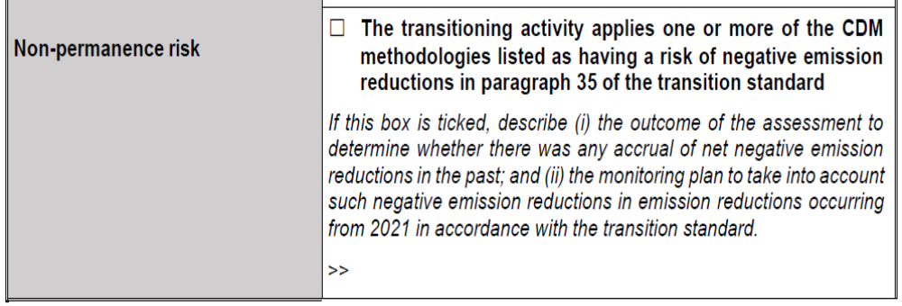
Negative Emission Reductions Risk & large-scale CDM methodologies
The activity applies (11) CDM methodologies with risk of negative emission reductions (paragraph 35 of the Transition Standard)
If a CDM activity, or a PoA and its CPAs, applies any of the 11 methodologies identified with a risk of negative emission reductions, the participant must:
review all monitoring reports since the start of the crediting period,
determine whether there was net accumulation of negative reductions, and
ensure these are accounted for in the reductions from 2021 onward.
11 CDM methodologies identified with risk of negative emission reductions
ACM0005: Increasing the blend in cement production
ACM0006: Electricity and heat generation from biomass
ACM0017: Production of biodiesel for use as fuel
ACM0018: Electricity generation from biomass residues
ACM0020: Co-firing of biomass residues (heat and grid electricity)
ACM0022: Alternative waste treatment
AM0036: Fuel switch from fossil fuel to biomass residues
AM0057: Avoided emissions from biomass residue use in pulp and paper
AM0061: Rehabilitation or energy efficiency in existing power plants
AM0094: Distribution of biomass stoves or heaters
AM0108: Interconnection of electricity systems

Slide 27
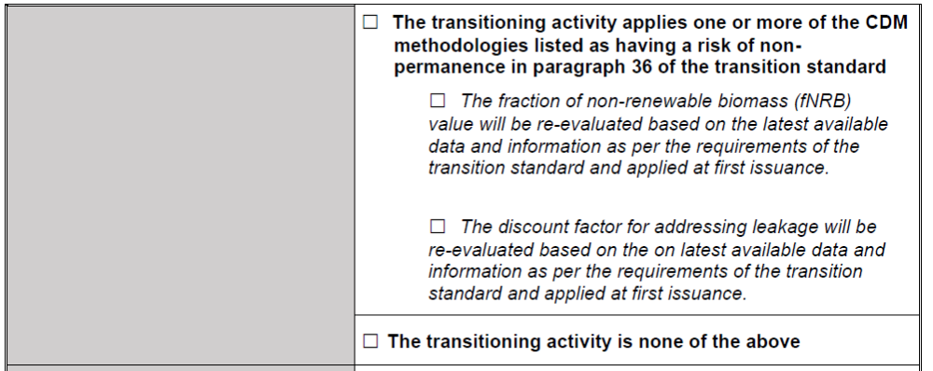
Non-Permanence Risk and small-scale CDM methodologies
The activity applies one or more of (4) small-scale CDM methodologies with risk of non-permanence (paragraph 36 of the Transition Standard)
The participant must reassess and apply updated values for the fraction of non-renewable biomass (fNRB) and the leakage discount factor, based on the most recent available data — including data from the A6.4 mechanism — at the time of the first issuance request.
This is also an option: no use of fossil fuels, identifed large or small scale CDM methdologies are not applied.
AMS-I.E
AMS-II.G
AMS-III.AV
AMS-III.BG
Switch from non-renewable biomass for thermal applications by the user
Energy efficiency in thermal applications of non-renewable biomass
Low greenhouse gas emitting safe drinking water systems
Sustainable charcoal production and consumption

Slide 28
Non-Permanence: Parameters to Reassess
Fraction of non-renewable biomass (fNRB)
Default values are found in the Methodological Tool: Fraction of non-renewable biomass. (A6.4-SBM021-A04). Regional, national and sub-national values are included.
Discount factor to address leakage
The most recent available default value will be used, such as the 0.95 net-to-gross adjustment contained in the applicable CDM methodologies, or ex-post surveys will be carried out to determine the leakage factor.
Default values that must be updated at the time of the first issuance request

Slide 29
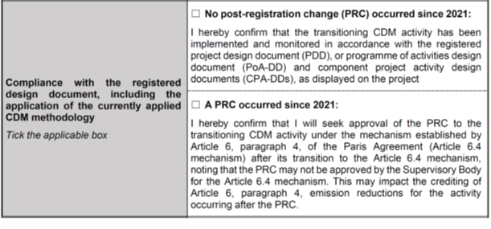
Compliance with registered design document. E.g. PRC
Mandatory
Participants must indicate whether a post-registration change (PRC) has occurred since 2021. Any PRC will be assessed by the Supervisory Body at the time of the 1st verification.
Check the applicable box: no PRC since 2021, or a PRC has occurred since 2021.

Slide 30
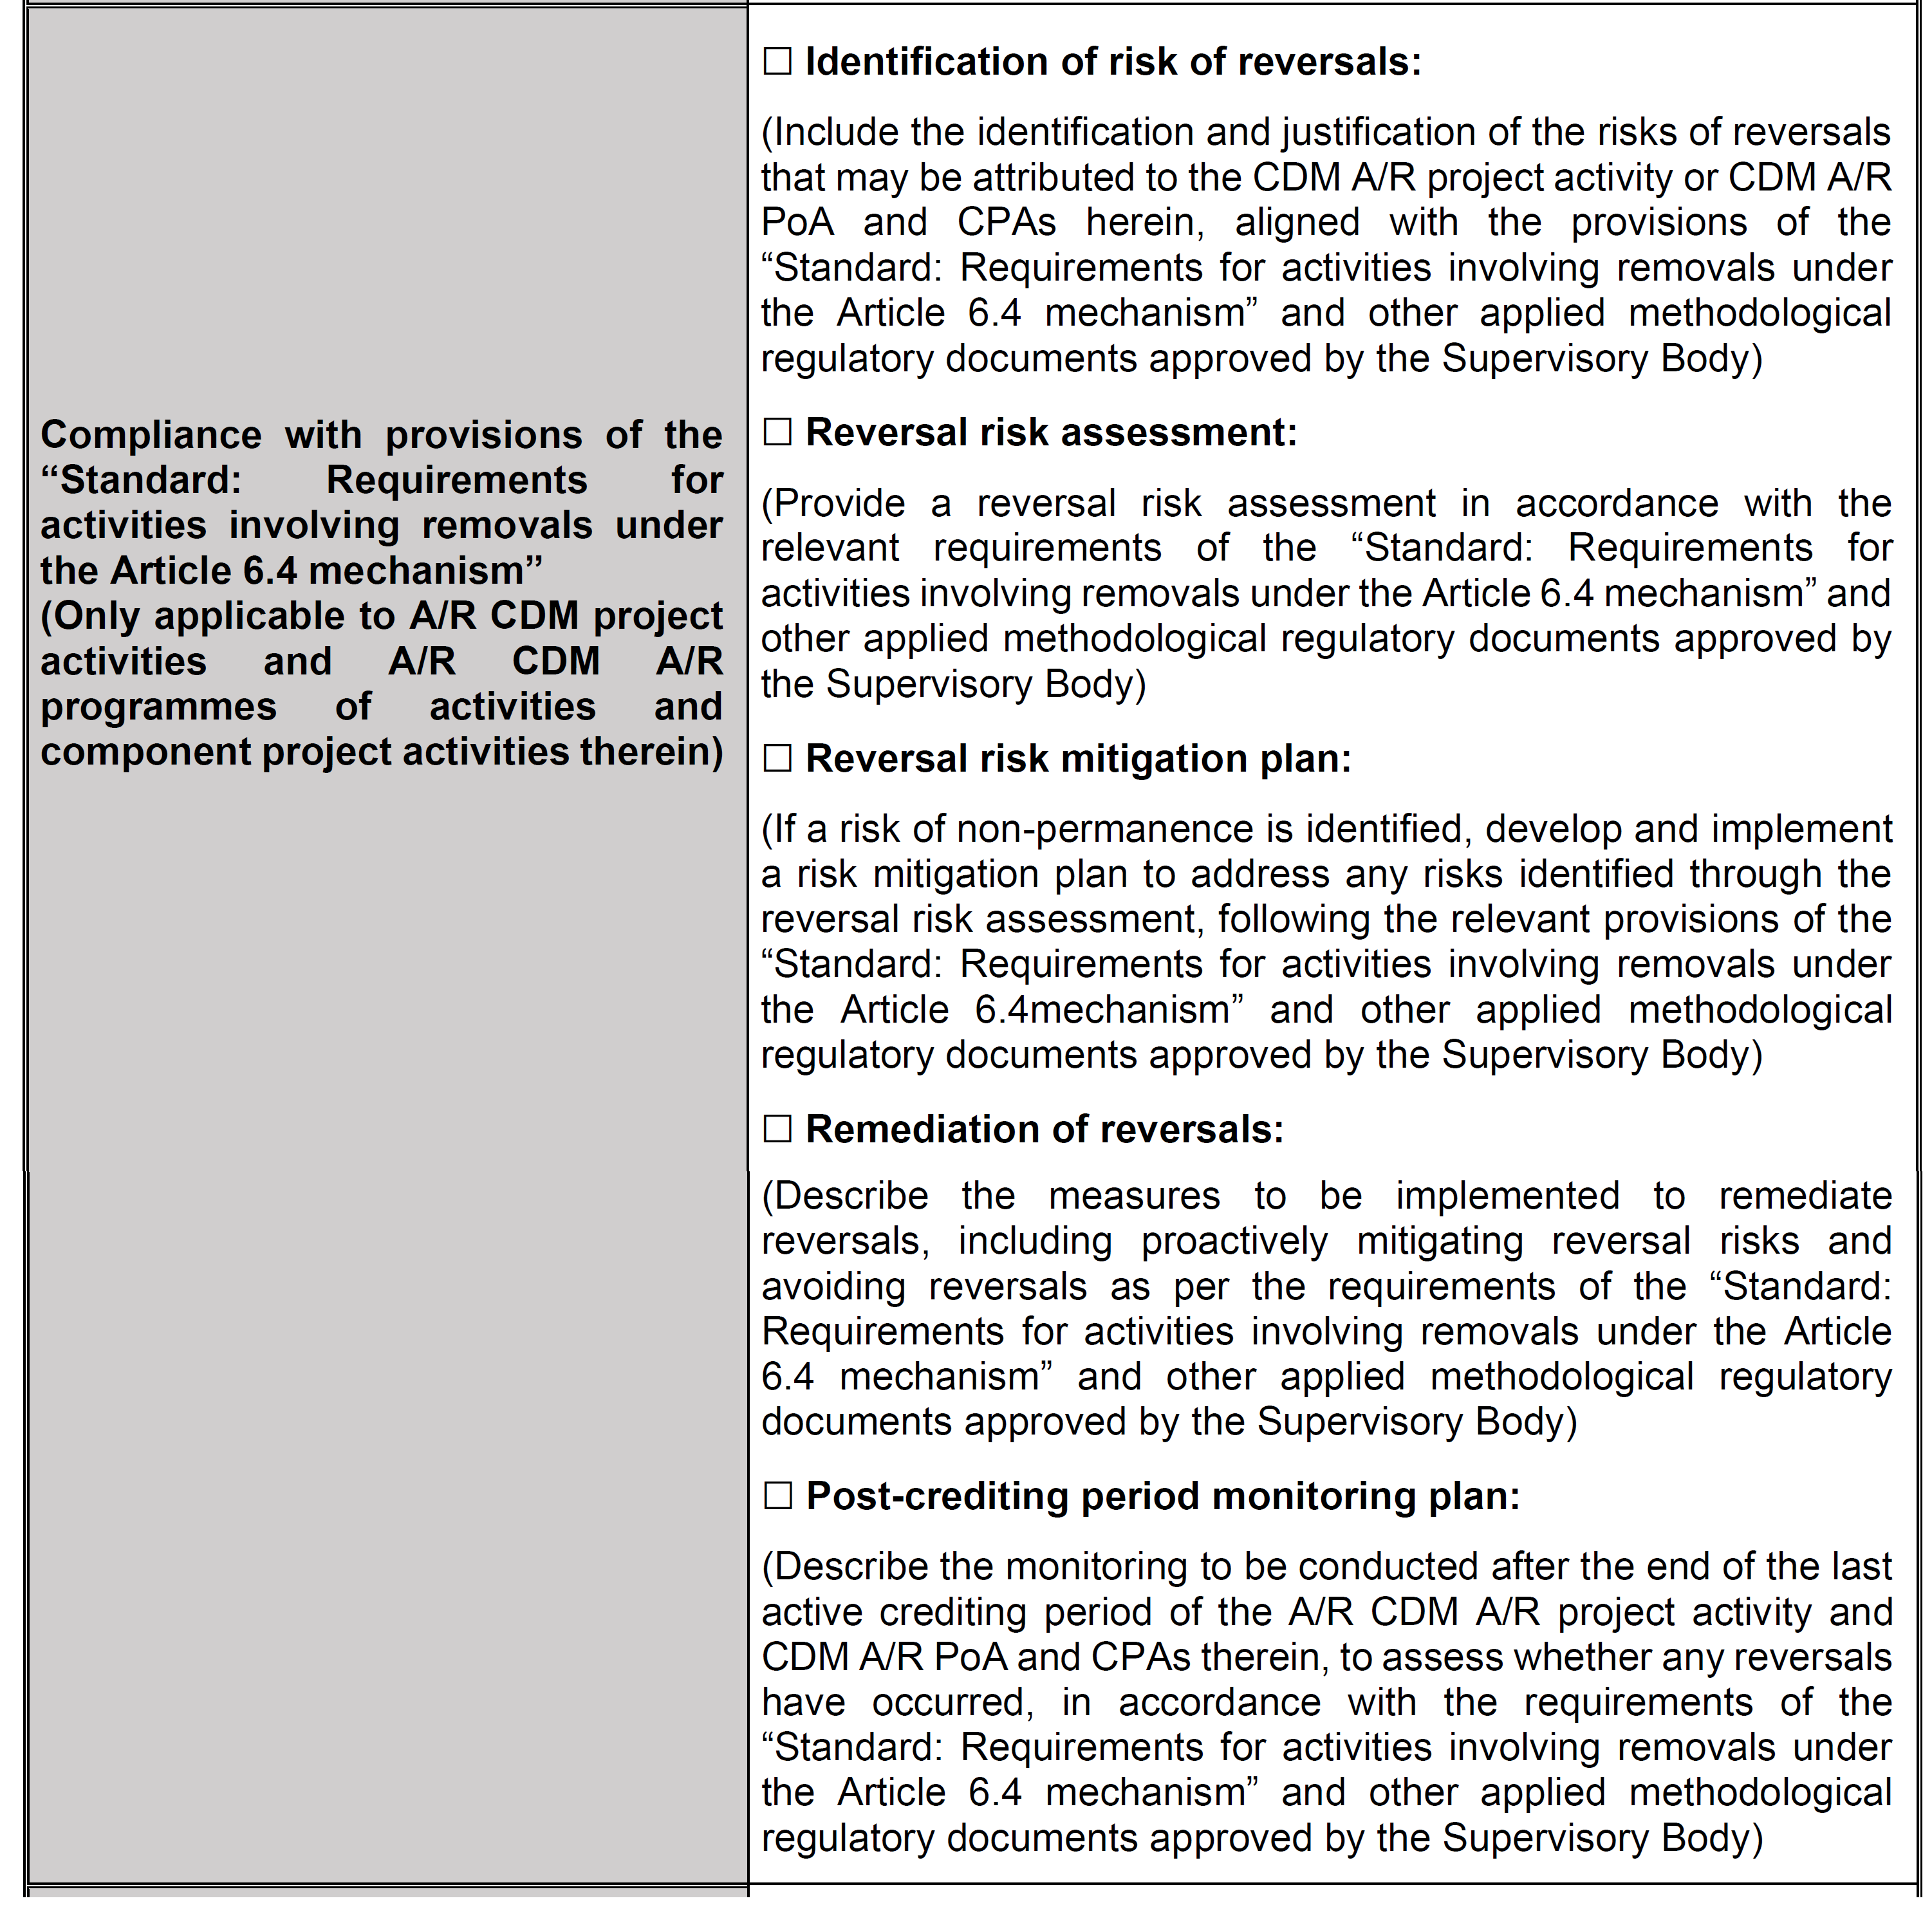
Compliance with the Standard: A/R activities
Compliance with the Standard: Requirements for activities involving removals under Article 6.4
Applicable only to A/R activities
These requirements apply only to CDM A/R project activities, CDM A/R PoAs and their component activities (CPAs).
Identification of reversal risk
Identify and justify the risks attributable to the activity.
Reversal risk assessment
Carry it out in accordance with the requirements of the applicable Standard.
Risk mitigation plan
Develop and implement measures if a risk is identified.
Reversal remediation
Measures to proactively remediate and avoid reversals.
Post-crediting period monitoring plan
Monitoring after the last active period to assess reversals.
Notes:
Approx. 11 PA and 1 PoA with 1 CPA - A/R CDM eligible projects

Slide 31
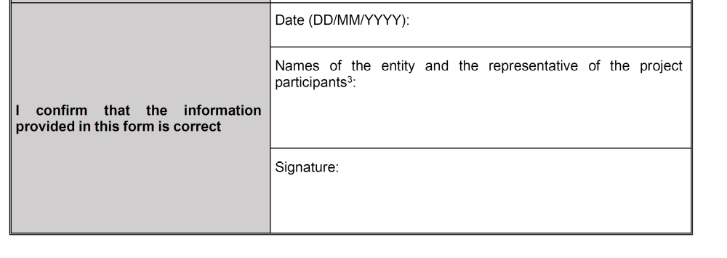
Signature and Confirmation of Information
I confirm that the information provided in this form is correct
Who must sign
The form must be completed and signed by the person authorized for scope (c) by the project participants of the CDM activity or programme of activities.
Date
Entity and representative
Signature
DD/MM/YYYY format.
Names of the entity and of the representative of the participants.
Of the person authorized for scope (c).
The authorization must correspond to the communication modalities submitted under the "CDM project cycle procedure for project activities" or the "CDM project cycle procedure for programmes of activities".

Slide 32
Addendum to design document: A6.4-FORM-AC-012
Was the objective achieved?
To develop a thorough understanding of the Addendum to the Design Document; and
To equip participants with the knowledge required to begin completing the Addendum accurately and effectively.
Notes:
After the host Party's approval, the next important step is the submission of additional documentation, which is the responsibility of the project participants. There are two possible cases depending on the methodology that applies to your project. [CLICK] Case 1: [CLICK] If the project continues using its current CDM methodology, participants must prepare an Addendum to the Project Design Document (PDD) using Form A6.4-AC-012. This form must be submitted after the PA's Transition Approval and until 31 December 2026. Case 2: [CLICK] If applying with an Article 6.4 methodology, the PDD must be revised using the new A6.4 templates, validated by a Designated Operational Entity (DOE), and then submitted together with the validation report. This information must be submitted within one year after the publication of the PA's Approval, or once the new methodology becomes available, whichever occurs later. This is after the PA's Transition Approval and until 31 December 2026. [CLICK] Next slide.

Slide 33
Key references for completing the Addendum
CORE REFERENCES
VERSION
A6.4-FORM-AC-012
Addendum to design document for CDM activity transition request
03.1
A6.4-STAN-AC-001
Standard: Transition of CDM activities to the Article 6.4 mechanism
05.1
A6.4-PROC-AC-001
Procedure: Transition of CDM activities to the Article 6.4 mechanism
07.0
A6.4-SBM021-A04
Methodological tool: Fraction of non-renewable biomass
01.0
A6.4-STAN-METH-002
Standard: Requirements for activities involving removals under the Article 6.4 mechanism
01.0
Explainer: Addendum to Design Document for CDM Activity Transition Request

Slide 34
Thank you!

Slide 35
Recurring issues – Request for Transition
Factual details: E.g.: PoA – lack of details of the CPA (reference number/country/title).
Fee payment: SIDS and LDCs are exempted to pay fees.
Addendum
Environmental, social and SD impacts section: should reflect the findings of the risks evaluation, mitigation of such risks and SD impacts and activity level SD indicators. E.g.:
  Elements 1 to 3 and 4 to 11 under environmental and social impacts, respectively (Forms 015 and 016).
  SDG positive impacts and SD indicators under SD impacts.
Non-permanence section should be dully filled up – avoid missing an option (use of fossil fuel or negative emissions or non-permanence –fNRB/leakage-or any of the options) to avoid delays in the process.
A6.4-SD tool
Lack of justification on the risk evaluation under A6.4-FORM-AC-015
Each answer shall be fully justified: NO/YES/POTENTIALLY
Relevant documentation justifying the evaluation should be included (with corresponding links or files sent via email)
Notes:
Approx. 11 PA and 1 PoA with 1 CPA - A/R CDM eligible projects

Slide 36
UNDERSTANDING AND USING THE ARTICLE 6.4 SUSTAINABLE DEVELOPMENT TOOL
SESSION 3

Slide 37
Article 6.4 Sustainable Development Tool
Procedural context
The Article 6.4 Sustainable Development Tool was developed under the mandate of the Supervisory Body of the Article 6.4 mechanism in response to guidance from Parties contained in Decision 3/CMA.3.
Mandate from Parties
Operationalization by the SBM
Detailed requirements
Paragraph 5(c) requested a review of the Clean Development Mechanism’s sustainable development tools and other safeguard systems used across existing market-based mechanisms, with the objective of creating a comparable framework for the Article 6.4 mechanism by the end of 2023.
See Decision 3/CMA.3, para. 5(c)
The use of the tool should be made mandatory, while also taking into account the specific Sustainable Development (SD) objectives of the host Party and aligning the tool with the Sustainable Development Goals (SDGs).
See SBM 004, para. 17
Robust social and environmental safeguards are required, together with tools and approaches that allow activity participants to assess and report how each activity contributes to sustainable development. SD priorities remain a national prerogative of host Parties.
See Annex, paras 24(a)(x)-(xi)
SBM 014: the Supervisory Body adopted the A6.4 SD Tool and decided that it shall be applied to all Article 6.4 activities, including all CDM activities seeking eligibility for transition submitted after 9 a.m. (CET) on 11 February 2025.

Slide 38
Structure and Forms
Project participants must analyze the environmental and social impacts, and the sustainable development benefits of the activity, following the A6.4 Sustainable Development Tool.
Core Architecture of A6.4 SD Tool
A6.4 SD Tool Components
Environmental and social impacts
Sustainable development
01
02
Normative references and definitions
Implementation procedure
11 safeguard elements (3 environmental and 8 social).
Host country priorities, aligned with the 17 SDGs.
03
04
Mandatory forms
Stakeholder engagement and A6.4 SD Tool
Environmental and social impacts
Environmental and Social Safeguards Risk Assessment Form
(A6.4-FORM-AC-015)
05
06
Sustainable development impacts
Validation and verification requirements
Environmental and Social Management Plan Form (A6.4-FORM-AC-016)
Sustainable Development Impacts Form (A6.4-FORM-AC-017)
07
Appendix 1 – Guiding questions

Slide 39
Article 6.4 Sustainable Development Tool
The 11 elements are assessed in the A6.4 Environmental and Social Safeguards Risk Assessment form.
Environmental safeguards
Social safeguards
01
Energy
04
Human rights
05
Labour
06
Health and safety
07
Gender equality
02
Air, land and water
08
Land acquisition and involuntary resettlement
09
Indigenous peoples
03
Ecology and natural resources
10
Corruption
11
Cultural heritage

Slide 40
Article 6.4 Sustainable Development Tool
Impact assessment
Participants must assess risks against the A6.4 environmental and social safeguard elements and criteria, including paragraph 11 of the preamble of the Paris Agreement, applicable national legislation, and binding international instruments for the host Party, using two forms:
A6.4-FORM-AC-015
Environmental and social safeguards risk assessment
A6.4-FORM-AC-016
Environmental and social management plan
Identification and assessment of the potential environmental and social risks of the proposed activity.
Avoidance, minimization and mitigation measures for those risks.
Mandatory basis for the design of the A6.4 activity.
Set of minimization and mitigation measures and strategies when full avoidance is not possible.
Defines the activity-level environmental and social indicator to be monitored.
Required to be completed when the A6.4-FORM-AC-015 identifies risks.

Slide 41
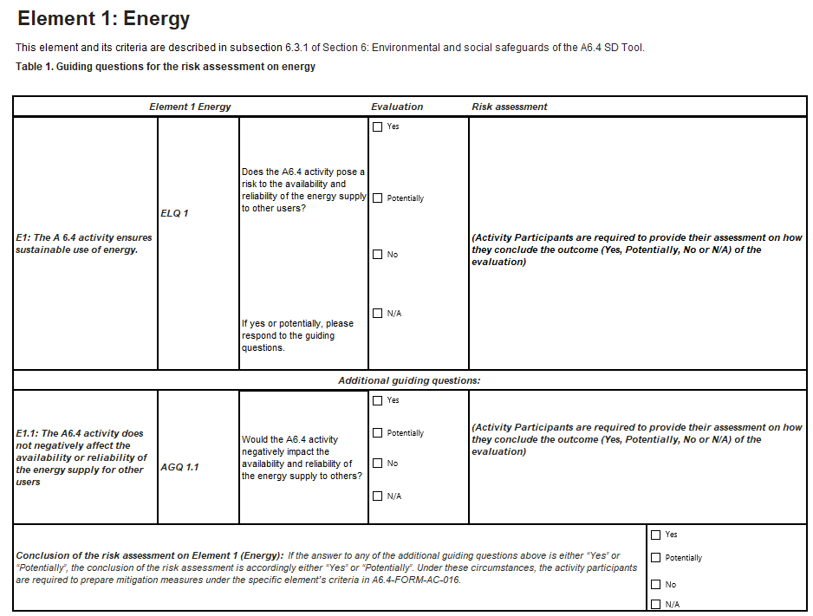
Article 6.4 Sustainable Development Tool
A6.4-FORM-AC-015: Environmental and social safeguards risk assessment
How to read the form (Example: Element 1 – Energy)
01
Element and criterion
E1: the A6.4 activity ensures the sustainable use of energy.
02
Guiding question
Identified with an ID (ELQ 1, AGQ 1.1) for each criterion.
03
Risk assessment
The participant provides a written justification for how it reached that conclusion.
04
Conclusion
If "Yes" or "Potentially", mitigation measures are required in the A6.4-FORM-AC-016.

Slide 42
Article 6.4 Sustainable Development Tool
A6.4-FORM-AC-016: Environmental and social management plan
What is recorded in the form
01
02
03
Element name
Element question (ELQ)
Additional question (AGQ)
Safeguard element assessed (e.g. Energy, Human rights).
Number of the element-level question with an identified risk.
Number of the corresponding additional guiding question.
04
05
06
A6.4-FORM-AC-015 (Risk Assessement) result
Mitigation measures
Activity indicators
Only "Yes" or "Potentially" cases move on to the management plan.
Actions to avoid, minimize and mitigate the identified risk.
Monitoring parameters, acceptance criteria and those responsible.
Environmental safeguard elements
Social safeguard elements

Slide 43
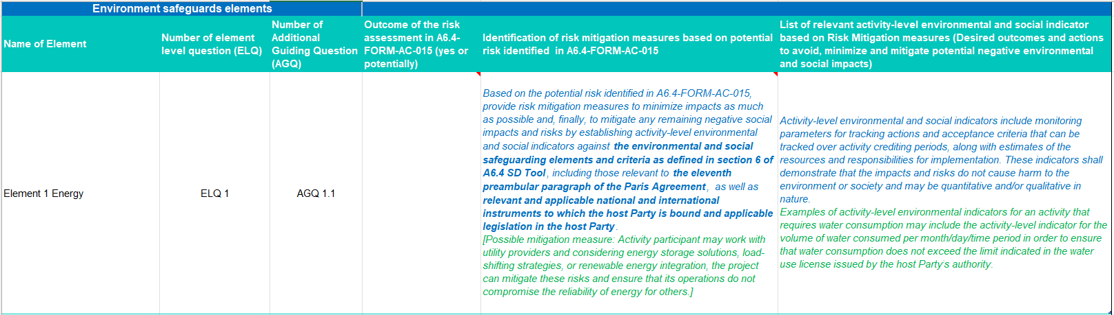
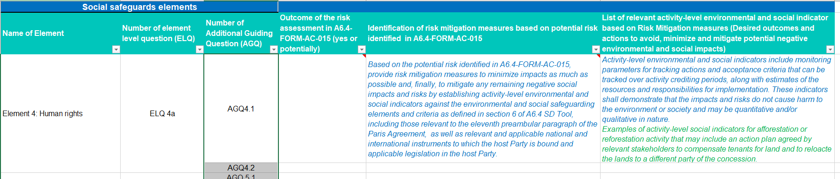
Article 6.4 Sustainable Development Tool

Slide 44
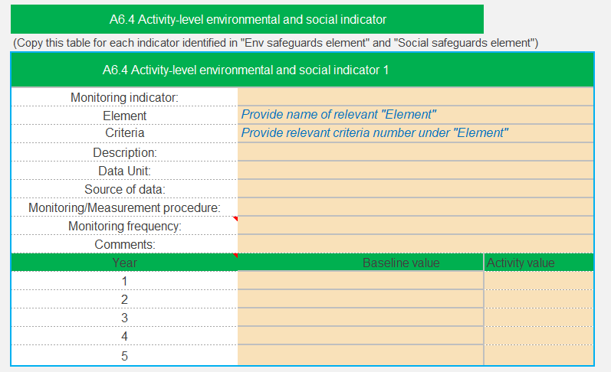
Article 6.4 Sustainable Development Tool
Implementation of the A6.4 SD Tool
Procedure for monitoring activity-level environmental and social indicators
Activity participants shall describe, in A6.4-FORM-AC-016, the monitoring procedures for activity-level environmental and social indicators relevant to mitigation strategies and measures to avoid or minimize identified risks, including:
  A description of the activity-level environmental and social indicators;
  Data unit and source of data;
  Information on monitoring or measurement procedures and methods;
  Monitoring frequency (at least annual).

Slide 45
Article 6.4 Sustainable Development Tool
Sustainable Development Impacts (A6.4-FORM-AC-017)
Participants must identify and assess the potential direct impacts — positive and negative — of the A6.4 activity on the sustainable development of the host Party, taking into account its national objectives and priorities and the 17 SDGs.
Positive impacts
Sustainable development benefits generated by the activity, aligned with the priorities of the host Party.
Negative impacts
Potential adverse effects that must be avoided, minimized or mitigated during the activity.
A6.4-FORM-AC-017
A6.4 Sustainable Development Impact Form
Identifies the positive and negative sustainable development impacts of the A6.4 activity.
Sets the activity-level sustainable development indicators to be monitored by participants when impacts are identified.
Submitted together with the A6.4-FORM-AC-015 (safeguards risks) and the A6.4-FORM-AC-016 (environmental and social management plan).

Slide 46
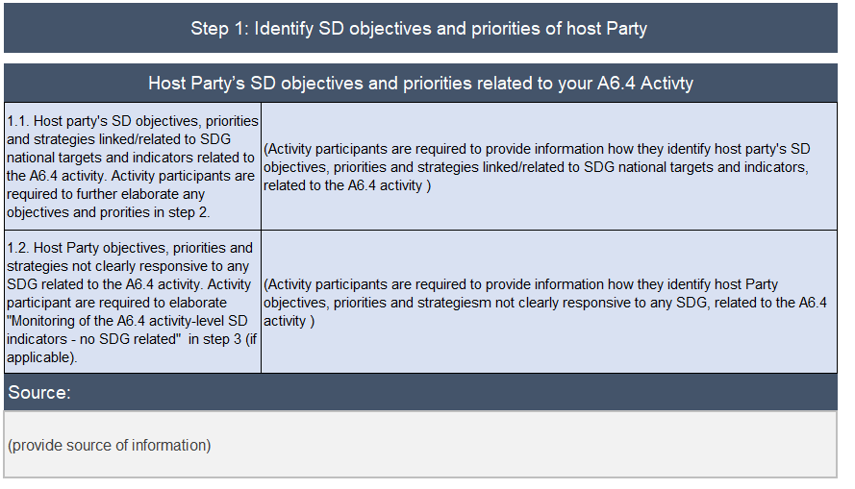
Article 6.4 Sustainable Development Tool
Sustainable Development Impacts (A6.4-FORM-AC-017)
Identify national SD objectives, strategies, and SDG priorities of the host Party.​
Explicitly reference any SDG-specific national targets.​
Include relevant host Party priorities even if they are not directly linked to a specific SDG.

Slide 47
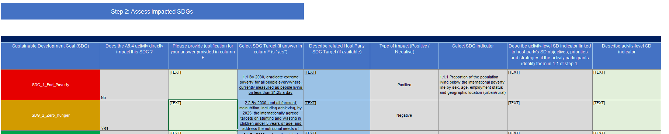
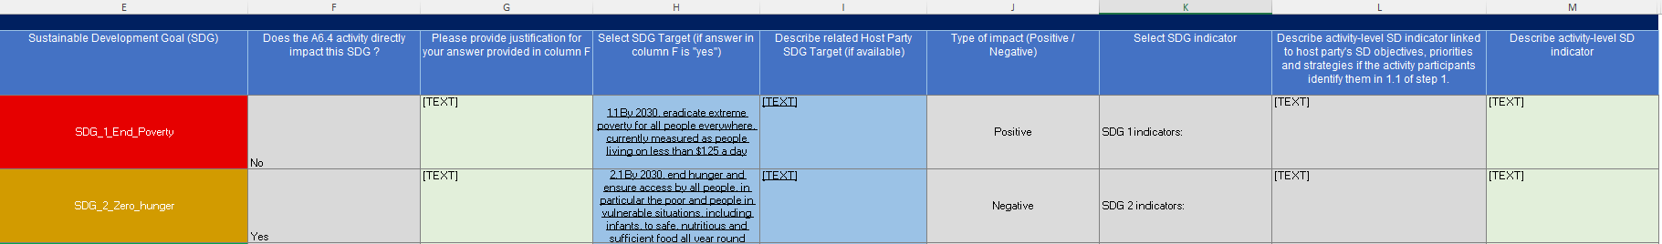
Article 6.4 Sustainable Development Tool
Sustainable Development Impacts (A6.4-FORM-AC-017)
Consult the official Global SDG indicator framework (17 Goals, 169 targets).​
Identify SDGs that the activity directly impacts, positively or negatively.​
Justify any excluded SDGs.
Select target(s) under the identified SDGs.
If applicable describe the host Party SDG targets.
Indicate the type of impact to the SDG.
Select SDG indicator.
If applicable, describe activity-level SD indicator linked to host party's SD objectives, priorities and strategies.
Since these indicators are defined at regional and national levels, activity participants shall develop their own activity-level SD indicators.

Slide 48
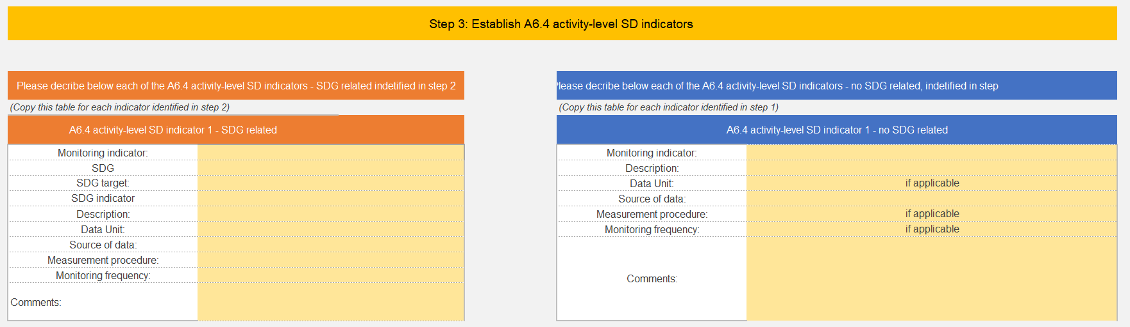
Article 6.4 Sustainable Development Tool
Form A6.4-FORM-AC-017 describes the procedures for monitoring activity-level sustainable development (SD) indicators, which include:
01
Sustainable Development Indicators
At the activity level, with the selected SDGs, their targets and indicators.
02
Data
Data unit and data source.
03
Procedures
Monitoring and measurement methods and procedures.
04
Frequency
Monitoring at least annual.

Slide 49
Article 6.4 Sustainable Development Tool
Activity-level sustainable development indicators must:
1
Alignment with the SDGs
2
Link to the activity
Be consistent with the objectives and intent of the SDGs and their corresponding targets.
Be directly affected by the activity.
3
Ongoing nature
4
Monitoring approach
Not be an isolated event, but an effect sustained over time.
Include the monitoring approach and parameters, with its frequency, for each SDG target indicator defined in form A6.4-FORM-AC-017.

Slide 50
Interactive Q&A session
SESSION 4

Slide 51

Feedback Survey
Your feedback is important for us to evaluate the effectiveness of these sessions and improve technical support for project participants
Please take a minute to fill out this survey.
All responses are confidential.

Slide 52

Closing Remarks
Photo
William Otieno
UNFCCC Regional Collaboration Centre EASA, Regional Lead

Slide 53
Thank you
For any standing questions, you may email us at:
Article-6-Capacity-Building@unfccc.int
A6.4mechanism-info@unfccc.int
A6.4mechanism-activitycycle@unfccc.int
A6.4mechanism-meth@unfccc.int

