Slide 1





Building the Transition;
Financing a Resilient Future
#BeBoldOnBuildings
November 2024
COP29
Notes:
Good morning everyone, so glad to have you with us today,
My name is Natali Ghawi, The Health Equity and Resilience Manager at the World Green Building Council

Slide 2


Agenda
  Introduction 10’
  Panel Discussion 30’
  Breakout Discussion 15’
  Closing 5’
Notes:
So on our agenda for today I will be doing a quick introduction and scene setting and then we’ll dive right into the panel discussion followed by a short breakout discussion and then close out for the day

Slide 3
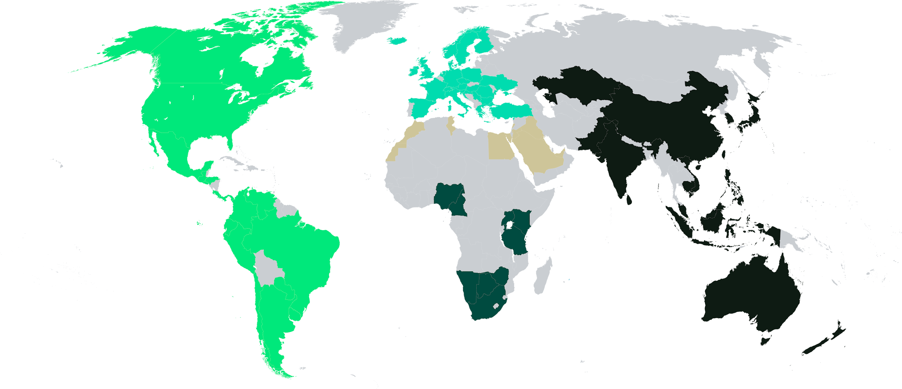
Our global network
  75+
  Green Building Councils
  accelerating action and
  implementing solutions
  across the globe
60+
Partners
collaborating to deliver
a holistic vision
48,000+
Private sector members
taking action and driving the sustainability agenda
Africa
Americas
Asia Pacific
Europe
MENA
Notes:
So just to kick us off I’m here on behalf of
The World Green Building Council; the largest and most influential action network accelerating the sustainable and just transition of the built environment.
We represent a global community of over 75 Green Building Councils and their 48,000 members around the world.
Together, we drive local action and create the global momentum that’s necessary for all people and our planet to thrive.
We do this in alignment with the ambitions of the Paris Agreement and the UN Sustainable Development Goals.

Slide 4


Resilient and decarbonised buildings for a healthy planet and a better future for all
Notes:
What unites us is our shared commitment for resilient and decarbonised buildings for a healthy planet and a better future for all.
Because while the built environment—where we live, work, and interact—is essential for human life.
The very structures designed to shelter and support us are now a major factor in climate change, threatening their ability to serve these core purposes effectively.

Slide 5

Surveying the sector
Buildings and construction sector accounts for:
  37%
  energy-related carbon emissions
  34%
  energy demand
  40–50%
  raw material use
Downsizing not an option:
  2 billion
  additional homes required next 75 years
  80%
  cities lack affordable housing options
Notes:
Right now, building and construction is one of the biggest emitters on the planet. Globally, it’s responsible for 37% of total carbon emissions. It consumes up to half of the raw materials flowing through the world economy. It generates half the world’s waste.
And this is having a material impact.
Unfortunately downsizing is not an option. The world needs to provide two billion additional homes over the next 75 years, and, currently, around 80% of cities lack affordable housing options for most of their population.
And while I see some bright spots of progress when I take stock of where we are, let us be clear: today, the built environment and construction sector is not on track to decarbonise in line with the Paris Agreement. And less than 2,000 days remain for us to achieve our 2030 climate targets.
So we have to accelerate mitigation and adaptation in the built environment, urgently.
Sources:
Centre for International Earth Science Information Network – CIESIN
The Global Status Report for Buildings and Construction (Buildings-GSR), 2023
Greening the Supply Chain Report, UNEP
The Global Status Report for Buildings and Construction (Buildings-GSR), 2023
European Parliament, ‘Access to decent and affordable housing for all’ (2020)

Slide 6



Recognising buildings’ potential
People
Economies
Planet
  200 million
  jobs worldwide
  38%
  Growth in green building market size in emerging markets by 2030
  Potential to:
  reverse planetary breakdown
  recover biodiversity
  preserve resources
  11–13%
  global GDP
  $4.5 trillion
  economic benefits from circular economy
Notes:
around the world there is a growing recognition of the multiple benefits that buildings bring to our societies.
It’s the vast reach of the built environment into every aspect of human life that makes it possible for it not only to be a solution to climate change but to truly nurture people, economies and planet.
For people, building and construction is responsible for over 200 million jobs, accounting for 11–13% of global GDP.
As an investment opportunity, real estate and infrastructure represent two-thirds of global wealth, the largest asset class by far, valued at over $300 trillion USD. With the growing risks of climate change, the greener these assets the safer and more insurable they will be. Also, the green building market size is predicted to grow an estimated 38% by 2030 in emerging markets alone. And, globally, the circular economy could yield up to $4.5 trillion USD in economic benefits by 2030.
And by improving our practices, the built environment can help slow and stop the planetary resource decline, recover biodiversity, and help us preserve our limited resources.
Sources:
https://www.ilo.org/sites/default/files/wcmsp5/groups/public/@ed_emp/@emp_policy/@invest/documents/publication/wcms_734235.pdf
https://www.ilo.org/sites/default/files/wcmsp5/groups/public/@ed_protect/@protrav/@migrant/documents/publication/wcms_538487.pdf
https://www.ey.com/en_uk/energy-resources/how-bold-action-can-accelerate-the-worlds-multiple-energy-transition
https://environment.ec.europa.eu/topics/ circular-economy_en

Slide 7
WorldGBC´s guiding goals
Total decarbonisation
of the built environment
Healthy, equitable and resilient buildings, cities & communities
Regeneration of natural systems & thriving circular economy
Notes:
So how do we make buildings the solution?
At the World Green Building Council, we are building momentum towards three guiding goals:
Total decarbonisation of the built environment.
Healthy, equitable and resilient buildings, cities & communities.
Regeneration of natural systems & thriving circular economy.

Slide 8

Our global network
Countries
accounting for
72%
built environment emissions
  60%
  world’s building
  stock
65%
global GDP
Notes:
To achieve these, the WorldGBC network is uniquely placed to drive ambition and foster alignment and collaboration among governments, businesses, and communities.
Our network covers 60% of the world’s building stock and 65% of global GDP.
With the countries represented by our network accounting for 72% of built environment emissions, this presents a huge potential to lead the reduction of the global impact of our industry and inspire regenerative, circular business models.
The national GBCs have access to over 48,000 members, ranging from private sector businesses to national and local governments, academic institutions, private individuals and many others.
In this way, WorldGBC can be a bridge between the built environment, policymakers the finance sector, and policymakers. Acting as a “universal translator,” providing standards and frameworks that financial institutions can use to better assess and manage climate-related risks in the built environment.

Slide 9
Putting buildings on the global agenda
COP30
Declaration de Chaillot – adopted by 70 countries
Buildings Breakthrough at COP28 – supported by 28 countries
Built environment day at UN Climate Summit COP26
Notes:
In recent years we’ve seen the built environment increasing in the international political agenda.
Starting with the launch of a built environment day at COP26 in Glasgow.
We’ve seen this translate into two multi-national agreements in the past 12 months – the Buildings Breakthrough at COP28 which calls for near zero emission and resilient buildings to be the new normal by 2030 – now supported by 28 countries. (And WorldGBC is proud to be leading on Priority Action 1 of the Buildings Breakthrough on Standards and Certifications alongside the GlobalABC.)
And the Buildings and Climate Global Forum in Paris earlier this year, which concluded with the Declaration de Chaillot (pronounced: shy-o)– adopted by representatives of 70 countries agreeing to international cooperation to enable progress towards a rapid, fair and effective transition of the sector.

Slide 10
There is time to reduce the risk of inaction
Global insurance losses from natural catastrophes have exceeded $100 billion annually in the last few years.
Investing in more resilient infrastructure could save humanity $4.2 trillion from climate change damages.
New climate finance goal, known as the New Collective Quantified Goal (NCQG), will be adopted.
The NCQG offers an opportunity to tackle many of the financial barriers blocking the transition to sustainable built environments.
Notes:
And all this is important because we know that presently the building sector is insufficiently resilient to the impacts of climate change
• Building resilience must be improved to protect people from heatwaves, droughts, coastal flooding and sea level rise, cyclones and strong winds, and cold. (UNEP, 2021).
- Built environments account for two-thirds of our global real assets (McKinsey, 2020), posing serious risks to our global economy.
• The insurance industry is already facing major losses from climate change – natural catastrophe events have led to a 3.6 times increase in insured losses over the last 30 years (Capgemini, 2022).
• Global insurance losses from natural catastrophes have exceeded $100 billion annually in the last few years (Swiss Re, 2023).
- Investing in more resilient infrastructure could save humanity $4.2 trillion from climate change damages according to World Bank.
• At this year’s COP, a new climate finance goal, known as the new collective quantified goal (NCQG), will be adopted. It is largely informed by NDCs (Nationally Determined Contributions), in which buildings are often overlooked.
• The NCQG offers an opportunity to tackle many of the financial barriers blocking the transition to sustainable built environments – and to reduce the cost of inaction

Slide 11
Nationally Determined Contributions (NDCs)
Background
Under the Paris Agreement, each country must draw up a national climate action plan (known as NDC – Nationally Determined Contribution) outlining their strategy to reduce greenhouse gas emissions (GHG) to enable the collective global goal of limiting temperature rise to 1.5ºC and adapt to the impacts of climate change.
Current NDC commitments fall far short of this target, with current commitments on track for 2.5-2.9ºC of warming.
The next NDC update is due in February 2025
Notes:
However, the NCQG is largely informed by NDCs, in which buildings are often overlooked.
As you know, 195 countries will next year be setting out their updated carbon goals and they need to submit revised Nationally Determined Contributions statements. NDCs will dominate the climate conversation next year and Brazil has said their Presidency will see them have a ‘laser focus’ on NDCs.
Current NDC commitments fall far short of this target, with current commitments on track for 2.5-2.9ºC of warming.
An NDC that delivers a 1.5 degree aligned pathway for our world is not possible unless it includes strong commitments - supported by action - for the building sector.
So that’s why we’re calling on governments to Be Bold on Buildings in their climate plans and national policies.
And our efforts here are not only focused on campaigning but also concrete support that can scale solutions we know exist.

Slide 12
Be Bold on Buildings:
NDC Scorecard for Sustainable Buildings
WorldGBC alongside 5 'pilot' GBCs (Egypt, Colombia, Brazil, Nigeria, Philippines) will develop a ‘NDC Scorecard for Sustainable Buildings’.
The Scorecard tool will be developed in collaboration with WorldGBC’s network of GBCs, wider stakeholders and political actors from the outset to ensure communities responsible for implementation are involved in the process.
This process will:
Identify best practice building policies that should be in the revised NDCs and integrated into national buildings regulatory frameworks
Create ownership and buy-in of local stakeholders and increase the chance of success for better policy outcomes and ambition in NDCs
Prepare and engage market political actors to participate in a wider process to develop a national decarbonisation roadmap with GBCs as facilitators
Notes:
We are seeing the need to build capacity and unite a fragmented industry
With the NDC scorecard we are co-creating a tool with our GBCs that will surface the best practice policy measures that should be included in NDCs.
And true to the values of our global-regional-local approach we will be developing this in collaboration with our GBCs and bringing local solutions that we know work to the global conversation.
The tool will highlight a suite of best practice policy measures that governments should be committed to in their NDCs.

Slide 13
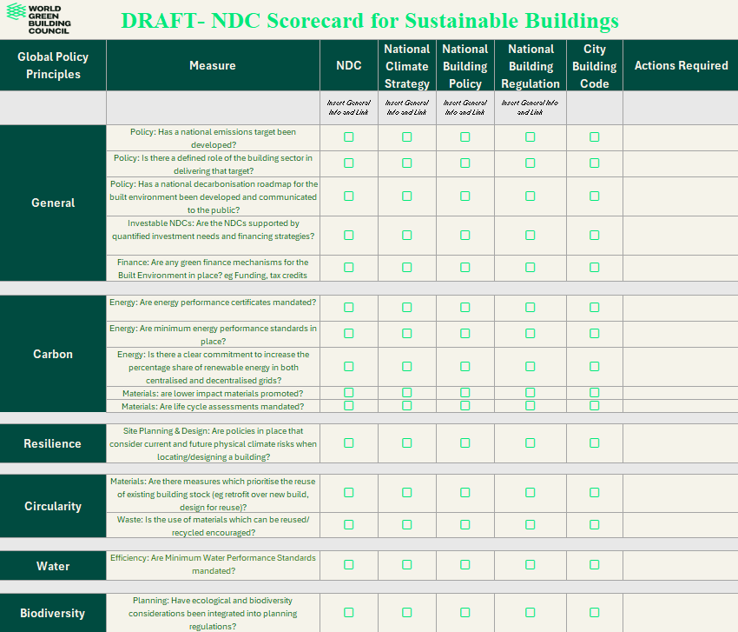
NDC Scorecard: Draft Skeleton Scorecard
>Digitalised website version
Notes:
This means best practice measures covering energy efficiency, embodied emissions, and electrification and resilience in the built environment, amongst others.
And crucially it will allow governments and stakeholders to analyse how both their NDC and national policies are aligned with these practice measures and highlight where gaps exist.

Slide 14
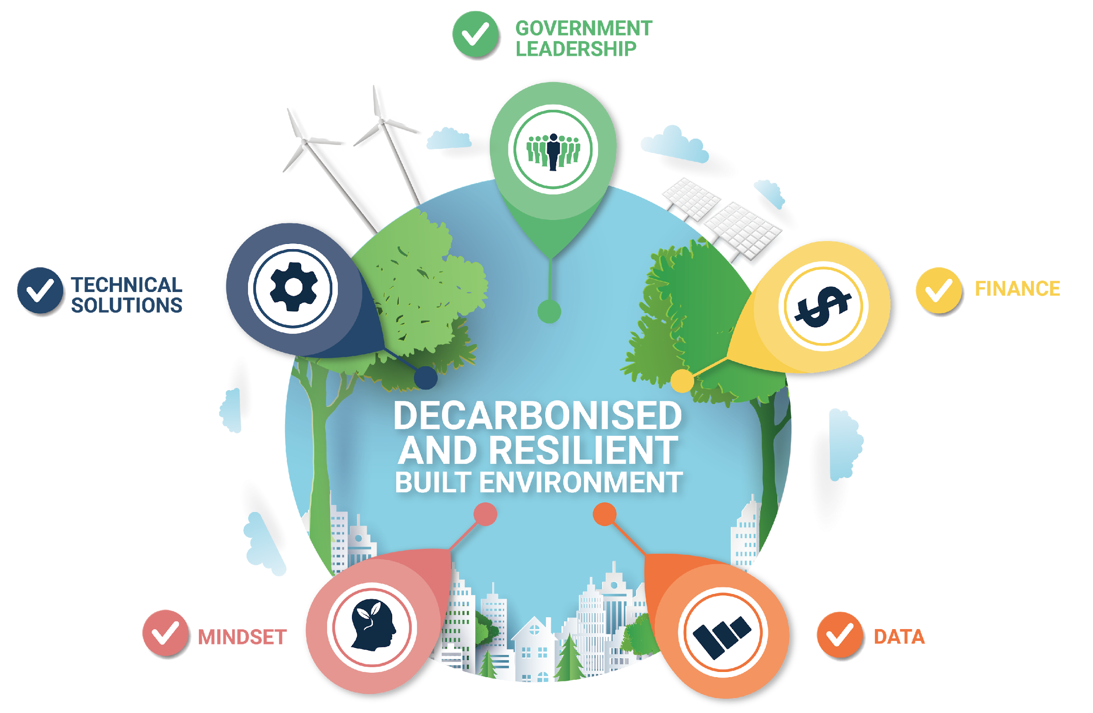
Zero Carbon and Climate Resilience Readiness Framework
Notes:
We also have our Zero Carbon and Climate Resilience Readiness Framework. The Framework is a WorldGBC regional project that provides the first steps towards decarbonising the built environment and achieving energy efficient and resilient buildings.
The Framework has been developed alongside Green Building Councils (GBCs) in our global network to provide locally-relevant solutions, and is currently being utilised by our regional networks in MENA, Asia Pacific and the Americas to define the enabling actions each country and our region need to prepare for the development of national roadmaps for decarbonisation and resilience of the built environment.
Developing them is a real collaborative process, involving stakeholders up and down the value chain and from around the region.
For sure, it’s going to provide a firm foundation for every nation in the region to build its own ambitious 1.5C roadmap.
Meaning that countries don’t have to start drawing up a roadmap from scratch. They’ll have a framework to start from.

Slide 15
WorldGBC Resilience Factsheet
The WorldGBC Network is working on a series of flagship miniature publications to highlight the network leadership and industry best practice in the relevant topics to accelerate the transition to decarbonised and resilient built environments.
The Resilience Fact Sheet underscores WorldGBC's call for a resilient built environment, emphasising the urgent need for a decarbonised and resilient built environment as part of the Buildings Breakthrough Advocacy Campaign and serving as a capacity building booster to the national decarbonisation and resilience roadmaps and the regional Zero Carbon and Climate Resilience Readiness Framework.
It will outline the definition of key principles and guidelines, scope, and global state of resilience. Identifying challenges and opportunities and examples of key leadership.
Notes:
The WorldGBC Network is also working on a series of flagship miniature publications to highlight the network leadership and industry best practice in the relevant topics to help build capacity and accelerate the transition to decarbonised and resilient built environments.
Reach out if you’d like to learn more or get involved!

Slide 16
Financing a resilient future
Enable action through climate finance:
Take into account the mitigation and adaptation potential of our built environments in the new climate finance goal (NCQG).
Reform financial infrastructure for more impactful and equitable climate finance.
Provide appropriate financial means to the Loss and Damage Fund to support vulnerable communities.
Leverage the development and implementation of green taxonomies.
Pledge a threefold increase in energy efficiency investments for buildings.
Strengthen resilience with adaptation planning:
Commit to making greater efforts to integrate resilience and adaptation into existing building sector policies and programmes.
Promote creation of National Adaptation Plans (NAPs) by 2025.
Recognise the role of buildings and the built environment in anticipating, adapting and responding to climate impacts.
Prioritise the use of nature-based solutions.
#BeBoldOnBuildings
Notes:
We’re here today to talk about Financing a resilient future. At this year’s COP, WorldGBC and the Green Building Council Network are calling on governments to commit to actions for the built environment so we can enable increased action through climate finance and strengthen resilience with adaptation planning.
We look forward to exploring this further in the discussion.

Slide 17
Thank you
Find out more:
worldgbc.org
#BeBoldOnBuildings

Slide 18


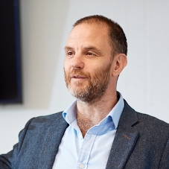
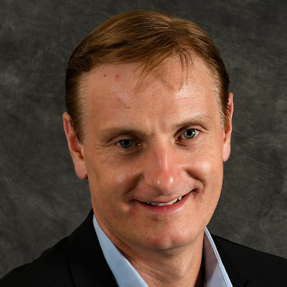
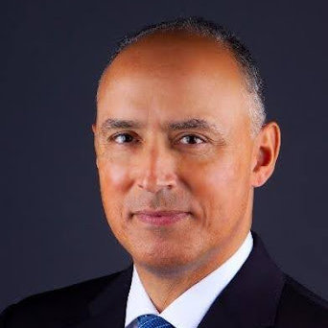
Panel Discussion;
Financing a Resilient Future
Natali Ghawi (Moderator)
Health Equity and Resilience Manager, WorldGBC
Audrey Nugent
Global Advocacy & Campaigns Director, WorldGBC
Simon McWhirter
Deputy Chief Executive, UK Green Building Council
Gregory Carli
Global ESG Advisory Leader, GHD
Darius Nassiry
Vice President, Climate Change, WSP
#BeBoldOnBuildings

Slide 19
Breakout / Mentimeter Discussion
What are the barriers to aligning finance and policy to incentivise resilience and adaptation in the built environment?
How can the built environment sector work with financial actors and policymakers to better align investments with national resilience and adaptation goals, includings NAPs and NDCs and local roadmaps. What tools, training or policy changes would most effectively drive increased investment in climate-resilient buildings and infrastructure?
How can resilience metrics be standardised across the building sector to ensure investment decisions reflect both local context and long-term mitigation and adaptation goals?

Slide 20
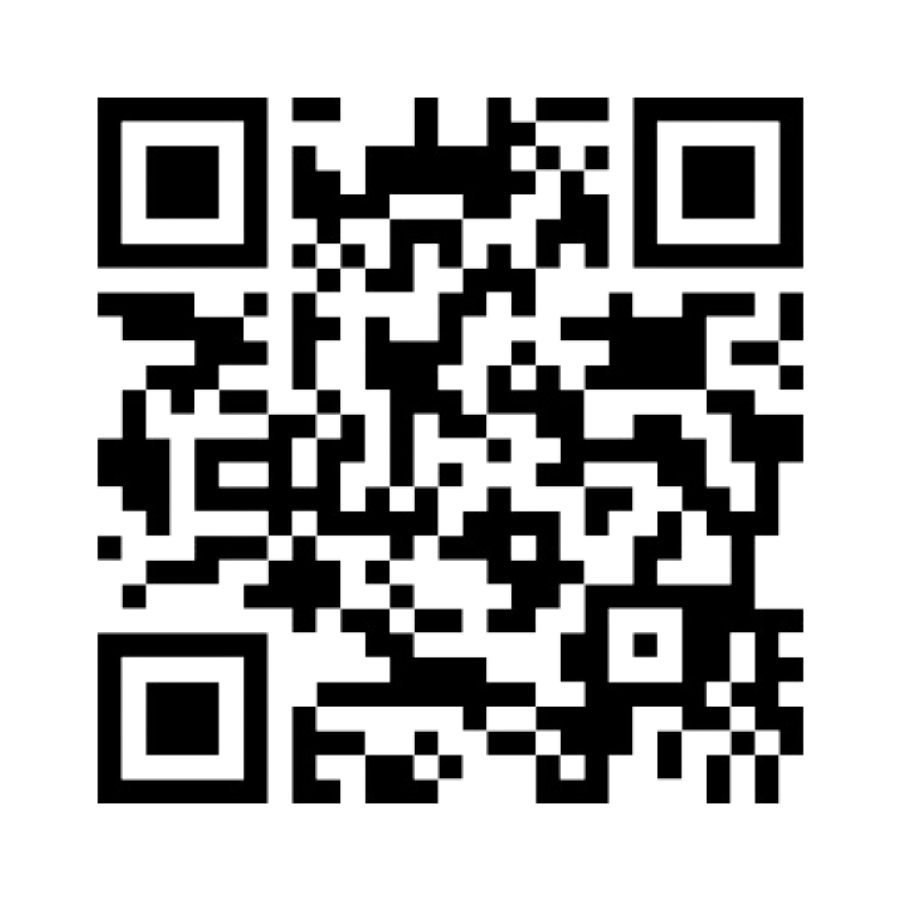
Breakout / Mentimeter Discussion
www.menti.com
6211 8175
Notes:
https://www.mentimeter.com/app/presentation/n/al5qk6xw6489jy84o2h1y14kzo7nhouo/edit?question=ohzr5qodfpiy
https://www.menti.com/al189zzb6u28

Slide 21
Thank you
Find out more:
worldgbc.org
#BeBoldOnBuildings

