Slide 1
Climate
Promise
2025

Slide 2
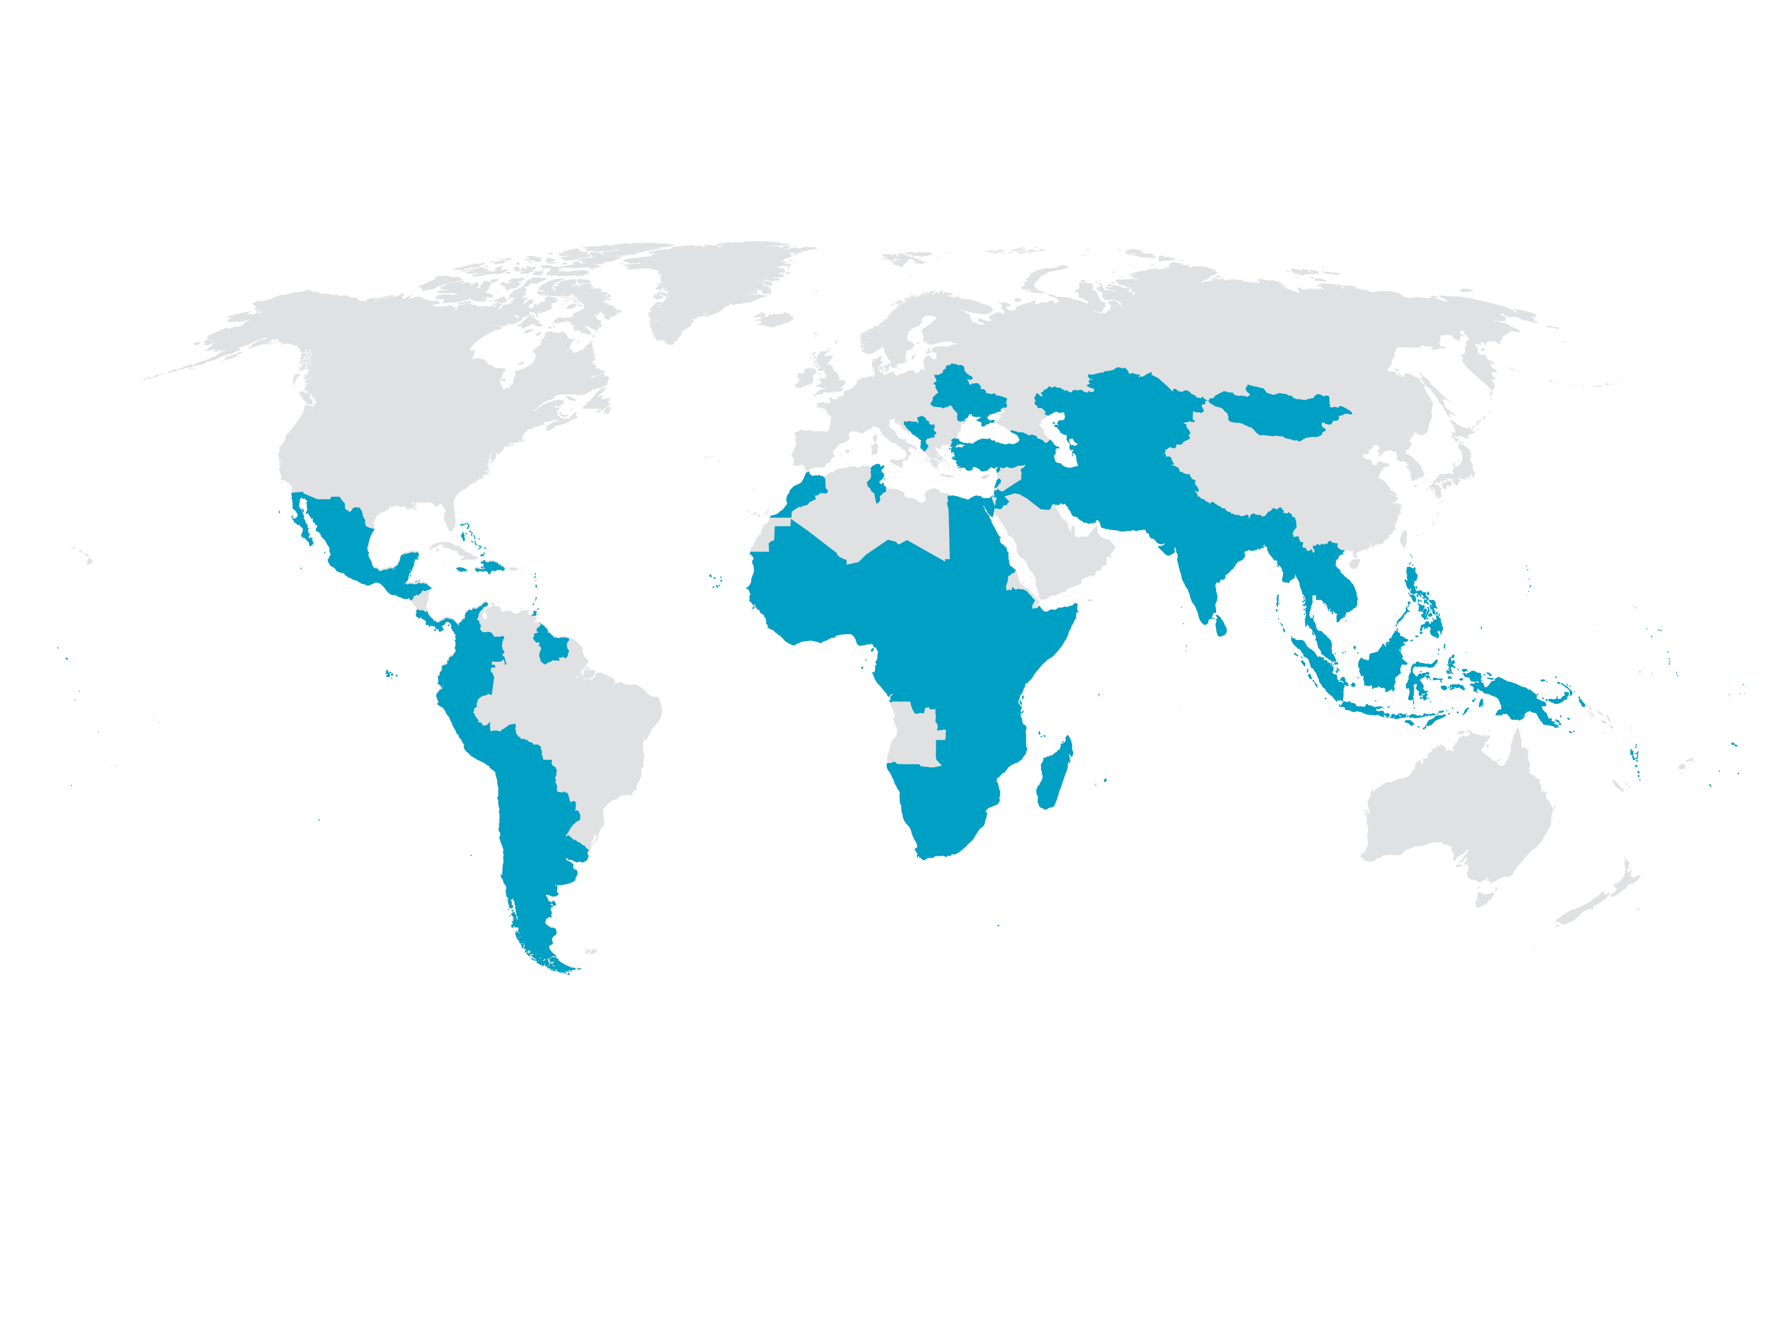
UNDP’s Climate Promise is the world’s largest offer of support to developing countries on NDCs
OVER
85%
of all developing countries worldwide represented
127
countries and territories ​ receiving support
35
partners collaborating at all levels
91% raised mitigation ambition, all with reference to energy​
93% raised adaptation ambition, many linked to National Adaptation Plans​
Nearly 95% of all NDCs supported included gender equality and referenced youth​
NDCs were higher quality, with better data, detailed costings, and linked to development and sectoral planning​
29 Small Island Developing States (SIDS)
17 Higher Emitters
51 in Fragile Settings
41 Least Developed Countries (LDCs)

Slide 3
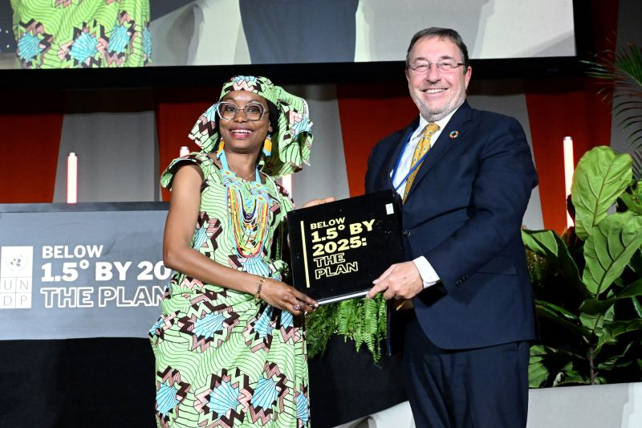
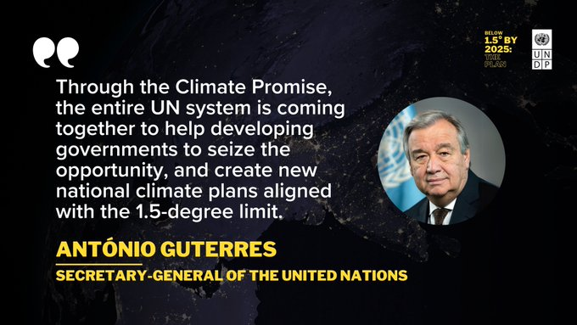
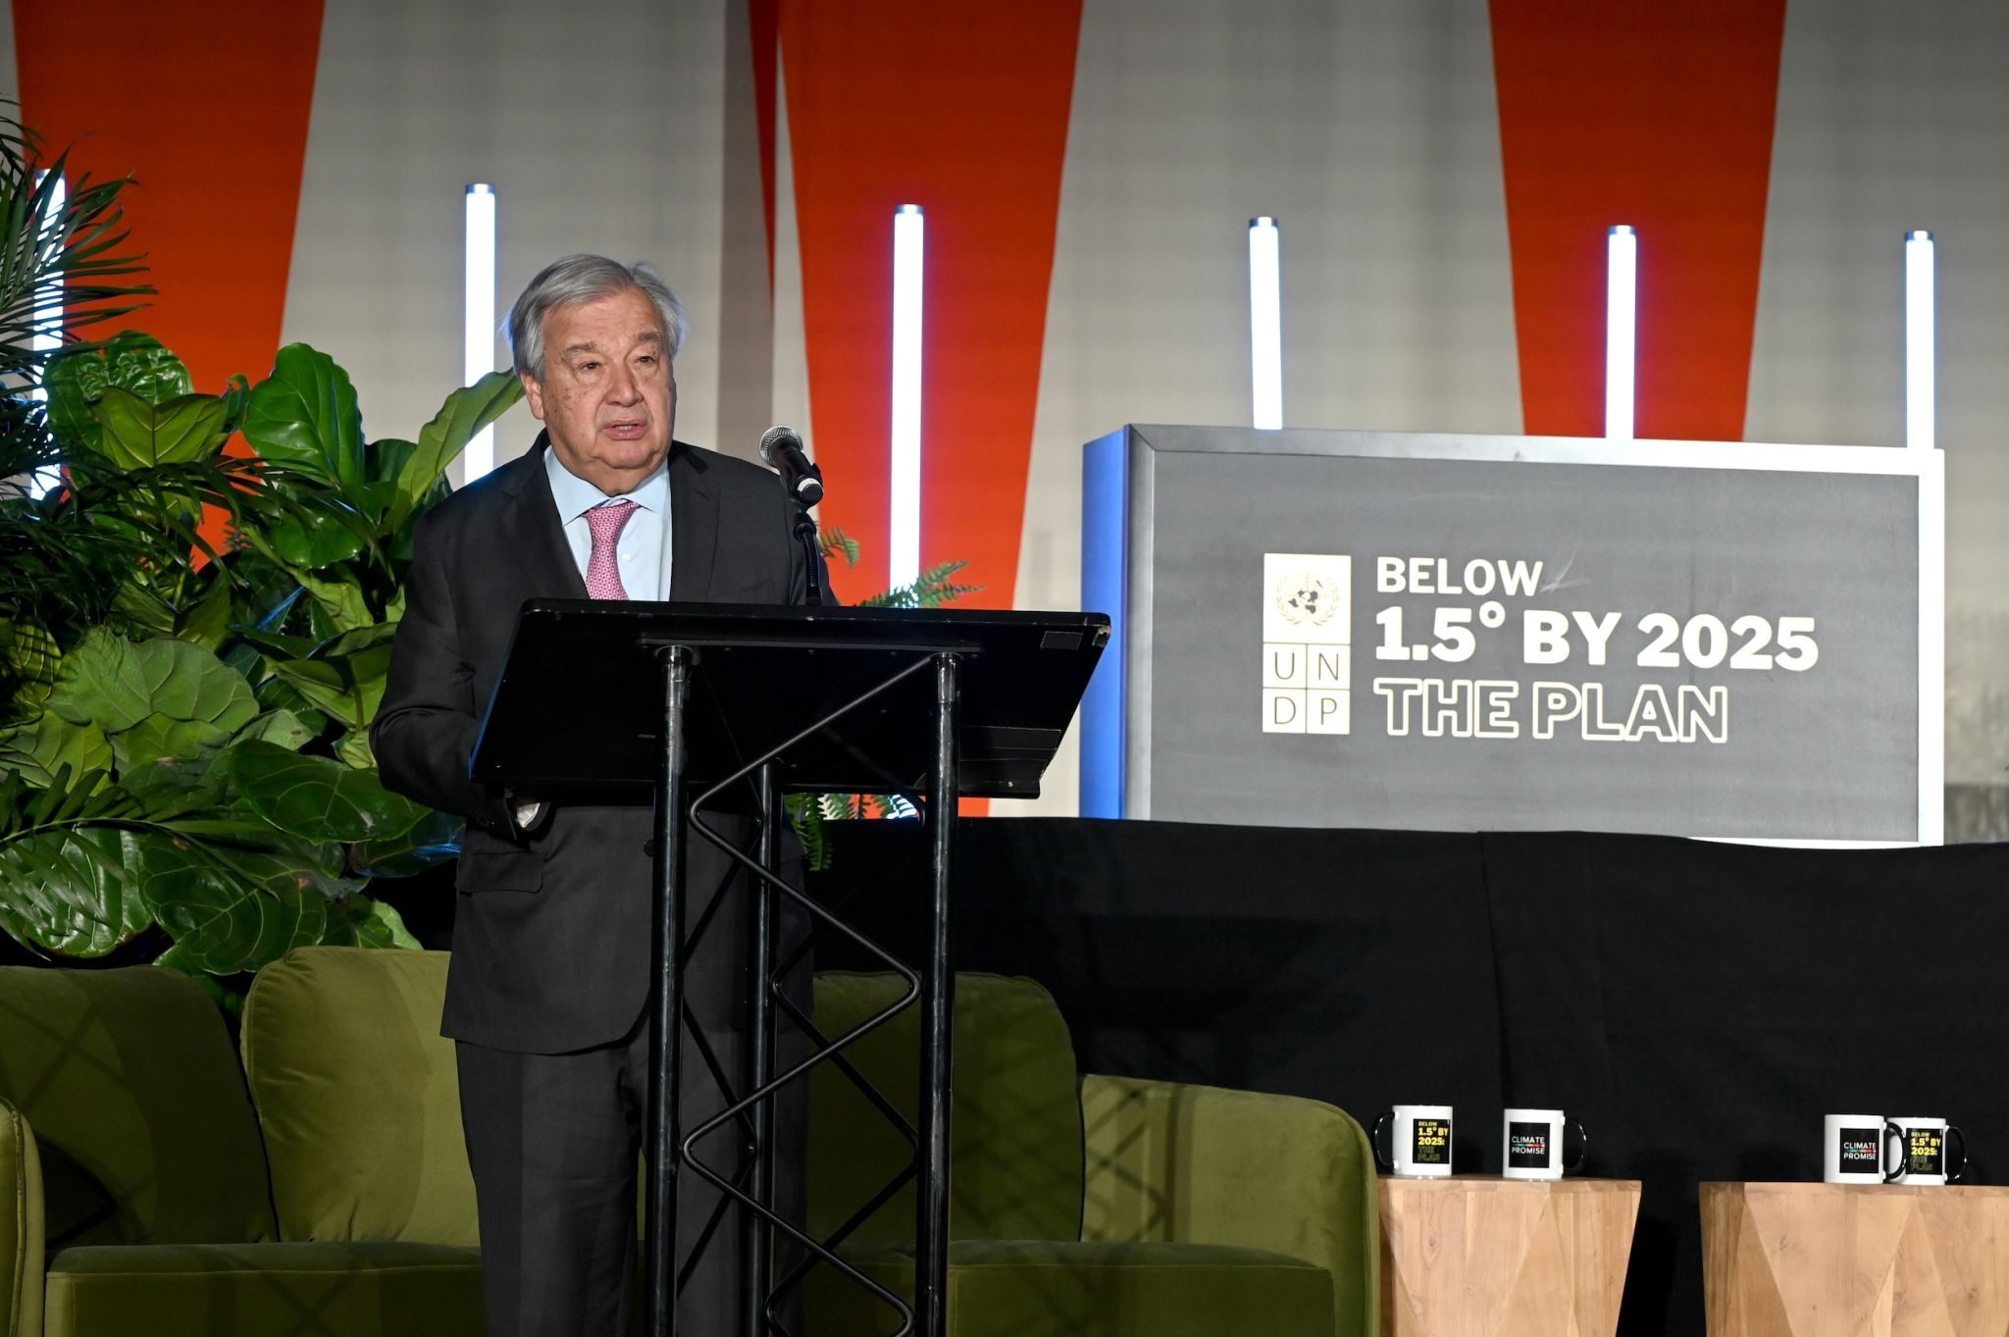
Climate Promise 2025
Support developing countries to align the 3rd generation of NDCs to the 1.5° C goal and SDGs, strengthen quality and investability, and accelerate implementation to drive sustainable development
Notes:
The Climate Promise 2025 builds on the experiences and results of the original Climate Promise.

Slide 4
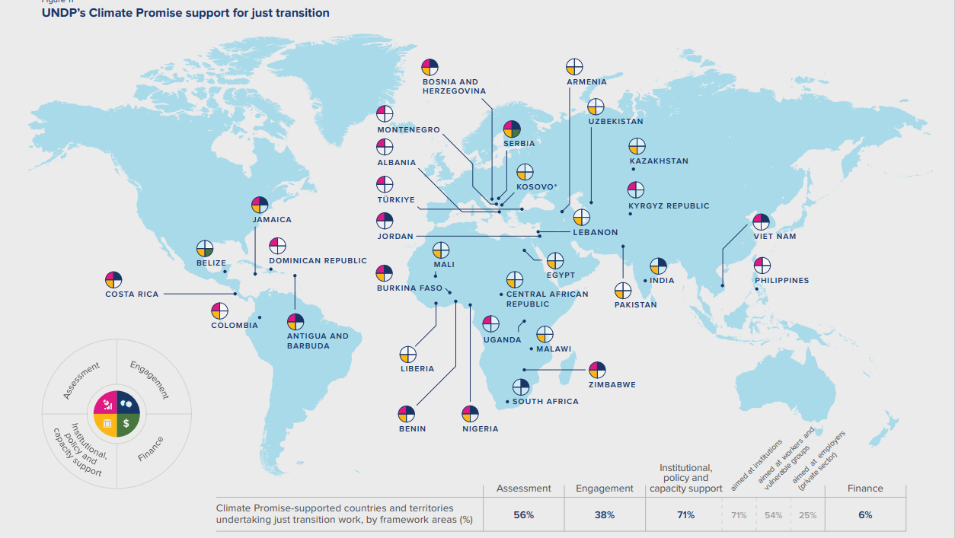
CAMBODIA
CHILE

Slide 5
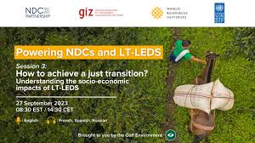
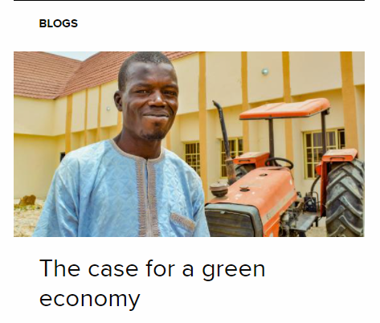
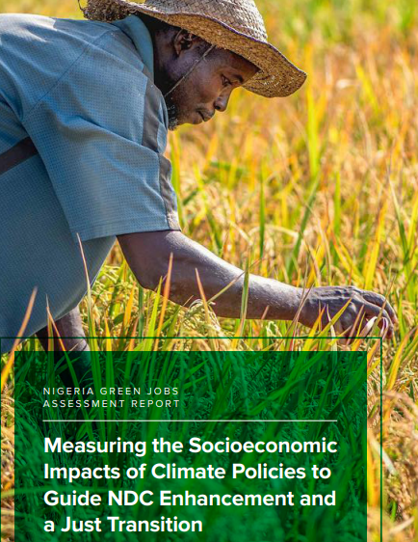
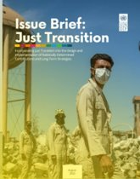
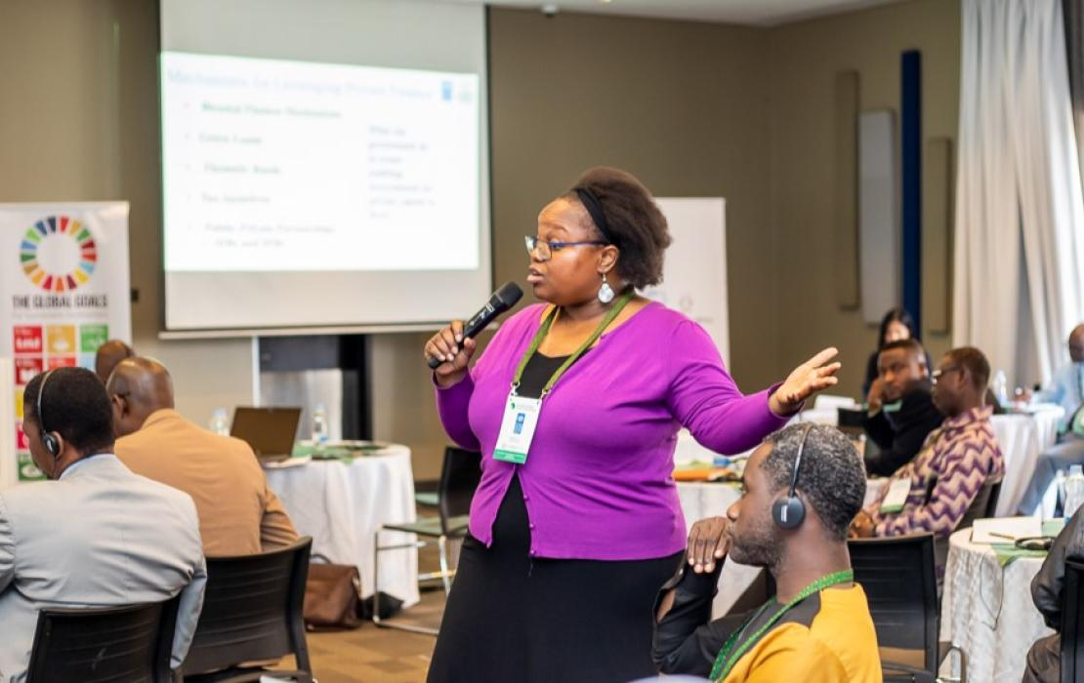
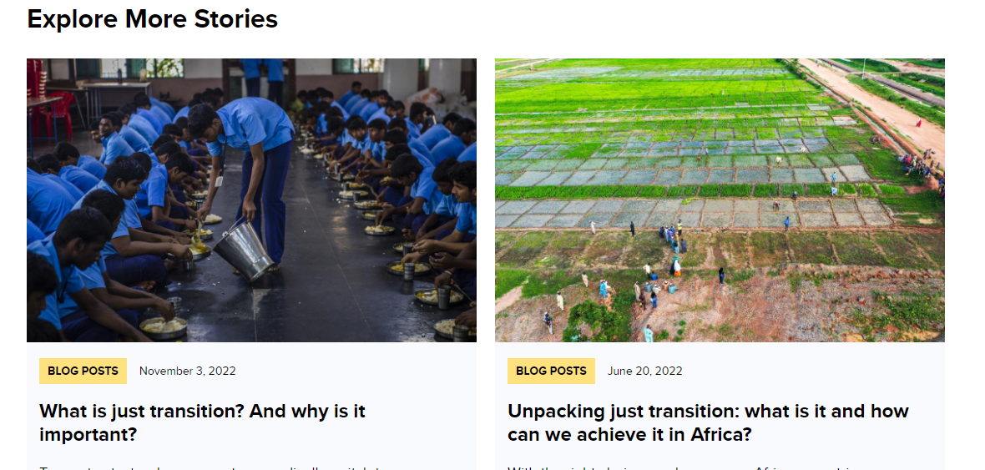
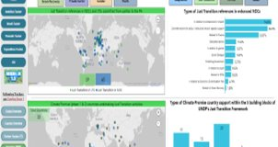
Climate Promise Support on Just Transition
Integrating the principles and process of Just transition into NDCs, NAP and LTS
Country Support
Capacity Building
Intelligence & Knowledge
Global Engagement
Communications
Technical & Financial support
Targeted support provided in over 50 countries
Global, regional ,country level capacity building
Webinars
Knowledge product, Guidance development, JT issue brief, flagship report, analytics, country examples
Global policy (UNFCCC, G20,etc)
Engagement at global/regional event
Explainer, Blog, Photo Story

