Slide 1
First Dialogue under the UAE Work Programme on Just Transition Pathways (UAE JTWP)
Breakout Discussion Group 3:
Policy coherence for implementing just transition pathways
2 June, 2024

Slide 2
Guiding questions:
How can just transitions pathways be effectively mainstreamed in implementing NDCs/NAPs/LT-LEDS?
How can a whole-of-government approach support the implementation of NDCs/NAPs/LT-LEDS that incorporate just transition pathways? How can it be ensured that these policies are coherent with national development priorities and other international commitments?

Slide 3
Q1: Effective mainstreaming of just transition pathways in implementing NDCs/NAPs/LT-LEDS
Inclusive Policy Frameworks - Stakeholder Engagement and Policy Coherence
Economic Diversification and Job Creation - Green Sectors and Social Protection Measures (unemployment benefits, healthcare, and pension schemes to support workers transitioning out of high-emission industries)
Participatory Planning and Implementation
Financial Mechanisms and Support - Climate Finance and Public and Private Investment
Capacity Building and Awareness Raising for Policymakers - Provide training and capacity-building for policymakers to enhance understanding of the linkages between just climate action, development priorities, and international commitments.
Transparency and Accountability - Mechanisms for transparency and accountability to track progress and ensure that commitments are being met.
Notes:
By integrating these elements into NDCs, NAPs, and LTLEDS, countries can ensure that their climate action strategies are not only effective in reducing emissions and building resilience but also equitable and inclusive, supporting a fair transition for all

Slide 4
Q2: Whole-of-government approach to support the implementation of NDCs/NAPs/LTLEDS that incorporate just transition pathways and policy coherence with national development priorities and other international commitments
High-Level Commitment from the highest levels of government to provide political support and legitimacy to the just transition agenda
Alignment with National Development Goals – Just Transition and Climate policies should be explicitly linked to national development goals such as poverty reduction, economic growth, job creation, and social equity.
Harmonized Regulations and Policies to avoid conflicts and redundancies, ensuring that objectives are aligned.
Coherent Institutional Arrangements to ensure that climate policies and just transition principles are integrated across various sectors such as energy, transport, agriculture, labor, health and finance.
Financial and Technical Support to enhance capacities for implementing just transition initiatives, including accessing climate finance mechanisms.
Partnerships to mobilize resources and expertise for sustainable development projects. Facilitate ongoing dialogue with the public to build trust and support for the government's efforts.
Communications and Public Awareness through strategic communication campaigns to raise public awareness about the benefits and importance of just transitions, fostering broader societal support.
Notes:
By adopting a whole-of-government approach, countries can create a supportive environment for the successful implementation of NDCs, NAPs, and LTLEDS that prioritize just transitions, ensuring that climate actions are fair, inclusive, and effective in promoting sustainable development.
Added Point 2 in the email here:

Slide 5
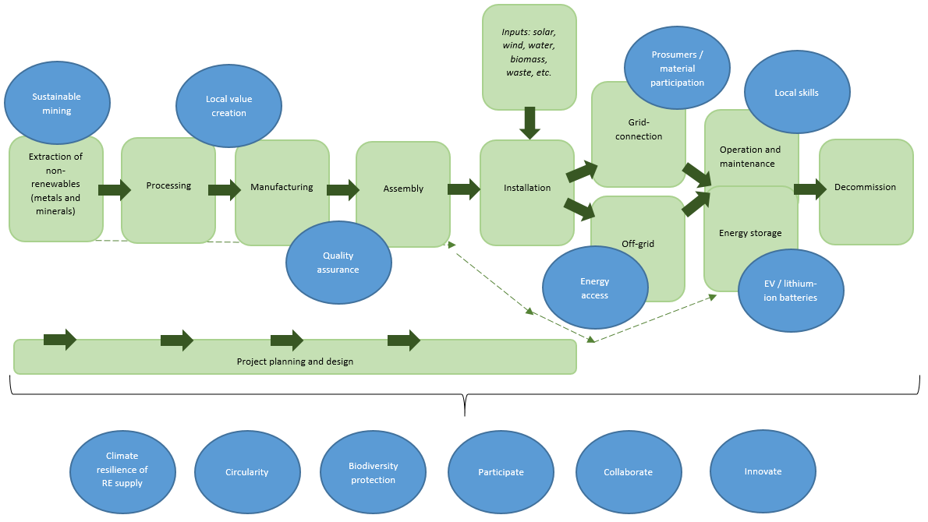
Example: RE technology value chains

Slide 6
Example: Industrial decarbonization
Energy intensive industries are major contributors to climate change. E.g., steel and cement together account for 15% of the global GHG emissions.
Demand for these materials is expected to grow.
Achieving decarbonization of energy intensive industries requires a major system transformation based on integrated policy interventions that would facilitate:
Creation of demand for low-carbon industrial products
Technology collaboration between manufacturers
Provision of knowledge of technology options and decarbonization pathways enabling leapfrogging in developing countries
Establishment of measurement, reporting, and verification (MRV) frameworks
Investment
Alignment, coordination, matchmaking between different actors

