Slide 1
SANGJI LEE
Global Technical Specialist on NDCs, green economy, and just transition
UNDP Climate Promise

Slide 2
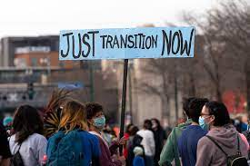
Why just transition is central to delivering the Paris Agreement?
Brings the public along >> increased ownership, ambition, and feasibility of climate measures (NDCs, NAP, LT-LEDS)
2. Realize socio economic empowerment and transformation
Notes:
Investing more in green jobs and business is one of the most popular climate policies according to the UNDP survey, demonstrating that
According to a study conducted by ILO, if we implement all the necessary measures towards achieving the Paris Agreement and invest in a circular economy, there could be a net job gain of 24 million jobs by 2030

Slide 3
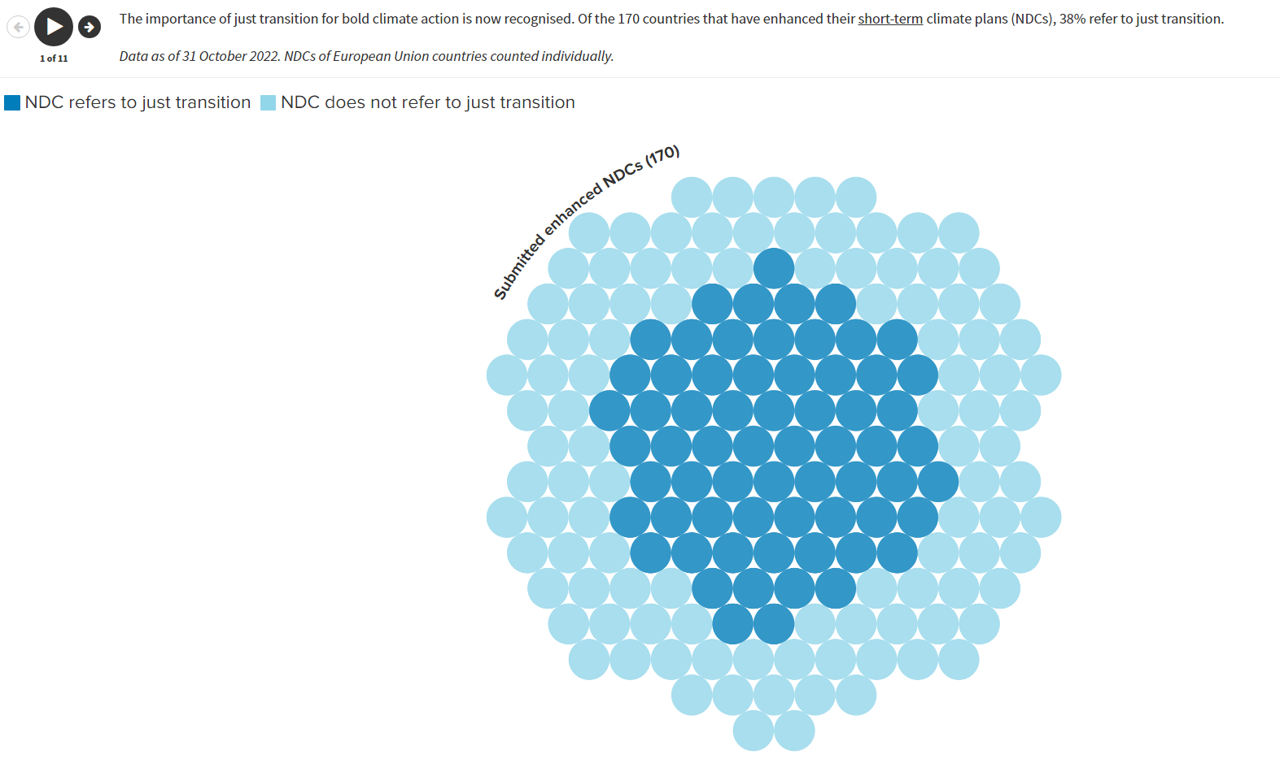
Global State of Play
The importance of just transition is now recognized, with the principles reflected in 38% of NDCs, 57% of long-term strategies, and a growing number of high-profile global initiatives
For more analysis
Last update: 31 October 2022

Slide 4
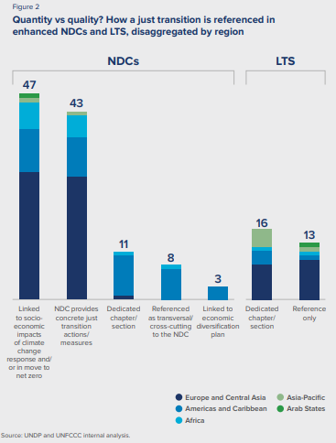
More, however, can be done to anchor just transition in climate plans – only 17% of NDCs and 55% of LTS have dedicated sections on this key issue

Slide 5
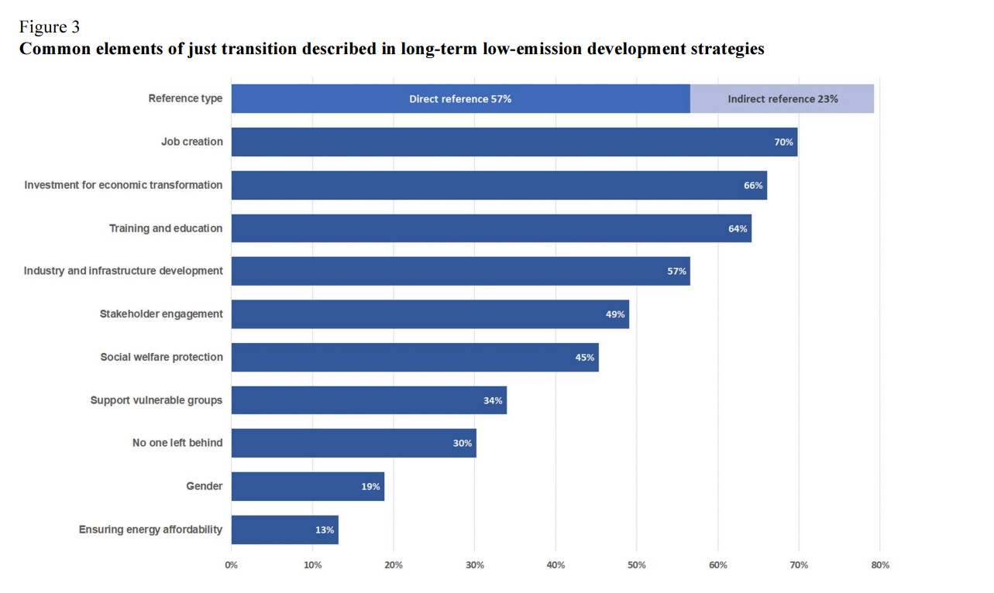
- 57 per cent of LT-LEDS underlined Parties’ commitment to just transition, with 26 per cent elaborating on the concept of just transition in a dedicated chapter. - Of the 43 per cent of LT-LEDS that did not explicitly mention just transition, 24 per cent illustrated elements that are linked to just transition, such as fairness, equity and inclusiveness.
Source: UNFCCC synthesis report 2023

Slide 6
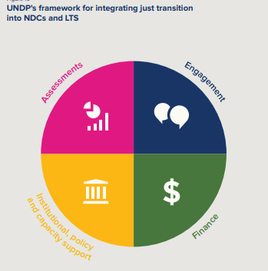
Key entry points
As countries worldwide continue to update and implement their NDCs and LTS, there is the opportunity to embed the principles, processes, and practices of just transition within them, and drive greater climate action
Notes:
There is no universally accepted definition, and the perception varies between countries and regions.
UNDP has been working through the Climate Promise to support countries to connect the dots between climate action, social inclusion and gender equality, and sustainable development.
NDCs and LTS have become key means through which governments are acknowledging the principles of a just transition and integrating them into process and practice

