Slide 1

Target 9(f) - Poverty and livelihoods
Expert group update: Anna, Catherine, Lama, Nega, Portia, Pramod, Valeria
Experts Workshop under the UAE-Belém work programme on indicators
Bonn Germany - 21st March 2025

Slide 2
GGA Target 9f
“Substantially reducing the adverse effects of climate change on poverty eradication and livelihoods, in particular by promoting the use of adaptive social protection measures for all”

Slide 3

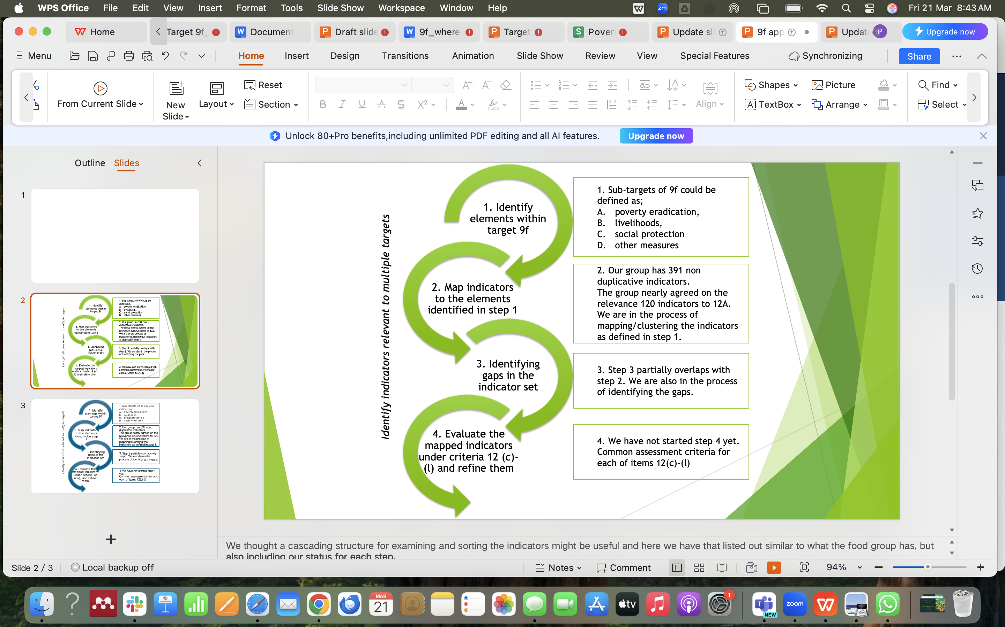
Summary of the current state of review and refinement process

Slide 4
Sample existing indicators
Proportion of population covered by social protection floors/systems, by sex, distinguishing children, unemployed persons, older persons, persons with disabilities, pregnant women with newborns, work-injury victims and the poor and the vulnerable (SDG 1.3.1)
% of economically and socially marginalized groups covered under social safety nets
% of women, men, boys, and girls benefiting from adaptive social protection
Decrease in poverty level where climate adaptation action is taken
% of targeted vulnerable people (women/men) benefiting from livelihood diversification
% of targeted population (women/men) adopting one or more climate-resilient livelihood practices
Percent of rural population covered under microcredit schemes
Percent of agricultural population covered by climate risk insurance mechanisms
Percent of agricultural population covered by social safety nets
% of hazard affected population reached by social protection schemes

Slide 5
Elements within Target 9f
Sub-component 1: .....reducing adverse effects of climate change on poverty eradication
-Poverty drivers: (eg. Economic empowerment; Human capital development; Governance and institutional strengthening; finance and resource mobilization)
-Poverty rate: Poverty threshold; Percentage of population that is food secure
Sub-component 2: .....reducing adverse effects of climate change on livelihoods
Livelihood comprises: Capabilities; Assets (including both material and social resources) and activities required for a means of living.
Capabilities (adaptive capacity)
    oSkills/knowledge
    oHealth
    oAbility to work
Assets (adaptive capacity)
    Social capital
    Natural capital (land, soil, water, forests, fisheries)
    Physical capital (basic infrastructure, tools, livestock, equipment)
    Financial resources (savings, credit, remittances)
Activities (livelihoods vulnerability and dynamics)
  oEmployment / self-employment / income generation / subsistence production
Sub-component 3: .....promoting the use of adaptive social protection measures
-Coverage by social protection systems (with all disaggregations)
-Social Assistance -Safety Nets: (eg. Cash transfers, In-kind transfers - food, shelter, agricultural inputs)
-Social Insurance: (eg. Weather-based insurance schemes; Health insurance adapted for climate-related diseases)
-Labour Market Programs (eg. Skills training and livelihood diversification)
-Access to Basic Services (eg. Climate-resilient healthcare and education)

Slide 6
Where we are......
318 indicators that were classified as YES or MAYBE under 12a assessment,
Out of 318 indicators (preliminary clustering – under discussion in the group)
    61 were already identified as additional duplicates/overlaps (appx. 20%)
    144 indicators were clustered under various aspects of livelihoods/poverty (assets/activity/capability, etc)
    31 indicators were clustered under poverty drivers or rates
    32 indicators were clustered under different measures of social protection
    50 indicators fell under the category of non-specific/ missing info/ more relevant to another target
Next step: agreeing on the clustering and start the prioritizing / scoring of the indicators under each clustered sub-target and identifying the gaps

Slide 7
To-do list
Complete clustering of indicators
Identify and compile gaps
Prioritise from clustered list and consider potential new indicators where necessary
Prepare metadata files for the prioritized indicators
Review interlinking/cross cutting indicators with other target groups???
Present finalized list of indicators with recommendations

Slide 8
Challenges
Indicators overlap across multiple clusters, making organisation and prioritisation going to be quite difficult.
Several indicators are vague statements or questions, not framed as measurable metrics (should be modified to measurable indicators).
Inadequate definitions lead to inconsistent interpretations; strong metadata is essential.
Relevance to Adaptation: Some indicators do not directly reflect progress on climate adaptation, needing refinement.
Not easy to measure success in reducing climate impacts on poverty and livelihoods
Harmonising disaggregation (gender, age, disability, migration) remains challenging across groups.
Notes:
Clustering helps to organize the indicators in smaller groups to ease the further analysis and prioritization, however, not always a straightforward process – some indicators fall under several clusters at the same time
Not all of the indicators are expressed as indicators but rather statements or questions
Some indicators lack definitions and may create different interpretations of a given indicator – strong metadata needed (template?)
Some indicators are not directly related to adaptation to track the progress of GGA – modifications needed; hence, this will bring them to Tier II or Tier III
Not easy to measure success in reducing climate impacts on poverty and livelihoods
Disaggregation of the indicator (gender, age, disability status, migration status others ) is a critical point that should be discussed and harmonized between the groups
No full clarity on the end objective
Some gaps I the list of indicators: e.g. access to basic healthcare services

