Slide 1
Ecosystem & Biodiversity
Group
Progress Update
March 20, 2025
Bonn, Germany

Slide 2







Experts
Dr. Mónica Gabay (Argentina)
Argentina's Undersecretariat of Environment
Juliana Baladelli Ribeiro (Brazil)
Boticario Group Foundation for Nature Protection
Dr. Elisabeth Gilmore (Canada)
Carleton University, Ottawa
Dr. Nfamara K. Dampha (Gambia) University of Minnesota
Dr Joanna Post (United Kingdom) Intergovernmental Oceanographic Commission - UNESCO
Kieran Noonan Mooney (Canada)
Convention on Biological Diversity Secretariat
Dr. Karina von Schuckmann (France)
Mercator Ocean International

Slide 3
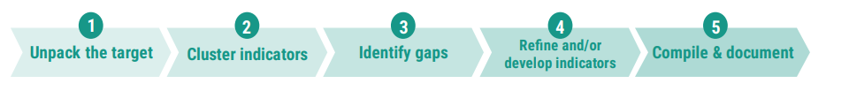
Summary of efforts
Developing indicator lists following common approaches
Evaluating of the indicator that fit the criteria of the decision text.
Discussing Interlinkages of indicators relevance to multiple thematic targets
Assessing relevance to input, outcome, and output orientation (e.g. across the NAPs)
Reflecting global indicators on overarching trends and common challenges
Identifying gaps

Slide 4
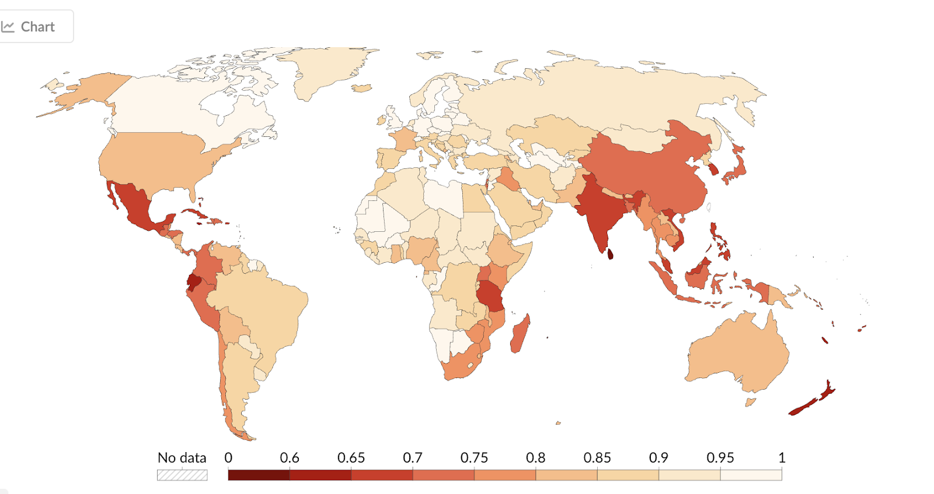
Eg.: Existing indicators with metadata
For ecosystems, the Global Biodiversity Framework (GBF) provides a common point of departure.
For example, the Red List Index shows trends in overall extinction risk for groups of species, due to climate-related stressors such as temperature shifts, habitat loss, and extreme weather events. Species are one of the main levels of biodiversity and risks to their status is an indication of the pressures on biodiversity.
A.3 under the Convention on Biological Diversity adopted through decision 15/5. Its metadata was welcomed in decision 16/31, and it is also an SDG indicator.
More information is available at: https://www.gbf-indicators.org/metadata/headline/A-3.

