Slide 1

Water thematic Expert group
Target 9a of the UAE Framework for Global Climate Resilience
Evaluation, Methodological approach, Next steps
Aditi Mukherji, Christiana Photiadou, Feng Hu, Michael Nagy, Natalia Odnoletkova,
Ousmane Seidou, Tom Slaymaker
Notes:
Water group members (in alphabetical order)

Slide 2
Thematic Target 9a Water (sub-components):
i) Significantly reducing climate-induced water scarcity and ii) enhancing climate resilience to water-related hazards iii) towards a climate-resilient water supply, iv) climate-resilient sanitation and towards v) access to safe and affordable potable water for all.
Notes:
The water experts have identified the following sub-components and will be identifying indicators relating to these sub-components
Significantly reducing climate-induced water scarcity
Enhancing climate resilience to water-related hazards
Towards a climate-resilient water supply
Towards a climate-resilient sanitation
Access to safe and affordable potable water for all

Slide 3
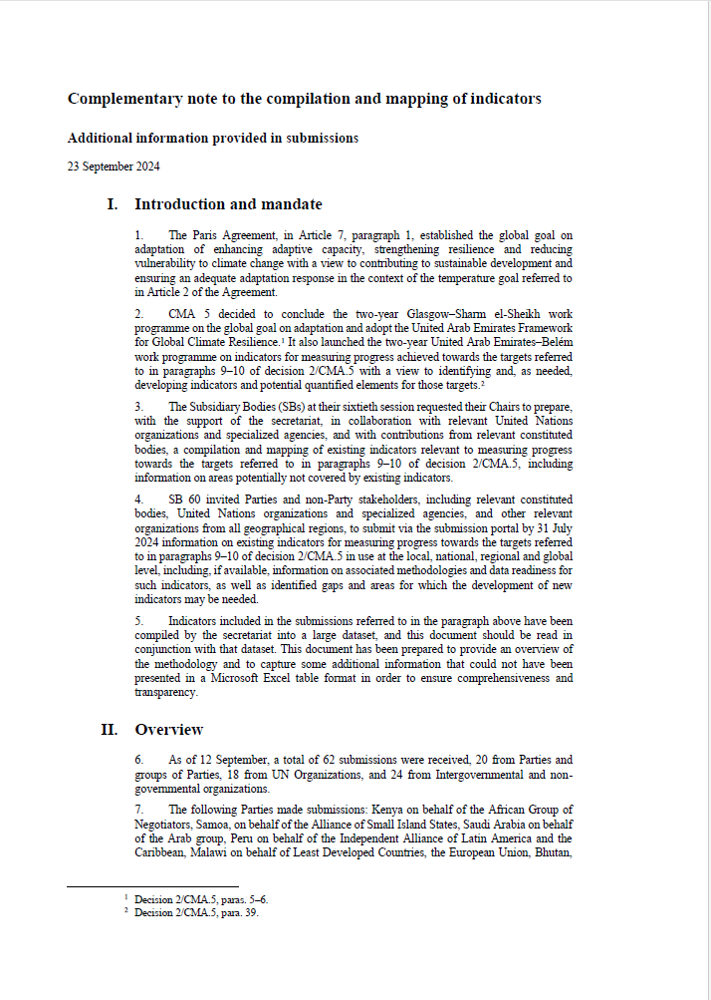
First phase of evaluation
During the first phase, the water expert group assessed the relevance of 1,046 indicators mapped to the water-related target (9a) within the UAE framework for Global Climate Resilience. The review focused on criteria identified in the SB60 Conclusions on:
12(a) The relevance of the indicators to measuring progress towards one or more of the targets referred to in paragraphs 9–10 of decision 2/CMA.5;
12(b) The specific relevance of the indicators to adaptation, including enhancing adaptive capacity, strengthening resilience and reducing vulnerability to climate change.
Notes:
Informal Progress from the Water Expert Group from 6 November 2024report: https://unfccc.int/topics/adaptation-and-resilience/workstreams/global-goal-on-adaptation/experts-informal-progress-reports-november-2024-uae-belem-work-programme
From this review the water group categorized at least 427 indicators as relevant for 12a (306 indicators not relevant) and at least 312 of the indicators as relevant for 12b (306 indicators not relevant).

Slide 4
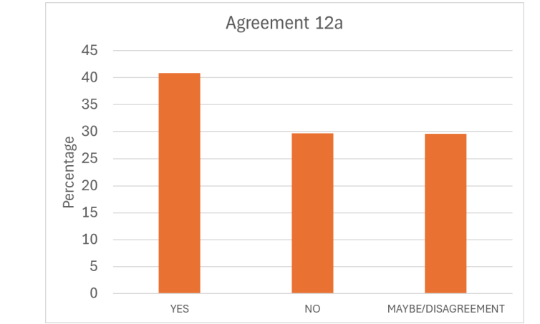
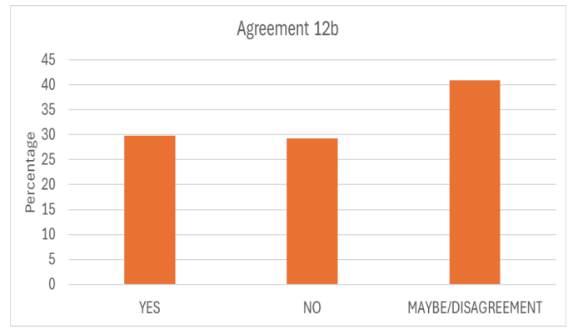
Evaluation of water-related indicators
to criteria 12(a) and 12(b)
- 2 Evaluators for each indicator
Yes, No, Maybe with explanation when needed for 12a and 12 b
Concluded evaluation for all indicators marked for water (mistake in the first list)
Proposed steps forward:
Remove all No indicators (definite No by both or more evaluators)
Consolidate the Yes/No, Yes/Maybe and No/Maybe
Create a list with definite Yes. The list can contain indicators However,
Yes/maybe can be considered an indicator that needs modifications, has potential.
However, such approach will need a validation process, and we will need a parallel more objective approach
Notes:
Do we present an updated analysis with yes, no, maybe?
Informal Progress from the Water Expert Group from 6 November 2024report: https://unfccc.int/topics/adaptation-and-resilience/workstreams/global-goal-on-adaptation/experts-informal-progress-reports-november-2024-uae-belem-work-programme

Slide 5
Methodological guidance for selecting and presenting water-related
To refine the list further and to respond to the call for developing a methodological approach, the Water Expert Group has initiated a second phase.
A key principle of this approach is to prioritize the use of adaptation-focused indicators, by building on indicators from existing global frameworks (e.g. Sustainable Development Goals (SDGs); Sendai Framework for Disaster Risk Reduction etc.), wherever possible.
If the existing indicators do not adequately address specific elements of the target, experts will suggest modifications or supplement with new indicators. This approach benefits countries and data producers by leveraging, as well as building on existing data collection systems and expertise, while allowing scope for modifications and additions to ensure that indicators are adaptation specific and aligned with the targets of the framework.
Proposed indicators can be tracked back to the consolidated mapping and validated through the evaluation processes concluded by the experts.
Notes:
Significant number (9%) relevant to target 9d (restoration, conservation and protection of inland water ecosystems)
Small number (6%) do not directly address any of the water related sub-components of targets 9a and 9d

Slide 6
Methodological guidance
Developing global and contextual indicator frameworks by:
Building on existing global frameworks (such as Sustainable Development Goals (SDGs) and Sendai Framework) where indicators are relevant to the specific targets and its sub-components
Modifying indicators under existing international frameworks to addressing specific gaps (such as adaptation and CC relevant)
Developing new indicators to address specific gaps if needed
Distinction between action and outcome/impact
For each of the above-mentioned sub-components, map indicators as either measuring progress in action, or outcome or impact. It should be noted that the same action/outcome indicator could be used for more than one sub-component, if relevant.
Action/output indicators: Measure steps taken to enhance water-related resilience, e.g., investments in flood protection or increasing the proportion of wastewater reused. Actions in some cases can be considered as enablers including means of implementation.
Outcome/ impact indicators: Assess the results of adaptation actions, such as changes in water stress levels or increase in proportion of safe water for population etc.
3. Global and contextual indicators: a dual-layer approach
Global indicators provide a framework for measuring progress across countries, ensuring consistency and international cooperation in measurements.
Contextual indicators offer flexibility, allowing countries to address unique circumstances and priorities.
Considering both ensures that the proposed list of indicators remains robust and coherent while enabling tailored responses to local adaptation challenges, fostering more effective and inclusive climate action. The contextual indicators can capture where appropriate and when suited cross-cutting consideration as they are described in /CMA6 para 21 d, e, f, g.
Notes:
Some of the indicators relevant to more than one component of target 9a
Most of the indicators submitted (31%) relevant to reducing climate-induced water scarcity
Approximately half as many (17%) relevant to monitoring resilience to water-related hazards
Large number (24%) relevant to climate-resilient water supply
Far fewer (13%) relevant to climate-resilient sanitation
Significant number (9%) relevant to target 9d (restoration, conservation and protection of inland water ecosystems)
Small number (6%) do not directly address any of the water related sub-components of targets 9a and 9d

Slide 7
Methodological guidance
Approach to indicator selection process
The proposed indicator selection process prioritizes the use of adaptation-related indicators from established frameworks (such as the SDGs and the Sendai Framework) and modifications and additions when needed, while adhering to the following criteria:
Relevance: Selected indicators must consider the relevance of the indicators to the targets of the framework and to enhancing adaptive capacity, strengthening resilience and reducing vulnerability to climate change. These indicators must directly measure the desired adaptation outcomes or actions, ensuring they are effective in driving data production and informing policy decisions in the context of water-related challenges.
Feasibility: While relevance is paramount, indicators should not be excluded solely due to difficulties in calculation or data availability in some countries, including developing countries. In addition, other sources of input can be recommended to be used to complement the data availability. This approach recognizes that reporting on relevant indicators can stimulate data collection efforts and serve as part of broader capacity-building activities.
Inclusivity: Selected indicators should allow for disaggregation by time, space, population groups, and other relevant dimensions where appropriate. This ensures that diverse experiences, vulnerabilities, and inequities are captured, supporting more inclusive and equitable adaptation monitoring.

Slide 8
Methodological guidance
The methodological approach that the water expert have prepared considers the following ‘criteria’ and paras which will be discussed in the workshop
Following guidance from the previous SB Chairs, for the refined mapping experts were asked to focus on criteria 12(a) and 12(b) to advance work before CMA 6:
• 12(a): The relevance of the indicators to measuring progress towards one or more of the targets referred to in paragraphs 9–10 of decision 2/CMA.5;
• 12(b): The specific relevance of the indicators to adaptation, including enhancing adaptive capacity, strengthening resilience and reducing vulnerability to climate change.
CMA 6, paragraph 17 provided additional criteria for possible consideration by experts, as appropriate:
• 17(a) The measurability and availability of data enabling the transparent monitoring of progress;
• 17(b) The ability to use data that are already available or can be easily collected by countries, including data from international databases and standardized reporting practices;
• 17(c) The use of metrics where baselines exist;
• 17(d) The relevance to multiple thematic targets;
• 17(e) Outcome and output orientation.

Slide 9
Water Indicators classification by component and type
Here, the indicators deemed relevant to 9a (water) are further classified as relevant to 5 subcomponents, and by type (Input, Process, Output, Outcome)
 | Significantly reducing climate-induced water scarcity | Enhancing climate resilience to water-related hazards | Towards a climate-resilient water supply | Towards a climate-resilient sanitation | Access to safe and affordable potable water for all
Input | 30 | 23 | 22 | 18 | 13
Process | 79 | 72 | 65 | 36 | 25
Output | 89 | 131 | 113 | 67 | 65
Outcome | 67 | 68 | 54 | 39 | 39
Component
Type

Slide 10
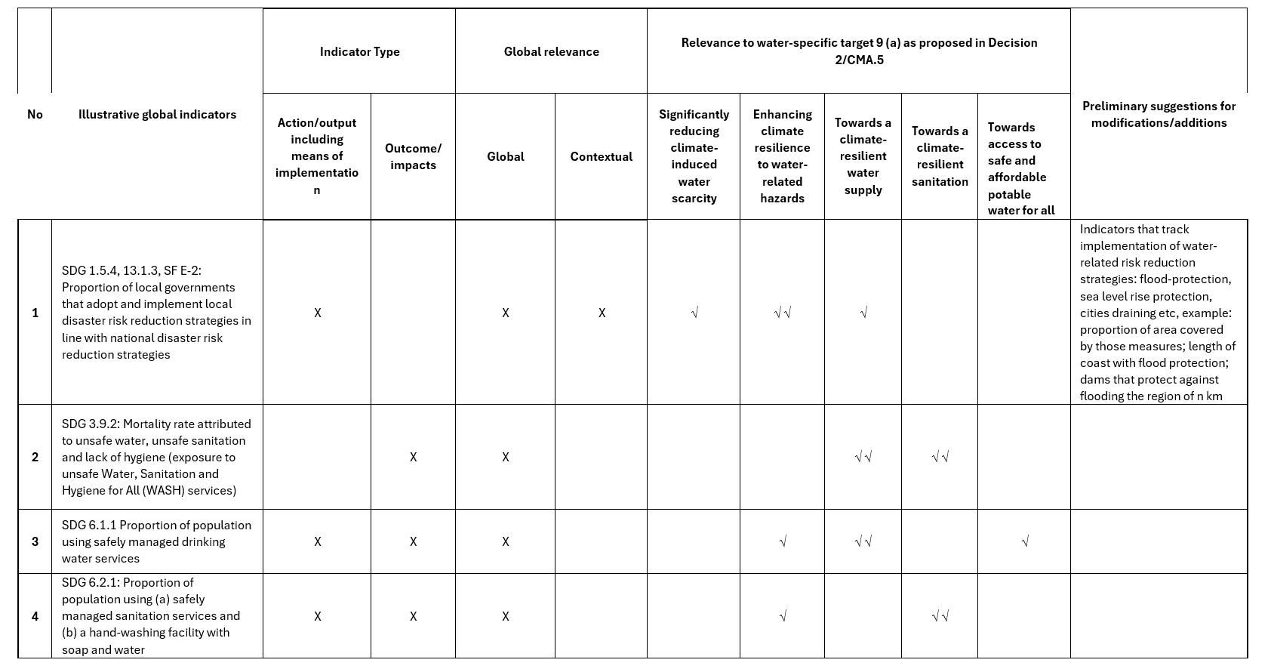
Illustrative examples
Notes:
In the examples we need to explain the Action/Output (incl enablers of implementation) and Outcome/Impacts
And global and contextual

Slide 11
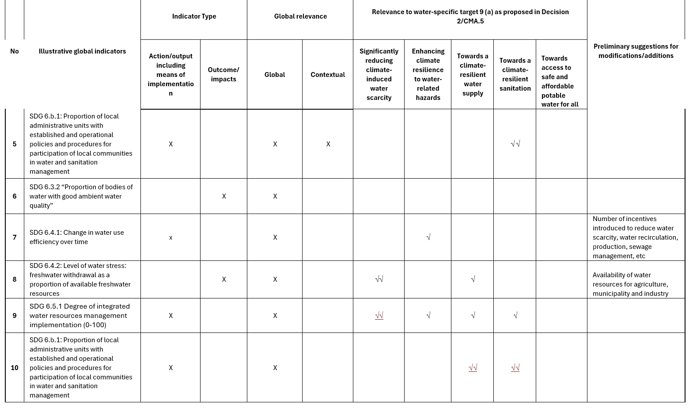
Illustrative examples

Slide 12
Next steps and timeline for prioritisation of water indicators
Develop further the examples identified from the existing frameworks.
Validation with the consolidated evaluated list (clear ‘Yes’, clear ‘Maybe’).
Create a consolidated list with detailed methodology – April 2025
Identify concrete gaps based on the following elements:
Targets and sub-components are not covered from the identified indicators from existing indicators or evaluated list
Cases where we need to modify existing indicators
Cases where we need to develop new indicators (if needed)
CMA6 para 17 Remaining criteria on measurability and availability, metrics, relevance to multiple targets, output and outcome orientation
Notes:
This is a proposed way forward. Please change, edit as you see fit
To add that existing indicators and frameworks beyond measurability and availability, they have also metadata and approved methodologies
We can also add here that we might use a machine learning exercise to create the consolidated list

Slide 13
Considerations
Engaging within the expert group
Linkages between thematic indicators (e.g. water vs ecosystems)
Linkages between thematic and dimensional indicators (e.g. early warning systems)
International indicators such as transboundary water bodies
Engaging with external stakeholders (specifically statistical bodies)
UN Statistical Division and custodian agencies (e.g. SDG, Sendai, etc)
UN Statistical Commission, regional commissions and national statistical offices
Relevant global and regional partnerships (e.g. UN Water)

