Slide 1
Synergy Solutions for a World in Crisis:
Tackling Climate and SDG Action Together
REPORT ON STRENGTHENING THE EVIDENCE BASE
SEPTEMBER 2023

Slide 2
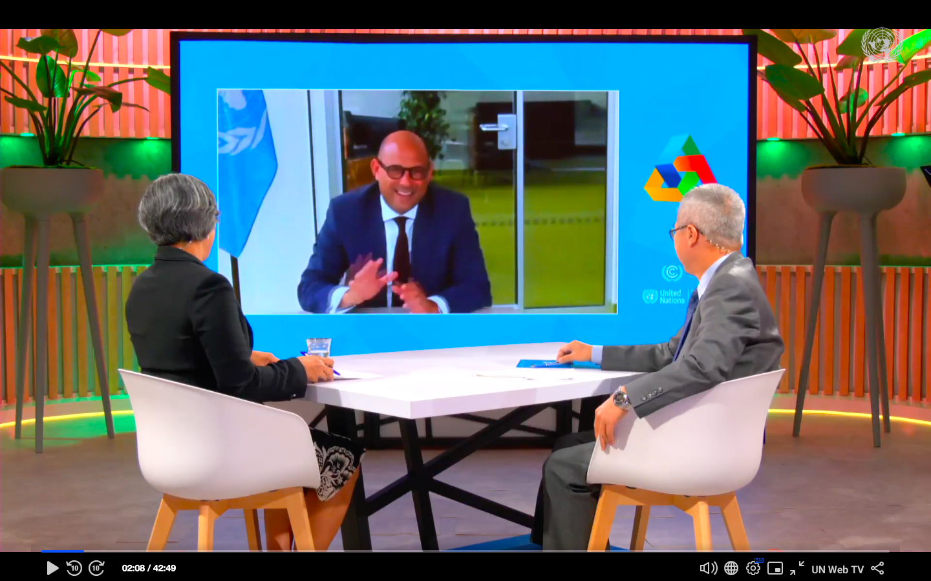
New report on Climate Action and SDG Synergy
“Synergy Solutions for a World in Crisis: Tackling Climate and SDG Action Together”
We must solve the climate emergency and sustainable development challenges together, or we will not solve them at all.
Launched on: 13 September, SDG Studio, New York
Co-convened by: UN DESA and UNFCCC
Prepared by: Expert Group on Climate and SDG Synergy

Slide 3
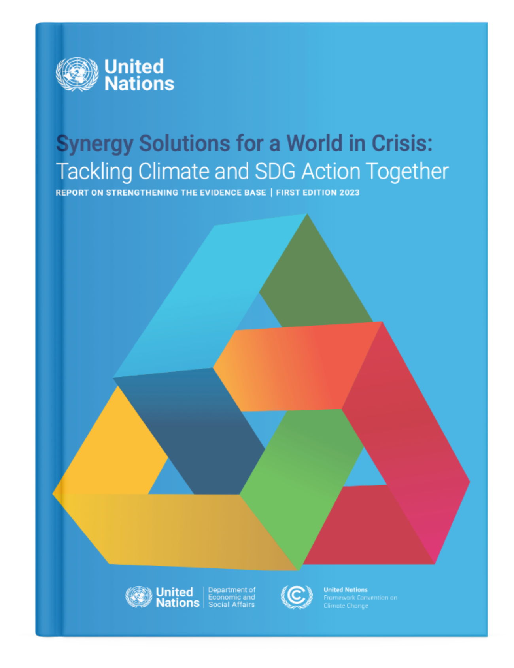
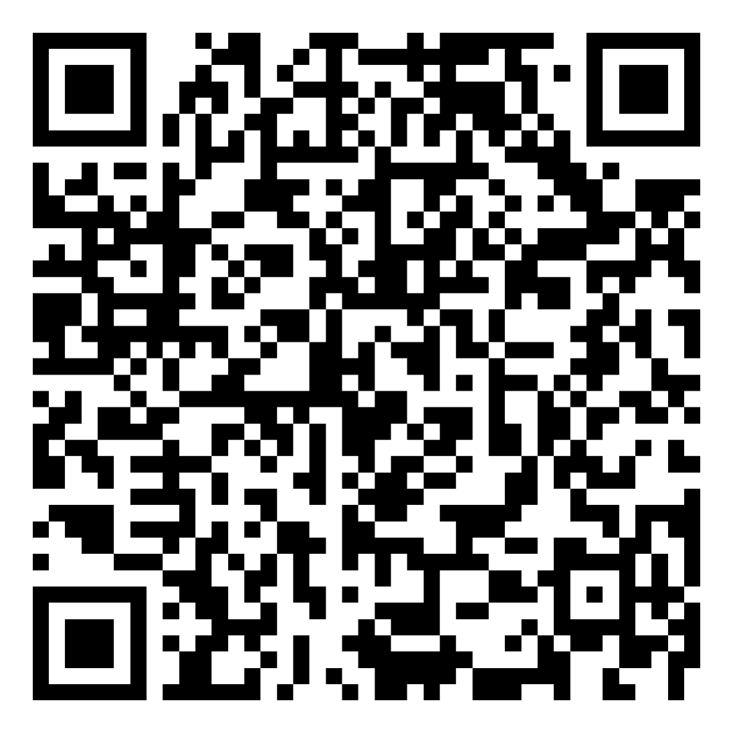
Key messages:
1
Seeking win-win synergies by tackling the climate and sustainable development crises together is the only way to correct the course we are on.
The vast pool of existing evidence underscores that the Paris goals and the SDGs are mutually re-enforcing, and one cannot be achieved without the other.
Progress away from siloed approaches and towards integrated planning, implementation, and reporting is underway but needs to move much faster.
Synergies are highly dependent on national priorities and context.
Moving forward – a ‘framework for action’ to foster systemic change is needed to support policymakers and stakeholders in their synergistic actions.
2
3
Report on Strengthening the Evidence Base
4
5
bit.ly/UNSynergyReport2023

