Slide 1

Climate Negotiations
Effective Climate Diplomacy
Young Climate Leaders Meeting
06 June 2023
Bonn, Germany
Veronica N. Jakarasi (CDFA)
Climate Finance Expert

Slide 2

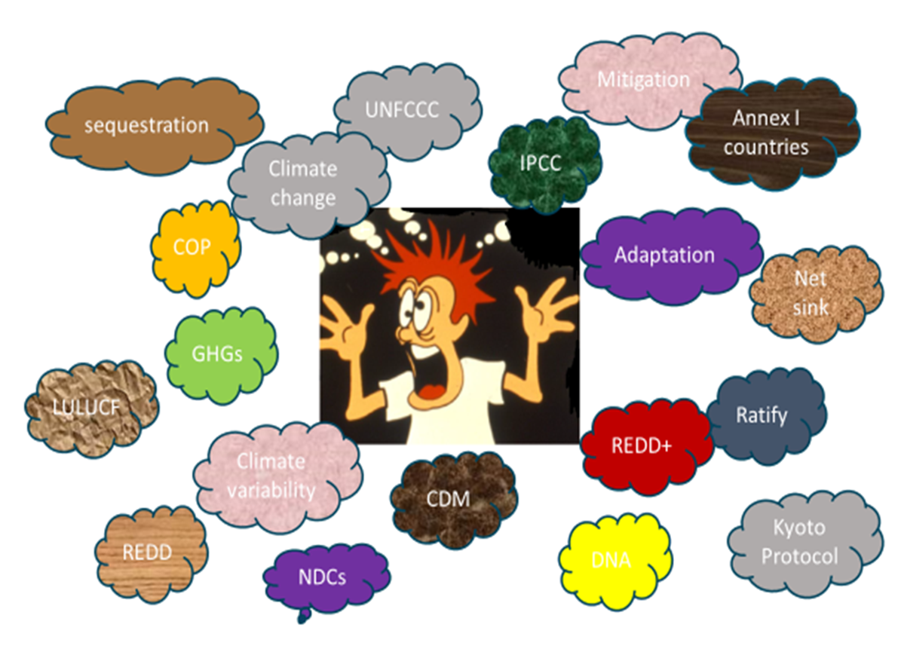
Demystifying Climate Change

Slide 3
Competencies & skills to tackle climate change
Communication skills - Ability to effectively communicate the urgency and importance of addressing climate change to a wide range of audiences.
Ability to listen - Actively listen and engage in dialogue to build understanding and consensus.
Leadership skills - Ability to inspire and motivate others, build coalitions and partnerships.

Slide 4
Competencies & skills to tackle climate change
Knowledge of climate science and policy - Understanding of climate policy landscape is essential for effective mobilization.
Partnership-building skills - Helps build and maintain partnerships and collaborations across sectors and stakeholders, engage key stakeholders, leverage resources, and negotiate and resolve conflicts.
Strategic thinking and planning - Ability to identify and prioritize goals, develop action plans, and measure progress.

Slide 5
Competencies & skills to tackle climate change
Innovation and creativity - Innovative and creative thinking to develop new technologies, business models, and policy solutions.
Cultural/Diversity competency - Understanding of cultural norms, values, and perspectives to work across sectors and engage diverse stakeholders.
Management skills – Capacity to develop and manage projects, stakeholder expectations and mobilisation.
Technology – Helps build online networks, mobilise support and innovative solutions

Slide 6
To do Activity
Accelerating Just Energy Transition and mobilizing resources into the Loss and Damage Fund ($$B)
Map the private sector players, advocates for climate justice, philanthropic partners
Share the cause and impacts of climate change, how communities are being affected and how their funding can contribute to a better future for all

Slide 7

THANK YOU

