Slide 1
BR-VTR
What’s New
February 2018

Slide 2
Content
BR-VTR 2016 Survey Results
BR-VTR Enhancements
Roster of Experts

Slide 3
2016 Survey Results
2016 BR2 review survey’s main results on BR-VTR

Slide 4
2016 Main Results
Majority of responses are positive
Improvements can still be made in some areas, namely, performance, reliability, user-friendliness
Q1. System speed
1. very slow | 9.26%
2. slow | 24.07%
3. good | 62.96%
4. fast | 3.70%
Q2. System reliability
1. unreliable | 7.27%
2. fair | 34.55%
3. good | 43.64%
4. fully reliable | 14.55%
Q3. User-friendliness
1. very difficult | 1.82%
2. difficult | 20.00%
3. easy | 65.45%
4. very easy | 12.73%
Q5. Using the tool increased efficiency in conducting the review
1. very unlikely | 7.27%
2. unlikely | 16.36%
3. most likely | 54.55%
4. likely | 21.82%
Q7. The Q&A module is useful for communicating with the Party
1. very unlikely | 3.64%
2. unlikely | 1.82%
3. most likely | 43.64%
4. likely | 50.91%
Q8. The Report preparation module is useful for drafting the review report
1. very unlikely | 5.45%
2. unlikely | 3.64%
3. most likely | 47.27%
4. likely | 43.64%
✓


Slide 5
BR-VTR Enhancements
Implemented enhancements for the
2018 NC7/BR3 review

Slide 6
BR-VTR Enhancements
Implemented enhancements for addressing the findings in the 2016 survey
Component | Enhancement
ERT Workspace | Read-only permissions for historical workspaces
 | Align libraries with iVTR and BUR-VTR
Q&A | Improved performance
 | Allow exporting Q&As in Word
 | Highlight new Party answers
 | Optimized Q&A layout
 | Add button to clean format when editing questions
Report Preparation | Common workflow
 | Improved activity description for each workflow step
 | New Word protocol
Notifications | Switch on/off notifications by users

Slide 7
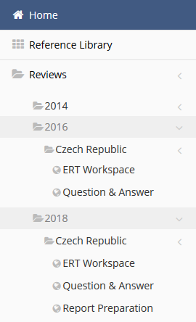
What’s New in ERT Workspace Module
Access to workspaces from previous reviews:
  Allows experts to retrieve materials from previous reviews
  Facilitates drafting of questions by new experts as they can see examples of questions previously sent to the Party
  Read-only access restricted to
  ‘ERT workspace’ and
  ‘Question and Answer’ modules

Slide 8
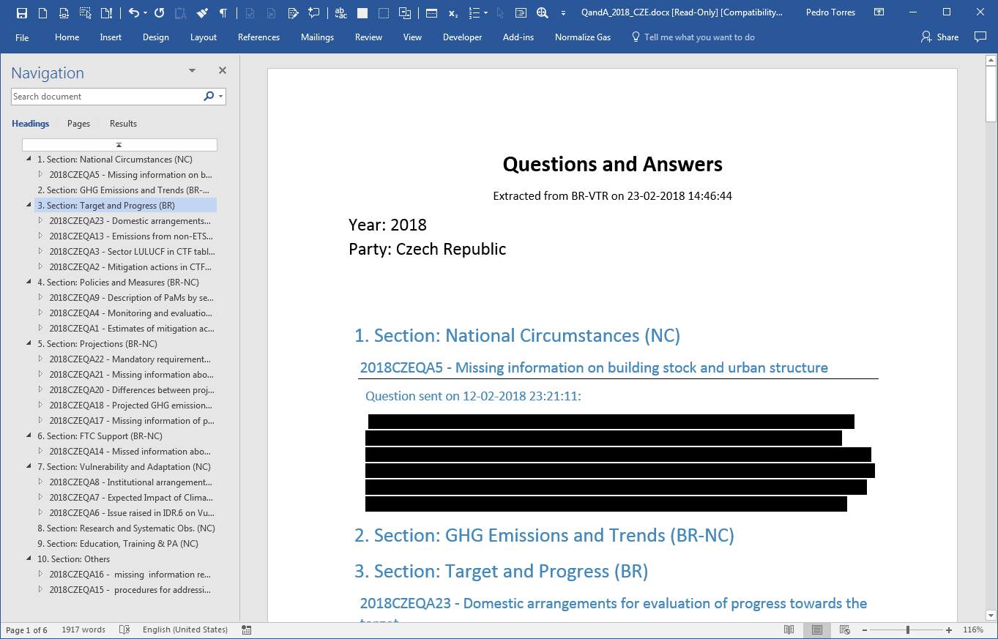
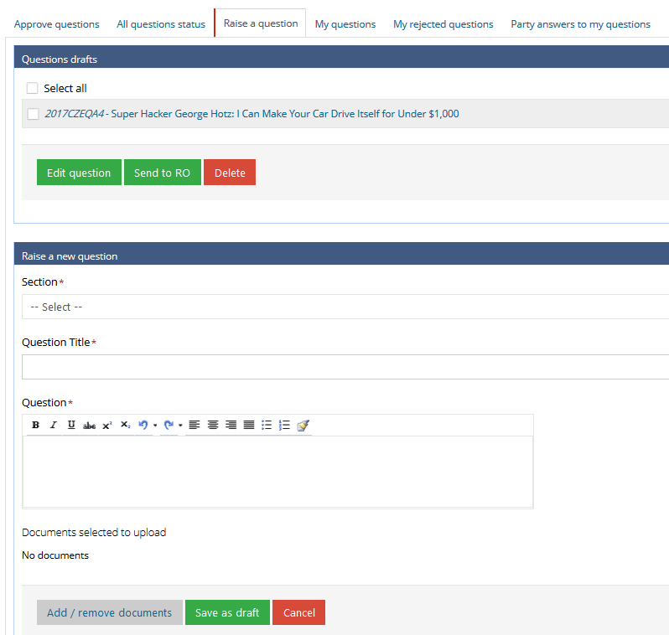
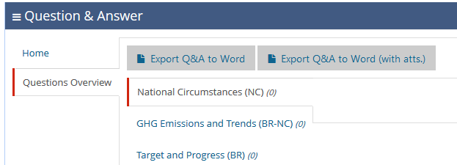
What’s New in Question and Answer Module
New Q&A layout to improve user-friendliness and efficiency
Structural changes in the source code to increased performance (as in iVTR)
Download Q&A to improve user-friendliness and efficiency
New answers from Parties marked bold for easy identification
Raise new questions and edit questions under the same tab to improve efficiency
New button to clear format to facilitate copy/paste and improve format consistency
New button labels to improve user friendliness

Slide 9
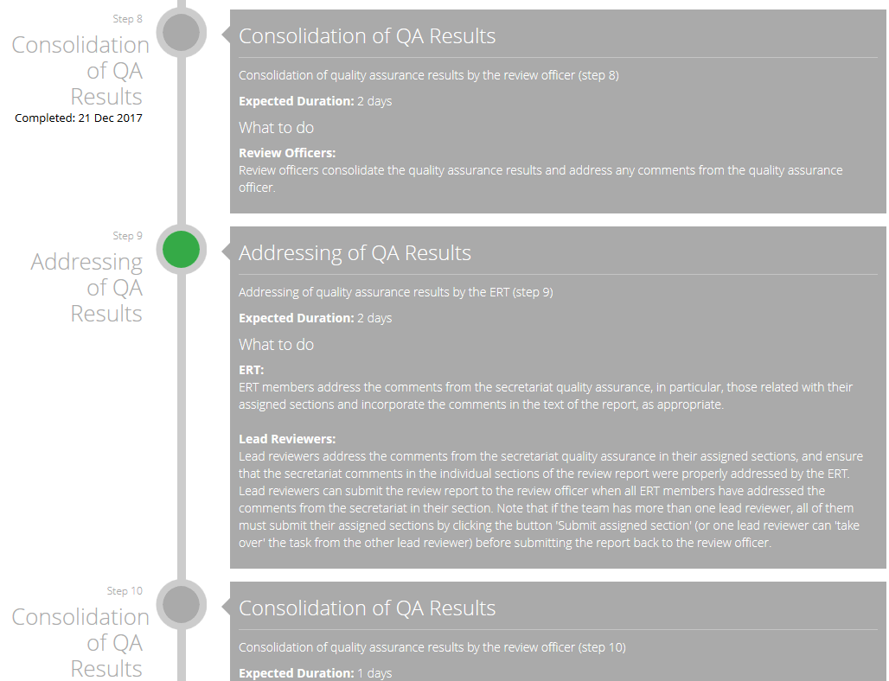
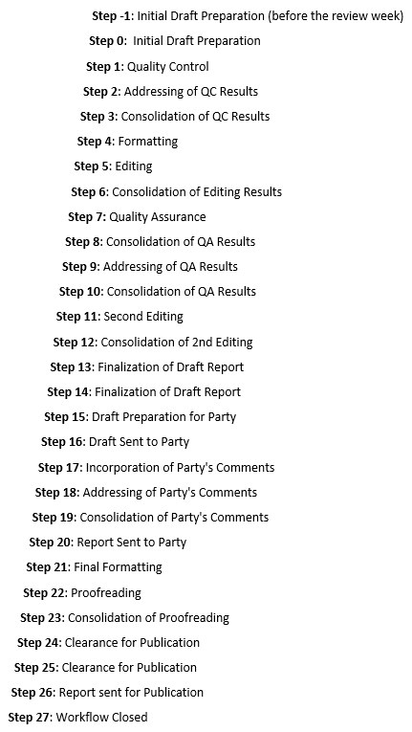


What’s New in Report Preparation Module
New common workflow, to improve procedural consistency
Covers all steps from initial draft preparation to report publication, to improve efficiency
Includes task description, to improve efficiency, user friendliness and transparency
Enhanced browser compatibility
Minimum requirements: Word 2010, with Service Pack 2
BUR
NC/BR
GHG
Three processes,
one workflow

Slide 10
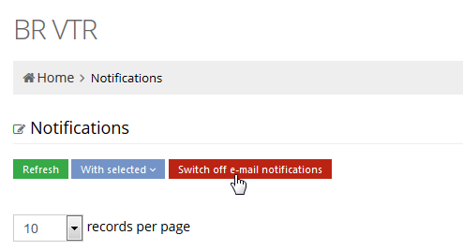
What’s New in Notifications
Switch on/off notifications

Slide 11
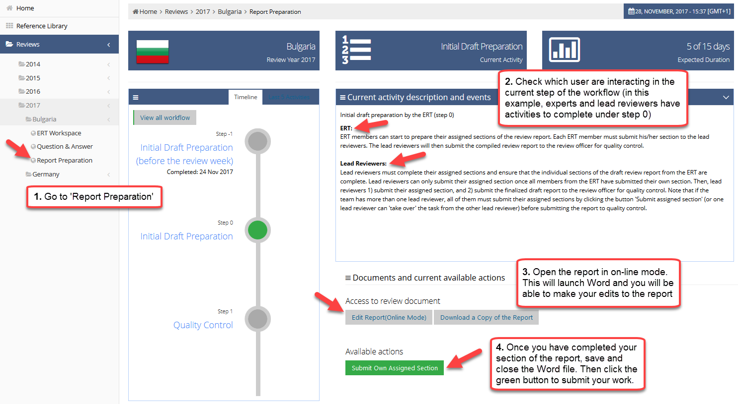
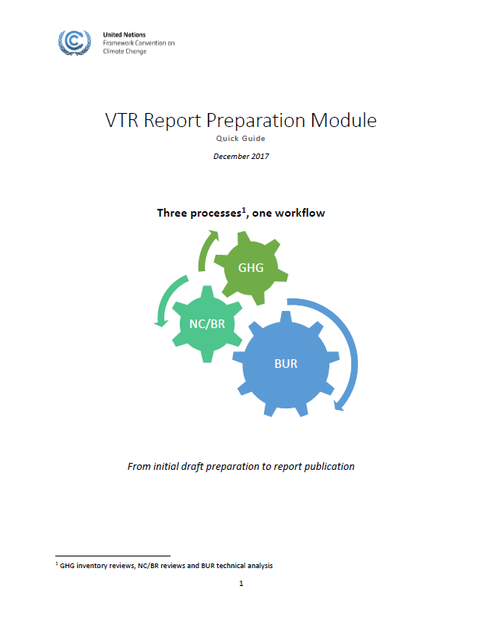
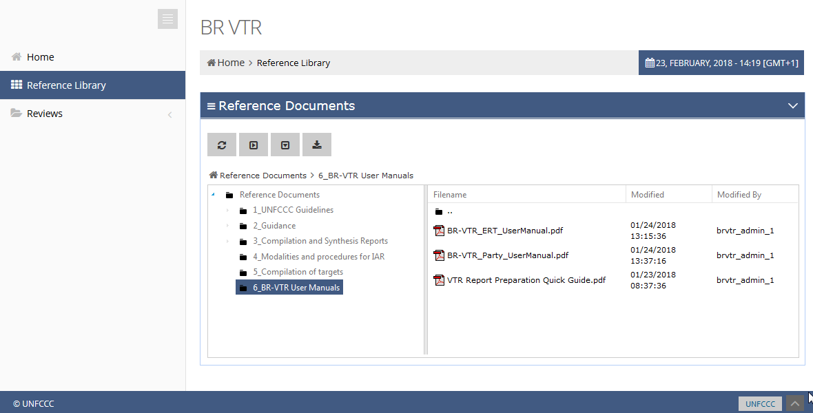
User Manuals
User manuals available in the Reference Library

Slide 12
Roster of Experts
Role of the ROE for communication and composition of ERT and for configuration of BR-VTR for the 2018 review cycle

Slide 13

ROE Data Workflow
Experts should keep their profile information up-to-date
ROE Database
Contact Information
Nomination Area
NFP Approval
Expertise
ERT Composition
BR-VTR
Exams Results
Event Participations
Other Info

Slide 14
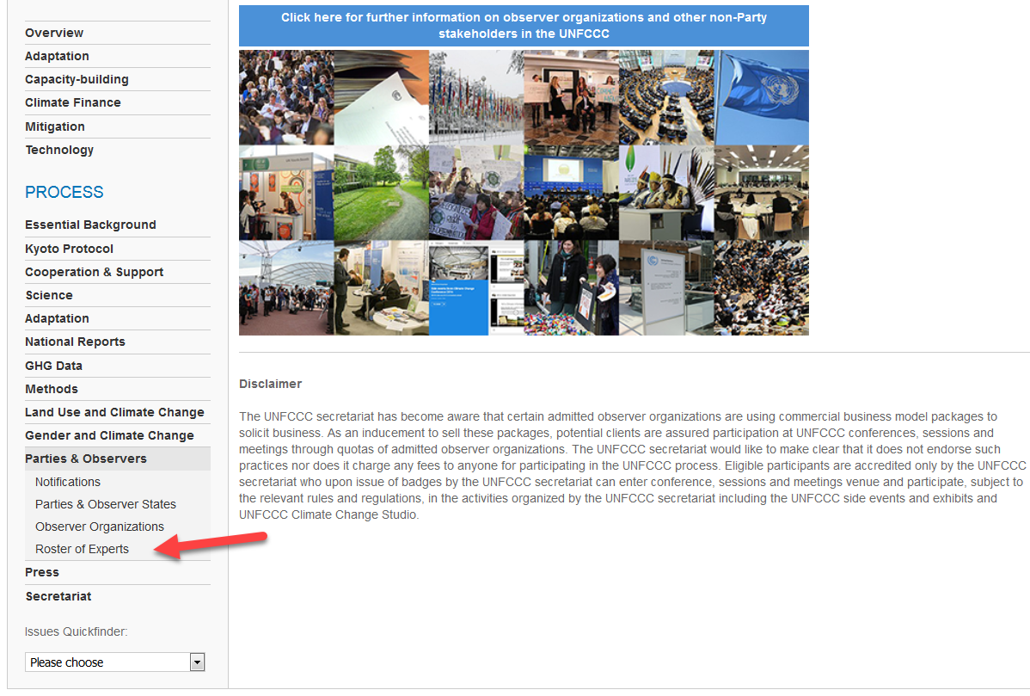
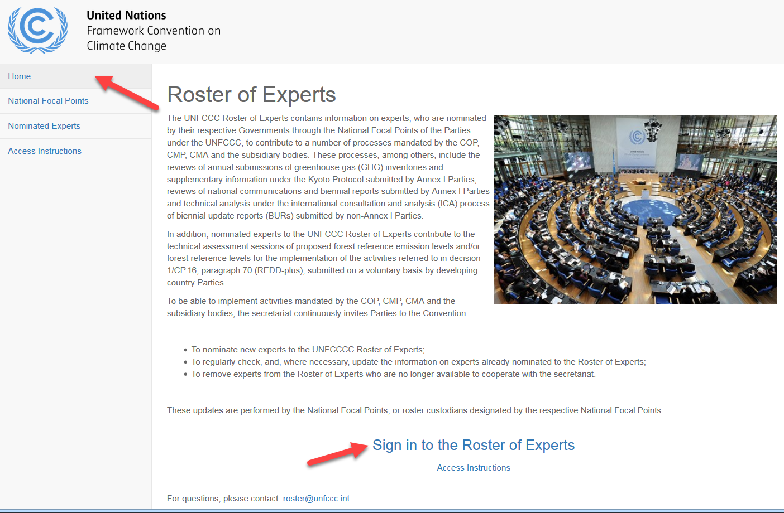
Login to ROE
http://www4.unfccc.int/sites/roe/Pages/Home.aspx
Access via the UNFCCC website

Slide 15
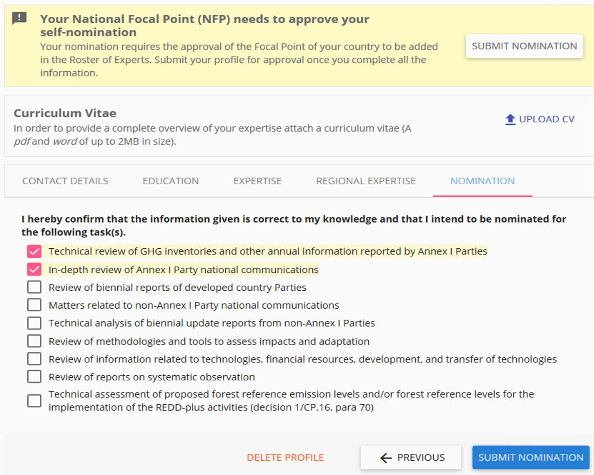
ROE Profile Information

Slide 16
Thank you

