Slide 1
First Dialogue under the UAE Work Programme on Just Transition Pathways
Just Transition pathways to achieving the goals of the Paris Agreement through NDCs, NAPs and LT-LEDs
2-3 June 2024
Breakout group 3: Exploring Further Opportunities of International Cooperation for Just Transition
Camilla Roman
Senior Technical Specialist, Priority Action Programme on Just Transition
International Labour Organization

Slide 2
Supporting just transition in NDCs, NAPs, LT-LEDs
Gaps, priorities, emerging trends
Tailored and practical approach to country support
Case studies on the integration of JT in NDCs, NAPs, LT-LEDs
Mapping and baseline (depth, policy areas, issues and target groups)
Gathering reflections and learnings
Demand-driven
Context specific
Leveraging and adapting tools, knowledge, exchanges

Slide 3
ILO support on addressing JT in NDCs
Employment and social impact assessments of climate policies
Facilitation of social dialogue and stakeholder engagement
Capacity development and international exchanges
Support for policy development and implementation
ILO’s Guidelines for a Just Transition towards Environmentally Sustainable Economies and Societies for All

Slide 4
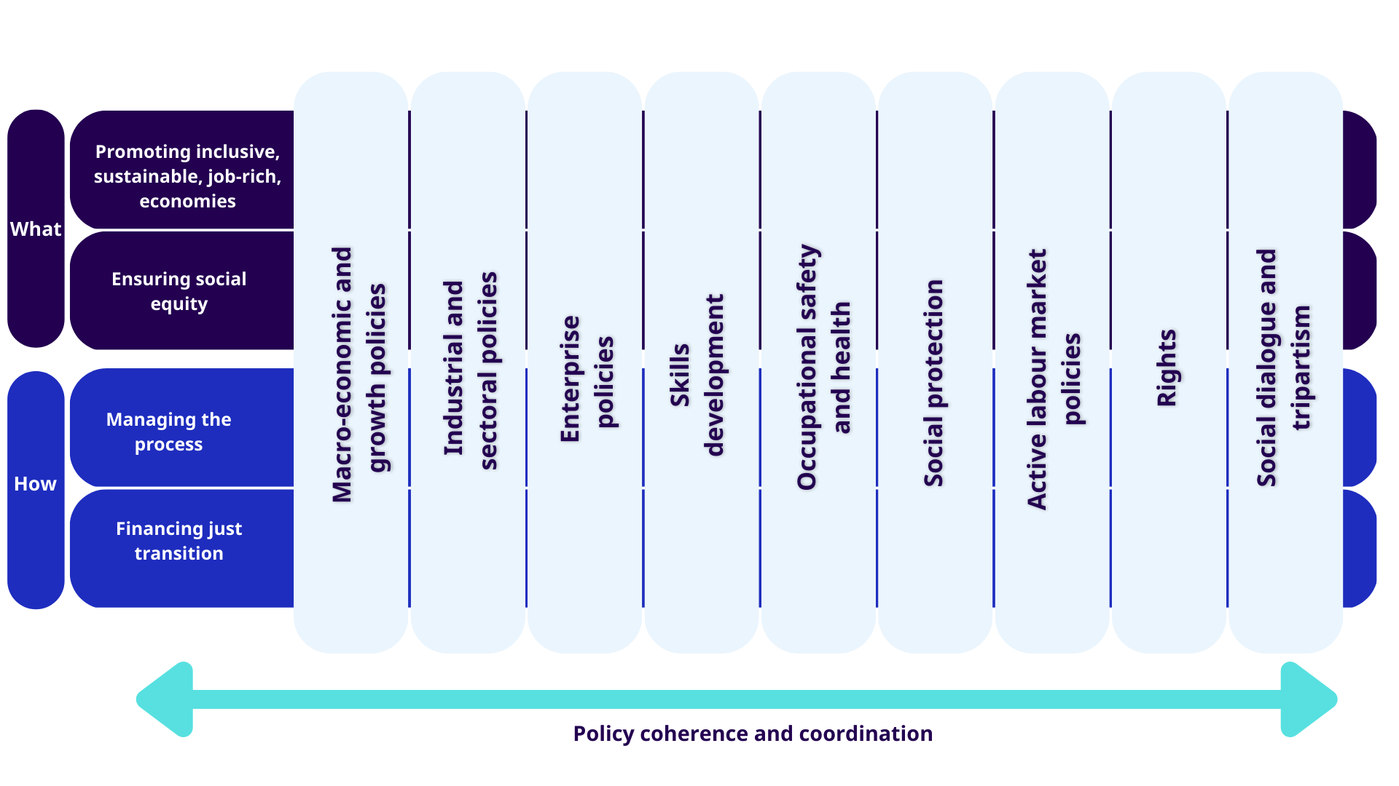
Coherent action across policy areas, process, finance
ILO’s Guidelines for a Just Transition towards Environmentally Sustainable Economies and Societies for All & ILC 2023 Resolution

Slide 5
How is just transition
reflected in NDCs/NAPs/
LT-LEDs?
What JT policy areas and
Issues are present and how
are they articulated?
What mechanisms for
social dialogue and
arrangements for policy
coordination are envisaged?

Slide 6
Some emerging considerations
Just transition uptake
Addressing positive and negative impacts
Leaving no one behind
Adaptation and mitigation
Employment considerations and beyond
Sectoral & economy-wide approaches
JT as a cross-cutting issue and in specific measures
Follow up action in climate policies and complementary instruments
Social dialogue and stakeholder engagement
Policy coordination
Inclusion of JT in climate policies and complementary instruments
- links to financing and engagement with international partners
Implications for international cooperation

Slide 7
Thank you

