Slide 1
JT experiencie in Portugal
1st Dialogue Under the UAE Work programme on Just Transition Pathways
Bonne, June 2024
Tiago Sameiro
tiago.sameiro@apambiente.pt

Slide 2
Portugal Position on addressing climate change
Just Transition Principals
Joint EU NDC (55% GHG emission reduction in 2030, in relation to 1990 level)
EU Climate Law (climate neutrality by 2050)
At national level:
National Climate Law
Roadmap for carbon neutrality 2050*
National Energy and Climate Plan 2030*
Ambitious 2030 targets, reflecting the urgency to accelerate the decarbonisation of the economy within this critical decade
New GHG reduction targets in line with the National Climate Law:
  55% until 2030
  65% to 75% until 2040
  90% until 2050
New major commitment: Achieving climate neutrality by 2045 *under revision
All people covered including persons with disabilities, displaced or marginalised
just transition of the workforce and the creation of decent work and quality jobs integrated into the drafting and implementation of NDCs, NAPs and LT-LEDS
Social dialogue with workers’ unions, employers and government as well as robust and early stakeholder engagement
Social protection systems, including social inclusion policies, can be reviewed and, where applicable, adapted in light of the green transition and climate risks
Tax-benefit systems and social protection systems should be examined against the specific needs stemming from the green transition and climate risks, and the imperative that accompanying policies do not lead to maladaptation nor create barriers for the green transition

Slide 3
JT Programme Targets
Biggest challenges in PT considering side effects in a just transition approach
Due to Phase-out of tax exceptions
Challenges
Approaches
Sines Coal Power Plant closure - one of the most pollutant in EU
Pego Coal Power Plant Shut down 10 years in advance considering the first perspective
An energy matrix reduction intensified by no nuclear power plants (concerning coal PP’s)
Direct and indirect unemployment impacts
Local economy impacts
Continuous learning process
3 different geographic areas
3 local authorities
3 different methodologies and approaches
Several sources of finance flows
Corporative Sector Decision
Matosinhos oil refinery

Slide 4
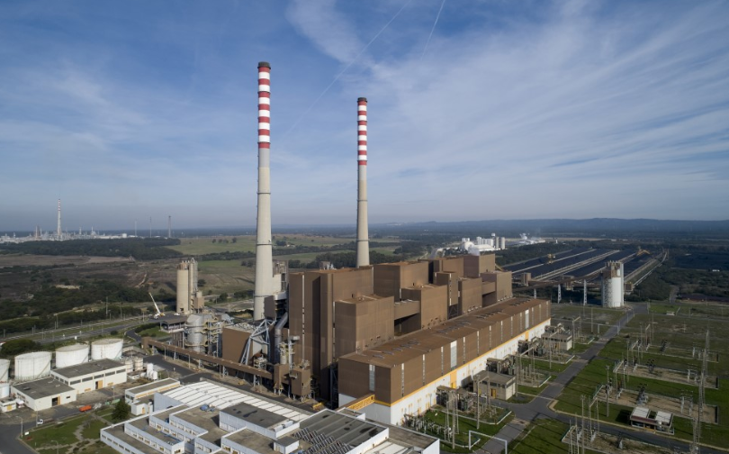
Sines Coal Power Plant
Alentejo Litoral sub-region
Self-employment and innovative entrepreneurship
JTP programme aiming diversify the local economy
Training and requalification activities
Supporting research and innovation in small and medium-sized enterprises (SME)
Source: EDP
renewable energy project, agri-food and tourism sectors
Support the professional reskilling of workers
Investing in sustainable local mobility

Slide 5
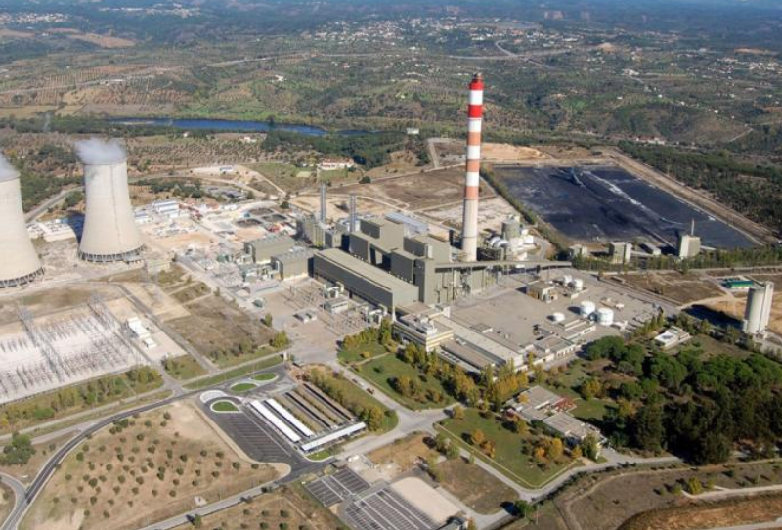
Pego Coal Power Plant
Middle Tagus sub-region
Reskilling workforce to renewables
Within JT Programme to mitigate the social and economic effects (SMEs)
Combined Renewable energy conversion project (wind, solar, batteries and green hydrogen)
Supporting the promotion and diversification of the territory’s economy
https://www.antenalivre.pt/regiao/central-pego
Supporting workers affected

Slide 6
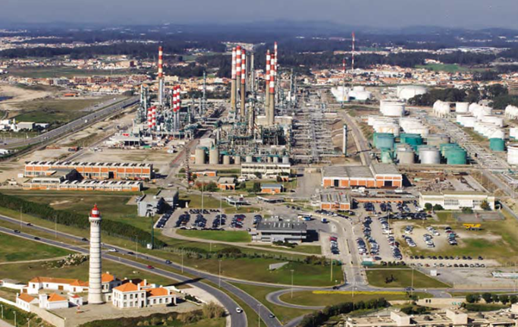
Matosinhos Oil Refinery
Porto city area
Within JT Programme to diversify the economy, supporting local SMEs
Requalification and training of the long-term unemployed
Supporting the promotion and diversification of the territory economy
Innovation hub on sustainable mobility, green energy, advanced manufacturing processes and marine economy
Source: Galp
Adapt their business models
Directly Support workers affected

Slide 7
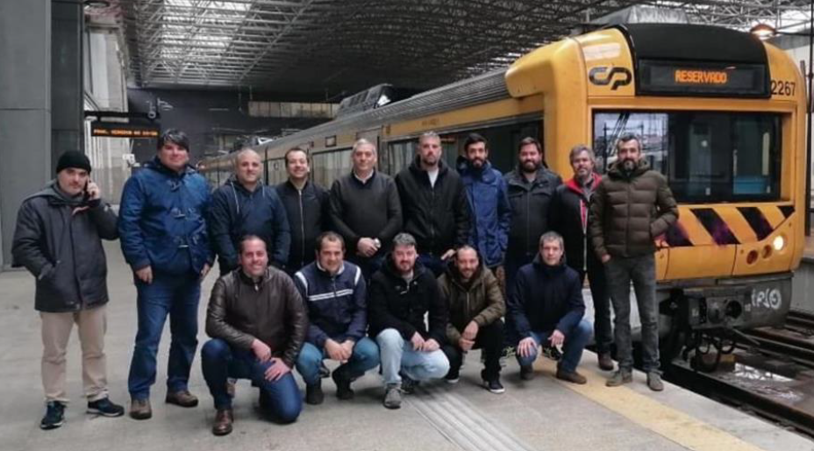
Matosinhos Oil Refinery workforce training Good Practices to transports
Characteristics
Approaches
Transport Training
400 direct workers and 1000 indirect workers
237-acre area
Relevant local and regional energy infrastructures
Adopted a tailor-made vocational training perspective
involving all stakeholders as workers, unions, side-affected companies
Refinery workforce training on qualified railway train driver licence
Renewable energies training actions
Entrepreneurship actions
Contributing to decarbonize transport sector
Supporting the Sustainable and Smart Mobility Strategy
Decreasing climate impacts
Better career perspectives along with reducing labor shortages in Portuguese market
Source:9th JT Platform Conference

Slide 8
Goals & Achievements
Bringing the public along by creating agreements with workforce, stakeholders and public in general, putting in place peaceful and advantageous transition processes to workers
Supporting a green jobs revolution in which the alternative jobs created have guaranteed living wages, proper workplace safety protections, and health benefits by finding useful alternatives within the scope of climate policies to achieve climate neutrality by, for instance, reintegrating refinery workforce in the “Sustainable and Smart Mobility Strategy” EU policy
In the scope of reinforcing the urgency for concerted efforts to tackle climate change.
Actions were based on tools planned in the National Energy and Climate Plan approved by government resolution in 2020 (Contribute to EU’s NDC’s)
Driving local solutions by giving priority to local authorities on managing the programmes and prioritizing local alternative businesses, including creating own jobs, for direct and indirect affected workforces
Laying the social groundwork for a resilient net-zero economy by guaranteeing that actions contribute to climate targets within a holistic perspective

Slide 9
Highlighting
Actions addressing climate change are built upon financial flows that comes also from revenues of the carbon pricing policy (EU ETS)
JT policies were previously adopted in the Roadmap for carbon neutrality 2050 & National Energy and Climate Plan 2030
JT programmes involving Local authorities and all relevant stakeholders
Programmes addressing workforce and local economies within green jobs & green economy that will contribute on other hand to address climate change

Slide 10
THANK YOU

