Slide 1
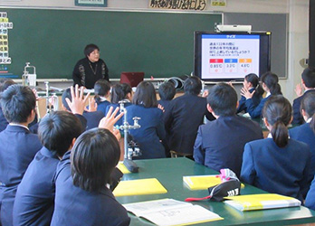
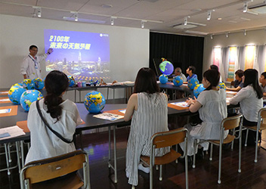
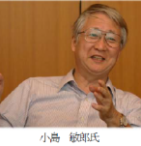
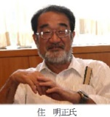
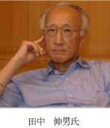
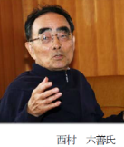
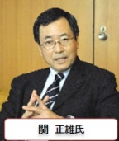
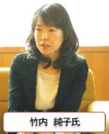
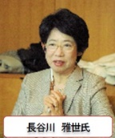
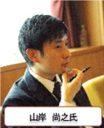
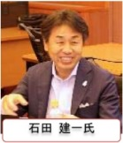
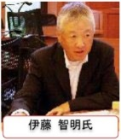
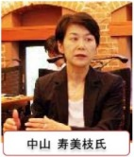
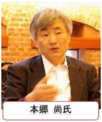
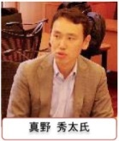
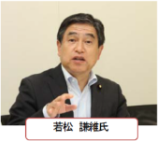
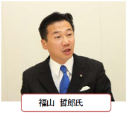
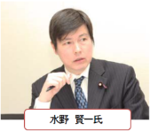
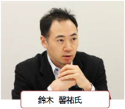
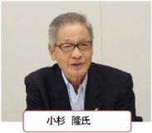
Climate Change Science Communication Practices in Japan: what we have found through dialogue
Seita Emori emori@nies.go.jp Deputy Director, Center for Global Environmental Research
National Institute for Environmental Studies, Japan
My background: climate modeling
Weather Report 2050 (WMO):
supervisor/commentator for a Japanese contribution by NHK, 2014
Climate Change Action Communicators (MoEJ)
~2000 certified communicators (citizens, teachers, weather reporters …)
Stakeholder Dialogues on the global climate challenge
business, NGO, government, politicians
AORI/NIES/JAMSTEC/MEXT
NHK/WMO

Slide 2
Structure of (polarized) opinions currently observed in Japan
What is the key to “solve” the climate problem?
tension
Technology
Social reform
High efficiency (coal) fire
<- Concerns about lock-in
Nuclear
<- Concerns about accidents, waste…
Innovative technologies
<- Concerns about realizability
Needs more development ->
(too expensive and variable)
Renewables
<- Could be deployed more
(inhibited by conventional system)
Efficiency improvement->
Energy saving
<- Lifestyle change
Moving away from
Material growth
Concerns about economic ->
depression, unemployment, …

Slide 3
Desired (and emerging?) transformation of opinions
What is the key to “solve” the climate problem?
tension
Technology
Social reform
Conventional technological development doesn't seem to work
Just appealing for social ideals doesn’t seem to change society
fusion?
Ideals
Institutions, Investors,
Entrepreneurs
Innovation
(ex. Too many cars
are produced!)
(ride share apps,
driverless cars)
Change in
mindset
Life style
Business model
Industrial structure
(purchasing a car
-> mobility service)
Changes in
behavior, demand
(manufacturing -> data industry?)

