Slide 1
Improved nutrient use and manure management towards sustainable and resilient agricultural systems The EU Approach
^{#FutureofCAP}

Slide 2
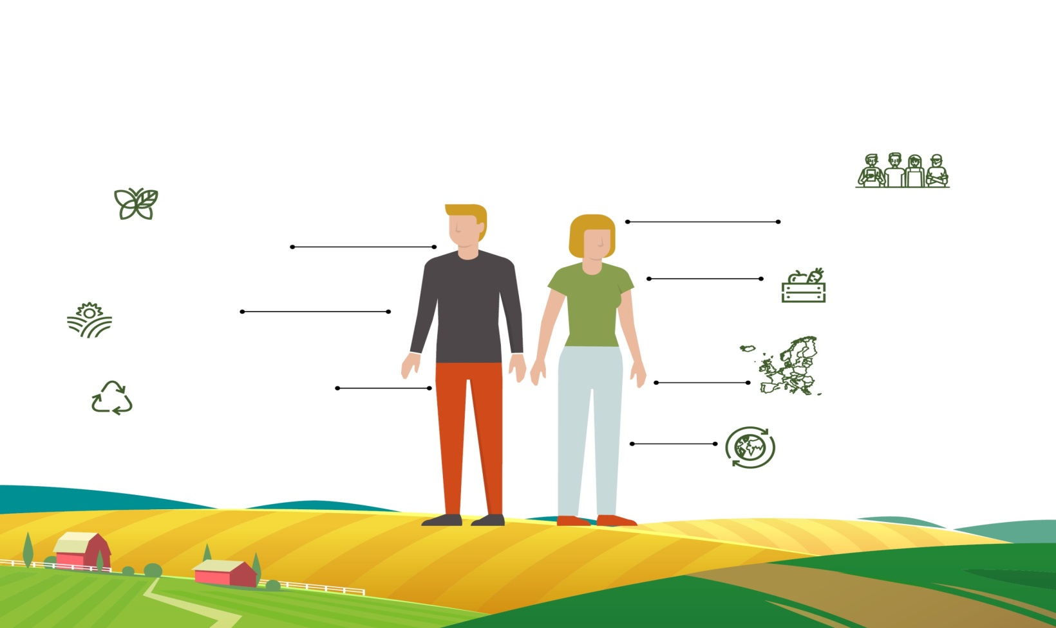
The EU Agriculture Policy
Climate & clean energy and environment
44 million jobs
in the food chain
Steward
48 % of eu land
Food security
for 500 million consumers
EU Agriculture
bio & circular economy
single market
eu AGRI-FOOD exports € 131 bn
Is a common policy framework at EU level allowing for adaptation to local conditions
Provides support for farm income and competitiveness, while fostering a sustainable agriculture
Supports the development of rural areas throughout the EU
Enables the functioning of the single market and to speak with one voice internationally
The CAP

Slide 3
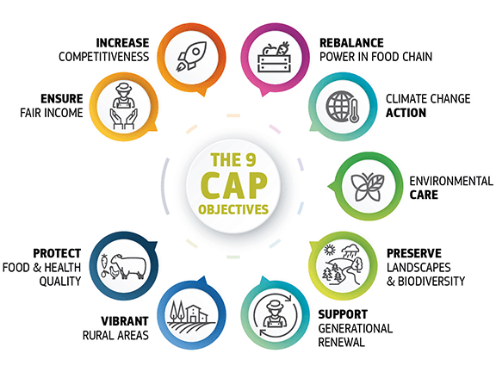
Innovation &
Modernization
Notes:
Within the 9 objectives of the CAP the Nutrient Management (FaST) is related with
Environmental Care
Climate change action
Increase competitiveness
And of course contribute to the cross-cutting objective of Innovation and Modernization.

Slide 4
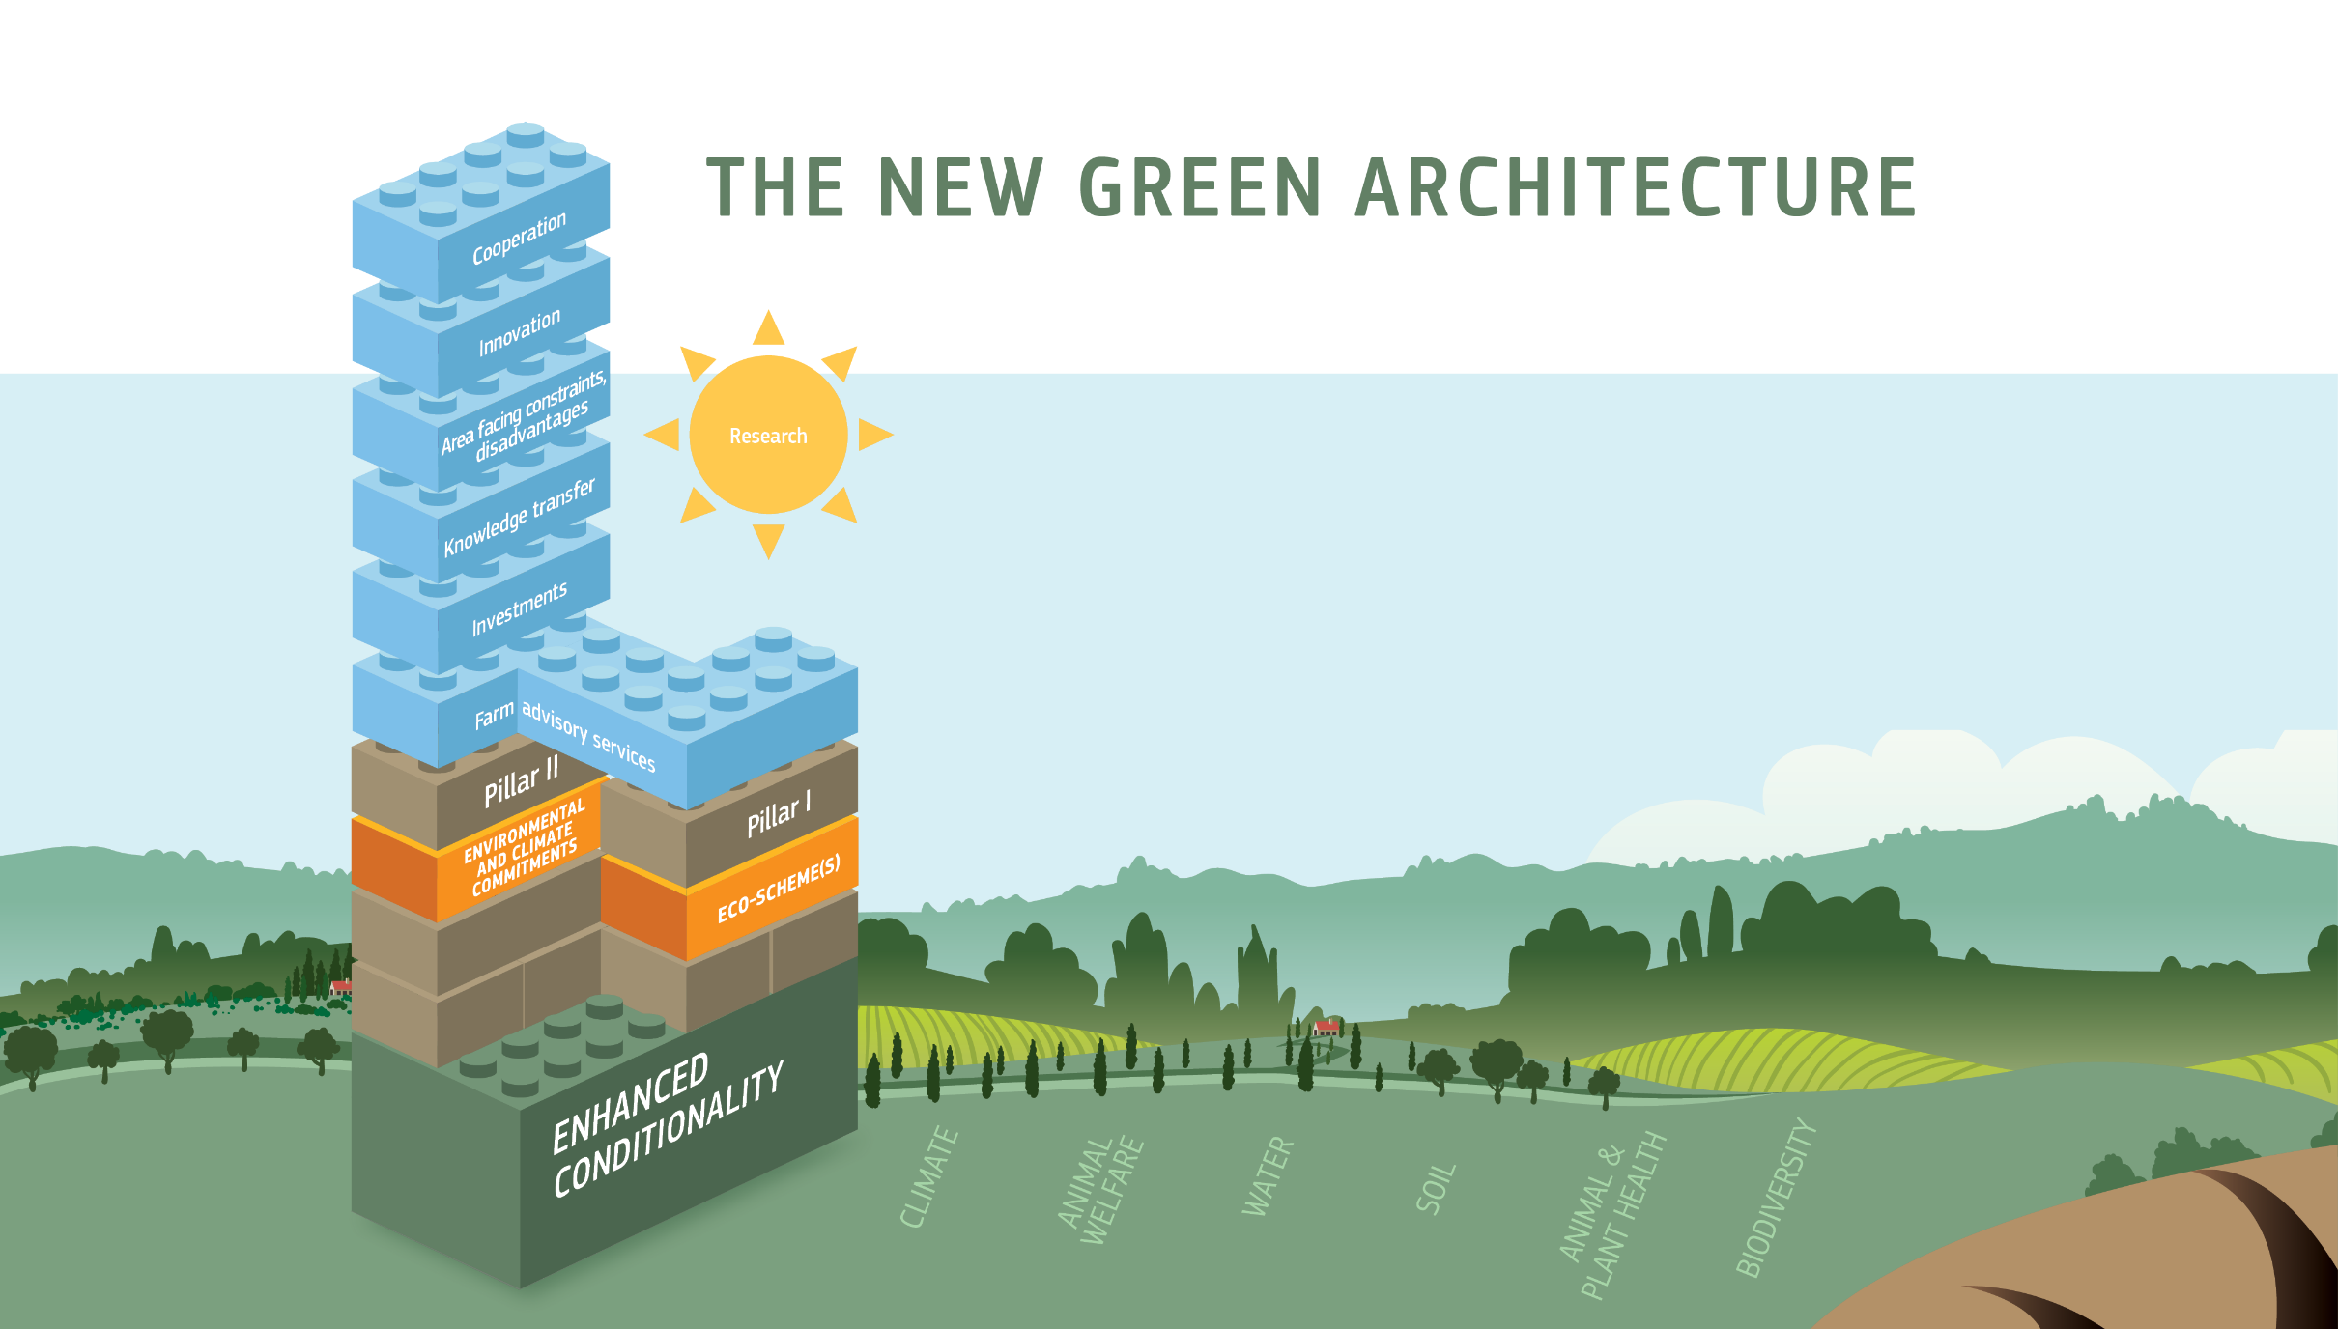
Green architecture for reduction of emission of N2O from agricultural lands
Designed for answering to the specific need of reducing N2O emissions to the atmosphere, throught reducing the nitrification process of nitrogen in excess due to fertilization.
Maintenance of leguminous in cropping systems
Conversion to organic farming
Result-based N2O schemes
Support for training, for the application of precision farming
Perennial cover in orchards
Investments for precision fertilization facilities and tools (hardware, software, services and data)
Catch crops beyond the sensitive period
Eco-schemes
Maintenance of organic farming
CAP Pillar II
Cost for soil sampling at sub parcel level to feed Farm Sustainability Toll (GAEC5)
Co-benefits for N2O reduction:
SMR2: Nitrate Directive
GAEC 5: Use of Farm Sustainability Tool for Nutrients. Refer to minimum requirements.
GAEC 7: No bare soil in most sensitive period(s). Define soil cover and sensitive period.
Conditionality
Baseline
CAP specific objective:
Contribute to climate change MITIGATION and adaptation, as well as sustainable energy
Notes:
The tools for achieving the environment and climate objectives are organised in three main layers in the new green architecture of the CAP
the conditionality, with new and improved standards/requirements as is the case of the FaST
the Eco-schemes under the first pillar
and the payments within CAP Pillar II related with the rural development).
Basic requirements defined by MS in the GAEC can be considered as basic level in terms of requirements and ambition,
to be enhanced with the creation of Eco-schemes and Pillar II .
This potential example is designed for answering to the specific need of reducing N2O emissions to the atmosphere, throught reducing the nitrification process of nitrogen in excess due to fertilization.
Departing from the use of the FaST as a basic requirements, the Member States can define additional interventions related with the minimization of the negative effects in the use of nutrients, some examples could be:
Maintenance of leguminous in cropping systems as part of the ecco-schemes
And Support for training, for the application of precision farming
BACKGROUND INFO
List of Broad type of interventions
Decoupled direct support
Basic income support for sustainability
Complementary redistributive income support for sustainability
Complementary income support for young farmers
Risk management tools
Coupled support
Payments for natural constraints and other region specific constraints
Schemes for the climate and the environment "eco schemes“. Article 28
Payments for management commitments (environment/climate, genetic resources, animal welfare)
Environmental, climate and other management commitments Article 65
Investments. Article 68
Installation grants
Cooperation. Article 71
Knowledge exchange and innovation. Article 72
Sectorial programmes
A consideration on WTO compliance: acknowledging flexibility and margin that Member States will have in combining their interventions, one could say that it is just not worth taking any risks with WTO Green Box classification. In any case it is good to recall the compliance with it.
Subset of Core reporting indicators pursuant to article 128 (selection of env and climate objectives)
Contribute to climate change mitigation and adaptation, as well as sustainable energy:
R.14 Carbon storage in soils and biomass: Share of agricultural land under commitments to reducing emissions, maintaining and/or enhancing carbon storage (permanent grassland, agricultural land in peatland, forest, etc.)
Foster sustainable development and efficient management of natural resources such as water, soil and air:
O.13 Number of ha (agricultural) covered by environment/climate commitments going beyond mandatory requirements
R.4 Linking income support to standards and good practices: Share of UAA covered by income support and subject to conditionality
Contribute to the protection of biodiversity, enhance ecosystem services and preserve habitats and landscapes:
R.27 Preserving habitats and species: Share of agricultural land under management commitments supporting biodiversity conservation or restoration.

Slide 5
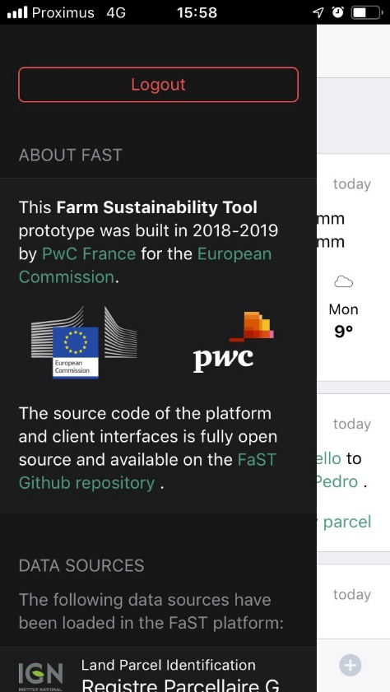
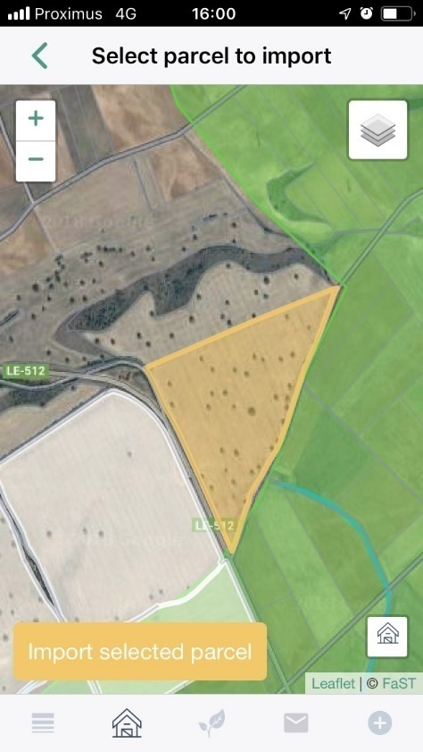
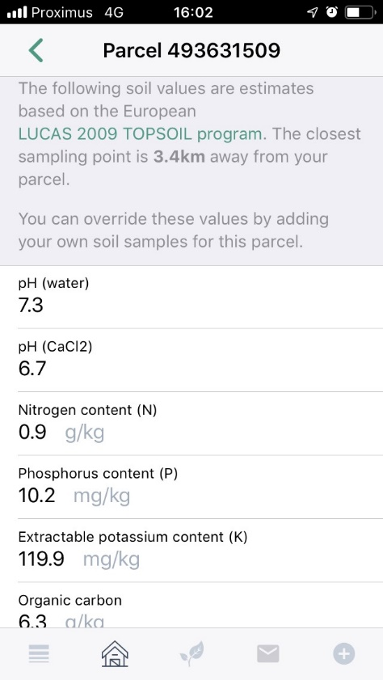
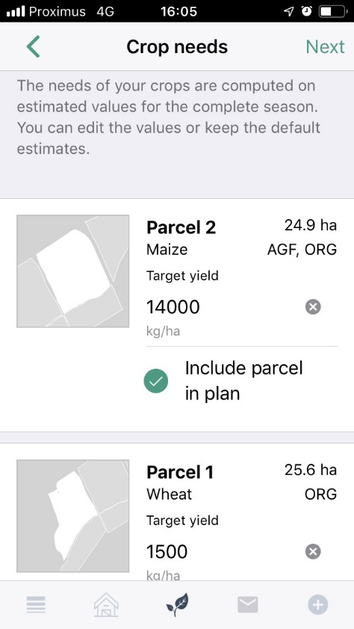
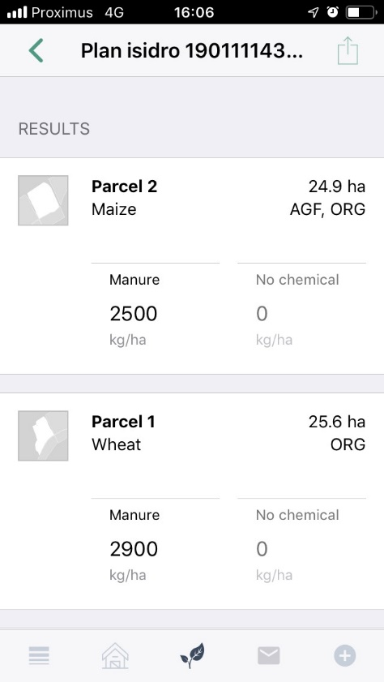
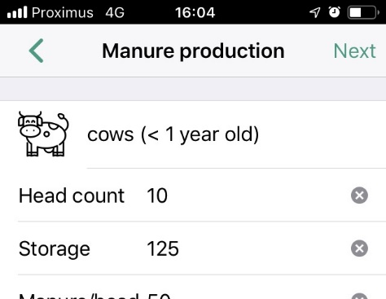
Farm Sustainability Tool for Nutrients – FaST
Example
1
2
3
4
5
Access to the APP or web browser using unique identification
Confirmation of the parcels based on the LPIS limits
Integration of data sources:
Soil data, Natura2000
Data entry and confirmation
(Crop and expected yield)
Nutrients Management Plan (Field/Farm scale)
Examples of the demo version from the Feasibility study.
Notes:
The concept of the Fast is a digital services that provide advice for the use of nutrients in agriculture, using the available data and knowledge.
In our view, the farmer access to the system using an unique identification.
The system provide access to existing information on the farm, LPIS farm boundaries and parcels, together with other satellite imagery, in user-friendly customizable layers.
The information necessary to perform the analysis and to assess the nutrients recommendation is extracted from the available data sources
And the farmer only confirm the data or add some additional data not available on this sources (i.e. crop and expected yield)
The system provides a
Additional interesting characteristics and potential improvements are:
Ablility to integrate further modules/apps/widgets, driving localisation and diversification of services to farmers (advisory services, commercial services etc).
Potential to develop into the ‘on-farm, digital and mobile terminal’ for most interaction between the farmer and the MA/PAs (to support payment applications, adhesion to and implementation of various contracted commitments, information exchange/notifications etc.).
Its modular and minimalistic structure will not replace existing commercial providers, but provide a platform for smaller, possibly more innovative service providers, for researchers or farm advisors, for whom the FaST open source ‘core module’ will act as on-farm entry support.

Slide 6
Farm Sustainability Tool for Nutrients – FaST: Benefits
Agronomic, environmental and climatic benefits
Optimization in the use of nutrients
Valorisation of sources of nutrients
Legal limits & requirements (simplification)
Digitalization, modernisation & digital skills
Electronic tool in the hands of the Farmer
Support other initiatives for a more modern CAP
Level-Playing-Field
Data and knowledge based advice
Data and information access
Notes:
The FaST has to be based on the existing data and knowledge, taking advantage of the developments achieved in the frame of research projects and traditional advisory services and will help to provide information to farmers based on existing data.
An important characteristic of the FaST is that the advice provided has to be compliant with the existing legal limits and requirement. This is an advantage fro the farmer, because they will receive clear and easy to follow instructions.
In addition, the tool has to be designed to consider the available sources of nutrients, manure, nutrients that remain in the soil after the previous crop etc.
This accounting system will help to optimize the use of external inputs
And the expected benefits of this chain are agronomic, environmental and the reduction of the emissions of green house gases.
Also we will need sufficient scale for a meaningful impact >> (this is why it is a GAEC)
As an electronic system, the FaST can be integrated and has synergies with other initiatives for a more modern CAP, this is the case of the Geospatial Aid Applications, developments for Geotagged pictures, etc, and is interoperable with other farm management services provided by administrations or privates.
The FaST could provide the necessary ground for more ambitious management practices (i.e. incentive under eco-schemes or management commitments)
The final result is that we are incrementing the digital skills of the sector and contributing to a more modern agriculture.
FaST will provide a level-playing-field for all farmers in EU
unique opportunity for small/medium farmers,
reduce the gap/accessibility to digital tools
compatible with more advanced tools
In our view, the minimum elements and functionalities described in the proposal will ensure the level-playing-field

Slide 7
Farm Sustainability Tool for Nutrients – FaST
Summary l
To reach the necessary scale for a meaningful impact (GAEC→First Pillar)
Benefits:
agricultural, economic, environmental and climate change mitigation
provides a real level-playing field for all farmers across EU
accessibility to data & knowledge-based advice
digitalization
Able to integrate further modules/apps/widgets/services (opening and reuse principles).
Certain level of technical detail will be necessary:
facilitates the implementation and roll-out of the FaST
ensures a real level-playing field for all farmers across EU
the elements proposed are really minimum

Slide 8
A Green Deal for Europe - General
Europe will strive becoming the world’s first climate neutral continent
More ambitious climate target for 2030
Sustainable Europe Investment Plan (1 trillion €/10y)
European Climate Pact (including regions, local communities, civil society, industry and schools)
Biodiversity Strategy for 2030
New Circular Economy Action Plan
8

Slide 9
A Green Deal for Europe - Agriculture
The Farm to Fork Strategy:
Covering the whole value chain
Ensuring a decent living for farmers
Providing Europeans with nutritious, affordable and safe food
Preserving rural areas and investing in their future
Action plan under development
9

Slide 10
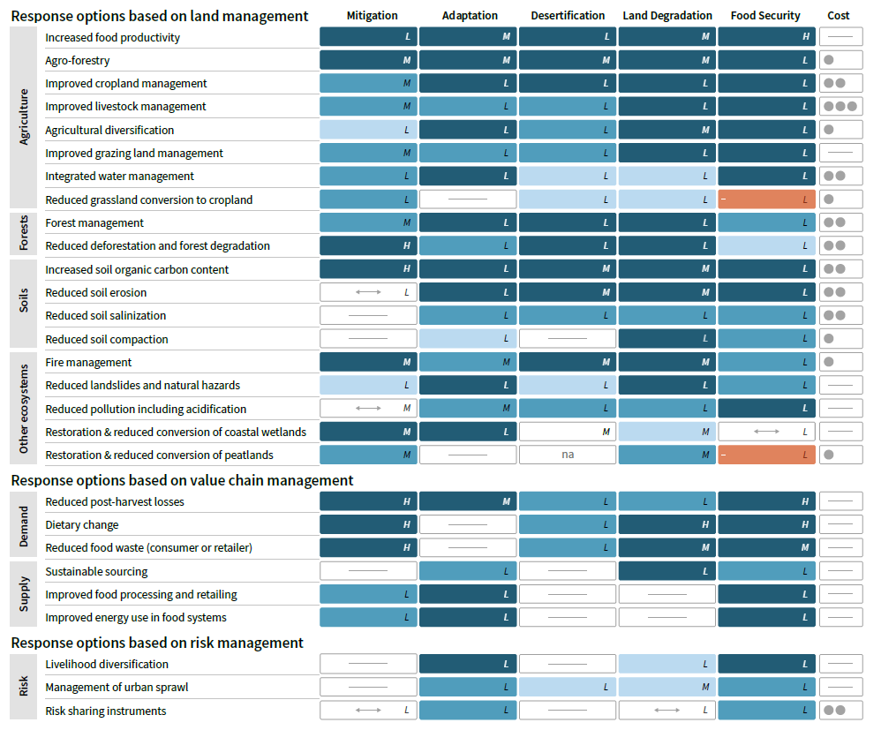
Assessment

Slide 11
AGRICULTURE MANAGEMENT
Context
11% of global emissions: CH₄ (enteric fermentation); N₂O (fertilizer)
CO₂ emissions from soil disturbances
Potential
GtCO2 yr⁻¹
>13
0.1 - 5.7
1.4 - 2.3
Improved cropland management (1.4-2.3 GtCO2e year)
a) management of the crop (crop rotation, use of cover crops, perennial cropping systems)
b) nutrient management: including optimized fertiliser application rate, fertiliser type
c) reduced tillage intensity and residue retention
d) improved water management
e) improved rice management: including water management such as mid-season drainage
f) biochar application.
Notes:
81% of nitrous oxide (N₂O) emissions are from Agriculture

Slide 12
Thank you for your attention!
Further information will be available at:
https://ec.europa.eu/agriculture/future-cap_en
https://tinyurl.com/EUsubmission
https://tinyurl.com/EU-agriculture-brochure

