Slide 1

Approach to the reviews of the Third Biennial Reports and Seventh National Communications
5th BRs and NCs lead reviewers meeting
28 February – 1 March, 2018

Slide 2


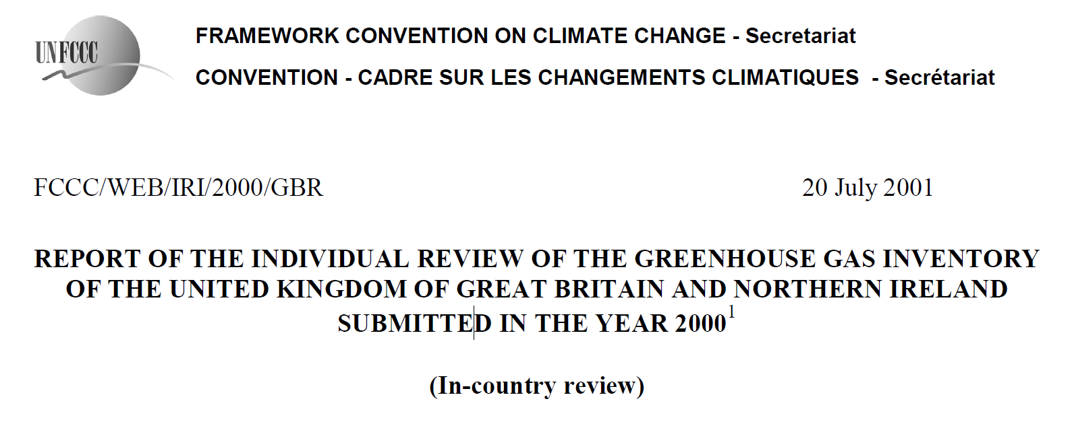

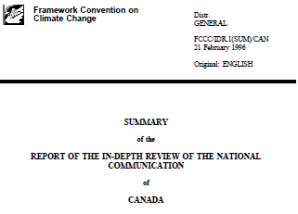
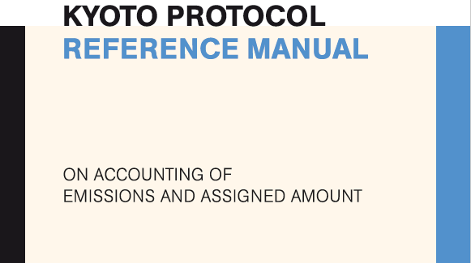

Building trust through MRV
Lead reviewers drive the implementation of MRV which improves climate change information, builds institutional arrangements and creates forum for global knowledge sharing.
1992
Convention
2015
1997
Paris Agreement
2018
2005
Marakesh Accords
2014
Cancun Agreement
Kyoto Protocol
COP 24
Paris Rulebook
1995
Reviews of AI NCs launched
2014
IAR launched
2007-2009
Initial reviews of KP
2016-2018
Negotiations on MPG for reviews and FMCP .
2014-2016
2001
Reviews of GHG inventory launched
True up period review of KP
2015
ICA launched
2011
TA of forest mang. Refer. level launched
Notes:
In 1995, 23 years ago NC reviews were launched and conducted by experts who were eager to support the process.
In this room we have 4 people who participate in NC1 reviews after 20 years are still in the process.
Could you guess, WHO are those people?
1995, Naoki (Matsuo) reviewed NC1 of CAN
1995 Katia – NC1 of Sweden and 1996, NC1 review of Norway
1997, Mahendra (Kumar) reviewed NC1 of Hungary
1996 Roberto – NC1 of Spain and in 1997, – NC1 of Russian Federation
Also 3 other expert are continue to serve as reviewers since 1996 – Wute (Thailand), Christo (Bulgaria) and Leonidas (Argentina).
In 2001 reviews of first GHG inventory were initiated (2000 GHG inventory submission) and 7 experts are still in the process.
Ole Kennev reviewed GHG inventory of the UK;
Javier Hanna (Bolivia), Ms Hongming Dong (China), Mr. Michael Gytarsky (Russian Federation), and Roberto - GHG of NZ
Ms. Sirintornthep Towprayoon (Thailand) was a reviewer in CRs
Ms Natalya Parasyuk (Ukraine), GHG review of AUS
In 2007 - Initial reviews in 2007 – 2009 and true up period review (compliance cases 2007-2016)
In 2011 - Technical Assessment of forest management reference level
2014 – IAR launched, 2015 - ICA launched
Paris rulebook expected in 2018

Slide 3

Third IAR cycle 2018-2019 (2021): milestones
The secretariat stands ready to coordinate 44 reviews from March 2018-March 2019 and conduct 3 rounds of MA. Yet 22 of reviews are subject to availability of supplementary resources.
MA3.1, sBI 49
15 Parties
MA3.2, SBI 50
14 Parties
MA3.3, SBI 51
15 Parties
Dec 2018
June 2019
Dec 2019
2018 Mar--APR
2018 MAY-JUNE
2018 AUG-SEP
2018 Nov – 2019 Mar
Batch 1
15 (6 CR and 9 ICR)
Batch 2.1
11 ICR
Batch 2.2
3 ICR
(Subject to supplementary funding)
Batch 3
15 ICR
(Subject to supplementary funding)
Notes:
3 review batches and 3 MA sessions
MRV system matured, enhanced - > the growth of pool of experts has not grew so fast. Overlapping Competition between the processes.
The younger sister – BUR – more attention.

Slide 4
BR3/NC7 reviews relay heavily on supplementary resources
22 core/ internally
22 supplementary resources
The IAR team is able to coordinate 22 BR3/NC7 reviews during the biennium review cycle (March 2018 – March 2019) from the core UNFCCC secretariat budget.
The remaining reviews, could be conducted only upon receipt of the supplementary funding.
For the remaining reviews, the review coordinators from other units/programmes are involved (subject of pioritization of tasks) and consultants (subject to supplementary funding. This implies larger coordination efforts to ensure consistency; and longer learning curve of new review coordinators to ensure quality.

Slide 5
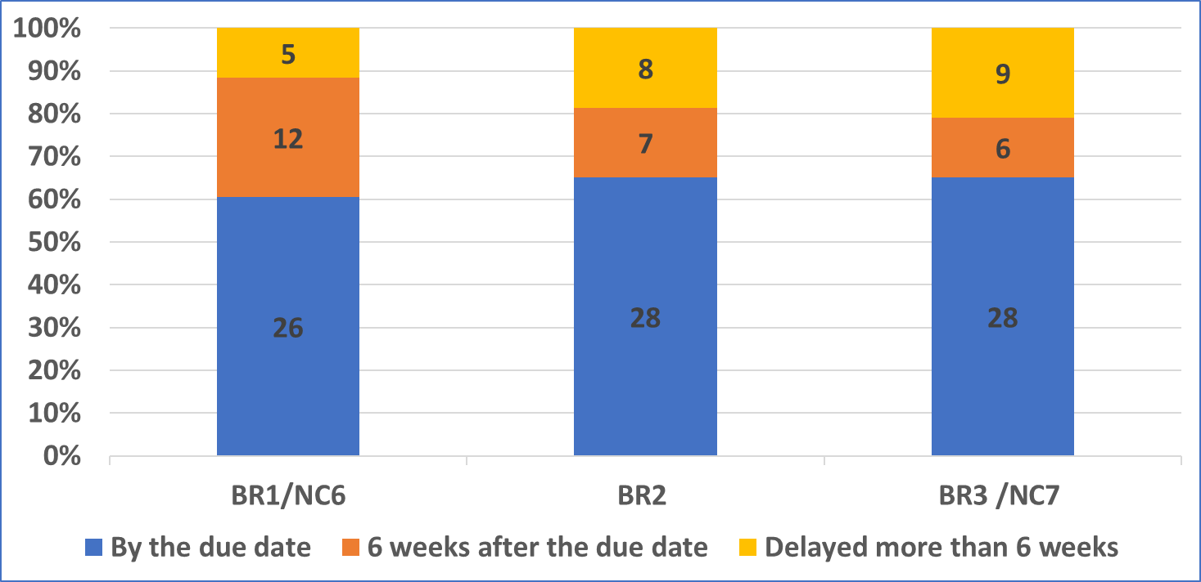
Challenges in timely submission remain
About 60% of BR3/NC7 was submitted by 1 Jan 2018. Delay in submission hampers the preparation for reviews, especially for the organization of the CRs, when several Parties are reviewed during the same week in the 1st half of 2018.
Notes:
64% was on time, 15 Parties where late in BR3 submission.
BR CTF3 – only a few queries: learned, CTF advanced/user friendly/more guidance.

Slide 6
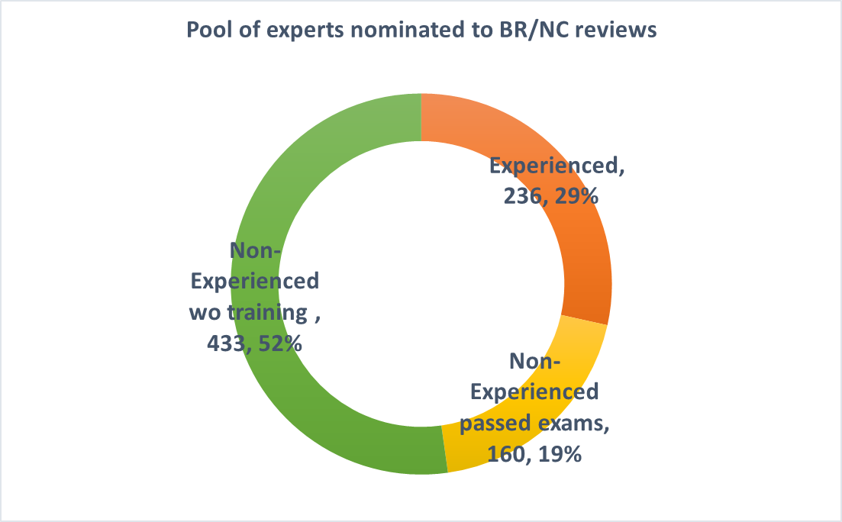
Challenges in sustaining the pool of experts
Only ¼ of pool of experts in RoE nominated for BR/NC reviews is qualified
and willing to participate in the reviews.
Half of all experts are non-experienced experts who have not enrolled in the BR/NC training programme and thus are not eligible for review;
Notes:
Identified 2 possible reasons:
1: “ Resistant to take training courses” -> how to encourage “new experts” to take courses/exams

Slide 7
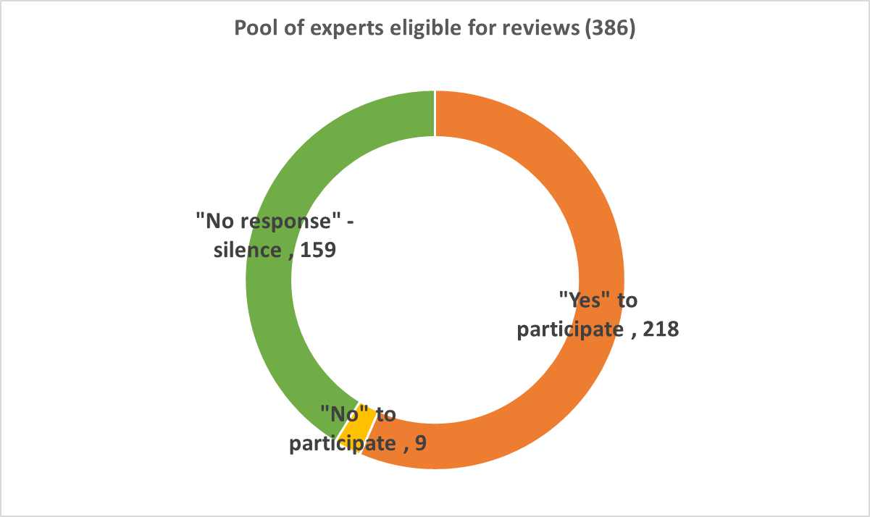

Challenges in sustaining the pool of experts
Only ¼ of pool of experts in RoE nominated for BR/NC reviews is qualified
and willing to participate in the reviews, as:
1/5th of BR/NC experts pool is “silent”, has not responded to the survey, either because of no interest or due to incorrect contact details.
Notes:
2. No interest / no reach
Q: How to update the list of experts ?

Slide 8
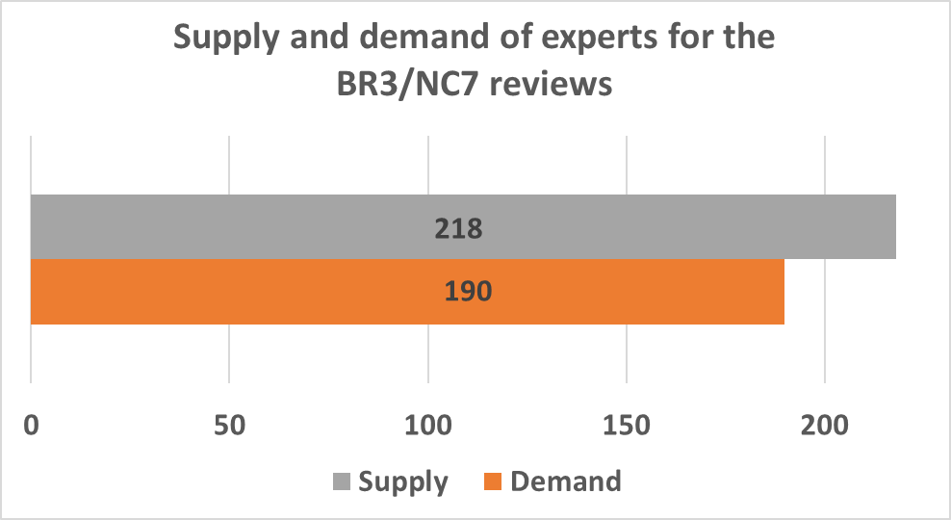
The number of experts should be increased
In total supply (218)
meets the demand
for BR3/NC7 cycle (190)
To ensure sustainability of the pool the number should be increased, in particular taking into account:
  competing review process where the same experts are involved (BURs, GHG);
  level of turnover of experienced experts;
  optimal ratio of non-experienced/experienced experts in an ERT (40/60);
  decline rate due to the clashing priorities.

Slide 9
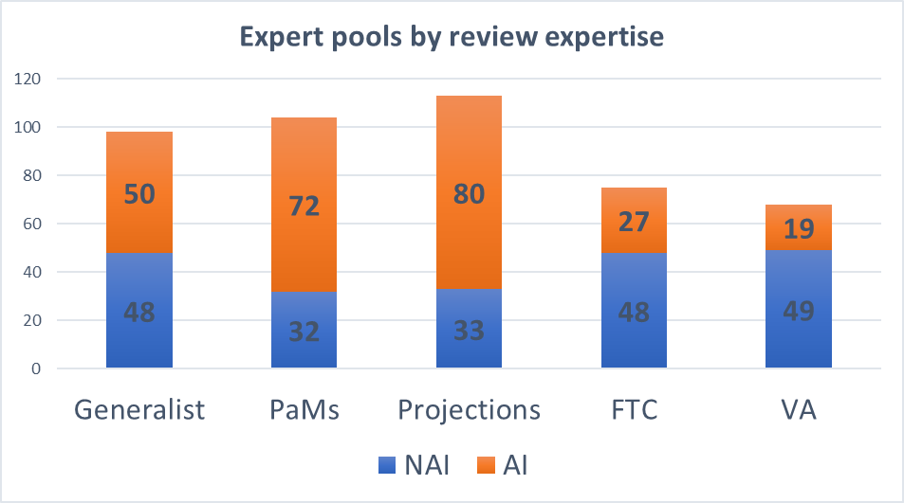
ERT composition: unequal distribution among the review expertise
Many experts who are willing and qualified to participate on BR3/NC7 review have multiple expertise.
PaMs and Projections experts come mostly from AI experts, while FTC and V&A experts come mostly from NAI.
Notes:
Many experts who are willing and qualified to participate on BR3/NC7 review have multiple expertise. largest pools for PaMs and Projections, less for V&A and FTC.
Consider more nominations (and the capacity building) of NAI experts in projections and PaMs.
This unequal distrubution should be considered while balancing the ERTs.

Slide 10
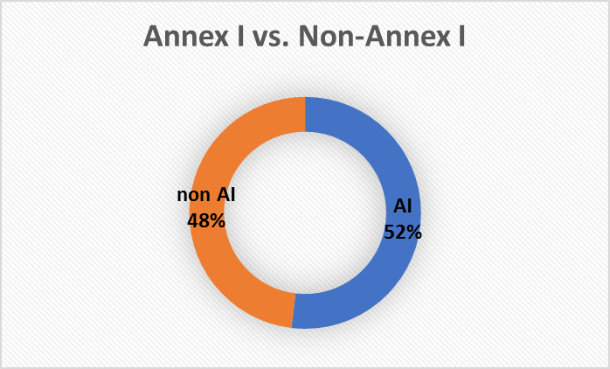
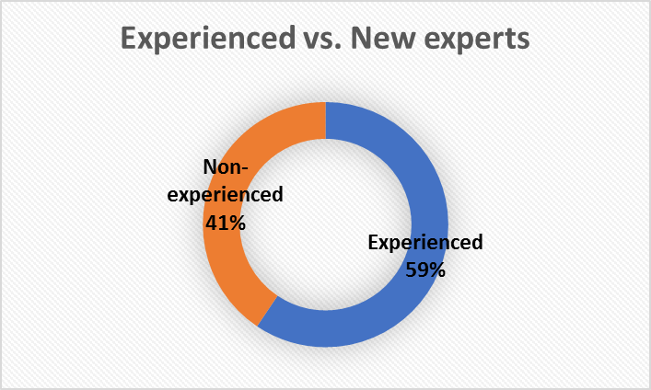
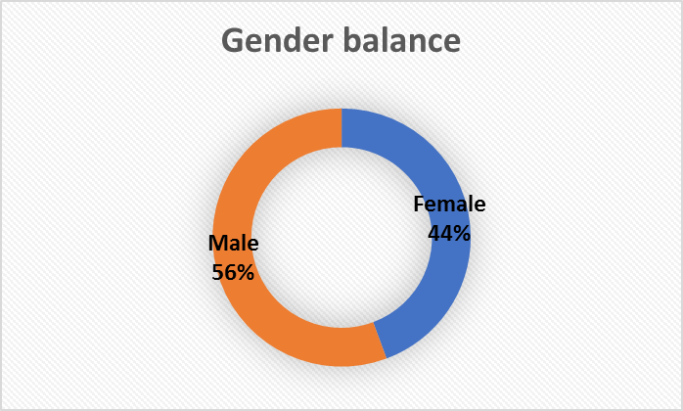
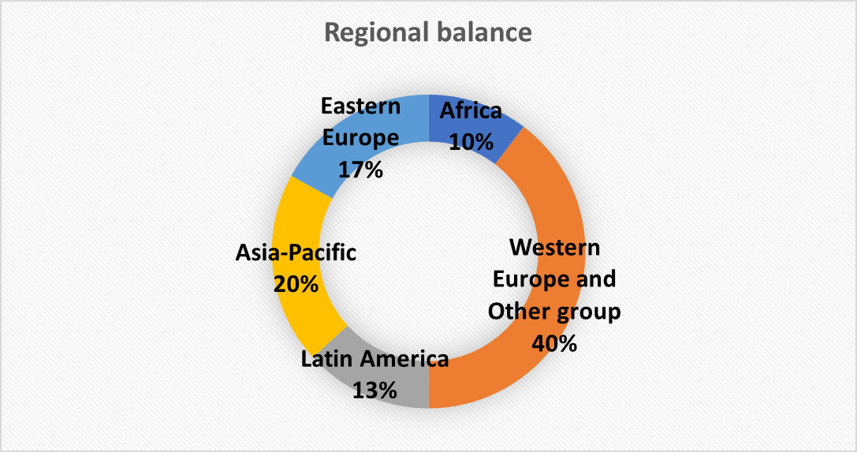
ERT composition: balance during 1sthalf 2018, 106 experts
Notes:
ERTs:
AI/ NAI
Gender
Experience/non experience (60/40) –Language – English
Regional balance - SIDS and Africa – little in the available and willing
Q for LRs - what is the best ratio of new experts? More experienced/ less new? Increased from 20% to 40% new BR2/BR3

Slide 11
Conclusions - points for consideration by LRs
Encourage Parties to submit on time, as delay of submission hampers the preparation of reviews
Encourage Parties to provide supplementary funding for BR/NC reviews, as 22 BR3/NC7 reviews are subject to availability of supplementary resources.
Note that the ERTs for the upcoming reviews are set in a balanced way taking the available and willing to participate experts.
Note the need to increase a pool of qualified experts, as only ¼ of pool of experts in RoE nominated for BR/NC reviews is qualified and willing to participate in the reviews.
Notes:
4 points: .
1. Delay submissions,
2. Need for supplementary funding for 22
3. Balanced ERTs
More experts are needed

Slide 12
Conclusions - points for consideration by LRs
The ways to increase the pool of these experts could be:
  To encourage National Focal Points to:
      nominate experts who are involved in national reporting; monitoring, so that the respective government could benefit from the expertise gained and capacities build to the experts during the reviews;
      to update the list of experts, leaving only those able to participate in reviews;
  To encourage experts who are nominated to the RoE:
      to participate in the training programme (September 2018);
      to update their contact details on the RoE

Slide 13

Thank you very much for your attention!

