Slide 1

17th Facilitative Sharing of Views Workshop
1st BUR
Guatemala

Slide 2
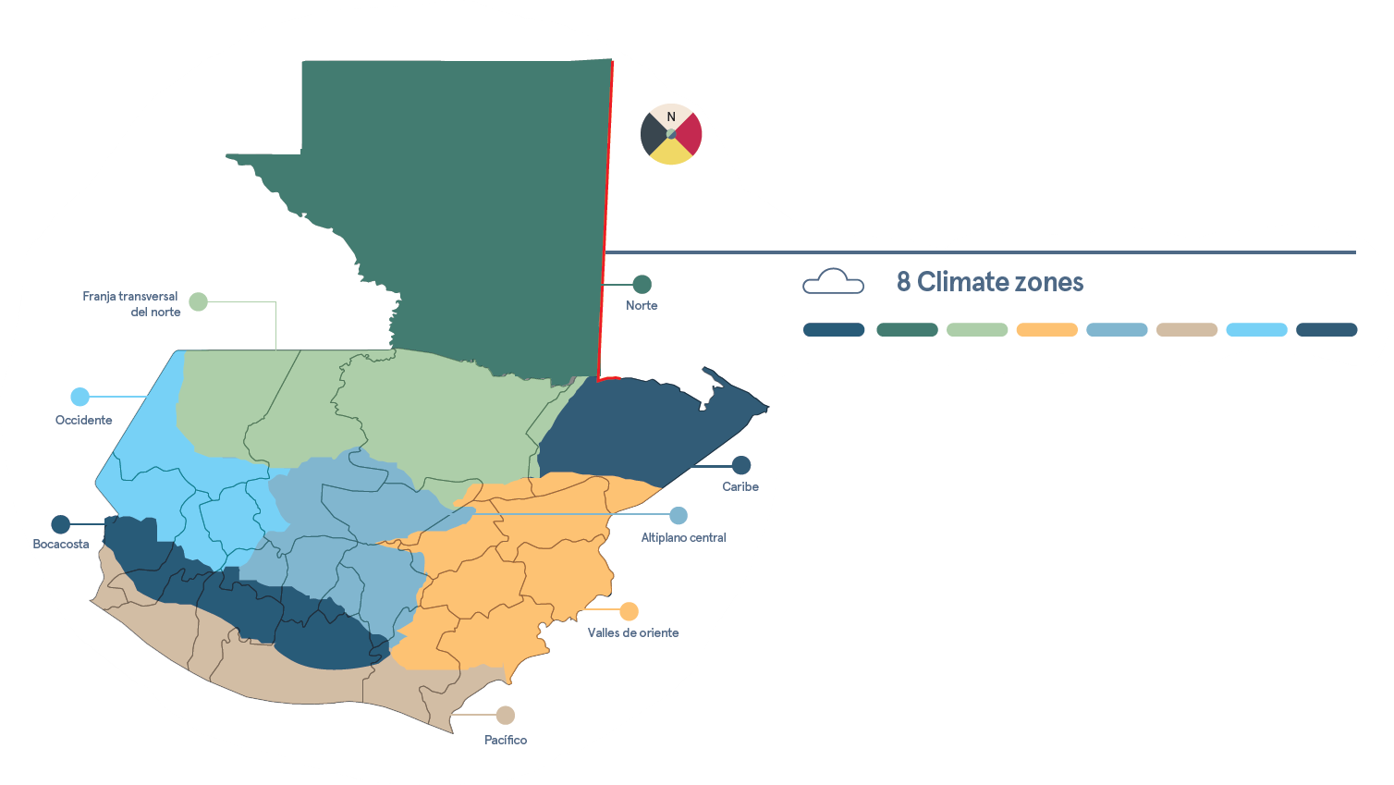

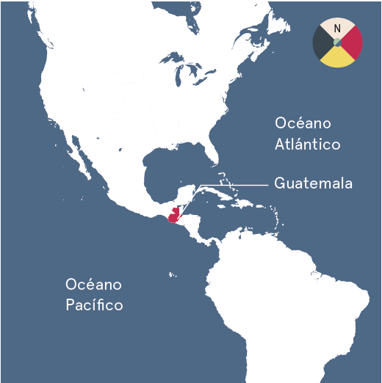






National
circumstances
8 Climate zones
Territorial extension
108,889 km² land + 120,229 km² marine extension
Population
46.2% rural areas
53.8% urban areas
16,346,950 (2021)
Main economic activities
Forest
17.6% manufacturing industry
15.9% private services
13.4% agriculture, livestock, forestry and fishing.
3,574,244 ha
33% of land covered by forest
Main exports
15.9% coffee
13.4% cardamom and banana (ea.)
10% clothing

Slide 3
National circumstances
Institutional arrangements
Climate Change Framework Law
(Decreto 7-2013)
National Climate Change Action Plan (PANCC)
National Council of Climate Change (CNCC)
National Inventory System (SNIGT)
National MRV system
(SNICC)
Sectoral Work Tables

Slide 4
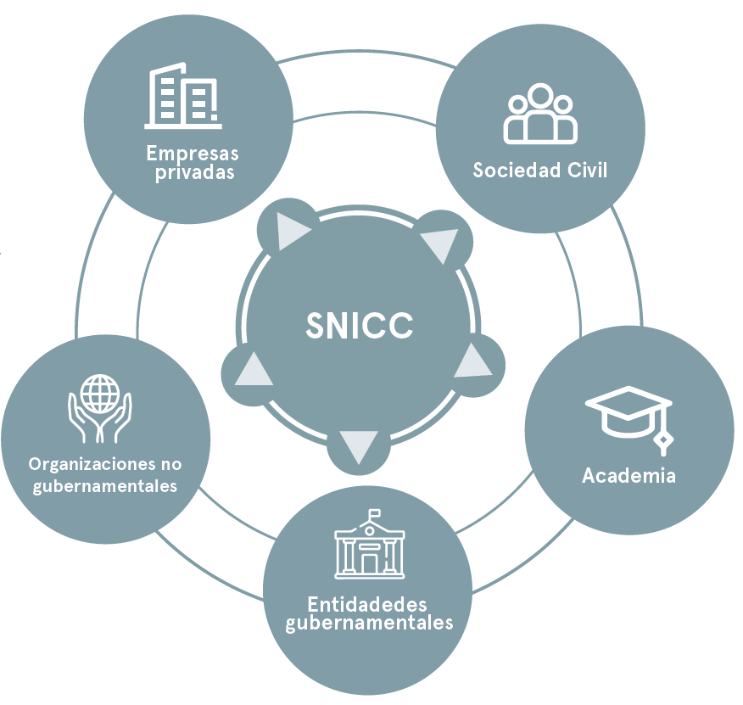




National MRV System
4 sub-systems
Private sector
Information about climate sciences
Information about vulnerability and adaptation
Civil society
Information about support recieved and requiered
Information about GHG emissions
NGOs
Academia
Government

Slide 5

2018
GHG
INVENTORY
CO₂
HFC
CH₄
N₂O

Slide 6
2018 GHG INVENTORY
Comparison to 2005 emissions
Increased by 65.5%
Increased by 100.3%
Increased by 13.9%
Decreased by 6.7%
Increased by 65.5%

Slide 7
Mitigation actions
Nationally Determined Contribution
LEDS
National Climate Change Action Plan
National Energy Plan (2017-2032)
Energy Efficiency Plan (2019-2032)
LUCF
AGR
ENE
MS
National policy on cattle ranching
National strategy for sustainable and low emisión cattle ranching
REDD+ strategy

Slide 8
Support recieved (2015-2020)
USD 332 mil (approx.)
50% adaptation
19% mitigation
31% crosscutting
90 projects
Support needed
Institutional arrangements and policy measures
MRV and data generation systems
Capacity building on new mechanisms
Financial support to implement actions

Slide 9
ETF transition and implementation
Support recieved through programmes (CBIT-GSP, ICAT, etc.)
Capacity building proyects (CBIT)
ETF
NDC-specific
reporting system addresing implementation
MPGs transition process (MARN team)

Slide 10
Thank you!

