Slide 1
Capacities for Rights-based Climate Action Day
Refugee Women for Climate Action

Slide 2
SEEK Feminist Network Research to Response
SEEK
Women and Climate Change
Projects
I Am Because We Are: Our Climate Stories
CoFe Tables: Feminist Leadership for Climate Justice

Slide 3
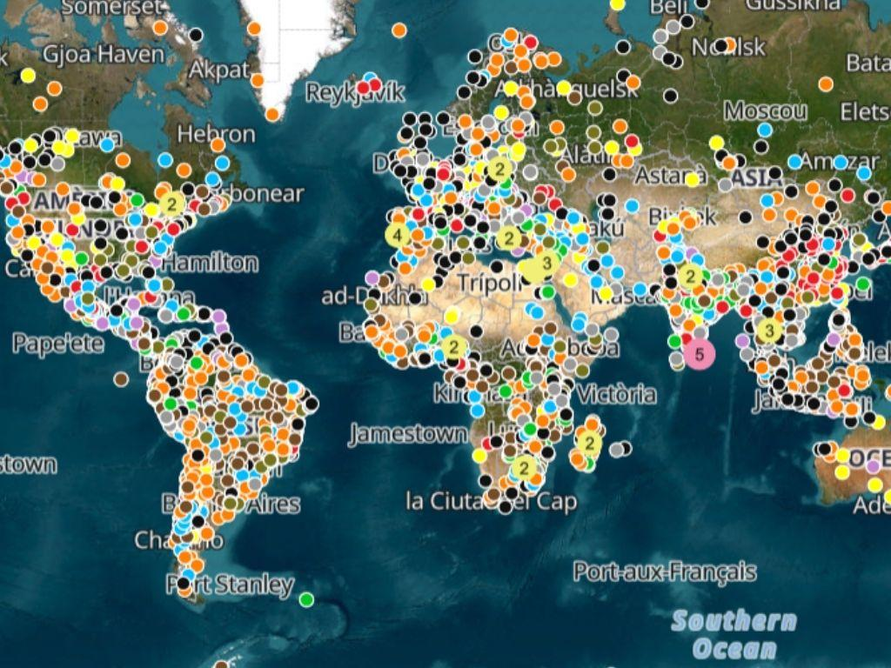
SEEK Feminist Network Research to Response
Systematic challenges - Climate Change
Environmental Degradation - Climate Change

Slide 4
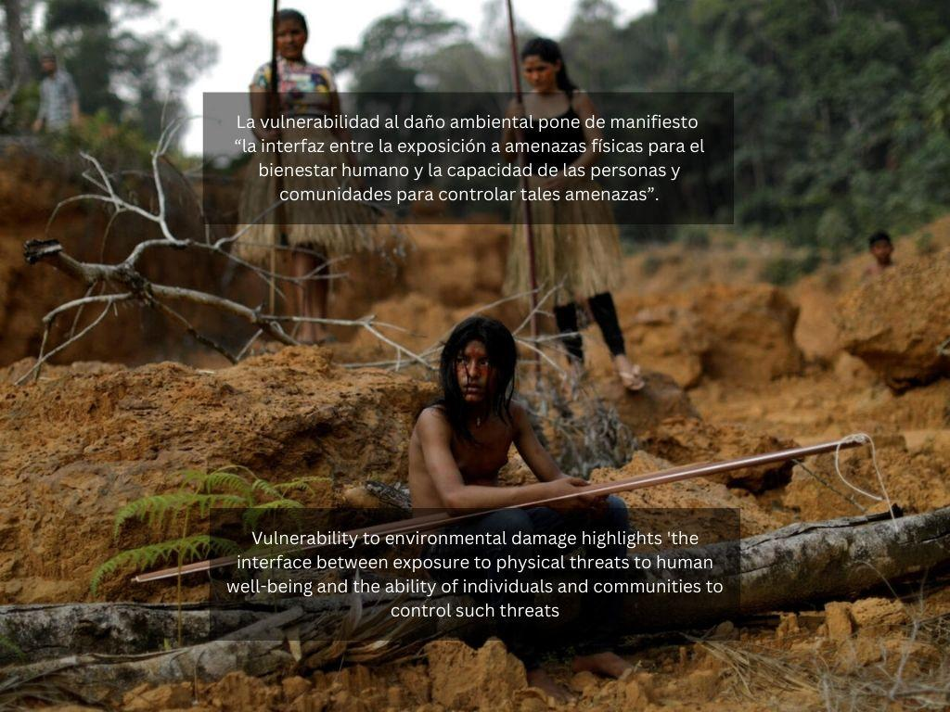
SEEK Feminist Network Research to Response
Systematic challenges - Climate Change
Environmental Degradation - Climate Change.
Vulnerabilities

Slide 5
SEEK Feminist Network
Standing Strong
as
AN OAK TREE
https://youtu.be/GWw6R7GYfog

Slide 6
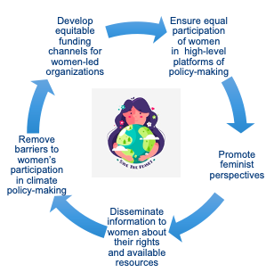
SEEK Feminist Network Research to Response
Preparedness:
- Adaptation:
We Adapt …
Do we Need Support?

Slide 7
SEEK Feminist Network Research to Response
Climate Justice – Human Rights
SEEK Research to Response Network Website: Home | SEEK | Feminist Research Network | Netherlands Find us on Facebook, Twitter, Instagram, LinkedIn & Youtube

