Slide 1


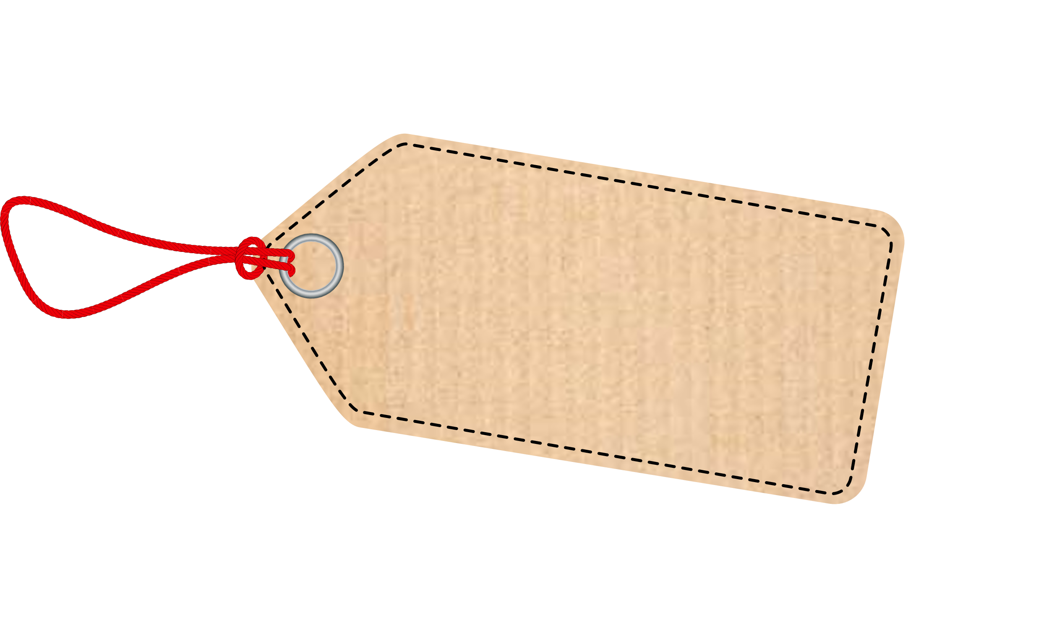





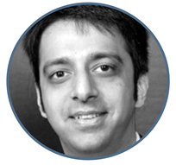
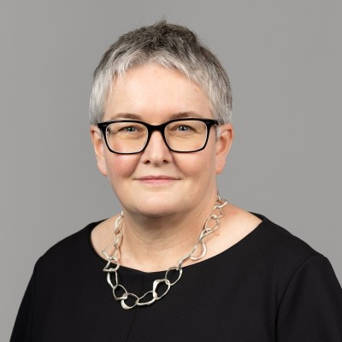
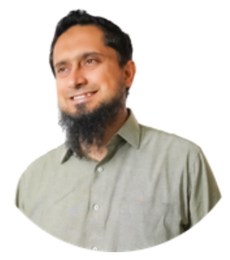
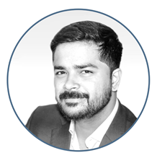
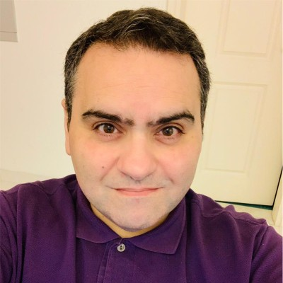





Impact investing
with precision and purpose
based on sound accounting principles
Rakesh Vazirani
Head of Sustainability Services
Business Stream Products
Helen Brand
Chief Executive
Saqib Sohail
Lead, Responsible Business Projects
Jayanth Kashyap
Investment Lead
Khaldoun Hajaj
Head of Government Affairs,
Middle East., Africa and Pakistan

Slide 2
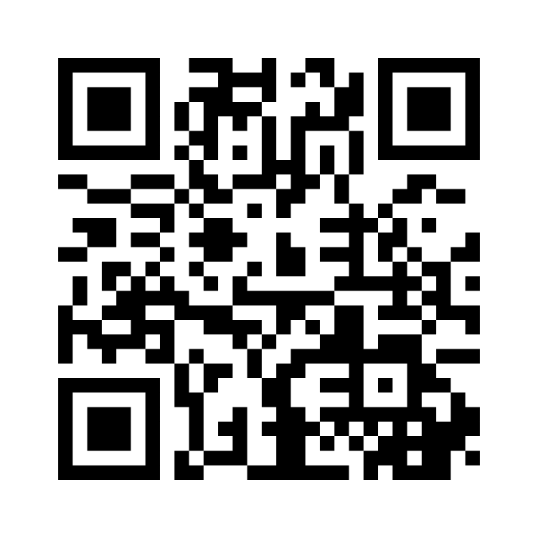
About you > please scan this code

Slide 3
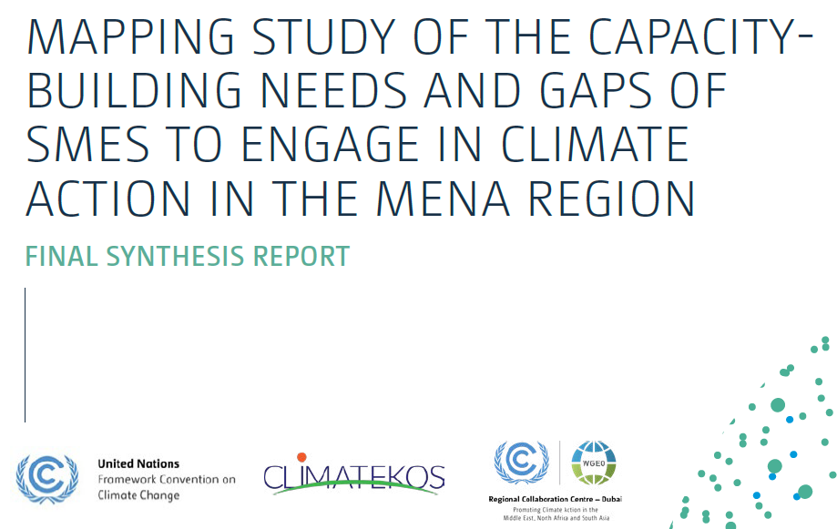
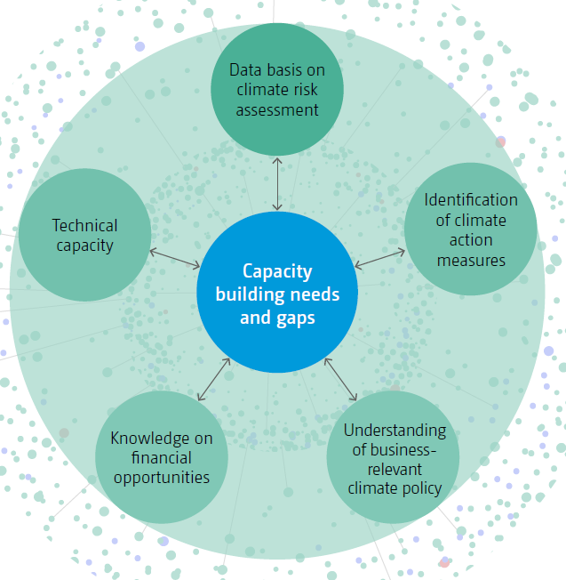
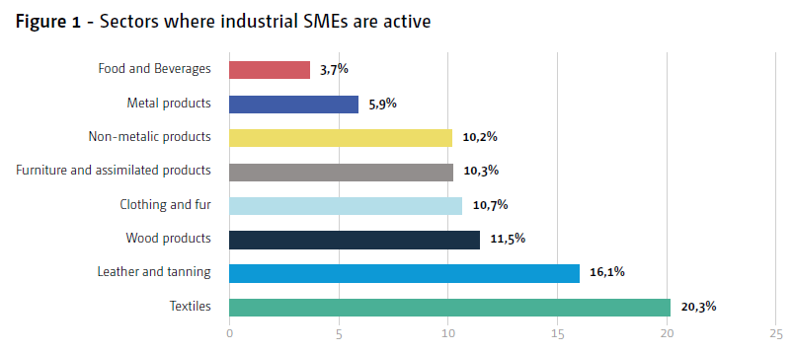
Out context

Slide 4
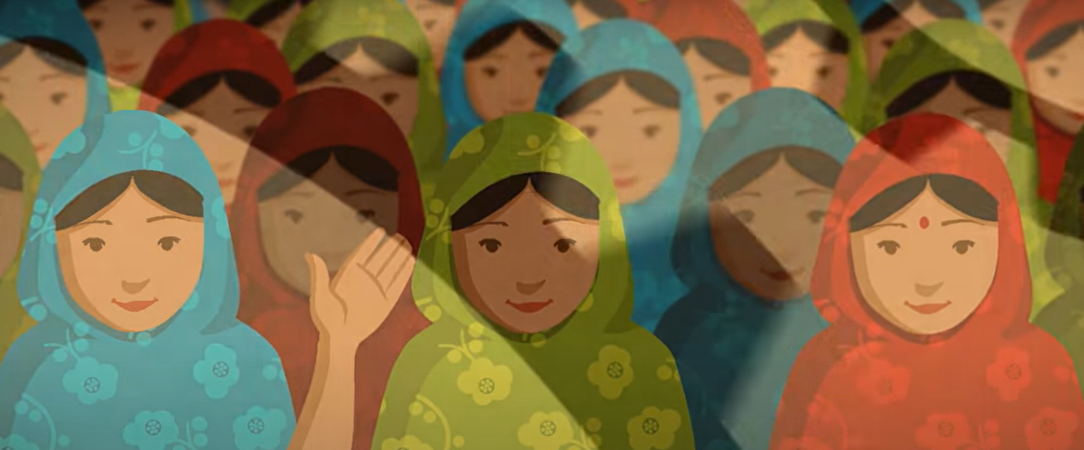

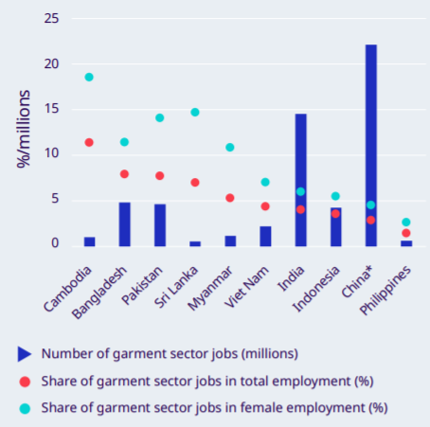
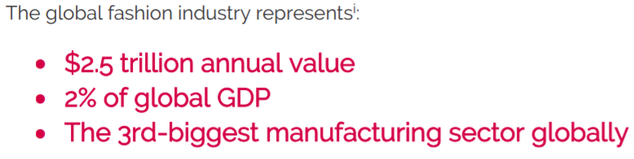
Fashion Industry : Impact
Image Source : Danish Fashion Institute
Image Source : ILO, 2019
Notes:
Its essential to start looking at the purpose of our industry and its impact.
This is what it does
It produces the wonderful products that allow people, allows all of us to express ourselves, our feelings, and is one of the factors that makes us feel good

Slide 5
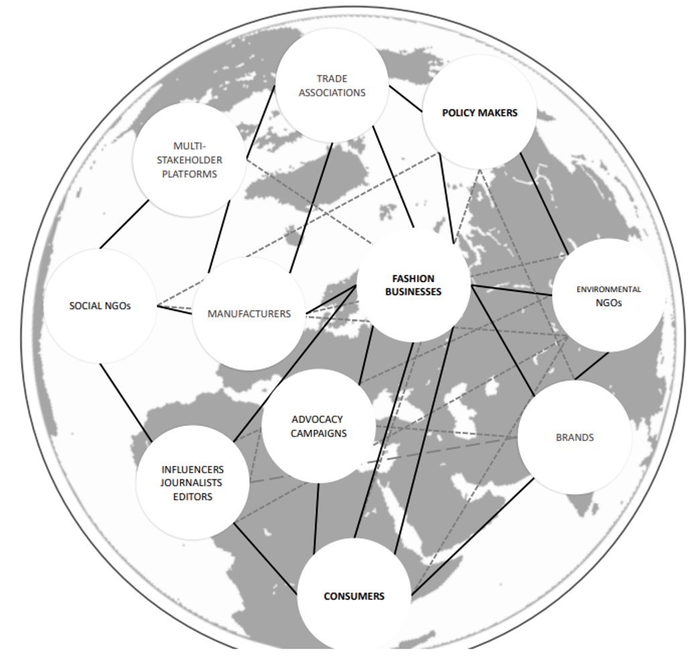
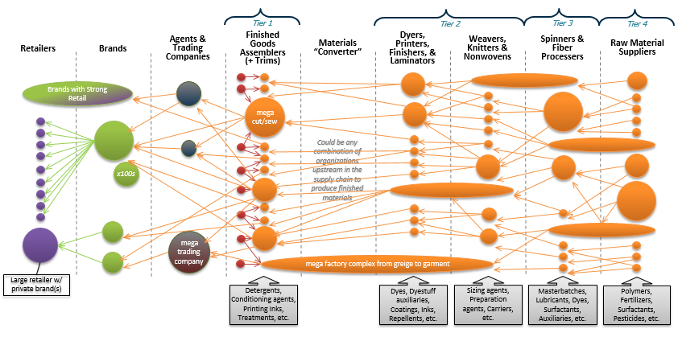
The Fashion Industry is also …
Image Source : Link
created by Matt Thurston, REI, with further modifications from OIA

Slide 6
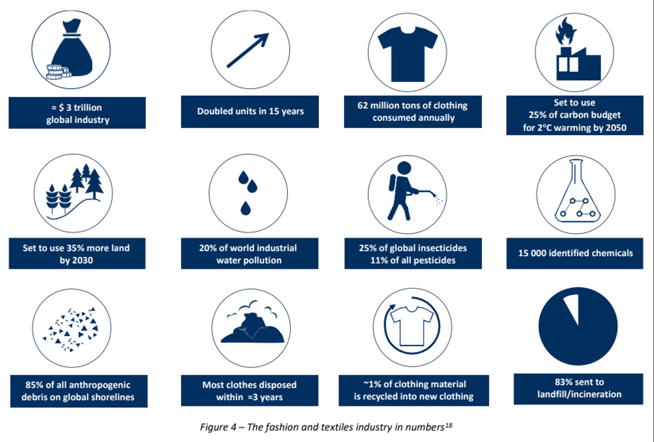
Impact in numbers
Image Source : Stockholm Resilience Centre

Slide 7
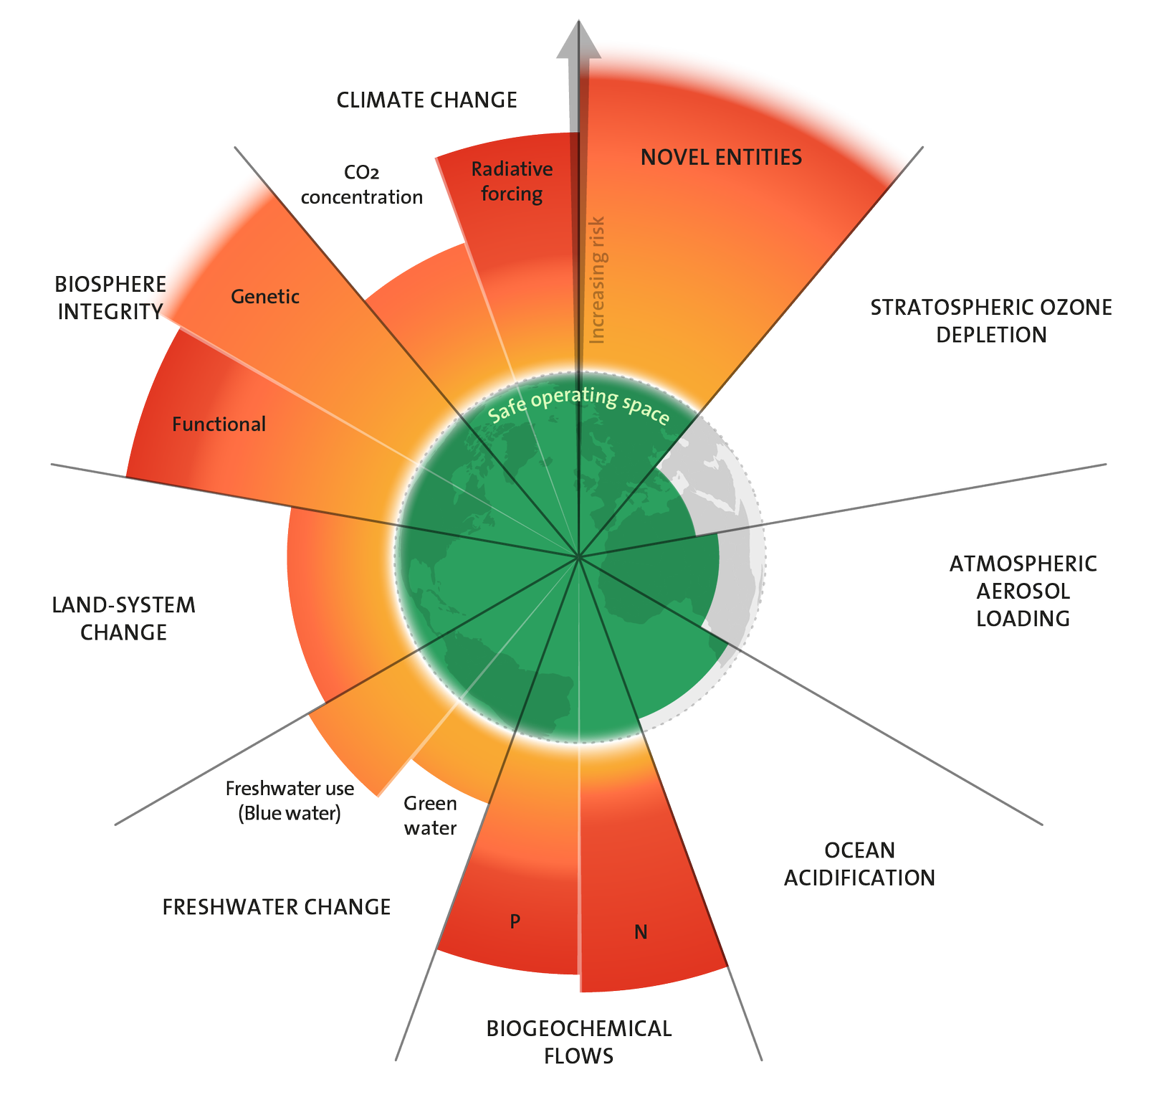
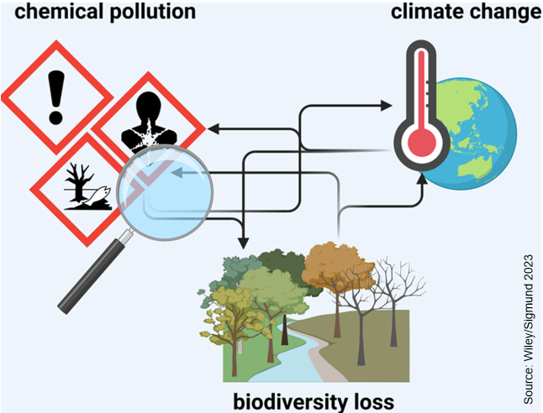
Impacts to/from triple planetary crisis
Image Source : Link

Slide 8

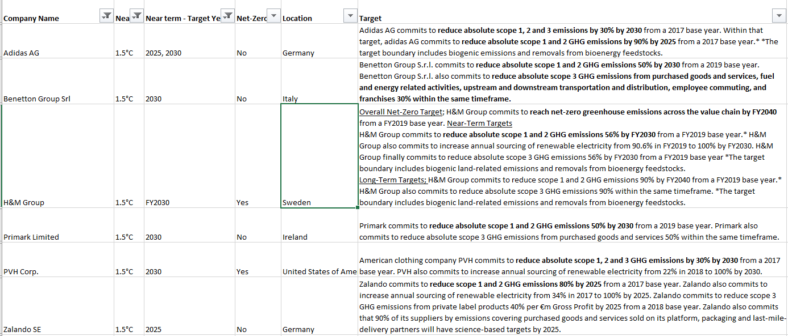
Carbon Related Targets (partial)

Slide 9

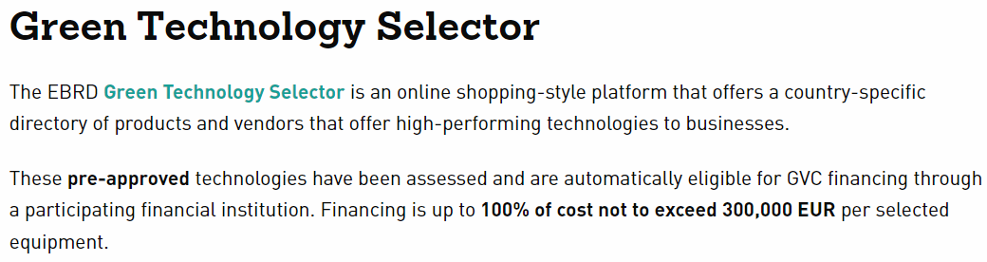
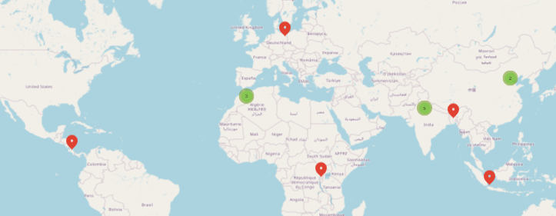
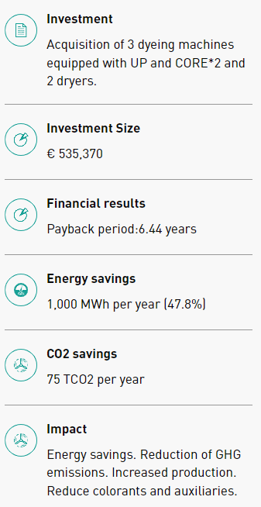
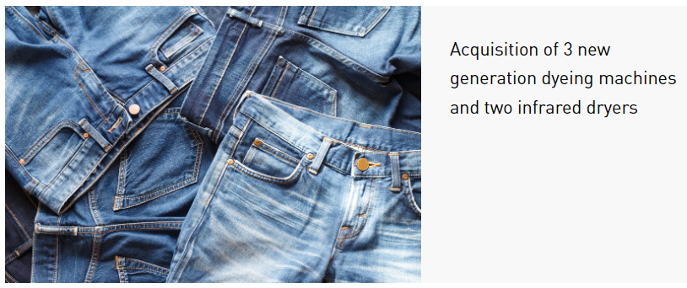
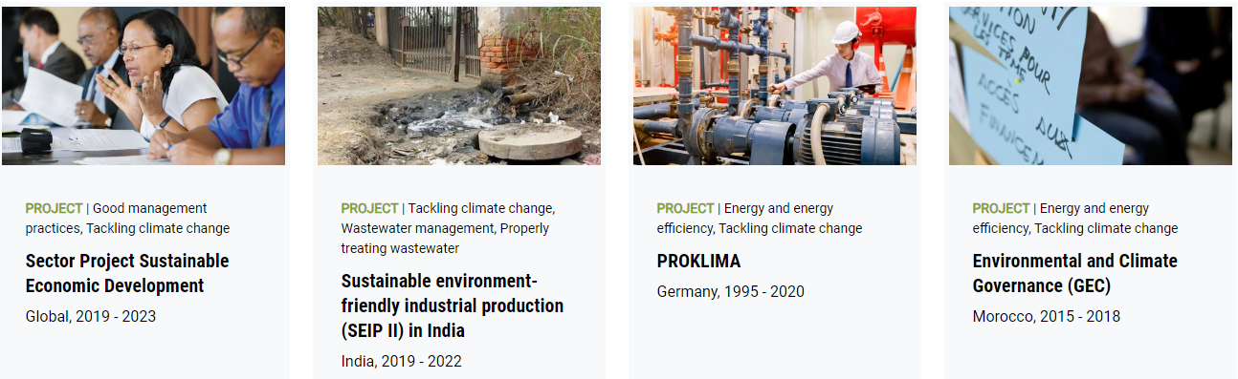

What about the technology & Knowledge ?

Slide 10

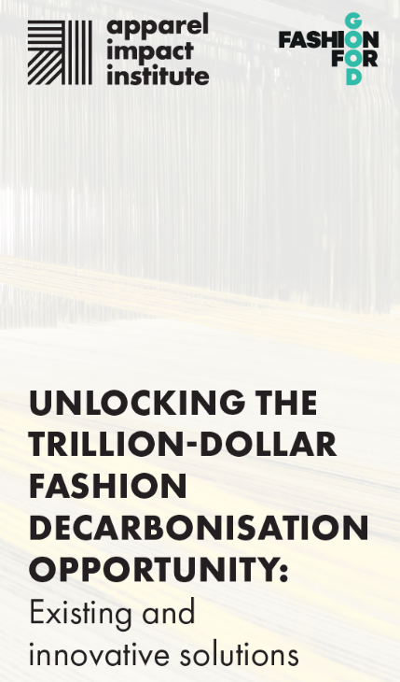

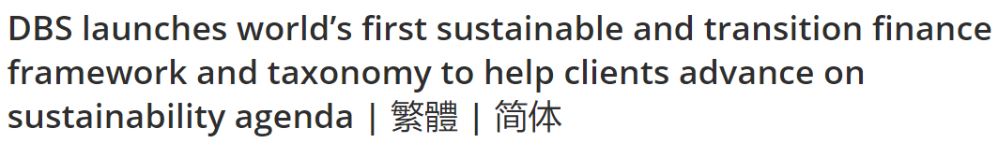
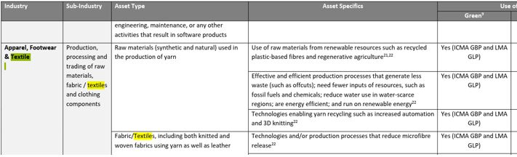
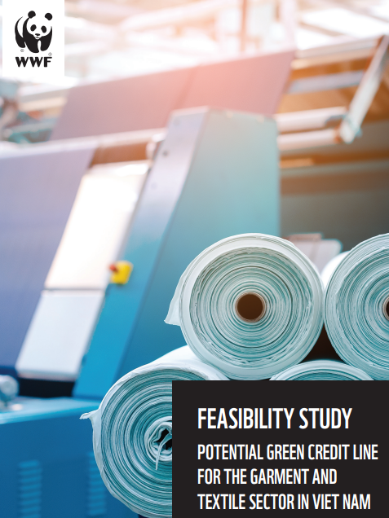
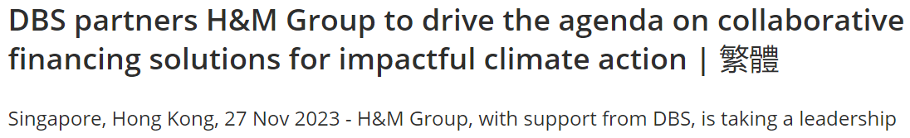
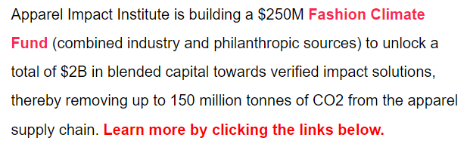
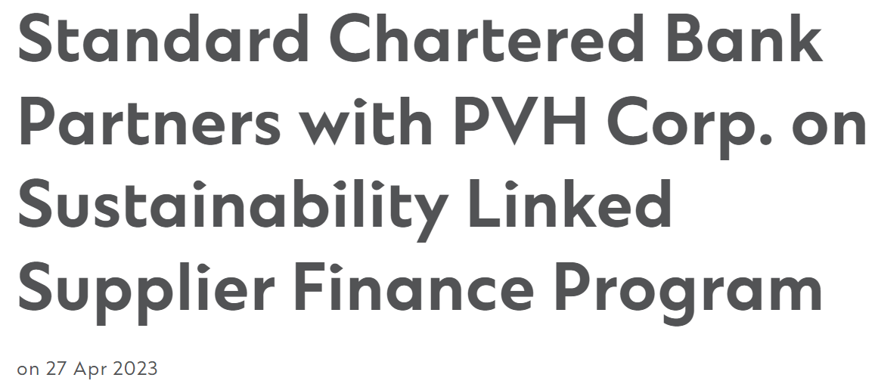
Possibilities for Green Finance

Slide 11

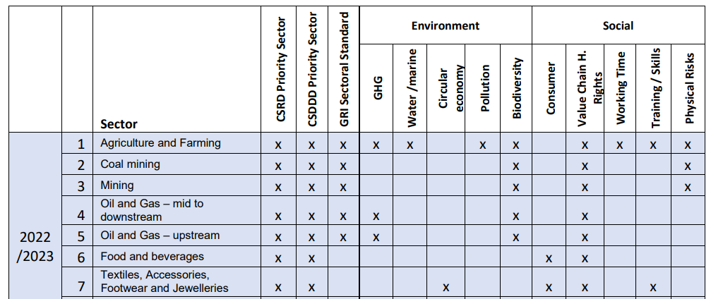
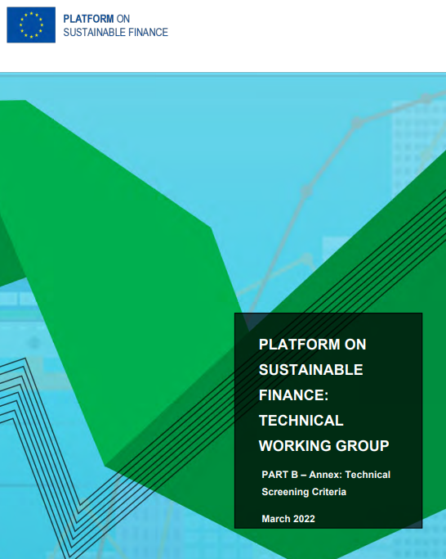
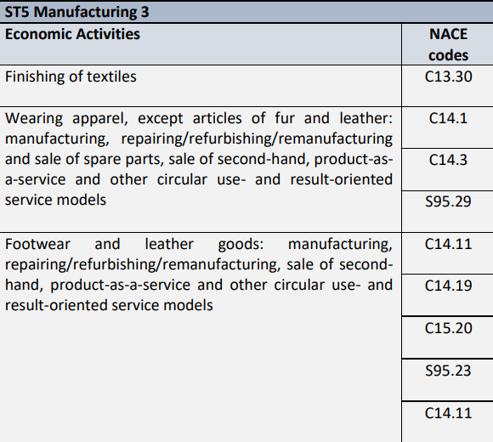
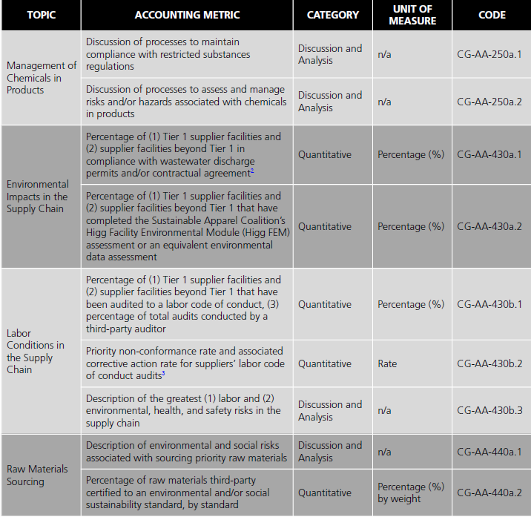
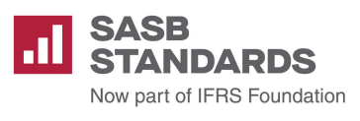
Framework for money $€

Slide 12
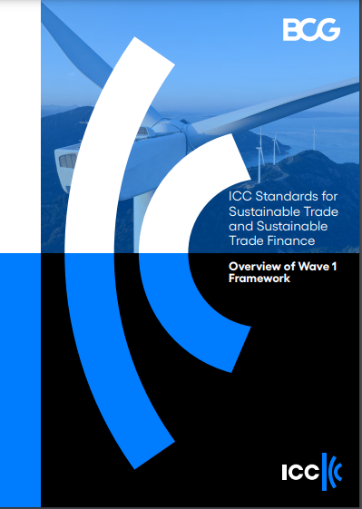

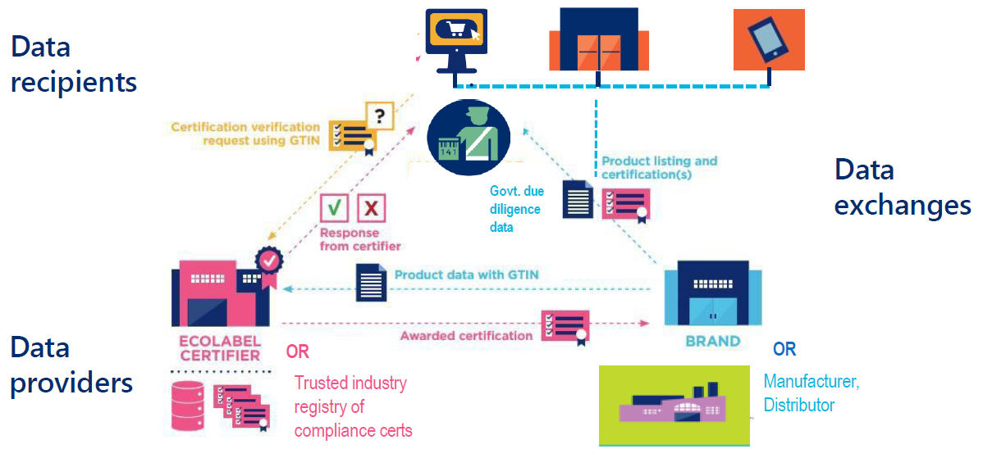
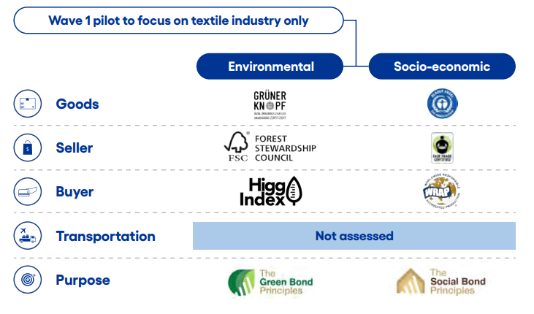
Sustainable Trade & Sustainable Trade Finance

Slide 13


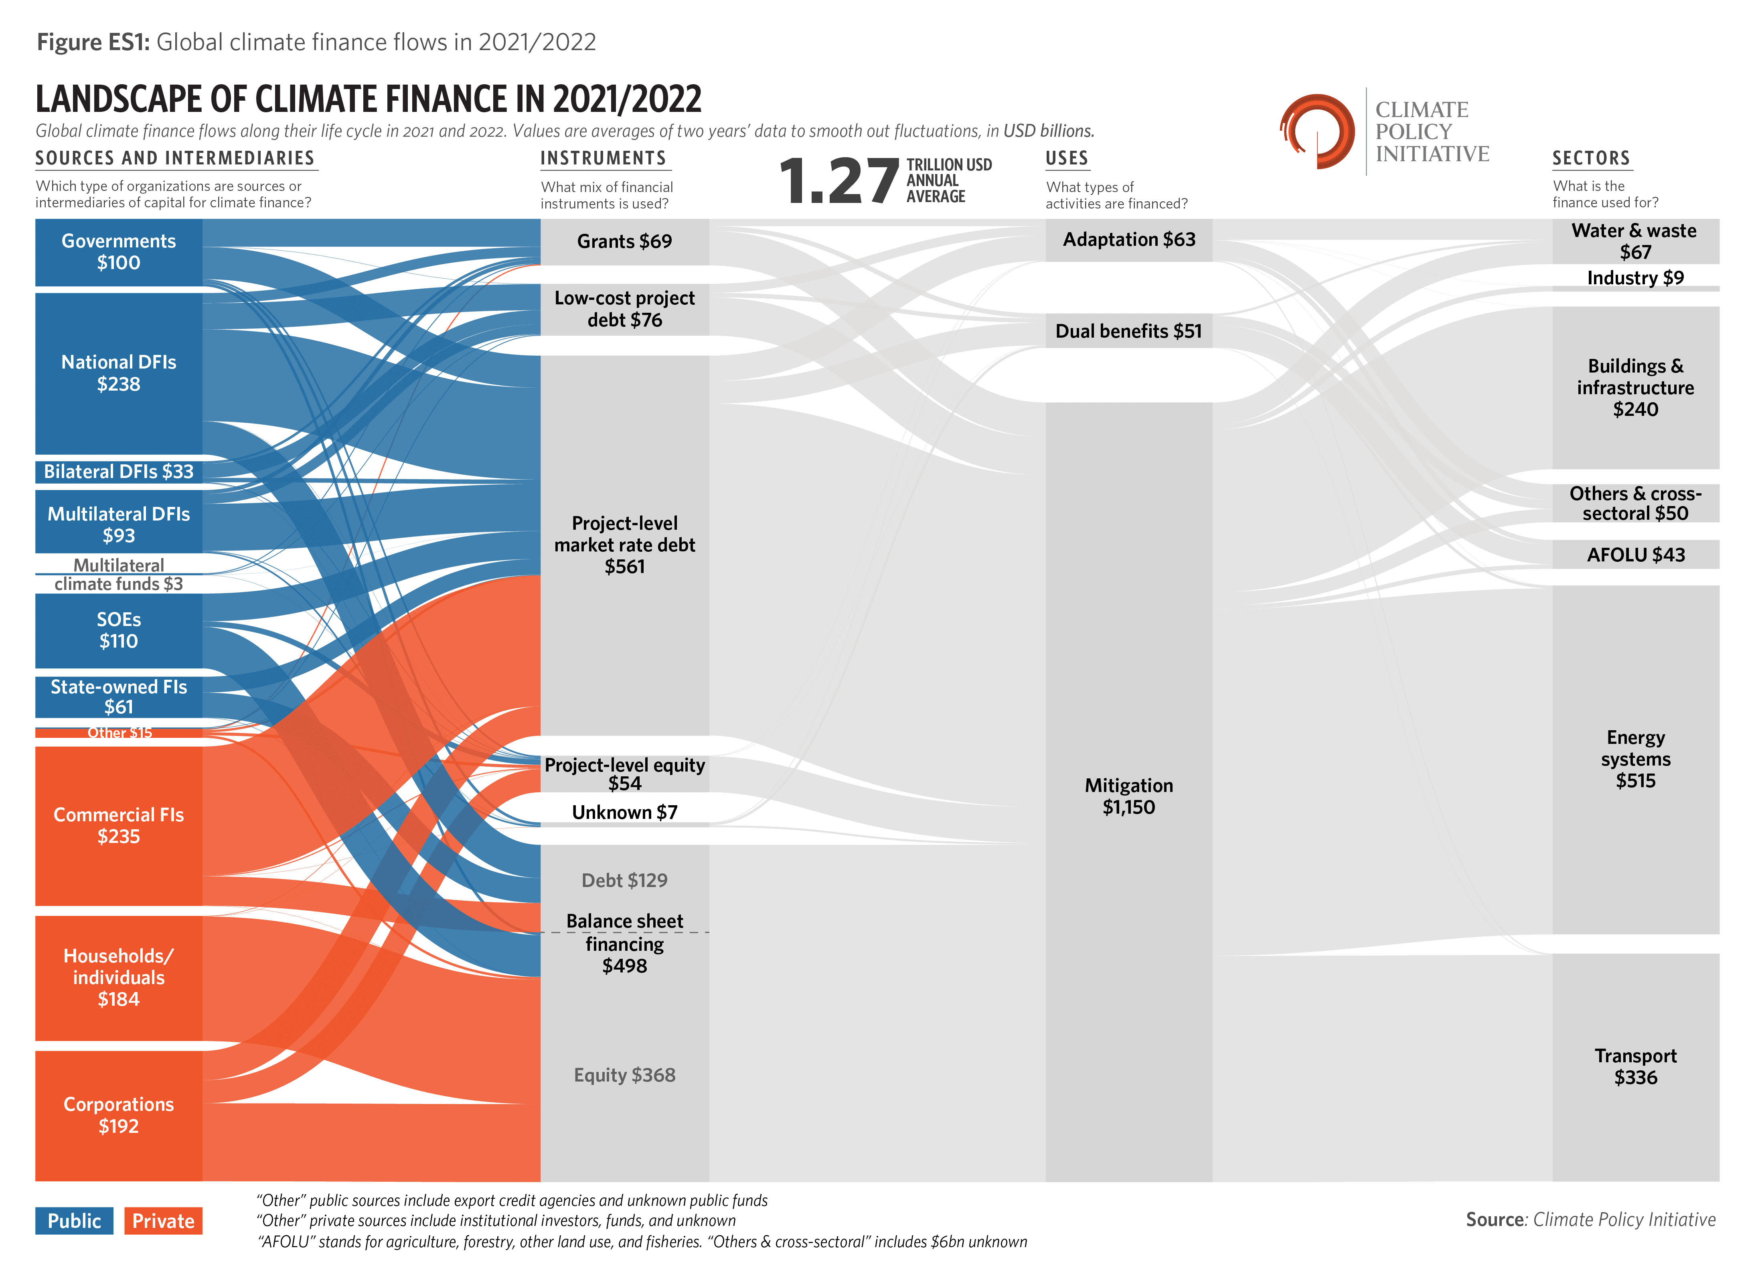
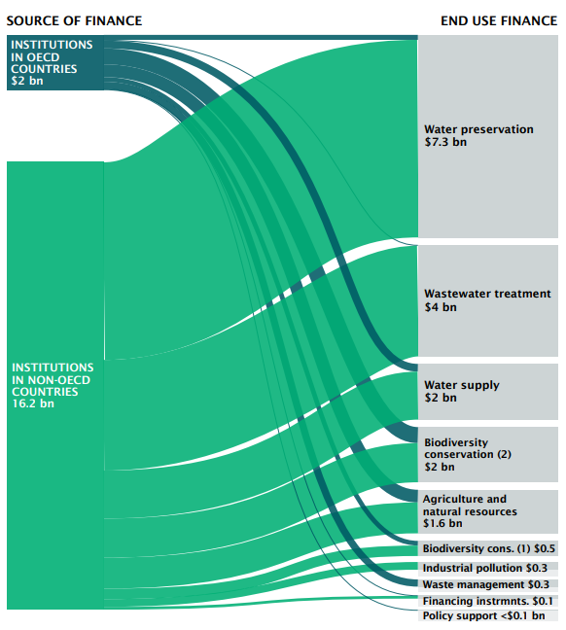
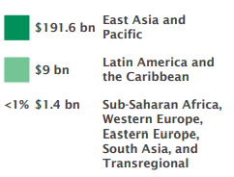
Show me the money !

Slide 14
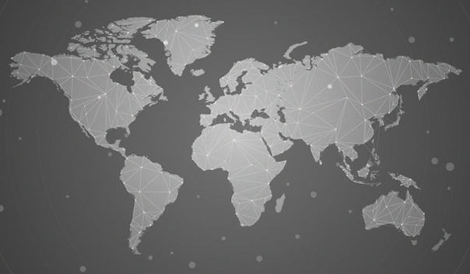

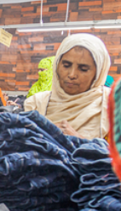
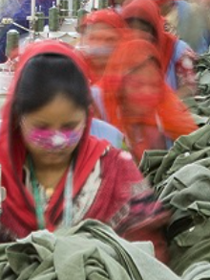
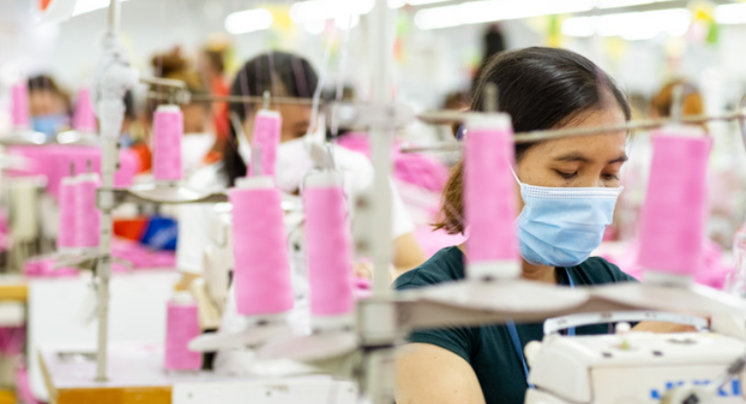
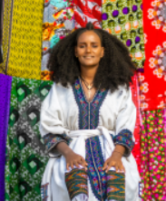
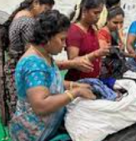
Samiha’s
Factory
Amal’s Factory
Chu’s
Factory
Ayotola’s
Factory
Ramaswamy’s Factory

Slide 15
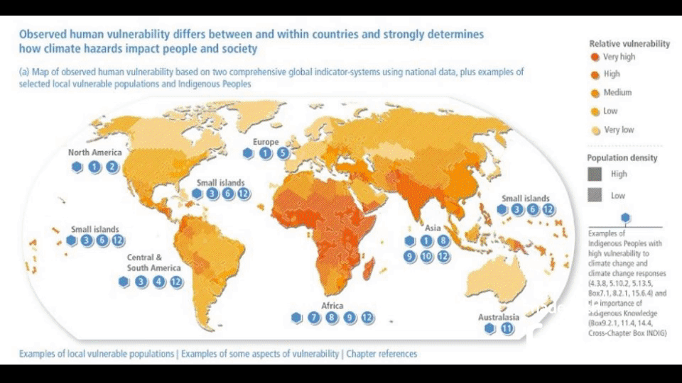

Slide 16
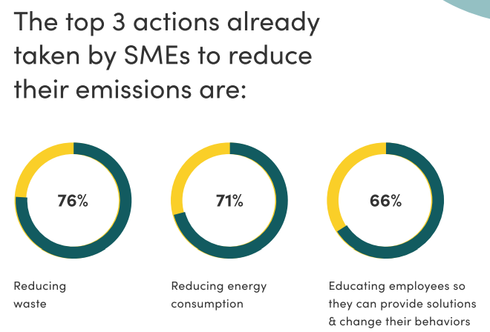



Slide 17


Slide 18



CLIMATE CHANGE MITIGATION PORTFOLIO
$ 100 million
invested
100 MW
wind energy operational
15% energy
from solar
16,000 Tonnes
CO emissions mitigated yearly
2
Net Zero by
2040

Slide 19





GRANT
500,000 Euros Grant awarded to AM & Retraced
250,000 Euros for MCI & MO over 4 years
Project Objective: Implementing a digital application to enable socio-ecological transparency across Pakistan’s cotton supply chain
The App will serve as a knowledge hub for sustainable cotton cultivation bringing farmers together and building a community to tackle future challenges in cultivating cotton together.
The following measures will be implemented:
• Preparation and adoption of Smart Farming
• Enable data sharing with existing systems - Traceability
• Training/capacity building for Alternate Livelihood
9

Slide 20


Slide 21


APPAREL IMPACT INVESTMENTS IN SOUTH ASIA
06 December 2023 | 5th Capacity Building Hub

Slide 22


Introduction

Slide 23














Only global impact investment fund focused on apparel manufacturers
Fund manager and partners
Fund manager
Anchor investors
The Laudes Foundation
The Mills Fabrica
Rabobank
Financial instruments
Financial instrument
Transaction size
Geographic focus
Long-term USD Debt
$1-2.5m
Focus India and Bangladesh

Slide 24




The textile industry challenge
Initial aim: GFF works with three key stakeholders to maximize impact
For manufacturers:
Sustainable production
Cost savings
Increased access to finance
Enhances reputation/visibility
Premium project?
Technology providers:
Accelerates roll-out and adoption of sustainable technology
Speed up of disruptive technologies
Technology provider
Technology
provider
Brands:
Long term offtake commitments
Greener, fairer supply chain
Supply chain responsibility
Drives
tech adoption
Provides long-term
finance for manufacturers
Supply chain improvement at no cost
Brand
Manufacturer
Brand

Slide 25






We finance equipment in the apparel manufacturing process
Investments related to capital-intensive and high-impact equipment, focus on
(i) wet processing & finishing stage like dyeing, washing, printing and finishing
_{(ii) wastewater treatment}
_{(iii) recycling}
Target investments
Other picture
Dyeing
Washing & pre-treatment
Wastewater
Printing & finishing
Recycling
E.g. cold pad batch dyeing
E.g. low liquor bleaching, cold pad batch bleaching
E.g. biological & reverse osmosis filtration
E.g. digital textile printing
Mechanical (and chemical) recycling solutions

Slide 26


Thank you!
Bob Assenberg
Fund Director
bob@goodfashionfund.com
Jayanth Kashyap Balasubramanian
Investment Lead
jayanth@goodfashionfund.com
Good Fashion Fund C.V
201 Herengracht 1016 BE
Amsterdam, The Netherlands

Slide 27


Questions ? please scan this code

