Slide 1
Private Finance Capacities Day
THE ROLE OF THE PRIVATE SECTOR IN PLANNING AND MOBILIZING NDC-ALIGNED INVESTMENTS
Joaquim Leite, Head of Climate Finance, NDC Partnership Support Unit
Notes:
Finance is the most frequently requested area of support among NDC Partnership countries.
85% of developing country members have submitted at least one request for support related to finance.
127 Partners have provided support, 43 of requests have received support

Slide 2
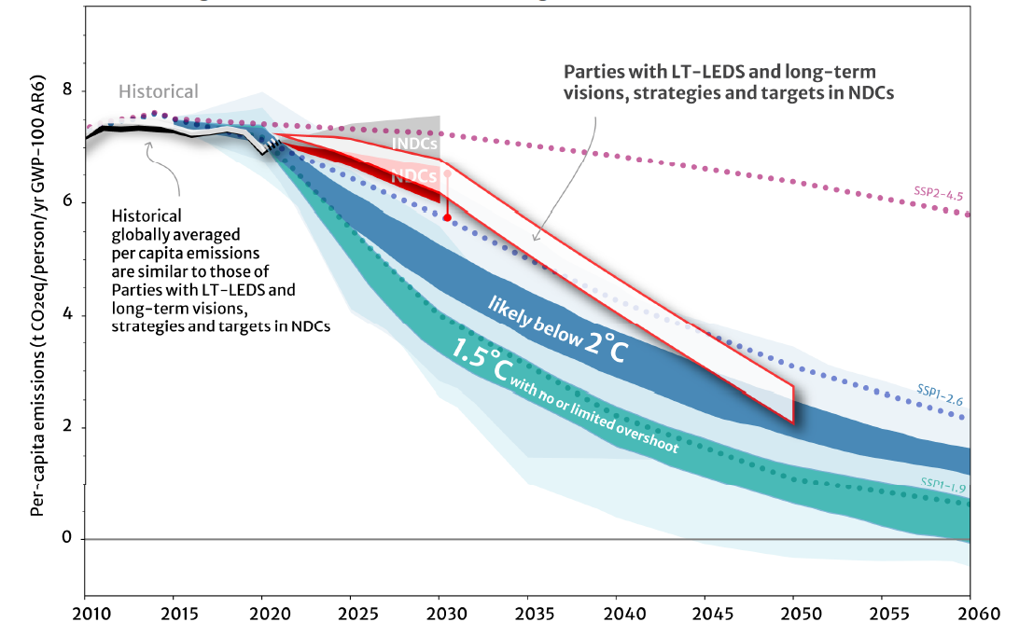
Global Challenge: Aligning Action Today With 1.5°
Despite progress, global commitment and stronger alignment are urgently needed to avert a high-risk climate future. ​
Substantial shift needed in financial flows: ~$5 trillion per year.​ (State of Climate Action, 2023)
The lates climate finance data: $8-10 trillion by 2030-2050. (CPI, 2023)
Economic cost of climate change impact is rising: $140-300 billion per year by 2030. ​
From UNFCCC, "Long-term low-emission development strategies: Synthesis report by the secretariat," 26 Oct. 2022.
Notes:
The emerging results of the Global Stocktake and the escalating socioeconomic impacts of climate-related events call for increased leadership across the whole of society.
The mid- and long-term visions, strategies and targets put in place by countries are narrowing the gap to achieve the Goals of the Paris Agreement.
However, more is needed on the ambition side to deliver on these collective goals.
In addition, the implementation of countries’ climate strategies and plans will require an unprecedented amount of climate finance.
Recent estimates indicate that we need 5.2 trillion dollars per year, or approximately 5% of the global GDP to successfully limit global temperature rise to 1.5°C. The latest estimation from CPI reveals we need $8-9 trillion by 2030, and over 10 trillion by 2050.
At the same time, the economic costs of climate change impacts are rising by the day, creating severe social and economic impacts with acute implications, especially for developing countries.
Tackling climate change requires a fundamental shift in development trajectories, investments, economic, and fiscal policies to fuel the rapid and systemic transition to a low-carbon and climate-resilient pathway.
Climate change demands a coordinated response from all, including private sector actors.

Slide 3
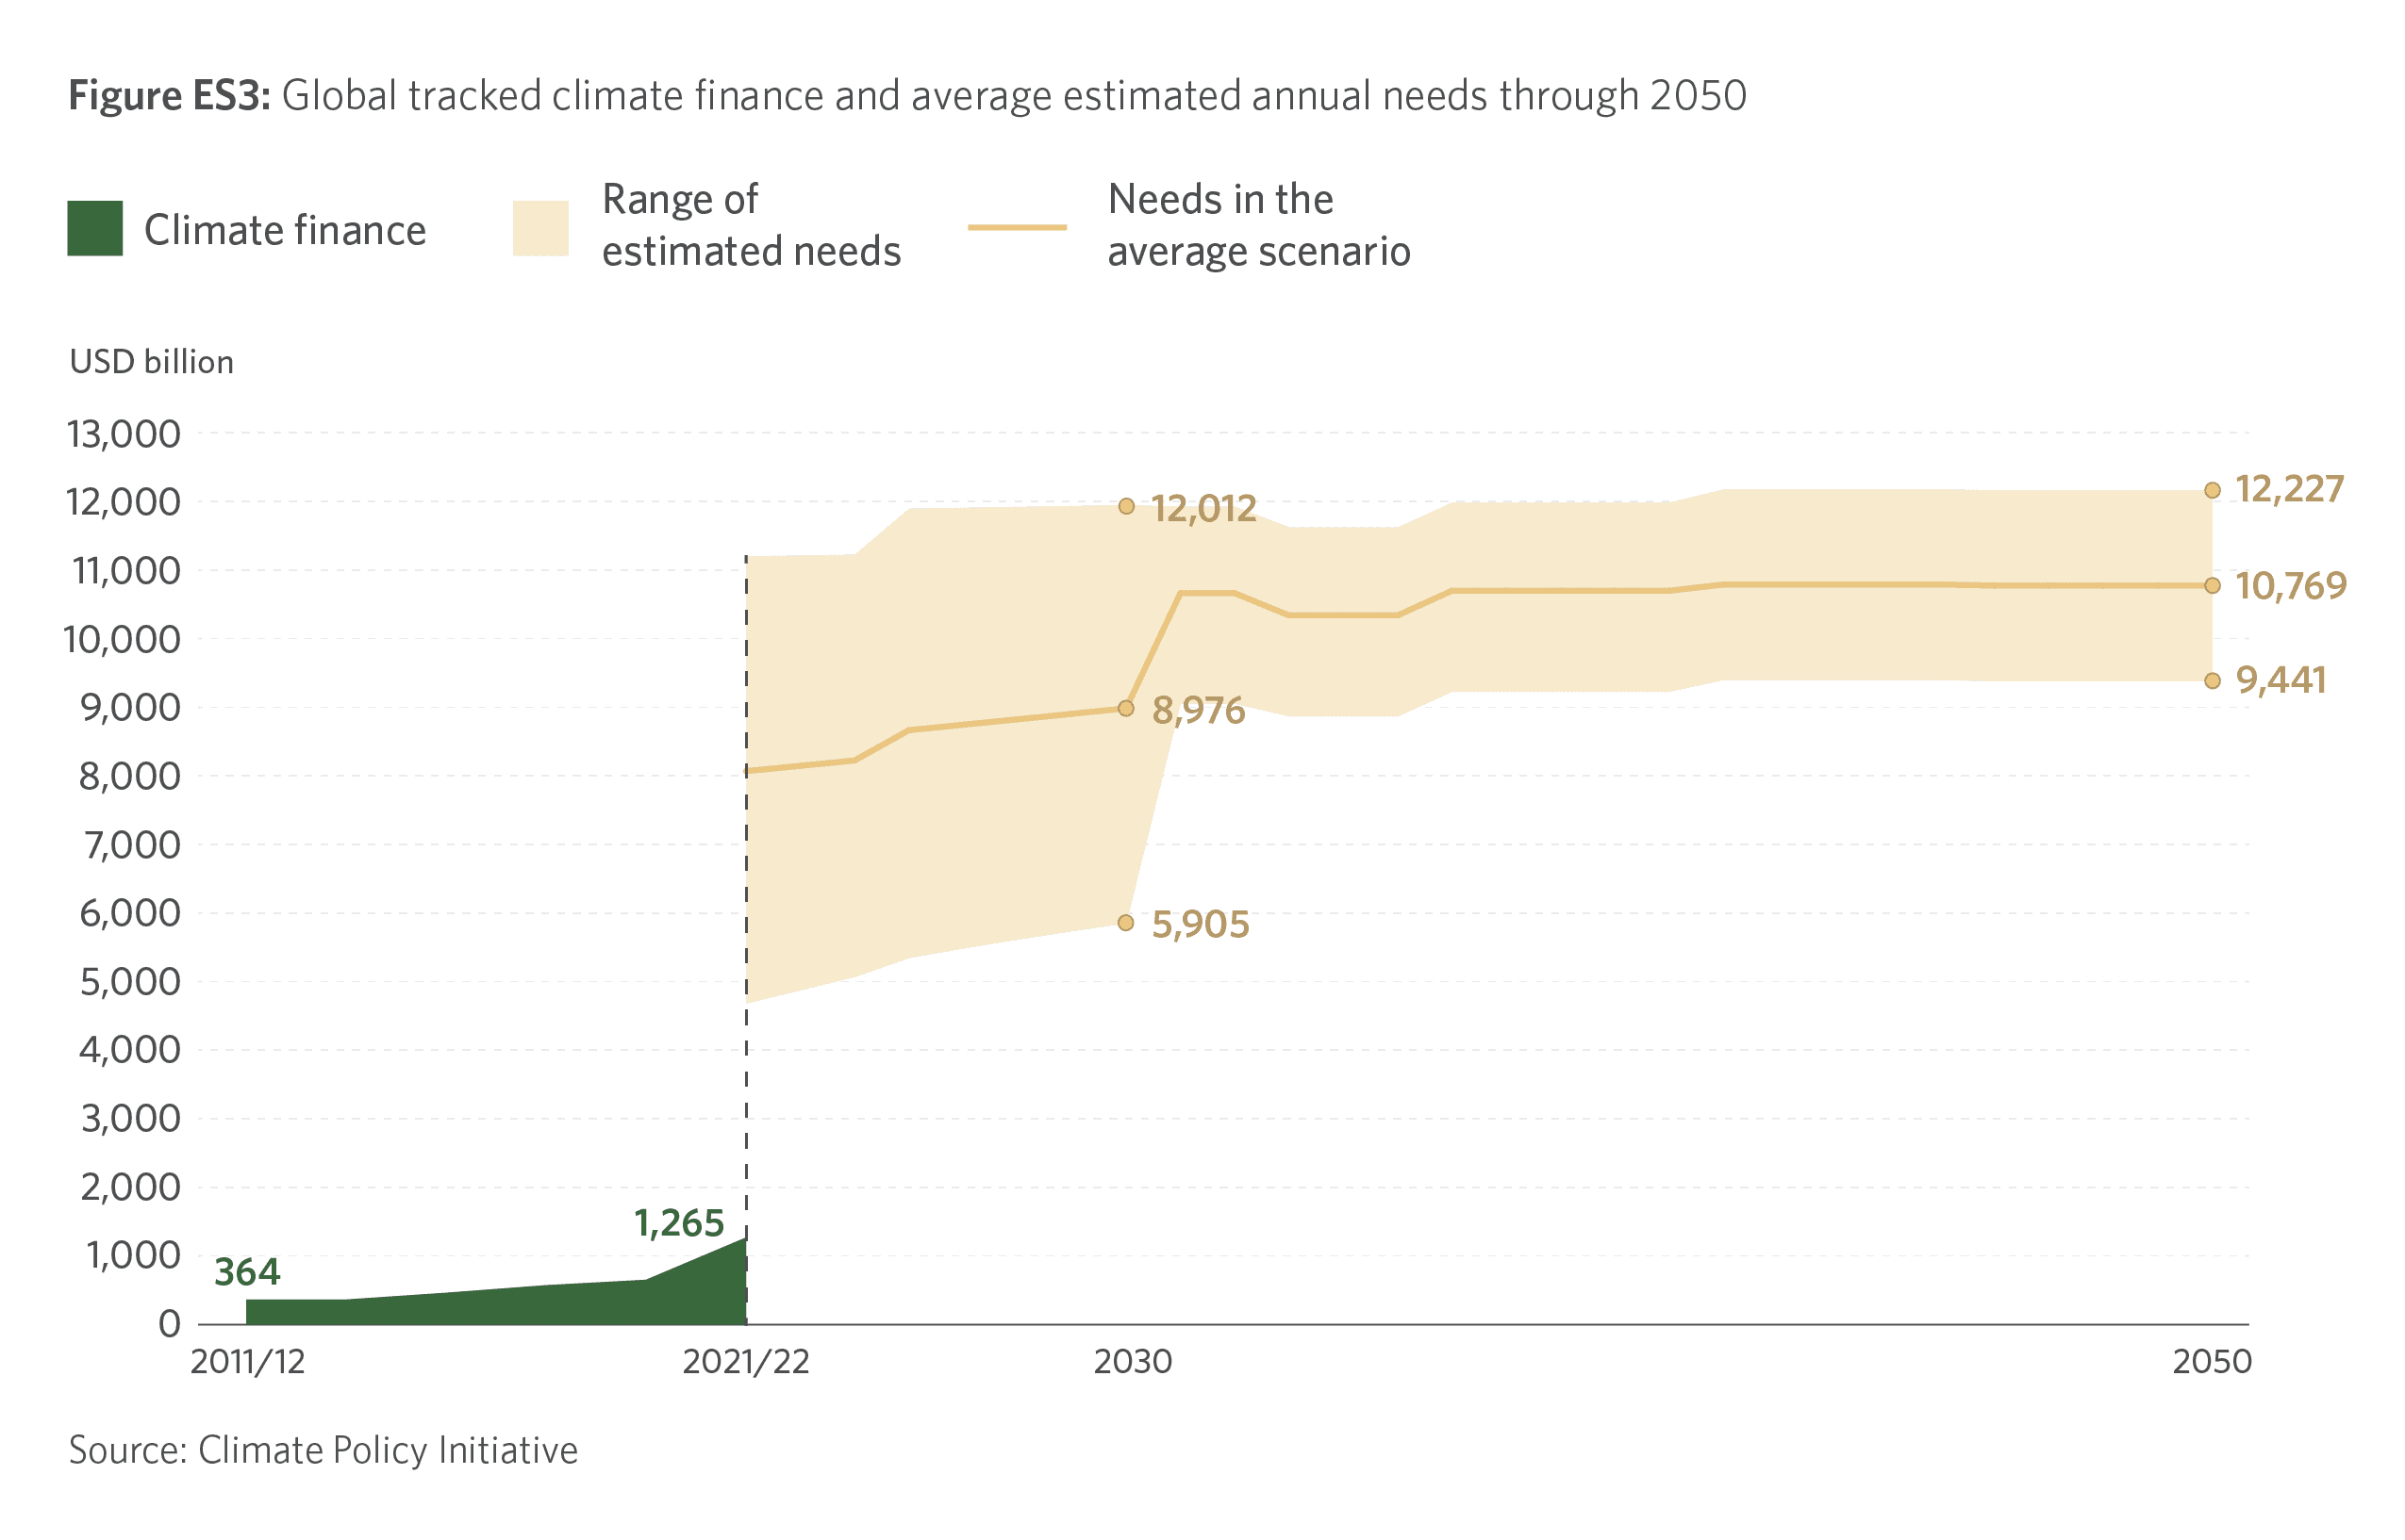
Climate finance mobilization and acceleration required
Global total climate finance:
Mobilized $1.27 trillion per year for climate action (640 billion from public and 625 billion from private)
The recent estimation reveals we need $5 trillion by 2030, and over 10 trillion by 2050 (CPI, 2023)
The gap remains significant
E.g., Adaptation finance alone is $387 billion per year, however its gap is $194-366 billion per year (UNEP, 2023)
Notes:
Global climate finance flows (public and private, domestic and international) reach $5.2 trillion per year or even 8-10 trillion by 2050.
This is the challenge ahead of us, currently we mobilized $1.3 trillion per year, compared to 2019/2020 it is nearly doubled performance.
Nevertheless, the climate finance gaps remains significant.
For example, UNEP Adaption Gap report presents that adaptation finance needs of developing countries are 10-18 times as big as international public finance flows (https://www.unep.org/resources/adaptation-gap-report-2023)

Slide 4
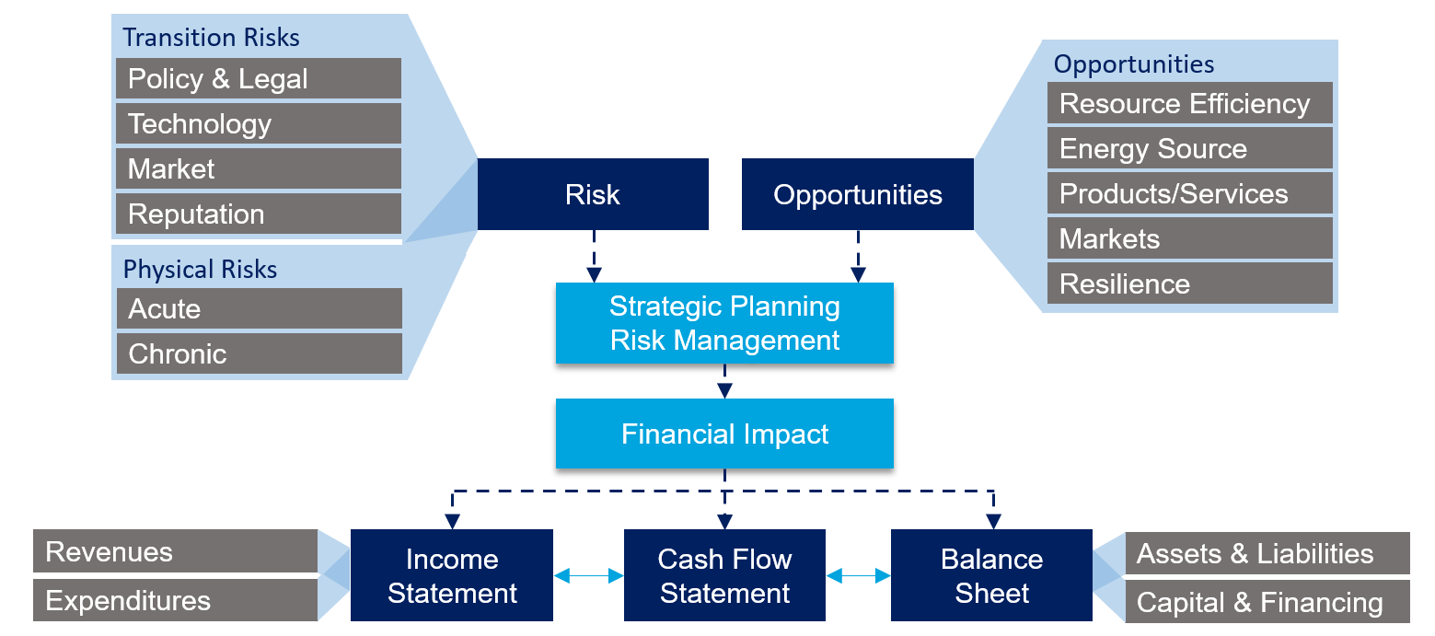
Private sector engagement
Potential adaptation market for private sector is $2 trillion by 2026 (WEF,)
*Source: Task Force on Climate Related Financial Disclosures, 2017.
Notes:
For private sector, there are many different types of actors: Commercial banks, Fis, corporations/businesses, funds, institutional investors, insurance companies as well as households and individuals,all have different stakes in implementing, financing and supporting climate action.
This figure presents how private sector actors are impacted by climate change – transitional and physical risks as well as highlights opportunities in how private sector can contributing to climate action.
There are significant opportunities for the private sector, For instance, opportunities for the private sector, with an estimated potential adaptation market of $2 trillion by 2026, according to the World Economic Forum.

Slide 5
Private sector opportunities, instruments
Category | Instruments | Examples
Green Finance | Green Loans, Climate Bonds, Green Sukuk, Green Mortgages, Green Banks | e.g., green loans for renewable energy projects, climate bonds, Islamic bonds, green mortgages for energy-efficient homes
Sustainable Finance Framework | Sustainable Finance Framework, Taxonomy | e.g., Climate Bond Taxonomy, Gender Bond Framework in line with global standards
Risk management | Climate-related risk management | e.g., climate risk modelling, climate strategy and risk assessment, supply chain risk management, insurance products for climate-related events
Corporate Responsibility, ESG Reporting | ESG & Climate-related disclosures and reporting | e.g., Corporate Climate Disclosure Reporting in line with TCFD, Climate Index and scorecards,
Fintech and Technology | Blockchain for Climate Finance | e.g., Digital green loan, digital climate wallet for carbon footprint, carbon offset markets, blockchain solutions for carbon credit trading, blockchain for sustainability supply chain
Funds and Investment | Blended financing model, Project funding, Crowdfunding | e.g., Blended models, Global Innovation Lab for Climate Finance, Impact Investing Funds, Investment Platforms
Notes:
This table presents example financial instruments that private sector actors are developing to mitigate and adapt to climate change.
For example,
corporates often showcase their contribution through the disclosure and reporting of their sustainability ESG reports.
Greening financing instruments are common among Fis - green loans, climate bonds
Innovative and blended financing mechanisms are getting popular which often helps private sector enter with low risks.

Slide 6
Finance at the NDC Partnership
Finance is the most frequently requested area of support among NDC Partnership countries.
35%
Of all requests
85%
Members have requested support
127
Partners have provided support
43%
Supported
Notes:
Finance is the most frequently requested area of support among NDC Partnership countries.
85% of developing country members have submitted at least one request for support related to finance.
127 Partners have provided support, 43 of requests have received support

Slide 7
Private sector engagement
at the NDC Partnership
285 requests related to Private sector (more than 80 countries)
Breakdown: Training, Strategy development, engagement of private sector stakeholders
Examples of requests:
Creating a private investment enabling environment in Liberia;
Establishing climate change scenario analysis framework and climate stress testing in line with NGFS in Georgia and Jamaica;
Developing green financial innovation and climate-integrated risk management frameworks in ECCB;
Working with private sector entities to identify gaps, priorities, for private sector involvement in NDC implementation in Antigua and Barbuda;
Developing a taxonomy, ESG safeguards, and guidance for accessing climate finance in Panama;
Notes:
285 requests related to Private sector (more than 80 countries)
Breakdown includes: Training, Strategy development, engagement of private sector stakeholders
Examples of requests:
Creating a private investment enabling environment in Liberia;
Establishing climate change scenario analysis framework and climate stress testing in line with NGFS in Georgia and Jamaica;
Developing green financial innovation and climate-integrated risk management frameworks in ECCB;
Working with private sector entities to identify gaps, priorities, for private sector involvement in NDC implementation in Antigua and Barbuda;
Developing a taxonomy, ESG safeguards, and guidance for accessing climate finance in Panama;

Slide 8
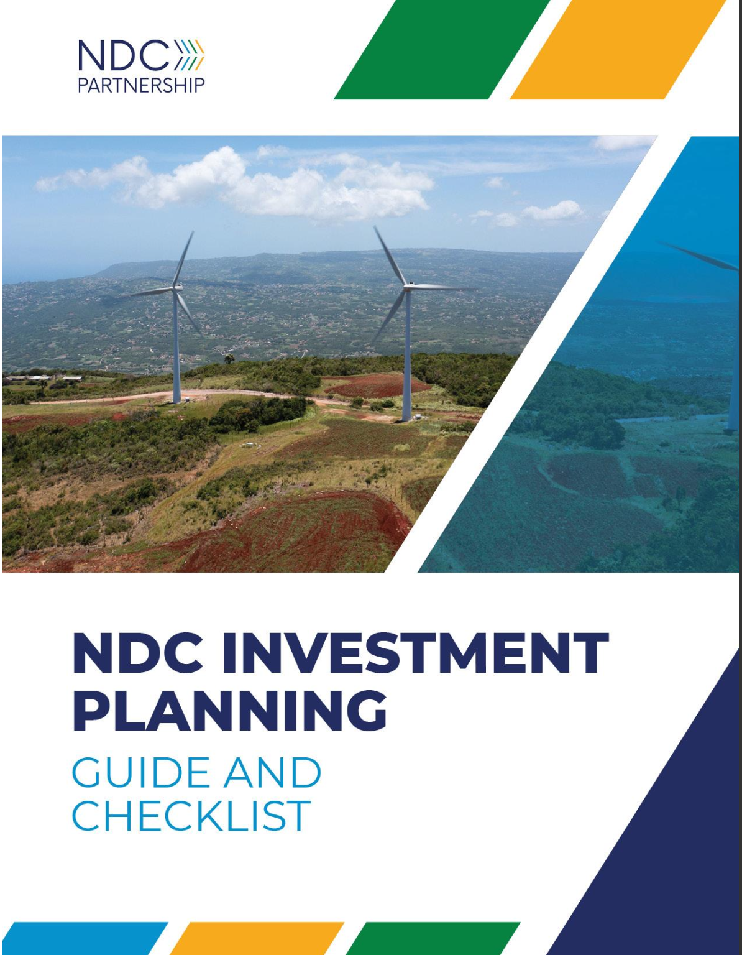
Investment Planning at the NDC Partnership
In early 2023 the NDC Partnership launched its NDC Investment planning guide.
Based on best-practices across the NDC Partnership and in consultation with the private sector.
Promotes a programmatic approach to NDC investment planning.
Strong focus on the planning for investments.
The NDC Partnership partnered with the Green Climate Fund (GCF) to enhance the Guide’s framework.
The Climate Investment Planning and Mobilization Framework.
Notes:
In early 2023 the NDC Partnership launched its NDC Investment planning guide.
Based on best-practices across the NDC Partnership and in consultation with the private sector.
Promotes a programmatic approach to NDC investment planning.
Strong focus on the planning for investments.
The NDC Partnership partnered with the Green Climate Fund (GCF) to enhance the Guide’s framework.
The Climate Investment Planning and Mobilization Framework.

Slide 9
The Climate Investment Planning and Mobilization Framework
The Framework serves as a non-prescriptive guide, bringing together the collective experience of climate investment planning and mobilization.
Provides a common language for countries and finance providers such as the private sector to navigate the progressive steps involved planning and mobilizing climate-aligned investments.
The Framework is also designed to facilitate the successful implementation of climate projects, programs, and investments.
Notes:
Jointly developed by GCF and NDC Partnership, the Climate Investment Planning and Mobilization Framework
The Framework serves as a non-prescriptive guide, bringing together the collective experience of climate investment planning and mobilization.
Provides a common language for countries and finance providers such as the private sector to navigate the progressive steps involved planning and mobilizing climate-aligned investments.
The Framework is also designed to facilitate the successful implementation of climate projects, programs, and investments.

Slide 10
The Climate Investment Planning and Mobilization Framework
Notes:
Framework composes 2 parts - Investment Planning and Finance Mobilization

Slide 11
The Climate Investment Planning and Mobilization Framework
Linkages with private sector engagement:
Beyond consultation and validation –> Co-development
The planning process should be aligned with investment frameworks, including those of the private sector
M&R of private sector investments –> Key in identifying gaps
Notes:
Under Investment Planning,
Objective of stage 1 is to secure the institutional capacities and structures necessary for effective climate investment planning, resource mobilization, and the implementation of climate objectives, as well as the mainstreaming of climate priorities.
Linkages with private sector engagement:
Co-development
The planning process should be aligned with investment frameworks, including those of the private sector
M&R of private sector investments –> Key in identifying gaps

Slide 12
The Climate Investment Planning and Mobilization Framework
Linkages with private sector engagement:
Common practices analysis -> Mapping existing solutions and sources of finance is key in prioritizing investments.
The results of the cost-benefit analysis should be communicated to financial agents for decision-making as it will will translate climate change risks and opportunities into economic and financial terms.
Notes:
Stage 2 intends to prioritize investments based on data and science-based evidence and in alignment with climate-related policy instruments.
Linkages with private sector engagement:
Common practices analysis -> Mapping existing solutions and sources of finance is key in prioritizing investments.
The results of the cost-benefit analysis should be communicated to financial agents for decision-making as it will will translate climate change risks and opportunities into economic and financial terms.

Slide 13
The Climate Investment Planning and Mobilization Framework
Linkages with private sector engagement:
Private sources of finance are mapped, including the investment criteria, risk profiles, and characteristics (such as the level of concessionality) associated
Comprehensive analysis of existing pipelines to determine the status of each investment requirement, its alignment with the preferences and objectives of potential financiers.
Address barriers for private sector investments
Notes:
Stage 3 aims to to align prioritize investments with existing pipelines, sources of finance and to address existing barriers for investments.
Linkages with private sector engagement:
Private sources of finance are mapped, including the investment criteria, risk profiles, and characteristics (such as the level of concessionality) associated
Comprehensive analysis of existing pipelines to determine the status of each investment requirement, its alignment with the preferences and objectives of potential financiers.
Address barriers for private sector investments

Slide 14
The Climate Investment Planning and Mobilization Framework
Linkages with private sector engagement:
Collaborative work between countries and the private sector to develop project concepts and structure investments.
Catalyze private sector participation in climate-aligned investments.
Notes:
Under Finance Mobilization - Stage 4-6 with the objective to deepen engagement with selected financial partners for investment mobilization.
Linkages with private sector engagement:
Collaborative work between countries and the private sector to develop project concepts and structure investments.
Catalyze private sector participation in climate-aligned investments.
MOVING FORWARD,
We expect the Global Stocktake to be a global accelerator for countries to pursue transformational change. For that, Private sector contribution is instrumental.
The NDC Partnership stands ready to support that engagement in collaboration with the Private Sector Actors and facilitate The Climate Investment Planning and Mobilization Framework.

Slide 15
Thank you for your attention
www.ndcpartnership.org
@ndcpartnership
NDC Partnership
@ndcpartnership
NDC Partnership
NDC Partnership
Notes:
Thank you for your attention. We invite all of you to get involved and stay engaged. We are available to receive feedback and answer your questions.

Slide 16
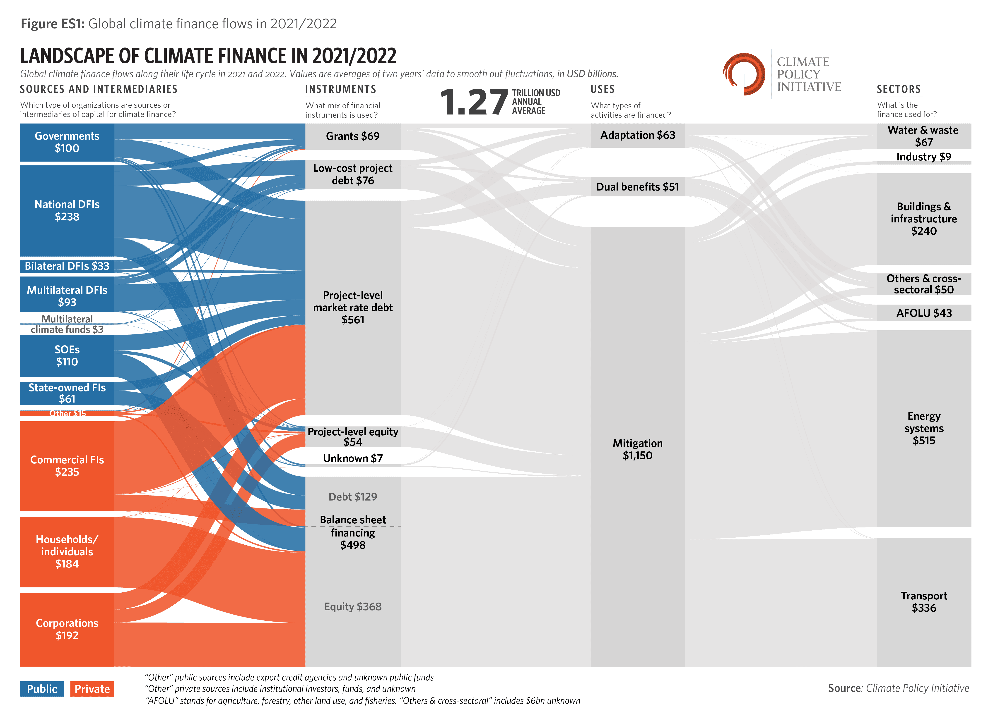

Slide 17
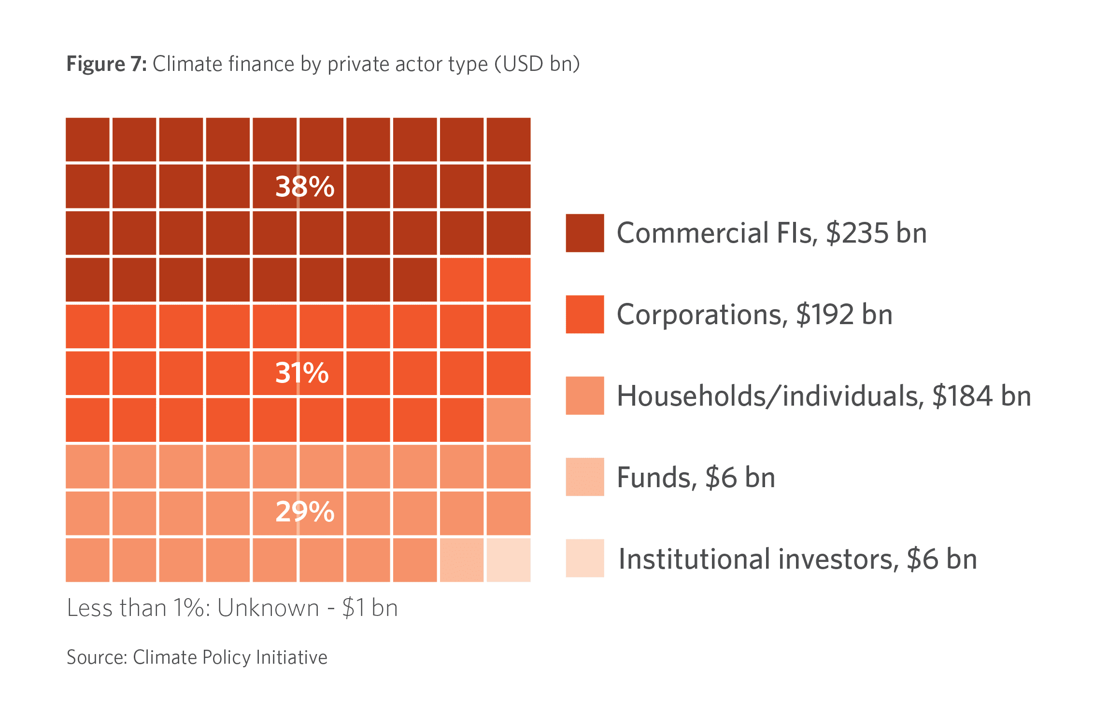
Private sector engagement
Types of private sector actor
Risks and opportunities for private sector

Slide 18
Private Finance Capacities Day
GCF/NDC Partnership Climate Investment Planning and Mobilization Framework
Selina Wrighter, Head of Policy and Strategy at the Green Climate Fund
Notes:
Finance is the most frequently requested area of support among NDC Partnership countries.
85% of developing country members have submitted at least one request for support related to finance.
127 Partners have provided support, 43 of requests have received support

Slide 19
Notes:
The emerging results of the Global Stocktake and the escalating socioeconomic impacts of climate-related events call for increased leadership across the whole of society.
The mid- and long-term visions, strategies and targets put in place by countries are narrowing the gap to achieve the Goals of the Paris Agreement.
However, more is needed on the ambition side to deliver on these collective goals.
In addition, the implementation of countries’ climate strategies and plans will require an unprecedented amount of climate finance.
Recent estimates indicate that we need 5.2 trillion dollars per year, or approximately 5% of the global GDP to successfully limit global temperature rise to 1.5°C. The latest estimation from CPI reveals we need $8-9 trillion by 2030, and over 10 trillion by 2050.
At the same time, the economic costs of climate change impacts are rising by the day, creating severe social and economic impacts with acute implications, especially for developing countries.
Tackling climate change requires a fundamental shift in development trajectories, investments, economic, and fiscal policies to fuel the rapid and systemic transition to a low-carbon and climate-resilient pathway.
Climate change demands a coordinated response from all, including private sector actors.

